Slide 1
Introduction to Antibody Structure
Rocco Moretti

Slide 2
What is an antibody? (Structurally)
Antigen
Heavy
Chain
Variable
Region
Light
Chain
Constant
Region
Notes:
Antibodies are proteins
They are made up of four chains; two light and two heavy
There is a LOT OF TERMINOLOGY to learn, but we’ll keep it fairly simple.

Slide 3
Antibody terminology: Ig
“Immunoglobulin”
or “full length antibody”
Notes:
Goal of the CroweLab is to discover new antibodies
Purpose: therapeutics, understanding viral neutralization or function, etc.
Antibodies are proteins – describe structure

Slide 4
Antibody terminology: Fab
“Fragment
antigen-binding”
Notes:
Goal of the CroweLab is to discover new antibodies
Purpose: therapeutics, understanding viral neutralization or function, etc.
Antibodies are proteins – describe structure

Slide 5
Antibody terminology: Fv
“Fragment
variable”
Notes:
Goal of the CroweLab is to discover new antibodies
Purpose: therapeutics, understanding viral neutralization or function, etc.
Antibodies are proteins – describe structure

Slide 6
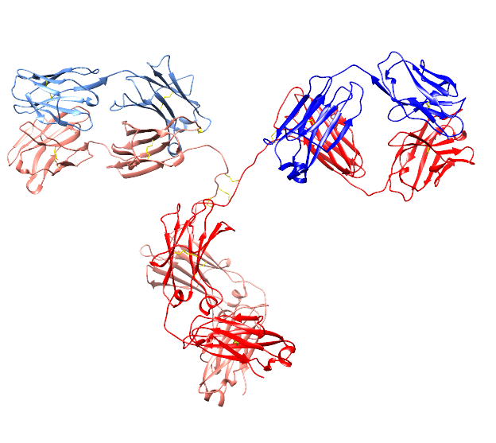
What is an antibody? (Structurally)

Slide 7
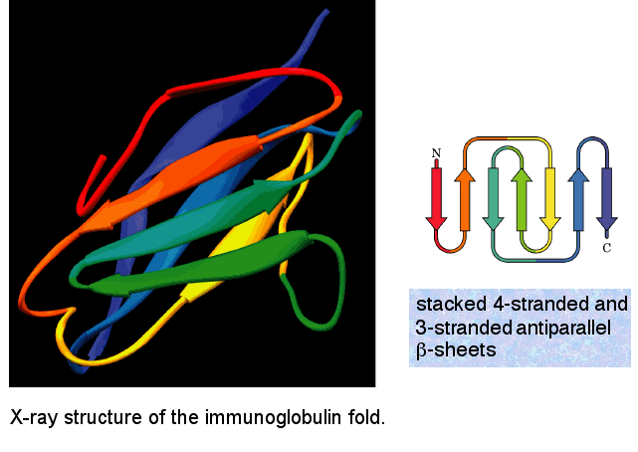
The immunoglobulin domain fold
Anthony S. Serianni
Notes:
Sandwich-like structure formed by two sheets of antiparallel beta strands
Stabilized by hydrophobic amino acids on the inner side of the sandwich (like peanut butter)
Also stabilized by highly conserved disulfide bond formed between the B and F strands
Not restricted to antibodies!
In antibodies, we typically call these antiparallel beta strands the FRAMEWORK region

Slide 8
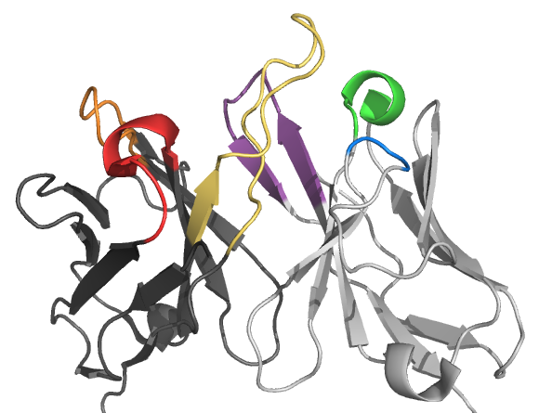
Complementarity determining regions
HCDR3
LCDR1
LCDR3
HCDR2
HCDR1
LCDR2
CH65
PDBID: 3SM5
Framework
Notes:
Framework regions
Specifically, antibodies bind their antigen via their complementarity determining regions;
The CDRs are made up of six loops, three from the heavy chain and three from the light chain.
When viewing antibodies as a population, the CDR loops are sites of great sequence and structural diversity.
This diversity is what allows the antibody repertoire to form specificities to a potentially infinite population of antigens.
WHAT?

Slide 9
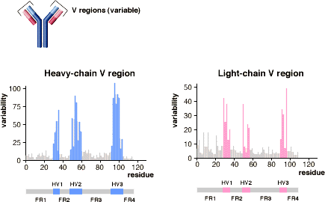
CDR are hypervariable
Light chain
CDR2
CDR1
CDR3
Epitope
CDR1
CDR2
CDR3
Heavy chain
Notes:
Specifically, antibodies bind their antigen via their complementarity determining regions;
The CDRs are made up of six loops, three from the heavy chain and three from the light chain.
When viewing antibodies as a population, the CDR loops are sites of great sequence and structural diversity.
This diversity is what allows the antibody repertoire to form specificities to a potentially infinite population of antigens.
WHAT?

Slide 10
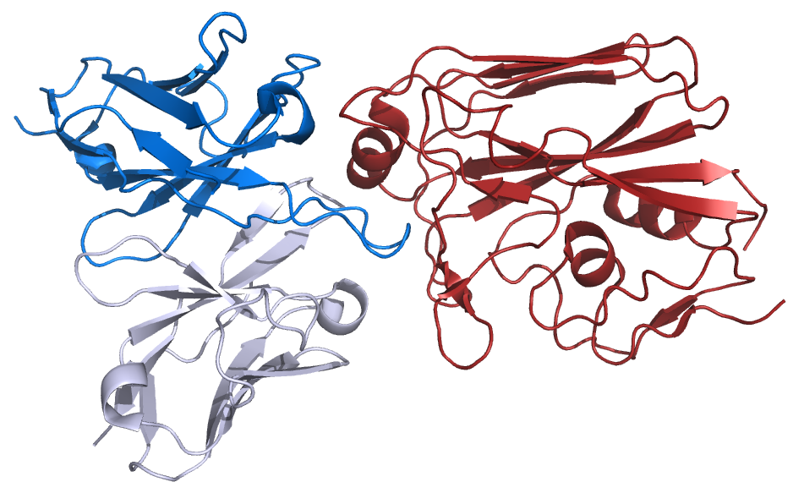
Recognition of antigens
Protein-protein interactions are determined by shape and physicochemical properties of solvent exposed loops, such as CDR loops.
Ab
Ag
PDB ID: 3SM5
Sequence
Structure
Function
Notes:
Epitope and Paratope

Slide 11
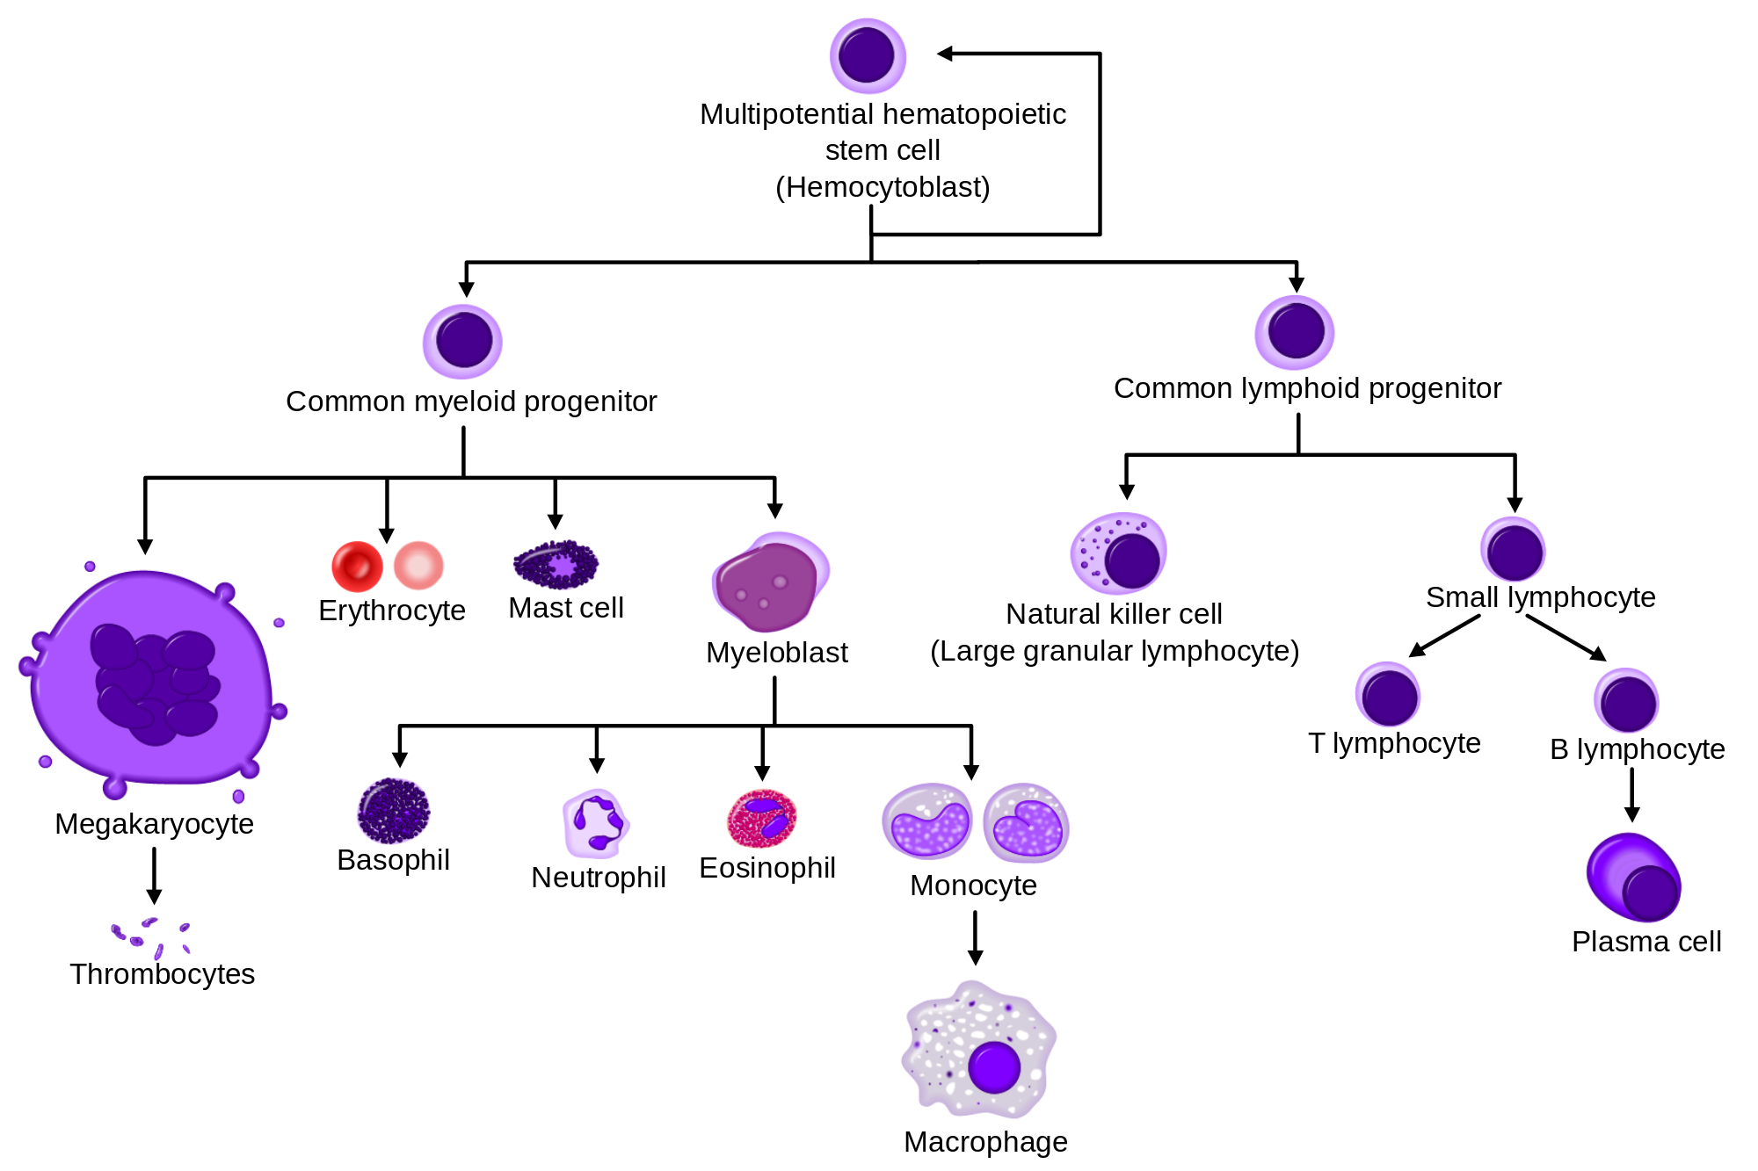
Antibodies are produced by B cells
Notes:
To discuss how this diversification is generated, you have to understand where antibodies come from.
Antibodies are produced specifically by B cells, which are a type of hematopoetic (or BLOOD) cell.

Slide 12
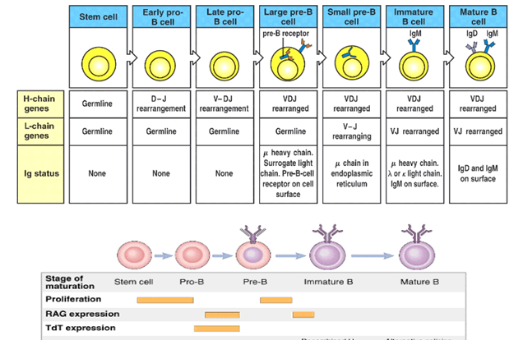
Antibody generation is an integral part of B cell development
Bone Marrow
Periphery
Notes:
B cells go through a lot of developmental steps in the Bone Marrow before they are able to enter the blood stream, lymphatics and tissues (‘periphery’)
Many of these developmental steps involve generation and expression of the B cell receptor (the antibody).

Slide 13
Antibody diversification is achieved primarily through four mechanisms
… and affinity maturation.
Notes:
Antibody diversification is achieved via three mechanisms.

Slide 14
V(D)J recombination

Slide 15
Junctional diversity

Slide 16

V(D)J gene sequences mapped to CDRs
V
N
D
N
J
FR1
CDR1
FR2
CDR2
FR3
CDR3
FR4
Notes:
ADD IMAGE OF ANTIBODY COLOURED BY VDJ

Slide 17
Heavy/light chain pairing
Notes:
Many heavy chains and many light chains, each of which undergo V(D)J recombination, results in MANY POSSIBILITIES!

Slide 18
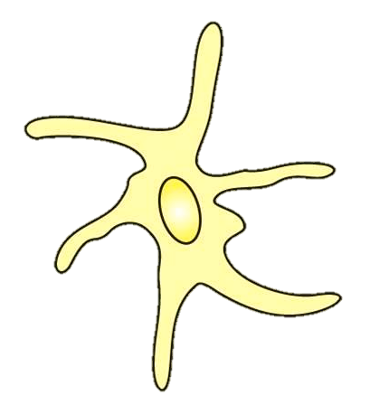
Affinity maturation
Survival
signal
High affinity
Follicular
dendritic cell
T cell
AID
Low affinity
Death via
apoptosis
Notes:
B cells accumulate random mutations via the enzyme AID (activation-induced cytidine deaminase) Deaminates cytosine into uracil; in B cells AID also creates other mutations but it’s not clear how
B cells compete for limited antigen presented by follicular dendritic cells in germinal centers, and B cells presenting low-affinity antibodies fail to bind antigen.
B cells that are unable to take antigen from follicular dendritic cells are unable to present antigen to T cells, and die by apoptosis.

Slide 19
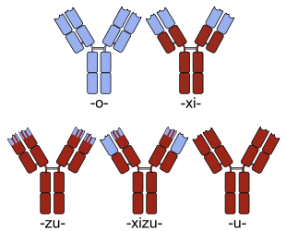
Humanized antibodies
Mouse
Antibody
Chimeric
Antibody
Chimeric/
Humanized
Antibody
Humanized
Antibody
Human
Antibody
Notes:
Naming convention: humanized antibody names end in “-zumab”.

Slide 20
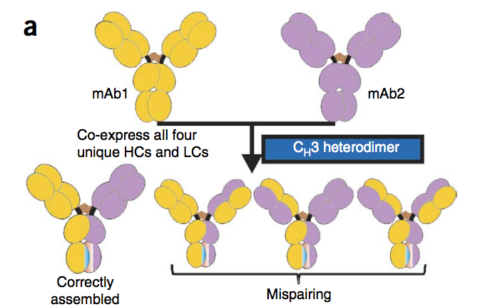
Bispecific antibodies
Lewis, SM et al., Nat. Biotech., 2014

Slide 21
Resources
Antibody structure:
North, Lehmann and Dunbrack, J Mol Bio 2011
Morea, Tramontano, Rustici, Chothia and Lesk, J Mol Bio 1998
Sequence analysis web tools:
IMGT V-Quest
IMGT DomainGapAlign
Antibody numbering guide:
AHo’s Amazing Atlas of Antibody Anatomy

