Slide 1
Rosetta Scoring Function
Cristina E. Martina
PostDoc, Meiler Lab
Leipzig Rosetta Workshop
December 2019
cristinaelisamartina@gmail.com

Slide 2
Why we need a scoring function?

Slide 3
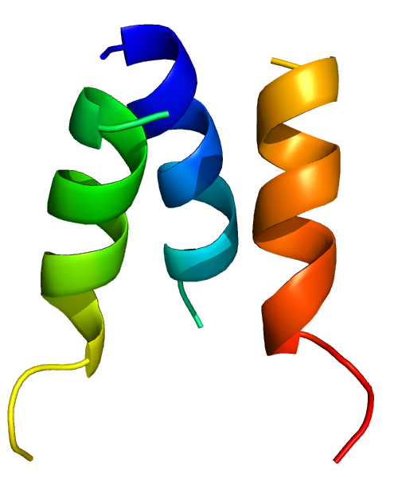
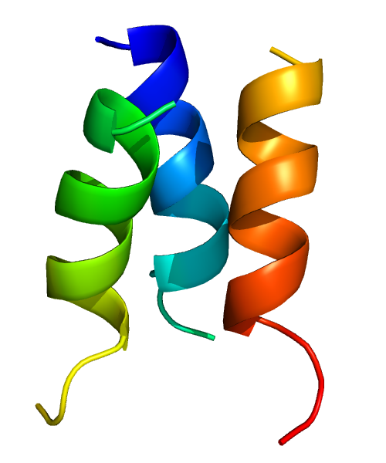
Conformational changes
Conformation A
Conformation B

Slide 4
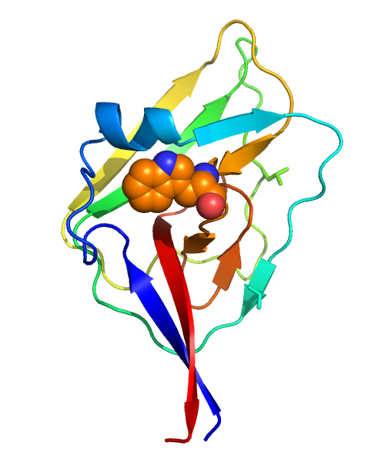
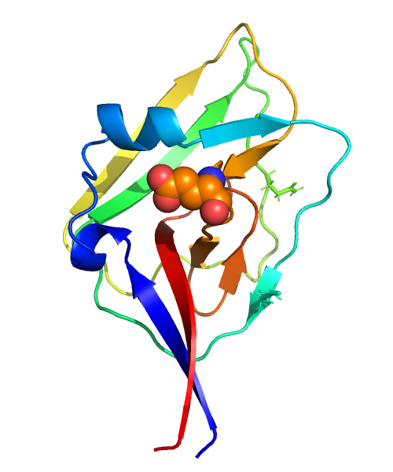
Mutations
Mutation A
Mutation B

Slide 5
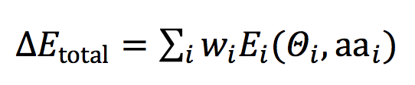
How discriminate among A and B?
Scoring Function
(or Energy Function)
The total energy (ΔE_{total}) is the sum of weighted energy terms (Σ_{i}w_{i}E_{i}) that are calculated as functions of geometric degrees of freedom (Θ_{i}) and chemical identities (aa_{i}).
(Alford RF, 2017)

Slide 6
Default scoring functions in Rosetta:
Score12
Talaris13
Talaris14
REF15
2004
2013
2017
Historically the total energy was given in Rosetta Energy Units, (REU)
The newest scoring function (REF15) is given in kcal/mol

Slide 7
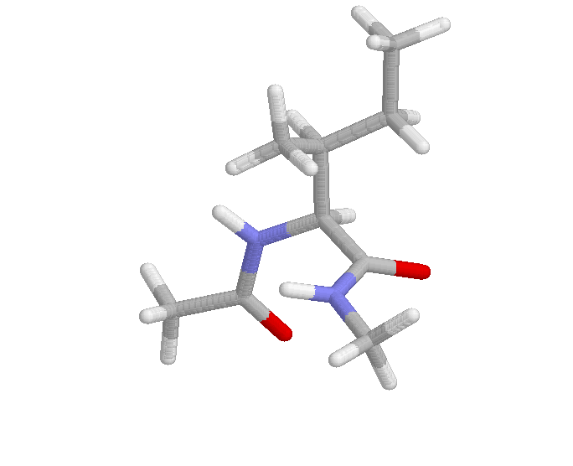
Types of scoring functions
Low Resolution
High Resolution
Centroid
Simple energy function
Faster
Global search of conformational space
(Ab-initio folding, loop modeling)
Full-atom
More accurate energy function
Time consuming
Local search of conformational space

Slide 8
Scoring in Rosetta
The lower the better!

Slide 9
Total Energy
Conformation A
Conformation B
Total Energy = 253 REU
Total Energy = -82 REU

Slide 10
Total Energy
Conformation A
Conformation B
But why the energy is different?
Total Energy = 253 REU
Total Energy = -82 REU

Slide 11


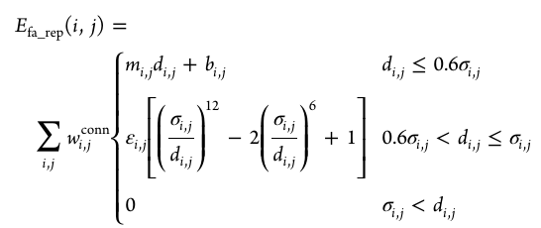
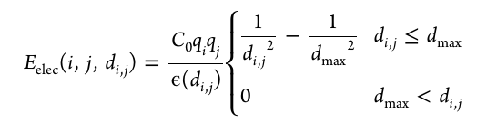
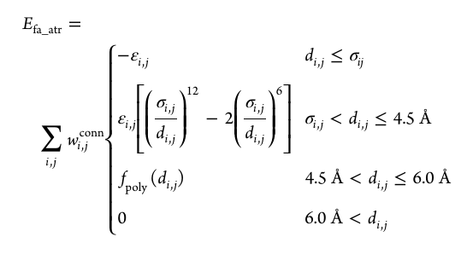
Energy terms
ΔE_{total} = w₁E₁ + w₂E₂ + w₃E₃ + w₄E₄ + … + w_{n}E_{n}
(Alford RF, 2017)

Slide 12
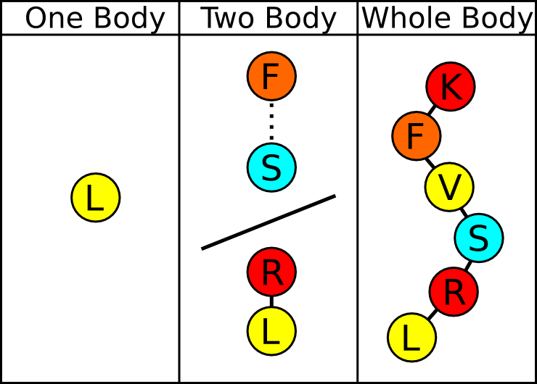
Energy terms

Slide 13
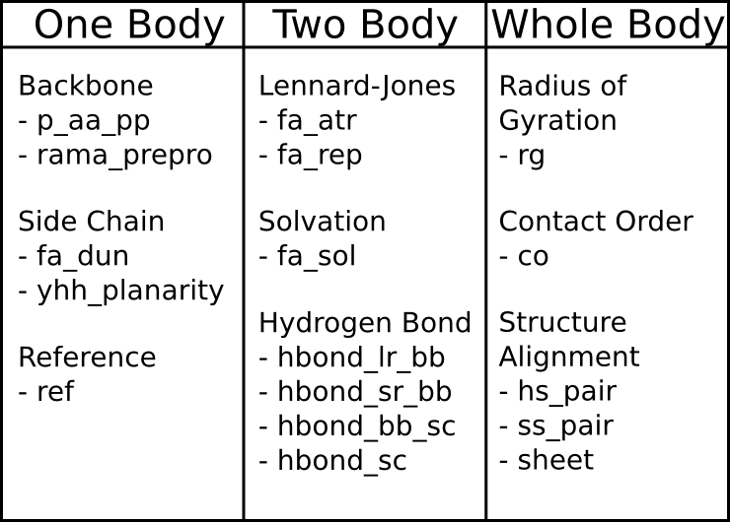
Energy terms

Slide 14
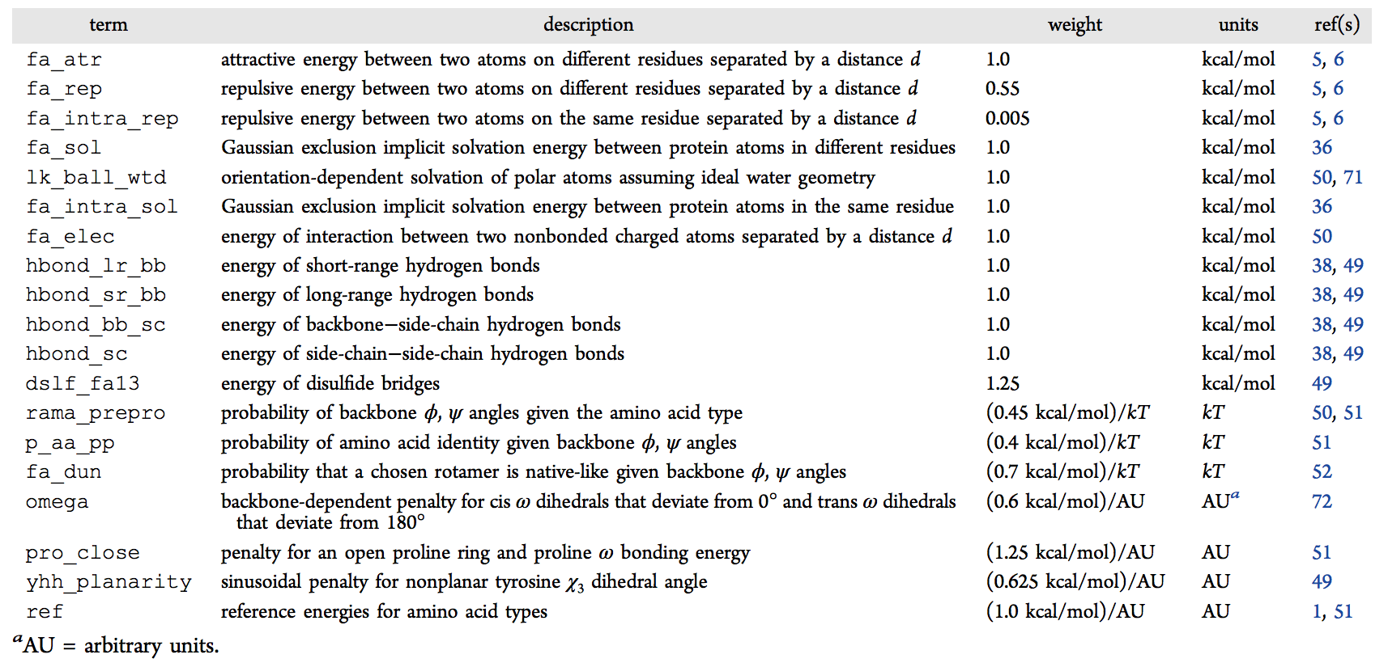
Energy terms - Full-Atom
(Alford RF, 2017)

Slide 15
Energy terms - Full-Atom
Physics-Based
Knowledge-Based
(Alford RF, 2017)

Slide 16
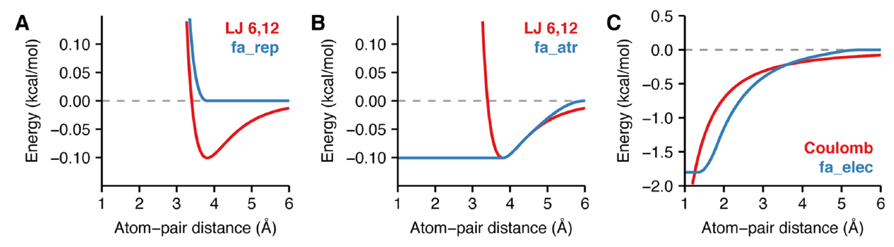
Physics-Based Energy terms
Van der Waals interactions
(Alford RF, 2017)

Slide 17
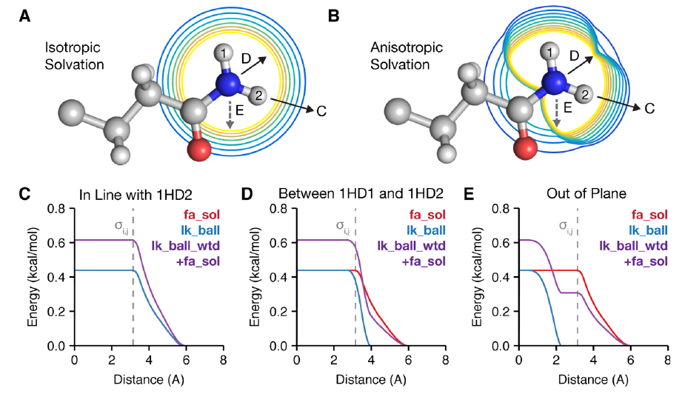
Physics-Based Energy terms
Implicit solvation
(Alford RF, 2017)

Slide 18
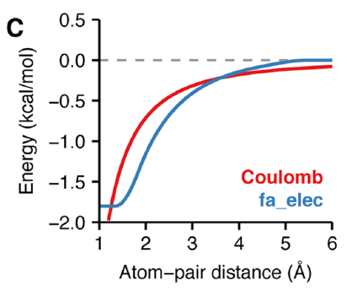
Physics-Based Energy terms
Electrostatics
(Alford RF, 2017)

Slide 19
Physics-Based Energy terms
Hydrogen Bonds
(Alford RF, 2017)

Slide 20
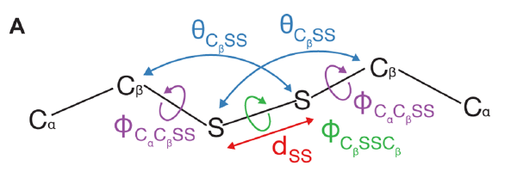
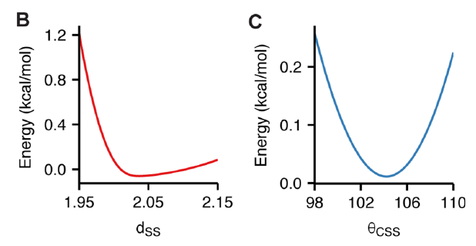
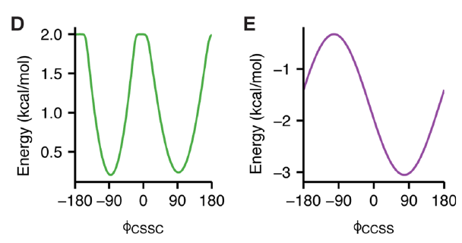
Physics-Based Energy terms
Disulfide Bonds
(Alford RF, 2017)

Slide 21
Energy terms - Full-Atom
Physics-Based
Knowledge-Based
(Alford RF, 2017)

Slide 22
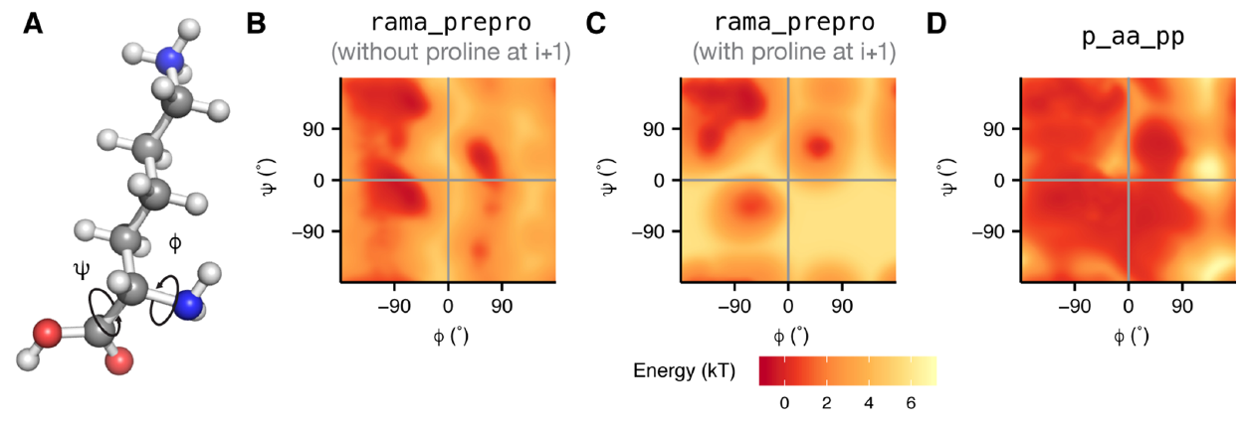
Knowledge-Based Energy terms
Protein Backbone
(Alford RF, 2017)

Slide 23
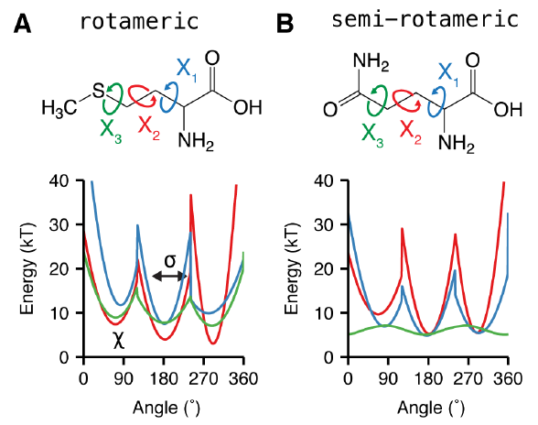
Knowledge-Based Energy terms
Protein Side-Chains
(Alford RF, 2017)

Slide 24
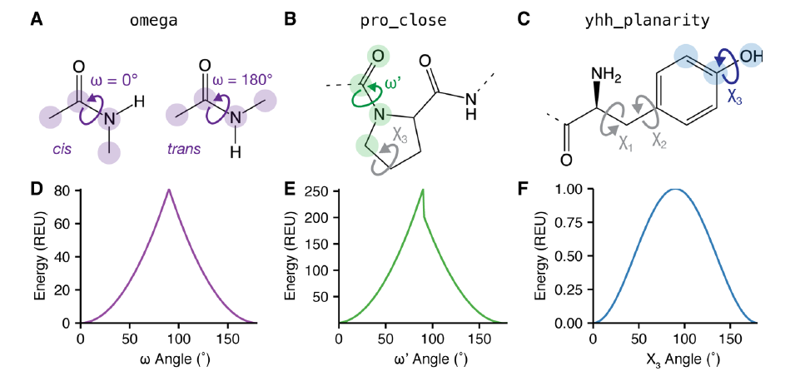
Knowledge-Based Energy terms
Special-Case Torsions
(Alford RF, 2017)

Slide 25
Knowledge-Based Energy terms
Special-Case, Design
Takes in account the unfolding energy of the amino acids
Adjusts amino acids frequencies during protein design
(Alford RF, 2017)

Slide 26
Weights
ΔE_{total} = w₁E₁ + w₂E₂ + w₃E₃ + w₄E₄ + … + w_{n}E_{n}
(Alford RF, 2017)

Slide 27
Weights
Some weights for specific energy terms are set to zero!
(Alford RF, 2017)

Slide 28
Weights
You can modify the weights if needed in special applications!
(Alford RF, 2017)

Slide 29
Modifying Weights:
Using the command line:
1 - score:weights <filename>
2 - score:set_weight <scoreterm₁> <wt₁> <scoreterm₂> <wt₂>
3 - score:patch <patchfile>
Using xml script file:
fa_atr = 0.423
fa_rep = 0.100
<ROSETTASCRIPTS>
<SCOREFXNS>
<ScoreFunction name=“ligand_soft_rep” weights=“ligand_soft_rep”>
<Reweight scoretype=“fa_elec” weight=“0.42”/>
</ScoreFunction>
<ScoreFunction name=“hard_rep” weights=“ligandprime”/>
</SCOREFXNS>
<OUTPUT scorefxn=“hard_rep” />
</ROSETTASCRIPTS>
(Alford RF, 2017)

Slide 30
Total Energy
Conformation A (253 REU)
Conformation B (-82 REU)

Slide 31
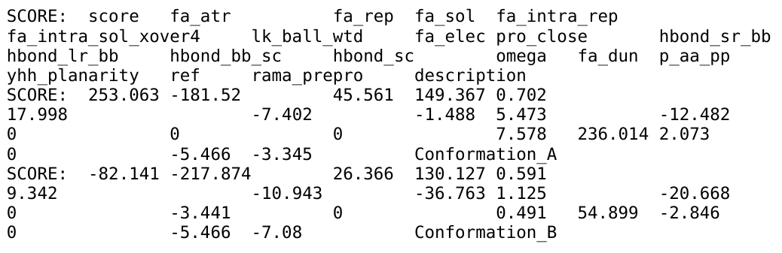
Score File (score.sc):

Slide 32
Score File (score.sc):

Slide 33
Score File (score.sc):

Slide 34
Total Energy
Conformation A (253 REU)
Conformation B (-82 REU)
 | score | fa_atr | fa_rep
A | 253.1 | -181.5 | 45.6
B | -82.1 | -217.9 | 26.4
Delta (A-B) | 335.2 | 36.4 | 19.2

Slide 35
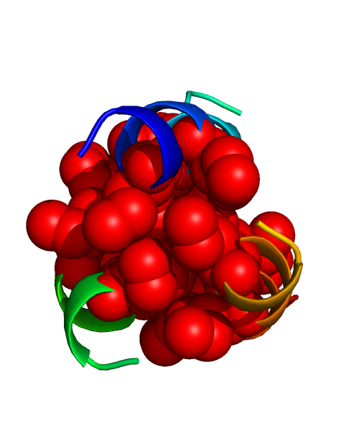
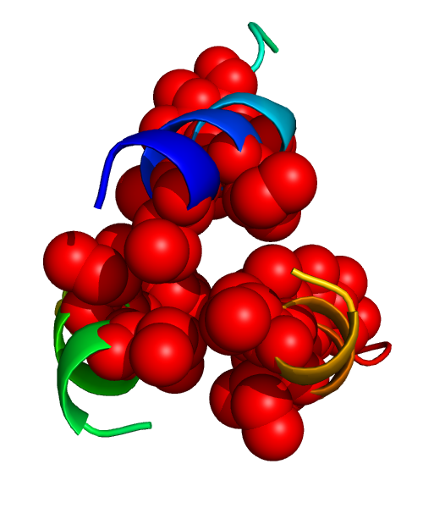
Total Energy
Conformation A (253 REU)
Conformation B (-82 REU)
 | score | fa_atr | fa_rep
A | 253.1 | -181.5 | 45.6
B | -82.1 | -217.9 | 26.4
Delta (A-B) | 335.2 | 36.4 | 19.2

Slide 36
Sampling in Rosetta

Slide 37
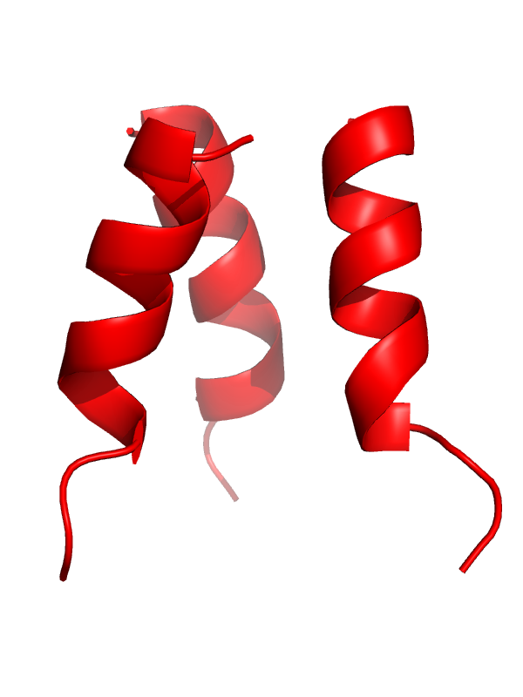
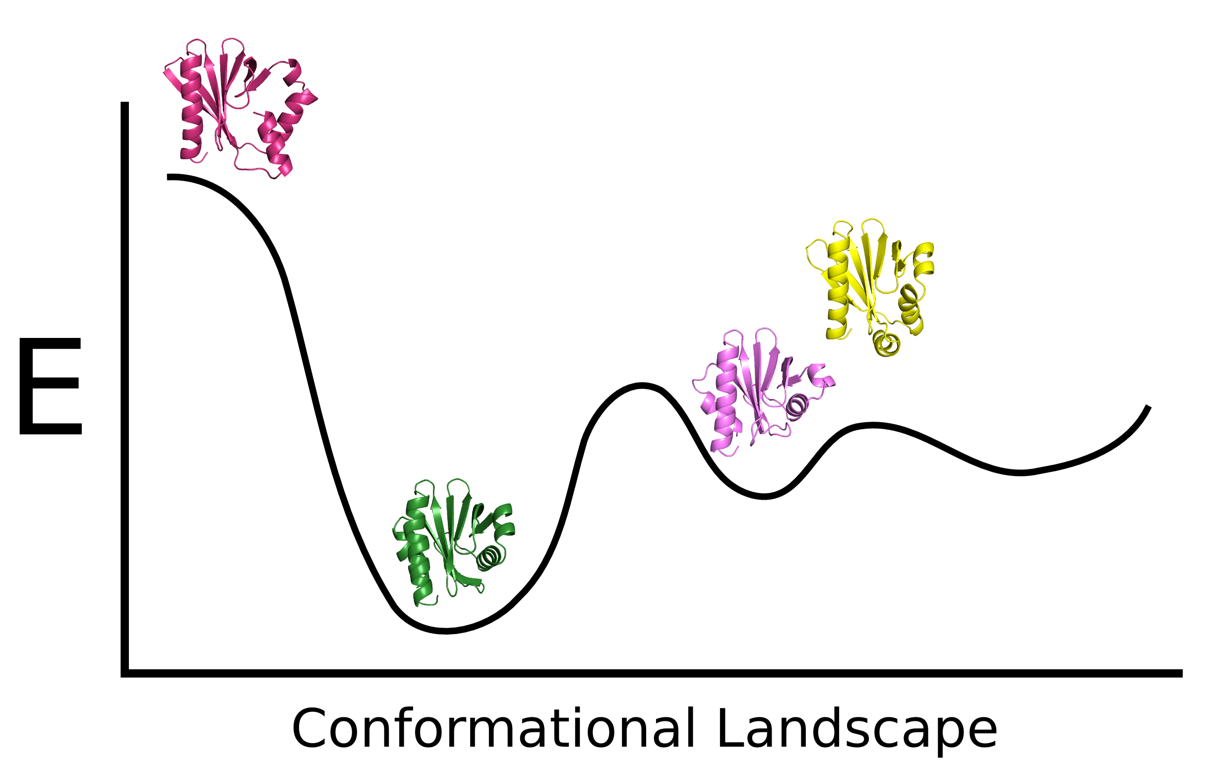
Metropolis Monte Carlo Algorithm

Slide 38
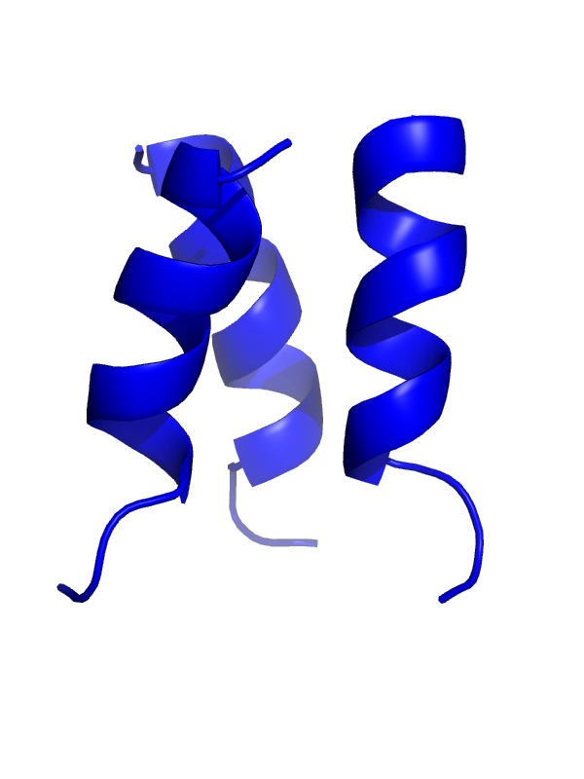
Metropolis Monte Carlo Algorithm
If E_{new} < E_{old} : Accept structure

Slide 39
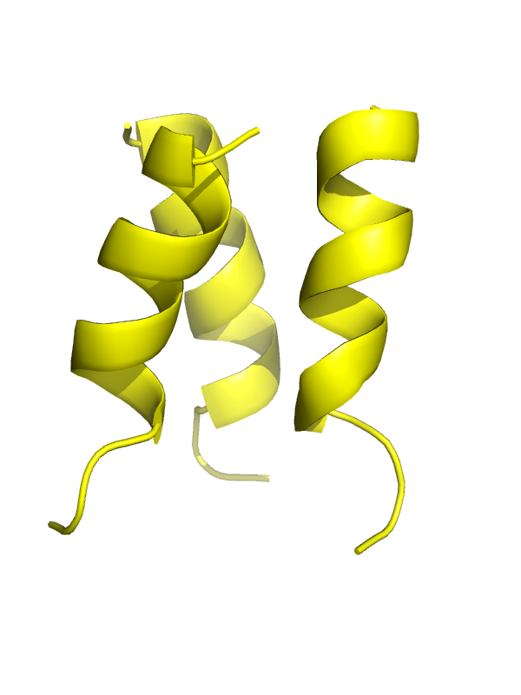
Metropolis Monte Carlo Algorithm
If E_{new} < E_{old} : Accept structure
If E_{new} > E_{old} : Pick a random number p(0, 1)
- if e^{[-(Enew-Eold)/kBT]} > p, accept structure
- if e^{[-(Enew-Eold)/kBT]} < p, discard structure

Slide 40
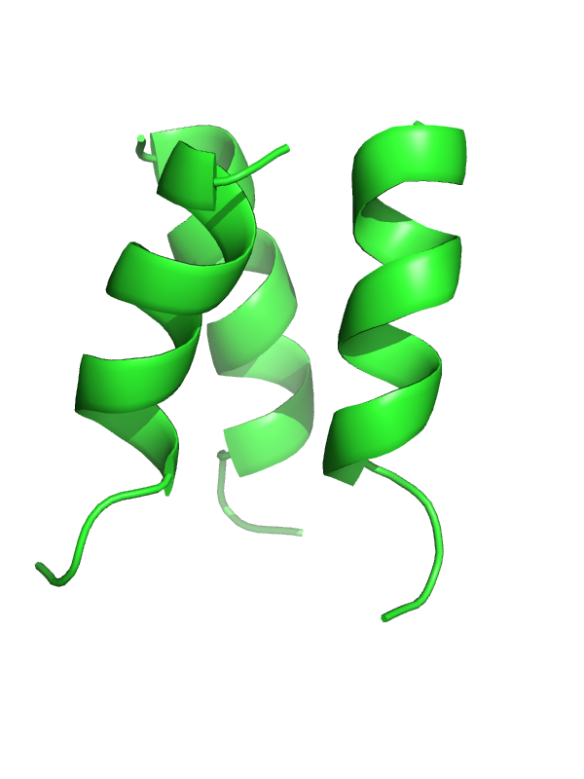
Metropolis Monte Carlo Algorithm
If E_{new} < E_{old} : Accept structure
If E_{new} > E_{old} : Pick a random number p(0, 1)
- if e^{[-(Enew-Eold)/kBT]} > p, accept structure
- if e^{[-(Enew-Eold)/kBT]} < p, discard structure
Rosetta overcomes energy barriers to find global minimum!!

Slide 41
Other score terms and functions

Slide 42
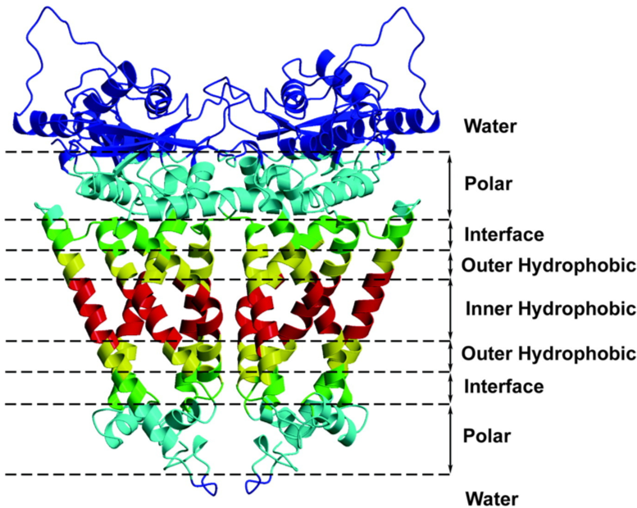
Membrane proteins:
Score functions for membrane proteins:
mpframework_smooth_fa_2012
ref2015_memb
franklin2019

Slide 43
Constraints:
(Usually obtained from experimental data)
Atom Pair Restrains a distance between Atom1 and Atom2
Dihedral Restrains a dihedral angle
Angle Restrains an angle
Coordinate Restrains an atom to a fix XYZ position
Site Restrains a residue to interact with another chain
…

Slide 44
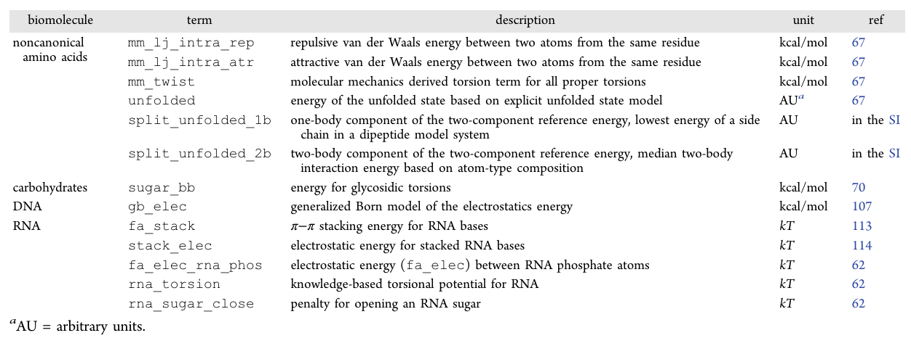
Score terms for other biomolecules:
(Alford RF, 2017)

Slide 45
Score terms for experimental data:
- Electron density
- Residual dipolar coupling (RDC)
- SAXs

Slide 46
References:
REF2015:
Alford RF, et. al, The Rosetta All-Atom Energy Function for Macromolecular Modeling and Design. Journal of Chemical Theory and Computation, 2017. 13 (6), 3031-3048
Park H, et. al Simultaneous Optimization of Biomolecular Energy Functions on Features from Small Molecules and Macromolecules Journal of Chemical Theory and Computation, 2016. 12 (12), 6201-6212
Old Scorefxn (Talaris):
O'Meara MJ, et. al, A Combined Covalent-Electrostatic Model of Hydrogen Bonding Improves Structure Prediction with Rosetta. Journal of Chemical Theory and Computation, 2015.
Leaver-Fay A, et. al Scientific benchmarks for guiding macromolecular energy function improvement. Methods in enzymology, 2013. 523: p. 109.
Links:
https://www.rosettacommons.org/docs/latest/rosetta_basics/scoring/score-types
https://www.rosettacommons.org/docs/latest/rosetta_basics/scoring/scoring-explained

