Slide 1
Rosetta Basics: IO and Navigating Rosetta
Rocco Moretti
rocco.moretti@vanderbilt.edu
Notes:
UPDATE VERSIONS/DATES/ETC.
PDF → MOLGRAPH 16
PUT THE CSB TEMPLATE ON THESE SLIDES

Slide 2
Goals for this Talk
1. General Rosetta Concepts:
How do I run basic Rosetta applications?
Input/Output: file types, options, etc.
2. Learn where things are in Rosetta
Your working directory is independent of these Rosetta directories
(AKA your data is stored outside of Rosetta)
QUESTIONS ARE ENCOURAGED!

Slide 3
Files for this talk are in ~/rosetta_workshop/tutorials/short_talks/RosettaIO/
Notice these files are located outside of Rosetta
you do NOT want to store your input/output files in
the Rosetta directories
Tip: Open each file in your favorite text editor (gedit, vi, emacs, etc.) as we introduce them through the talk

Slide 4
How do I get Rosetta?
https://www.rosettacommons.org/software/license-and-download
Weekly Releases: (e.g. “2019.07”)
Latest version of the code, released roughly every week
Every revision passes scientific performance tests
Numbered Releases (e.g. “3.11”)
A weekly release that’s relabeled, released roughly every 6 months
All tutorials use version 3.11
Links to documentation, forum and demos:
https://www.rosettacommons.org/docs/latest/Home
https://www.rosettacommons.org/demos/latest/Home
Notes:
Double check version

Slide 5
General Workflow
Input Files
Structure/Sequence
Options
Application-Specific
Applications
Output Files
Structures
Scores
Analysis Scripts
Scientific Results

Slide 6
Reading structures into Rosetta
PDB files | Silent files
International standard Readable by PyMol, MOE, Chimera, etc One line per atom Useful for small number of structures www.wwpdb.org/documentation/file-format | Specific to Rosetta Compact One line per residue Useful for archiving many structures Binary silent files: more compact, but not human-readable https://www.rosettacommons.org/docs/latest/rosetta_basics/file_types/silent-file
Notes:
mmCif?

Slide 7
How do I run a Rosetta command?
Every command has the same basic layout:
Path to the application Arguments
<path_to_rosetta>/main/source/bin/<app_name>.default.linuxgccrelease –arg1 –arg2
Example for you first Rosetta command:
<path_to_rosetta>/main/source/bin/score_jd2.default.linuxgccrelease –in:file:s \ input_files/test1.pdb –out:file:scorefile output_files/test1.sc –out:pdb \ output_files/test1_out.pdb
**Note: the “\” represents a continuous line

Slide 8
Common command line arguments
Input options:
-parser:protocol example.xml ## RosettaScripts XML file
-in:file:s example_in.pdb ## input a PDB structure file
-in:file:fasta example.fasta ## input a FASTA sequence file
-in:file:silent example_in.silent ## input a Rosetta silent file
-in:file:extra_res_fa example.params ## input a parameters file for uncommon compounds
-nstruct 42 ## produce 42 outputs
Output options:
-out:file:silent example_out.silent ## output structures to silent file
-out:file:scorefile example_out.sc ## output scorefile for run

Slide 9
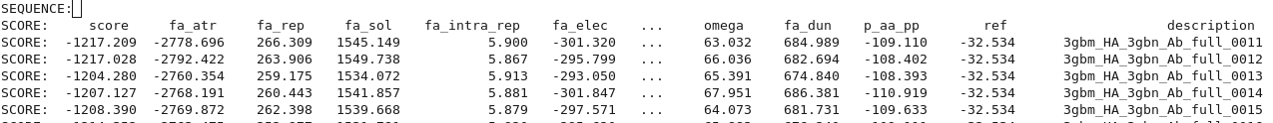
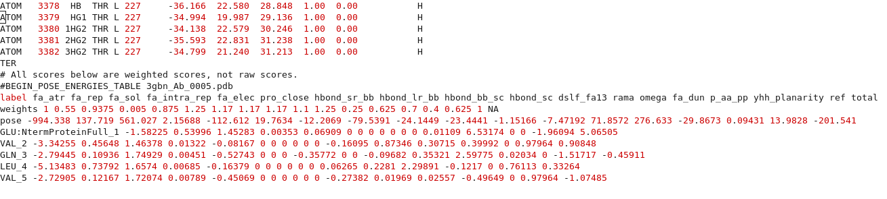
Scores can be found in output scorefiles and PDBs
output_files/test1.sc
Bottom of output_files/test1.pdb

Slide 10
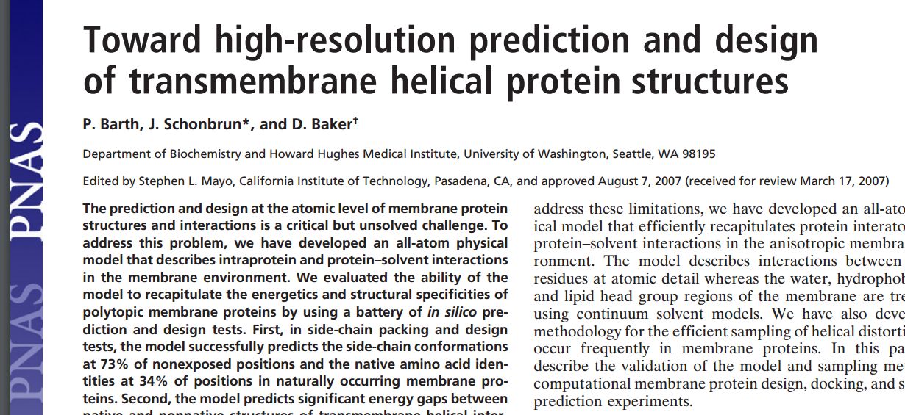
How do I run a Rosetta command?
$ROSETTA/main/source/bin/AbinitioRelax.linuxgccrelease -database ../../rosetta_database -in:file:fasta ./input_files/1elwA.fasta -in:file:native ./input_files/1elw.pdb -in:file:frag3 ./input_files/aa1elwA03_05.200_v1_3 -in:file:frag9 ./input_files/aa1elwA09_05.200_v1_3 -abinitio:relax -relax:fast -abinitio::increase_cycles 10 -abinitio::rg_reweight 0.5 -abinitio::rsd_wt_helix 0.5 -abinitio::rsd_wt_loop 0.5 -use_filters true -psipred_ss2 ./input_files/1elwA.psipred_ss2 -kill_hairpins -out:file:silent 1elwA_silent.out
-nstruct 10
OR
$ROSETTA/main/source/bin/AbinitioRelax.linuxgccrelease @options.txt

Slide 11
Use an options file for your runs
$ROSETTA/main/source/bin/AbinitioRelax.linuxgccrelease @options.txt
-in:file
-fasta ./input_files/1e1wA.fasta
-native ./input_files/1e1w.pdb
-frag3 ./input_files/aa1elwA03_05.200_v1_3
-frag9 ./input_files/aa1elwA09_05.200_v1_3
-psipred_ss2 ./input_files/1elwA.psipred_ss2
-abinitio:relax
-relax:fast
-abinitio::increase_cycles 10
-abinitio::rg_reweight 0.5
…
-out:file:silent ./output_files/1elwA_silent.out
-nstruct 10

Slide 12
Other files: application-specific
Span File: Defines which residues are in the membrane
Loops File: Identifies the loop residues for loop closure
Params File: Custom parameters for small molecules or non-canonical amino acids
Constraint File: Experimentally derived restraints
Fragment File: Short protein segments used for comparative modeling and de novo folding
Res Files: Indicates which residue positions should be designed

Slide 13
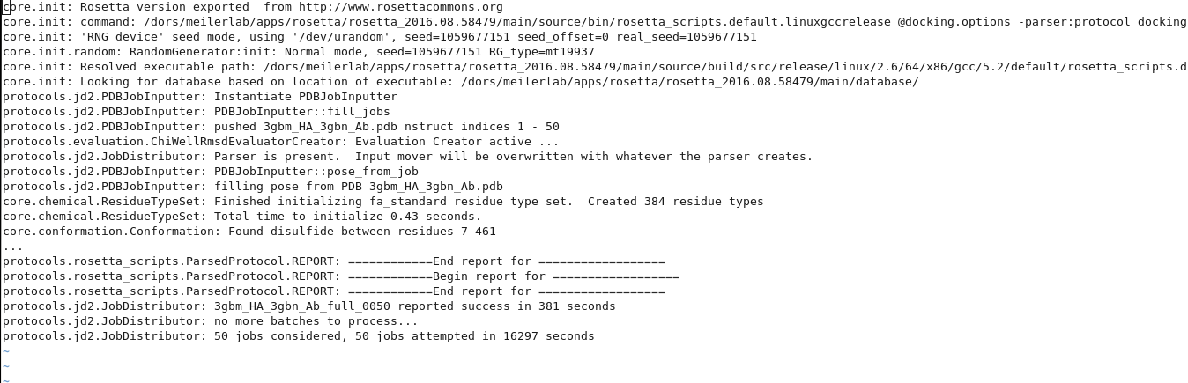
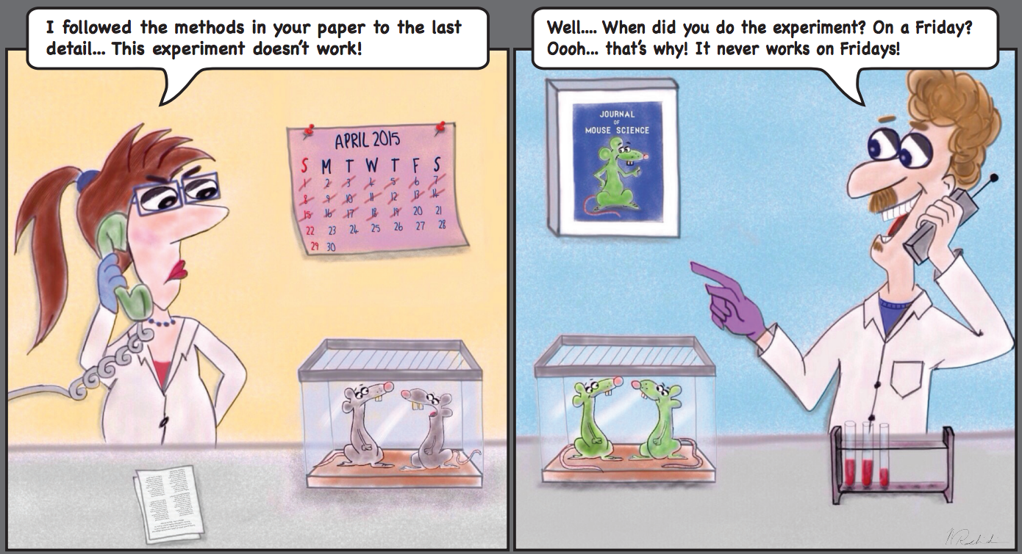
Tracer output (log files)
Options to control tracer output:
Silence certain tracers:
-mute core.chemical.ResidueTypeSet
Change verbosity level (Error/Warning/Info/Debug/Trace)
-out:levels all:Warning core.init:Info

Slide 14
Any Questions?

Slide 15
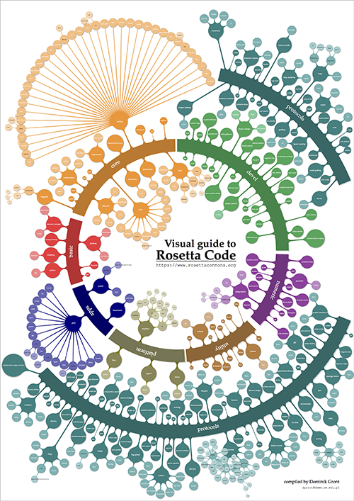

Slide 16
Basic Rosetta Structure
cd ~/rosetta_workshop/rosetta/
rosetta/
main/
tools/
demos/
documentation/

Slide 17
~/rosetta_workshop/rosetta/main/
Rosetta/main/source/bin/
Most applications you will run are
calling programs within the bin directory
rosetta_scripts.default.linuxgccrelease
score_jd2.default.linuxgccrelease
relax.default.linuxgccrelease
Rosetta/main/source/scons.py
Used for compiling
Rosetta/main/source/src/
This is where all of the code lives
Rosetta/main/source/scripts/
Some useful scripts live here
(e.g. params file generation)
rosetta/
main/
source/
database/
tests/
Notes:
Database files automatically called
Weights files: these files

Slide 18
~/rosetta_workshop/rosetta/main/database/
Contains pre-defined information that an application needs
— users generally don’t change things here.
Note: Most of the time, applications know where the database is without having to specify it.
Rosetta/main/database/scoring/
Default weights files
Rotamer libraries
Rosetta/main/database/chemical/
Residue information--params files
Atom sets
rosetta/
main/
source/
database/
tests/
Notes:
Database files called when running an application
Weights files: these files

Slide 19
~/rosetta_workshop/rosetta/main/tests/
Rosetta/main/tests/
Tests for Rosetta code (useful for developers only)
rosetta/
main/
source/
database/
tests/
Notes:
It is fun to read through as this is what’s currently being tested by developers

Slide 20
Basic Rosetta Structure
cd ~/rosetta_workshop/rosetta/
rosetta/
main/
tools/
demos/
documentation/

Slide 21
~/rosetta_workshop/rosetta/tools/
rosetta/
tools/
protein_tools/
perl_tools/
hts_tools
And others...
These scripts are incredibly help for smaller, more basic tasks
Used mainly to setup or analyze runs

Slide 22
~/rosetta_workshop/rosetta/tools/protein_tools/scripts/
rosetta/
tools/
protein_tools/
perl_tools/
hts_tools
And others...
Some useful scripts to be aware of:
clean_pdb.py*
Makes a PDB “Rosetta-proof” and used at the beginning of almost any protocol
pdb_renumber.py
Renumbering your PDB starting from 1
score_vs_rmsd.py
Setup for score vs. RMSD plots
top_n_percent.py
Extracts tags (protein names) for top given percent of models based on score term

Slide 23
Basic Rosetta Structure
cd ~/rosetta_workshop/rosetta/
rosetta/
main/
tools/
demos/
documentation/

Slide 24
~/rosetta_workshop/rosetta/demos
rosetta/
demos/
tutorials/
public/
Protocol_capture
tutorials/
Past tutorials
public/
Protocol examples
protocol_capture/
protocols associated with a publication
DISCLAIMER: May be out of date, always check
Wiki/RosettaCommons/forum for latest information!

Slide 25
Basic Rosetta Structure
cd ~/rosetta_workshop/rosetta/
rosetta/
main/
tools/
demos/
documentation/

Slide 26
~/rosetta_workshop/rosetta/documentation/
rosetta/
documentation/
getting_started/
rosetta_basics/
application_documentation
scripting_documentation
Very useful to go through when you’re just getting started in
Rosetta or any structural biology software
Understanding general Rosetta concepts
Where to find FAQs (How long does this run take?)
Options list, file types
Protocols you can use
General structural biology FAQs
How do I do X?
https://www.rosettacommons.org/docs/latest/Home

Slide 27
Other Rosetta Resources:
https://www.rosettacommons.org
Documentation
User guides
Forum
Software Download

