Slide 1
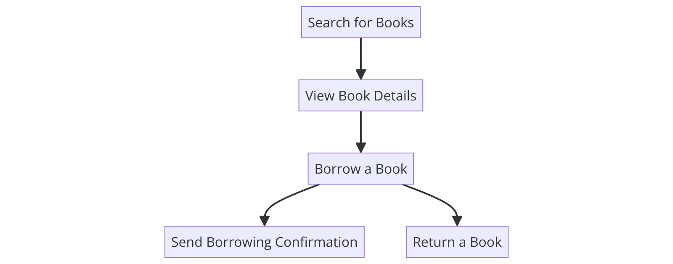
Complete User Case Story Process Diagram
User searches: User inputs search criteria to find books in the library catalog.
User views details: User selects a book to view detailed information.
User borrows a book: User borrows the book by providing necessary identification.
User returns a book: User returns the borrowed book to the library.
Borrowing confirmation sent: Library sends a confirmation message to the user.

Slide 2

Task #1 - Search for Books
Task: User inputs search criteria to find available books in the library catalog.
Inputs/Outputs: Inputs include title, author, and genre; outputs are a list of books matching the search criteria.
Stateless: This task is suitable for a stateless function as it does not require retaining any user-specific information between requests. Each search is independent of the previous ones.
Photo by Priscilla Du Preez on Unsplash

Slide 3

Task #2 - View Book Details
Task: User selects a book from the search results to view its details.
Inputs/Outputs: Input is the book ID; output is detailed information about the book, including title, author, summary, and availability.
Stateless: This task is suitable for a stateless function because it involves fetching data based on a single request without needing to remember previous interactions.
Photo by Christian Wiediger on Unsplash

Slide 4
Task #3 - Borrow a Book
Task: User borrows a book from the library.
Inputs/Outputs: Inputs are book ID and user ID; outputs include a borrowing confirmation and an updated status of the book (e.g., marked as borrowed).
Stateful: This task requires maintaining state as it involves multiple steps (checking book availability, updating inventory, and recording borrowing details), making it a candidate for a stateful function.
Photo by Christian Wiediger on Unsplash

Slide 5

Task #4 - Return a Book
Task: User returns a borrowed book to the library.
Inputs/Outputs: Inputs are book ID and user ID; outputs include a return confirmation and an updated status of the book (e.g., marked as available).
Stateful: This process should be stateful to handle the various steps involved in checking the book condition, updating the inventory, and processing any fees or penalties.
Photo by Jamie Taylor on Unsplash

Slide 6
Task #5 - Send Borrowing Confirmation
Task: Send a confirmation message to the user after successful borrowing.
Inputs/Outputs: Inputs are user details (email) and borrowing details (book ID, due date); output is a confirmation message sent to the user.
Stateless: This task can be stateless as it simply involves sending a message based on a completed transaction. No state needs to be retained between requests.
Photo by Priscilla Du Preez on Unsplash

