Slide 1
Using Denotational Semantics to Determine the Function of a Program
A Senior Design Project

Slide 2
Group
Members
Samuel Toth (tothse@mail.uc.edu)
Advisor
Anca Ralescu (RALESCAL@UCMAIL.UC.EDU)

Slide 3
Project Description
Denotational semantics is the translation of programming language constructs into mathematical objects. These objects will be a part of the state of the program and can describe the mathematical steps taken in order to reach the current state. By understanding these semantics, we hope to approach the idea of determining the functionality and purpose of a program. This can be done by utilizing machine learning algorithms to learn a classification of algorithms based upon a ground truth idea of functionality. In the case of this project, we are translating simple programming problems into assembly code and then basing the learning algorithms based on classes of types of algorithm (i.e. sorting, search, ect).

Slide 4
Review of Progress
Gathering of Research on both denotational semantics and machine learning related to the project
Gathering of basic code and thus it’s assembly code
Starting of an regular expression code in order to change files from assembly disassembly to usable codes
Implementation of simple Machine learning algorithms for a first look at methods

Slide 5
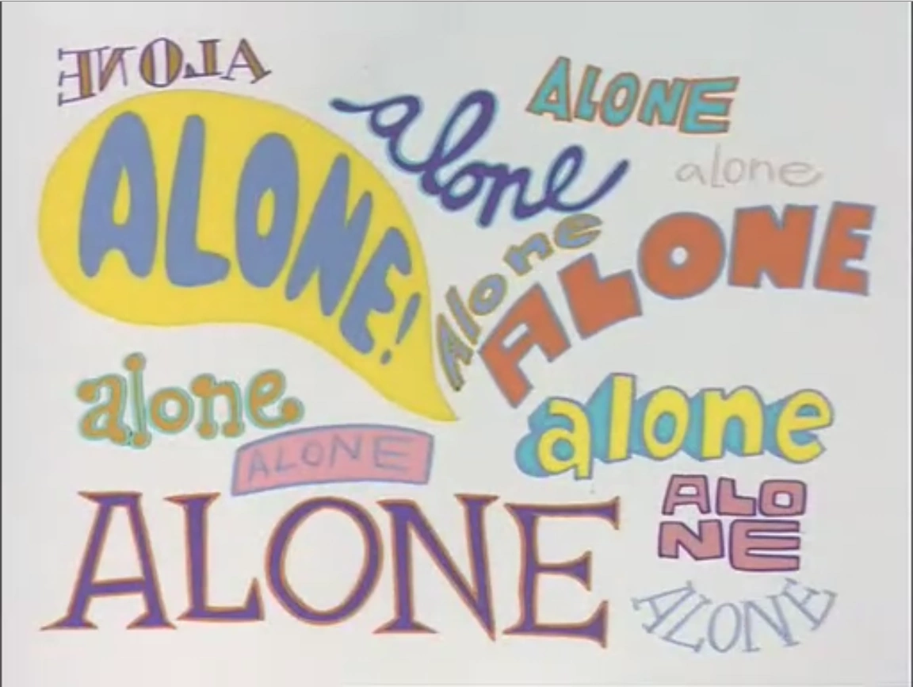
Division of Work
As a solo project, all of the work goes to student, Samuel Toth

