Slide 1
Comparing Julia to other Languages
Samuel Wynsma

Slide 2


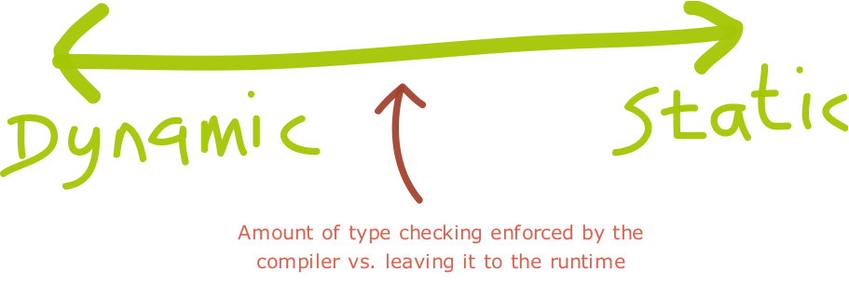
What is Julia
Julia, according to the designers of it, is a mathematical/statistical language that is capable of doing calculations at the speed of C/C++.
Julia is a dynamically typed language.
Julia's code is similar to python

Slide 3

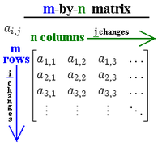
The Tests
Because Julia is supposed to be as fast as C++, I tested it against C++ on how well it handled statistical data
Because Julia is a dynamically typed language, I tested to see if it could use less code like Python and still run at the same speed.
I did three tests:
Single Variable Test
Bivariate Test
Matrix Test against R

Slide 4
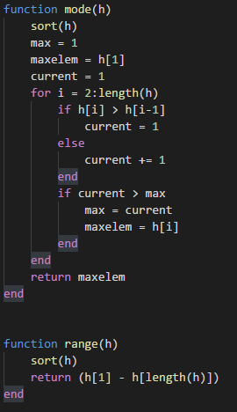
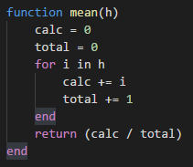
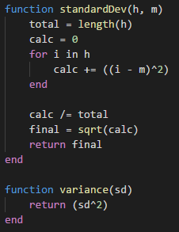
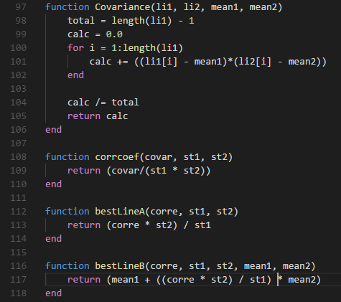
Demo

Slide 5
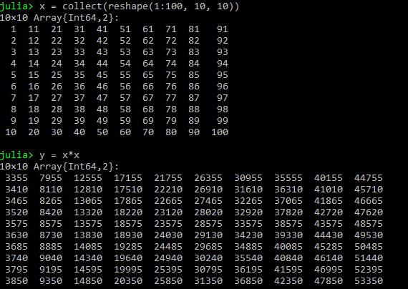
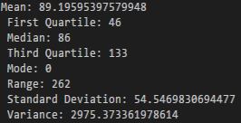

Results of the three tests
Julia was very fast at the statistical tests.
Julia came up slightly short at the matrix multiplication test.
Julia has more code than Python, and is close to as fast as C++ when it comes to statistical application.

Slide 6
Questions?

