Slide 1
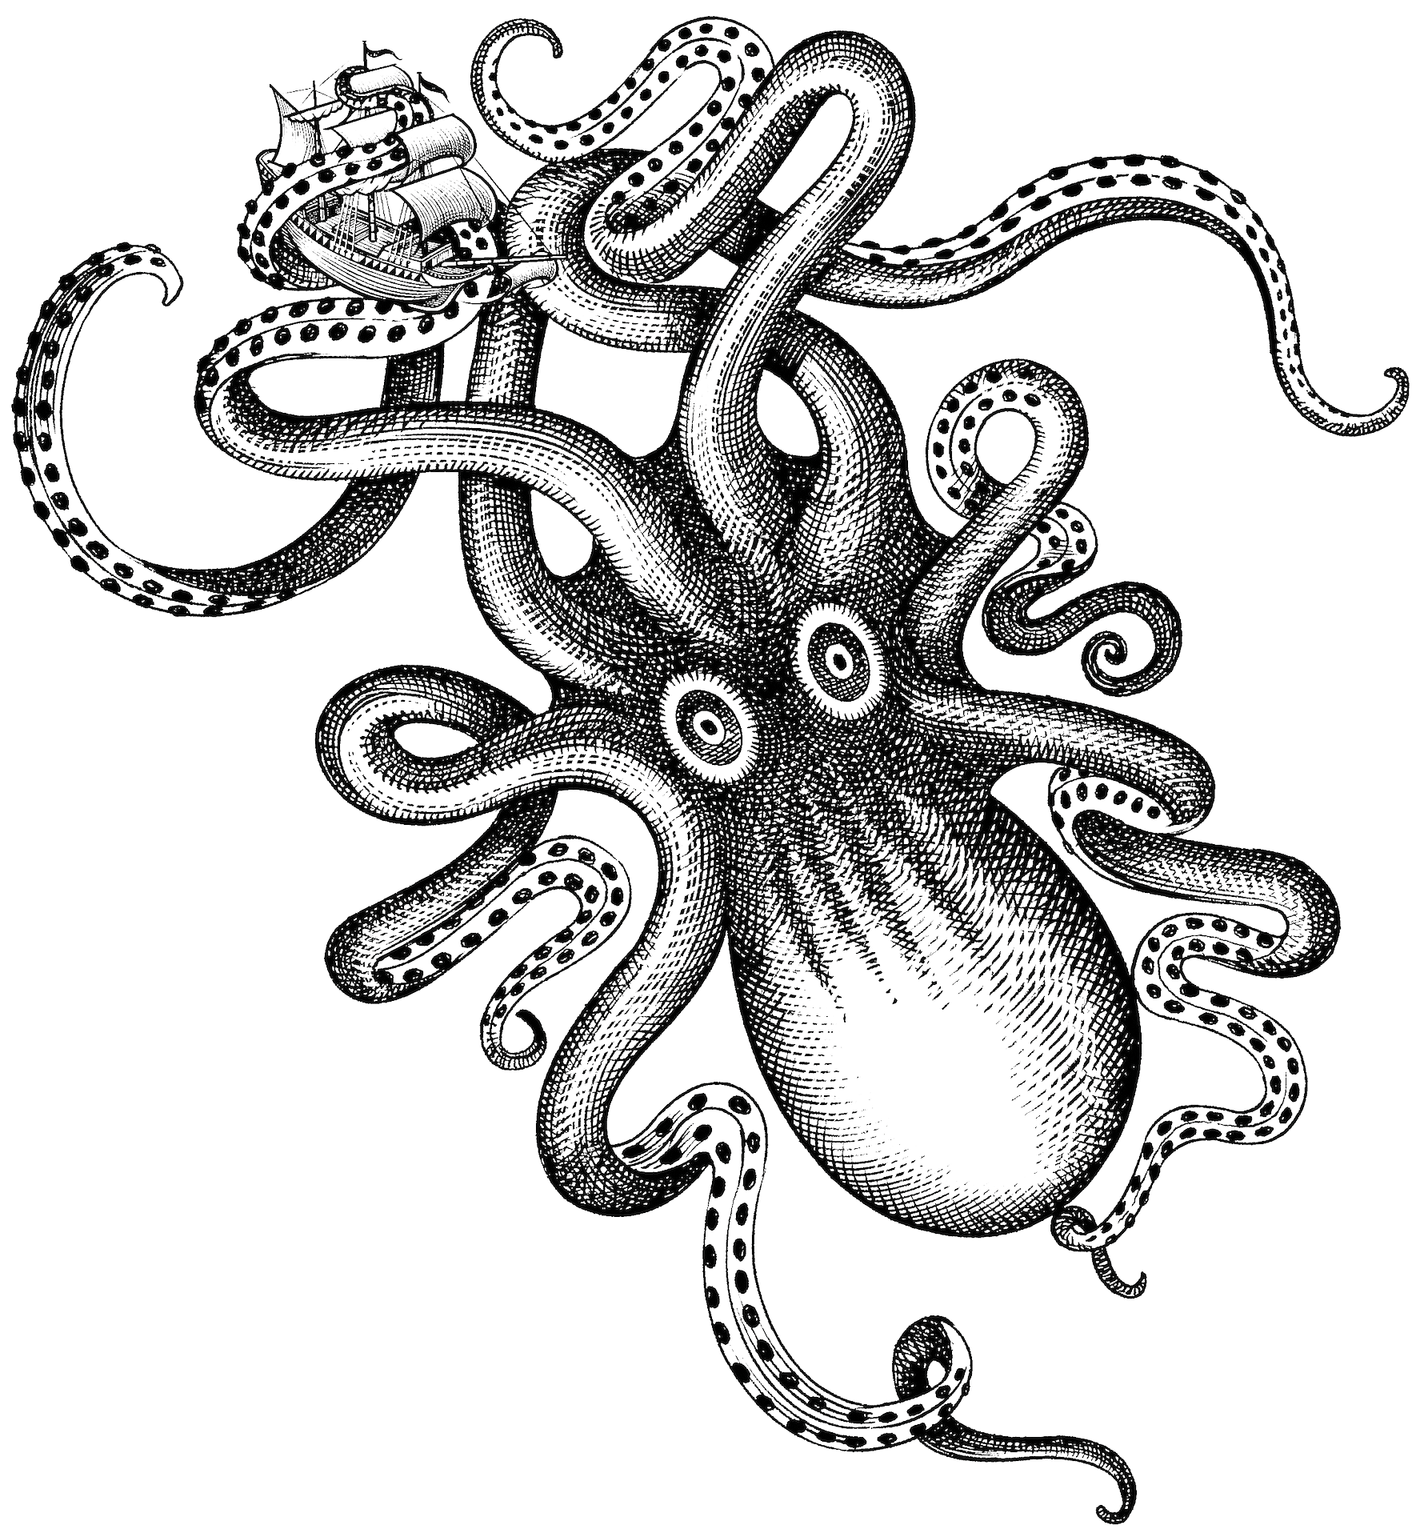
Rootkits and Bootkits
Attack Vectors Lurking Beneath the OS in UEFI and BIOS
Notes:
Gabe - A rootkit is any form of software which bypasses privilege protection to escalate the privilege level of any process or user to a root privilege level.
A boot kit is any form of software which hijacks the boot process to take over the system prior to our at the beginning of media booting.

Slide 2
What is Beneath Your OS?
BIOS/UEFI
Basic Input/Output System
Unified Extensible Firmware Interface
Out of Band Management
Usually reserved for servers
Hardware Drivers
DXE – Driver eXecution Environment
EFI - Extensible Firmware Interface
PEIM – Pre-EFI Init Module
Legacy BIOS Drivers
SEC Code
Stored in the CPU
Notes:
Gabe
All of the above are loaded on the motherboard itself, with the exception of SEC. SEC is the code stored in the CPU.
UEFI claims to have prevented all attacks against it from the OS, but this claim is shoddy due to software such as Black Lotus and System Sleep exploits

Slide 3
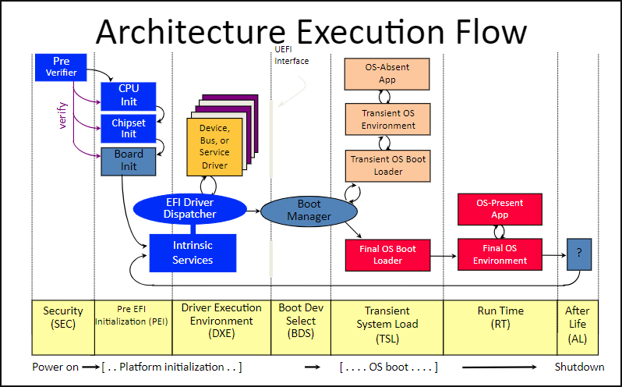
UEFI Boot Order
Notes:
Gabe
Ok, this is where stuff gets tricky.
SEC is the CPU starting up, where it receives power on power input pin 3.
PEI is where the board begins to be started, however things such as PCIE slots, RAM are started up at this point. System management mode is started here
DXE is where all of the drivers (such as mouse control, keyboard control, networking for PXE) are initialized. SMRAM and RAM exist at this phase as a raw memory map. system management ram is still accessible until ExitBootServices() is called, cleaning up and partitioning SMRAM and SMMODE to a new, isolated mode.
BDS is where you get the screen to select a drive/OS.
TSL is where you get the windows loading circle, at this point UEFI should not be accessible to the OS
RT is the the system is booted
AL is when the system shutdown, UEFI watchdogs and SMM watchdogs which report back to the next boot phase with results of last boot TECHNICALLY NONE OF THIS IS ACCESSIBLE (OR SHOULD BE) AFTER BOOT

Slide 4
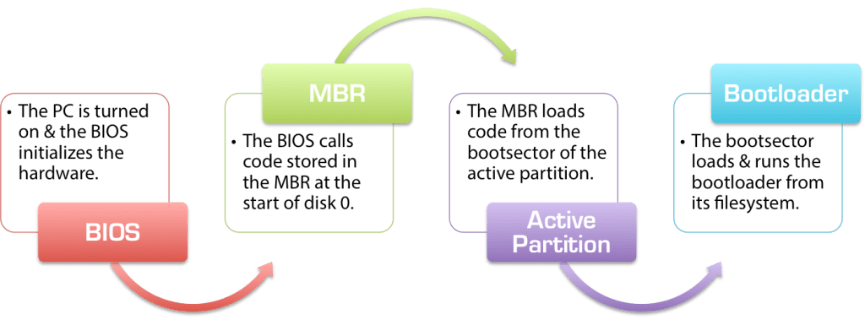
BIOS Boot Order
Notes:
Gabe - BIOS begins by setting up POST (Power On Self Test) to allow the system to ensure the hardware works
Then it creates IVT or interrupt vector table. Important values are stored off to the CMOS registers, to be used later
master boot record then finds disks boot sections via iterative search (specific offsets provided by original equipment manufacturer)
Once found, an active partition is listed for the user to boot into
THe bootloader (code in BIOS) loads the drive at the boot section, and begins processing to boot an OS
THIS IS ALL ACCESSIBLE AFTER BOOT VIA KERNEL

Slide 5
Persistence and Its Importance
From Mitre (https://attack.mitre.org/tactics/TA0003/):
"The adversary is trying to maintain their foothold. Persistence consists of techniques that adversaries use to keep access to systems across restarts, changed credentials, and other interruptions that could cut off their access. Techniques used for persistence include any access, action, or configuration changes that let them maintain their foothold on systems, such as replacing or hijacking legitimate code or adding startup code."
Specifically, this is startup code.
Notes:
Nate does this
Sam makes slide on Issues with traditional fixes
Reflash of SPI Chip and MOBA
Clean OS install doesn't fix this
The only thing that can fix a bios level rootkit is a complete clean and new OS, Mother Board, and spi chip. Which basically means a new computer.
Make points on steps to remove to show how hard.
The only thing that can fix a bios level rootkit is a complete clean OS, Mother Board

Slide 6
Common vectors of achieving persistence
Registry Modifications
Creating keys or modifying existing ones to execute scripts or executables on startup.
HKEY_CURRENT_USER\Software\Microsoft\Windows\CurrentVersion\Run
Startup Folders
Placing scripts or executables in folders that run on system boot.
Services and Drivers
Installing malicious services or drivers that load during boot.
Bootkits and Rootkits
Modifying the boot process or kernel to maintain control over the system.
DLL Hijacking
Loading malicious Dynamic Link Libraries (DLLs) instead of legitimate ones.
Notes:
Nate does this
Sam makes slide on Issues with traditional fixes
Reflash of SPI Chip and MOBA
Clean OS install doesn't fix this
The only thing that can fix a bios level rootkit is a complete clean and new OS, Mother Board, and spi chip. Which basically means a new computer.
Make points on steps to remove to show how hard.
The only thing that can fix a bios level rootkit is a complete clean OS, Mother Board

Slide 7
Common ways to remove malware
Identify and Isolate.
Kill active processes.
Remove persistence mechanisms.
Delete malware files and/or restore backup.
This allows the user to continue using the same system. BIOS and UEFI rootkits and bootkits are much harder to remove and effectively force you to abandon all the files on your computer completely to ensure removal.

Slide 8
Removal of BIOS Bootkit or Rootkit
Rootkit:
Uninstall OS
Reinstall OS
Bootkit: Uninstall OS
Remove CMOS Battery and hold power for 30s for power drain of NVRAM variables
Replace CMOS Battery
Reinstall OS
Notes:
Nate does this

Slide 9
Removal of UEFI Bootkit or Rootkit
Rootkit:
Uninstall OS
Reinstall OS
Bootkit: Uninstall OS
Remove SPI Chip and CMOS Battery (to also clear NVRAM)
Reflash UEFI SPI CHIP
Replace CMOS Battery
Reinstall OS
Notes:
Nate does this

Slide 10
Vectors to Achieve UEFI Persistence
SMM (System Management Mode)
Dxe Drivers Extended beyond Lifetime
Sleep Mode Interrupt
swi(3) use after free
Notes:
Sam does this

Slide 11
Vectors to Achieve BIOS Persistence
"Intended" Super User Operations
Linux Kernel Mode Driver Updates
Windows Kernel Updates
Windows BIOS Updates
Windows Hypervisor Updates
MBR Overrides (Grub, Windows Boot Loader, etc)
Unintended Operations
MBR Overrides (overflows from disk image, hijacks of global memory map pointer table
Malformed BIOS Driver Calls
Physical Hijacking
USB, Chip replacement, Chip reprogramming
Notes:
Sam does this

Slide 12
Solutions
Trusted Execution Environment
Secure Execution Environment (Qualcomm)
Trust Zone (AMD)
Knox (Samsung Phones)
Root of Trust
Hardware vs Software
Trusted Anchor Module (Cisco)
Trusted Execution Technology (Intel)
Titan M (Google Pixel 3)
Notes:
Sam does this

