Slide 1
Life Expectancy Analysis
Done by-
Samuela Abigail Mathew 71762108039
Nivetha S S 71762108030
Haripriya V 71762108011
Pavithra G. 71762108031

Slide 2
Agenda
Problem statement
Global Analysis
Continent-wise analysis
Summary
Hypothesis testing
Results

Slide 3
Problem Statement
Life expectancy refers to the average number of years a person who has reached a certain age can expect to live based on actuarial data.
The analysis was done using Life Expectancy dataset of WHO to study the factors which affect life expectancy of a person with the aim of finding the predicting factor contributing to lower value of life expectancy, help in identifying countries with low life expectancy and suggest ways to improve it.
The dataset has 22 attributes (columns) and 2938 rows, consisting of data from year 2000-2015 for 193 countries.

Slide 4
Global Analysis
The following were observed over the 15 years from the dataset- Over 55% countries have life expectancy greater than 70 years, 40% have between 50-70 years, and remaining have between 20-50 years with the global average life expectancy being 69 years.
The global minimum and maximum life expectancy is 36 years (Haiti) and 89 years (Belgium, Finland, France, France, Germany, Italy, New Zealand, Norway, Portugal, Spain, Sweden) respectively.
Life expectancy has strong correlation with BMI, income composition of resources, schooling, GDP, Polio, Diphtheria, adult mortality, HIV/AIDS, status, and thinness.

Slide 5
Continent-wise Analysis
1.Africa
Africa has 54 countries of which all are still developing. The mean life expectancy of Africa is 58.6 years with minimum and maximum being 39 (Sierra Leone) and 79 years (Egypt) respectively.
Countries with high life expectancy of greater than 70 years are Algeria, Tunisia, Seychelles, Libya and Mauritius. Over the 15 years, these had a distinguishing trend of low adult mortality and high BMI compared to other African countries.
Countries with very less life expectancy are Sierra Leone and Central African Republic.
Life expectancy has strong negative correlation with adult mortality and HIV/AIDS, and has positive correlation with BMI, Polio, schooling, Diphtheria, and income composition of resources where correlation with income composition of resources and BMI is the strongest.

Slide 6
2.Asia
Asia has 47 countries in which Cyprus, Japan and Singapore are developed and the rest are developing countries.
The mean life expectancy of Asia is 71.2 years with minimum and maximum being 54.8 (Afghanistan) and 87 years (Republic of Korea, Singapore) respectively.
Over the 15 years, Israel and Japan have mostly maintained greater than 80 years life expectancy, identified by their distinct trend of low adult mortality. Countries having least life expectancy are Afghanistan and Lao People’s Democratic Republic in range 54-65 years, identified by their distinct trends of high adult mortality and high percentage of thinness.
Life expectancy has strong negative correlation with adult mortality, status, and thinness (both categories) where correlation with adult mortality is strongest, and strong positive correlation with income composition of resources and schooling.

Slide 7
3.Oceania
Oceania has 16 countries of which 2 are developed- Australia, New Zealand. Country with lowest life expectancy of 58.9 years is Papua New Guinea, and New Zealand has highest life expectancy of 89 years.
Over the 15 years, Australia and New Zealand have maintained life expectancy in range 78-83 years or above, identified by their distinct trends of low adult mortality, very high alcohol consumption, high percentage expenditure, and high GDP.
Whereas Papua New Guinea has a low life expectancy of 58-63 years, identified by it’s distinct trends of very high adult mortality, very high infant deaths, very high under-five deaths, and very high HIV/AIDS.
Life expectancy has strong negative correlation with status, adult mortality, HIV/AIDS, under-five deaths, and infant deaths where correlation with status is strongest. Life expectancy has strong positive correlation with alcohol, schooling, income composition of resources, GDP, and percentage expenditure where correlation with alcohol and schooling is strongest.

Slide 8
4.Europe
Europe has 41 countries of which 26 are developed countries, thus having highest proportion of developed countries.
Russian Federation has the lowest life expectancy of 64.6 years, and countries Belgium, Finland, France, Germany, Italy, Norway, Portugal, Spain, and Sweden have highest life expectancy of 89 years. The mean life expectancy is 77.4 years.
Over the 15 years, all developed countries of Europe have maintained life expectancy greater than 78 years, identified by their trends of high percentage expenditure, high GDP, and low thinness.
Russian Federation, Ukraine, Belarus, and Republic of Moldova have relatively less life expectancy in range 65-73 years, identified by their trends of high adult mortality and high thinness.
Life expectancy has strong positive correlation with percentage expenditure, GDP, income composition of resources, and schooling, and strong negative correlation with adult mortality and thinness (both categories) where correlation with thinness (both categories) is strongest.

Slide 9
5.North America
It has 23 countries and the only developed country is United States of America. Canada has the highest life expectancy of 87 years and Haiti has lowest life expectancy of 36.3 years. The mean life expectancy is 73.7 years.
Over the 15 years, it was found that all countries except Haiti had high life expectancy of mostly in range 70-75 years, especially Canada, Costa Rica, Cuba, and USA which had life expectancy greater than 76 years. Haiti has trend of high HIV/AIDS.
Life expectancy has strong positive correlation with income composition of resources and schooling, and strong negative correlation with thinness (both categories), HIV/AIDS, and adult mortality where correlation with thinness is strongest.

Slide 10
6.South America
It has 12 countries were all are developing, where lowest and highest life expectancy is 62.6 years (Bolivia) and 85 years (Chile) respectively. The mean life expectancy is 73 years.
Over the 15 years, Chile has maintained highest life expectancy in range 77-85 years. Bolivia, Guyana, and Suriname have relatively less life expectancy in range 62-71 years, having distinct trends of high adult mortality and high HIV/AIDS.
Life expectancy has strong positive correlation with income composition of resources and schooling, and strong negative correlation with thinness (both categories), HIV/AIDS, and adult mortality where correlation with thinness is strongest.

Slide 11
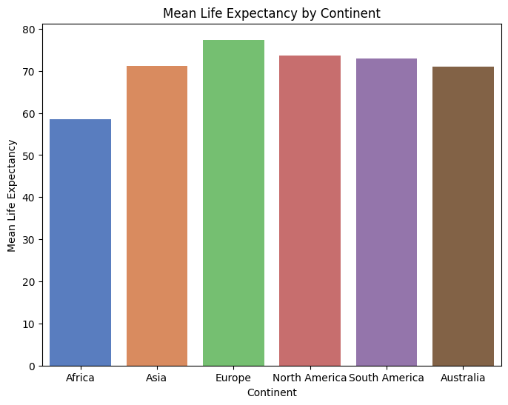
Summary
Life expectancy is slowly increasing over the years, with Europe having the highest average life expectancy and Africa having the lowest average life expectancy.
Life expectancy varies significantly continent-wise, with each continent affected by different factors

Slide 12
Hypothesis Testing
Some questions answered by hypothesis testing-
Should a country having a lower life expectancy value (<65) increase its healthcare expenditure in order to improve its average? –Yes
How does infant death and adult mortality rates affect life expectancy? -As adult mortality and infant death rates increase, life expectancy decreases.
What is the impact of schooling and income composition of resources on the lifespan of humans? When years of schooling is and income composition of resources is more, life expectancy is more.
Do densely populated countries tend to have lower life expectancy? -No, population density has no significant impact on life expectancy

Slide 13
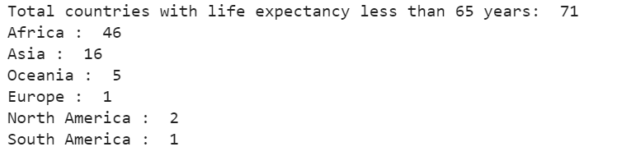
Results
Factors contributing to low life expectancy are developing status, high rates of adult mortality, HIV/AIDS, and thinness, less years of schooling, low Polio and Diphtheria immunization rates, and low income composition of resources, BMI, and GDP.

