Slide 1

Emerging Tech Skills: Developer Survey Analysis 2024
Name: Samue Chan Yankah
Date: 31 August 2025

Slide 2



OUTLINE
Executive Summary
Introduction
Methodology
Results
Visualization – Charts
Dashboard
Discussion
Findings & Implications
Conclusion
Appendix

Slide 3

EXECUTIVE SUMMARY
Python, JavaScript and Sql are the top programming languages in current demand
PostgreSql and MonoDB show strong growth among databases
Vs Code dominates IDE usage
Job postings emphasize cloud and data skills
Dashboards reveal regional skill gaps and future trends

Slide 4

INTRODUCTION
• Purpose: Identify emerging tech skills from developer data
• Audience: IT consulting firm stakeholders
• Value: Inform hiring and training strategies

Slide 5

METHODOLOGY
Sources: Stack Overflow survey, jo-postings.xlsx, training portals
Collection: CVS import, Excel parsing
Wrangling: Cleaned missing values, normalized skill names ,merged datasets

Slide 6
RESULTS
- Bar chart: Top 10 languages (e.g., Python, JavaScript, Java)
- Future trend chart: Based on survey or GitHub growth
- Mention implications: e.g., Python’s dominance in AI, JavaScript in web dev

Slide 7
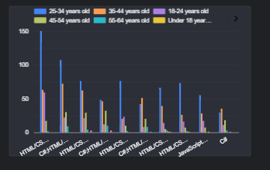
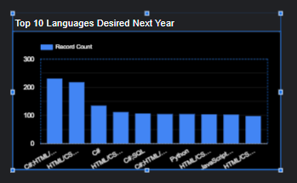
PROGRAMMING LANGUAGE TRENDS
Current Year
Next Year

Slide 8
PROGRAMMING LANGUAGE TRENDS - FINDINGS & IMPLICATIONS
Findings
Python remains dominant across roles
Rust and TypeScript show upward momentum
Implications
Developers should invest in modern, scalable languages

Slide 9
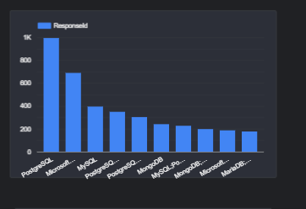
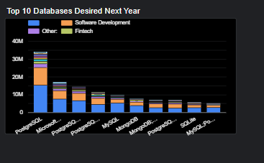
DATABASE TRENDS
Current Year
Next Year
< Bar chart of top 10 databases for the current year goes here >
< Bar chart of top 10 databases for the next year goes here.>

Slide 10
DATABASE TRENDS - FINDINGS & IMPLICATIONS
Findings
• PostgreSQL leads in reliability and scalability
• MongoDB and Firebase gaining traction for cloud-native apps
Implications
Shift toward flexible, developer-friendly database

Slide 11

DASHBOARD
https://lookerstudio.google.com/reporting/936ddaff-3a99-47d6-b667-965303936193

Slide 12
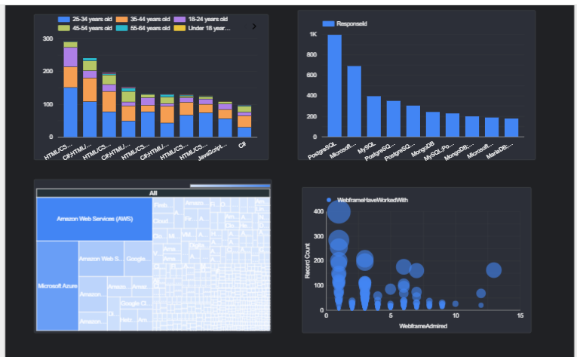
DASHBOARD TAB 1

Slide 13
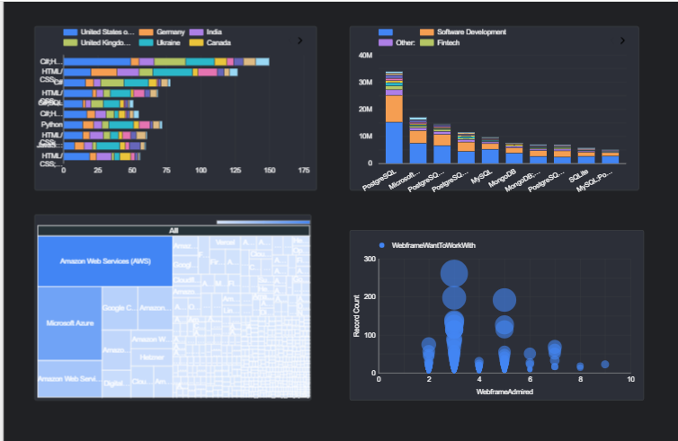
DASHBOARD TAB 2

Slide 14
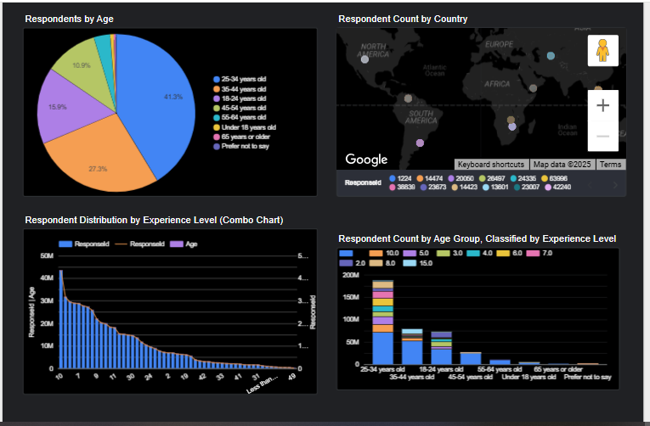
DASHBOARD TAB 3

Slide 15
DISCUSSION
- Younger developers favor emerging languages like Go and Rust
- Cloud and AI-related roles show regional clustering
- Database preferences vary by company size

Slide 16
OVERALL FINDINGS & IMPLICATIONS
Findings
Python and SQL are essential
Rust and Go are rising stars
Cloud and AI tools are reshaping workflows
Education paths are diversifying
Implications
Expect increased competition for developers skilled in Python, cloud tech, and AI tools.
Consider candidates with non-traditional education paths—online learners are thriving.
Invest in remote-friendly infrastructure to attract top talent.

Slide 17

CONCLUSION
Align learning with market demand
Focus on versatile tools (Python, SQL)
Stay updated on emerging tech (Rust, cloud DBs)
Use dashboards to monitor trends
Developer trends reflect evolving industry needs
Job market favors adaptable, full-stack skillsets
Data-driven insights can guide career and hiring strategies

Slide 18
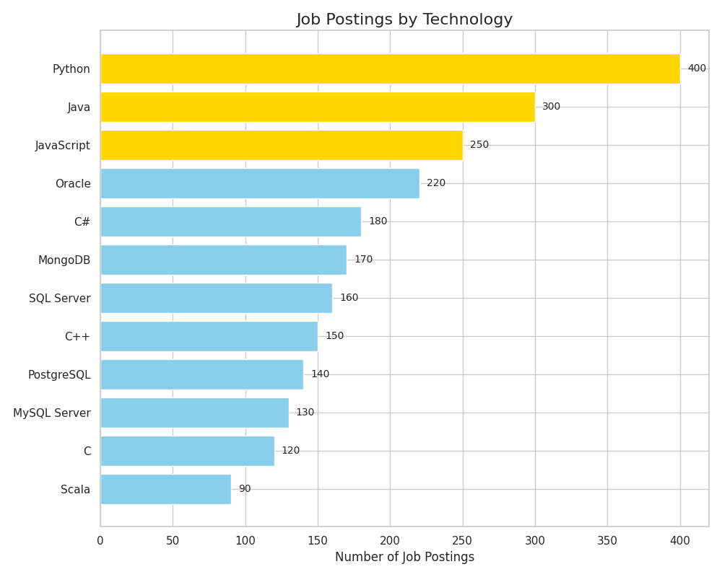
JOB POSTINGS

Slide 19
POPULAR LANGUAGES
In Module 1 you have collected the job postings data using web scraping in a file named “popular-languages.csv”. Present that data using a bar chart here. Order the bar chart in the descending order of salary.

