Slide 1
Driver for Adafruit Neo Trinkey - SAMD21 USB Key
Samuele Lo Piccolo

Slide 2
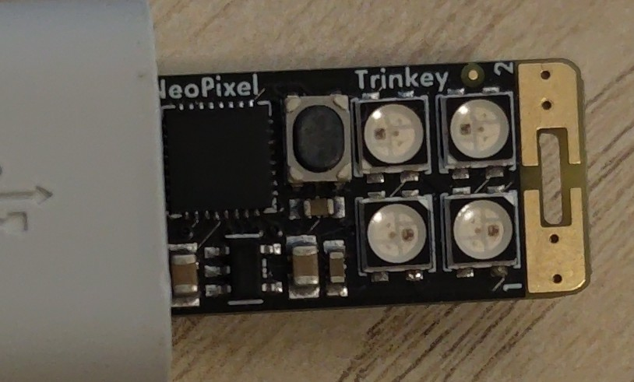
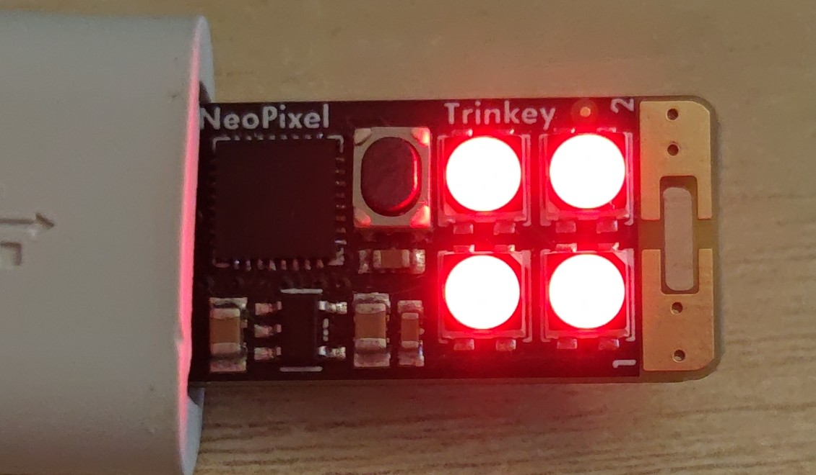
Main Purpose of this Project
The objective was communication with a USB-CDC serial interface provided by CircuitPython, the REPL, to be able to control the LEDs on the device from a Linux host instead of making a static Circuit Python program.

Slide 3
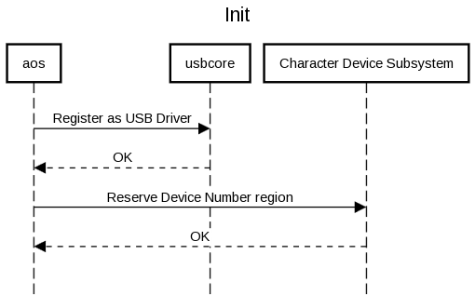
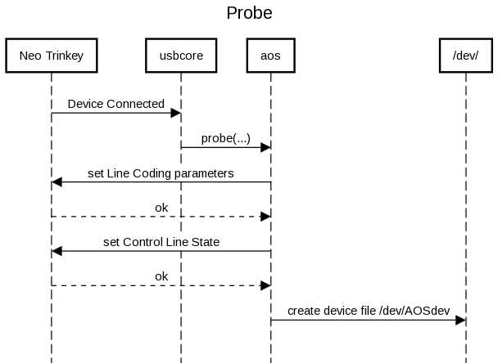
Implementation of the Driver – Init and Probe
The driver registers itself with USBcore, exporting the device table and exposing the Probe function.
Then it reserves the character device region, needed to create a device file when the device connects.
The Probe function sets up the CDC interface of the
Neo Trinkey for bulk transfers by setting the Line Coding parameters and the Control Line State
It also creates the device file in /dev/

Slide 4
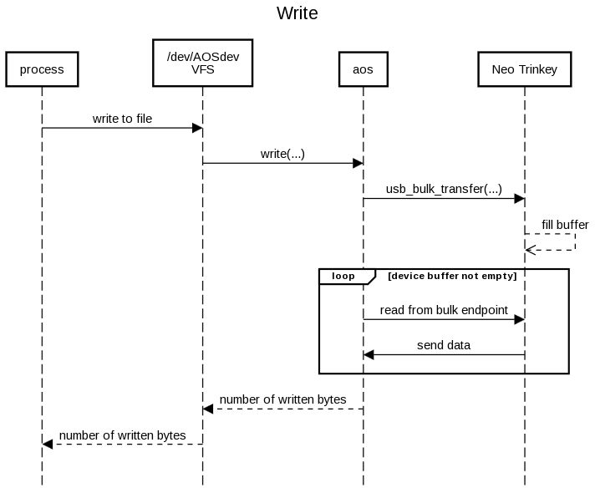
Implementation of the Driver - Write
The Write function transfers up to 64 bytes at a time to the device, then it empties a buffer present on the device to make sure no write gets ignored when the buffer is full.

Slide 5
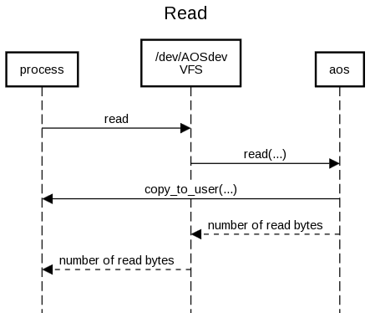
Implementation of the Driver - Read
The Read function does not interact with the
Neo Trinkey at all since it’s the write function
that has the duty of keeping the device buffer empty to avoid problems.
It just accesses a local buffer that contains the data produced by the device and returns it to userspace;
this local buffer is flushed if it ever overflows or if every character is read.

Slide 6
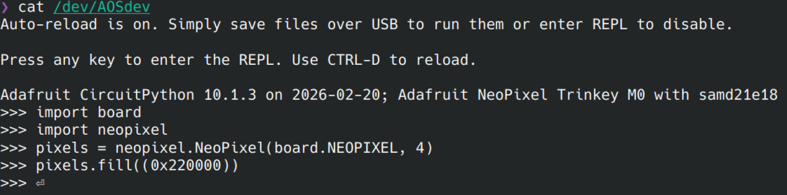
Validation
My main approach to test the correctness of the poject was to use Linux command line tools to communicate through /dev/AOSdev and verifying that the LEDs behaved as intended.
In the pictures I show the commands needed to turn the LEDs red and the REPL output.

Slide 7
Problems Encountered
The main problem was figuring out some device quirks without documentation.
For instance here I use \r because that’s the expected newline instead of \n
The biggest problem was figuring out why sometimes the device stopped accepting writes after a while.
I had to go by trial and error, but I managed to understand that the device was waiting for me to read from it before it could accept any new writes.

Slide 8
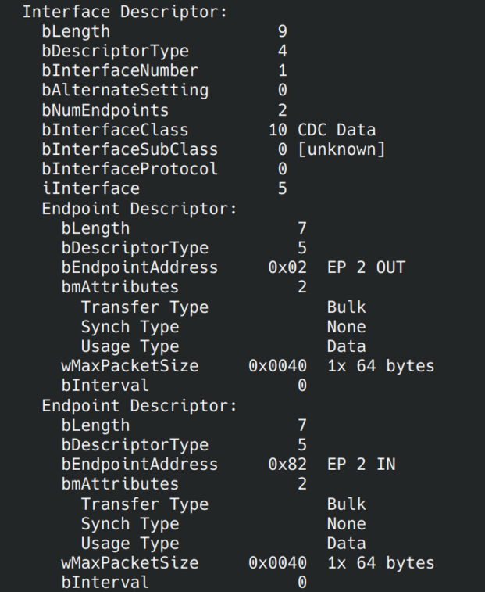
Learning Outcomes
I learned how USB descriptors work and how to identify the ones I needed to use for my project.
I have also gained a better understanding of how to work in a Linux environment and of the Linux kernel module development workflow.

