Slide 1


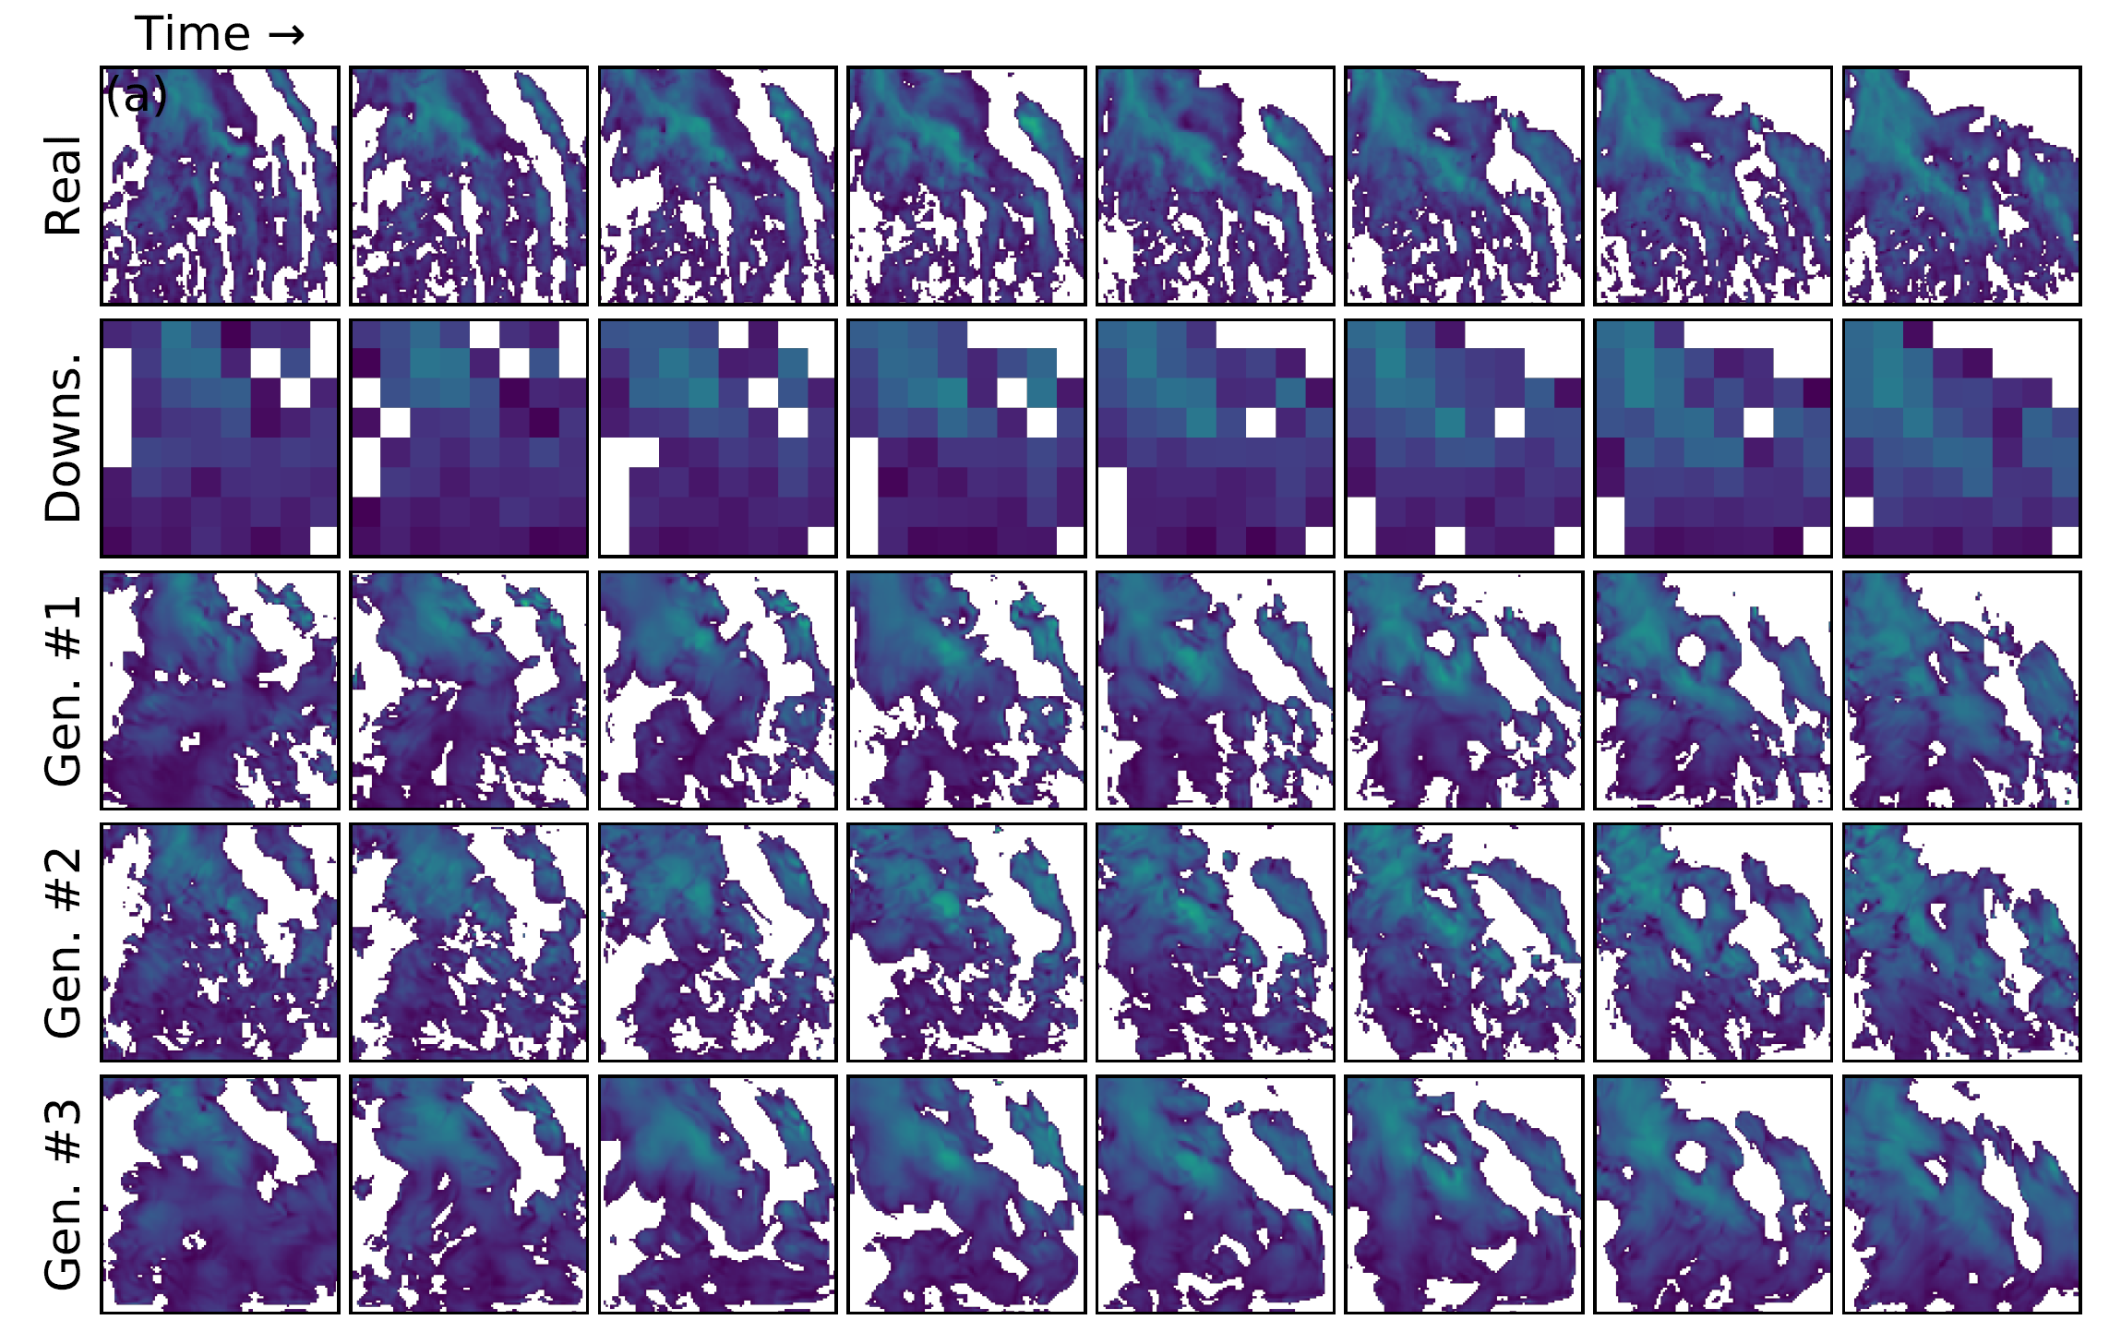
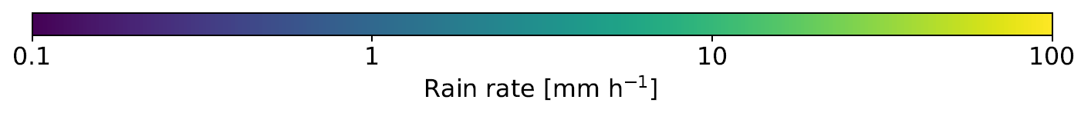
ML for Earth & Env Sci (Week 5, FA2025)
How can we add & evaluate uncertainty in our ML predictions?
Generated rain rates from the downsampled version of the real satellite image
Source: Leinonen et al. (2020)
Notes:
COSERO hydrological model

Slide 2
Min 80-105: Introduction to Generative Modeling
Learning Objectives (Géron Ch17, Haynes et al.):
Define generative modeling
Know different ways of adding uncertainty to ML models
Understand how to evaluate such uncertainty estimates
Know three state-of-the-art generative models
Apprehend applications of latent data representations

Slide 3
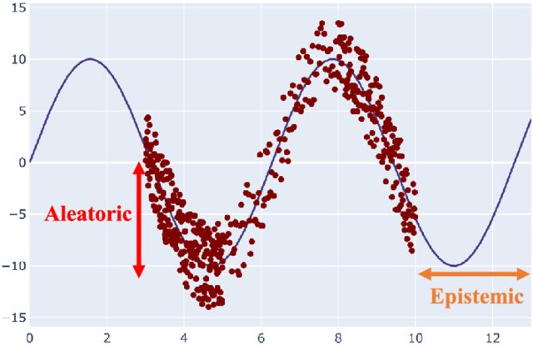
When given an input, generative models predict distributions of outputs rather than a single output vector
Uncertainty Quantification
Stochastic Modeling
Abdar et al. (2021)
Notes:
VOTE: Which uncertainty can be reduced with more data?
VOTE2: Which of the three generated satellite image is most likely?

Slide 4
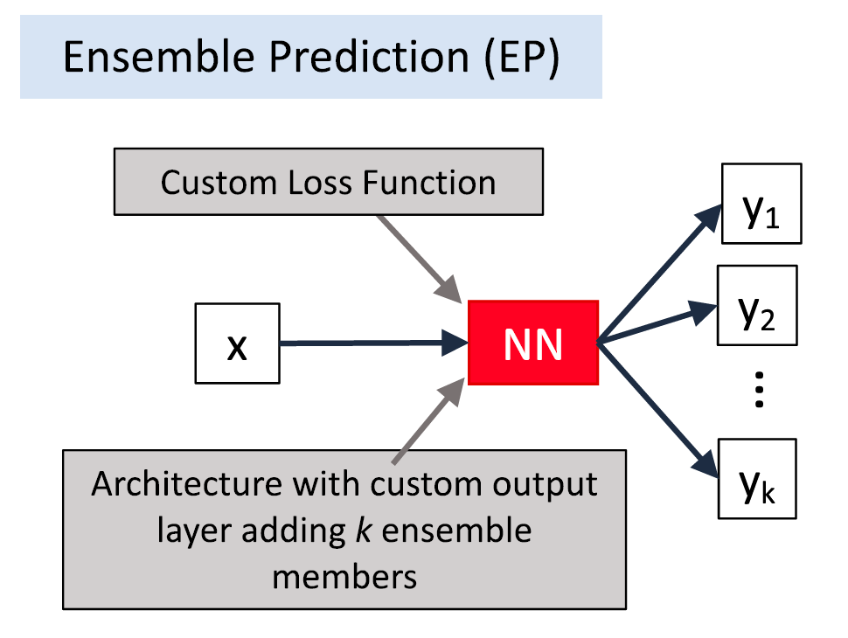
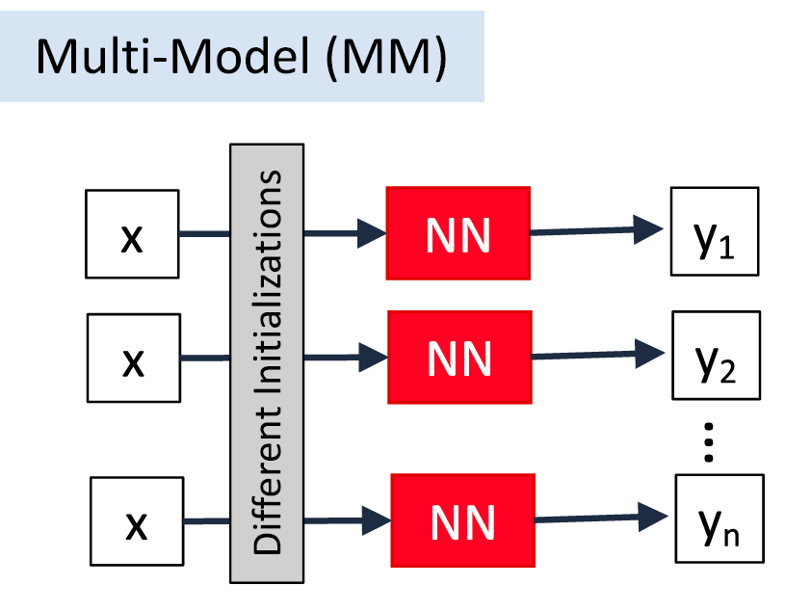
In practice, there are many ways of adding UQ!
Haynes et al. (2023)
Notes:
Emphasize “smart error bounds” because they are state-dependent

Slide 5
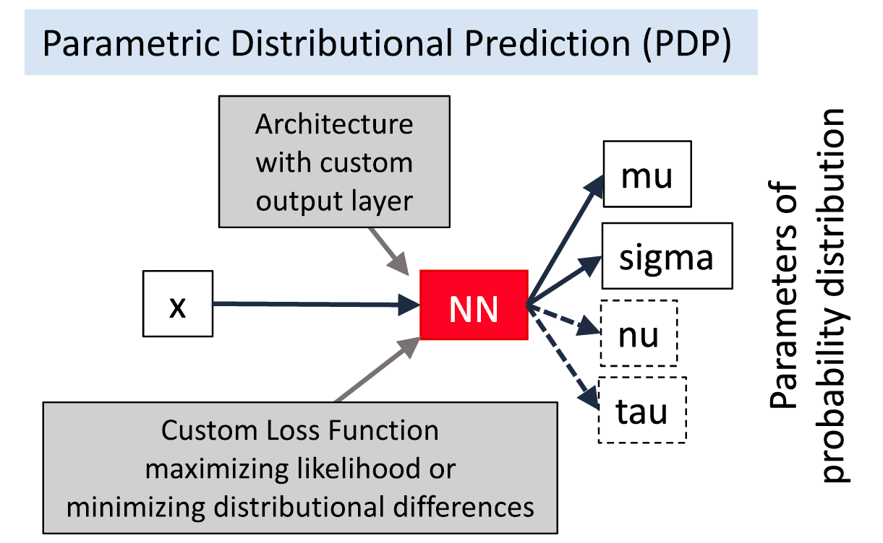
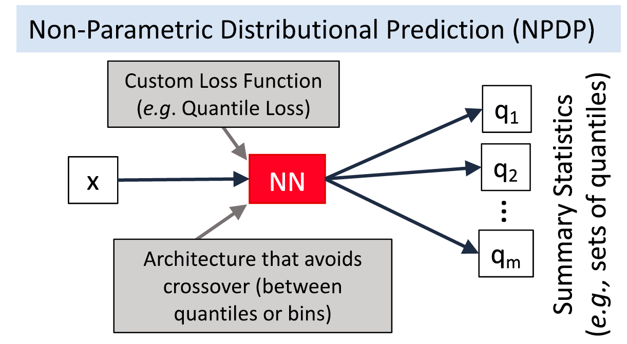
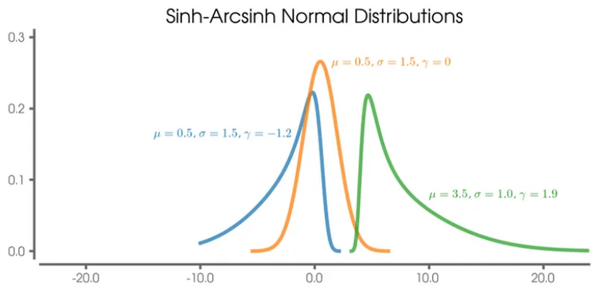
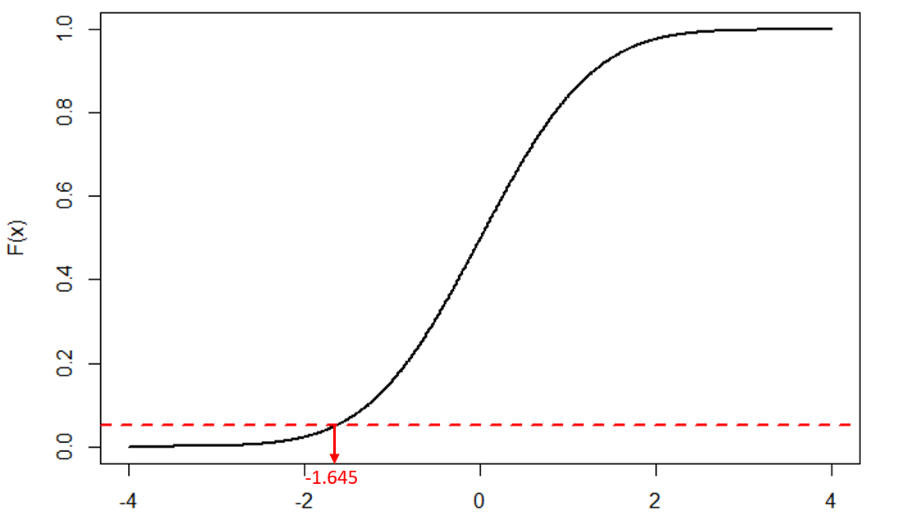
In practice, there are many ways of adding UQ!
Haynes et al. (2023). Kujawska et al. (2021)
Notes:
VOTE: Can you think of other methods?

Slide 6
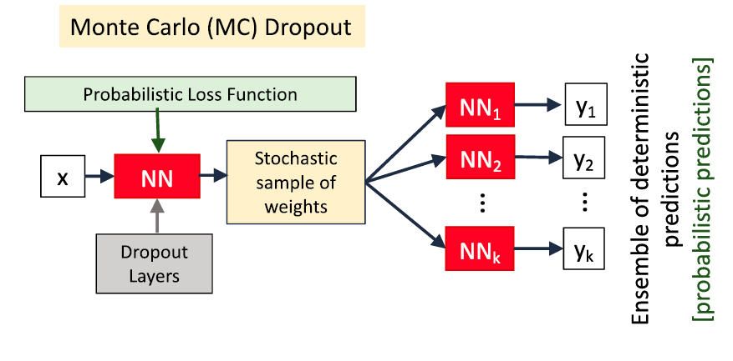
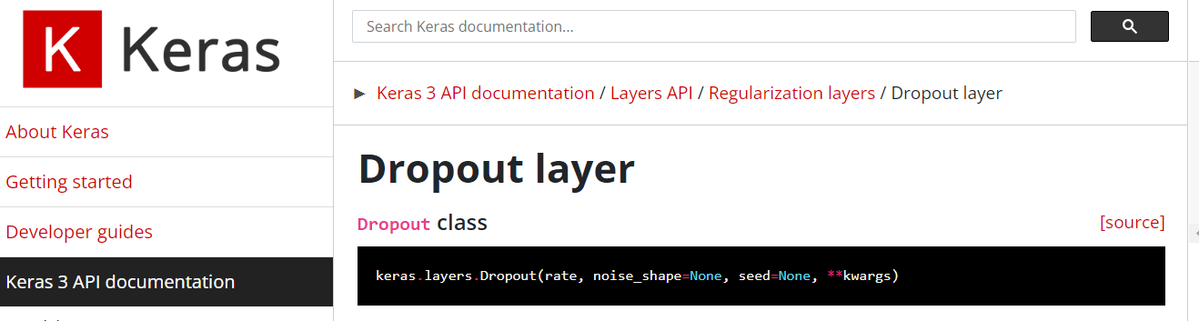
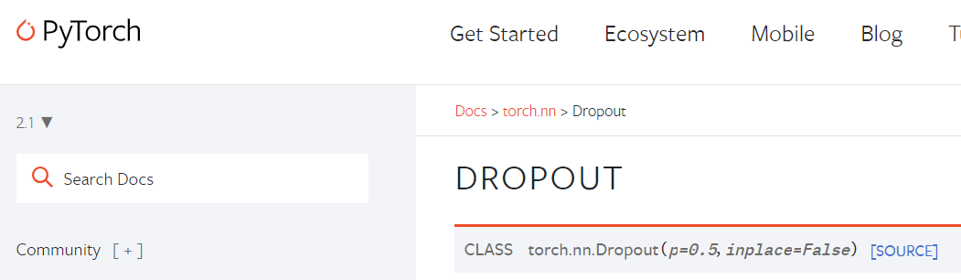
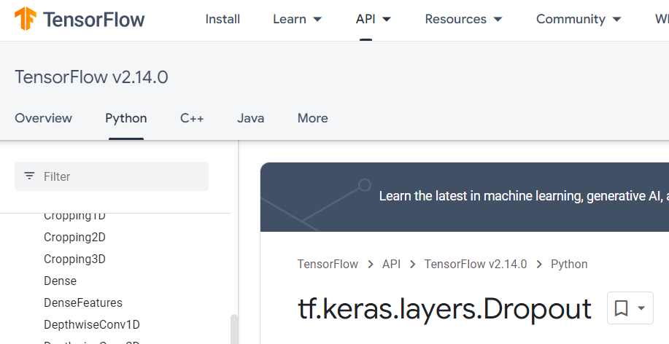
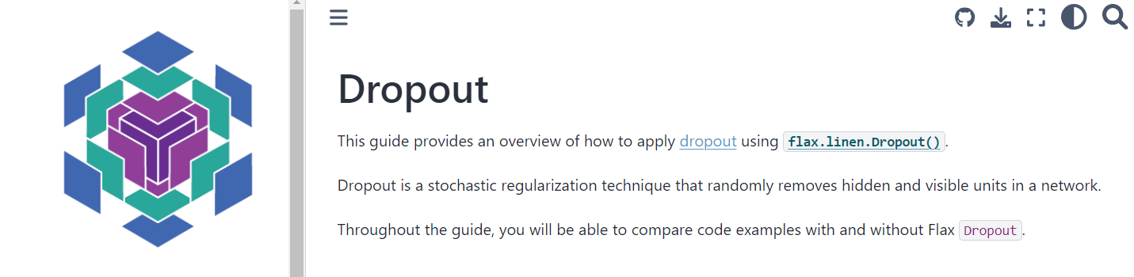
MC-Dropout randomly drops neural connections (Training) Regularization & (Test time) UQ

Slide 7
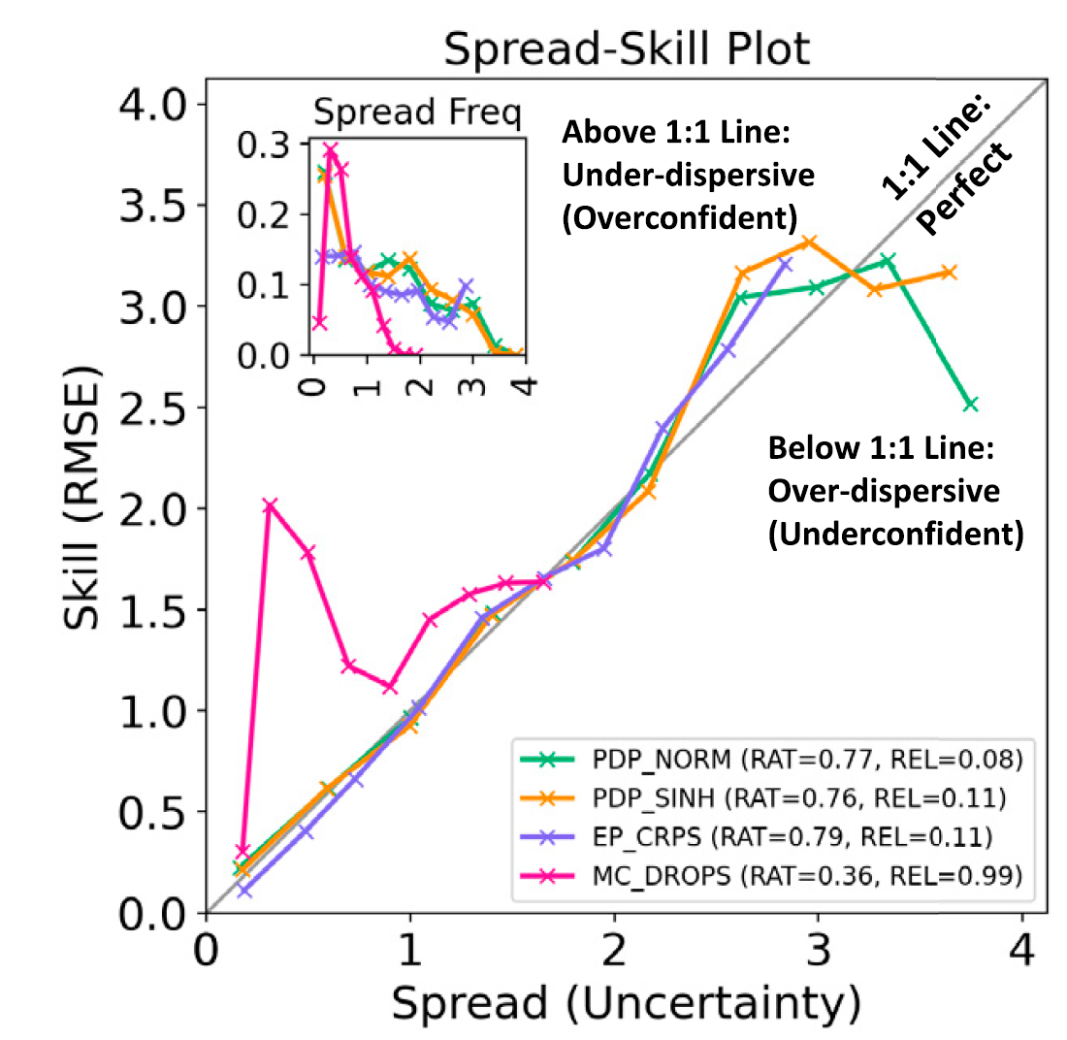
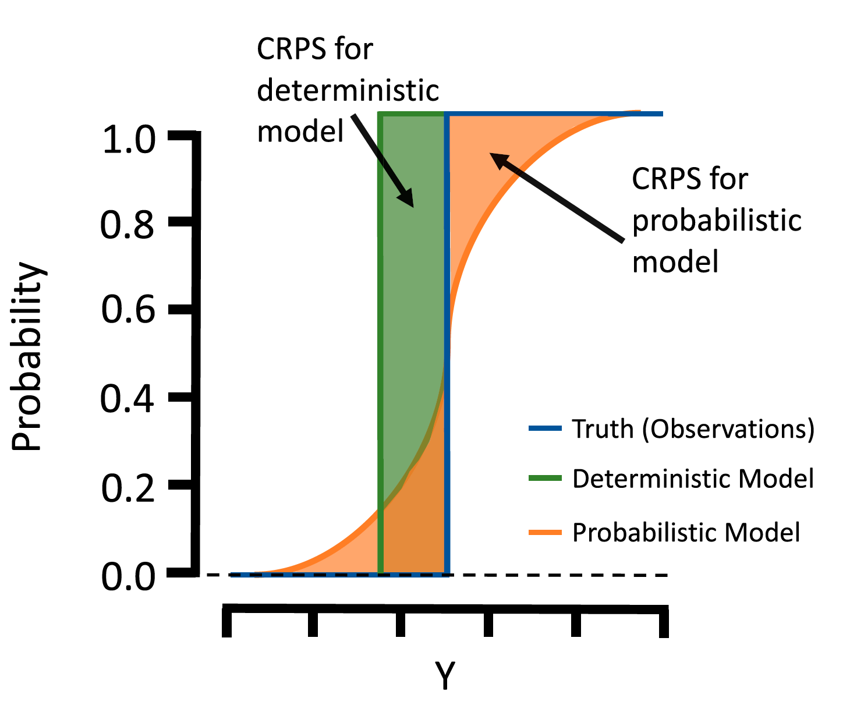
Spread-Skill Plot and CRPS* evaluate the generated distribution *(Continuous Ranked Prob. Score)
Notes:
But now how can we evaluate it? Build intuition with simple case.

Slide 8
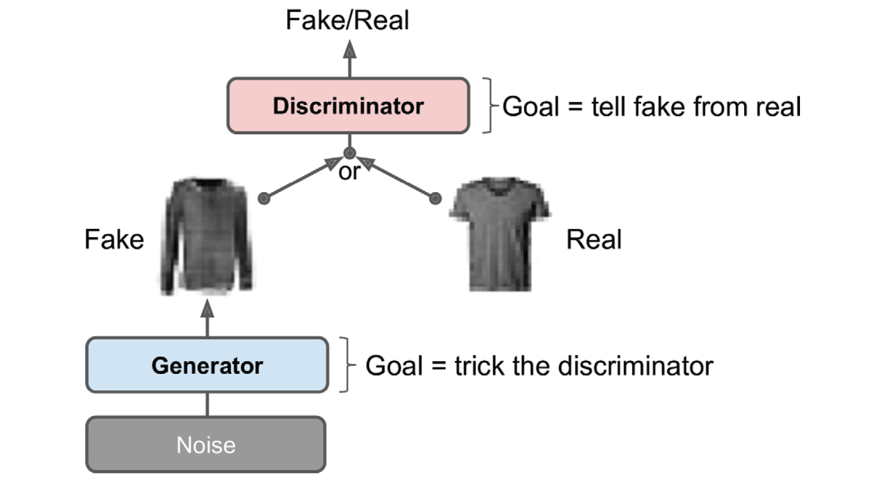
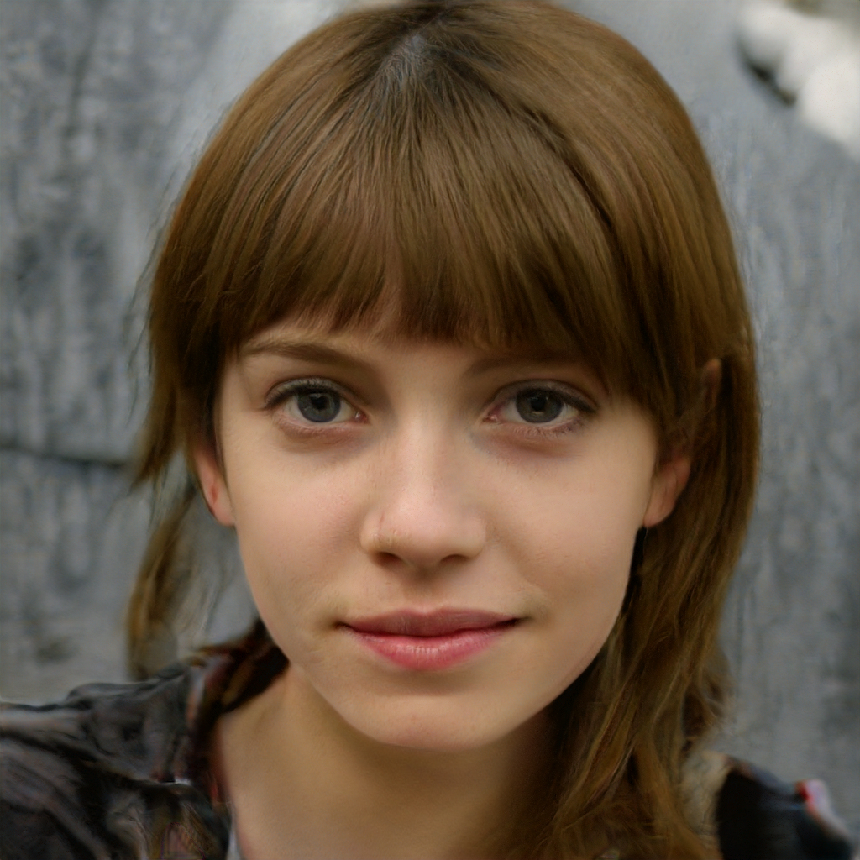
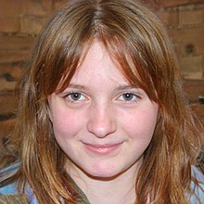
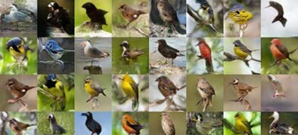
1) Generative Adversarial Nets pit a generator (fed noise) against a discriminator (fed the fake or real images)
Géron textbook, Wikipedia (GAN), Bodla et al. (2018)
Notes:
Know three state-of-the-art generative models

Slide 9
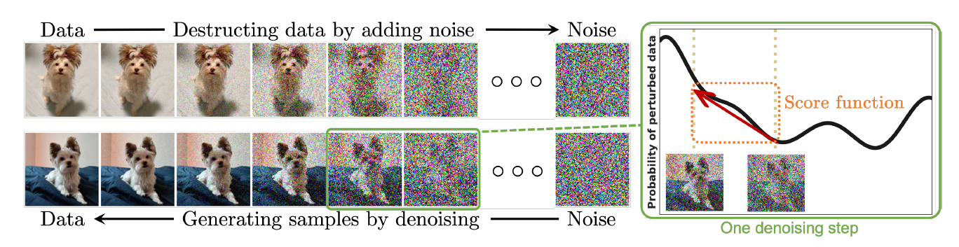
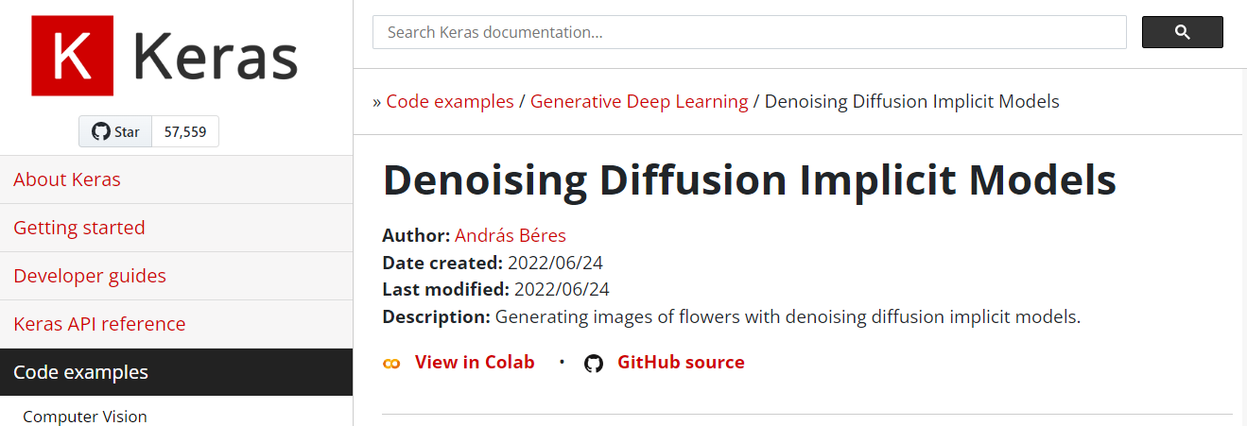
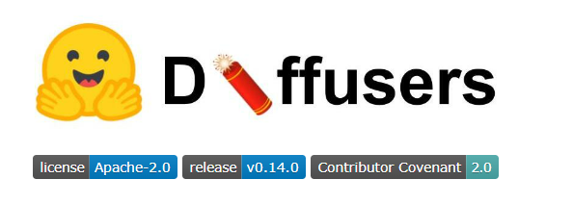
2) Diffusion Probabilistic Models smoothly perturb data by adding noise, then reverse this process to generate new data from noise.
Yang et al. (2022)

Slide 10
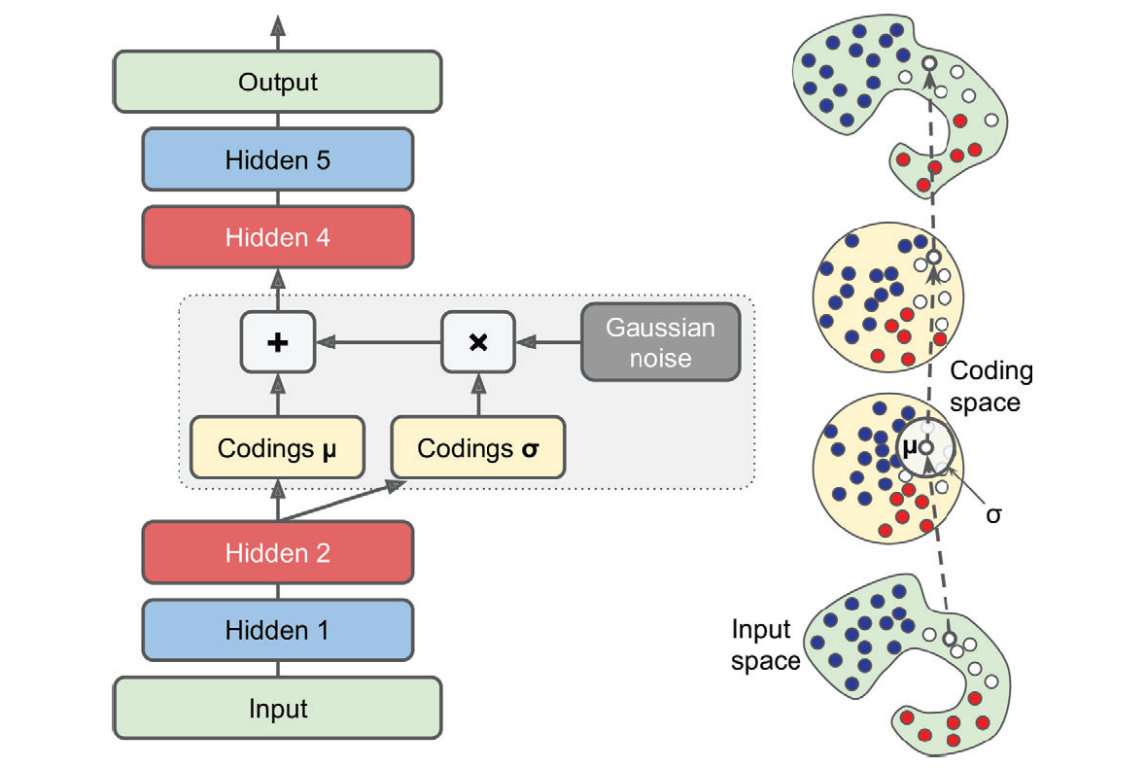
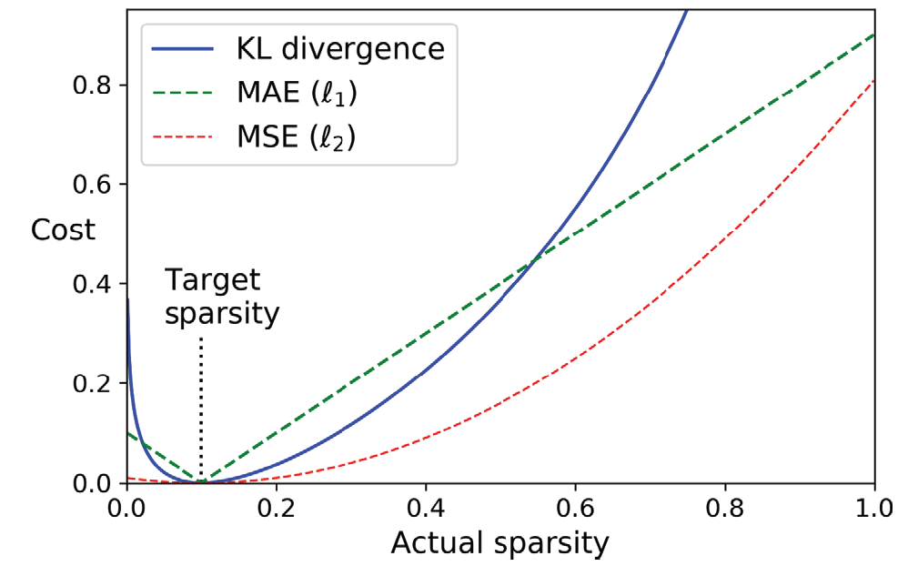
3) Variational Autoencoders probabilistically encode/decode data from latent representations

Slide 11
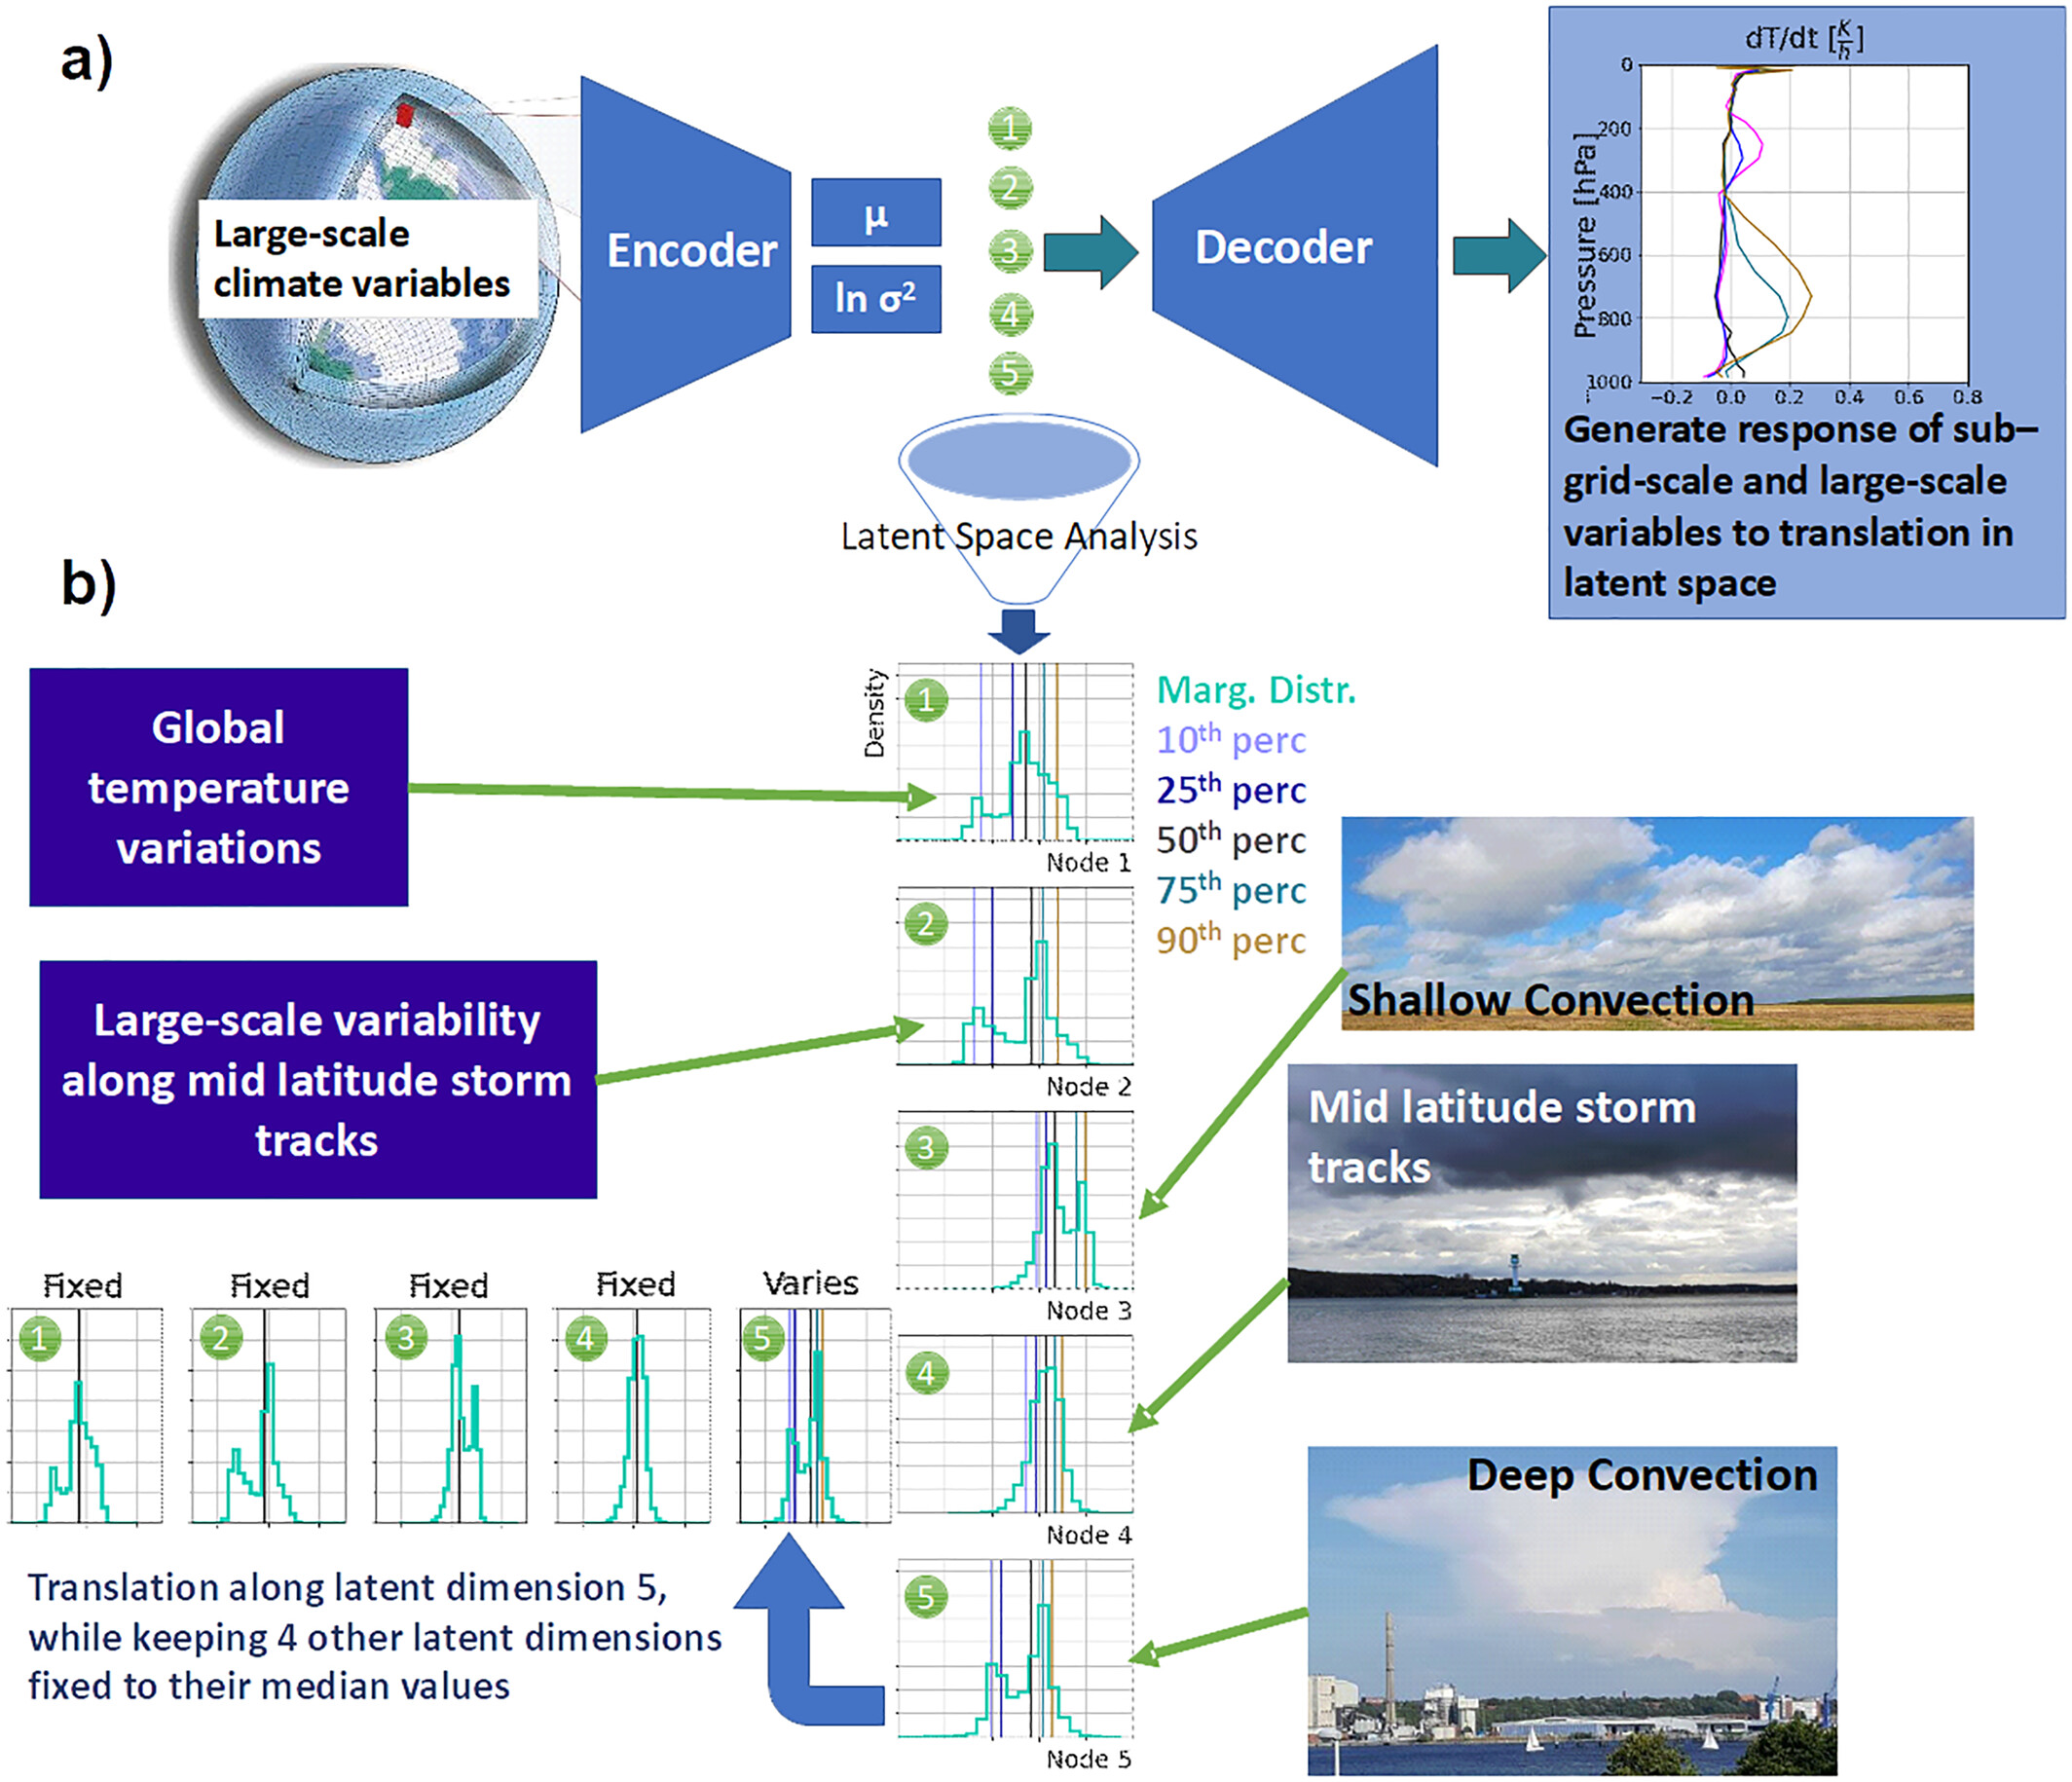
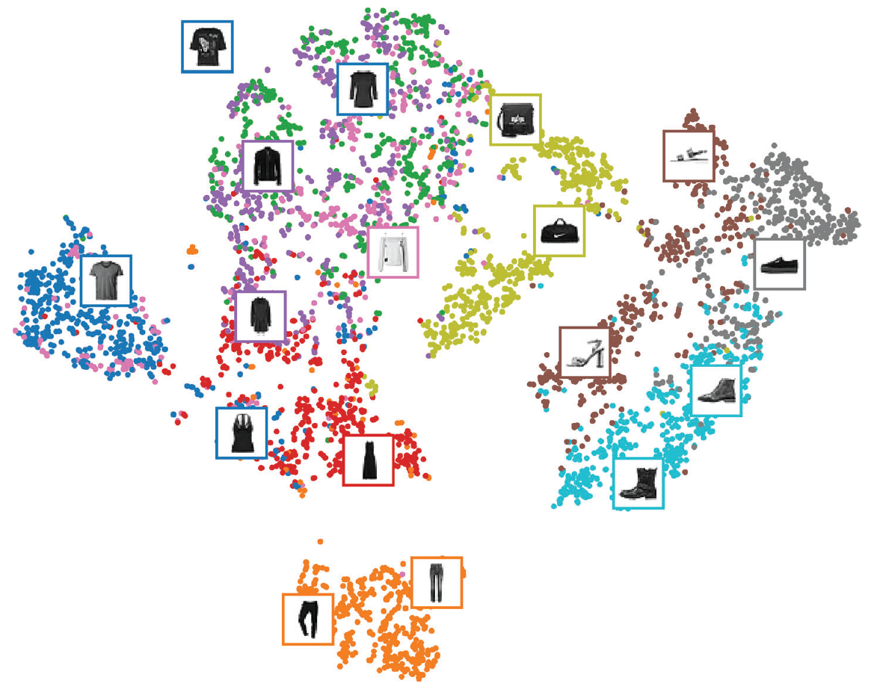
Latent manifold or “Latent space”
Géron textbook, Behrens et al. (2022)

Slide 12
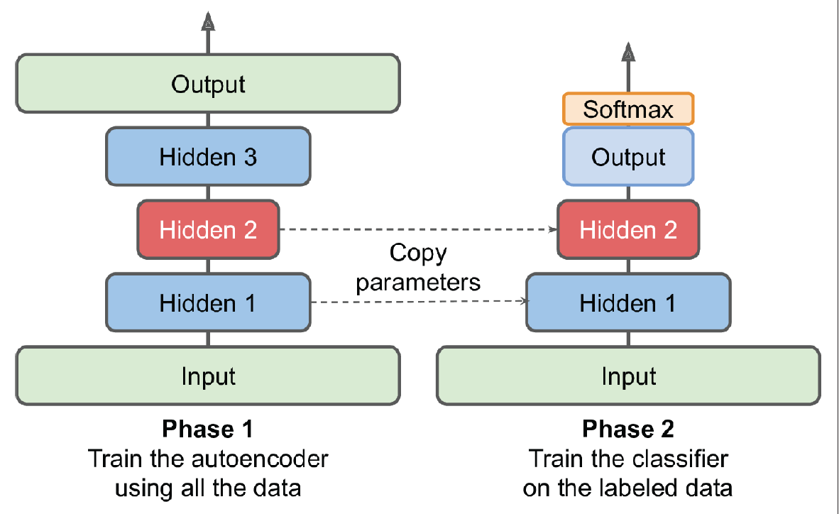
Latent manifolds can be used for e.g., scientific analysis and semi-supervised learning

Slide 13
Logistics

Slide 14
Notebooks: All “theory” + 1 “environmental application”
Theory
Environmental Applications
CNN: 6.2 (Computer vision)
RNN: 7.3 (Composing music)
XAI: 9.2 (XAI on simple datasets)
Gen ML: 10.1 (UQ) + 10.2 (Gen NNs)
Choose one of the following:
CNN: 6.3 (Land cover classification)
RNN: 7.4 (Hydrological modeling)
GNN: 8.3 (Neural weather pred.)
GenML: 10.3* (Climate downscaling)
Hybrid: 11.2 (Glacier modeling)

Slide 15
Mid-term Presentations: Thursday, Nov 13th in GEO 2113
4min presentations + 6min Q&A/feedback
Tip = 1 slide/minute
Scientific question: What’s our goal and why do we care?
Dataset: Characteristics, challenges, training/validation/test split, etc.
Methodology: Which ML algorithm(s) are you planning to use and why?
Results: What are your initial results & what do you plan to do next?

Slide 16
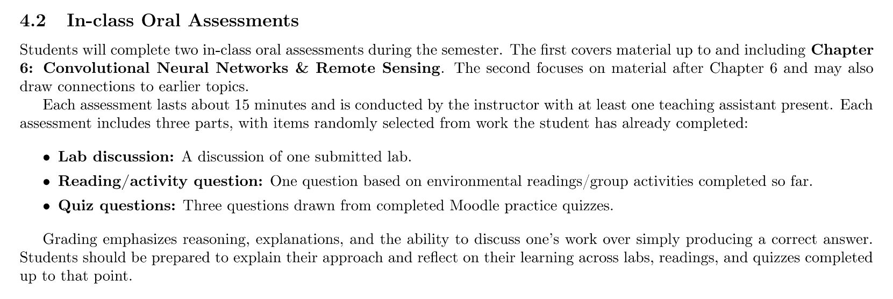
(For students taking this course for credits) Second oral evaluation: Dec 3rd & 4th

Slide 17
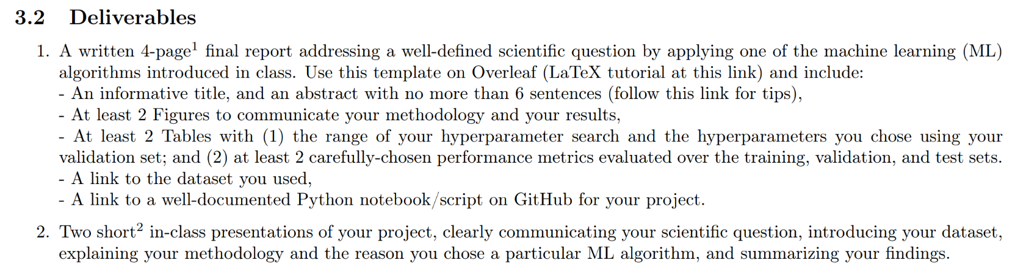
In-class Peer Review: Wednesday, Dec 10th, 12-2PM
Submit first draft of your project by December 9th

Slide 18
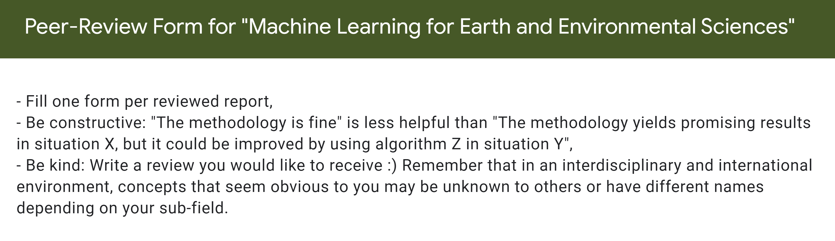
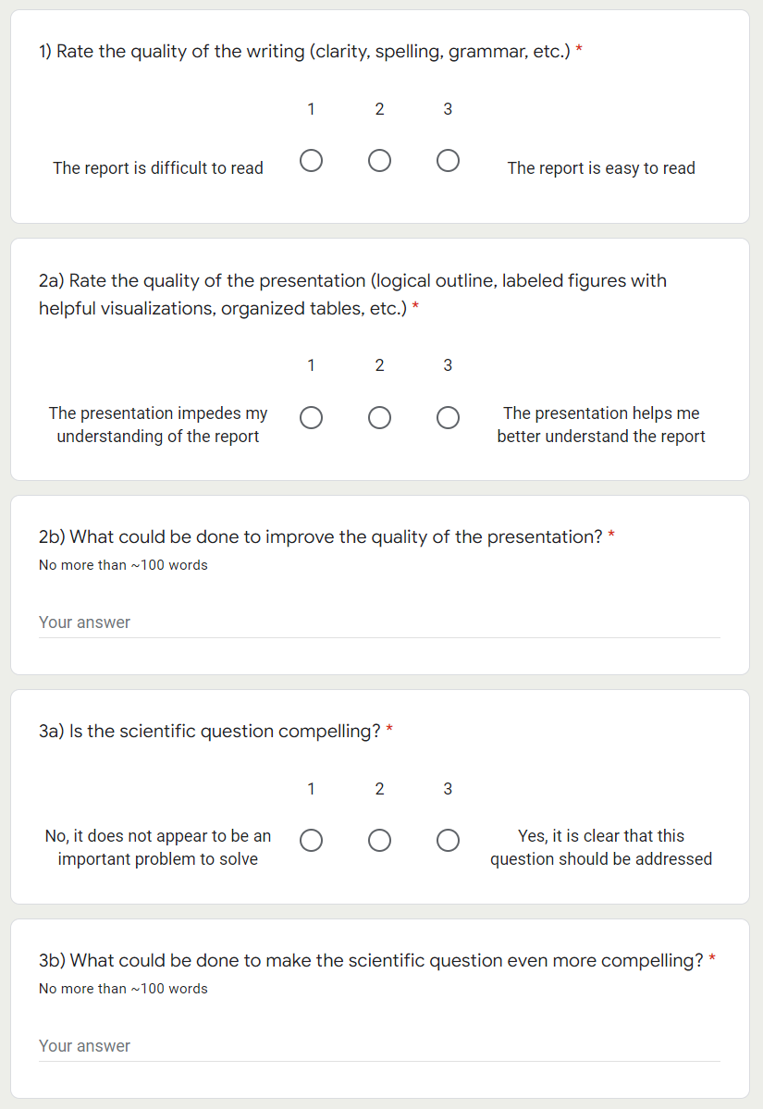
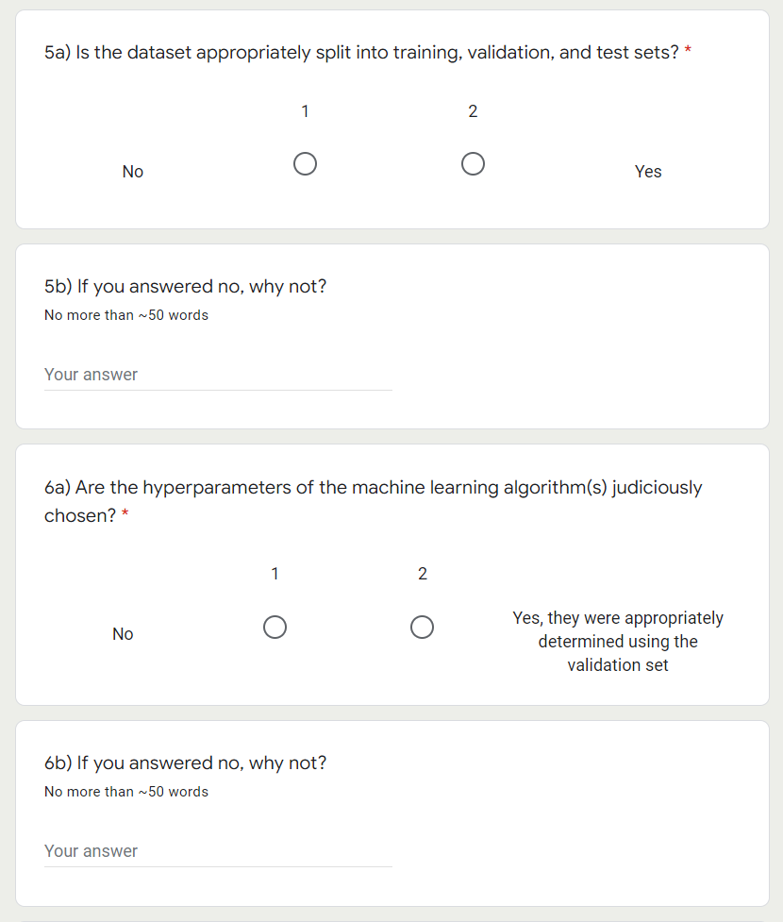

Slide 19
Final Presentations on Dec 11 & Dec 18 in GEO2138 Registration slots on Moodle
5min presentations + 5min Q&A
Tip = 1-2 slides for each of the following categories:
Scientific question: What’s our goal and why do we care?
Dataset: Characteristics, challenges, training/validation/test split, etc.
Methodology: Which ML algorithm(s) did you choose and why?
Results: What are your findings and how does it answer the sci. question?

Slide 20
Legacy Slides

Slide 21
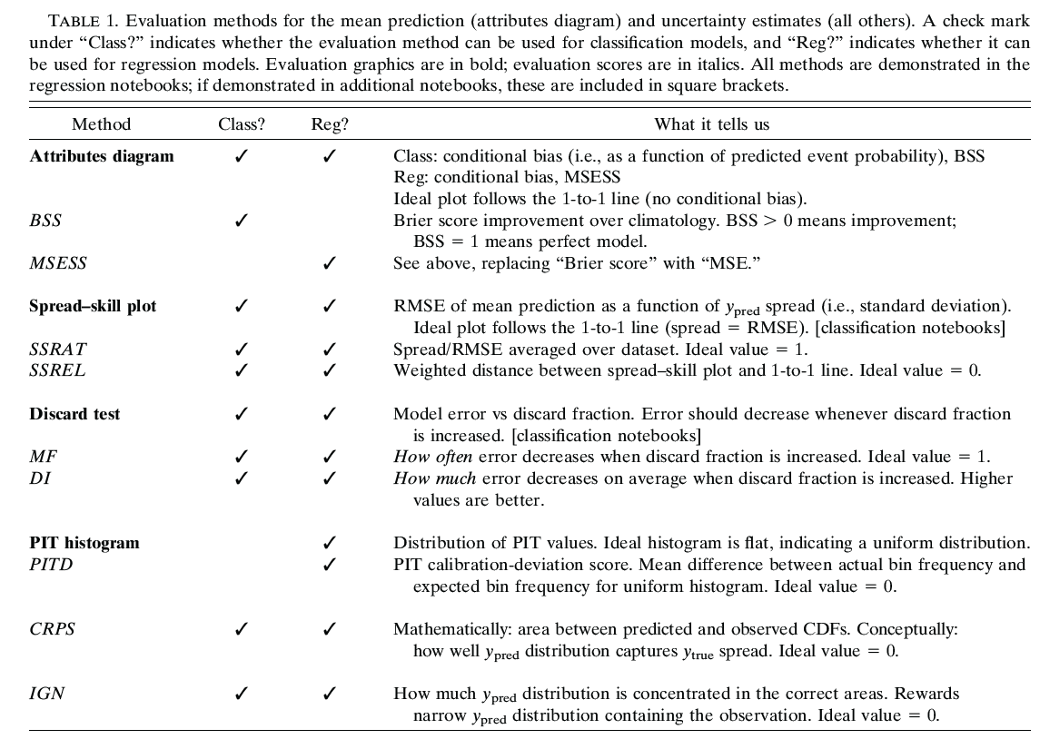

Slide 22
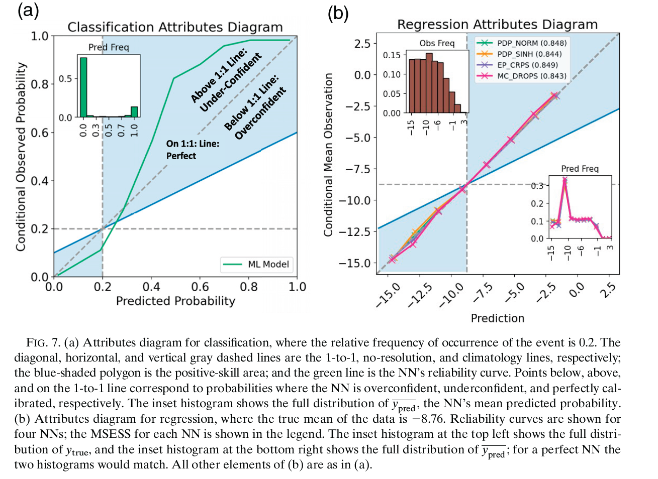

Slide 23
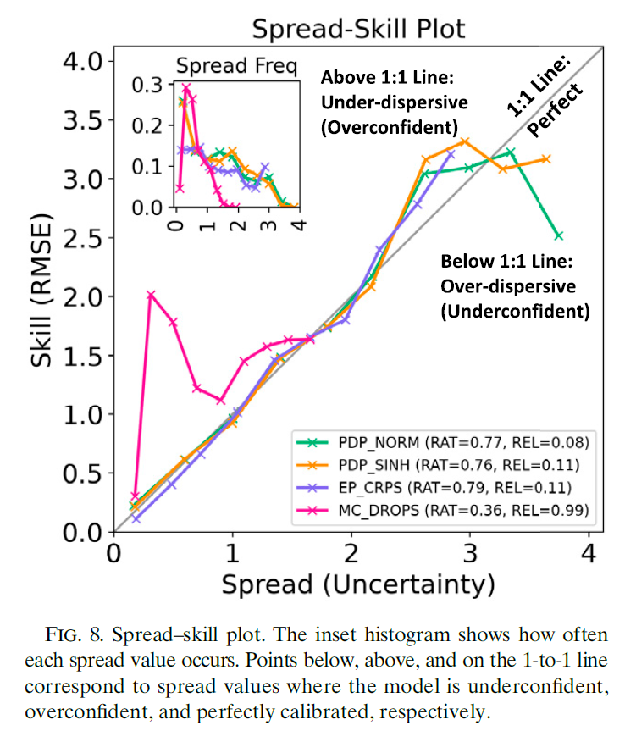
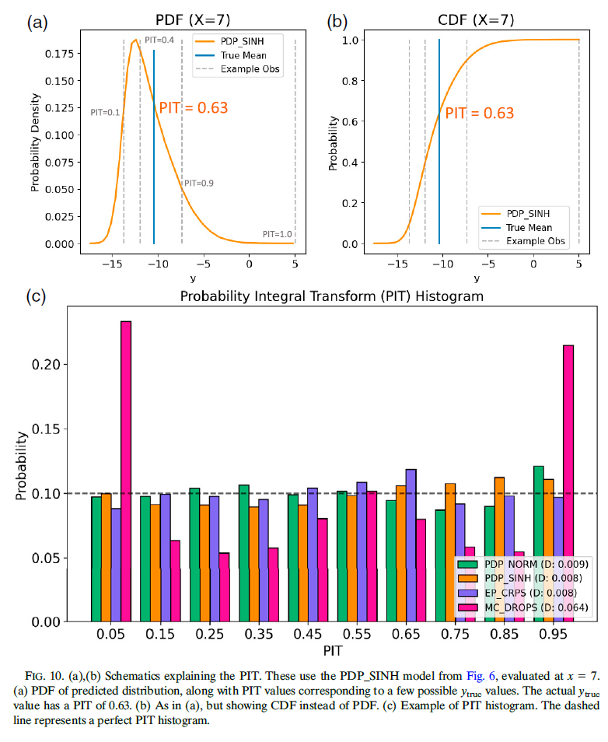

Slide 24
