Slide 1


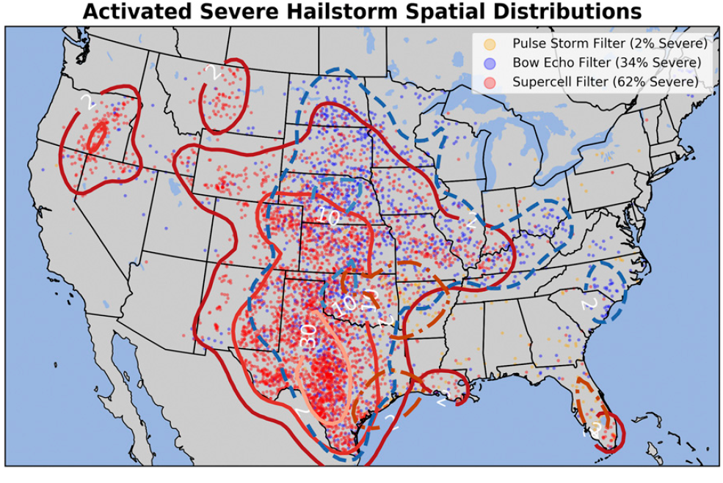
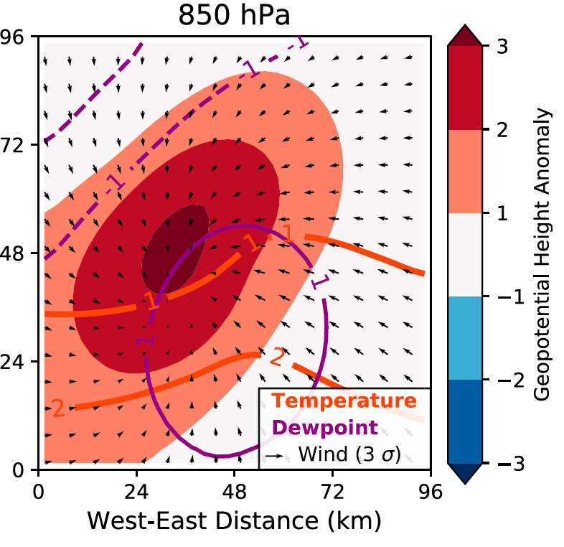
ML for Earth & Env Sci (Chapter 9, FA2025)
How can we better understand and communicate our ML predictions?
(Left) Which neurons activate? (Right) Which patterns maximize the probability of severe hail?
Source: Gagne et al. (2019)

Slide 2
Min 75-105: Intro to XAI = eXplainable Artificial Intelligence
Learning Objectives (Reading = Molnar extracts):
Understand the importance of XAI
Distinguish local from global explanation methods
Distinguish model-agnostic from model-specific methods
Know how to implement permutation feature importance and partial dependence plots
Apprehend explanation methods for neural networks

Slide 3
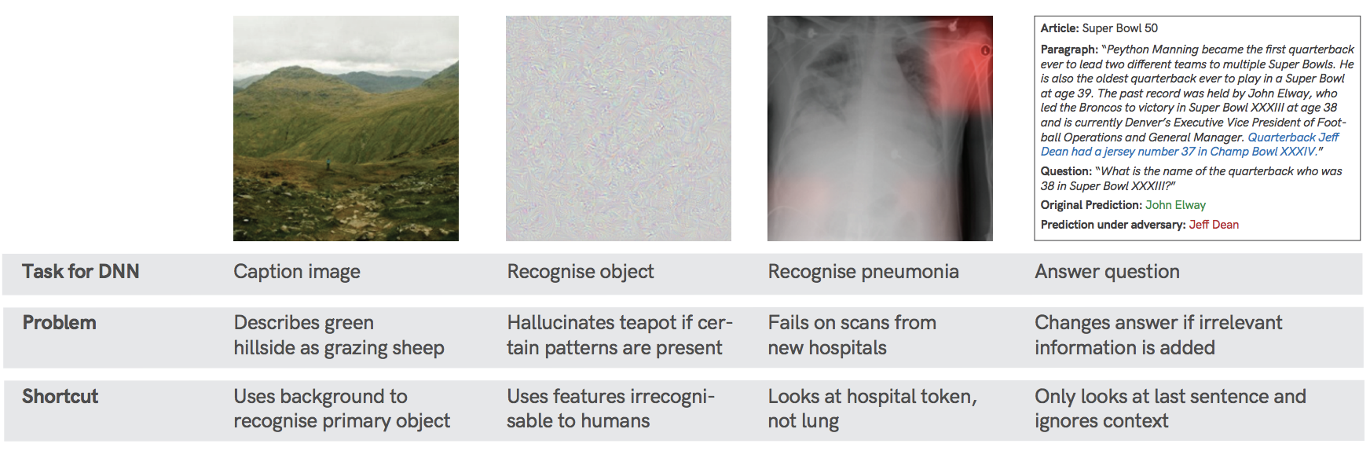
Why bother with XAI?
Environmental examples from students
Horse/label
Would you trust the model
Source: Geirhos et al. (2020) arXiv:2004.07780.
Notes:
VOTE 1: What do you think the bias is?

Slide 4
Why bother with XAI? Because NNs take shortcuts!
Source: Geirhos et al. (2020) arXiv:2004.07780.

Slide 5
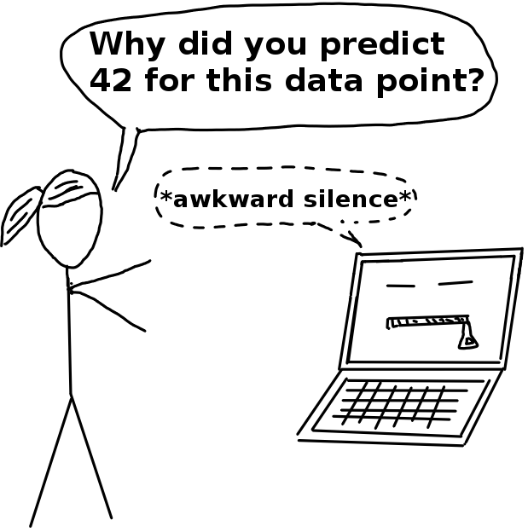
Interpretability = Degree to which a human can understand the cause of a decision
Advantages of XAI: Robustness, Trustworthiness, Scientific Insight
Wildfire susceptibility mapping to inform risk management
Land use classification to inform policy
Spam email detection
When the model output has no importance
Source: Interpretable Machine Learning, C. Molnar (2019)
Notes:
VOTE 2: In which cases do we need XAI?

Slide 6
Interpretability = Degree to which a human can understand the cause of a decision
Advantages of XAI: Robustness, Trustworthiness, Scientific Insight
Wildfire susceptibility mapping to inform risk management
Land use classification to inform policy
Spam email detection
When the model output has no importance
Source: Interpretable Machine Learning, C. Molnar (2019)

Slide 7
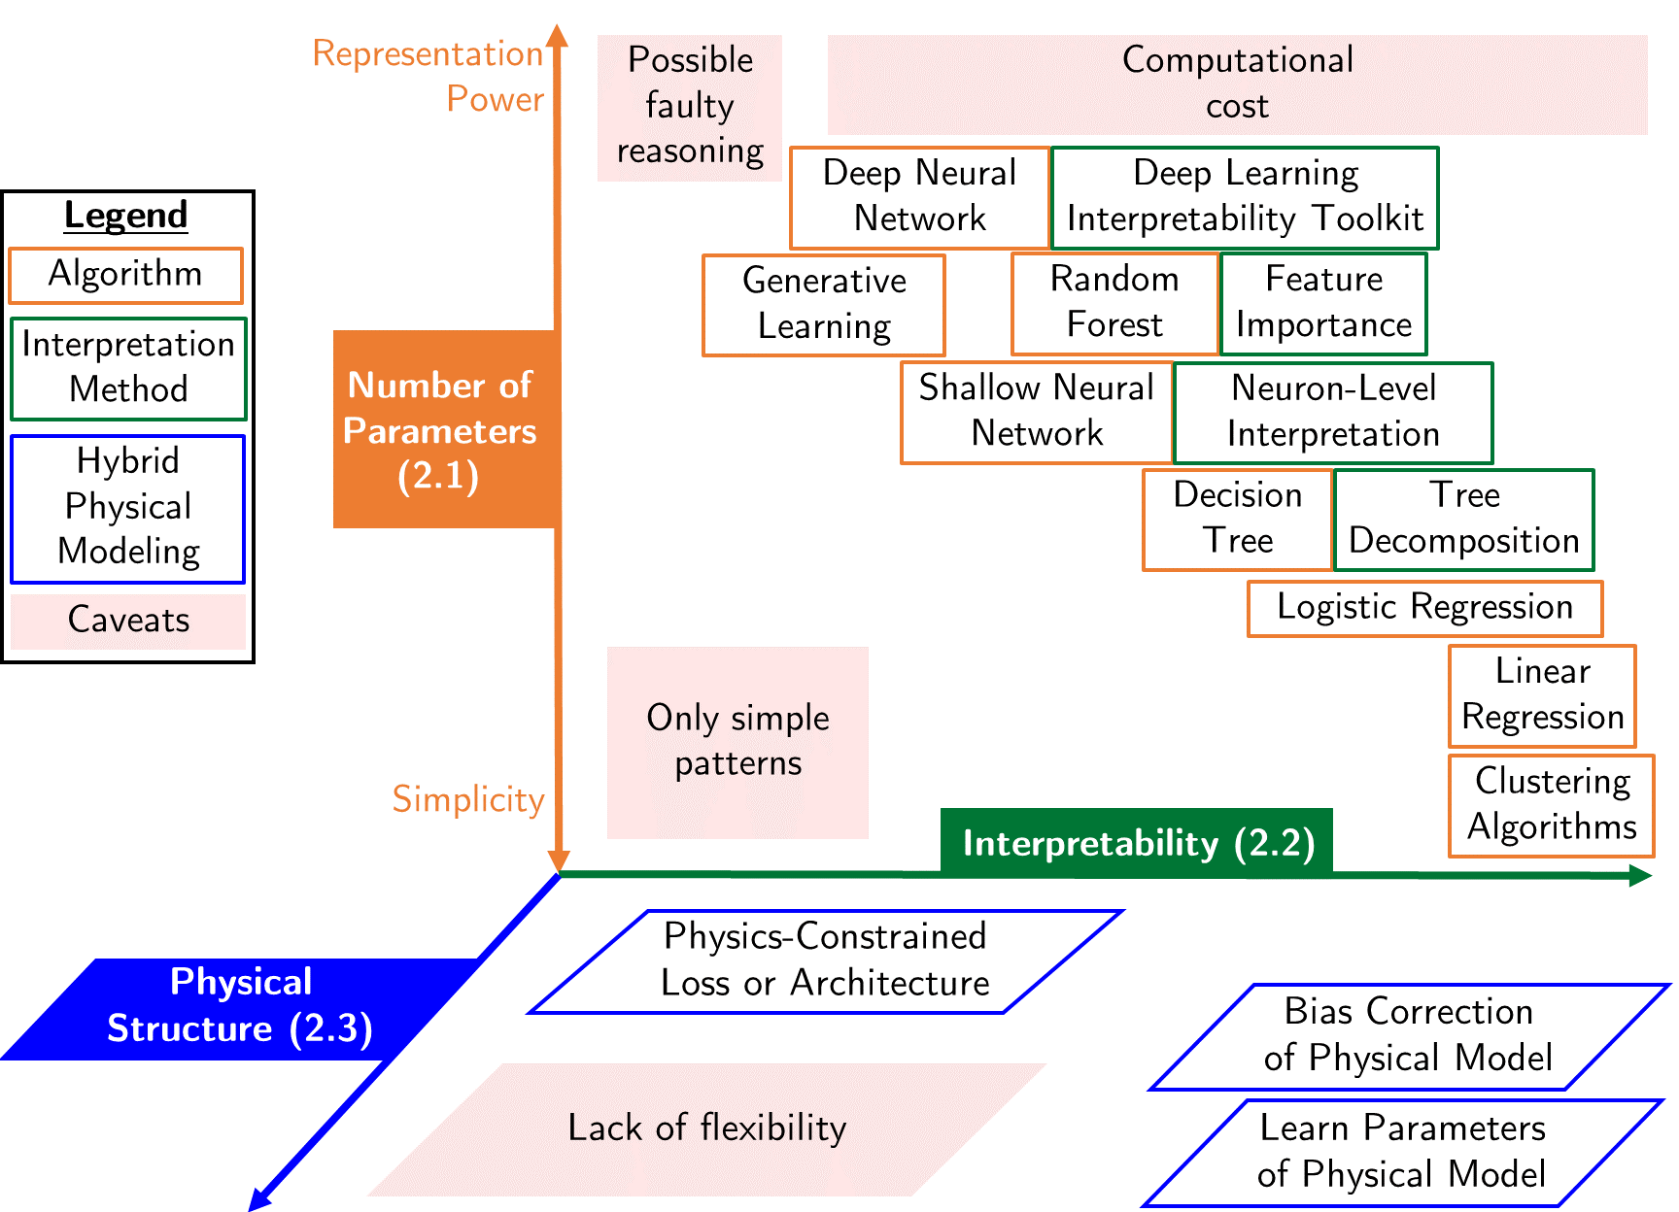
Some algorithms are inherently interpretable
Example: Linear regression with one output and two inputs
Naive: Read coefficients
Feature importance:
(One sample) Compare terms
(Entire set) Average absolute terms over the entire set
Source: Beucler et al. (2021)
Notes:
VOTE 3: Does reading the coefficient always work? In which cases does it not work? How can we solve this?

Slide 8
Local (sample-level) ≠ Global Explanation
Ensemble mean of absolute values
Feature importance:
(One sample) Compare terms
(Entire set) Average absolute terms over the entire set
Source: Beucler et al. (2021)

Slide 9
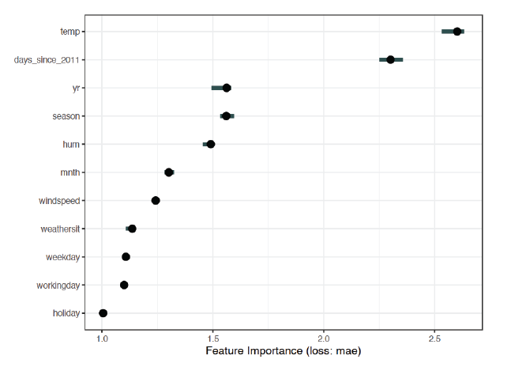
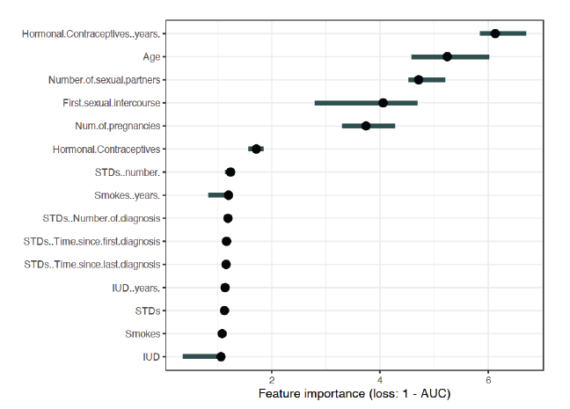
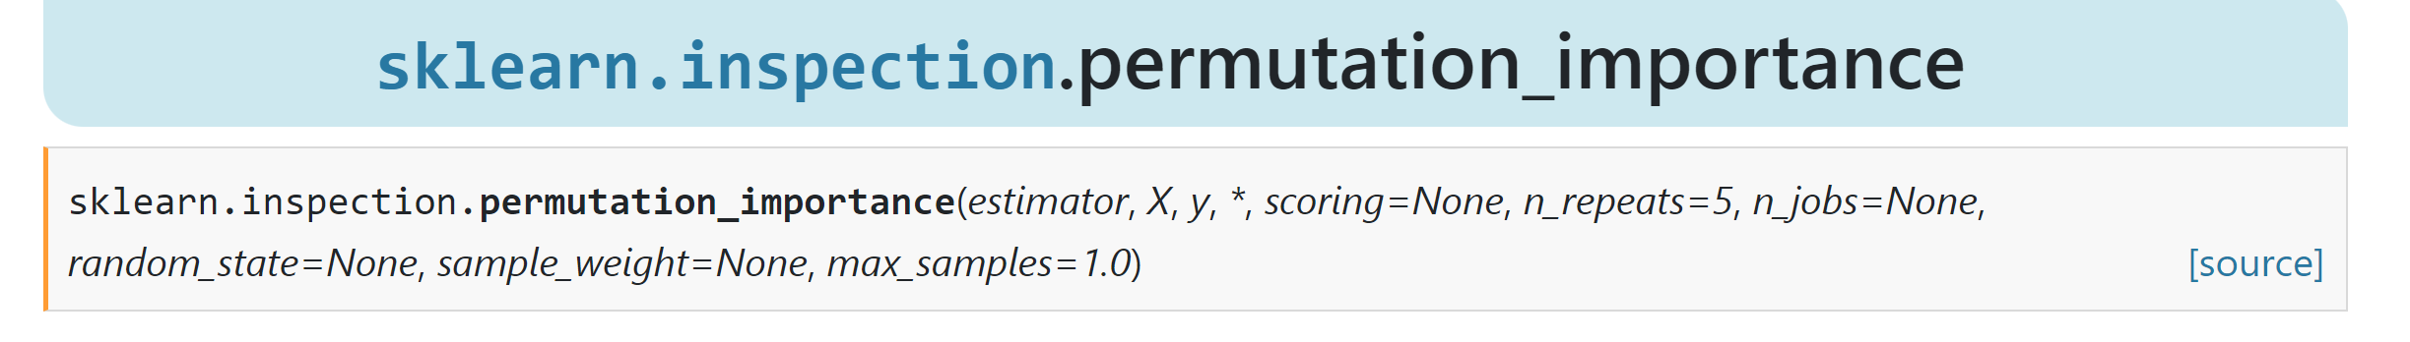
Permutation feature importance = Increase in prediction error in response to feature permutation
temp
Predicting bike counts with SVM
⚠️holiday
For your project: Calculate random PFI on test data using e.g., scikit-learn
Notes:
Example of Global explanation

Slide 10
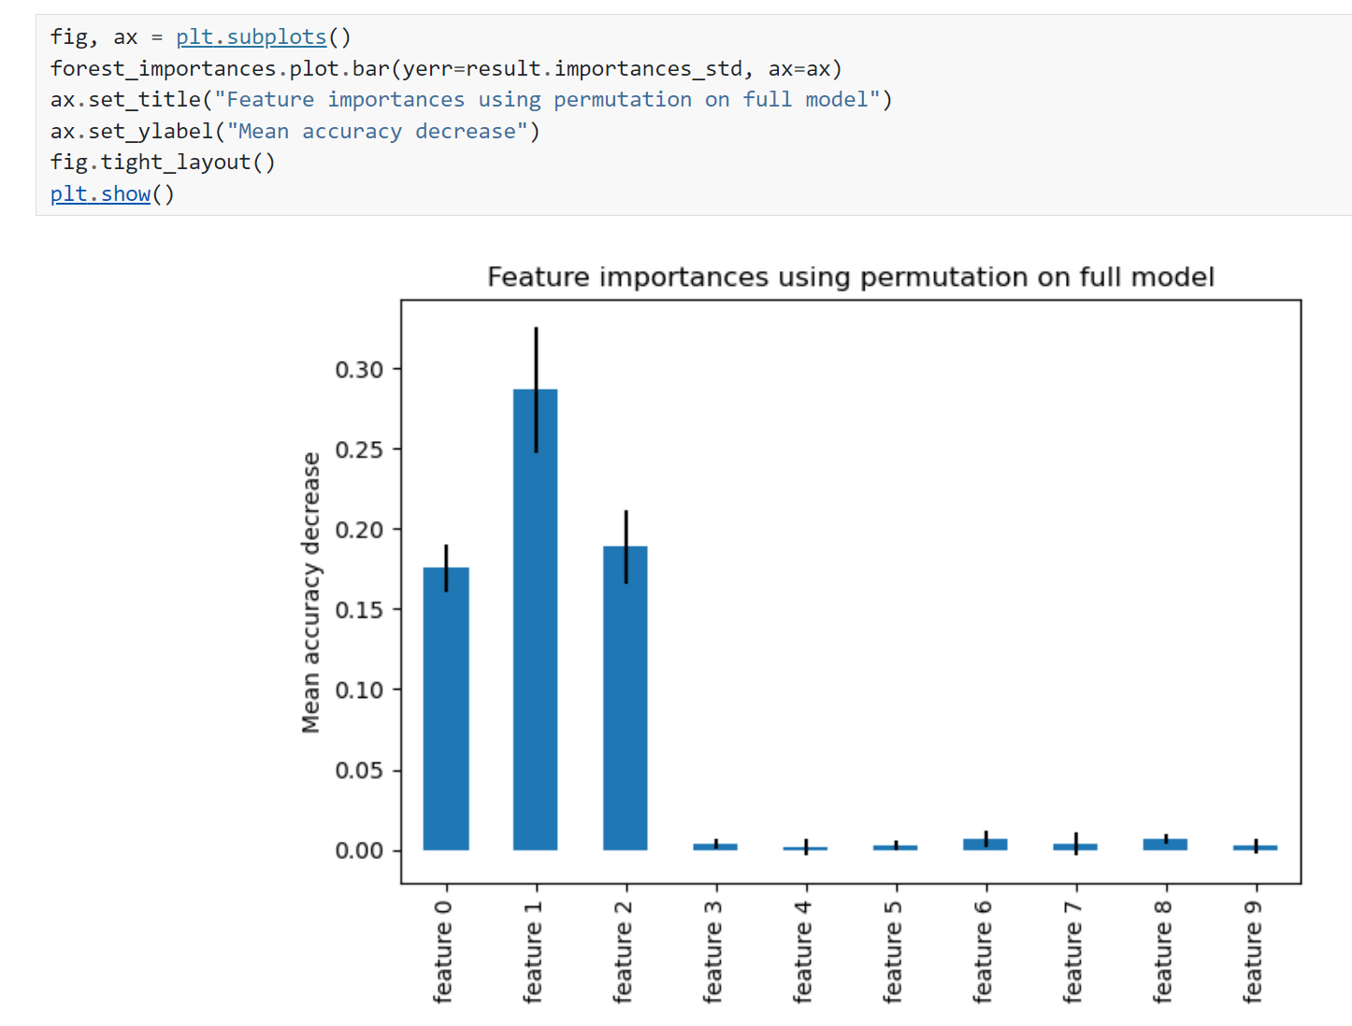
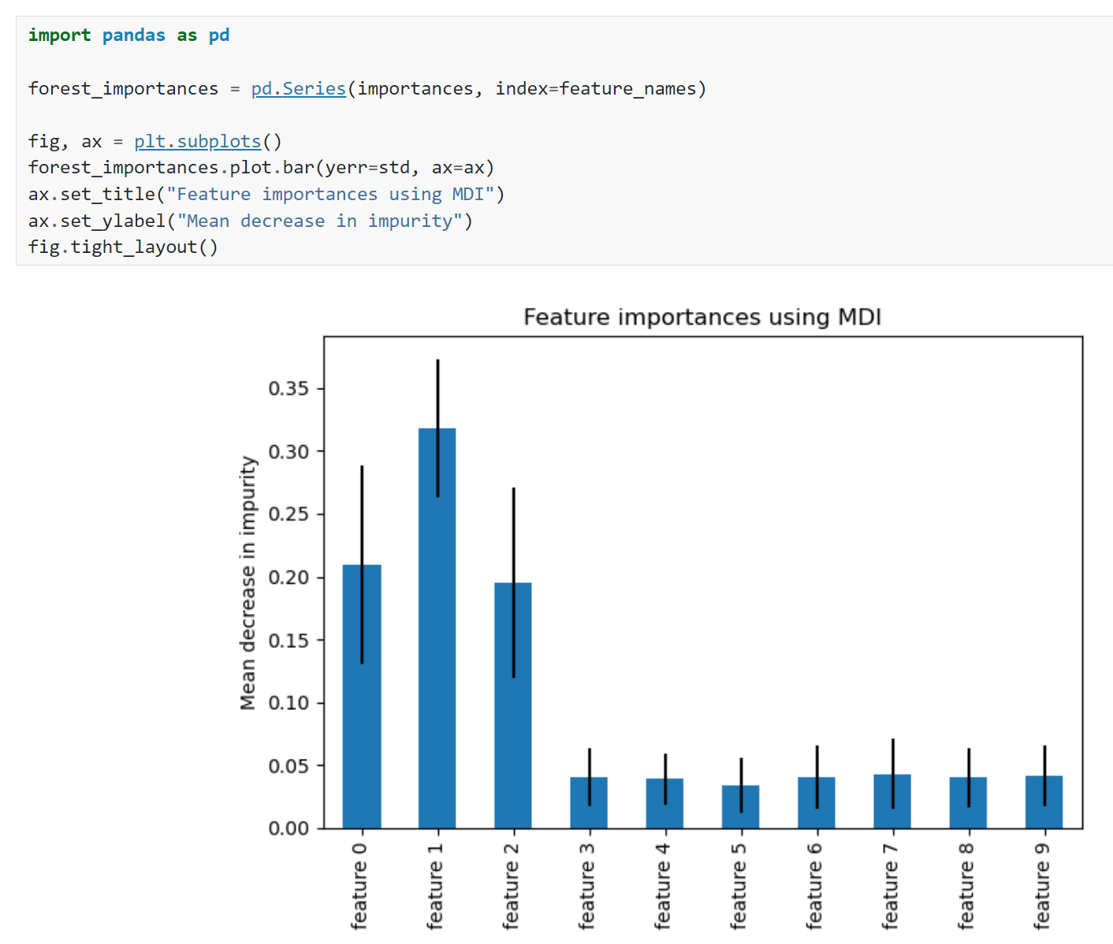
Model-agnostic versus model-specific explanation Example: Random forests (see final project)
Random
Feature
Permutation
Mean Decrease Impurity
Source: https://scikit-learn.org/stable/auto_examples/ensemble/plot_forest_importances.html
Notes:
Vote ☺

Slide 11
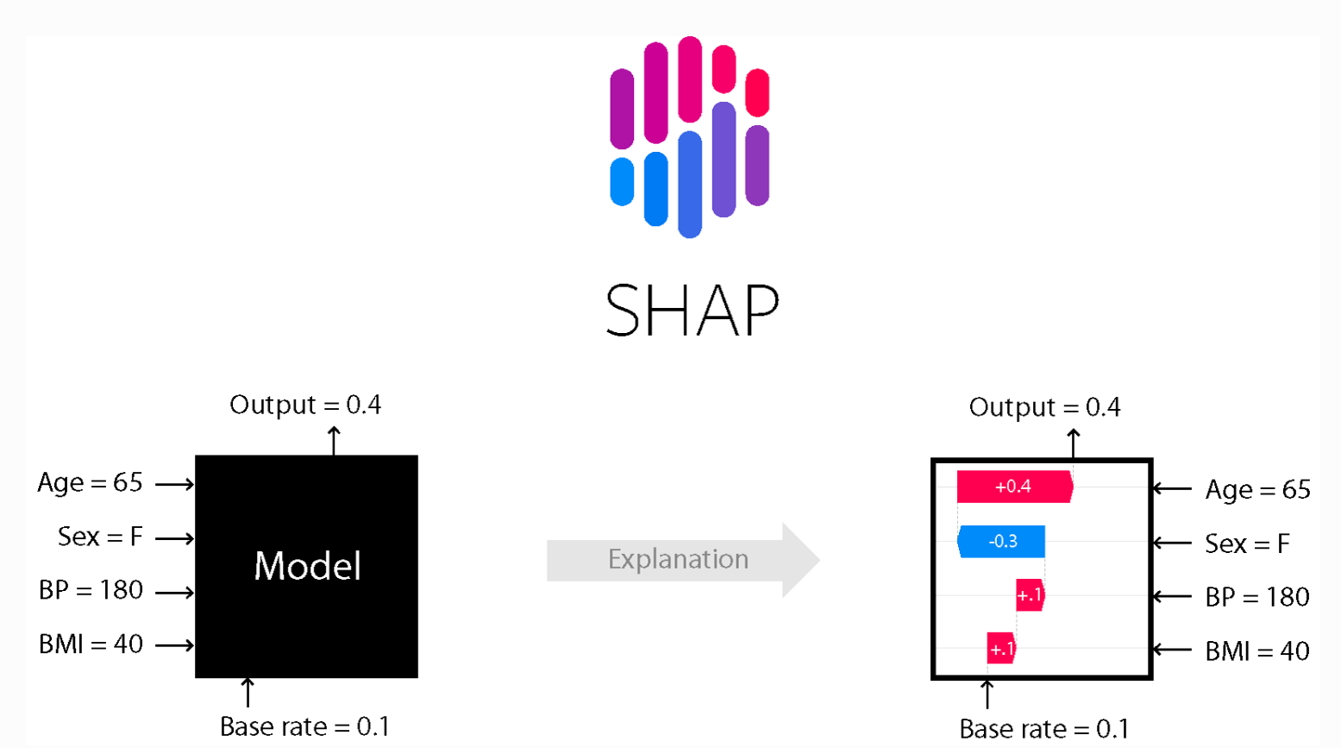
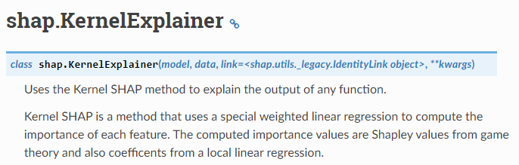
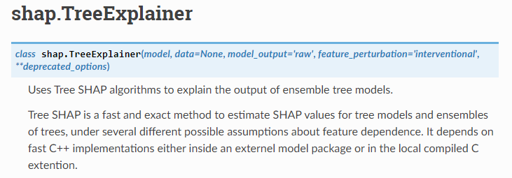
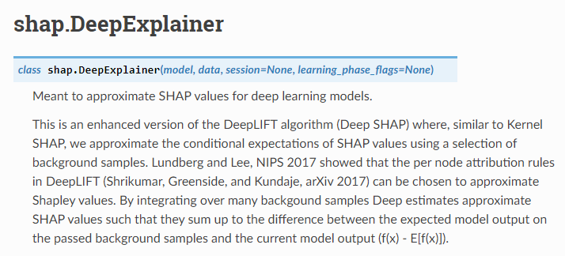
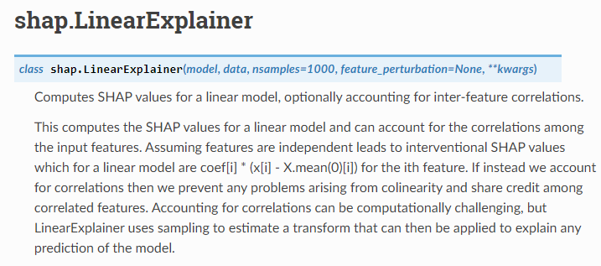
Model-agnostic versus model-specific explanation Example 2: SHAPley values
Source: Shapley (1951), https://shap.readthedocs.io/en/latest/
Notes:
Local accuracy ensures that the sum of all feature contributions equals the difference between the model's output for a specific instance and the average output.
Missingness means a missing feature receives a zero value, and
consistency dictates that if a model changes to be more favorable to a feature, the feature's Shapley value will not decrease.
https://christophm.github.io/interpretable-ml-book/shap.html

Slide 12
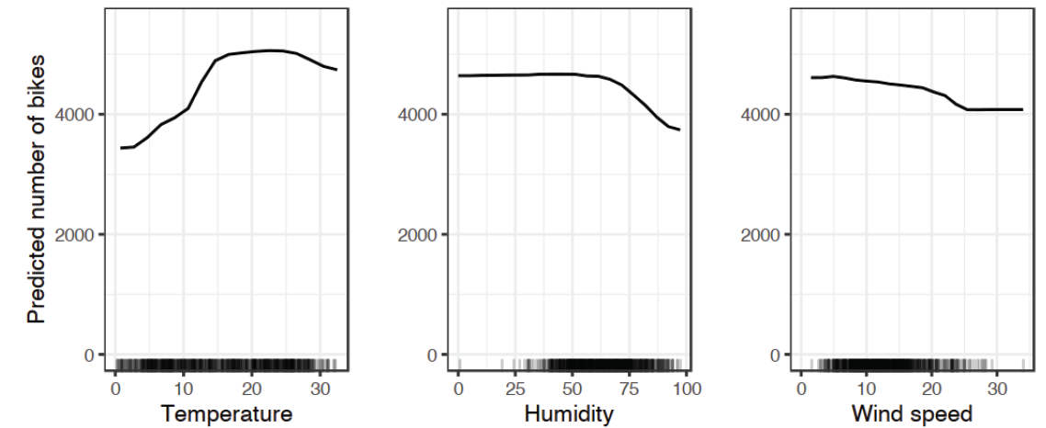


Partial Dependence Plots “show the marginal effect of 1 or 2 inputs on the predicted outputs”
Notes:
Strict PDP vs. M-plots

Slide 13
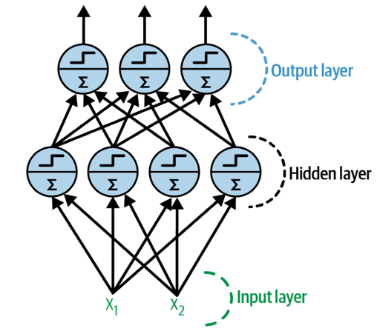
5 weeks ago = General case: Artificial Neural Networks

Slide 14
4 weeks ago = Convolutional Neural Networks (CNNs)
Regularized versions of Artificial Neural Networks used to process images
Source: Giphy, Analytics India Magazine (K. Maladkar)

Slide 15
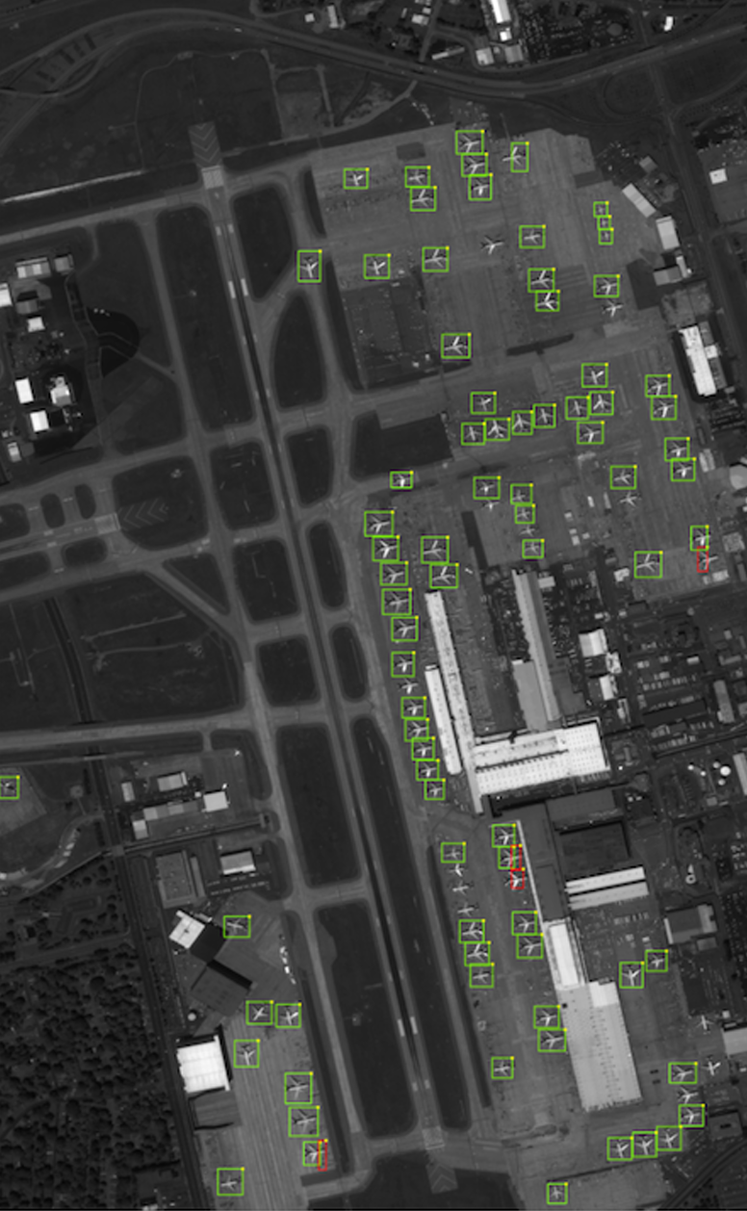
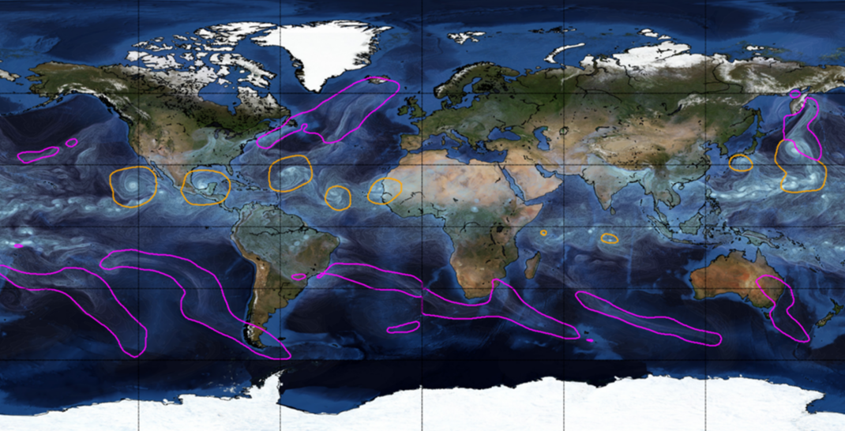
Object Detection for Remote Sensing
Instance Segmentation for Storm Detection
Source: Zhu et al. (2017), Prabhat et al. (2020)

Slide 16
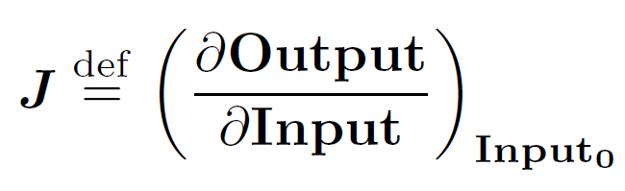
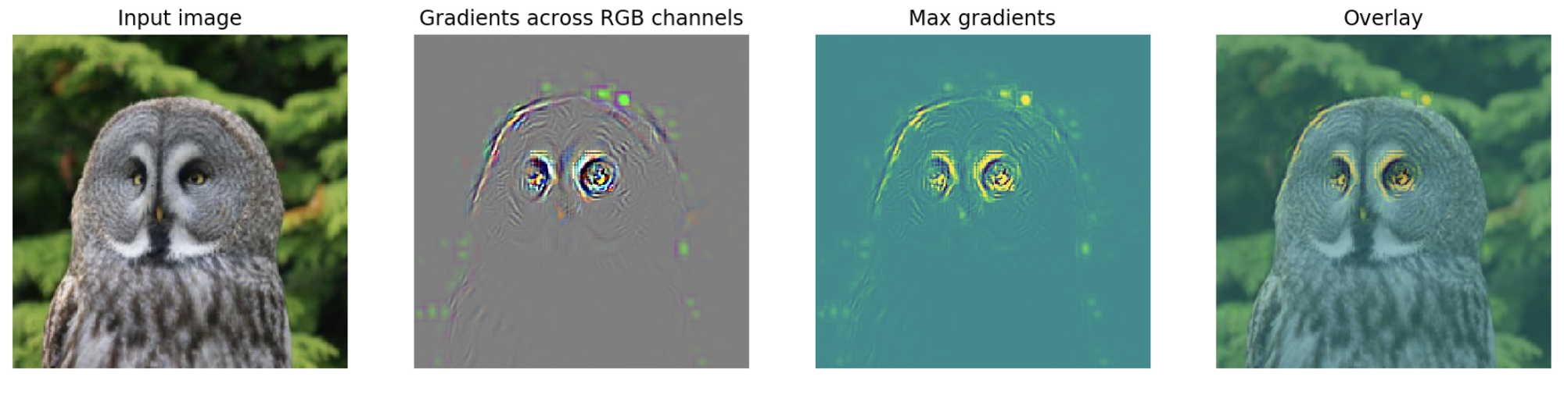
Saliency Map = Squared Jacobian of the emulated mapping
Deep learning libraries efficiently calculate Jacobian via automatic differentiation
Image source: flashtorch (Github) See: Paszke et al. (2017), Springenbert et al. (2015)
Notes:
And at this point, it may bring back a lot of harsh memories trying to wrap your head around complex models….
Does *not* change the complexity of the model but changes the focus to explaining individual predictions
VOTE: How can we make this a global explanation? Can we take the training mean of the Jacobian? Can we take the training mean of the saliency map?

Slide 17
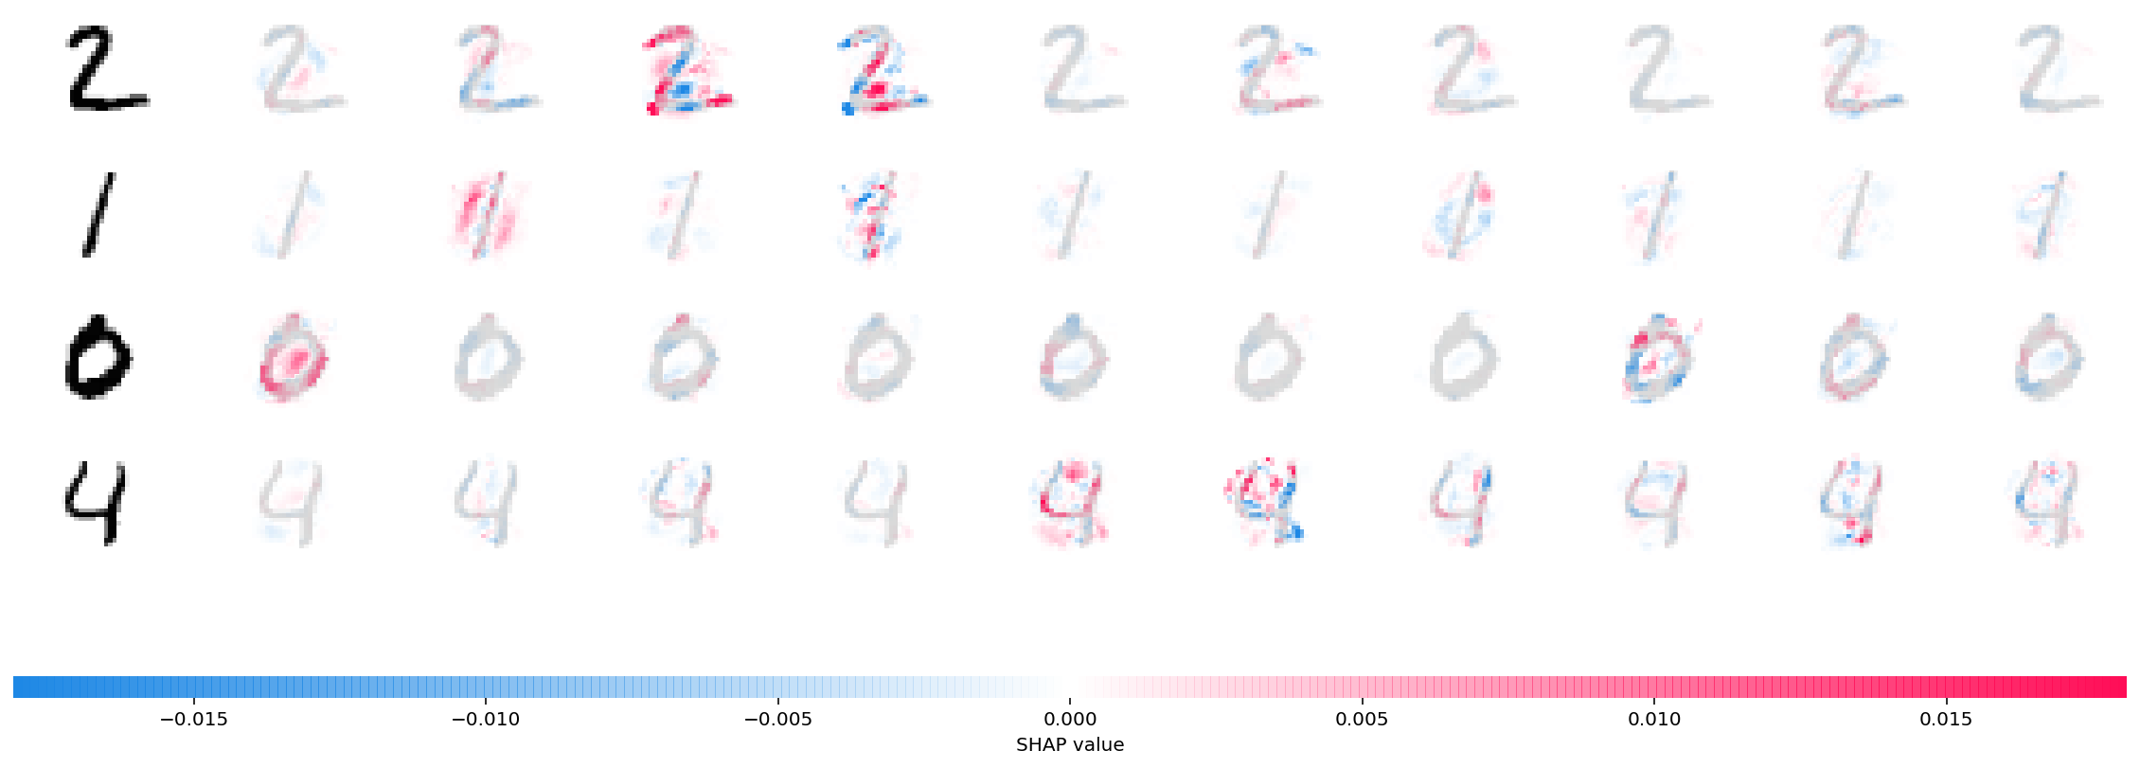
Next lab: SHAP DeepExplainer For a global explanation, average |SHAP values|

Slide 18


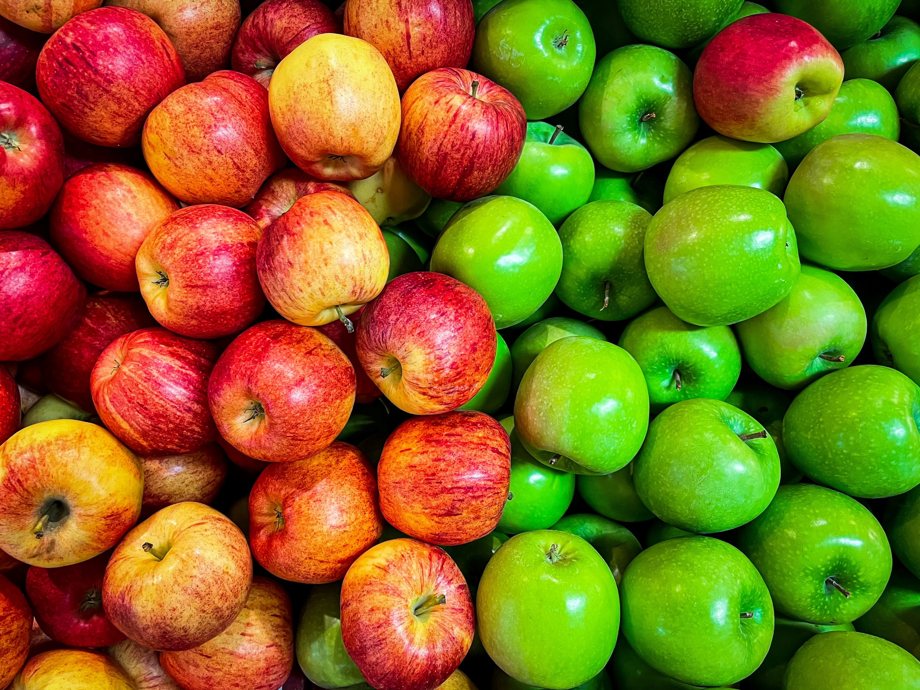
Min 60-75: Break

Slide 19
Logistics

Slide 20
Workload distribution 5 ECTS ~10-15 Hours/week
Activity | Estimated Workload | NEXT WEEK
Environmental Reading + Check out activities | 1-2 hours | Gagne et al., 2019 (xAI)
“Theory” Reading | 2-3 hours | Molnar (xAI) If early: Géron Ch. 17 (Gen AI)
Next Week’s In-Person Class | 4 hours | Generative Modelling
Notebooks ⬇️ (Lab tomorrow) | 1-2 hours | All e-book Chapter 9 exercises
Final Project ⬆️ (Lab) | 3-4 hours | Work on final project

Slide 21
Notebooks: All “theory” + 1 “environmental application”
Theory
Environmental Applications
CNN: 6.2 (Computer vision)
RNN: 7.3 (Composing music)
XAI: 9.2 (XAI on simple datasets)
Gen ML: 10.1 (UQ) + 10.2 (Gen NNs)
Choose one of the following:
CNN: 6.3 (Land cover classification)
RNN: 7.4 (Hydrological modeling)
GNN: 8.3 (Neural weather pred.)
GenML: 10.3* (Climate downscaling)
Hybrid: 11.2 (Glacier modeling)

Slide 22
Mid-term Presentations: Thursday, Nov 13th in GEO 2113
4min presentations + 6min Q&A/feedback
Tip = 1 slide/minute
Scientific question: What’s our goal and why do we care?
Dataset: Characteristics, challenges, training/validation/test split, etc.
Methodology: Which ML algorithm(s) are you planning to use and why?
Results: What are your initial results & what do you plan to do next?

Slide 23
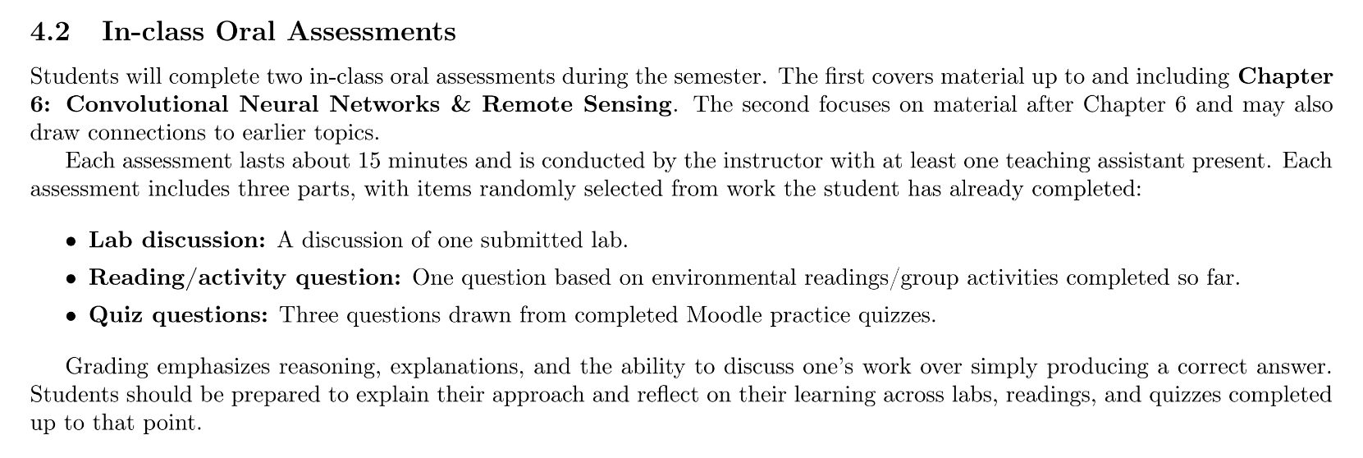
(For students taking this course for credits) Second oral evaluation: Dec 3rd & 4th

Slide 24
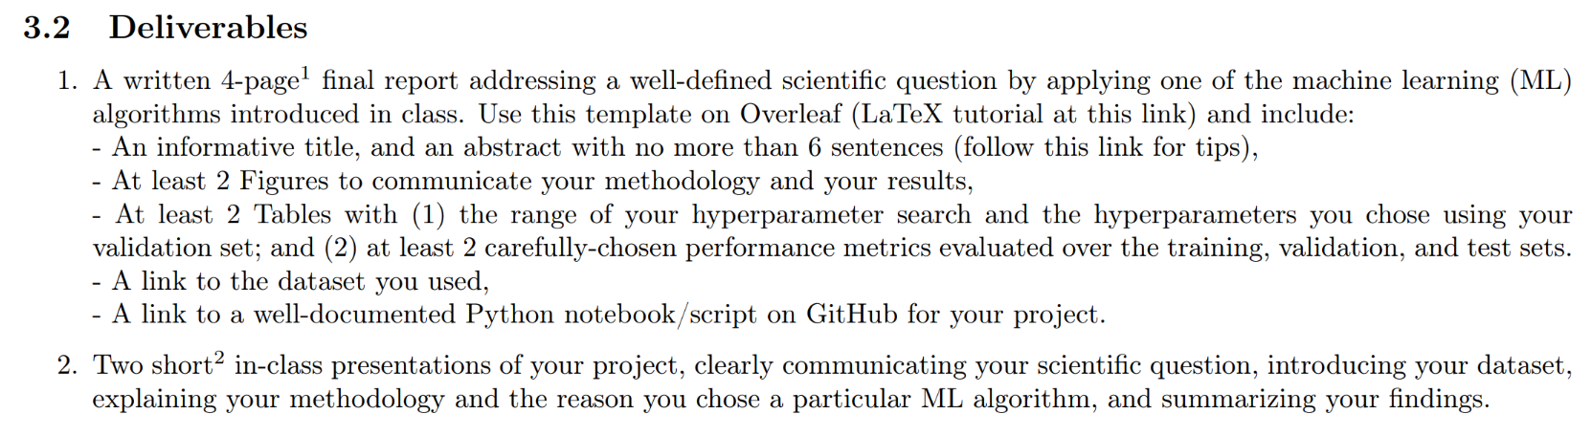
In-class Peer Review: Wednesday, Dec 10th, 12-2PM
Submit first draft of your project by December 9th

Slide 25
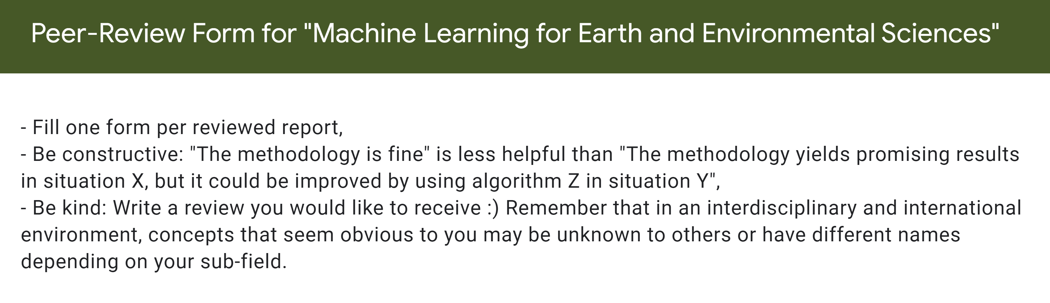
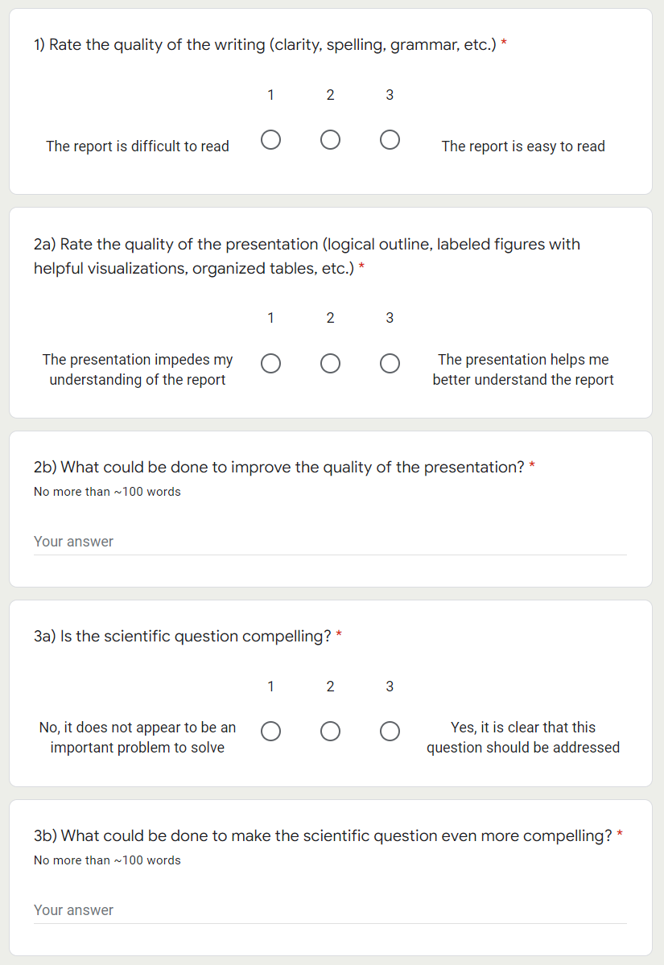
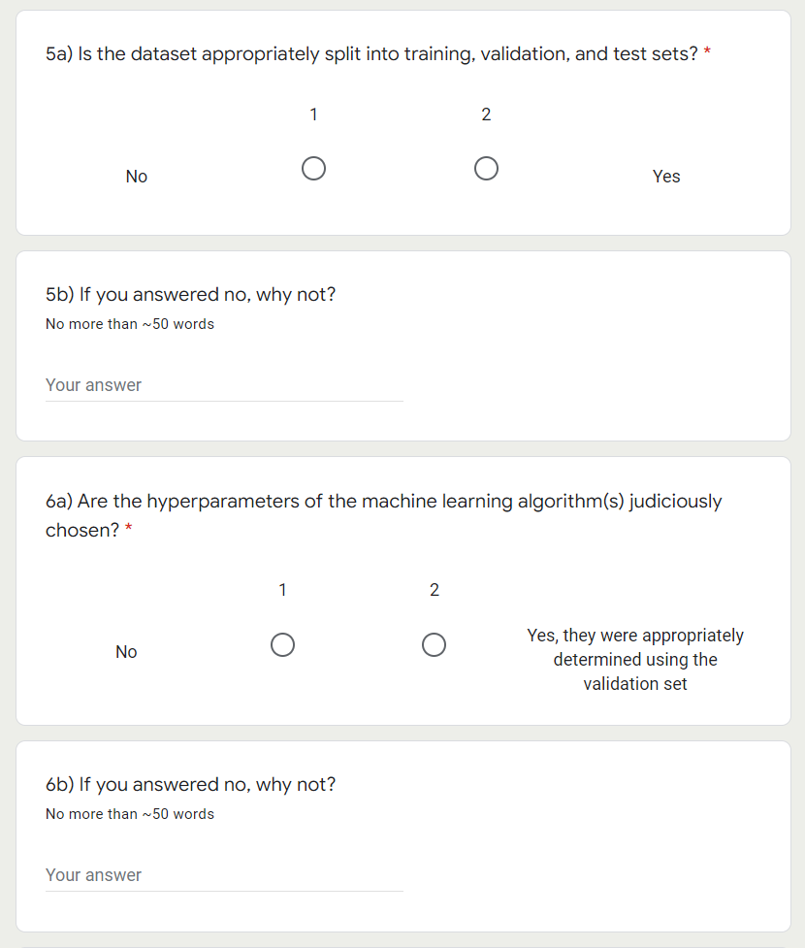

Slide 26
Final Presentations on Dec 11 & Dec 18 in GEO2138 Registration slots on Moodle
5min presentations + 5min Q&A
Tip = 1-2 slides for each of the following categories:
Scientific question: What’s our goal and why do we care?
Dataset: Characteristics, challenges, training/validation/test split, etc.
Methodology: Which ML algorithm(s) did you choose and why?
Results: What are your findings and how does it answer the sci. question?

