Slide 1
Workload distribution 5 ECTS ~10-15 Hours
Activity | Estimated Workload | NEXT WEEK
Read Géron | 2-3 hours | Extracts from Molnar’s textbook (Moodle)
Environmental Reading + Check out activities | 1-2 hours | Gagne et al., 2019
Notebooks ⬇️ | 1-2 hours | All of e-book Chapter 9’s exercises
Final Project ⬆️ | 3-4 hours | Work on presentation: (idea/task, methods, data, preliminary results)
Class | 4 hours | xAI

Slide 2
Notebooks: All “theory” + 1 “environmental application”
Theory
Environmental Applications
CNN: 6.2 (Computer vision)
RNN: 7.3 (Composing music)
XAI: 9.2 (XAI on simple datasets)
Gen ML: 10.1 (UQ) + 10.2 (Gen NNs)
Choose one of the following:
CNN: 6.3 (Land cover classification)
RNN: 7.4 (Hydrological modeling)
GNN: 8.3* (Neural weather pred.)
GenML: 10.3* (Climate downscaling)
Hybrid: 11.5* (Glacier modeling)

Slide 3
Logistics for future evaluations
Note: Future oral assessments will be organized to avoid the delays we experienced last week.

Slide 4
Mid-term Presentations: Thursday, Nov 13th in GEO 2113
4min presentations + 6min Q&A/feedback
Tip = 1 slide/minute
Scientific question: What’s our goal and why do we care?
Dataset: Characteristics, challenges, training/validation/test split, etc.
Methodology: Which ML algorithm(s) are you planning to use and why?
Results: What are your initial results & what do you plan to do next?

Slide 5
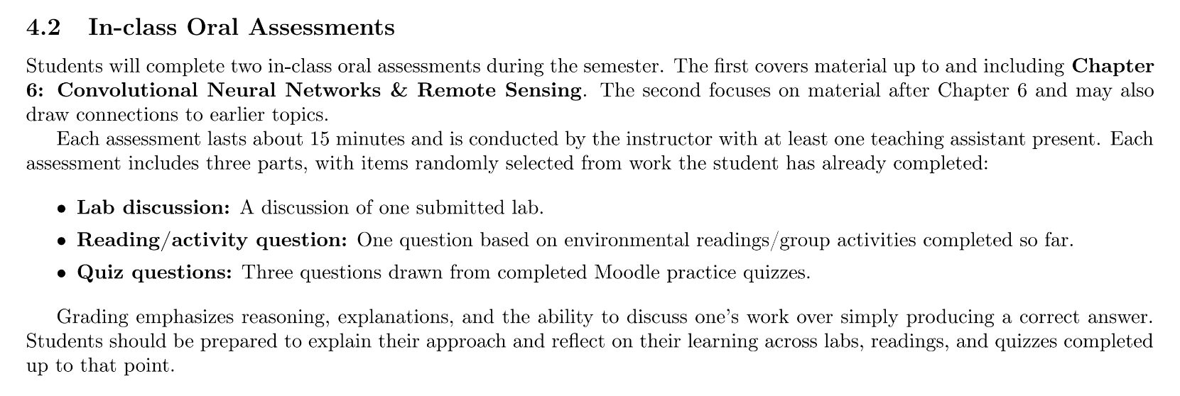
(For students taking this course for credits) Second oral evaluation: Dec 3rd & 4th

Slide 6
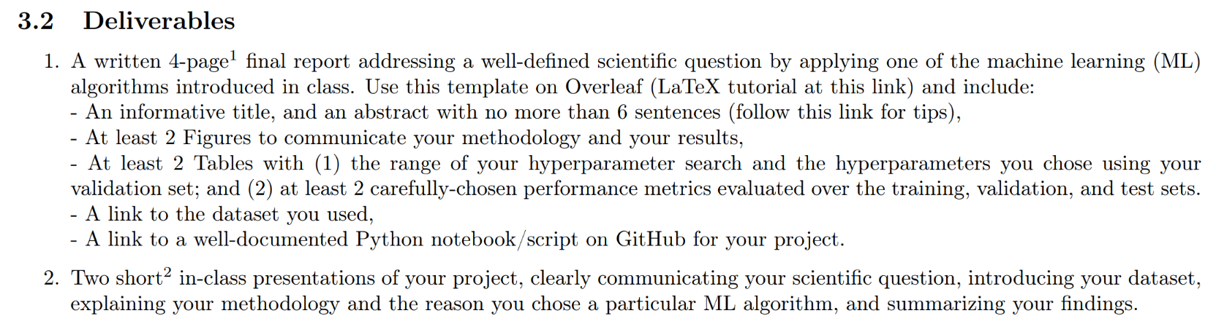
In-class Peer Review: Wednesday, Dec 10th, 12-2PM
Submit first draft of your project by December 9th

Slide 7
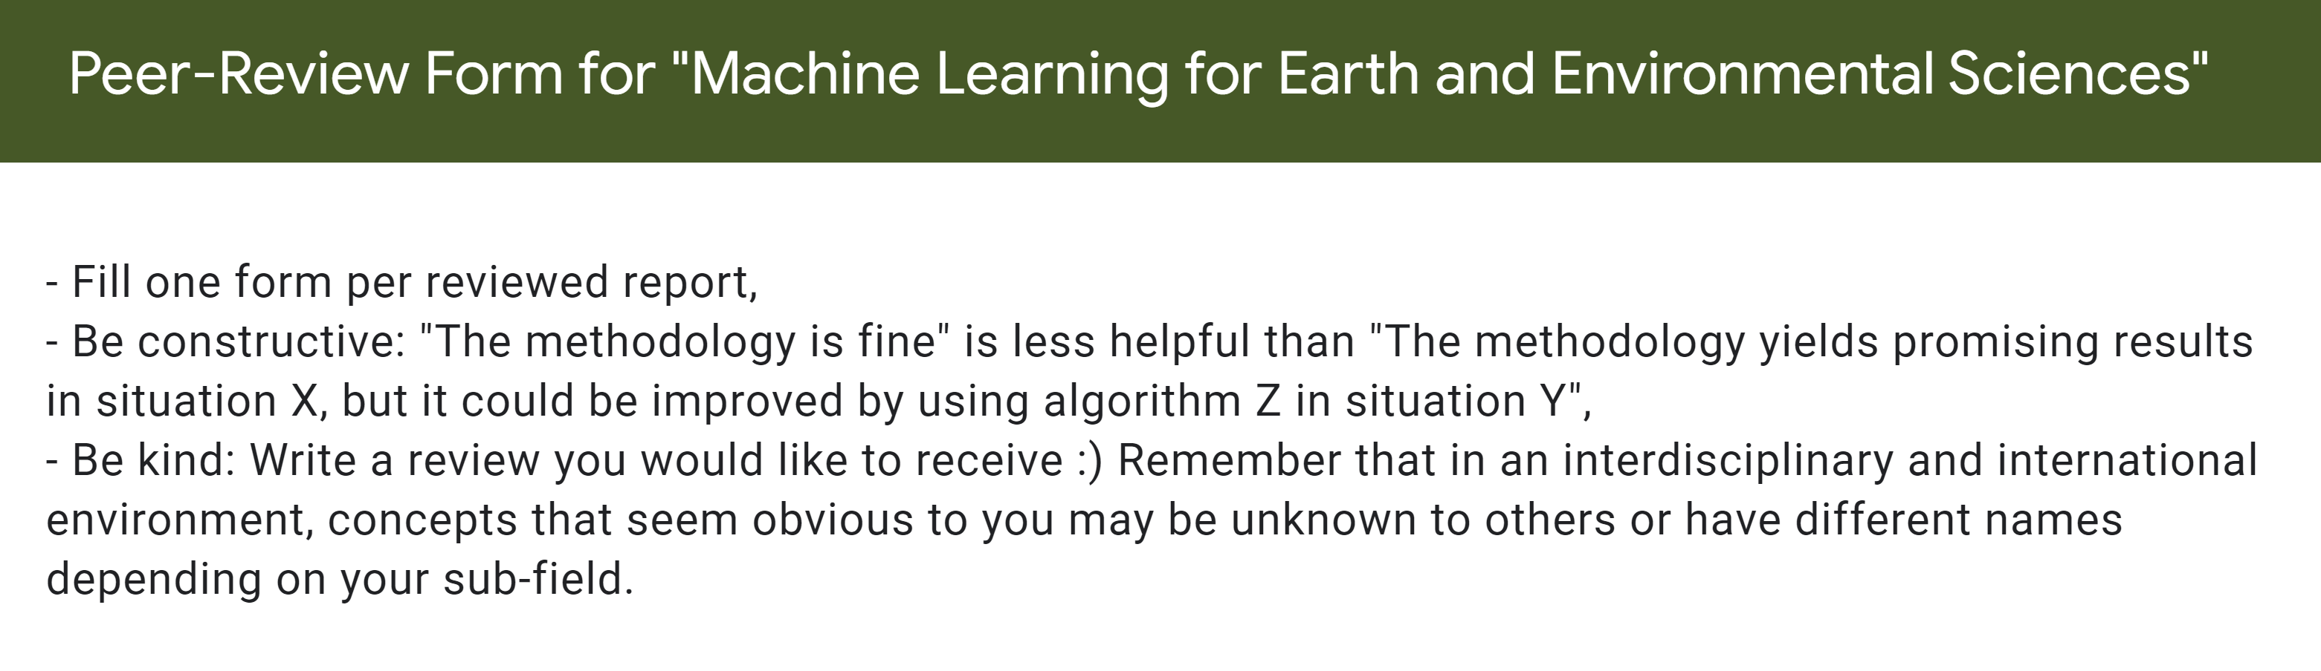
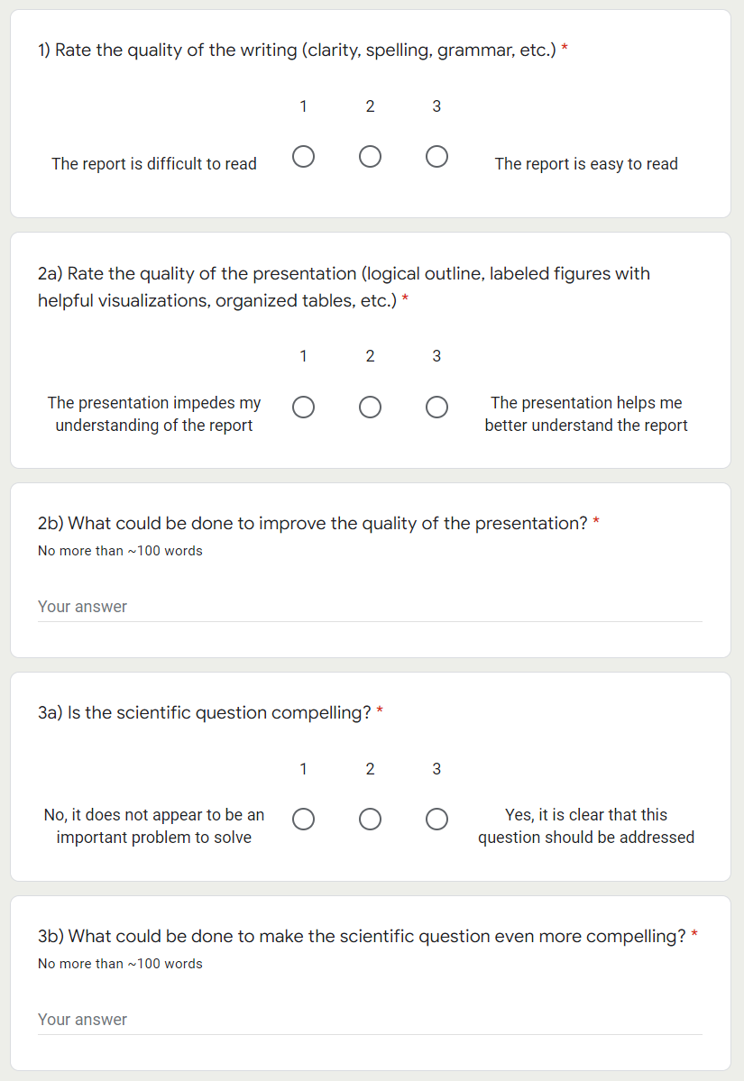
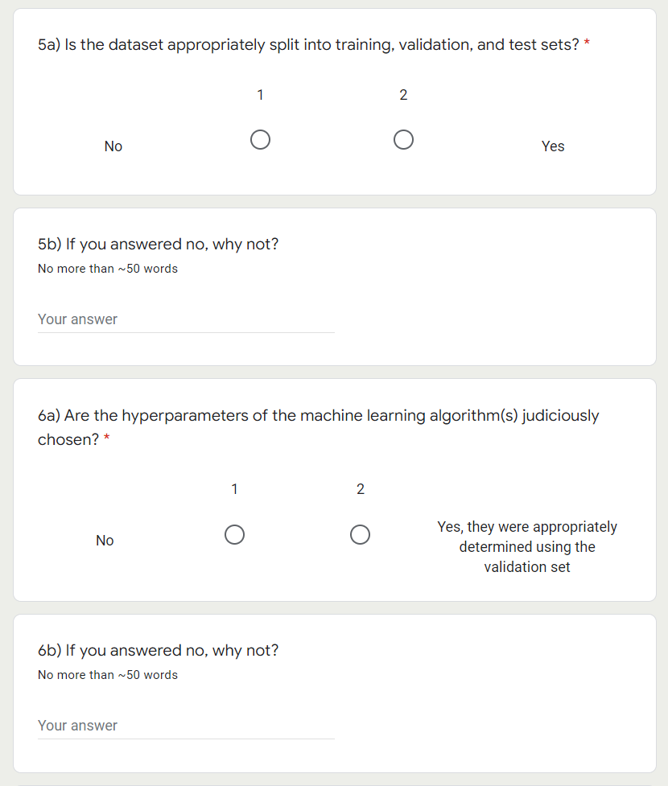

Slide 8
Final Presentations on Dec 11 & Dec 18 in GEO2138 Registration slots on Moodle
5min presentations + 5min Q&A
Tip = 1-2 slides for each of the following categories:
Scientific question: What’s our goal and why do we care?
Dataset: Characteristics, challenges, training/validation/test split, etc.
Methodology: Which ML algorithm(s) did you choose and why?
Results: What are your findings and how does it answer the sci. question?

