Slide 1
Threat-Shape
The shape of a national cyber-threat profile
Samuele Proietti · Marco Alberti
Visual Analytics, Sapienza University of Rome · EuRepoC 2000–2024
Notes:
Threat-Shape: a visual analytics tool over the European Repository of Cyber Incidents. Two of us, Samuele Proietti and Marco Alberti.

Slide 2
Counting answers how much, never what kind
What repositories answer
What an analyst needs
How many incidents hit a country
In which year, of which type
Filter, count, tabulate
Which sectors are hit more than expected
Which operations and access vectors recur
Whether the adversary is a state, a criminal or a volunteer
How the profile differs from a peer nation
“220 incidents hit Russia”
“Two different adversaries, one incident count”
Intended user: a threat-intelligence analyst at a national CSIRT, preparing a situational assessment for decision-makers.
Notes:
The official EuRepoC dashboard already answers the left column. Our user has to answer the right one, and today that means exporting the data and writing code.

Slide 3
The data: four tables, one matrix
3,414
18
61,452
incidents, 2000–2024
analytical columns kept of 85
AS index (3,414 × 18)
Encoding
14 categorical blocks (type, access, impact, issue, actor, sector, law…) exploded into 123 binary indicators, plus 4 ordinal severity variables
“Not available” kept as its own indicator: whether a field was coded is itself a signal — and it produced one of our findings
AS index counts the 18 conceptual variables, not the 127 encoded columns: above the 10,000–50,000 band, deliberately
Notes:
The AS index is above the band on purpose. Counting the encoded width instead would give over 430,000 and would describe the encoding rather than the data.

Slide 4
From 127 columns to a plane
Standardize
PCA → 20
t-SNE → 2D
zero mean, unit variance
per column
›
static, offline denoising
50.7% of the variance
›
perplexity 30, fixed seed
trustworthiness 0.990
Perplexity chosen by trustworthiness, not by KL divergence, which falls with perplexity by construction (0.9877 / 0.9897 / 0.9885 for 15 / 30 / 50)
PCA is never recomputed; t-SNE is the technique integrated in the analysis flow, refitted on whatever the analyst selects
Notes:
Two reductions, two different roles: PCA denoises once, t-SNE is the one that runs again on a selection.

Slide 5
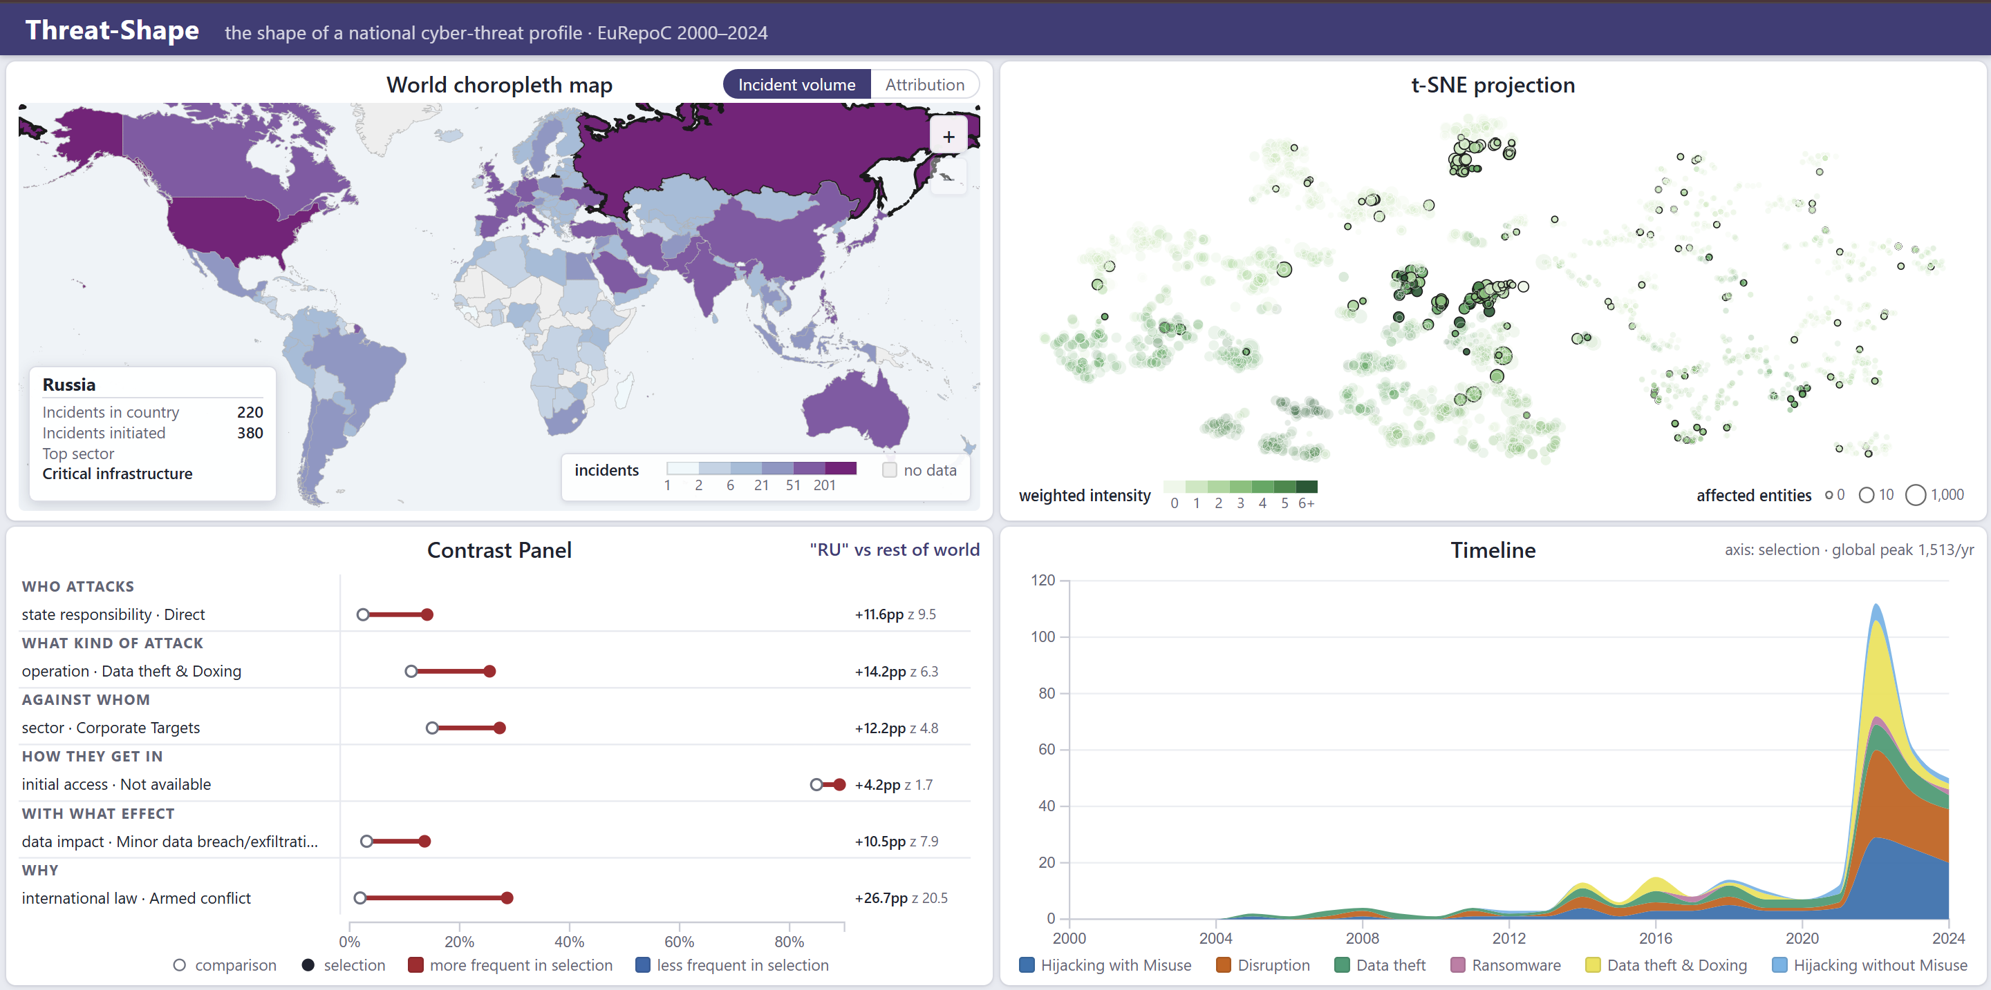
Four coordinated views, one selection
Notes:
Each view is both a source and a target: a selection made anywhere is answered everywhere. No view talks to another directly - they share one selection store.

Slide 6
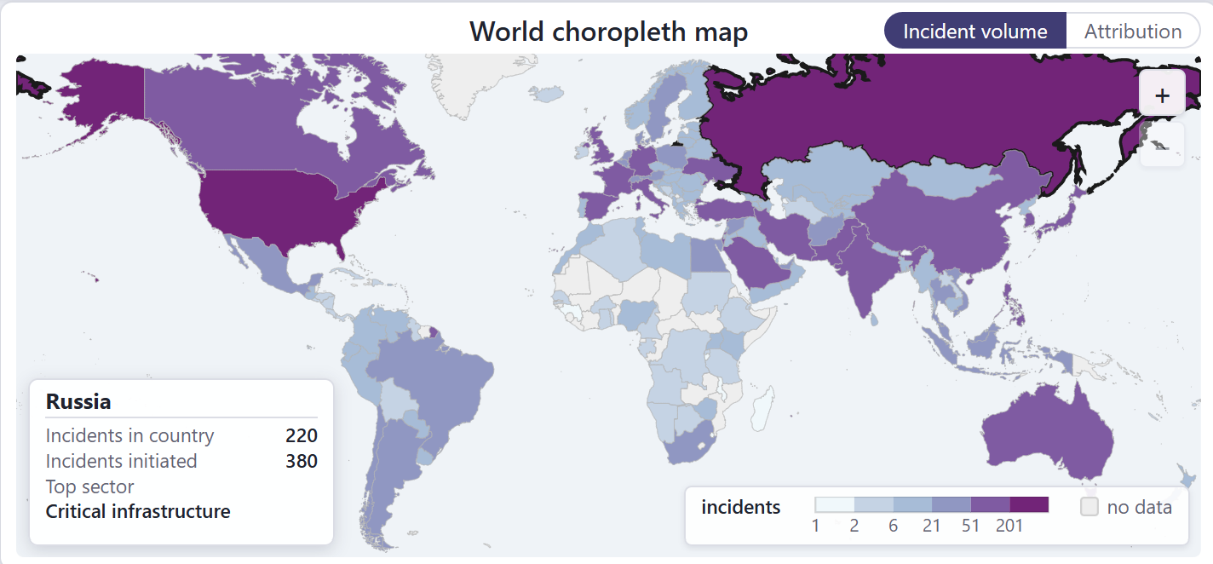
View A — world choropleth
Entry view: the selection starts here
Divergent scale on the standardized deviation, plus a layer for unattributed incidents
Miller projection: neither conformal nor equal-area, chosen so small states stay clickable
Russia selected: 220 incidents suffered, 380 initiated, top sector critical infrastructure.
Notes:
The map is the entry point. The details panel answers the three questions an analyst asks of a country before anything else.

Slide 7
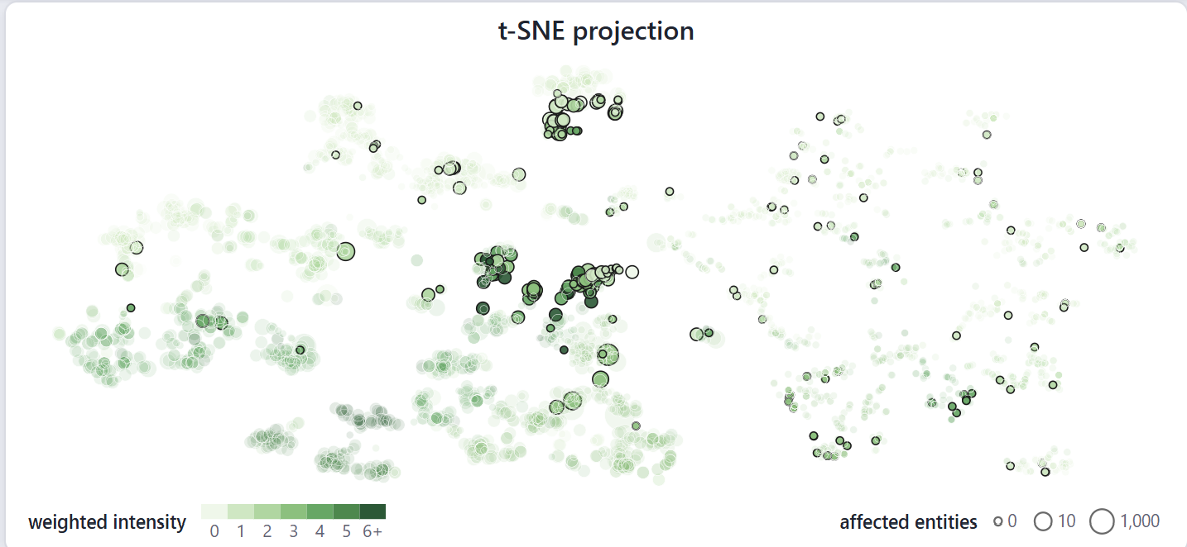
View B — t-SNE projection
Colour: weighted intensity, sequential single hue
Size: affected entities, log scale, value on the area
No axes: the coordinates have no units, and distances between clusters mean nothing
One mark per incident; the Russian incidents concentrate in two dense regions.
Notes:
This is the organising view. Neighbourhood means similarity of profile, which is the question the whole tool exists to answer.

Slide 8
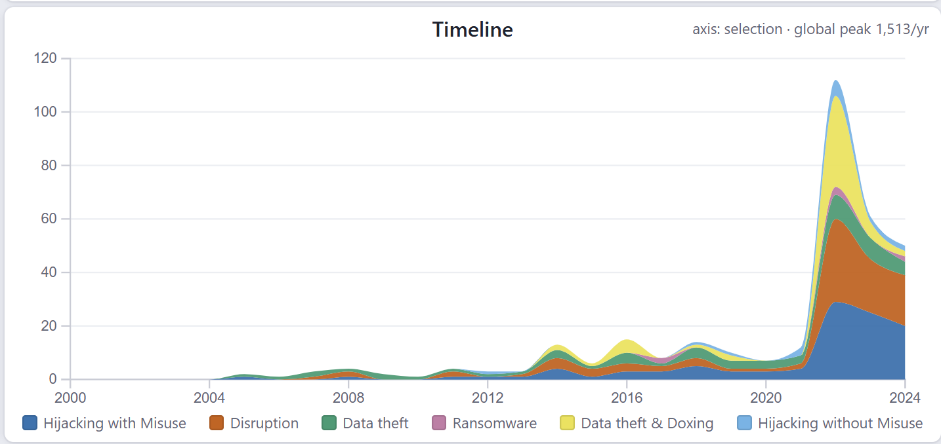
View C — stacked area timeline
Okabe–Ito palette: safe under the common colour-vision deficiencies
Bands count type occurrences, not incidents
The brushed window restricts every computation to its years
Incident types per year; the count axis follows the current selection.
Notes:
The caveat matters: the bands sum to about 1.7 times the incident count, 2.1 in 2023, so the axis would overstate volume if we did not say so.

Slide 9
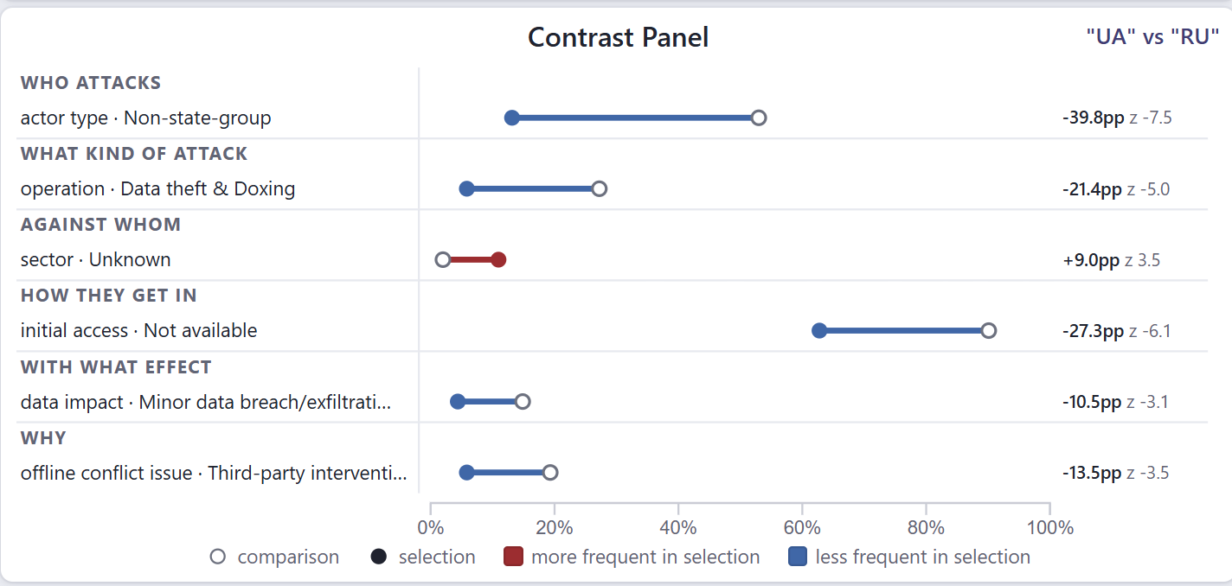
View D — contrast panel
A dumbbell per indicator: hollow dot the comparison, filled dot the selection
Grouped into who, what, against whom, how, with what effect, why
Length is the difference; order is |z|, the reliability
Ukraine against Russia: the two rates, their difference and its reliability.
Notes:
A difference of 22.7 points says nothing about whether it runs from 8 to 31 per cent or from 57 to 80. That is why both rates are on screen.

Slide 10
Three computations, none before a selection
Standardized deviation
z = (x − μ) / σ per country–sector cell of the current selection. Cells with an expected count below 5 are flagged “small sample”, never suppressed.
Local re-projection
t-SNE refitted on the selected subset alone, perplexity (n−1)/3 capped at 30. Below 30 incidents the tool refuses and says so.
Contrastive z-scores
Pooled two-proportion test over the 123 indicators; features failing the validity condition are shown faded, and a group below 20 incidents is refused.
On load the contrast panel is empty by construction, and the endpoints refuse a request without a selection: no typed URL produces a global result.
Notes:
Each refusal is a design decision: an embedding of twelve points looks exactly as confident as one of twelve hundred.

Slide 11
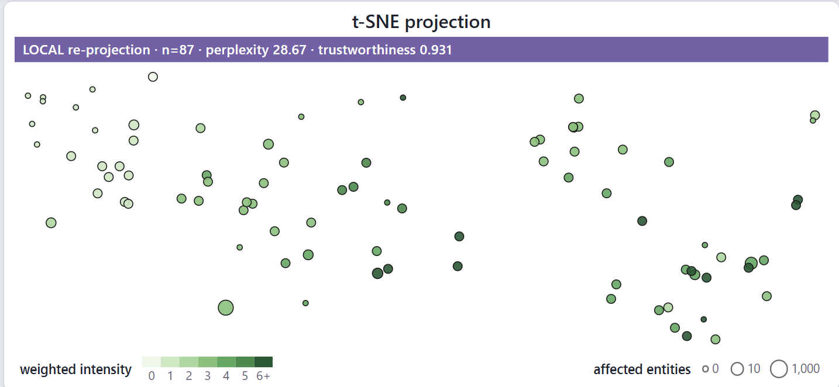
The reduction inside the analysis flow
Refitted, not filtered: structure the global embedding compressed can re-emerge
The banner is there because a local layout looks like the global one
Trustworthiness 0.93–0.98 on the subsets we report
A selected cluster, re-embedded on its own: n, perplexity and trustworthiness are reported.
Notes:
This is what 'dimensionality reduction integrated in the analysis flow' means here: the projection is recomputed on the analyst's own selection.

Slide 12
Insight 1 — one country, two operational families
37 incidents
78 incidents
Mean weighted intensity 1.59
Denial of service: banks, regional networks, broadcasters
Impact lasting a single day: +73.5pp, z = 10.8
No data taken
Mean weighted intensity 3.26
Intrusion: 800 servers wiped, providers and state TV breached
Data exfiltration: +65.9pp, z = 10.0
Tied to an offline conflict over territory and resources
Same attackers in both — Ukraine's military intelligence and volunteer groups — and the same 38–40% unattributed. The projection cut by what the operation does, not by who runs it.
Notes:
A count-based dashboard reports 220 incidents against Russia and stops. These two groups differ by a factor of two in intensity.

Slide 13
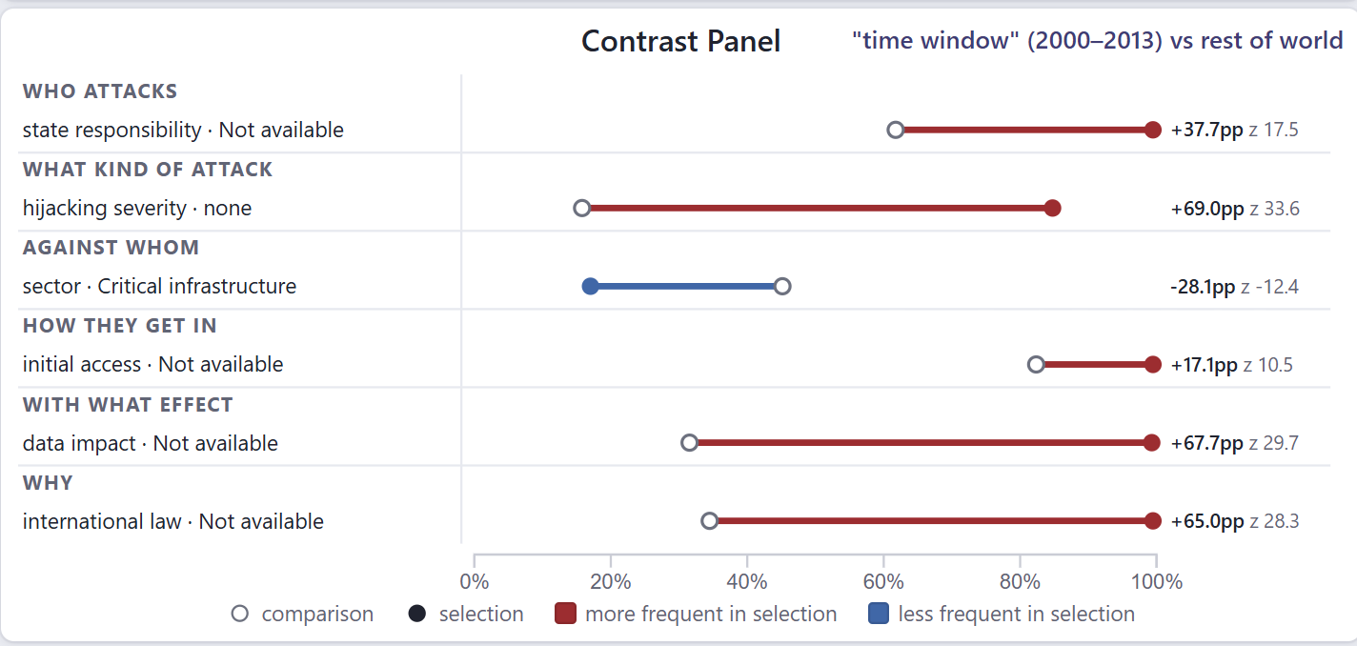
Insight 2 — a coding break that looks like a trend
“Not available” on law and impact: 100% in 2013, 2% in 2024
Type labels per incident grow from 1.21 to 2.04
Part of the timeline's rise is coding granularity, not threat
Brushing 2000–2013: the five strongest features are all artefacts of coding, |z| between 26 and 34.
Notes:
A finding about the data, produced by our own contrast panel - and the trap the same panel sets. Compare characteristics only inside the homogeneous era.

Slide 14
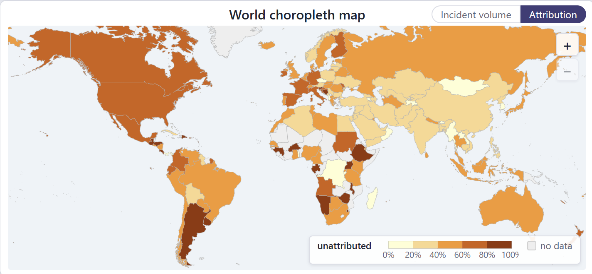
Insight 3 — attribution follows the adversary
Below 30%: KR, SA, AE, IN, CN, VN, UA
Above 55%: FR, ES, MX, CA, IT, US, DE, CH, AU, BE
State-affiliated initiators: 45.2% against 15.6%
Share of a country's incidents with no named initiator state: two clear regimes.
Notes:
The intuitive explanation - western CERTs attribute better - is backwards. What differs is who attacks them.

Slide 15
Two negative claims, made checkable
26/26
trigger audit
46/46
visual encodings
no select or radio elements; each store mutator called from one view; endpoints answer 404 to GET and 422 to an empty selection
palettes measured against three simulated colour-vision deficiencies; divergent scales only on signed quantities; a legend in every view
25/25
runtime triggers
34/34
legends & layout
replays interactions in the browser and asserts what is on screen
every legend populated in every state, no view scrolls, no chart wider than its card
The suites caught a click that re-projected the wrong selection, and a redraw that reached the views directly instead of going through the store.
Notes:
No analytic is started by a menu, and no result exists before an interaction. Both are negative claims, so we made them testable.

Slide 16
What the tool cannot tell you
The corpus records publicly reported incidents, coded by humans: under-reporting is invisible, and insight 2 shows how strongly coding practice can drive a result
Each contrast tests 123 indicators with no multiple-comparison correction, so our claims lean on |z| > 3 and on features that agree with each other
Initiators have no map layer: the Ukraine–Russia mirror had to be read in the contrast panel rather than seen geographically
Three or more countries are compared as a group against the rest of the world, with no per-member breakdown — measured, click order would otherwise decide the answer
Notes:
Limits stated up front; each of them is a decision we can defend rather than an oversight.

Slide 17
What the demo will show
A country clicked, and the same selection answered in four views
A cluster lassoed, and the projection refitted on it alone
A time window brushed, and every computation restricted to it
Two countries compared directly, feature by feature
github.com/SamueleProietti/Visual_Analytics-Project
Notes:
Interaction belongs to the demo, so the deck stops here.

