Slide 1
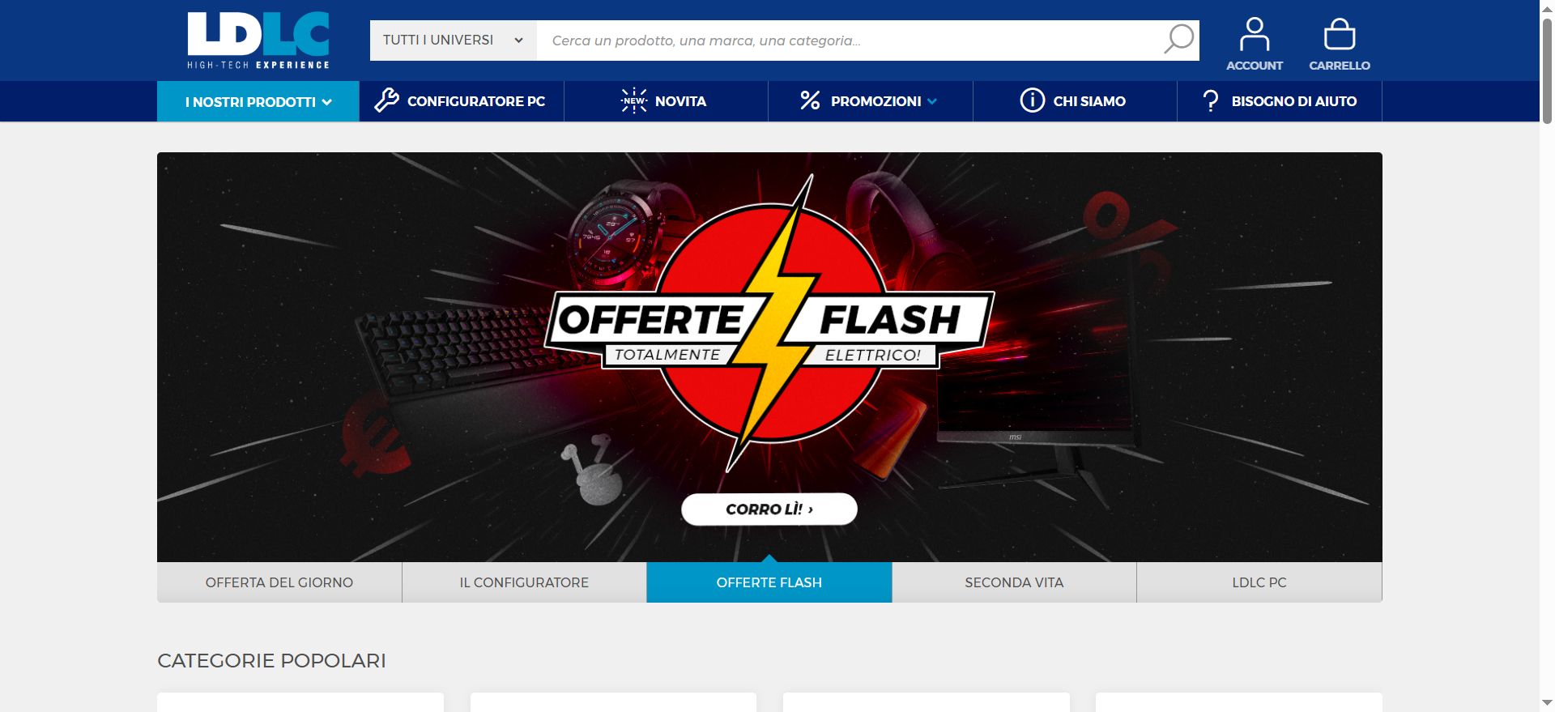
https://www.ldlc.com/it-it/

