Slide 1

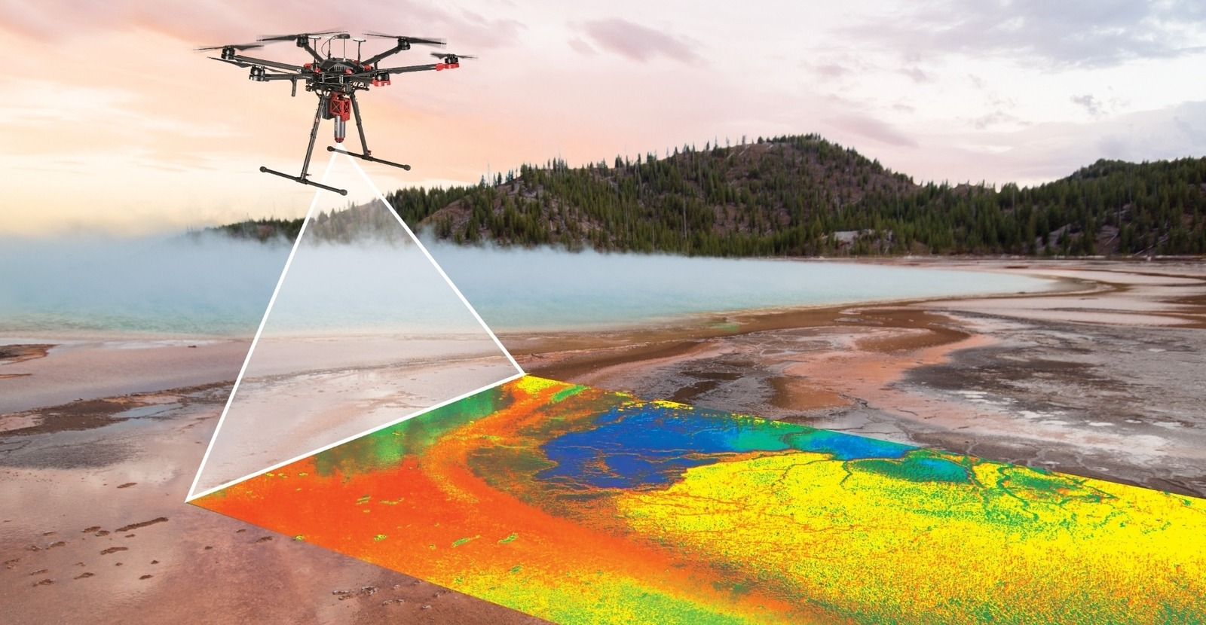
Hybrid Models for hyperspectral image classification
Course: Neural Networks
Exam date: 06/02/2026
Author: Samuele Tomassacci
Student ID : 2216267

Slide 2

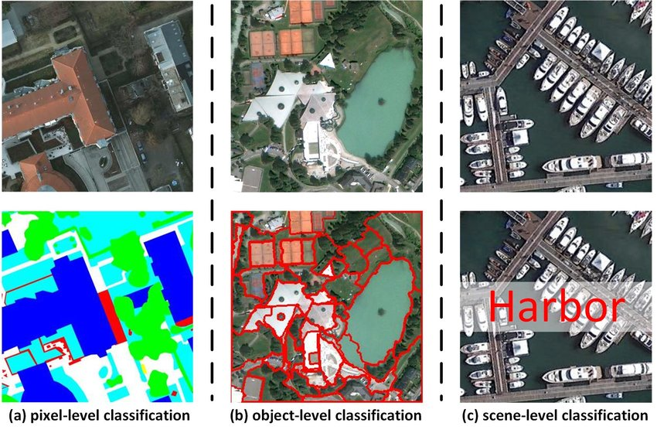
Definition of the task
The reference paper is "CNN-Transformer and Channel-Spatial Attention based network for hyperspectral image classification with few samples“[1]
The paper addresses a pixel-level classification task on hyperspectral imagery
Limited training samples
Two main challenges are faced:
Curse of Dimensionality
Input
Output
[1] C. Fu, T. Zhou, T. Guo, Q. Zhu, F. Luo, and B. Du, "CNN-Transformer and Channel-Spatial Attention based network for hyperspectral image classification with few samples," Neural Networks, vol. 186, art. no. 107283, 2025, doi: 10.1016/j.neunet.2025.107283
Samuele Tomassacci
Neural Networks

Slide 3
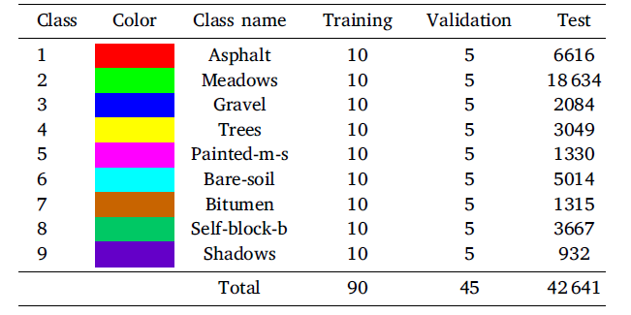
Dataset
The dataset used is Pavia University Dataset
A single hyperspectral image of size 610x340 with 103 spectral bands, acquired during a flight campaign over Pavia University using the ROSIS sensor
42,776 pixels are labelled into 9 different classes
The input of the model is 15x15 patch, centred on the pixel to be classified.
Limited training samples, indeed the training dataset is composed of only 10 samples per class
Samuele Tomassacci
Neural Networks

Slide 4
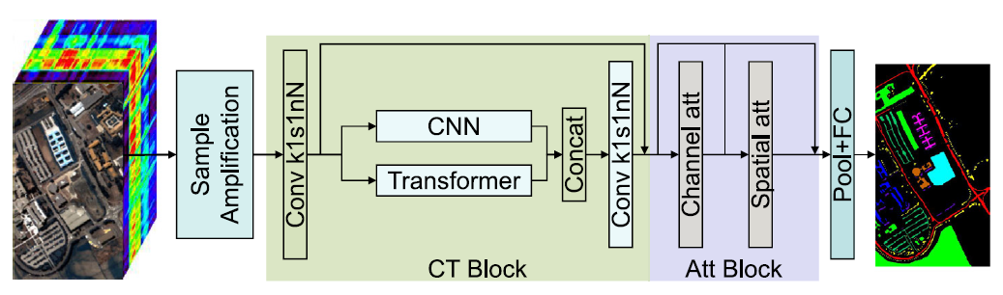
Model Overview
Three key novelties:
Sample Amplification algorithm
Hybrid module based on CNNs and Transformers called CT Block
Channel-Spatial attention
Samuele Tomassacci
Neural Networks

Slide 5
Sample amplification
Since training samples are extremely limited, data augmentation is necessary to achieve good results. These are the transformations used:
Addition of random gaussian noise
Random rotation
Linear summation of samples of the same class
For each training sample, all three transformations are applied, and the resulting samples are added to the dataset together with the original one.
Samuele Tomassacci
Neural Networks

Slide 6
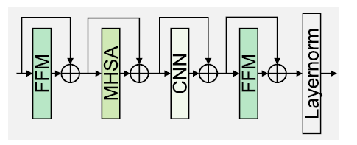
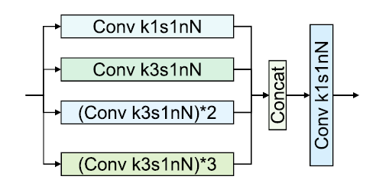
CT Block
It is composed of two parallel branches, whose outputs are then concatenated on the channel axis and convolved to restore the initial number of channels
Transformer Block
To extract non-local features
CNN Block
To extract local features
Samuele Tomassacci
Neural Networks

Slide 7
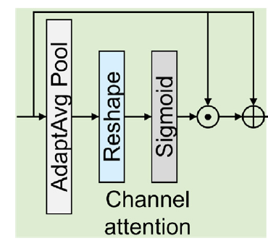
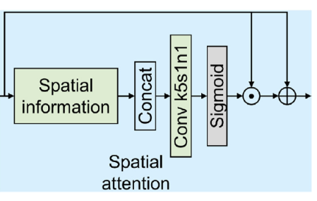
Channel-Spatial Attention
Two consecutive modules to analyse data from both a spatial and a spectral perspective
Channel attention aims to assign a weight to each channel in order to emphasize the most important ones over the others.
After a pooling across the spatial dimensions, 1D convolution is applied to find the weights
Spatial attention aims to assign a weight to each spatial pixel of the patch.
Firstly, max, min, mean and std are computed for each pixel across the channels. To extract the weights convolution operations are applied to the tensor composed of the statistics above
Samuele Tomassacci
Neural Networks

Slide 8
Experiments
Overall Accuracy
Average Accuracy
Kappa coefficient
Metrics used for evaluation:
One run consists of training the model using a randomly generated training dataset and then testing it
Given the limited training samples, only one run would lead to unstable results, depending on training dataset initialization
For this reason, ten consecutive runs are performed, and the average and standard deviation of the metrics across all runs are computed.
Samuele Tomassacci
Neural Networks

Slide 9
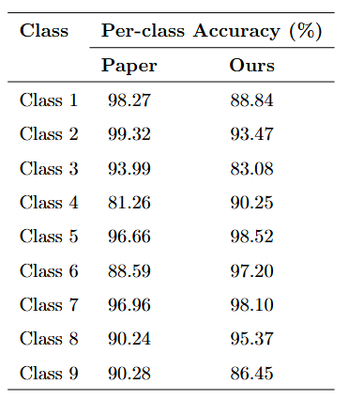
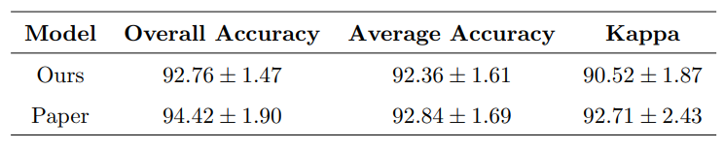
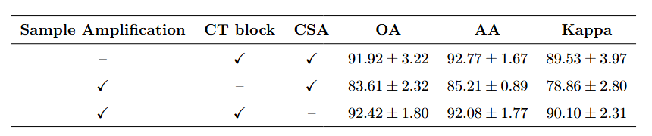

Results
Final results over 10 runs (mean ± std)
Ablation study
From the table it is evident that the core component is the CT block, indeed without it all the three metrics exhibit a sharp drop
Samuele Tomassacci
Neural Networks

Slide 10
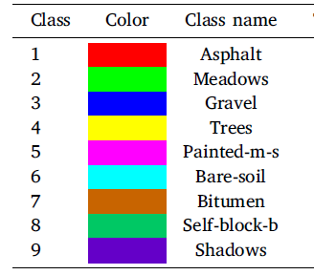
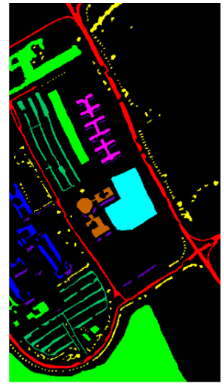
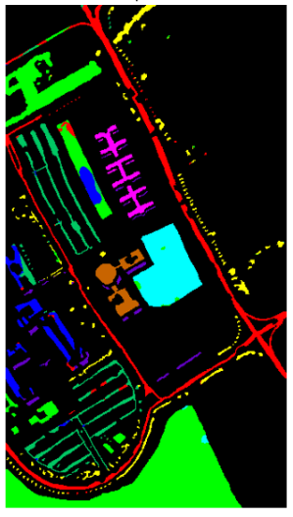
Results
Semantic land cover classification results: ground truth (left) and model prediction (right). The legend shows the correspondence between color and class.
Ground truth
Predicted
Samuele Tomassacci
Neural Networks

Slide 11
Conclusions
Model performance and validation
The model achieves strong and stable results on the Pavia University dataset, with OA, AA, and Kappa values comparable to the reference paper, validating the correctness of the implementation and its effectiveness in few-shot scenarios.
Feature extraction capability
The integration of CNN–Transformer architecture with channel–spatial attention enables the model to capture both local spectral–spatial features and global contextual information, leading to high per-class accuracies despite data imbalance.
Future works
Future work will focus on channel pruning by removing less informative spectral channels, reducing the input dimensionality and significantly improving model efficiency and inference speed.
Samuele Tomassacci
Neural Networks

