Slide 1

Notes:
‹#›

Slide 2
Resilient Microservices Architecture for Real-Time Seismic Signal Classification
At-least-once ingestion Replica-based processing Fault isolation and consistency guarantees

Slide 3
The Architectural Problem
How can a distributed system:
Process real-time seismic streams
Classify frequency-based events
Survive processing node failures
Preserve data consistency
without interrupting operational visibility?
*
Pagina ‹#›

Slide 4
Separation of Responsabilities
The system is structured into three independent planes:
Data Plane → Processing & Intelligence
Control Plane → Resilience & Fault Management
Management Plane → Access & Monitoring
Each plane isolates a different system responsibility.
*
Pagina ‹#›

Slide 5
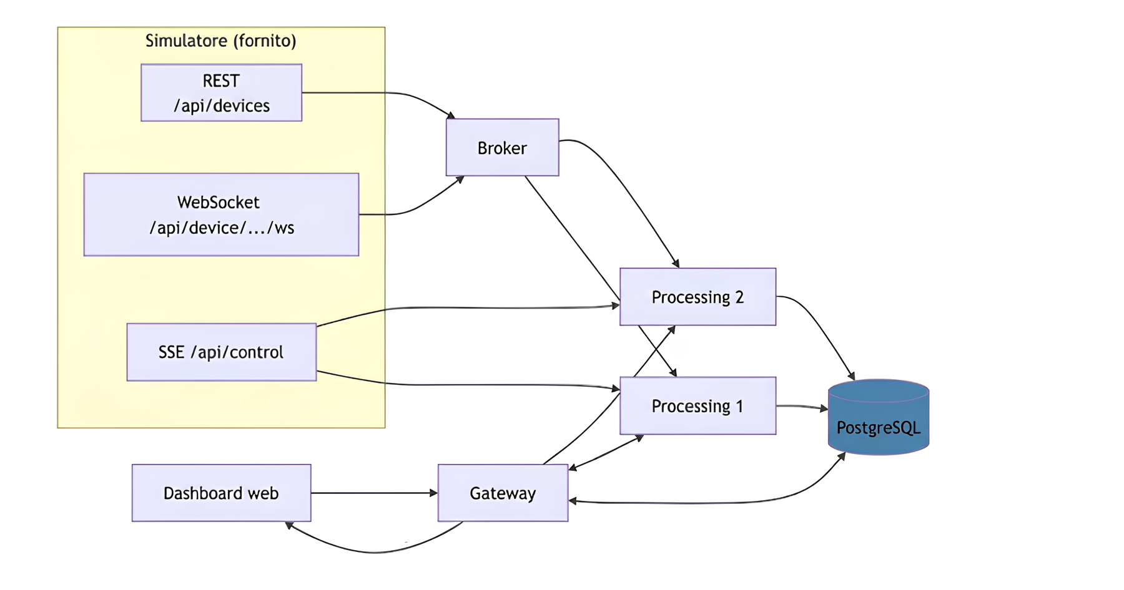
High-Level System Flow
*
Pagina ‹#›

Slide 6
Deployment Model
Core services:
Simulator – data ingestion source
Broker – message fan‑out to processing services
Processing Replicas – scalable analysis units
Persistent Storage – PostgreSQL event store
Gateway – aggregated API façade
Web Layer – UI served via nginx reverse proxy + React
Containerized orchestration ensures isolation, reproducibility and deterministic networking
*
Pagina ‹#›

Slide 7
Data Plane | Ingestion Model
The Broker:
Discovers sensors via REST
Maintains one WebSocket per sensor
Forwards each sample to all processing replicas
This creates an at-least-once delivery model.
Duplicates are possible by design.
The broker is completely stateless: it does not perform FFT or persistence
*
Pagina ‹#›

Slide 8
Data Plane | Processing Logic
Each processing Replica:
Receives samples via HTTP POST
Maintains a per-sensor sliding window
Runs FFT to extract dominant frequency
Classifies event by frequency band
Writes to PostgreSQL using an idempotent dedup_key
Classification Model:
Frequency Range | Event Type
0.5–3 Hz | Earthquake
3–8 Hz | Explosion
≥8 Hz | Nuclear
*
Pagina ‹#›

Slide 9
Data Plane | Idempotent Persistence Strategy
Because both replicas process the same samples,
they may classify the same event.
To guarantee consistency:
dedup_key (CHAR(64), UNIQUE)
INSERT ... ON CONFLICT DO NOTHING
Shared PostgreSQL as consistency anchor
The database becomes the single source of truth across replicas.
*
Pagina ‹#›

Slide 10
Persisted Event (JSON Response)
Persisted classified event, exposed by the gateway API as the authoritative view of the system’s intelligence layer.
{
"dedup_key": "a1b2c3…",
"sensor_id": "sensor-11",
"classification": "conventional_explosion",
"dominant_frequency_hz": 6.719,
"energy": 123.45,
"detected_at": "2026-03-28T14:24:02.650816+00:00",
"replica_id": "1",
"created_at": "2026-03-28T14:24:03.120000+00:00"
}
Titolo Presentazione
*
Pagina ‹#›

Slide 11
Data Plane | User Stories | Intelligence&Processing
“Transforming raw seismic telemetry into tactical information.”
US-03: As a Data Analyst, I need to classify signals to asses nature of vibration
US-07: As an IT Administrator, I need replicate processing service across containers, so that system keeps operating after shut down
US-08: As a Database Steward, I need idempotent persistence to ensure that data from multiple replicas is stored without duplicates.
US-15: as a Developer, I need a Sliding window of samples per sensor to ensure that frequency analysis is consistent over time.
Technical Implementation:
Signal Analysis through real-time Fourier Transform on a sliding window of samples.
Classification Engine through automatic categorization based on frequency
Reliable Storage based on PostgreSQL with unique constraint logic
*
Pagina ‹#›

Slide 12
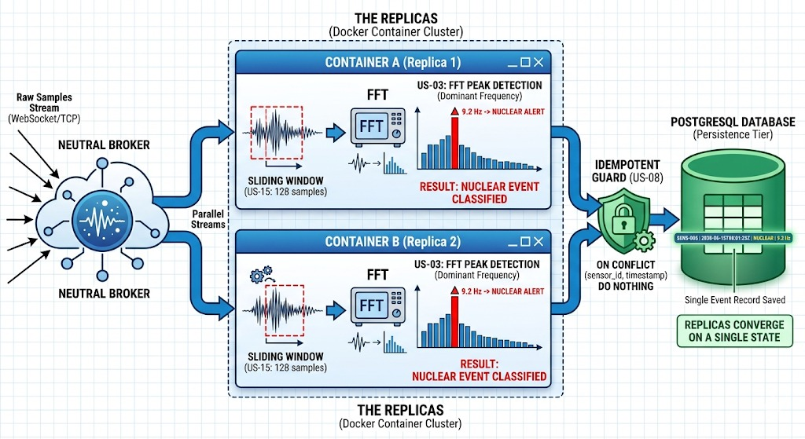
Data Plane | User Stories | Mockup
*
Pagina ‹#›

Slide 13
Control Plane | Fault Injection
Processing replicas subscribe to:
GET /api/control (SSE)
On receiving:
{"command": "SHUTDOWN"}
Simulates a crash-stop failure model in the processing tier: the replica immediately terminates.
*
Pagina ‹#›

Slide 14
Control Plane | Resilience Strategy
The system maintains continuity through:
Active-Active Architecture: Parallel signal processing across independent replicas.
Fan-Out Broadcast: Stateless broker sends identical data streams to all nodes simultaneously.
Zero Ingestion Downtime: Failure is isolated; data ingestion continues seamlessly on surviving nodes.
*
Pagina ‹#›

Slide 15
Control Pane | User Stories | Resilience&Survival
“Ensuring system continuity under infrastructure destruction.”
US-11: As a Security Officer, I want replicas to self-terminate upon an SSE SHUTDOWN command to simulate node destruction.
US-12: As a Technical User, I need to monitor the Health Status of all distributed nodes to ensure system availability.
Technical Implementation:
Fault Injection
Active Monitoring through periodic health checks
Dynamic Reconfiguration after failure
*
Pagina ‹#›

Slide 16
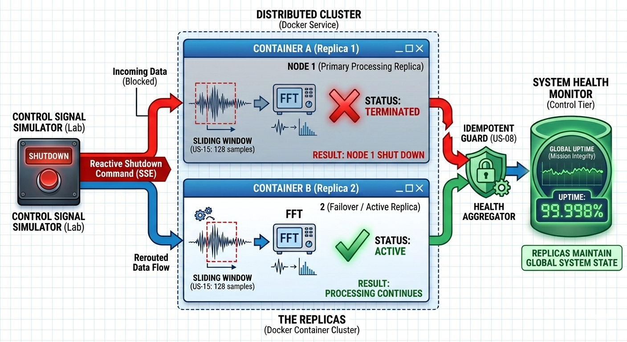
Control Plane | User Stories | Mockup
*
Pagina ‹#›

Slide 17
Management Plane | CommandCenter&Access
Isolating user access from core processing logic
Stateless Gateway: Acts as an aggregated API façade, decoupling the UI from the processing nodes.
Role-Based Interfaces: Tailored data exposure for Commanders, Analysts, and IT Admins.
Single Source of Truth: All historical and durable intelligence is exclusively queried from PostgreSQL.
Web Container: Serves the React SPA via Nginx proxy, ensuring isolated and secure browser access.
*
Pagina ‹#›

Slide 18
Management Plane | User Stories | UI
“A lightweight, secure interface for the Command Center.”
US-04/05/06: As a Defence Operator I need classified signals to trigger defense protocols.
US-09: As a Command-Center Op., I want a real-time dashboard to visualize recent events and system health.
US-10: As a Strategic Researcher, I need historical log of persisted threats so that patterns in activity can be reviewed
US-13: As a Field Analyst I want to show the sensor ID for every alert, so that the source channel of the detection is explicit
Technical Implementation:.
Real-time Visualization
Multi-Color classification
Dashboard including time of detection and Sensor ID
*
Pagina ‹#›

Slide 19
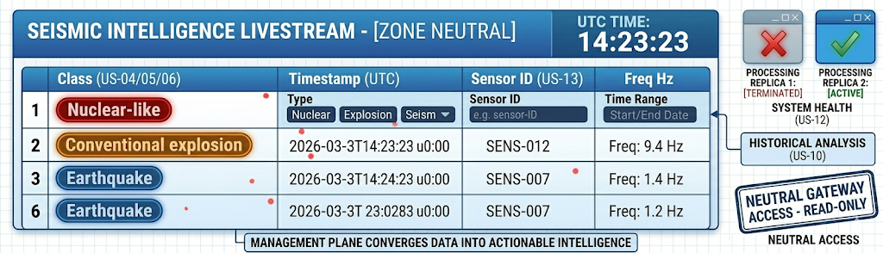
Management Plane | User Stories | Mockup
*
Pagina ‹#›

Slide 20
DEMO SETUP
Clone the repository
git clone https://github.com/Samuelecoccoletti/Project-42.git
cd Project-42/source
Load Simulator & Start the Stack
docker load -i seismic-signal-simulator.tar
docker compose up --build
Access the System
dashboard: http://localhost:3000/docs
Health Check: http://localhost:8090/health
*
Pagina ‹#›

Slide 21
Conclusion
What This System Demonstrates:
Practical distributed ingestion architecture
Replica-based parallel signal processing
Controlled fault simulation via SSE
Consistent persistence under concurrent processing
The system prioritizes continuity of intelligence even under partial system degradation.
*
Pagina ‹#›

