Slide 1
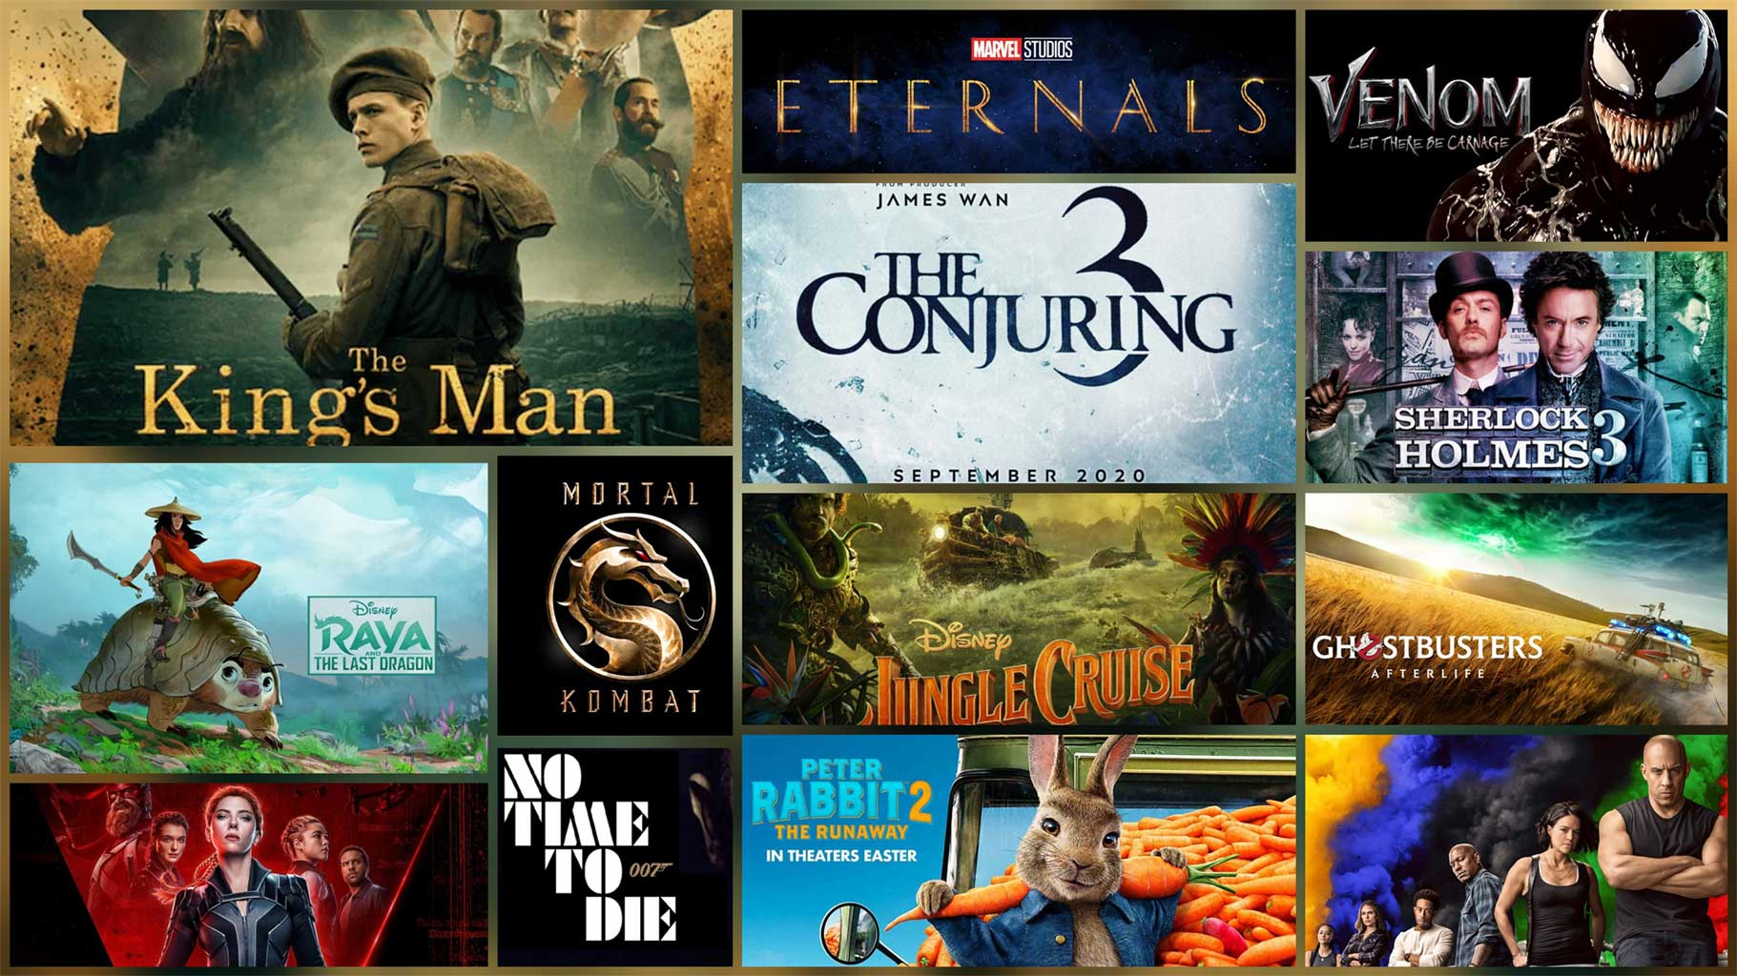
Movie mail webapp
By Samuel Bartolome

Slide 2
Problem Scenario
Features:
A customer can rent DVDs by mail.
A customer can have a watchlist of DVDs.
A customer can pay with Credit Card or Bank Account.
A customer can have different subscriptions.
The platform offers different kind of functionality
An employee manages bank account payments

Slide 3
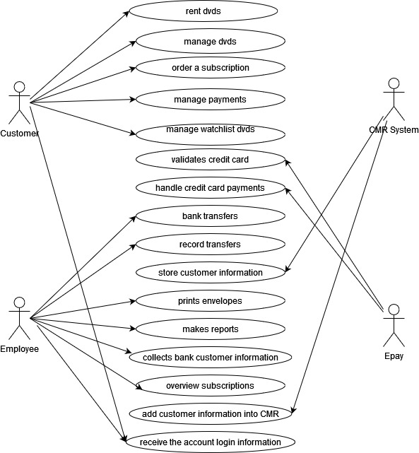
USE CASES

Slide 4
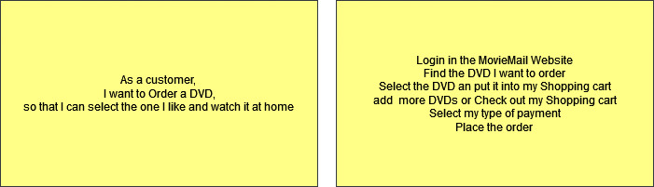
Acceptance Criteria

Slide 5
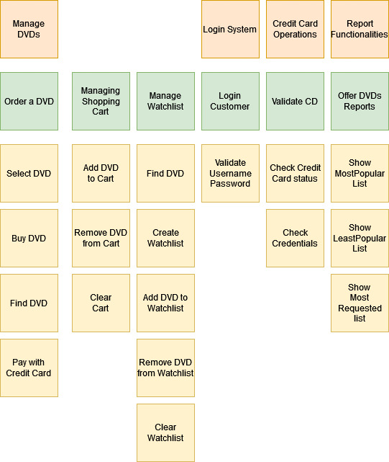
User Story Map

Slide 6
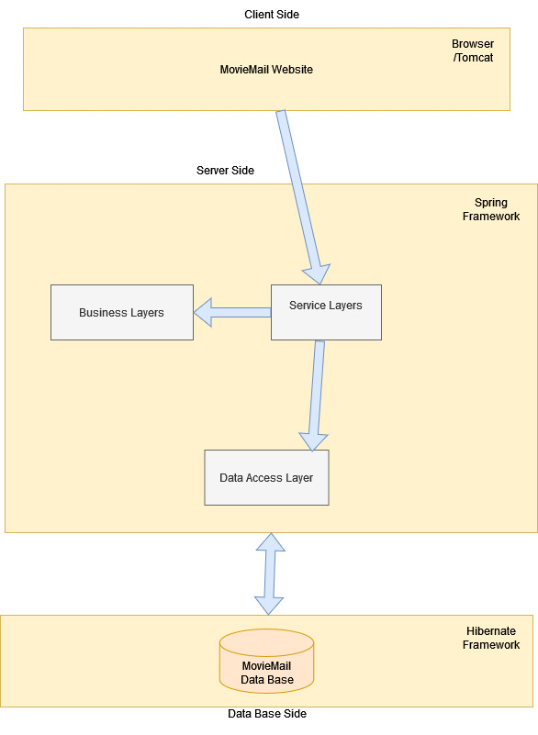
Architecture Diagram

Slide 7
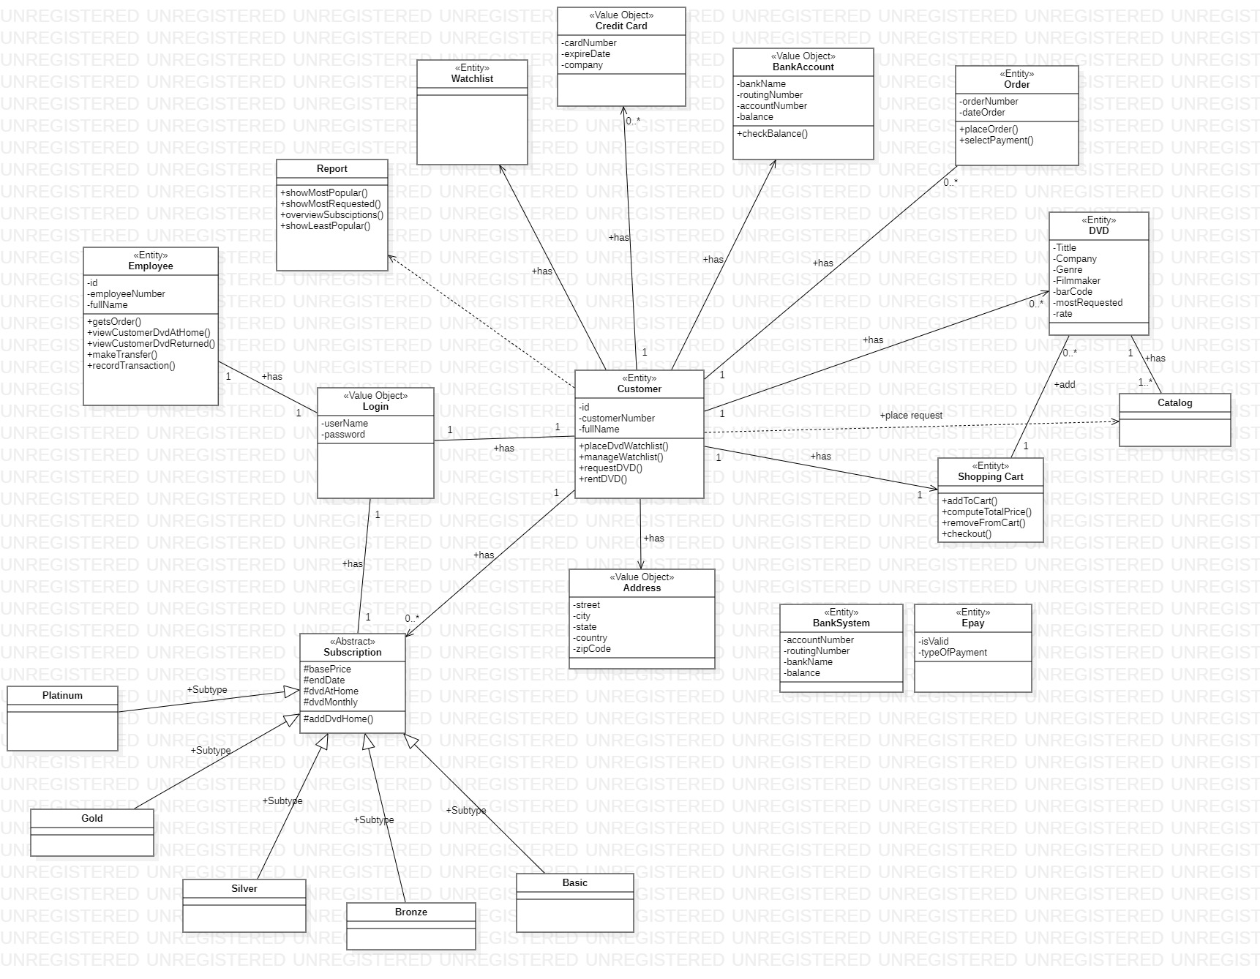
Class Diagram

Slide 8
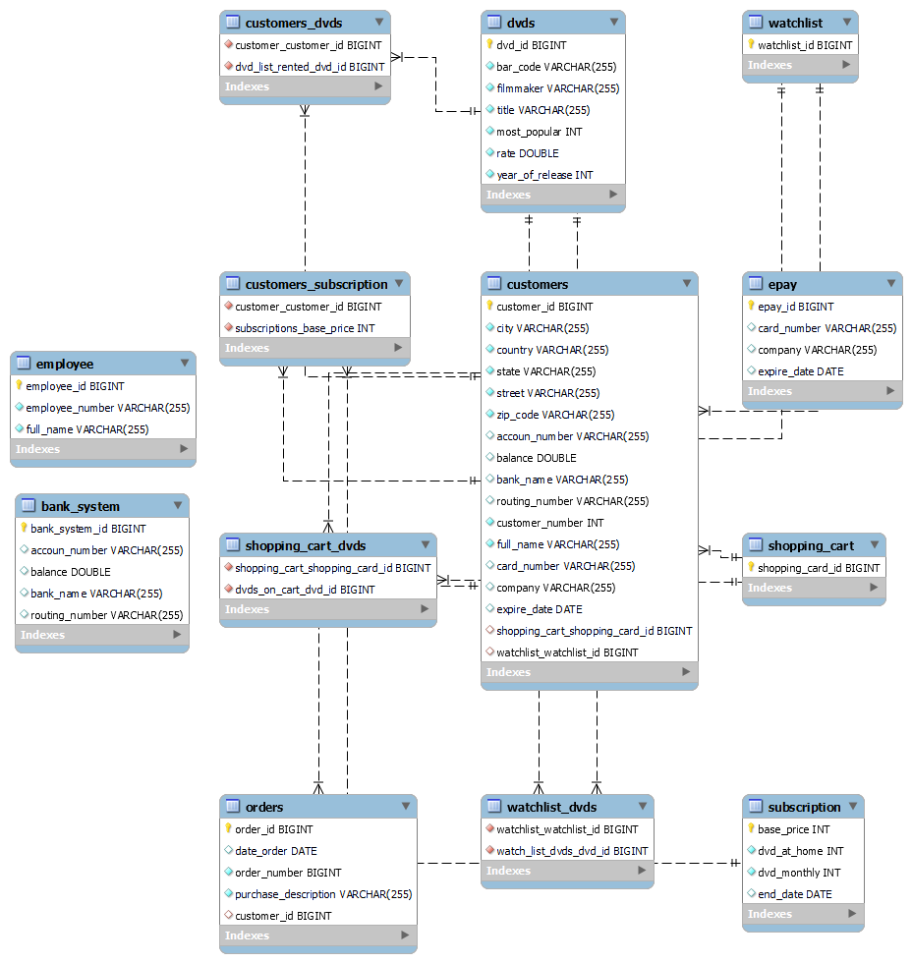
E-R Diagram Rest API Data Base

Slide 9
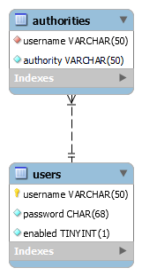
E-R Diagram Login Data Base

Slide 10
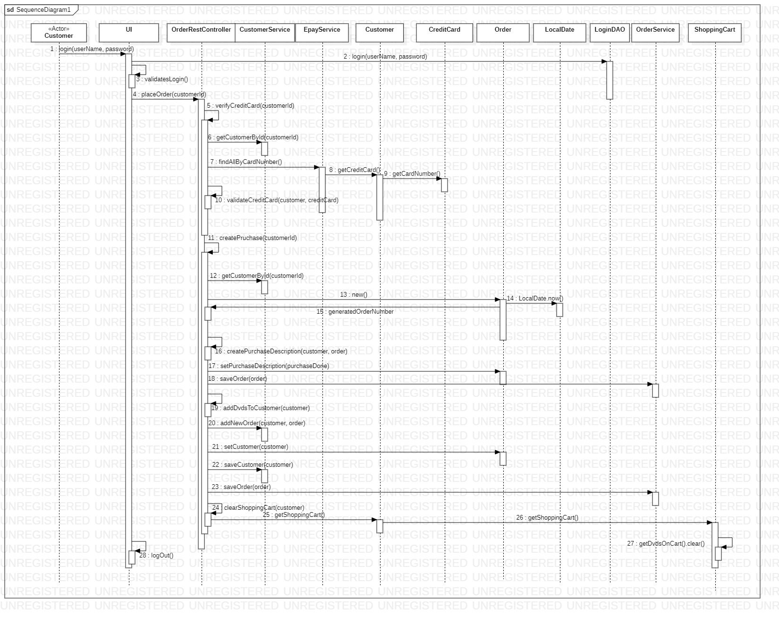
Place Order Sequence Diagram

Slide 11
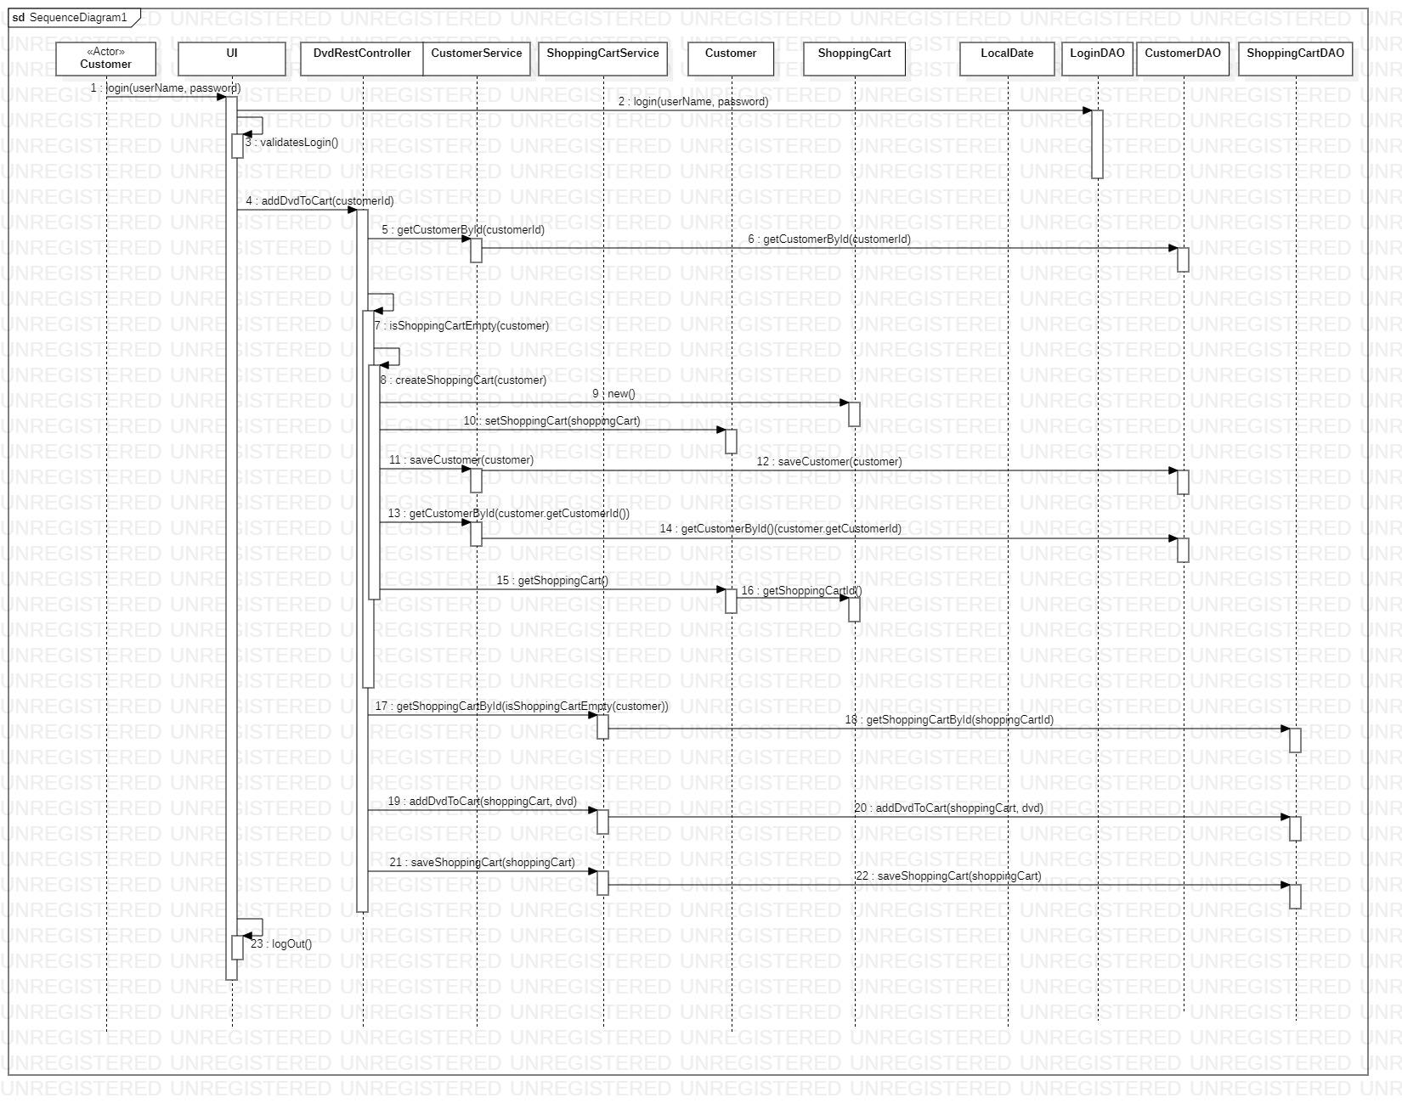
Shopping Cart Add DVD Sequence Diagram

Slide 12
Skills Implement:
Analysis best practices
Design best practices
Clean Code
Agile principles
Data Persistent
MVC Pattern, Front Controller Pattern, Liskov Principle, Inheritance, Encapsulation, Open-Closed etc.
RESTFull APIs
Spring Security

Slide 13
Thank you!
< Conclusión >

