Slide 1
THE UNIVERSITY OF ZAMBIA | SCHOOL OF NATURAL AND APPLIED SCIENCES | DEPARTMENT OF COMPUTING AND INFORMATICS
Automated Extraction and Analysis of Timing-Based Paradata Features for Survey Quality Assurance
Detecting fabricated, rushed and disengaged interviews from the audit logs SurveyCTO and ODK already produce
Samuel Kaoma
Computer number 2022016530 | CSC 4004
Supervisor: Mr. Mofya Phiri
Final Year Project Presentation | Academic Year 2026
Notes:
Good morning. My project takes the audit logs that SurveyCTO and ODK already write for every interview, and turns them into an automated check on survey data quality. Everything I report today is reproducible from the repository, and each figure names the file it comes from.

Slide 2
TEAM
Team roles and responsibilities
Member | Computer No. | Primary role / responsibilities
Samuel Kaoma | 2022016530 | Sole developer, responsible for every stage: literature review and requirements, system design, parsers, feature library and anomaly detector, synthetic data generator and evaluation, automated tests and continuous integration, report and documentation.
Supervisor: Mr. Mofya Phiri
1
40
44
32
developer: an individual project
timing features implemented
automated tests, all passing
weeks, against the project plan
AI tool use (GitHub Copilot, Claude, ChatGPT) is disclosed episode by episode in Appendix A of the report.
Final Year Project • Academic Year 2026
2
Notes:
This is an individual project, so every role on the template's table is mine, under Mr. Phiri's supervision. AI tools were used during development and writing, and each use is logged in Appendix A.

Slide 3
OVERVIEW
Presentation overview
1
Background and context
4 to 5
5
Discussion and limitations
16 to 17
CRISP-DM: business understanding
CRISP-DM: evaluation: what the results mean
2
System analysis and design
6 to 8
6
Conclusion
18
CRISP-DM: data understanding, data preparation, modelling
CRISP-DM: evaluation: was the aim met
3
Implementation and development
9 to 12
7
System demonstration
19 to 22
CRISP-DM: building the preparation and modelling stages
CRISP-DM: deployment
4
Testing, results and evaluation
13 to 15
Method: CRISP-DM, applied iteratively
CRISP-DM: evaluation
The phase tracker on each slide shows where we are.
Evaluation twice sent the work back: to rebuild the test data, and to fix a timestamp bug.
About 15 minutes. Risks are on slide 12, limitations on slide 17, references on slide 23. Slides 20 to 22 are shown only if the live demo fails.
Method: Chapman et al. (2000) CRISP-DM 1.0, p. 10; Wirth and Hipp (2000), section 5; report section 3.
Final Year Project • Academic Year 2026
3
Notes:
The talk follows the department template: background, design, implementation, testing and results, discussion, conclusion, and the system demonstration at the end. The method is CRISP-DM, applied iteratively, as section 3 of the report describes: its six phases run from understanding the problem to deployment, and the tracker at the top of each slide shows which phase we are in. It was iterative in practice: the first evaluation scored 1.00 everywhere, which sent me back to rebuild the test data with held-out seeds and overlapping profiles, and a clean-environment audit sent me back to data preparation to fix a pandas 3 timestamp bug.

Slide 4
Business understanding
Data understanding
Data preparation
Modelling
Evaluation
Deployment
BACKGROUND AND CONTEXT · THE PROBLEM
Rich timing data, almost entirely unused
Every interview on SurveyCTO or ODK writes a timestamped event log: when each question opened, how long it took, when the enumerator navigated back. This is paradata, and survey methodology has shown for decades that fabrication, speeding and disengagement leave clear signatures in it.
It goes unused because the two platforms log differently, and because converting millions of raw event rows into defensible indicators is beyond most survey teams. Current practice falls back on total interview duration and manual back-checking.
0.66
34
recall of a duration-only
check on my benchmark
of 100 anomalies it
misses entirely
Every one of those 34 has a total duration sitting inside the Tukey fences. Aggregate duration cannot see them.
WHO IT IS FOR Survey teams and field supervisors running SurveyCTO or ODK surveys, and researchers reusing the feature library. The enumerators whose work a flag concerns are stakeholders too, which is why every flag has to be explainable.
A third of bad interviews pass the check that field practice actually runs.
Source: output/examiner_audit/strict_examiner_audit_report.md, n500 SurveyCTO benchmark, 100 anomalies in 500 interviews.
Final Year Project • Academic Year 2026
4
Notes:
The starting point is that the data already exists. What is missing is tooling. And the check people do run, total duration, misses a third of the anomalies in my benchmark.

Slide 5
Business understanding
Data understanding
Data preparation
Modelling
Evaluation
Deployment
SCOPE
Aim and six objectives
Aim. Design and implement an automated pipeline that extracts, catalogues and analyses timing-based paradata features from SurveyCTO and ODK audit logs, to support scalable survey data quality assessment.
1
Catalogue timing-based quality indicators from the survey methodology literature
4
Compute statistical measures: variance, entropy, skewness, kurtosis
2
Build format-aware parsers producing a common intermediate representation
5
Detect anomalies with IQR fences plus rules, validated on precision and recall
3
Implement 30 to 50 timing features across question, section and survey levels
6
Deliver structured outputs, feature documentation and a paradata format guide
Five of the six are met in full. Objective 2 is met for the two synthetic formats and only in part for native exports.
Final Year Project • Academic Year 2026
5
Notes:
These are the six objectives as written in the proposal, unchanged. Five are met in full. The second, format-aware parsers, is met for the two synthetic layouts the evaluation ran on and only in part for the platforms' native exports: ODK's documented audit log is parsed and tested, SurveyCTO's native text audit is not yet. I say so rather than round it up.

Slide 6
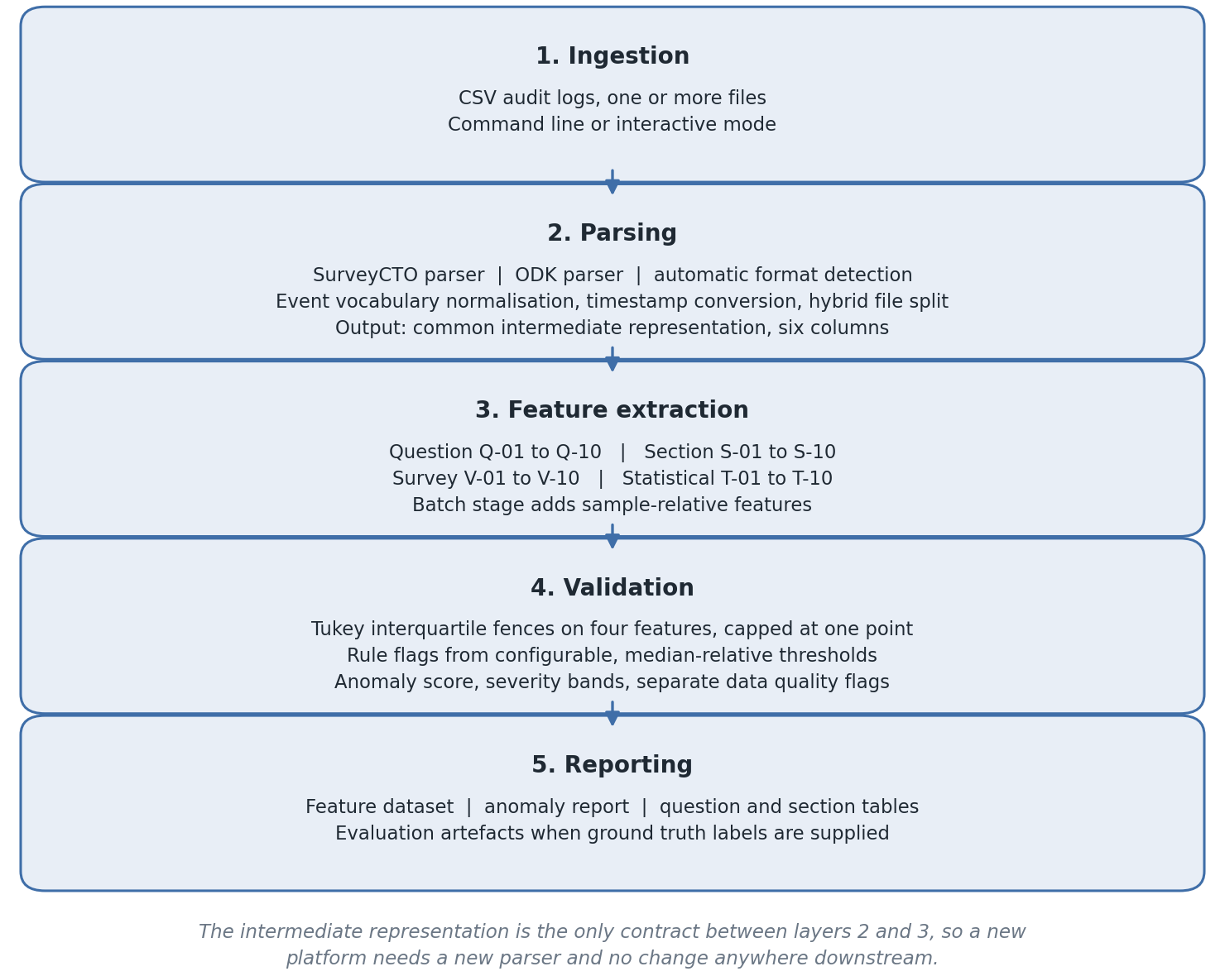
Business understanding
Data understanding
Data preparation
Modelling
Evaluation
Deployment
SYSTEM ARCHITECTURE AND COMPONENTS · CHAPTERS 3 AND 4
Five layers, one contract between them
The intermediate representation is the only contract between parsing and everything above it.
SurveyCTO exports epoch milliseconds against XPath node ids. ODK exports ISO 8601 strings against instance and name columns. Both reduce to the same six columns: interview id, field name, event type, start, end and duration in milliseconds.
Because nothing above layer 2 knows which platform produced a row, the same detector runs unmodified on both, and adding a platform is a parser and no more.
Modules.
src/parsers SurveyCTO and ODK parsers into the intermediate representation
src/features question, section, survey and statistical extractors
src/validation detector, configuration and evaluation reporting
src/pipeline the controller that runs the batch
run_pipeline.py the one command a user runs
Cross-format parity is a result, not an assumption: the same detector scores 1.0000 / 1.0000 on both formats at n500.
Final Year Project • Academic Year 2026
8
Notes:
This is Figure 1 in the report, and the right-hand column names the module behind each layer. The key claim is the contract at layer 2. I test that claim by running both formats through and comparing. Parsers mark rather than repair: missing field names, unparseable timestamps and negative durations are flagged into a separate data-quality path, so device faults never read as behavioural anomalies.

Slide 7
Business understanding
Data understanding
Data preparation
Modelling
Evaluation
Deployment
DATA UNDERSTANDING · SYNTHETIC DATA
What the four profiles look like
Canonical profiles, cleanly separated
Genuine interviews centre on about 8 s per question, scaled by question complexity, with about two back-navigations.
Fabrications are flat at 1.2 s ± 0.08 s whatever the question, with no back-navigation.
Speeders answer every question in 0.2 to 0.8 s.
Disengaged interviews are slow but just as flat, at 6.0 s ± 0.2 s, with six to ten back-navigations.
Canonical data checks that the pipeline works. The reported results come from stress data on held-out seeds 7 and 99, where the profiles overlap.
Chart: Q-01 per question for four generated interviews, one per profile, canonical n500 benchmark, output/robustness_validation/question_features_benchmark_n500_surveycto.csv.
Final Year Project • Academic Year 2026
7
Notes:
This is the data understanding phase. There is no labelled field data, so the data is synthetic, generated in four behaviour profiles, alongside the two platform log formats shown in the demonstration. The chart shows one generated interview per profile at canonical difficulty. The normal interview in teal climbs in the health questions, nine to twelve, because those items carry the highest complexity weights. The fabricated interview in amber is flat at about 1.2 seconds whatever the question, and the speeder is flat below one second. The disengaged interview is slow but just as flat. Flatness is what entropy and the coefficient of variation measure. The canonical profiles are cleanly separated on purpose. The reported numbers come from the stress difficulty, where some genuine interviews are fast with little navigation and some fabrications are only mildly compressed, so the profiles overlap.

Slide 8
Business understanding
Data understanding
Data preparation
Modelling
Evaluation
Deployment
ALGORITHMS AND MODELS · MODELLING APPROACH
Detection that a supervisor can argue with
Modelling approach: unsupervised, rule-based outlier detection over 40 timing features. No machine-learning model: there is no labelled field data to train on, and every flag must be explainable.
1
Statistical fences
2
Rule flags
3
Score = count of flags
Tukey fences on total duration, mean response time, entropy and variance. No distributional assumption, and resistant to the outliers they are meant to find. Capped at one point jointly, so correlated timing outliers cannot stack.
Implausible session length, low mean response time against the sample median, low entropy, uniform pacing by coefficient of variation, compressed spread, absent or excessive back-navigation, elevated pauses. Median-relative and configurable.
Suspicious at 2, anomalous at 5. Data-quality faults route to their own category. Every flagged interview lists exactly which named flags fired.
A flag leads to a conversation with a named enumerator, so it has to be explainable. That is why the score is a count, not a model output.
Final Year Project • Academic Year 2026
9
Notes:
This is the modelling phase. The modelling approach is unsupervised and rule-based, not machine learning, for two reasons: there is no labelled field data to train a model on, and a flag is an accusation about a person's work, so a supervisor must be able to see exactly which rules fired and check them. Statistical fences catch values far outside the batch, rule flags catch known patterns from the literature, and the score is simply how many flags fired.

Slide 9
IMPLEMENTATION
Development environment
OPERATING SYSTEM
PROGRAMMING LANGUAGE
LIBRARIES
Windows 11
Python 3.14
pandas, NumPy, SciPy
Used for development. Continuous integration runs on Ubuntu Linux.
CI also tests Python 3.12 with pandas 2, to catch version breaks.
statsmodels and scikit-learn for statistics; matplotlib and seaborn for figures.
DATABASE
IDE AND TOOLS
VERSION CONTROL
None: CSV in, CSV out
VS Code, Jupyter
Git, GitHub, Actions
Audit logs are read from CSV exports and every output is a CSV file.
pytest for the 44 automated tests; notebooks for analysis.
CI runs the tests and the pipeline on every push to main.
One command rebuilds the environment: pip install -r requirements-validated.txt (148 pinned packages).
Final Year Project • Academic Year 2026
10
Notes:
Everything is Python. Pinned versions: pandas 3.0.1, NumPy 2.4, SciPy 1.17, statsmodels 0.14, scikit-learn 1.8, pytest 9. The CI matrix exists because a pandas 3 change silently broke timestamp conversion during development.

Slide 10
Business understanding
Data understanding
Data preparation
Modelling
Evaluation
Deployment
IMPLEMENTATION · CHAPTER 4
Key implementation details
1
Automatic format detection. The controller recognises each file from its columns and timestamp shape, so the user never declares the platform, and it splits files that mix both platforms.
2
Batch-level features. Measures such as duration relative to the sample median are computed only once every interview in the batch has been extracted.
3
Configuration, not code. Every threshold lives in a configuration object validated at load time, overridable from a file or the command line, and each configuration records where its values came from.
4
Evaluation that cannot leak. Predictions join to ground-truth labels one to one and fail loudly on duplicate or missing IDs. The detector never sees the labels.
5
Defensive parsing. Unparseable timestamps, missing field names and negative durations are flagged rather than dropped, and epoch seconds are detected and rescaled.
All five defects found during development now have a regression test in the suite.
Final Year Project • Academic Year 2026
11
Notes:
The point of these five choices is that the system fails loudly rather than silently: wrong formats, bad rows and label leaks all surface instead of quietly changing the numbers.

Slide 11
IMPLEMENTATION
Challenges and solutions
1
Perfect scores that meant the test was too easy
2
A library upgrade that silently broke timestamps
Early runs scored 1.00 everywhere: anomalies were too cleanly separated and parts of the detector mirrored the generator.
Solution: held-out seeds, overlapping stress profiles and a prevalence sweep.
Under pandas 3, ISO 8601 times converted to values a thousand times too small, with no error raised.
Solution: found in a clean-environment audit and fixed; CI now tests pandas 2 and 3.
3
Mild fabrication slipping through
4
References that could not be found
Only 93 of 132 mildly fabricated interviews were flagged under stress.
Solution: a diagnostic traced it to entropy calibration. The fix catches 132 of 132 but costs precision, so it ships switched off.
Two sources in the first submission could not be located.
Solution: withdrawn, every reference checked against its source, each check recorded in Appendix E.
Each challenge is recorded in the report, so every fix can be checked.
Final Year Project • Academic Year 2026
12
Notes:
The first and third are the ones I learned most from. A perfect score is a warning that the test is too easy, and the entropy fix is an improvement I deliberately did not make the default because its extra false flags land on genuine enumerators.

Slide 12
IMPLEMENTATION · PROPOSAL SECTION 7
Risks and mitigations
Risk | Likelihood | Mitigation | What happened
Missing or incomplete audit log data | Medium | Validate input; handle incomplete records gracefully | Parsers mark missing names, bad timestamps and negative durations instead of dropping rows (TC-01).
Format changes in SurveyCTO or ODK logs | Low | Configurable field mapping; documented format guide | Automatic format detection and event mapping; native ODK logs detected. SurveyCTO's native text audit is still unsupported.
Slow processing on large datasets | Medium | Vectorised pandas; benchmark at increasing sizes | 10,000 interviews in 1,069 s: roughly constant cost per interview, about 0.11 s.
Incorrect or unstable detection | Medium | Validate on labelled synthetic data; report precision and recall | Occurred: early perfect scores were too easy. Rebuilt evaluation gives precision 0.96 to 1.00, recall 0.84 to 1.00.
Features that do not discriminate | Low | Mann-Whitney tests; document weak features | 30 of 40 features are significant; the other 10 are documented, not hidden.
Library version change | Not foreseen | Pinned environment; CI on pandas 2 and 3 | pandas 3 silently broke ISO timestamp conversion; found in a clean-environment audit and fixed.
Sources that cannot be verified | Not foreseen | Check every reference against its source | Two references withdrawn; every check recorded in Appendix E.
Risks 1 to 5 and their likelihoods are from the proposal's risk analysis (section 7). Risks 6 and 7 were not foreseen and were mitigated after they occurred.
Final Year Project • Academic Year 2026
13
Notes:
The first five rows are the risk table from my proposal, with what actually happened. The fourth is the one that materialised and mattered most. The last two I did not foresee; I include them because how they were handled is part of the risk management.

Slide 13
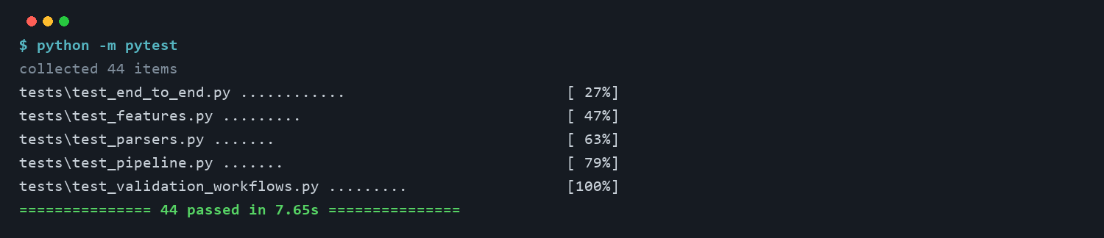
Business understanding
Data understanding
Data preparation
Modelling
Evaluation
Deployment
TESTING · APPENDIX D.2
Test results: 44 of 44 pass
TC | Test suite | What it checks | Tests | Result
TC-01 | Parsers | Both formats parse; ISO times convert to epoch ms; native ODK logs detected; one history parses identically from both formats | 7 | PASS
TC-02 | Feature extraction | Question, section, survey and statistical features; administrative events kept out of section statistics | 9 | PASS
TC-03 | Pipeline controller | Per-interview aggregation, automatic format detection, question and section output files written | 7 | PASS
TC-04 | Detector and configuration | Score contract, upstream data-quality flag preserved, configurable thresholds, entropy fence off by default | 9 | PASS
TC-05 | End to end | Full run on the labelled sample: precision and recall meet thresholds, fabricated interviews score at least 5 | 12 | PASS
44 / 44
pass in about 8 seconds. CI repeats them on Python 3.12 with pandas 2 and Python 3.14 with pandas 3.
Screenshot: python -m pytest, run on 12 October 2026 (Python 3.14.0, pytest 9.0.2). Suites: tests/test_*.py.
Final Year Project • Academic Year 2026
14
Notes:
Each test case on the template corresponds to one test file. The full list of 44 tests is in the repository; five of them are regression tests for the five defects found during development.

Slide 14
Business understanding
Data understanding
Data preparation
Modelling
Evaluation
Deployment
RESULTS 6.3
Against the methods field practice actually uses
Method | Precision | Recall | F1
Full detector | 1.0000 | 1.0000 | 1.0000
Duration-only IQR baseline | 0.9565 | 0.6600 | 0.7811
V-10 rule, 20+ events without going back | 0.4648 | 0.6600 | 0.5455
+34
percentage points of recall over the
check field teams actually run (0.66 to 1.00)
The duration-only baseline misses 34 of the 100 anomalies, every one with a total duration inside the fences.
The V-10 rule flags 142 interviews to find the same 66, giving 76 false positives. Neither meets the 0.75 recall threshold.
Under stress on held-out seeds: the duration check finds 0 of 400 anomalies, the full detector 346 (Table 6a).
All three methods are computed from the same raw files, the same features and the same labels inside one script, so the comparison involves no manual step.
This is the central result: multi-feature timing analysis captures about a third of anomalies that aggregate duration cannot see.
Sources: output/examiner_audit/strict_examiner_audit_report.md, n500 SurveyCTO benchmark; output/robustness_validation/baseline_breakdown.csv, held-out stress runs.
Final Year Project • Academic Year 2026
15
Notes:
This is the project's central claim, and it is measured rather than asserted, because all three methods run inside the same audited script. The gain is 34 percentage points of recall, from 0.66 to 1.00. Under the harder stress condition the gap widens rather than narrows: the duration check finds none of the 400 anomalies across the four held-out runs, while the full detector finds 346.

Slide 15
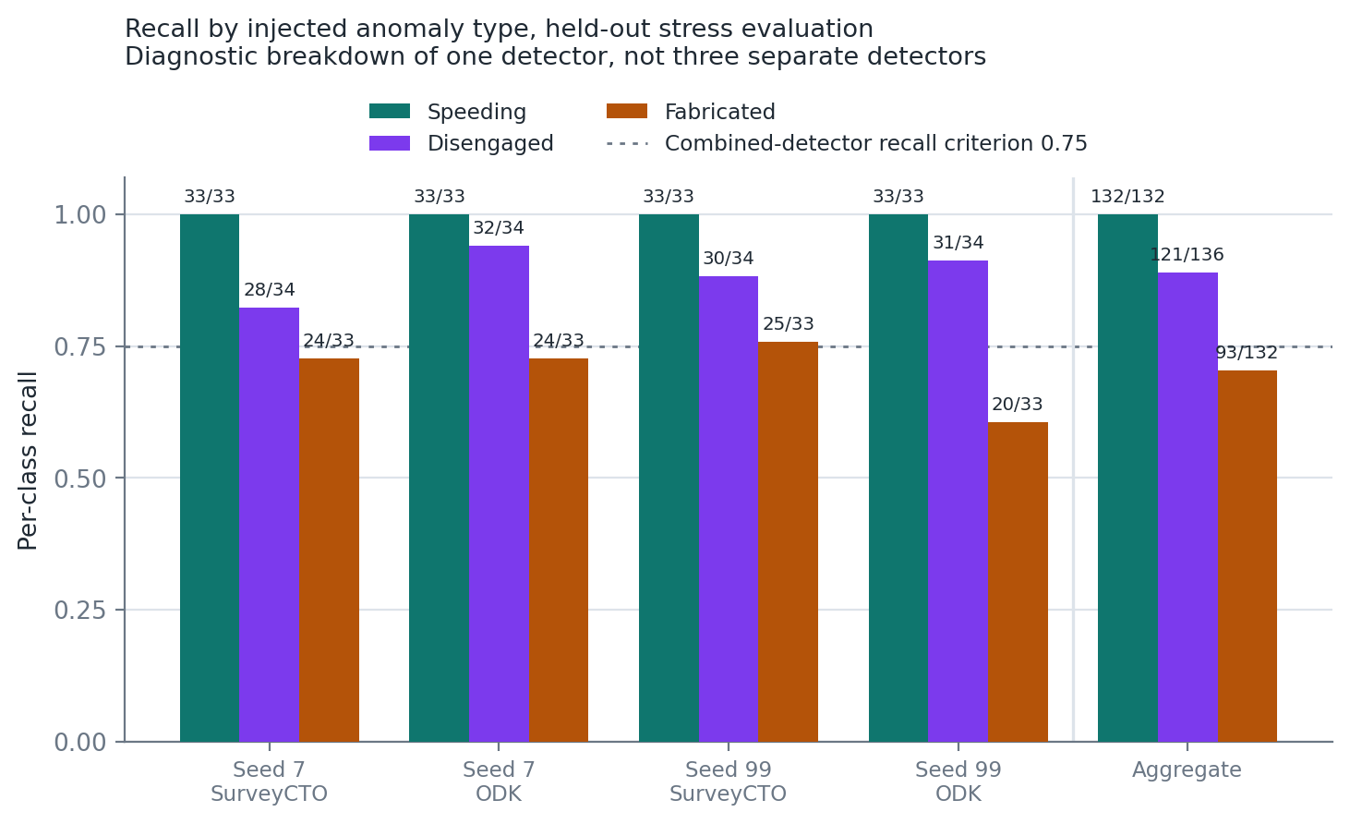
Business understanding
Data understanding
Data preparation
Modelling
Evaluation
Deployment
RESULTS 6.6
Where the method is strong and where it is weak
Speeding 132 / 132
Detected without exception in all four runs.
Disengaged 121 / 136
0.89, driven by the median-relative pause rule with elevated back-navigation.
Fabricated 93 / 132
0.70, per-run between 0.61 and 0.76. The weakest class: the misses are mild fabrications.
These are diagnostic breakdowns of one detector, not three detectors. The 0.75 criterion is defined for the combined detector and is not a per-class commitment.
Final Year Project • Academic Year 2026
16
Notes:
I report the weakest class prominently rather than burying it, because locating where a method fails is more useful than an aggregate that hides it.

Slide 16
Business understanding
Data understanding
Data preparation
Modelling
Evaluation
Deployment
DISCUSSION · CHAPTER 7
Discussion of findings
1
What do the results mean?
2
Does it solve the original problem?
Timing data alone separates speeding, disengagement and blatant fabrication. Mild fabrication is the weak point, at 0.70 recall under stress, and the diagnostic places that in threshold calibration.
For the formats tested, yes. Recall rises from 0.66 with a duration-only check to between 0.84 and 1.00, with precision at 0.96 or above, from raw exports in one command.
3
How does it meet the objectives?
4
How does it compare with existing work?
Five of six objectives are met in full. Objective 2, the parsers, is met for the two synthetic formats and only in part for the platforms' native exports.
Birnbaum et al. (2013) reach up to 96 percent accuracy with models trained on human-labelled data. The rates are not comparable, but both judge timing against a relative baseline, and this design needs no labels.
Most important finding: multi-feature timing analysis catches what a duration check misses, without labelled training data.
Final Year Project • Academic Year 2026
17
Notes:
The comparison with Birnbaum et al. is about which signals carry the result, not about detection rates: their labels come from people fabricating under controlled conditions, mine from a generator. The next slide sets out what these results do not establish.

Slide 17
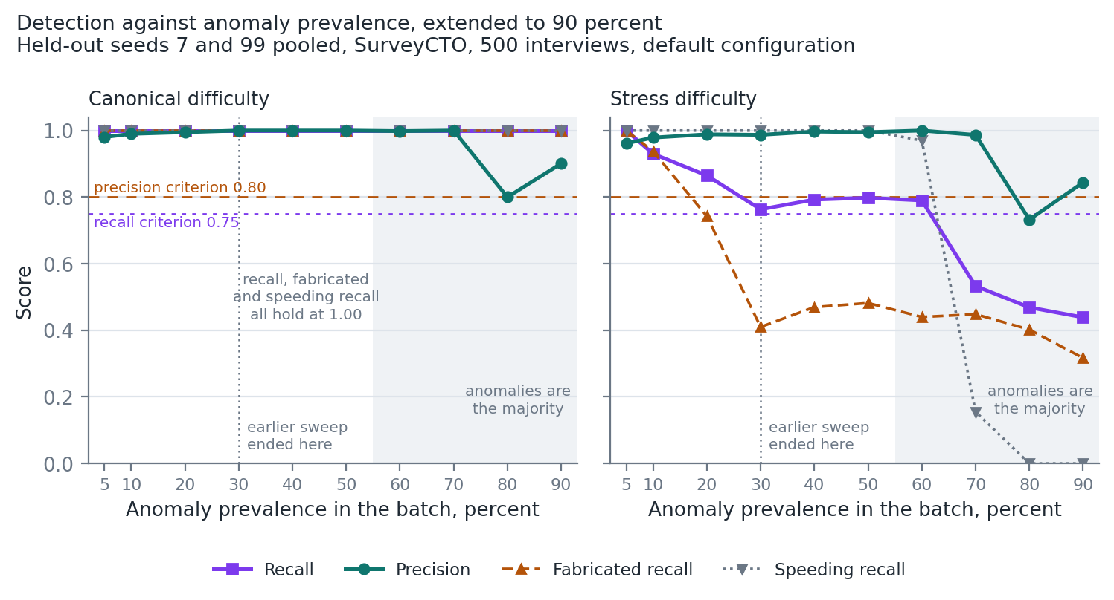
Business understanding
Data understanding
Data preparation
Modelling
Evaluation
Deployment
LIMITATIONS · CHAPTER 8
What this does not establish
Evaluation is synthetic throughout
Results are an upper bound on field performance, against a documented threat model.
Detection is univariate
Anomalies visible only in joint feature patterns evade both fences and rules.
Anomalies must be a minority of the batch
Both criteria hold up to 50 percent prevalence; at 90 percent, stress recall falls to 0.44 (left).
Thresholds and external dependencies
Other instruments should recalibrate; device clocks and audit schemas must hold.
The method assumes anomalies are a minority of the batch: pool batches across enumerators, never one caseload alone.
Source: scripts/run_prevalence_envelope.py; output/prevalence_envelope/envelope_summary.csv. Held-out seeds 7 and 99 pooled, 500 interviews.
Final Year Project • Academic Year 2026
19
Notes:
These are the limits of what the results establish. The evaluation is synthetic throughout, so the results are an upper bound on field performance; eight of the forty features never vary in the corpus, so the evaluation is silent on them. Detection is univariate. The limitation that matters most for deployment is the prevalence envelope on the left: my supervisor ran the same interviews at rising prevalence and found recall falling, and I reproduced it with a committed script, eighty runs from five to ninety percent. Both criteria hold up to fifty percent in every condition. Past half, the batch median is an anomalous interview, so the thresholds are estimated from a batch that is mostly anomalous. One enumerator's fabricated caseload, analysed alone, is largely undetectable, so the detector must run on batches pooled across enumerators. Validation against real field paradata remains the most important extension.

Slide 18
paradata.samuelkaoma.dev · github.com/Samuelkaoma-eng/SKACE-TIME-DATA
Timing paradata is usable, and it beats what field practice runs today.
Precision 0.96 to 1.00 and recall 0.84 to 1.00 on data the detector had never seen, inside a measured envelope: anomalies must be a minority of the batch. Five of six objectives met in full.
+34
40
≤ 50%
0.70
points of recall over duration-only checking
documented, tested features
anomaly prevalence the method holds to
fabricated recall: the honest weak point
Final Year Project • Academic Year 2026
20
Notes:
If there is one thing to take from this, it is that I would rather report where the method is weak than show you only the aggregate that hides it: fabricated recall of 0.70 under stress, and a detector that needs anomalies to be a minority of the batch. I will finish by showing the system itself.

Slide 19
Business understanding
Data understanding
Data preparation
Modelling
Evaluation
Deployment
SYSTEM DEMONSTRATION · HOW TO RUN IT
Where and how to run the system
1
Open a terminal in the project folder (VS Code terminal or PowerShell)
Live demo, with fallbacks
cd "SKACE-Time-Data"
1. Run step 3 live. Fallback: slide 20
2. Show raw files and the report. Fallback: slide 21
3. Explain why ODK401 was flagged. Slide 22
4. Run the tests, step 4. Fallback: slide 13
2
Install the pinned environment, once
pip install -r requirements-validated.txt
3
Run the pipeline on the two sample exports, with the labels for evaluation
python run_pipeline.py --inputs data/odk.csv data/surveycto.csv `
--parser auto --output-dir output --label demo `
--ground-truth data/ground_truth_labels.csv
7.5 s
~30 min
4
Run the automated tests
for the sample run, so it can be run live
for the full synthetic evaluation, shown as results
python -m pytest
Every run, its output files and the executed audit notebook are also live at paradata.samuelkaoma.dev, rebuilt from the repository on every push.
Final Year Project • Academic Year 2026
21
Notes:
This is where the system runs: a terminal opened in the project folder before the slot, with the environment already installed, so step 2 is not run live. Step 3 is the single command behind every demo screenshot; on the 24 sample interviews it finishes in about seven and a half seconds and prints precision and recall at the end. Outputs land in output, named by the label. Step 4 runs the 44 tests in about ten seconds. The full synthetic evaluation takes about thirty minutes, so its results are shown as figures, and they are also published at paradata.samuelkaoma.dev with the executed notebook. Run steps 3 and 4 live. If the live run fails, slides 20 to 22 are screenshots of exactly the same steps.

Slide 20
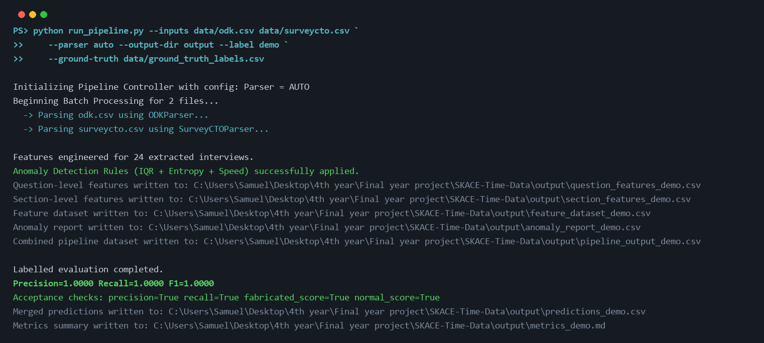
Business understanding
Data understanding
Data preparation
Modelling
Evaluation
Deployment
SYSTEM DEMONSTRATION · FALLBACK: STEP 3
The run, captured
Captured on 15 October 2026 from the command in step 3. A live run prints the same lines; paths are absolute because the pipeline prints them so.
Final Year Project • Academic Year 2026
22
Notes:
Fallback for the live run. This is the exact output of the command in step 3: both files are detected automatically, 24 interviews are scored, five files are written, and because the labels were supplied it finishes with precision and recall of 1.00 on the sample and passes all four acceptance checks.

Slide 21
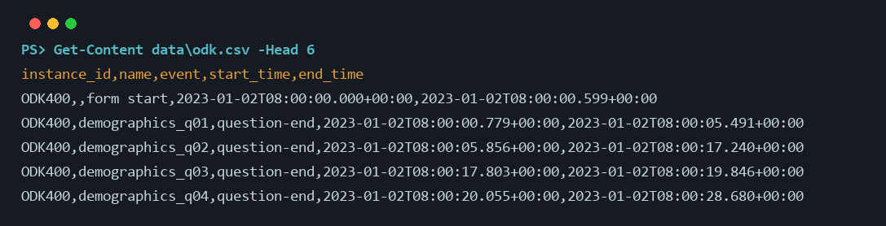
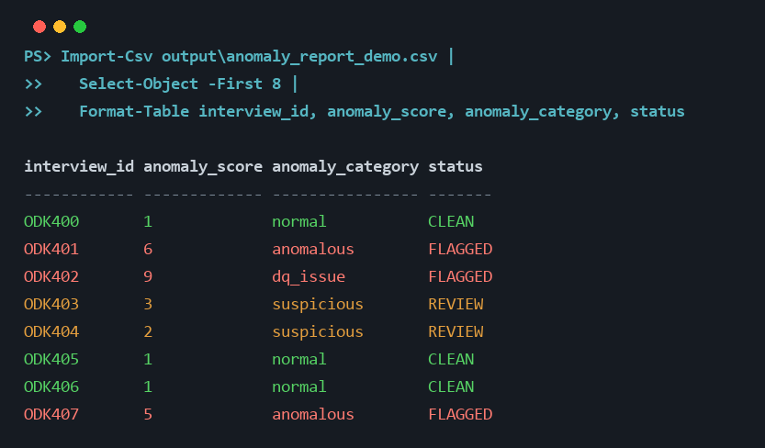
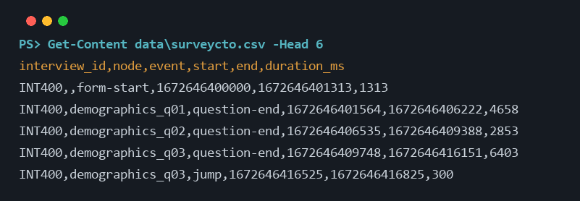
Business understanding
Data understanding
Data preparation
Modelling
Evaluation
Deployment
SYSTEM DEMONSTRATION · INPUT AND OUTPUT
From raw audit log to scored interview
ODK: ISO 8601 times, instance and name columns.
SurveyCTO: epoch milliseconds, node and duration columns.
Score 0 to 1: CLEAN. 2 to 4: REVIEW. 5 or more: FLAGGED. dq_issue marks a data-quality problem rather than behaviour.
451 raw event rows become 24 scored interviews: 6 clean, 8 for review and 10 flagged, of which 6 are data-quality faults rather than behaviour.
Fallback screenshots, captured in PowerShell from the project folder after the run command (step 3).
Final Year Project • Academic Year 2026
23
Notes:
On the left is the raw data exactly as the platforms export it, the first rows of each file. The two formats differ: ODK uses ISO timestamps, SurveyCTO uses epoch milliseconds. On the right is the result after one command: every interview has a score, a category and a status. Of the ten flagged, six are data-quality faults, the degenerate records the sample includes on purpose, and four are behavioural anomalies. ODK401 scores six and is flagged; the next slide shows why.

Slide 22
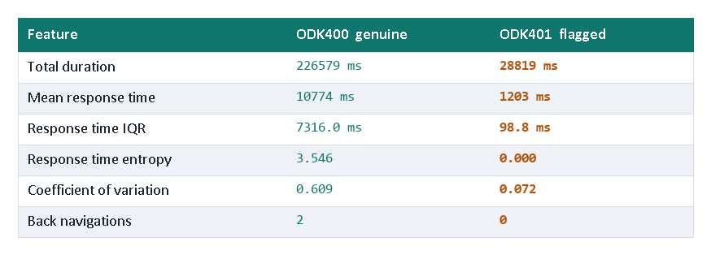
Business understanding
Data understanding
Data preparation
Modelling
Evaluation
Deployment
SYSTEM DEMONSTRATION · EXPLAINING A FLAG
Why was this interview flagged?
ODK401 scored 6 and was categorised anomalous.
Six flags fired: low mean response time, zero back navigation, low entropy, uniform timing, compressed response time IQR, and low within-section variance.
Entropy of exactly 0.000 means every response time fell in a single one-second bin. A human answering twenty questions of varying difficulty does not produce that.
Ground truth confirms it: fabricated.
This is the sentence a field supervisor can take to an enumerator. An opaque model score is not.
output/feature_dataset_demo.csv and output/anomaly_report_demo.csv, same run.
Final Year Project • Academic Year 2026
24
Notes:
If you remember one slide from the demonstration, this is it. Explainability was a design constraint, not a nice-to-have, and this is what it buys.

Slide 23
REFERENCES
Key references
Birnbaum, B., Borriello, G., Flaxman, A.D., DeRenzi, B. and Karlin, A.R. (2013) 'Using behavioral data to identify interviewer fabrication in surveys', CHI '13, pp. 2911-2920.
Bushery, J.M., Reichert, J.W., Albright, K.A. and Rossiter, J.C. (1999) 'Using date and time stamps to detect interviewer falsification', Proceedings of the Survey Research Methods Section, ASA, pp. 316-320.
Chandola, V., Banerjee, A. and Kumar, V. (2009) 'Anomaly detection: a survey', ACM Computing Surveys, 41(3), pp. 1-58.
Chapman, P., Clinton, J., Kerber, R., Khabaza, T., Reinartz, T., Shearer, C. and Wirth, R. (2000) CRISP-DM 1.0: Step-by-step data mining guide. SPSS.
Finn, A. and Ranchhod, V. (2017) 'Genuine fakes: the prevalence and implications of data fabrication in a large South African survey', The World Bank Economic Review, 31(1), pp. 129-157.
Goel, D., Abraham, R. and Lahoti, R. (2022) Improving Survey Quality Using Paradata. IZA Discussion Paper No. 15041.
Hoogeveen, J. and Pape, U. (eds.) (2020) Data Collection in Fragile States: Innovations from Africa and Beyond. Cham: Palgrave Macmillan.
Hubert, M. and Vandervieren, E. (2008) 'An adjusted boxplot for skewed distributions', Computational Statistics & Data Analysis, 52, pp. 5186-5201.
Kreuter, F. (ed.) (2013) Improving Surveys with Paradata. Hoboken, NJ: Wiley.
Schwanhäuser, S., Sakshaug, J.W. and Kosyakova, Y. (2022) 'How to catch a falsifier', Public Opinion Quarterly, 86(1), pp. 51-81.
Wirth, R. and Hipp, J. (2000) 'CRISP-DM: towards a standard process model for data mining', Proceedings of the 4th International Conference on the Practical Applications of Knowledge Discovery and Data Mining, Manchester, pp. 29-39.
Yan, T. and Tourangeau, R. (2008) 'Fast times and easy questions', Applied Cognitive Psychology, 22(1), pp. 51-68.
All 30 references in the report are confirmed to exist in Appendix E; nine are verified only at abstract or record level.
Final Year Project • Academic Year 2026
25
Notes:
The two references withdrawn after verification, Wenz et al. (2019) and Conrad et al. (2013), no longer appear anywhere.

Slide 24
paradata.samuelkaoma.dev · github.com/Samuelkaoma-eng/SKACE-TIME-DATA
Thank you. Questions?
Every result is live at paradata.samuelkaoma.dev; the code, data, tests and report are in the repository.
Final Year Project • Academic Year 2026
26
Notes:
Thank you. I am happy to take questions.

