Slide 1
THE UNIVERSITY OF ZAMBIA | SCHOOL OF NATURAL AND APPLIED SCIENCES | DEPARTMENT OF COMPUTING AND INFORMATICS
Automated Extraction and Analysis of Timing-Based Paradata Features for Survey Quality Assurance
Study guide: the whole system, slide by slide. The speaker notes teach each slide.
Samuel Kaoma
Computer number 2022016530 | CSC 4004
Supervisor: Mr. Mofya Phiri
September 2026
Notes:
Good morning. My project takes the audit logs that SurveyCTO and ODK already write for every interview, and turns them into an automated check on survey data quality. Everything I report today is reproducible from the repository, and each figure names the file it comes from.

Slide 2
STUDY GUIDE
How to use this deck
The problem
The system
1
What paradata is, the three behaviours the system looks for, and the literature behind the design.
2
The repository, how to run it, the forty features and the detector, in outline.
The data, step by step
A live run
3
One interview from generator to raw file to parsed rows to features, flags, score and outputs.
4
The demonstration slides from the talk, run on the sample data in the repository.
The evaluation
Trust and limits
5
Every statistic explained before it is used: metrics, effect sizes, fences, masking, the envelope.
6
Tests, reproduction, ethics, limitations, and the references.
Glossary and viva
Read the speaker notes on every slide: they carry the explanation. Slides give the facts; notes teach them.
7
Every term in one place, then sixteen likely questions with full answers in the notes.
Samuel Kaoma | 2022016530 | CSC 4004
2
Notes:
This deck is for learning the system, not presenting it. Work through it in order the first time. Each slide states facts taken from the repository or the report; the notes explain what they mean and why the design is the way it is. The separate presentation deck is the one to use in the room.

Slide 3
PART 1 · THE PROBLEM
What an audit log records, and what it can reveal
Paradata
Fabrication
Data about how an interview was carried out, not what was answered: when each question opened and closed, how long the interviewer paused, when they went back. SurveyCTO calls its log a text audit; ODK calls it a form audit log.
The interviewer invents answers without a real interview, often called curbstoning. Timing is short and uniform: the same pace for easy and hard questions, little going back.
Speeding
Answers given faster than the question could be read. Zhang and Conrad set the limit at 300 ms per word; the whole interview is implausibly short.
Disengagement
A slow, flat, distracted interview: uniform pacing, long pauses, going back and forth. A weaker signature, so it is expected to be suspicious rather than anomalous.
All three change the rhythm of an interview. The whole system measures rhythm.
Sources: Couper (1998, p. 44); Bushery et al. (1999, p. 317); Zhang and Conrad (2014); report sections 1 and 2.
Samuel Kaoma | 2022016530 | CSC 4004
3
Notes:
Start here. The platforms already record a timestamp for every event in an interview. Nobody usually looks at it beyond total duration. The three behaviours the project targets each leave a different timing pattern: fabricators are fast and uniform, speeders are implausibly fast, disengaged interviewers are slow, flat and erratic. The key idea to hold on to is that a real respondent's pace varies with the question, and the anomalies do not.

Slide 4
THE PROBLEM
Rich timing data, almost entirely unused
Every interview on SurveyCTO or ODK writes a timestamped event log: when each question opened, how long it took, when the enumerator navigated back. This is paradata, and survey methodology has shown for decades that fabrication, speeding and disengagement leave clear signatures in it.
It goes unused because the two platforms log differently, and because converting millions of raw event rows into defensible indicators is beyond most survey teams. Current practice falls back on total interview duration and manual back-checking.
0.66
34
recall of a duration-only
check on my benchmark
of 100 anomalies it
misses entirely
Every one of those 34 has a total duration sitting inside the Tukey fences. Aggregate duration cannot see them.
A third of bad interviews pass the check that field practice actually runs.
Source: output/examiner_audit/strict_examiner_audit_report.md, n500 SurveyCTO benchmark, 100 anomalies in 500 interviews.
Samuel Kaoma | 2022016530 | CSC 4004
4
Notes:
The starting point is that the data already exists. What is missing is tooling. And the check people do run, total duration, misses a third of the anomalies in my benchmark.
STUDY NOTE: The core claim of the project in one number. A duration-only check, which is what field teams mostly run, recovers 66 of the 100 anomalies on the n500 benchmark. The 34 it misses are the disengaged interviews, whose total duration is normal. Under stress it recovers none of 400. Learn this slide cold.

Slide 5
SCOPE
Aim and six objectives
Aim. Design and implement an automated pipeline that extracts, catalogues and analyses timing-based paradata features from SurveyCTO and ODK audit logs, to support scalable survey data quality assessment.
1
Catalogue timing-based quality indicators from the survey methodology literature
4
Compute statistical measures: variance, entropy, skewness, kurtosis
2
Build format-aware parsers producing a common intermediate representation
5
Detect anomalies with IQR fences plus rules, validated on precision and recall
3
Implement 30 to 50 timing features across question, section and survey levels
6
Deliver structured outputs, feature documentation and a paradata format guide
Five of the six are met in full. Objective 2 is met for the two synthetic formats and only in part for native exports.
Samuel Kaoma | 2022016530 | CSC 4004
5
Notes:
These are the six objectives as written in the proposal, unchanged. Five are met in full. The second, format-aware parsers, is met for the two synthetic layouts the evaluation ran on and only in part for the platforms' native exports: ODK's documented audit log is parsed and tested, SurveyCTO's native text audit is not yet. I say so rather than round it up.
STUDY NOTE: Know the six objectives by number, because the conclusion scores them. Objective 2, format-aware parsers, is met only in part: the evaluation used synthetic layouts, ODK's documented native log is parsed and tested, SurveyCTO's native text audit is not.

Slide 6
CHAPTER 2
The literature sets the design, not intuition
Source | Finding | What it decided in this system
Groves et al. (2009) | Total Survey Error: quality is the product of error at every stage | Paradata as an interview-stage error signal
Birnbaum et al. (2013) | Behavioural logs from ODK Collect identify fabrication with up to 96% accuracy | Question- and interview-level timing features
Yan & Tourangeau (2008) | Response times depend on question length, answer options and the respondent, and are positively skewed | Complexity-relative pace; rank-based statistics
Schwanhäuser et al. (2022) | Falsifiers score inconsistently on any single indicator, so combine many | A score that counts flags across feature families
Iglewicz & Hoaglin (1993) | Mean and standard deviation are distorted by the outliers they are meant to find | Tukey fences over z-score thresholding
Bushery et al. (1999) | Date and time stamps alone can identify suspect interviewers | The premise the whole pipeline rests on
Finn & Ranchhod (2017) | Fabrication in a large field survey; effects uneven across estimators | Why detection beats case-by-case reasoning
Hoogeveen & Pape (2020) | Thin supervisory capacity in fragile and low-resource settings | Explainable flags, median-relative thresholds
28 references, each checked against its source (Appendix E). Where no source supports a feature, the report calls it a design choice.
Samuel Kaoma | 2022016530 | CSC 4004
6
Notes:
Each row ends in a design decision. Two references in my first submission could not be located, Wenz et al. and Conrad et al. 2013, and they are withdrawn; the rows that rested on them now rest on Birnbaum et al. and Schwanhäuser et al., which I have read. Every reference was checked for existence and for whether it supports the claim it is cited for, and Appendix E records how far each was read.
STUDY NOTE: Each source maps to a design decision. If asked about a source, say what it found and what it decided here. Do not cite Yan and Tourangeau for 'fast answers mean low quality': they explicitly do not study that (p. 56, p. 65).

Slide 7
CHAPTER 1
What this project contributes
1
A format-agnostic intermediate representation
2
A documented, tested feature library
Six columns that reduce SurveyCTO and ODK logs to one shape. Supporting a new platform means writing one parser and changing nothing downstream.
40 timing features with stable identifiers across question, section, survey and statistical families, shipped with a coverage table generated from the code.
3
A like-for-like baseline comparison
4
An evaluation designed to fail
The full detector and two current-practice methods computed from the same files, features and labels inside one audited script.
Held-out seeds, overlapping profiles, a prevalence sweep, and a breakdown that isolates and reports the weaker half of my own detector.
Samuel Kaoma | 2022016530 | CSC 4004
7
Notes:
My supervisor asked me to make the contribution claim explicit. These are the four, and the fourth is the one I would defend hardest: the evaluation was built to expose weakness, not to flatter the system.
STUDY NOTE: Four contributions: the six-column representation, the documented feature library, the like-for-like baseline comparison, and an evaluation designed to fail. Be ready to say which you think is strongest and why.

Slide 8
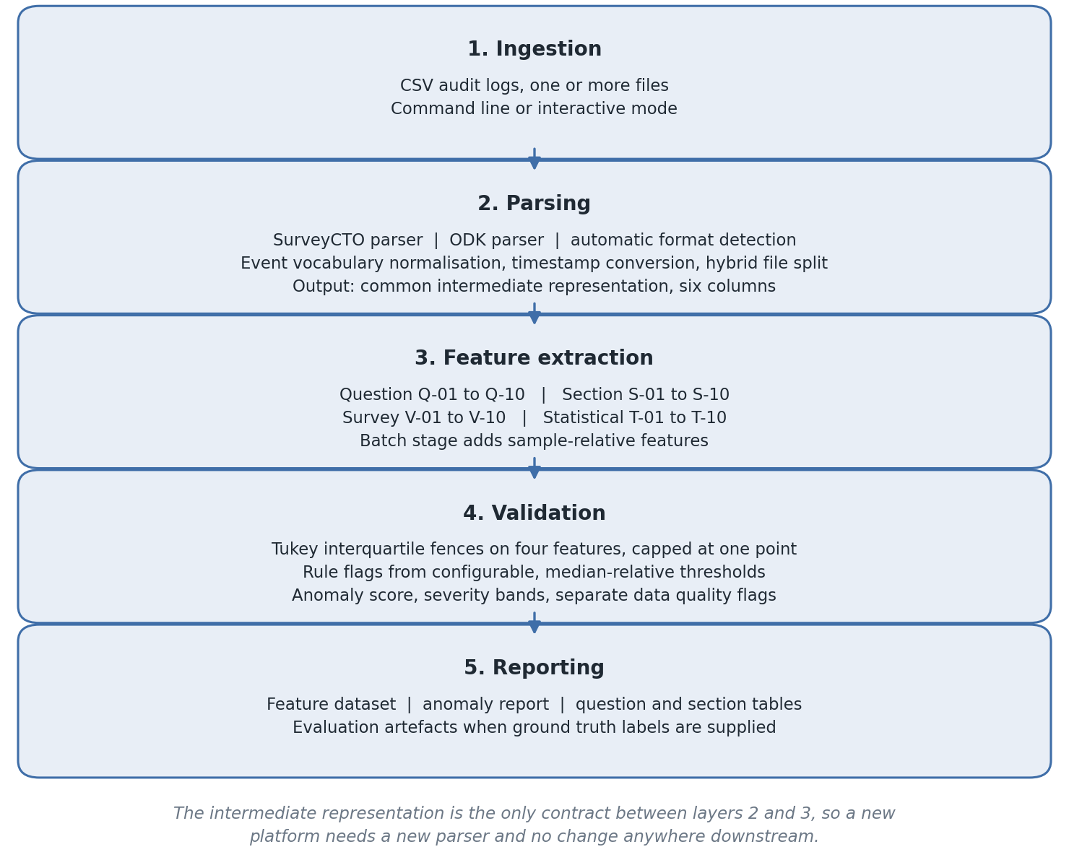
CHAPTERS 3 AND 4
Five layers, one contract between them
The intermediate representation is the only contract between parsing and everything above it.
SurveyCTO exports epoch milliseconds against XPath node ids. ODK exports ISO 8601 strings against instance and name columns. Both reduce to the same six columns: interview id, field name, event type, start, end and duration in milliseconds.
Because nothing above layer 2 knows which platform produced a row, the same detector runs unmodified on both, and adding a platform is a parser and no more.
Parsers mark rather than repair. Missing field names, unparseable timestamps and negative durations are flagged into a separate data-quality path, so device faults never read as behavioural anomalies.
Cross-format parity is a result, not an assumption: the same detector scores 1.0000 / 1.0000 on both formats at n500.
Samuel Kaoma | 2022016530 | CSC 4004
8
Notes:
This is Figure 1 in the report. The key claim is the contract at layer 2. I test that claim by running both formats through and comparing.
STUDY NOTE: Five layers: ingestion, parsing, feature extraction, validation, reporting. The only contract is the six-column representation between parsing and features. The parity result, identical features from both formats on the same history, tests that contract.

Slide 9
PART 2 · THE SYSTEM
Where everything lives in the repository
Path | What is in it
run_pipeline.py | the one command: parse, extract features, detect, write outputs, and evaluate when labels are given
src/parsers/ | surveycto_parser.py, odk_parser.py, base_parser.py: raw files to the six common columns
src/features/ | question_, section_, survey_ and statistical_features.py: the forty features
src/validation/ | anomaly_detector.py (flags and score), detector_config.py, reporting.py, statistical_tests.py
src/pipeline/controller.py | runs the stages in order and adds the batch-stage features such as V-09
tests/ | 44 tests, and the synthetic data generator (test_adversarial.py, generate_benchmark_datasets.py)
scripts/ | the evaluation and build scripts: robustness round, envelope, baselines, parity, memory, figures, Word build
data/, output/ | committed benchmark inputs, and every recorded result the report quotes
report/, docs/ | the report source, figures, validation report, AI log, tracker, evidence index, Word and PDF deliverables
Every number in the report names a file under output/ and a command that regenerates it (Appendix D).
Repository: github.com/Samuelkaoma-eng/SKACE-TIME-DATA, tag v-final-release.
Samuel Kaoma | 2022016530 | CSC 4004
9
Notes:
Know this map before the viva, because examiners often ask where something is implemented. The pipeline code is under src and is small: two parsers, four feature modules, one detector. The generator lives under tests because it began as a test fixture. Everything the evaluation claims is regenerated by a script in scripts, and its output is committed under output.

Slide 10
PART 2 · THE SYSTEM
Running it: five commands
Install the validated environment
python -m pip install -r requirements-validated.txt
Run the tests
python -m pytest -q # 44 passed
Run the pipeline on a file, with labels
python run_pipeline.py --inputs <audit_log.csv> --ground-truth <labels.csv> --label demo --output-dir output
Reproduce the robustness round
python scripts/run_robustness_validation.py
Reproduce the prevalence envelope
python scripts/run_prevalence_envelope.py # about 45 minutes
Without --ground-truth the run stops at the anomaly report, which is how it would be used on real data.
Appendix D of the report lists every command in order; D.11 rebuilds the Word and PDF files and needs pandoc and Microsoft Word.
Samuel Kaoma | 2022016530 | CSC 4004
10
Notes:
If an examiner asks you to show it working, these are the commands. Parser selection is automatic unless you pass --parser. The label becomes part of every output file name. Detector thresholds can be changed with --detector-config pointing at a JSON file, which is also how the entropy fence is switched on: {"anomaly_detector": {"entropy_fence_scale": 3.0}}.

Slide 11
CHAPTER 3
Forty features in four families
Q-01 to Q-10
S-01 to S-10
V-01 to V-10
T-01 to T-10
Question level
Section level
Survey level
Statistical
Response time, time to first interaction, edit count, revisits, completion ratio, idle time, event count, constraint triggers
Mean section pace, section duration, within-section variance, pace ratio, pause counts and durations, back-navigation
Total duration, early and late pace, trajectory ratio, back-navigation rate, start hour, day of week, duration vs median
Variance, interquartile range, Shannon entropy, skewness, excess kurtosis, mean, median, coefficient of variation, min, max
Two features are proxies forced by the source data: event count stands in for keystroke count, and field completion ratio is derived from measurable time on field, because neither platform logs keystrokes or answer content. Both are documented as proxies so they are not over-read.
40 catalogued, 40 implemented, 40 exported, 40 exercised end to end. 34 have a direct naming test.
Source: docs/feature_coverage.md, regenerated by scripts/build_feature_coverage.py rather than maintained by hand.
Samuel Kaoma | 2022016530 | CSC 4004
11
Notes:
The taxonomy was fixed at proposal stage and did not move. The coverage table is generated from the code, so it cannot drift.
STUDY NOTE: The taxonomy overview. The deep-dive slides that follow in Part 3 give the formula for every feature.

Slide 12
CHAPTER 3
Detection that a supervisor can argue with
1
Statistical fences
2
Rule flags
3
Score = count of flags
Tukey fences on total duration, mean response time, entropy and variance. No distributional assumption, and resistant to the outliers they are meant to find. Capped at one point jointly, so correlated timing outliers cannot stack.
Implausible session length, low mean response time against the sample median, low entropy, uniform pacing by coefficient of variation, compressed spread, absent or excessive back-navigation, elevated pauses. Median-relative and configurable.
Suspicious at 2, anomalous at 5. Data-quality faults route to their own category. Every flagged interview lists exactly which named flags fired.
A flag leads to a conversation with a named enumerator, so it has to be explainable. That is why the score is a count, not a model output.
Samuel Kaoma | 2022016530 | CSC 4004
12
Notes:
The design constraint that mattered most was explainability. A flag is an accusation about a person's work, so a supervisor must be able to see exactly which rules fired and check them.
STUDY NOTE: The detector in outline. Two mechanisms, statistical fences and rule flags, combined into a count. Part 3 works one interview through every flag.

Slide 13
Inside the pipeline, one step at a time.
The next thirteen slides follow the data: how the benchmark is generated, what the raw exports look like, how they are parsed, how each of the forty features is computed, how flags become a score, and what the pipeline writes. Every example is a real row from the committed n500 benchmark, seed 42.
Samuel Kaoma | 2022016530 | CSC 4004
13
Notes:
Before the live demonstration, I want to walk one interview through the whole system so that nothing in the results is a black box.

Slide 14
CHAPTER 5.1 · SYNTHETIC DATA
A labelled benchmark, generated from a seed
20 questions in 5 sections
Profile | Response time per question | Back-navigation | Pause after | Expected
Normal | log-normal, median 8.0 s, σ 0.5, × complexity weight | Poisson, mean 2 | 0.15–0.6 s | normal
Fabricated | 1.2 s ± 0.08 s, every question alike | none | 0.05–0.2 s | anomalous
Speeding | uniform, 0.2–0.8 s | none | 0.03–0.15 s | anomalous
Disengaged | 6.0 s ± 0.2 s, every question alike | ⅓ to ½ of questions | 0.4–1.2 s | suspicious
Data quality | one zero-duration record (canonical suite only) | – | – | dq_issue
Demographics, household, health, economic, nutrition. Each question has a complexity weight from 0.50 to 1.40, so genuine times rise and fall with the question.
One plan, two formats
A seeded plan fixes each interview's profile and start time. The same plan is written as a SurveyCTO file and an ODK file.
n500, seed 42
400 normal, 33 fabricated, 33 speeding, 34 disengaged: 20 percent prevalence. 12,286 SurveyCTO rows, 12,298 ODK rows.
Canonical difficulty. Normal interviews also trip a validation constraint now and then (Poisson, mean 0.6).
Fabricated and speeding interviews ignore question complexity. That complexity-blind pacing is the signal the features look for.
Source: tests/test_adversarial.py (AdversarialDataGenerator) and data/synthetic_datasets/n500/dataset_summary.json.
Samuel Kaoma | 2022016530 | CSC 4004
14
Notes:
The benchmark is generated, not collected, and I want to be precise about how. The instrument has twenty questions in five sections, each with a fixed complexity weight, so a genuine respondent is slower on the health recall items than on demographics. Each profile is a distribution: normal interviews are log-normal around eight seconds scaled by complexity; fabricated ones are tightly clustered around 1.2 seconds regardless of the question; speeders answer in under a second; disengaged interviews are slow, uniform and full of back-navigation. The labels come from the plan, so they are known exactly. The limitation, which I state in section 8, is that the same person wrote the generator and the detector.

Slide 15
CHAPTER 5.1 · SYNTHETIC DATA
What the four profiles look like
Stress difficulty makes them overlap
Genuine interviews come from four sub-types, including fast but valid (median 4.5 s) and low navigation.
Fabrications are only mildly compressed: 45 percent at 1.8 s ± 0.18 s, the rest at 3.8 s ± 0.65 s with up to one back-navigation.
Speeders answer in 1.2 to 3.6 s, not under a second.
Disengaged interviews get four to eight back-navigations, and a third of them one pause of 30 to 90 s.
Canonical data checks that the pipeline works. The reported results come from stress data on held-out seeds 7 and 99.
Chart: Q-01 per question for four real interviews, output/robustness_validation/question_features_benchmark_n500_surveycto.csv.
Samuel Kaoma | 2022016530 | CSC 4004
15
Notes:
This is what the profiles look like as data. The normal interview in teal climbs in the health questions, nine to twelve, because those items carry the highest complexity weights. The fabricated interview in amber is flat at about 1.2 seconds whatever the question, and the speeder is flat below one second. The disengaged interview is slow but just as flat. Flatness is what entropy and the coefficient of variation measure. The canonical profiles are cleanly separated on purpose; the stress difficulty on the right is where the profiles overlap and where the reported numbers come from.

Slide 16
RAW INPUT 1 · SURVEYCTO
The SurveyCTO file the pipeline reads
interview_id | node | event | start | end | duration_ms
INT-00001 |  | form-start | 1672646400000 | 1672646401020 | 1020
INT-00001 | demographics_q01 | question-end | 1672646401312 | 1672646407193 | 5881
INT-00001 | demographics_q02 | question-end | 1672646408353 | 1672646414471 | 6118
INT-00001 | demographics_q03 | question-end | 1672646415210 | 1672646420893 | 5683
INT-00001 | demographics_q03 | jump | 1672646421387 | 1672646421687 | 300
INT-00001 | demographics_q04 | question-end | 1672646421787 | 1672646428082 | 6295
One row per event, about 25 per interview.
start and end are epoch milliseconds: 1672646401312 is 2 January 2023, 08:00:01.312 UTC.
Events: form-start, question-end, constraint, jump, end. Form rows have a blank node.
duration_ms is end minus start.
This is the project's synthetic layout. SurveyCTO's native text audit is documented but not yet parsed (report section 3.1).
Source: data/synthetic_datasets/n500/audit_logs_surveycto.csv, the first rows of INT-00001. 12,286 rows in all.
Samuel Kaoma | 2022016530 | CSC 4004
16
Notes:
This is literally the first rows of the file. Each interview opens with a form-start row with no question name, then one row per question answered. The jump row is a back-navigation: this interviewer went back after question three. I want to be clear that this is the layout my generator writes. SurveyCTO's real text audit is either a per-field summary in seconds or, with the eventlog appearance, an event log in milliseconds, and my parser does not read it yet. That is why objective 2 is only partly met.

Slide 17
RAW INPUT 2 · ODK
The ODK file: same interviews, different shape
instance_id | name | event | start_time | end_time
INT-00001 |  | form start | 2023-01-02T08:00:00.000+00:00 | 2023-01-02T08:00:02.449+00:00
INT-00001 | demographics_q01 | question-end | 2023-01-02T08:00:02.569+00:00 | 2023-01-02T08:00:08.642+00:00
INT-00001 | demographics_q01 | jump | 2023-01-02T08:00:09.831+00:00 | 2023-01-02T08:00:10.131+00:00
INT-00001 | demographics_q02 | question-end | 2023-01-02T08:00:10.231+00:00 | 2023-01-02T08:00:16.342+00:00
INT-00001 | demographics_q03 | question-end | 2023-01-02T08:00:16.979+00:00 | 2023-01-02T08:00:23.229+00:00
Different column names: instance_id and name.
Times are text, ISO 8601 with a UTC offset, and there is no duration column.
Different event names: form start, question-end, constraint error, jump, end screen.
12,298 rows for the same 500 interviews.
ODK's documented audit log (event, node, start, end in epoch ms) is also parsed and tested; the evaluation ran on this layout.
Source: data/synthetic_datasets/n500/audit_logs_odk.csv, the first rows of INT-00001.
Samuel Kaoma | 2022016530 | CSC 4004
17
Notes:
Same interviews, different platform. Everything that could differ does: column names, timestamp format, event vocabulary. Note the timestamps are text here, which is where the pandas 3 defect lived: converting these strings to milliseconds silently gave durations a thousand times too small until I replaced the integer cast with timedelta arithmetic and added a regression test. The ODK and SurveyCTO rows for INT-00001 are not the same interview history in this pack; the matched-history comparison is Table 6b.

Slide 18
RAW INPUT 3 · GROUND TRUTH
The labels, kept apart from the detector
interview_id | anomaly_type | expected_category | is_anomalous
INT-00001 | disengaged | suspicious | 1
INT-00002 | normal | normal | 0
INT-00008 | fabricated | anomalous | 1
INT-00013 | speeding | anomalous | 1
500
100
labels in the n500 file
of them anomalous: 20 percent
anomaly_type is the profile the generator injected. expected_category is what the detector should output. is_anomalous is the binary label behind precision and recall.
Disengaged interviews are expected to be suspicious, not anomalous: their signature is weaker by design.
A dataset_summary.json beside each pack records its size, seed, difficulty and class counts, so any pack can be regenerated exactly.
The detector never reads this file. Labels are joined to predictions one to one after scoring, and a missing id fails loudly.
Source: data/synthetic_datasets/n500/ground_truth_labels.csv and dataset_summary.json.
Samuel Kaoma | 2022016530 | CSC 4004
18
Notes:
The ground truth is written from the same plan that generated the interviews, so it is exact. It is only ever read after the detector has scored every interview. The evaluation join is strict one to one: if an interview is missing or duplicated on either side the run fails rather than quietly computing metrics on a subset.

Slide 19
PARSING · CHAPTER 3.1
Both formats become the same six columns
Common column | From SurveyCTO | From ODK
interview_id | interview_id | instance_id
field_name | node (blank → unknown_field) | name (blank → unknown_field)
event_type | question-end → field_end, form-start → form_start, end → form_end | question-end → field_end, form start → form_start, end screen → form_end
start_ms, end_ms | epoch ms, as read | ISO 8601 → epoch ms
duration_ms | as read | end_ms − start_ms
field_name | event_type | start_ms | duration_ms
unknown_field | form_start | 1672646400000 | 1020
demographics_q01 | field_end | 1672646401312 | 5881
demographics_q02 | field_end | 1672646408353 | 6118
demographics_q03 | field_end | 1672646415210 | 5683
demographics_q03 | jump | 1672646421387 | 300
INT-00001 after parsing (interview_id and end_ms columns omitted for space). The same rows come out of the ODK file.
Parsers mark rather than repair: blank names, unparseable times and negative durations are flagged into a separate data-quality path.
Everything after this point reads only these six columns, which is why a new platform needs only a new parser.
Source: src/parsers/surveycto_parser.py and odk_parser.py; format detection is automatic (--parser auto).
Samuel Kaoma | 2022016530 | CSC 4004
19
Notes:
This is the contract between parsing and everything else. Both parsers produce exactly these six columns. Constraint events keep their platform names, constraint and constraint error, and the question features match both. From here on no code knows which platform the data came from, which is how I can show later that the same interviews give identical features in both formats.

Slide 20
FEATURES 1 · QUESTION LEVEL
Q-01 to Q-10: one row per question
ID | Feature | How it is computed from the six columns
Q-01 | Response time | sum of event durations on the field, navigation events excluded
Q-02 | Time to first interaction | field start to first answer if the log marks both; otherwise the first event's duration
Q-03 | Edit count | events on the field minus one
Q-04 | Revisit flag | 1 if the field was returned to after leaving it
Q-05 | Revisit count | number of returns to the field
Q-06 | Completion ratio | 1 if measurable time was spent on the field (answers are not in the log)
Q-07 | Idle time | sum of gaps between consecutive events on the field
Q-08 | Event count | events on the field: a stand-in for keystrokes, which neither platform logs
Q-09 | Constraint triggers | events whose type contains constraint or error
Q-10 | First-to-last span | last event end minus first event start, navigation excluded
INT-00002, first question
demographics_q01: Q-01 = 2,689 ms, one event, no revisit, no constraint. The row for every question has these ten values.
10,000
question rows for n500: 20 × 500
The interview row averages these over its questions. Q-03 and Q-08 carry the same information on these logs; the report says so.
Source: src/features/question_features.py; output/robustness_validation/question_features_benchmark_n500_surveycto.csv.
Samuel Kaoma | 2022016530 | CSC 4004
20
Notes:
Question-level features are computed per field from the parsed rows. The important design choice is Q-01: it sums event durations and excludes navigation markers, so a back-navigation does not inflate time on a question. That was one of the defects I fixed: Q-01 was first implemented as a first-to-last span, identical to Q-10. Two features are proxies because the logs do not contain keystrokes or answers, and I document both rather than overclaim them.

Slide 21
FEATURES 2 · SECTION LEVEL
S-01 to S-10: pace and pauses inside each section
ID | Feature | How it is computed
S-01 | Mean section pace | mean Q-01 of the section's questions
S-02 | Section duration | last event end minus first event start in the section
S-03 | Within-section variance | variance of Q-01 across the section's questions
S-04 | Pace ratio | S-01 divided by the interview's mean pace
S-05 | Pauses over 5 s | gaps between consecutive events longer than 5,000 ms
S-06 | Pauses over 30 s | gaps longer than 30,000 ms
S-07 | Mean pause | mean of the positive gaps
S-08 | Longest pause | largest gap
S-09 | Section back-navigation | events named back or backward (zero here: the generator emits jump)
S-10 | Completion rate | questions visited over the most seen in any section
INT-00002 | S-01 pace | S-07 pause
demographics | 5,204 ms | 175 ms
household | 5,840 ms | 446 ms
health | 14,514 ms | 361 ms
economic | 8,425 ms | 295 ms
nutrition | 7,895 ms | 452 ms
Section names come from the question name prefix; 2,500 section rows for n500.
INT-00002 is slowest in health, whose questions carry the highest complexity weights. A fabricator's sections all look alike.
Source: src/features/section_features.py; output/robustness_validation/section_features_benchmark_n500_surveycto.csv.
Samuel Kaoma | 2022016530 | CSC 4004
21
Notes:
Section features capture rhythm inside a block of related questions. The example on the right is a genuine interview: pace almost triples in the health section, because those are recall-heavy items. That variation is what a fabricator does not reproduce. Two honest caveats: S-09 matches back or backward, while the generator only emits jump, so it is zero throughout this corpus; and S-04 averages to one by construction when sections are the same size.

Slide 22
FEATURES 3 · SURVEY LEVEL AND BATCH STAGE
V-01 to V-10: the whole interview, and its place in the batch
ID | Feature | How it is computed
V-01 | Total duration | last event end minus first event start, form rows included
V-02 | Early pace | milliseconds per question over the first third of events
V-03 | Late pace | the same over the last third
V-04 | Pace trajectory | V-03 divided by V-02
V-05 | Back-navigation rate | jump or back events over the other events
V-06 | Back-navigation total | count of jump or back events
V-07 | Start hour | hour of the first event, UTC
V-08 | Day of week | day of the first event
V-09 | Relative duration | V-01 divided by the median V-01 of the batch
V-10 | No-navigation run | 1 if 20 or more consecutive events without navigation
The batch stage
V-09 is computed only after every interview in the batch has been processed. INT-00002 scores 1.01; the fabricated INT-00008 scores 0.16.
Several flags are batch-relative in the same way: half the median mean response time, twice the median pause.
That lets the method adapt to the instrument. It is also why it needs anomalies to be a minority of the batch.
Batch-relative thresholds are the method's strength and its limit: results 6.4 measures where the limit falls.
Source: src/features/survey_features.py; src/pipeline/controller.py for V-09.
Samuel Kaoma | 2022016530 | CSC 4004
22
Notes:
Survey-level features describe the interview as a whole. V-09 is special: it compares each interview with the median of the batch, so it cannot be computed one interview at a time. The same idea runs through the detector's thresholds. It is deliberate, because what counts as fast depends on the questionnaire, and it follows Goel et al.'s dynamic benchmarking. But it means the median must come from a mostly genuine batch, which is the limitation I come back to in the results.

Slide 23
FEATURES 4 · STATISTICAL
T-01 to T-10: the shape of the response-time distribution
ID | Feature | Of the interview's 20 Q-01 values
T-01 | Variance | sample variance
T-02 | Interquartile range | Q3 − Q1
T-03 | Entropy | Shannon entropy in one-second bins, in bits
T-04 | Skewness | third standardised moment
T-05 | Excess kurtosis | fourth standardised moment − 3
T-06 | Mean | arithmetic mean
T-07 | Median | middle value
T-08 | Coefficient of variation | standard deviation ÷ mean
T-09 | Minimum | fastest answer
T-10 | Maximum | slowest answer
Entropy, worked
H = − Σ pᵢ log₂ pᵢ
pᵢ is the share of the 20 response times in one-second bin i.
INT-00002, normal: times spread over many bins, H = 3.17 bits.
INT-00008, fabricated: all 20 times fall between 1 and 2 s, one bin, H = 0 bits.
Coefficient of variation: 0.48 normal against 0.08 fabricated; below 0.10 fires the uniform-timing flag.
Entropy separates the classes most strongly of all forty features: Cohen's d −10.57, rank-biserial 1.00 on n500 (Table 2).
Source: src/features/statistical_features.py; output/feature_validation_results.csv.
Samuel Kaoma | 2022016530 | CSC 4004
23
Notes:
The statistical family describes the distribution of one interview's response times. Entropy is the one to understand: binning into fixed one-second bins means identical behaviour gives identical entropy in both formats, whatever the timestamp precision. A fabricator who paces every question the same lands in one bin and scores zero. The coefficient of variation is scale-free, so it catches a uniformly slow fabricator as well as a uniformly fast one.

Slide 24
FEATURES 5 · FOUR REAL INTERVIEWS
The same features, four behaviours
Feature | INT-00002 normal | INT-00008 fabricated | INT-00013 speeding | INT-00001 disengaged
Total duration (V-01) | 177.6 s | 28.5 s | 15.3 s | 141.4 s
Relative duration (V-09) | 1.01 | 0.16 | 0.09 | 0.80
Mean response time (T-06) | 8,376 ms | 1,186 ms | 512 ms | 6,036 ms
Response-time IQR (T-02) | 4,451 ms | 97 ms | 306 ms | 216 ms
Entropy (T-03) | 3.17 bits | 0.00 bits | 0.00 bits | 0.97 bits
Coefficient of variation (T-08) | 0.48 | 0.08 | 0.38 | 0.03
Back-navigations (V-06) | 0 | 0 | 0 | 8
Mean pause (S-07) | 346 ms | 127 ms | 95 ms | 635 ms
Anomaly score | 0 | 8 | 7 | 6
Category | normal | anomalous | anomalous | anomalous
No single feature separates them all: speeding has a normal-looking CV, disengagement a normal-looking duration. Hence the score.
Source: output/robustness_validation/feature_dataset_ and anomaly_report_benchmark_n500_surveycto.csv. Amber marks values that fired a flag or drove one.
Samuel Kaoma | 2022016530 | CSC 4004
24
Notes:
Here are four real rows side by side. Read across a row: the fabricated and speeding interviews are short, but so could a genuine fast respondent be. Read down a column: the fabricated interview is extreme on almost everything, the disengaged one only on variation and navigation. That is why detection counts flags across families rather than thresholding any one feature. The disengaged interview was expected to be suspicious and scored anomalous; both count as detected.

Slide 25
DETECTION · CHAPTER 3.4
From features to flags to a score
Flag | Fires when | Form
Short relative duration | V-09 < 0.5 | batch-relative
Low mean response time | T-06 < 0.5 × batch median | batch-relative
Low entropy | T-03 < 0.5 bits | absolute
Uniform timing | CV < 0.1, or variance < 10 | absolute
Low response-time IQR | T-02 ≤ 0.5 × median, after a compression flag | conditional
Low within-section variance | S-03 ≤ 0.25 × median, after a compression flag | conditional
No back-navigation | V-10 = 1 or V-06 = 0, after a compression flag | conditional
Back-navigation | V-05 ≥ 0.25 moderate, ≥ 0.5 high | absolute
Long / elevated pause | S-08 ≥ 2 × median; S-07 ≥ 2.5 × median | batch-relative
Tukey fences × 4 | V-01, T-06, T-03, T-01 outside Q1 − 1.5 IQR, Q3 + 1.5 IQR | one point jointly
INT-00008, fabricated
7 rule flags: short relative duration, low mean response time, no back-navigation, low entropy, uniform timing, low IQR, low section variance.
3 fences fired: duration, mean response time, entropy, capped at 1 point.
7 + 1 = 8 → anomalous
Score ≥ 2 suspicious, ≥ 5 anomalous.
Every point in the score is a named flag, so the report can say exactly why an interview was flagged.
Source: src/validation/anomaly_detector.py; Table 1a of the report lists every flag and default.
Samuel Kaoma | 2022016530 | CSC 4004
25
Notes:
This is the whole detector on one slide. Each flag is a named rule on a named feature. The conditional flags fire only once a compression flag has fired, so a genuinely fast respondent is not also penalised for low spread. The four Tukey fences share one point because they measure the same underlying pacing. The cut-off of two means no single rule can send an interviewer for review on its own; five needs agreement across duration, distribution and navigation.

Slide 26
OUTPUTS
What one run writes
File | One row per | Rows, n500 | What it is for
pipeline_output_<label>.csv | interview | 500 | all 40 features plus every flag, the score and the category: 72 columns
feature_dataset_<label>.csv | interview | 500 | the 40 features alone: the analyst's dataset, usable without the detector
question_features_<label>.csv | question | 10,000 | Q-01 to Q-10 for every question
section_features_<label>.csv | section | 2,500 | S-01 to S-10 for every section
anomaly_report_<label>.csv | interview | 500 | score, category, status (REVIEW, FLAGGED, CLEAN) and the named flags
predictions_<label>.csv | interview | 500 | the anomaly report joined to ground truth
metrics_<label>.csv / .json / .md | run | 1 | precision, recall, F1, confusion counts and the acceptance checks
detection_by_type_<label>.csv | anomaly type | 3 | per-class recall
The last three files appear only when a ground truth file is supplied. On real data the run ends at the anomaly report.
Source: output/robustness_validation/*_benchmark_n500_surveycto.*; label set with --label.
Samuel Kaoma | 2022016530 | CSC 4004
26
Notes:
One command writes all of these. The feature dataset is a deliverable in its own right: a survey team that never uses my detector still gets forty documented features per interview. The anomaly report is what a supervisor reads. The evaluation files only exist in evaluation, when labels are supplied, and the next slides show them from a live run.

Slide 27
The system, running.
Everything on the next five slides is a live run of the pipeline on the sample data in the repository, using the command as documented. No figure here is a stored capture.
Samuel Kaoma | 2022016530 | CSC 4004
27
Notes:
I want to show the thing working rather than describe it. This is one command against two raw exports, one from each platform.

Slide 28
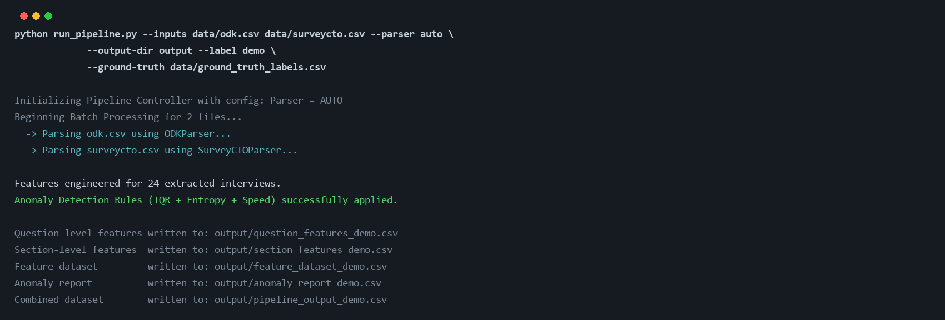
DEMONSTRATION 1
One command, two platforms, five outputs
The analyst points the pipeline at the raw exports and nothing else.
Format detection is automatic: it recognises the ODK file by its ISO 8601 timestamps and instance columns, and the SurveyCTO file by its epoch milliseconds and XPath node ids, then routes each to its own parser.
Both land in the same intermediate representation, so from that point on the twenty-four interviews are processed identically regardless of which platform produced them.
Granular question-level and section-level exports come out of the same run, not a separate step.
Live run: python run_pipeline.py --inputs data/odk.csv data/surveycto.csv --parser auto --output-dir output --label demo
Samuel Kaoma | 2022016530 | CSC 4004
28
Notes:
Note the two parsers being selected automatically. The operator does not have to know or declare which platform a file came from.

Slide 29
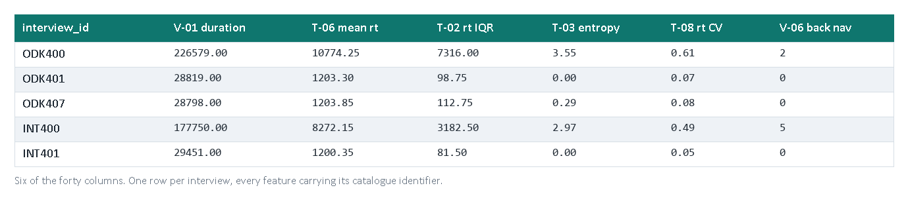
DEMONSTRATION 2
The feature dataset: one row per interview
Forty columns, six shown.
Every column carries its catalogue identifier, so a number in this file traces back to a definition in the feature documentation and to a citation in the literature review.
ODK401 is already visible as unusual: entropy of exactly zero and a response time IQR under 100 ms against a genuine interview at 7,316 ms.
This file is the analyst's deliverable whether or not they ever use the detector.
output/feature_dataset_demo.csv, written by the run on the previous slide.
Samuel Kaoma | 2022016530 | CSC 4004
29
Notes:
I stress this because the feature library stands on its own. A survey team that disagrees with my thresholds can still use these forty columns.

Slide 30
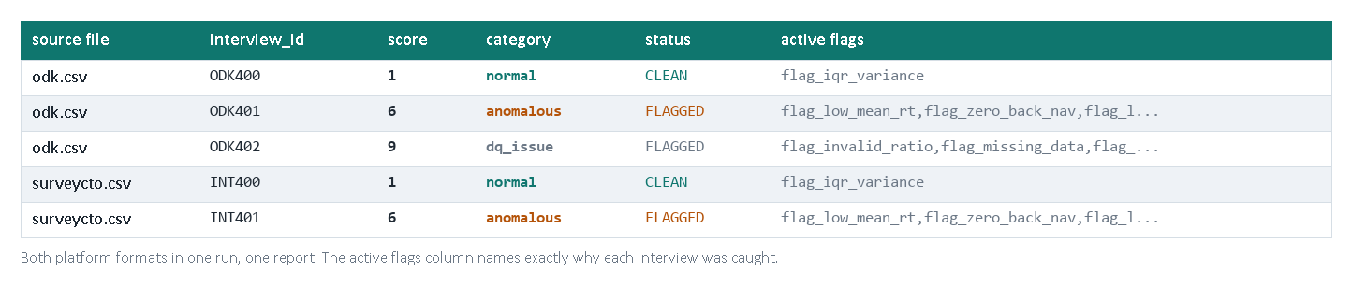
DEMONSTRATION 3
The anomaly report: a score you can argue with
Both formats, one report.
Each interview carries a score, a category, a status and the named flags that fired.
ODK402 is routed to dq_issue rather than scored behaviourally: it is a corrupt record, not a suspicious enumerator.
Device faults never read as behavioural anomalies, because they have their own category.
output/anomaly_report_demo.csv, from the same run.
Samuel Kaoma | 2022016530 | CSC 4004
30
Notes:
The separation of data quality issues from behavioural anomalies matters in the field: a broken tablet should not put an enumerator under suspicion.

Slide 31
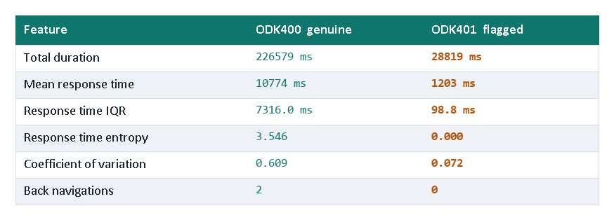
DEMONSTRATION 4
Why was this interview flagged?
ODK401 scored 6 and was categorised anomalous.
Six flags fired: low mean response time, zero back navigation, low entropy, uniform timing, compressed response time IQR, and low within-section variance.
Entropy of exactly 0.000 means every response time fell in a single one-second bin. A human answering twenty questions of varying difficulty does not produce that.
Ground truth confirms it: fabricated.
This is the sentence a field supervisor can take to an enumerator. An opaque model score is not.
output/feature_dataset_demo.csv and output/anomaly_report_demo.csv, same run.
Samuel Kaoma | 2022016530 | CSC 4004
31
Notes:
If you remember one slide from the demonstration, this is it. Explainability was a design constraint, not a nice-to-have, and this is what it buys.

Slide 32
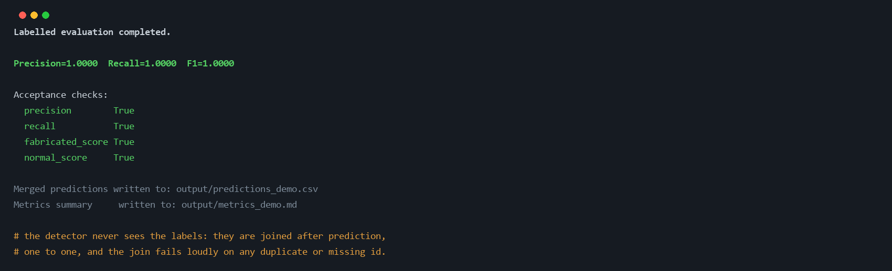
DEMONSTRATION 5
Evaluation happens in the same run
Supply a ground truth file and the same command emits precision, recall, F1 and the acceptance checks.
The detector never sees the labels. Predictions are made first, then joined to ground truth one to one, and the join fails loudly on any duplicate or missing interview id.
That separation is what makes every number in the rest of this presentation trustworthy.
This is the canonical suite: deliberately easy, so it verifies the intended mapping rather than proving field performance.
output/metrics_demo.md and output/predictions_demo.csv, same run. The harder conditions start on the next slide.
Samuel Kaoma | 2022016530 | CSC 4004
32
Notes:
I am explicit that this canonical run is easy by design. It is a contract test. The stress results later are where the real claim is.

Slide 33
The live site.
The same pipeline also runs behind a review dashboard at paradata.samuelkaoma.dev. The next slides explain what each page shows, how it is built and hosted, and what it is not.
Samuel Kaoma | 2022016530 | CSC 4004
27
Notes:
Everything so far runs from a terminal. I also put the same pipeline output behind a web page, so that a supervisor, an examiner or I can see the whole system in one place: the input data, the method, the results and the charts, for the same batch. STUDY NOTE: the site is a demonstration of the operating procedure in section 7 of the report. It is not a deployed survey system, and you should say so before anyone asks. The next eight slides give you what you need: what the site is, the pages one by one, how it is built and hosted, what it is not, and the questions you may get.

Slide 34
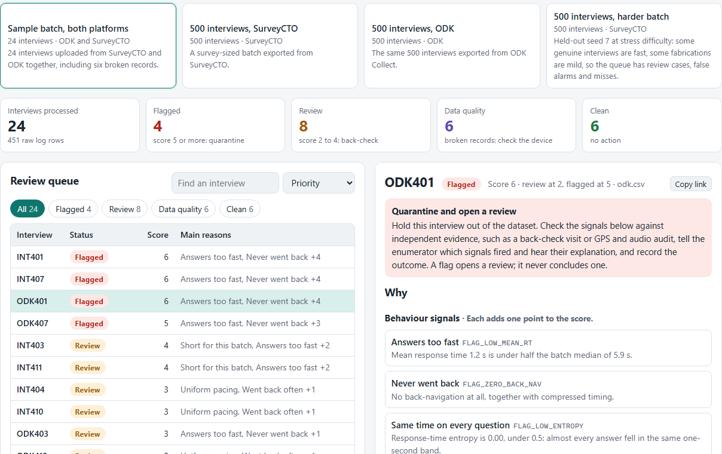
THE LIVE SITE · WHAT IT IS
A review queue, not a report
Batch in, queue out.
A batch of audit logs goes through the pipeline once. Every interview lands in a lane.
Flagged, review, data quality, clean.
Flagged first. Broken records get their own lane.
Each interview says why.
Rules in words, values against the batch median.
A supervisor's real question is not 'what is the precision' but 'which interviews do I check this week, and why'. The page is built around that question.
Screenshot of the Review queue view, sample batch, interview ODK401. paradata.samuelkaoma.dev.
Samuel Kaoma | 2022016530 | CSC 4004
28
Notes:
This is the first thing the site opens on. On the left is the queue, sorted by what to look at first: flagged, then review, then data quality, then clean. On the right is the selected interview: what to do with it, then each rule that fired, with the interview's value next to the batch median. The four tiles at the top are the batch summary. The cards above them are the batches, which stand for uploads received from the field. STUDY NOTE: I rebuilt the page around the supervisor's question, 'which interviews do I check and why', after the first version led with precision and recall, which only make sense when you have labels. A field team has none. The labels are used only on the Validation page. For ODK401 the page lists the same six flags as slide 31: low mean response time, never went back, same time on every question, uniform pacing, compressed spread, flat within sections.

Slide 35
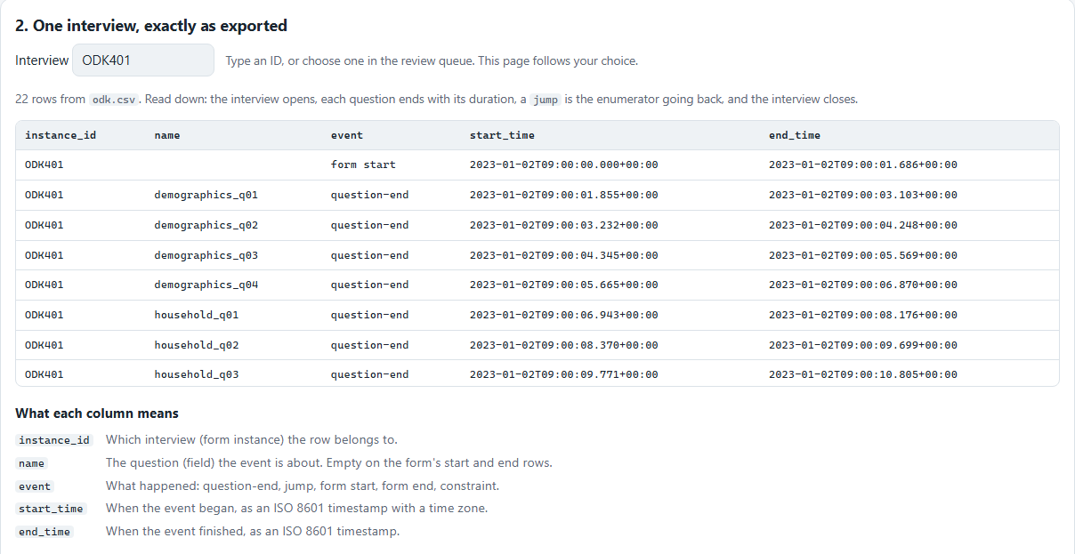
THE LIVE SITE · DATA IN
The input data, exactly as exported
One row per event.
Twenty to twenty-five rows an interview: open, each question, any jumps, close.
The two platforms differ.
Column names, timestamps, event names.
Synthetic layouts.
Not the platforms' native exports. Native ODK is recognised; native SurveyCTO is not yet.
The page never asks you to take the input on trust: the raw rows of any interview are one click away.
Screenshot of the Data in view: the raw rows of one interview and a glossary of its columns.
Samuel Kaoma | 2022016530 | CSC 4004
28
Notes:
This answers the question 'what does the input data actually look like'. The page shows the raw rows of one interview exactly as exported, then explains each column. You can change the interview and the batch. Below this section the page counts the events in the batch, then puts SurveyCTO and ODK side by side: interview id, question, timestamps, duration and event names all differ. STUDY NOTE: be ready to say what these files are. They are the layouts the generator writes and the pipeline was evaluated on. They follow the structure of the platforms' audit logs but they are not native exports. The format guide states this at the top. ODK's native audit.csv is also detected and parsed, verified against a log built from the documentation, not a real export. SurveyCTO's native text audit is not supported. That is the honest limit of objective 2.

Slide 36
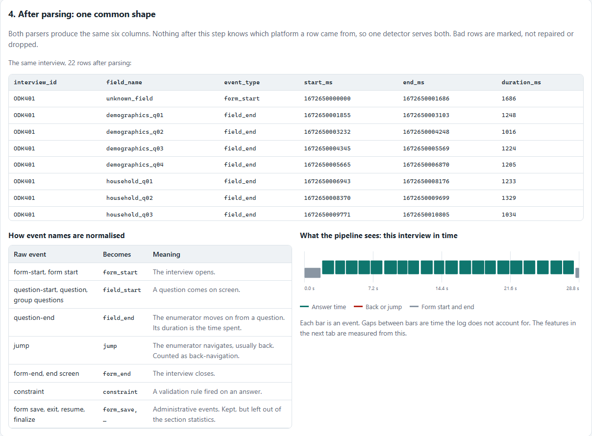
THE LIVE SITE · PARSING
One common shape for both platforms
Six columns.
interview id, field name, event type, start, end, duration.
Mark, do not repair.
A bad timestamp or a missing name is flagged, not dropped or guessed.
Platform-blind from here.
Nothing after this step knows which platform a row came from.
The time line.
What the features are measured from.
This is the contract between parsing and everything above it, the claim behind Figure 1 in the report.
Screenshot of the Data in view: the same interview after parsing, how event names are normalised, and its time line.
Samuel Kaoma | 2022016530 | CSC 4004
28
Notes:
Here the same interview is shown after parsing. The six columns are the common intermediate representation. The table on the lower left shows how raw event names map to the normalised ones. The chart on the right is the interview in time: each bar is an event, taller red bars are jumps, and the gaps between bars are time the log does not account for. STUDY NOTE: this is where the platform asymmetry would show up if there were one. I tested it by writing one generated history in both formats and comparing: every feature and every decision came out identical (Table 6b). That is the evidence for 'the same detector runs unmodified on both'.

Slide 37
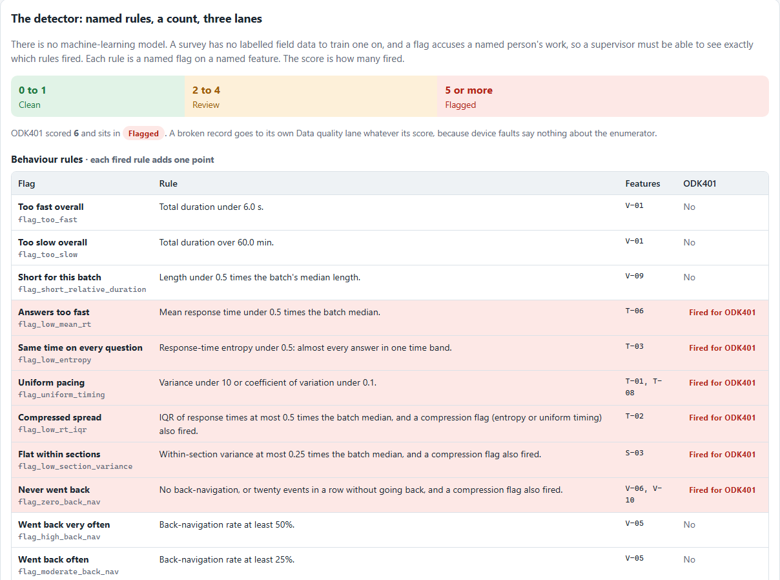
THE LIVE SITE · METHOD
Named rules, a count, three lanes
Forty features.
Four families, each with its definition and the interview's value.
Twenty-one flags.
Every rule in words. The ones that fired for this interview are highlighted.
Score is a count.
0 to 1 clean, 2 to 4 review, 5 or more flagged.
Batch-relative.
A table shows the numbers this batch's rules compare against.
No machine-learning model: a flag accuses a named person, so every point has to be explainable.
Screenshot of the Method view for ODK401: the three lanes and the behaviour rules, with the fired rules highlighted.
Samuel Kaoma | 2022016530 | CSC 4004
28
Notes:
The Method page is the whole detector on one screen. The feature table is read from the same feature documentation file the repository ships, so it cannot drift from it. The rules table lists every flag the detector can raise, in words, with the thresholds in force, and highlights the ones that fired for the selected interview. STUDY NOTE: three things to say here. First, the score is a count of fired rules, with the four statistical fences capped at one point together, because duration, mean time, entropy and variance share one underlying pacing. Second, the thresholds that say 'compared with the batch median' are relative to the batch, which is the assumption behind the prevalence envelope: most of the batch must be genuine. Third, a broken record goes to its own Data quality lane whatever its score. In the sample batch six of the ten flagged interviews are broken records, not behaviour.

Slide 38
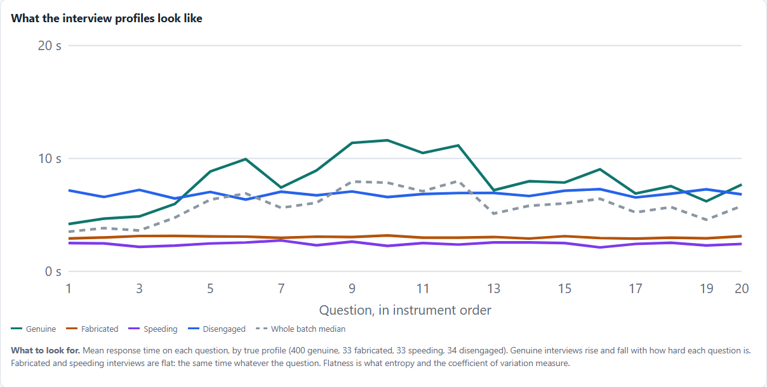
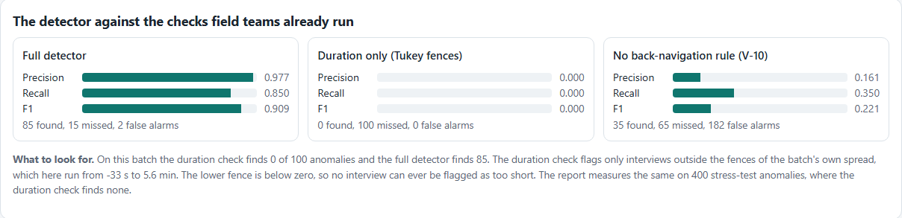
THE LIVE SITE · CHARTS
The charts that make the argument
Right: the detector against the two checks teams already run, on the harder batch. Duration alone finds none of the 100 anomalies; the full detector finds 85, with 2 false alarms.
Left: mean response time per question for each true profile. Genuine rises and falls with question difficulty. Fabricated and speeding are flat.
Same data as Table 6a: held-out seed 7, stress difficulty, SurveyCTO.
Screenshots of the Charts view, harder batch (held-out seed 7, stress difficulty). The page also has score, box-plot and prevalence charts.
Samuel Kaoma | 2022016530 | CSC 4004
28
Notes:
Two charts here, both on the harder batch, which is held-out seed 7 at stress difficulty, the same data as Table 6a. The left chart is what the profiles look like as data: flatness is what entropy and the coefficient of variation measure. The right chart is the central result. Duration-only finds 0 of 100, the V-10 rule 35 with 182 false alarms, the full detector 85 with 2 false alarms. STUDY NOTE: the reason the duration check finds nothing is not that the anomalies finish in an ordinary time. The batch's lower fence is minus 33 seconds, so no interview can ever be flagged as too short. Speeding and fabricated interviews are short; the fence just cannot see them, because the genuine spread and the many short interviews drag it below zero. The Charts page also draws the score histogram, box plots of six features by profile, the prevalence envelope and detection by type.

Slide 39
THE LIVE SITE · HOW IT IS BUILT
Built once per push, then only read
1 GitHub
2 Dokploy
3 Docker build
4 nginx
5 Name and HTTPS
The school repository, branch main. A push sends a webhook to Dokploy.
Own project, SKACE Paradata. Pulls the repository with a read-only deploy key and builds the Dockerfile.
Runs the real pipeline on four synthetic batches, executes the audit notebook, writes the data for the page.
Serves the page, the data and the output files. No Python runs for a visitor. /health shows the commit.
paradata.samuelkaoma.dev, an A record at name.com, with a Let's Encrypt certificate from Dokploy.
Why this design. Nothing sensitive runs on the server and no real data is on it. The page is rebuilt from the repository, so it cannot drift from the code: the footer names the commit it was built from.
The pipeline runs once, on the build server. Visitors only read files.
Samuel Kaoma | 2022016530 | CSC 4004
49
Notes:
This is how the site gets onto the internet. A push to main on the school repository sends a webhook to Dokploy, the same platform that serves my other projects. Dokploy pulls the repository using a read-only deploy key that I added to the repository, so it can read the code and cannot change it, and builds the Dockerfile. The build runs the real pipeline on four synthetic batches, executes the audit notebook, and writes the results as JSON for the page. nginx then serves the files. A build takes a few minutes on the server. STUDY NOTE: the point to make if asked about security is that the pipeline never runs at request time. There is no upload, no login and no real data, so there is nothing for a visitor to break or leak. The name is an A record I added at name.com, and the certificate is issued by Let's Encrypt through Dokploy. The health endpoint returns the status, the data mode, which is always synthetic, and the commit the build came from, so you can check that what is live is what is in the repository.

Slide 40
THE LIVE SITE · WHAT TO SAY
What it is, and what it is not
It is
It is not
The real pipeline, unchanged, run on four synthetic batches when the site is built.
A view of the operating procedure in section 7: batch in, queue out, reasons in words.
Reproducible: rebuilt from the repository on every push, with the commit in the footer.
A deployed survey system: no upload, no login, no saved outcomes, no real data.
A live run: the pipeline ran at build time and visitors read the results.
A per-enumerator view: audit logs carry no enumerator id, so that needs the survey data.
Evidence on field data: every batch is synthetic, with known labels.
Say: a demonstration of the operating procedure, built on the real pipeline output.
Samuel Kaoma | 2022016530 | CSC 4004
49
Notes:
Know the answer to 'is this deployed?' before anyone asks it. It is a demonstration. The pipeline runs when the site is built, on synthetic batches, and the page reads the output. A survey team would run the same command on its own machine on a day's audit logs. STUDY NOTE: the limits are deliberate. I did not expose an upload because paradata is sensitive and an open upload endpoint is a security surface. I did not build saved outcomes, although section 7 says a deployment should record them, because that needs a database and an access policy, which is a pilot's work. The explanation sentences on the page are generated by the build script from the detector's own thresholds. The detector itself only emits flag names, so some of the wording, like 'together with compressed timing', is mine and would need updating if a rule changed. The report says deployment was out of scope, so do not call this a deployment. Call it a demonstration of the procedure.

Slide 41
VIVA 5 · THE LIVE SITE
Questions about the website
Is this a deployed system?
Why can a team not upload its own log?
No. It demonstrates the operating procedure in section 7. The pipeline runs when the site is built; visitors read the results. No upload, login or real data.
I chose not to expose an upload endpoint for sensitive paradata. A team runs the command on its own machine; the site shows what that produces.
Where do the explanation sentences come from?
Is the data real?
The detector emits flag names only. I wrote the sentences in the build script, using the detector's own thresholds so the numbers stay in sync.
No. Every batch is synthetic with known labels. The harder batch is held-out seed 7, the same data as Table 6a, so its numbers match the report.
Full answers: speaker notes.
Samuel Kaoma | 2022016530 | CSC 4004
60
Notes:
Q: Is this a deployed system? A: No. It is a demonstration of the operating procedure in section 7, built on the real pipeline output. The pipeline runs when the site is built, on synthetic batches, and the page reads the files. There is no upload, no login, no saved outcomes and no real data. The report says deployment was out of scope, and this does not change that.
Q: Why can a team not upload its own log? A: Paradata is sensitive, and an open upload endpoint is a security surface I chose not to create. A team runs one command on its own machine and gets the same files; the site shows what that produces and how a supervisor would read it.
Q: Where do the explanation sentences come from? A: The detector emits flag names only. The build script restates each rule as a sentence, taking the thresholds from the detector so the numbers stay in sync. Some phrases are my wording, so a changed rule would need its sentence updated.
Q: Is the data real? A: No. All batches are synthetic with known labels. The harder batch is held-out seed 7 at stress difficulty, the same data as Table 6a, so its precision of 0.977 and recall of 0.850 match the report. Also be ready for: why did you build it? A: To structure the presentation and to let the panel see the input data, the method and the results for one batch in one place.

Slide 42
CHAPTER 5
An evaluation built to fail
Early runs scored 1.00 everywhere. I read that as a warning that the test was too easy, not as a result. Three changes followed.
1
Detector settings that mirrored the generator were removed or generalised. A coupling between two flags was deleted, fixed pause constants became configuration, and the disengagement rule was made median-relative.
2
Every reported run uses random seeds never touched during development or calibration: seeds 7 and 99.
3
A stress difficulty was added where genuine respondents can be fast with little navigation and fabricated interviews can be only mildly compressed, so the profiles overlap by construction.
4
A class prevalence sweep from 5 to 30 percent, later extended to 90 percent, because performance at one anomaly rate does not carry over to others.
The detector never sees ground truth. A strict one-to-one join computes metrics only after prediction, and fails loudly on any duplicate or missing id.
Samuel Kaoma | 2022016530 | CSC 4004
33
Notes:
This is the part I would most want to be judged on. Perfect early scores were a signal the evaluation was wrong, and rebuilding it produced lower numbers that are actually defensible.
STUDY NOTE: Three safeguards against a flattering evaluation: remove settings that mirror the generator, use held-out seeds, and add a stress difficulty. The prevalence sweep was later extended to 90 percent, which is where the method's limit appeared.

Slide 43
PART 5 · THE EVALUATION
Which data answers which question
Dataset | Size | Difficulty | Seeds | Used for
Canonical suite | 24 interviews, 12 per format | canonical | fixed | contract test: every profile mapped to its expected category
Benchmark packs | 120 to 10,000 at 20% | canonical | 42 (and 11) | baselines, feature validity, scale and memory
Imbalance sweep | 500 at 5, 10, 20, 30% | canonical | 7, held out | precision against prevalence (Table 5)
Stress runs | 500 each, both formats | stress | 7 and 99, held out | the headline results (Tables 6 and 7)
Platform parity | 500, one history, both formats | both | 42, 7, 99 | are the parsers equivalent? (Table 6b)
Prevalence envelope | 100 and 500 at 5 to 90% | both | 7 and 99, held out | where the method stops working (Table 5a)
Seeds 11 and 42 were used in development. Seeds 7 and 99 were only opened after the detector was frozen.
Report section 5.3; the robustness round is scripts/run_robustness_validation.py.
Samuel Kaoma | 2022016530 | CSC 4004
34
Notes:
A held-out seed is the synthetic equivalent of a test set: the detector's settings were fixed before any data from those seeds was generated, so it cannot have been tuned to them. When you quote a number, know which dataset it came from. The headline precision 0.96 to 1.00 and recall 0.84 to 1.00 is across the robustness round; stress recall alone is 0.84 to 0.89.

Slide 44
PART 5 · THE EVALUATION
Precision, recall and F1, from a confusion matrix
 | Truly anomalous | Truly genuine
Flagged | TP 871 | FP 7
Not flagged | FN 54 | TN —
Precision = TP / (TP + FP)
871 / 878 = 0.9920
Of the interviews flagged, how many were really anomalous. Low precision means false accusations.
Recall = TP / (TP + FN)
871 / 925 = 0.9416
Of the anomalies present, how many were flagged. Low recall means fabrication gets through.
Aggregated over the ten runs of the robustness round, combined detector (Table 4). TN is not needed for the three measures.
F1 = 2PR / (P + R)
0.9662
One number balancing the two. Targets were set on precision (0.80) and recall (0.75) separately.
Precision depends on prevalence: with few anomalies, one false positive costs a lot. That is why prevalence is swept.
Source: output/robustness_validation/component_breakdown.csv; report Table 4.
Samuel Kaoma | 2022016530 | CSC 4004
35
Notes:
Everything in the results rests on these two ratios, so be able to derive them. Precision asks: when the system points at an interview, how often is it right? Recall asks: of the interviews that are really anomalous, how many does it catch? In this setting precision protects enumerators from false accusations and recall protects the data. The proposal committed to precision at least 0.80 and recall at least 0.75 for the combined detector.

Slide 45
PART 5 · THE EVALUATION
How feature validity is tested
Mann-Whitney U
Bonferroni adjustment
Compares normal and anomalous interviews by ranks, not means, so it makes no assumption about the distribution. Chosen because response times are strongly right-skewed.
Forty features are tested on the same data, so each p-value is multiplied by 40 to keep the chance of any false discovery at 5 percent. Benjamini-Hochberg would select the same thirty.
Cohen's d
Rank-biserial correlation
The difference in means in units of pooled standard deviation. Around 0.8 is conventionally large; entropy scores −10.57.
From the U statistic: the share of normal-anomalous pairs ordered one way minus the share ordered the other. 1.00 means the two groups do not overlap at all.
30 of 40 features separate the classes after adjustment. Entropy separates them completely on n500 (Table 2).
Report section 6.2 and Appendix C; scripts/feature_validation.py; Cohen (1988), Kerby (2014), Benjamini and Hochberg (1995).
Samuel Kaoma | 2022016530 | CSC 4004
36
Notes:
Feature validity asks a different question from detection: does this feature, on its own, differ between genuine and anomalous interviews? The test is rank-based because timing data is skewed. Two measures of size matter: Cohen's d says how far apart the means are, the rank-biserial says how much the groups overlap. Eight features are constant on synthetic data, so the test is silent on them, not negative. Remember that separation on one feature does not mean the detector uses it well: see the fabrication diagnostic.

Slide 46
RESULTS 6.2
Which features actually separate the classes
Feature | Cohen's d | Rank-biserial | Adjusted p
T-03 response time entropy | -10.57 | 1.0000 | 1.6e-52
Q-10 first to last interaction duration | -4.14 | 0.9983 | 3.0e-52
T-06 response time mean | -4.14 | 0.9983 | 3.0e-52
S-01 mean section pace | -4.14 | 0.9983 | 3.0e-52
V-01 total interview duration | -3.79 | 0.9930 | 1.1e-51
T-02 response time interquartile range | -3.51 | 1.0000 | 2.0e-52
30 of 40 significant
Mann-Whitney U, because response times are right-skewed. p-values Bonferroni-adjusted at a family-wise alpha of 0.05 across all forty tests.
Ten do not discriminate. Two are contextual, start hour and day of week. Eight are constant across the synthetic corpus, so the evaluation is silent on them rather than negative.
Entropy has a rank-biserial of exactly 1.0000: on this dataset the two groups do not overlap at all. Remember that: it matters for the fabrication diagnostic.
Source: output/feature_validation_results.csv. Full forty-feature table is Appendix C of the report.
Samuel Kaoma | 2022016530 | CSC 4004
37
Notes:
Bonferroni is the adjustment, which my supervisor asked me to state. Entropy is the standout, and the fact that it separates completely is what makes the later diagnosis possible.
STUDY NOTE: Read with the statistics slide in Part 5. Thirty of forty features separate the classes after Bonferroni adjustment. Eight are constant on synthetic data. Entropy has rank-biserial 1.00: no overlap at all.

Slide 47
RESULTS 6.3
Against the methods field practice actually uses
Method | Precision | Recall | F1
Full detector | 1.0000 | 1.0000 | 1.0000
Duration-only IQR baseline | 0.9565 | 0.6600 | 0.7811
V-10 rule, 20+ events without going back | 0.4648 | 0.6600 | 0.5455
+34%
recall over the check
field teams actually run
The duration-only baseline misses 34 of the 100 anomalies, every one with a total duration inside the fences.
The V-10 rule flags 142 interviews to find the same 66, giving 76 false positives. Neither meets the 0.75 recall threshold.
All three methods are computed from the same raw files, the same features and the same labels inside one script, so the comparison involves no manual step.
This is the central result: multi-feature timing analysis captures about a third of anomalies that aggregate duration cannot see.
Source: output/examiner_audit/strict_examiner_audit_report.md, n500 SurveyCTO benchmark.
Samuel Kaoma | 2022016530 | CSC 4004
38
Notes:
This is the project's central claim, and it is measured rather than asserted, because all three methods run inside the same audited script.
STUDY NOTE: The central result. The same raw files, features and labels go through all three methods in one script, so the comparison has no manual step. The V-10 rule was relabelled from 'zero back-navigation baseline' because it is one of the detector's own rules.

Slide 48
PART 5 · THE EVALUATION
A Tukey fence, computed on real data
n500 canonical | Q1 | Q3 | IQR | Lower fence | Below it
Total duration, V-01 | 153.3 s | 194.1 s | 40.8 s | 92.2 s | 66
Mean response time, T-06 | 7,129 ms | 9,124 ms | 1,995 ms | 4,137 ms | 66
Entropy, T-03 | 3.00 bits | 3.41 bits | 0.41 bits | 2.38 bits | 100
lower = Q1 − 1.5 × IQR
upper = Q3 + 1.5 × IQR
Quartiles only, so no distributional assumption.
The 66 below the duration fence are the speeders and fabricators. The disengaged interviews sit inside it: that is the 34 the duration-only baseline misses.
Entropy puts all 100 anomalies below its fence.
The fences are computed from the batch being scored, which includes the anomalies. On canonical data the anomalies are far enough out that it does not matter. Under stress, and as prevalence rises, it does: that is masking, next.
One fence on duration is roughly what field practice runs today. It recovers 66 of 100 anomalies here, and none under stress.
Computed from output/robustness_validation/feature_dataset_benchmark_n500_surveycto.csv; report sections 3.3 and 6.3.
Samuel Kaoma | 2022016530 | CSC 4004
39
Notes:
Work this example through once by hand and you understand the statistical layer. Sort the 500 total durations; the first quartile is 153.3 seconds and the third 194.1, so the interquartile range is 40.8. One and a half of those below the first quartile is 92.2 seconds; 66 interviews fall below it, and those 66 are exactly the speeders and fabricators. The disengaged ones are slow but not short, so duration cannot see them. That is the whole argument for looking inside the interview.

Slide 49
RESULTS 6.3
Turning the same scrutiny inward
The proposal foregrounded IQR thresholding. Isolating the two halves of my own detector shows that is not where the detection comes from.
Component | Precision | Recall | F1 | TP | FP | FN
Combined, as shipped | 0.9920 | 0.9416 | 0.9662 | 871 | 7 | 54
Rules only | 0.9988 | 0.9319 | 0.9642 | 862 | 1 | 63
Interquartile fences only | 0.6628 | 0.6162 | 0.6387 | 570 | 290 | 355
The rule layer carries it. On its own it is within a point of the combined detector on both measures. Adding the fences recovers nine true positives the rules miss and costs six false positives: recall 0.9319 to 0.9416, precision 0.9988 to 0.9920. That is the entire measured contribution of the statistical component.
Masking, measured. IQR recall holds at 1.00 through 5, 10 and 20 percent prevalence, then falls to 0.6667 at 30 percent. The fences are estimated from data containing the outliers they are meant to isolate, so as contamination rises the quartiles move with it.
Combining the two is still worth doing, but the margin is small and should be stated as such.
Source: output/robustness_validation/component_breakdown.csv, aggregated over all ten runs of the robustness round.
Samuel Kaoma | 2022016530 | CSC 4004
40
Notes:
Nobody asked me for this breakdown. I think it is the most important slide in the deck, because it reports that the component my own proposal emphasised contributes least. If I will say that about my own method, the rest of my numbers are worth more.
STUDY NOTE: The component breakdown. Rules alone: precision 0.9988, recall 0.9319. Fences alone: 0.6628, 0.6162. Combined: 0.9920, 0.9416. The fences add nine true positives and six false positives. Be honest that the statistical layer is the weaker half.

Slide 50
PART 5 · THE EVALUATION
Masking: when the anomalies move the fence
What it is
What it did here
A threshold estimated from data that contains the outliers it is meant to find. The more anomalies in the batch, the more they pull the quartiles, and the median, towards themselves.
The interquartile fences alone keep recall 1.00 at 5, 10 and 20 percent prevalence, then fall to 0.67 at 30. Contamination costs recall, not precision, because the fence moves towards the anomalies.
Why the rules suffer too
What would remove it
Half the median mean response time, twice the median pause: the rules are relative to the batch median. Past 50 percent prevalence the median is an anomalous interview.
Thresholds estimated from a reference set of verified genuine interviews, for example back-checked ones from an earlier round, instead of from the batch. Not built here; section 8 names it.
The same mechanism explains the fabrication shortfall under stress and the collapse above 50 percent prevalence.
Report sections 2.5, 6.3, 6.4 and 8; Hubert and Vandervieren (2008, section 1).
Samuel Kaoma | 2022016530 | CSC 4004
41
Notes:
This is the single most important idea for the viva. Every adaptive threshold in the detector is computed from the batch it is judging. That is good, because what counts as fast depends on the questionnaire. It is also the weakness: the anomalies are part of the batch, so they shift the threshold. At low prevalence the shift is small. Under stress, mild fabrications sit close to the genuine interviews and the shifted threshold misses them. Above half, the median is itself anomalous and the method fails outright.

Slide 51
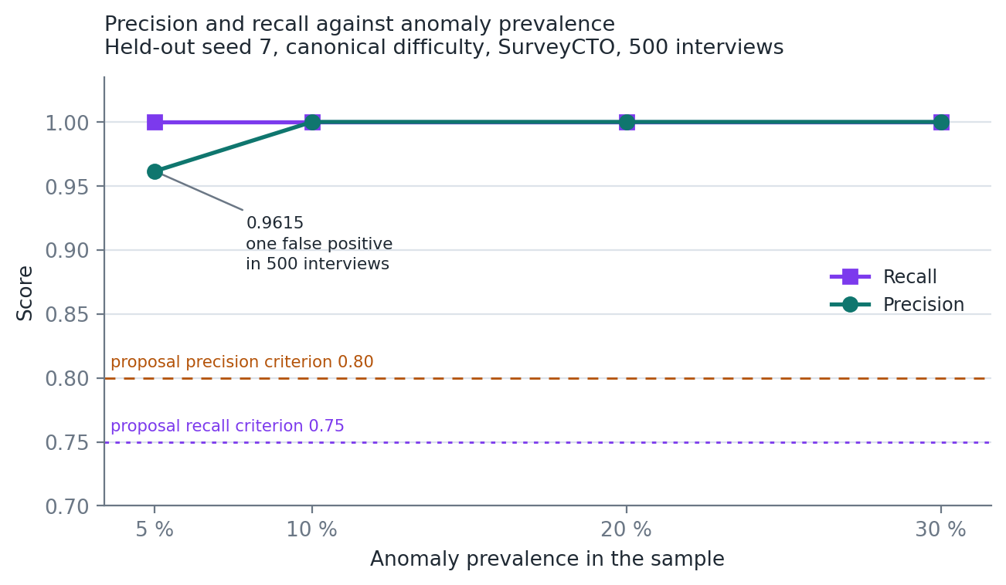
RESULTS 6.4
Performance as anomalies get rarer
Recall holds at 1.0000 across the sweep.
Precision is 1.0000 at 10, 20 and 30 percent and 0.9615 at 5 percent, where a single false positive among twenty-five true anomalies costs almost four points.
That is a property of the metric, not a failure of the detector, but it matters operationally: real fabrication rates are low, so this quantifies the review burden a deployment should expect.
Roughly one false alarm per five hundred interviews at realistic prevalence.
Source: output/robustness_validation/metrics_sweep_r*.csv. Held-out seed 7, canonical difficulty, SurveyCTO, 500 interviews.
Samuel Kaoma | 2022016530 | CSC 4004
42
Notes:
Review capacity is the scarce resource in the settings this is aimed at, so I treat the low-prevalence precision as an operational result rather than a metric artefact. This sweep stops at thirty percent. The next slide extends it to ninety, which is where the method's limit shows.
STUDY NOTE: Low prevalence costs precision: one false positive among 25 anomalies is four points. The next slide extends this sweep.

Slide 52
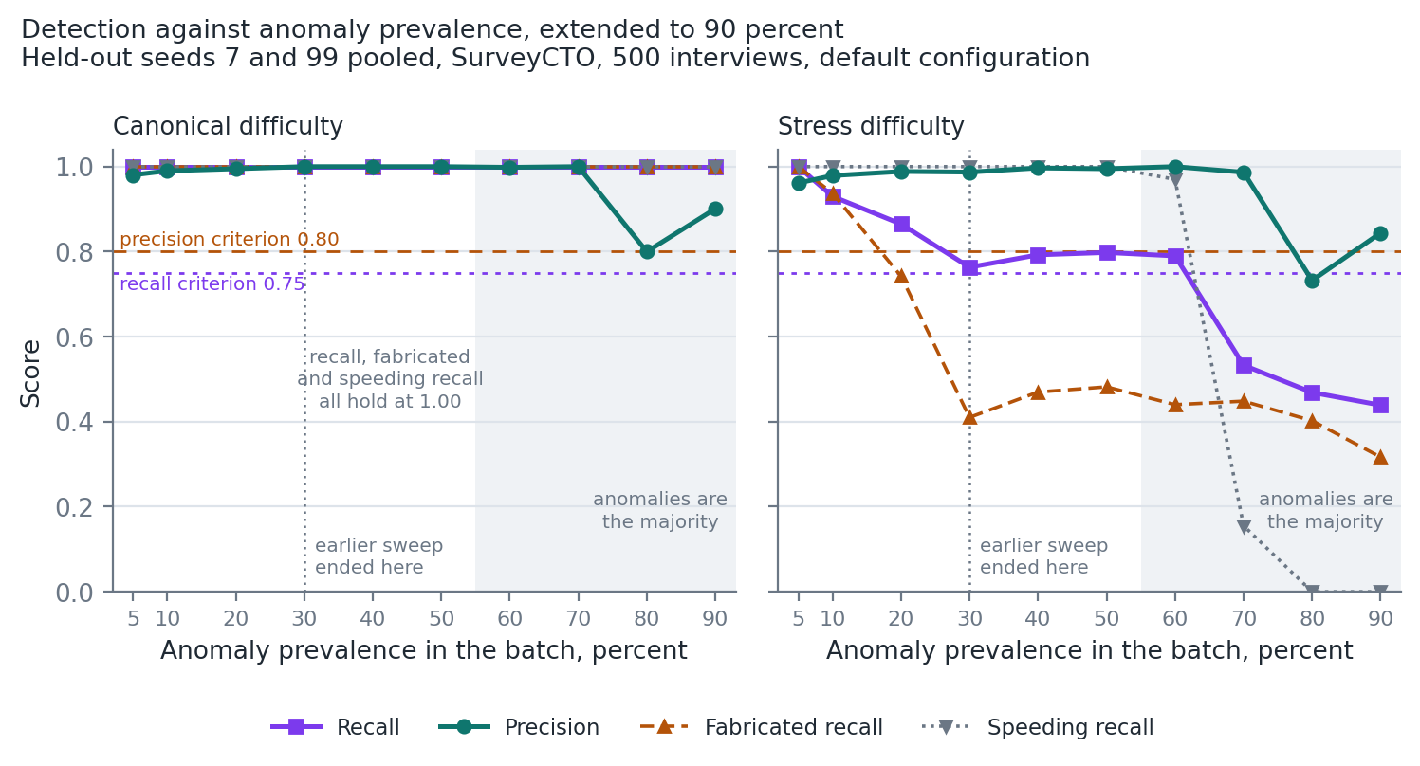
RESULTS 6.4, EXTENDED
Where the method stops working
≤ 50%
prevalence up to which both criteria hold, in every condition
0.44
0.73
stress recall at 90 percent
stress precision at 80 percent
Past half, the batch median is an anomalous interview. Speeders set it, so speeding recall falls to 0; the genuine minority becomes the outliers.
The method assumes anomalies are a minority of the batch: pool batches across enumerators, never one caseload alone.
Source: scripts/run_prevalence_envelope.py; output/prevalence_envelope/envelope_summary.csv. Held-out seeds 7 and 99 pooled, 500 interviews.
Samuel Kaoma | 2022016530 | CSC 4004
43
Notes:
My supervisor ran the same interviews at rising prevalence and found recall falling to 0.40 and precision to 0.72. I reproduced it with a committed script, eighty runs from five to ninety percent. Both criteria hold up to fifty percent in every condition. Beyond that the thresholds are estimated from a batch that is mostly anomalous. Fabrication degrades earlier, from about thirty percent. The case this matters for is an enumerator who fabricates their whole caseload: analysed alone, it is almost all anomalous and largely undetectable. So the detector must run on batches pooled across enumerators. Removing the assumption would need thresholds from a verified reference set, which I have not built.

Slide 53
RESULTS 6.5
Held-out seeds, overlapping profiles
Dataset | Precision | Recall | F1
Seed 7, SurveyCTO | 0.9770 | 0.8500 | 0.9091
Seed 7, ODK | 0.9570 | 0.8900 | 0.9223
Seed 99, SurveyCTO | 1.0000 | 0.8800 | 0.9362
Seed 99, ODK | 1.0000 | 0.8400 | 0.9130
0.9570
0.8400
lowest precision
anywhere in the round
lowest recall
anywhere in the round
Proposal criteria: precision at or above 0.80, recall at or above 0.75. Both are cleared on every run with margin, on data the detector had never seen, under a difficulty built so that genuine and anomalous behaviour overlap.
Performance is consistent across the two platform formats, which is the cross-format parity claim tested rather than assumed.
No committed target is missed by any run in the entire evaluation.
Source: output/robustness_validation/metrics_stress_seed*.csv. Full per-run confusion counts are Appendix B of the report.
Samuel Kaoma | 2022016530 | CSC 4004
44
Notes:
Seeds 7 and 99 were generated after the detector was frozen. The stress generator deliberately blurs the line between genuine and fabricated.
STUDY NOTE: The headline held-out numbers. Precision 0.9570 to 1.0000, recall 0.84 to 0.89 under stress. All above the 0.80 and 0.75 targets.

Slide 54
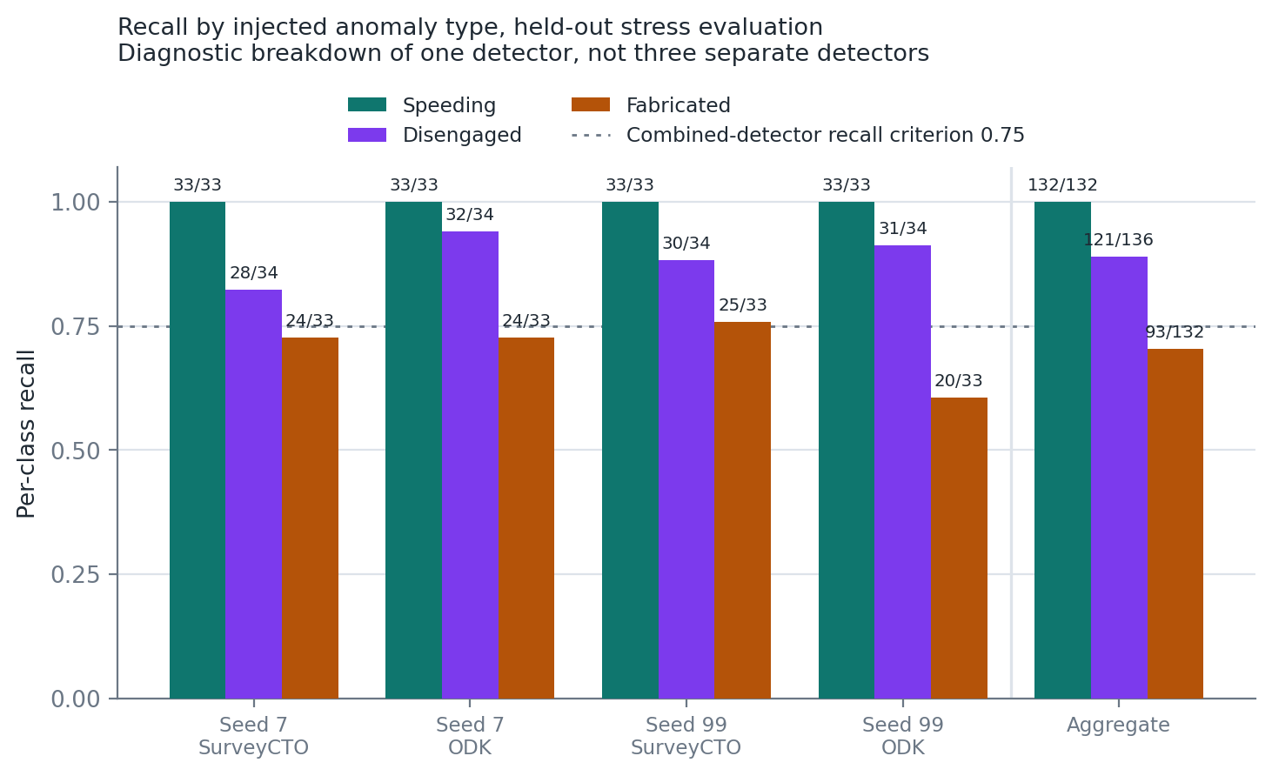
RESULTS 6.6
Where the method is strong and where it is weak
Speeding 132 / 132
Detected without exception in all four runs.
Disengaged 121 / 136
0.89, driven by the median-relative pause rule with elevated back-navigation.
Fabricated 93 / 132
0.70, per-run between 0.61 and 0.76. The weakest class, and the next two slides are about it.
These are diagnostic breakdowns of one detector, not three detectors. The 0.75 criterion is defined for the combined detector and is not a per-class commitment.
Samuel Kaoma | 2022016530 | CSC 4004
45
Notes:
I report the weakest class prominently rather than burying it, because locating where a method fails is more useful than an aggregate that hides it.
STUDY NOTE: Per-class recall under stress: speeding 132 of 132, disengaged 121 of 136, fabricated 93 of 132. These are breakdowns of one detector, not separate targets.

Slide 55
RESULTS 6.6 AND CHAPTER 8
Diagnosing the fabrication misses
The misses are not indistinguishable from genuine interviews.
On the development seeds, response time entropy separates the two populations completely: highest fabricated 1.983 against lowest genuine 2.039. No overlap at all.
A structural limit of the Tukey fence
For right-skewed non-negative quantities such as response time variance, the lower fence Q1 minus 1.5 x IQR falls below zero and is unreachable. No low-side outlier can ever be flagged on those features.
Fabrication is a low-side deviation on exactly those quantities. Entropy escapes it only because it is bounded and roughly symmetric.
So why are they missed? Two mechanisms.
1. The behavioural entropy rule uses an absolute constant of 0.5, calibrated to the tightly compressed fabrication profile. It cannot fire for the mildly compressed one.
2. The entropy fence is estimated on data already containing 20 percent injected anomalies, which drags the lower quartile and the fence down with it. Masking again.
A retraction
An earlier version of my validation document attributed these misses to a joint pattern that univariate methods cannot capture. The data does not support that. I have named the retraction in the document, and no threshold was changed in producing the diagnostic, so every reported result stands unaltered.
This is a calibration and fence-construction failure, not a demonstration that univariate analysis has reached its ceiling.
Samuel Kaoma | 2022016530 | CSC 4004
46
Notes:
The distinction on this slide is the one I most want to get across. The univariate limit is real and I state it as a limitation. But this particular shortfall is not an instance of it, because a single feature separates the missed cases perfectly.
STUDY NOTE: The diagnostic: missed fabrications are separable on entropy (highest fabricated 1.983 against lowest genuine 2.039 on development seeds). The misses are calibration, not a lack of signal.

Slide 56
CHAPTER 7
I built the fix, measured it, and shipped it switched off
The correction keeps the absolute constant as a floor and adds a fence at the median minus three times the distance to the third quartile. That half of the distribution is less contaminated, not uncontaminated, and the fence is tighter than Tukey's. Developed on development seeds, frozen, evaluated once against held-out data.
Measure | Shipped detector | With the correction
Fabricated per-class recall | 0.70 | 1.00
Lowest precision anywhere in the round | 0.9570 | 0.8333
Off by default
The fix is on main as the option entropy_fence_scale, unset by default; the old branch is archived. Setting it to 3.0 reproduces the right-hand column exactly.
Turning it on is a judgement about the cost of a missed fabrication against a genuine enumerator sent for review: a deployment decision, not a methodological one.
The gain concentrates in the stress condition. The cost concentrates at low prevalence, where recall was already complete and every extra flag falls on a genuine interview.
Real fabrication rates are low. So as it stands the correction buys no additional detection in the condition that most resembles deployment, and pays for it in false accusations against real enumerators.
Source: docs/validation_report.md section 5, and section 7 of the final report.
Samuel Kaoma | 2022016530 | CSC 4004
47
Notes:
I did not decline to fix this because it was hard. I fixed it, measured it once on held-out data, and the measurement said it costs more than it earns in the condition that matters, low prevalence. So it ships switched off, as one configuration key, and I report both numbers. Two corrections to what I first wrote: the upper half of the distribution is less contaminated, not uncontaminated, and the fence does not reduce to Tukey's; under symmetry it equals a Tukey fence with multiplier 1.0.
STUDY NOTE: Why the fix is off by default: at low prevalence it adds false accusations and no detection. Know the two numbers, 0.70 to 1.00 and 0.9570 to 0.8333, and the correction to the Tukey claim.

Slide 57
RESULTS 6.7
Scaling to ten thousand interviews
Dataset | Interviews | Runtime | Precision | Recall
n500, SurveyCTO | 500 | 56.12 s | 1.0000 | 1.0000
n10000, SurveyCTO | 10,000 | 1,068.87 s | 0.9945 | 1.0000
x19.05
11
runtime, for x20
the data
false positives
in 10,000
Near-linear, as the design targets. Recall holds at 1.0000 and precision moves only from 1.0000 to 0.9945. Memory was not a constraint: files are processed independently and only interview-level summaries are held for the batch stage.
Which run these times come from. They are the strict examiner audit, the run that carries the scale check as an explicit pass or fail condition. A separate aggregate timing file records 57.54 s and 1,037.74 s from a different run, a factor of 18.04. These are two measurements, not one reported twice, and both place the runtime factor below the twentyfold growth in input size.
Source: output/examiner_audit/strict_examiner_audit_report.md, keys n500_runtime_seconds and n10000_runtime_seconds.
Samuel Kaoma | 2022016530 | CSC 4004
48
Notes:
My supervisor caught that two different runs give 19.05 and 18.04. Rather than pick one silently I name the source run, print its raw times, and disclose the other.
STUDY NOTE: Scale: 500 to 10,000 interviews took 56.12 s to 1,068.87 s, factor 19.05, near linear. The factor varies between runs and machines; the constant cost per interview, about 0.11 s here, is the stable result. Memory grows about 34 KiB per interview.

Slide 58
CHAPTER 5 AND APPENDIX D
How the numbers are verified
44
16 / 16
5
automated tests
strict audit checks
defects found and fixed
Parsers, each extractor, the detector, config validation, the entropy fence option and the end-to-end pipeline. All pass with pandas 3.0.1 and 2.3.2.
Raw-format consistency, normalisation, features recomputed by hand from the raw logs, score reconstruction, baselines, cross-format parity and scale. Every check passes.
Including a pandas 3 timestamp resolution fault that silently produced values a thousand times too small, and a response time computed as a span rather than a sum. All five are covered by tests.
Every quantitative claim in the report resolves to a file under output/, and Appendix D gives the command that regenerates each one. The whole robustness round rebuilds from recorded seeds with a single command.
Final state: tag v-final-release. An independent run on a different Python and pandas reproduced the robustness round exactly.
Samuel Kaoma | 2022016530 | CSC 4004
49
Notes:
None of the figures I have shown require you to trust me. Each names a file, each file regenerates from a documented command, and Appendix D runs end to end from a clean environment built from the pin file. My supervisor ran it on a different Python and pandas and the robustness round reproduced exactly.

Slide 59
PART 6 · TRUST AND LIMITS
How to check any number yourself
Test file | Tests | Covers
test_end_to_end.py | 12 | whole pipeline on generated data, including the precision and recall targets
test_features.py | 9 | each feature family, epoch conversion, pace thirds, relative duration
test_validation_workflows.py | 9 | effect sizes, score contract, fence multiplier, entropy option, configs
test_parsers.py | 7 | both formats, ISO timestamps, native ODK log, one history parsed identically
test_pipeline.py | 7 | aggregation, granular outputs, automatic format detection
Tag | What it marks
v-validation-complete | the validation milestone
v-submission-package | the first submission package
v-resubmission | the version the supervisor reproduced
v-final-release | the final state; Appendix D runs clean
archive/entropy-fence | the retired branch's history
An independent run on a different Python and pandas reproduced the robustness round exactly: 44 tests, clean pin file.
Report Appendix D and docs/evidence_index.md; tags on github.com/Samuelkaoma-eng/SKACE-TIME-DATA.
Samuel Kaoma | 2022016530 | CSC 4004
50
Notes:
If an examiner doubts a number, the answer is always the same: it is in a file under output, and Appendix D gives the command that regenerates it. The tags pin the exact commit for each milestone. The final release fixed the one gap the supervisor found: the pin file lacked the two packages the Word and PDF rebuild imports.

Slide 60
CHAPTER 3.6 AND APPENDIX A
Ethics, and the disclosure that goes with it
Data and privacy
Responsible use
AI usage disclosure
All evaluation data is synthetic, generated from recorded seeds. No respondent data of any kind was processed.
Paradata records timing and navigation, not answers or identities.
No data belonging to any third party was uploaded to any external tool at any point.
A flag is an accusation about a named enumerator's work, so it must be explainable and it must be reviewable.
Flags are signals for human review, never proof, and never a sole basis for sanction.
The severity bands separate an interview that warrants a question from one that warrants investigation.
Appendix A records every episode of tool use: what was asked, what was provided, and whether the output was accepted, modified or rejected.
Tool versions where recoverable, and stated as unrecoverable where not.
No code-level suggestion entered the work without a test or recorded output check behind it.
The tool flags interviews for review. It must never be the sole basis for action against a person.
Samuel Kaoma | 2022016530 | CSC 4004
51
Notes:
My supervisor's standard is that the AI usage disclosure is a report appendix, not a file in a repository. It is now Appendix A, expanded with prompt summaries, data categories and explicit accept, modify or reject decisions.

Slide 61
CHAPTER 8
What this does not establish
Evaluation is synthetic throughout
Results estimate an upper bound on field performance. Eight of the forty features are constant across the corpus, so the evaluation is silent on them rather than negative. It measures the detector against a documented threat model, not the full space of real behaviour.
Detection is univariate
Anomalies visible only in joint feature patterns will evade both fences and rules. The fabrication shortfall is not an instance of this, since one feature separates the missed cases cleanly, but the limit is real.
Anomalies must be a minority of the batch
Thresholds are estimated from the batch they judge. Both criteria hold up to 50 percent prevalence; beyond it recall under stress falls to 0.44. One enumerator's fabricated caseload, analysed alone, is largely undetectable, so batches must be pooled across enumerators.
Thresholds and external dependencies
Defaults come from the literature and calibration data; instruments unlike the twenty-question household pattern should recalibrate. The pipeline also depends on device clocks and on each platform holding its current audit schema.
Samuel Kaoma | 2022016530 | CSC 4004
52
Notes:
The platform asymmetry I once reported here is gone: when the same interviews are written in both formats, every feature and every decision is identical. In its place is the limitation that matters most for deployment, the prevalence envelope. Validation against real field paradata with verified outcomes remains the most important extension.
STUDY NOTE: The limitations an examiner will probe. The first three are about the evidence; the batch-minority assumption is about the method.

Slide 62
PROJECT MANAGEMENT
Delivered against the 32-week plan
Weeks 1 to 7
Weeks 8 to 13
Weeks 14 to 21
Weeks 22 to 29
Weeks 30 to 32
Proposal and literature review
>
Design and parsers
>
Features and detection
>
Validation and documentation
>
Report and submission
Done
Done
Done
Done
Done
Deliverable (Proposal section 4) | Status | Where
Python feature library, 30 to 50 features, documented | 40 features | src/features/, feature documentation
Paradata format guide, SurveyCTO and ODK | Done | docs/paradata_format_guide.md
Labelled synthetic validation datasets | Done | data/synthetic_datasets/, n500 to n10000
Validation report with precision, recall, effect sizes | Done | docs/validation_report.md
Final paper and this presentation | Done | report/, docs/deliverables/
AI usage log as a report appendix | Done | Appendix A of the final report
Every phase and deliverable is evidenced in docs/milestone_tracker.md and docs/evidence_index.md against named commits and tags.
Samuel Kaoma | 2022016530 | CSC 4004
53
Notes:
Each row here maps to a tag and a set of commits in the evidence index, so any claim on this slide can be opened and checked.

Slide 63
ASSESSMENT
Mapping to the course learning outcomes
Outcome | Where it is demonstrated
i. Concepts, applications and challenges | Literature review covers outlier detection theory and the univariate versus multivariate trade-off. Challenges are measured, not asserted: masking, threshold calibration, and the unreachable Tukey lower fence.
ii. Preprocess data | Two platform parsers reduce heterogeneous audit logs to one intermediate representation. Timestamp normalisation across epoch milliseconds and ISO 8601, hybrid file splitting, and explicit quality flagging.
iii. Implement algorithms | Unsupervised detection: Tukey fences combined with rule logic, evaluated as binary classification. Mann-Whitney U with Cohen's d and Bonferroni adjustment for feature validity.
iv. Data warehousing | Addressed in part: the parser pipeline is an ETL design with a common target schema, though no OLAP cube or star schema was built.
v. Evaluate models | Precision, recall, F1 against labelled ground truth, two named baselines, a prevalence sweep, a per-component breakdown, and a scale check from 500 to 10,000 interviews.
vi. Apply tools | Python throughout: pandas, NumPy, SciPy, statsmodels, scikit-learn, pytest, with continuous integration. Weka and RapidMiner were not appropriate to a custom parsing pipeline.
vii. Ethical and professional issues | Synthetic data only, explainable flags, human review required before action, and a full AI usage disclosure as Appendix A.
Samuel Kaoma | 2022016530 | CSC 4004
54
Notes:
Outcome iv is the one I address only in part, and I say so rather than stretching the claim.

Slide 64
github.com/Samuelkaoma-eng/SKACE-TIME-DATA
Timing paradata is usable, and it beats what field practice runs today.
Precision 0.96 to 1.00 and recall 0.84 to 1.00 on data the detector had never seen, inside a measured envelope: anomalies must be a minority of the batch. Five of six objectives met in full.
+34%
40
≤ 50%
0.70
recall over duration-only checking
documented, tested features
anomaly prevalence the method holds to
fabricated recall: the honest weak point
Samuel Kaoma | 2022016530 | CSC 4004
55
Notes:
If there is one thing to take from this, it is that I would rather report where the method is weak than show you only the aggregate that hides it: fabricated recall of 0.70 under stress, and a detector that needs anomalies to be a minority of the batch. Thank you. I am happy to take questions.

Slide 65
CHAPTER 2
Key references
Birnbaum, B., Borriello, G., Flaxman, A.D., DeRenzi, B. and Karlin, A.R. (2013) 'Using behavioral data to identify interviewer fabrication in surveys', CHI '13, pp. 2911-2920.
Bushery, J.M., Reichert, J.W., Albright, K.A. and Rossiter, J.C. (1999) 'Using date and time stamps to detect interviewer falsification', Proceedings of the Survey Research Methods Section, ASA, pp. 316-320.
Chandola, V., Banerjee, A. and Kumar, V. (2009) 'Anomaly detection: a survey', ACM Computing Surveys, 41(3), pp. 1-58.
Finn, A. and Ranchhod, V. (2017) 'Genuine fakes: the prevalence and implications of data fabrication in a large South African survey', The World Bank Economic Review, 31(1), pp. 129-157.
Goel, D., Abraham, R. and Lahoti, R. (2022) Improving Survey Quality Using Paradata. IZA Discussion Paper No. 15041.
Hoogeveen, J. and Pape, U. (eds.) (2020) Data Collection in Fragile States: Innovations from Africa and Beyond. Cham: Palgrave Macmillan.
Hubert, M. and Vandervieren, E. (2008) 'An adjusted boxplot for skewed distributions', Computational Statistics & Data Analysis, 52, pp. 5186-5201.
Kreuter, F. (ed.) (2013) Improving Surveys with Paradata. Hoboken, NJ: Wiley.
Schwanhäuser, S., Sakshaug, J.W. and Kosyakova, Y. (2022) 'How to catch a falsifier', Public Opinion Quarterly, 86(1), pp. 51-81.
Yan, T. and Tourangeau, R. (2008) 'Fast times and easy questions', Applied Cognitive Psychology, 22(1), pp. 51-68.
Full list of 28 references in the final report, Harvard style, each checked against its source in Appendix E.
Samuel Kaoma | 2022016530 | CSC 4004
56
Notes:
The two references withdrawn after verification, Wenz et al. (2019) and Conrad et al. (2013), no longer appear anywhere.

Slide 66
PART 7 · GLOSSARY
Terms, 1 of 2
Term | Meaning
Audit log / text audit | the platform's timestamped record of every event in an interview
Paradata | data about the process of an interview rather than its answers
Common intermediate representation | the six columns both parsers produce
Epoch milliseconds | time as milliseconds since 1 January 1970 UTC
Curbstoning | an interviewer fabricating an interview; the fabrication profile
Satisficing | answering with minimum effort rather than optimally (Krosnick)
Canonical / stress | clean, separated profiles / deliberately overlapping ones
Held-out seed | a random seed never used while the detector was being built
Prevalence | the share of anomalous interviews in a batch
Samuel Kaoma | 2022016530 | CSC 4004
57
Notes:
Be able to define each of these in one sentence without notes. Audit log / text audit: the platform's timestamped record of every event in an interview. Paradata: data about the process of an interview rather than its answers. Common intermediate representation: the six columns both parsers produce. Epoch milliseconds: time as milliseconds since 1 January 1970 UTC. Curbstoning: an interviewer fabricating an interview; the fabrication profile. Satisficing: answering with minimum effort rather than optimally (Krosnick). Canonical / stress: clean, separated profiles / deliberately overlapping ones. Held-out seed: a random seed never used while the detector was being built. Prevalence: the share of anomalous interviews in a batch.

Slide 67
PART 7 · GLOSSARY
Terms, 2 of 2
Term | Meaning
Quartiles, IQR | the 25th and 75th percentiles; the distance between them
Tukey fence | Q1 − 1.5 IQR and Q3 + 1.5 IQR; values outside are flagged
Masking | outliers distorting the statistic meant to detect them
Shannon entropy | unpredictability of the response-time distribution, in bits
Coefficient of variation | standard deviation divided by mean; scale-free spread
Precision / recall | share of flags that are right / share of anomalies caught
Cohen's d / rank-biserial | size of a difference / degree of overlap between groups
Bonferroni | multiplying p-values by the number of tests
Prevalence envelope | the range of prevalence in which both targets hold: up to 50%
Samuel Kaoma | 2022016530 | CSC 4004
58
Notes:
Be able to define each of these in one sentence without notes. Quartiles, IQR: the 25th and 75th percentiles; the distance between them. Tukey fence: Q1 − 1.5 IQR and Q3 + 1.5 IQR; values outside are flagged. Masking: outliers distorting the statistic meant to detect them. Shannon entropy: unpredictability of the response-time distribution, in bits. Coefficient of variation: standard deviation divided by mean; scale-free spread. Precision / recall: share of flags that are right / share of anomalies caught. Cohen's d / rank-biserial: size of a difference / degree of overlap between groups. Bonferroni: multiplying p-values by the number of tests. Prevalence envelope: the range of prevalence in which both targets hold: up to 50%.

Slide 68
Preparing for the viva.
Sixteen questions an examiner is likely to ask, with the short answer on the slide. The speaker notes hold the full answer and where the evidence is in the report.
Samuel Kaoma | 2022016530 | CSC 4004
59
Notes:
Backup slides for the question session.

Slide 69
VIVA 1 · THE METHOD
Why it is built this way
Why rules and fences, not machine learning?
Why a count, with cut-offs 2 and 5?
There is no labelled field data to train on, and a flag accuses a named enumerator, so every point must be explainable. No labelled field data exists for these platforms, and a flag leads to a conversation with a named enumerator, so the score has to be a list of reasons. A supervised model is the stronger design once labels exist, as Birnbaum et al. (2013) show with 96 percent accuracy on experimentally labelled data; section 7 compares the two.
A count makes every point a named reason. Two stops any single rule triggering review; five needs agreement across families. Section 3.4 and Table 1a. In the canonical suite every genuine interview scored at most one, so two sits above genuine behaviour. Five typically needs duration, distributional shape and navigation to agree.
Why cap the four fences at one point?
Why median-relative thresholds?
Duration, mean time, entropy and variance share one underlying pacing; uncapped, one behaviour could score four. Section 3.4. The component breakdown in section 6.3 also shows the rules carry most of the detection: rules alone reach precision 0.9988 and recall 0.9319, fences alone 0.6628 and 0.6162.
What counts as fast depends on the instrument. Relative thresholds adapt, as in Goel et al.'s dynamic benchmarking. Goel et al. (2022, abstract and p. 4). The cost is the prevalence envelope: relative thresholds need a mostly genuine batch. Say this before the examiner does.
Full answers and where the evidence is: speaker notes.
Samuel Kaoma | 2022016530 | CSC 4004
60
Notes:
Q: Why rules and fences, not machine learning?
A: There is no labelled field data to train on, and a flag accuses a named enumerator, so every point must be explainable. No labelled field data exists for these platforms, and a flag leads to a conversation with a named enumerator, so the score has to be a list of reasons. A supervised model is the stronger design once labels exist, as Birnbaum et al. (2013) show with 96 percent accuracy on experimentally labelled data; section 7 compares the two.
Q: Why a count, with cut-offs 2 and 5?
A: A count makes every point a named reason. Two stops any single rule triggering review; five needs agreement across families. Section 3.4 and Table 1a. In the canonical suite every genuine interview scored at most one, so two sits above genuine behaviour. Five typically needs duration, distributional shape and navigation to agree.
Q: Why cap the four fences at one point?
A: Duration, mean time, entropy and variance share one underlying pacing; uncapped, one behaviour could score four. Section 3.4. The component breakdown in section 6.3 also shows the rules carry most of the detection: rules alone reach precision 0.9988 and recall 0.9319, fences alone 0.6628 and 0.6162.
Q: Why median-relative thresholds?
A: What counts as fast depends on the instrument. Relative thresholds adapt, as in Goel et al.'s dynamic benchmarking. Goel et al. (2022, abstract and p. 4). The cost is the prevalence envelope: relative thresholds need a mostly genuine batch. Say this before the examiner does.

Slide 70
VIVA 2 · THE EVALUATION
Is the evidence sound?
You wrote the generator and the detector. Isn't that circular?
Early runs scored 1.00. Why distrust that?
Partly, and section 8 says so. Held-out seeds, stress overlap and removing generator-mirroring settings limit it. The evaluation measures the detector against a documented threat model, not the full range of real behaviour. Mitigations: settings that mirrored the generator were removed before the final round, reported runs use seeds 7 and 99 never used in development, and the stress difficulty overlaps genuine and anomalous profiles. The real answer is back-checked field data, which is the first item of future work.
The profiles were too cleanly separated and the detector was partly tuned to the generator. A perfect score meant an easy test. Section 7 and the reflection in 9.1. The evaluation was rebuilt to fail: held-out seeds, overlapping profiles, a prevalence sweep and a component breakdown that reports the weaker half of the detector.
Do SurveyCTO and ODK results differ?
What does the baseline comparison show?
Not once the same interviews are written in both: all forty features and every decision are identical (Table 6b). The earlier apparent asymmetry came from the two files holding different generated interviews. scripts/run_platform_parity.py writes one history into both formats; the parser is not the cause.
Duration-only checking finds 66 of 100 anomalies on the canonical benchmark and none of 400 under stress. Table 3 and Table 6a. The full detector finds all 100 on the canonical benchmark and 84 to 89 percent under stress. A V-10 rule baseline, a run of 20 events without back-navigation, finds 35 to 51 percent under stress at precision below 0.22.
Full answers and where the evidence is: speaker notes.
Samuel Kaoma | 2022016530 | CSC 4004
61
Notes:
Q: You wrote the generator and the detector. Isn't that circular?
A: Partly, and section 8 says so. Held-out seeds, stress overlap and removing generator-mirroring settings limit it. The evaluation measures the detector against a documented threat model, not the full range of real behaviour. Mitigations: settings that mirrored the generator were removed before the final round, reported runs use seeds 7 and 99 never used in development, and the stress difficulty overlaps genuine and anomalous profiles. The real answer is back-checked field data, which is the first item of future work.
Q: Early runs scored 1.00. Why distrust that?
A: The profiles were too cleanly separated and the detector was partly tuned to the generator. A perfect score meant an easy test. Section 7 and the reflection in 9.1. The evaluation was rebuilt to fail: held-out seeds, overlapping profiles, a prevalence sweep and a component breakdown that reports the weaker half of the detector.
Q: Do SurveyCTO and ODK results differ?
A: Not once the same interviews are written in both: all forty features and every decision are identical (Table 6b). The earlier apparent asymmetry came from the two files holding different generated interviews. scripts/run_platform_parity.py writes one history into both formats; the parser is not the cause.
Q: What does the baseline comparison show?
A: Duration-only checking finds 66 of 100 anomalies on the canonical benchmark and none of 400 under stress. Table 3 and Table 6a. The full detector finds all 100 on the canonical benchmark and 84 to 89 percent under stress. A V-10 rule baseline, a run of 20 events without back-navigation, finds 35 to 51 percent under stress at precision below 0.22.

Slide 71
VIVA 3 · LIMITS AND DECISIONS
Where the method is weak
What if an enumerator fabricates their whole caseload?
Why did your sweep first stop at 30 percent?
Analysed alone, that batch is almost all anomalous and detection collapses. Criteria hold only up to 50 percent prevalence. Section 6.4, Table 5a and Figure 3; section 8. Pooling across enumerators keeps one caseload a minority, but fails if a whole team fabricates. Thresholds from a verified reference set, for example back-checked interviews from earlier rounds, would remove the assumption; it is future work.
Real fabrication rates are low, so I tested low prevalence. That missed the concentrated case, which is now measured to 90. Answer directly: it was a gap, it was pointed out, and the envelope is now measured and stated. A stated limit with a figure behind it is stronger than a silent one.
Why is fabricated recall only 0.70 under stress?
You built a fix. Why is it off by default?
Mild fabrications clear median-relative thresholds by narrow margins. Entropy separates them with no overlap: calibration, not signal. Section 6.6 and the diagnostic in docs/fabricated_detection_diagnostic.md: highest fabricated entropy 1.983 against lowest genuine 2.039 on development seeds. The worked example INT-00009 clears each flag by under five percent.
It lifts fabricated recall to 1.00 but drops the lowest precision to 0.83, at low prevalence where real surveys are. Section 7. At five percent prevalence it adds four false accusations and no extra detection. It ships as entropy_fence_scale, unset by default. It also does not reduce to Tukey's fence as I first wrote: under symmetry it equals a multiplier of 1.0.
Full answers and where the evidence is: speaker notes.
Samuel Kaoma | 2022016530 | CSC 4004
62
Notes:
Q: What if an enumerator fabricates their whole caseload?
A: Analysed alone, that batch is almost all anomalous and detection collapses. Criteria hold only up to 50 percent prevalence. Section 6.4, Table 5a and Figure 3; section 8. Pooling across enumerators keeps one caseload a minority, but fails if a whole team fabricates. Thresholds from a verified reference set, for example back-checked interviews from earlier rounds, would remove the assumption; it is future work.
Q: Why did your sweep first stop at 30 percent?
A: Real fabrication rates are low, so I tested low prevalence. That missed the concentrated case, which is now measured to 90. Answer directly: it was a gap, it was pointed out, and the envelope is now measured and stated. A stated limit with a figure behind it is stronger than a silent one.
Q: Why is fabricated recall only 0.70 under stress?
A: Mild fabrications clear median-relative thresholds by narrow margins. Entropy separates them with no overlap: calibration, not signal. Section 6.6 and the diagnostic in docs/fabricated_detection_diagnostic.md: highest fabricated entropy 1.983 against lowest genuine 2.039 on development seeds. The worked example INT-00009 clears each flag by under five percent.
Q: You built a fix. Why is it off by default?
A: It lifts fabricated recall to 1.00 but drops the lowest precision to 0.83, at low prevalence where real surveys are. Section 7. At five percent prevalence it adds four false accusations and no extra detection. It ships as entropy_fence_scale, unset by default. It also does not reduce to Tukey's fence as I first wrote: under symmetry it equals a multiplier of 1.0.

Slide 72
VIVA 4 · SOURCES, ENGINEERING AND AI
Can the work be trusted?
Two references could not be found. What did you do?
What was the hardest bug?
Withdrew them, checked every reference against its source, and recorded how far each was read (Appendix E). Seventeen feature justifications rested on the two lost references and were rebuilt; Appendix F now shows 23 of 40 features with a named source and 17 as design choices. A recheck against the full texts corrected several paraphrases and page numbers.
pandas 3 moved datetimes to microseconds, so ODK durations came out 1,000 times too small, silently. Found in a clean-environment audit, fixed with timedelta arithmetic, and covered by a regression test. Also fixed: Q-01 had been a first-to-last span identical to Q-10, not the sum of event durations the documentation describes.
How can an examiner reproduce your numbers?
How did you use AI, and what is yours?
Appendix D, from tag v-final-release, in a fresh environment from requirements-validated.txt. An independent run on a different Python and pandas reproduced the robustness round exactly. The pin file now includes the two packages the Word and PDF rebuild needs, so every step of Appendix D runs.
Appendix A logs every episode. The design, taxonomy, method and every judgement are mine; no number was taken on trust. Claude was used for code review, drafting and reference checking; every output was verified against a file or a source before it was used, and the log records what was accepted, modified or rejected, including a correction I declined to make the default.
Full answers and where the evidence is: speaker notes.
Samuel Kaoma | 2022016530 | CSC 4004
63
Notes:
Q: Two references could not be found. What did you do?
A: Withdrew them, checked every reference against its source, and recorded how far each was read (Appendix E). Seventeen feature justifications rested on the two lost references and were rebuilt; Appendix F now shows 23 of 40 features with a named source and 17 as design choices. A recheck against the full texts corrected several paraphrases and page numbers.
Q: What was the hardest bug?
A: pandas 3 moved datetimes to microseconds, so ODK durations came out 1,000 times too small, silently. Found in a clean-environment audit, fixed with timedelta arithmetic, and covered by a regression test. Also fixed: Q-01 had been a first-to-last span identical to Q-10, not the sum of event durations the documentation describes.
Q: How can an examiner reproduce your numbers?
A: Appendix D, from tag v-final-release, in a fresh environment from requirements-validated.txt. An independent run on a different Python and pandas reproduced the robustness round exactly. The pin file now includes the two packages the Word and PDF rebuild needs, so every step of Appendix D runs.
Q: How did you use AI, and what is yours?
A: Appendix A logs every episode. The design, taxonomy, method and every judgement are mine; no number was taken on trust. Claude was used for code review, drafting and reference checking; every output was verified against a file or a source before it was used, and the log records what was accepted, modified or rejected, including a correction I declined to make the default.

