Slide 1
MetaboTyping Agentic Workbench
Gene-, metabolite-, study-, and variable-led evidence reuse
Samuel Montalvo, Ph.D. | Stanford University
Notes:
Timing: 1 minute.
Open with the expanded scope: the workbench can now start from a gene, metabolite, study, paper, or variable, but every path still ends in reviewable evidence rather than an autonomous scientific claim.
Preview the throughline: allowlisted retrieval, offline appraisal, explicit uncertainty states, human gates, and executable regression tests.
[Sources]
- /Users/samuelmontalvo/Documents/GitHub/metabotyping-agentic-workbench/README.md
- /Users/samuelmontalvo/Documents/GitHub/metabotyping-agentic-workbench/docs/skill_evaluation_report.md
- /Users/samuelmontalvo/.codex/skills/stanford-presentation-template/assets/stanford-slide-template.pptx

Slide 2
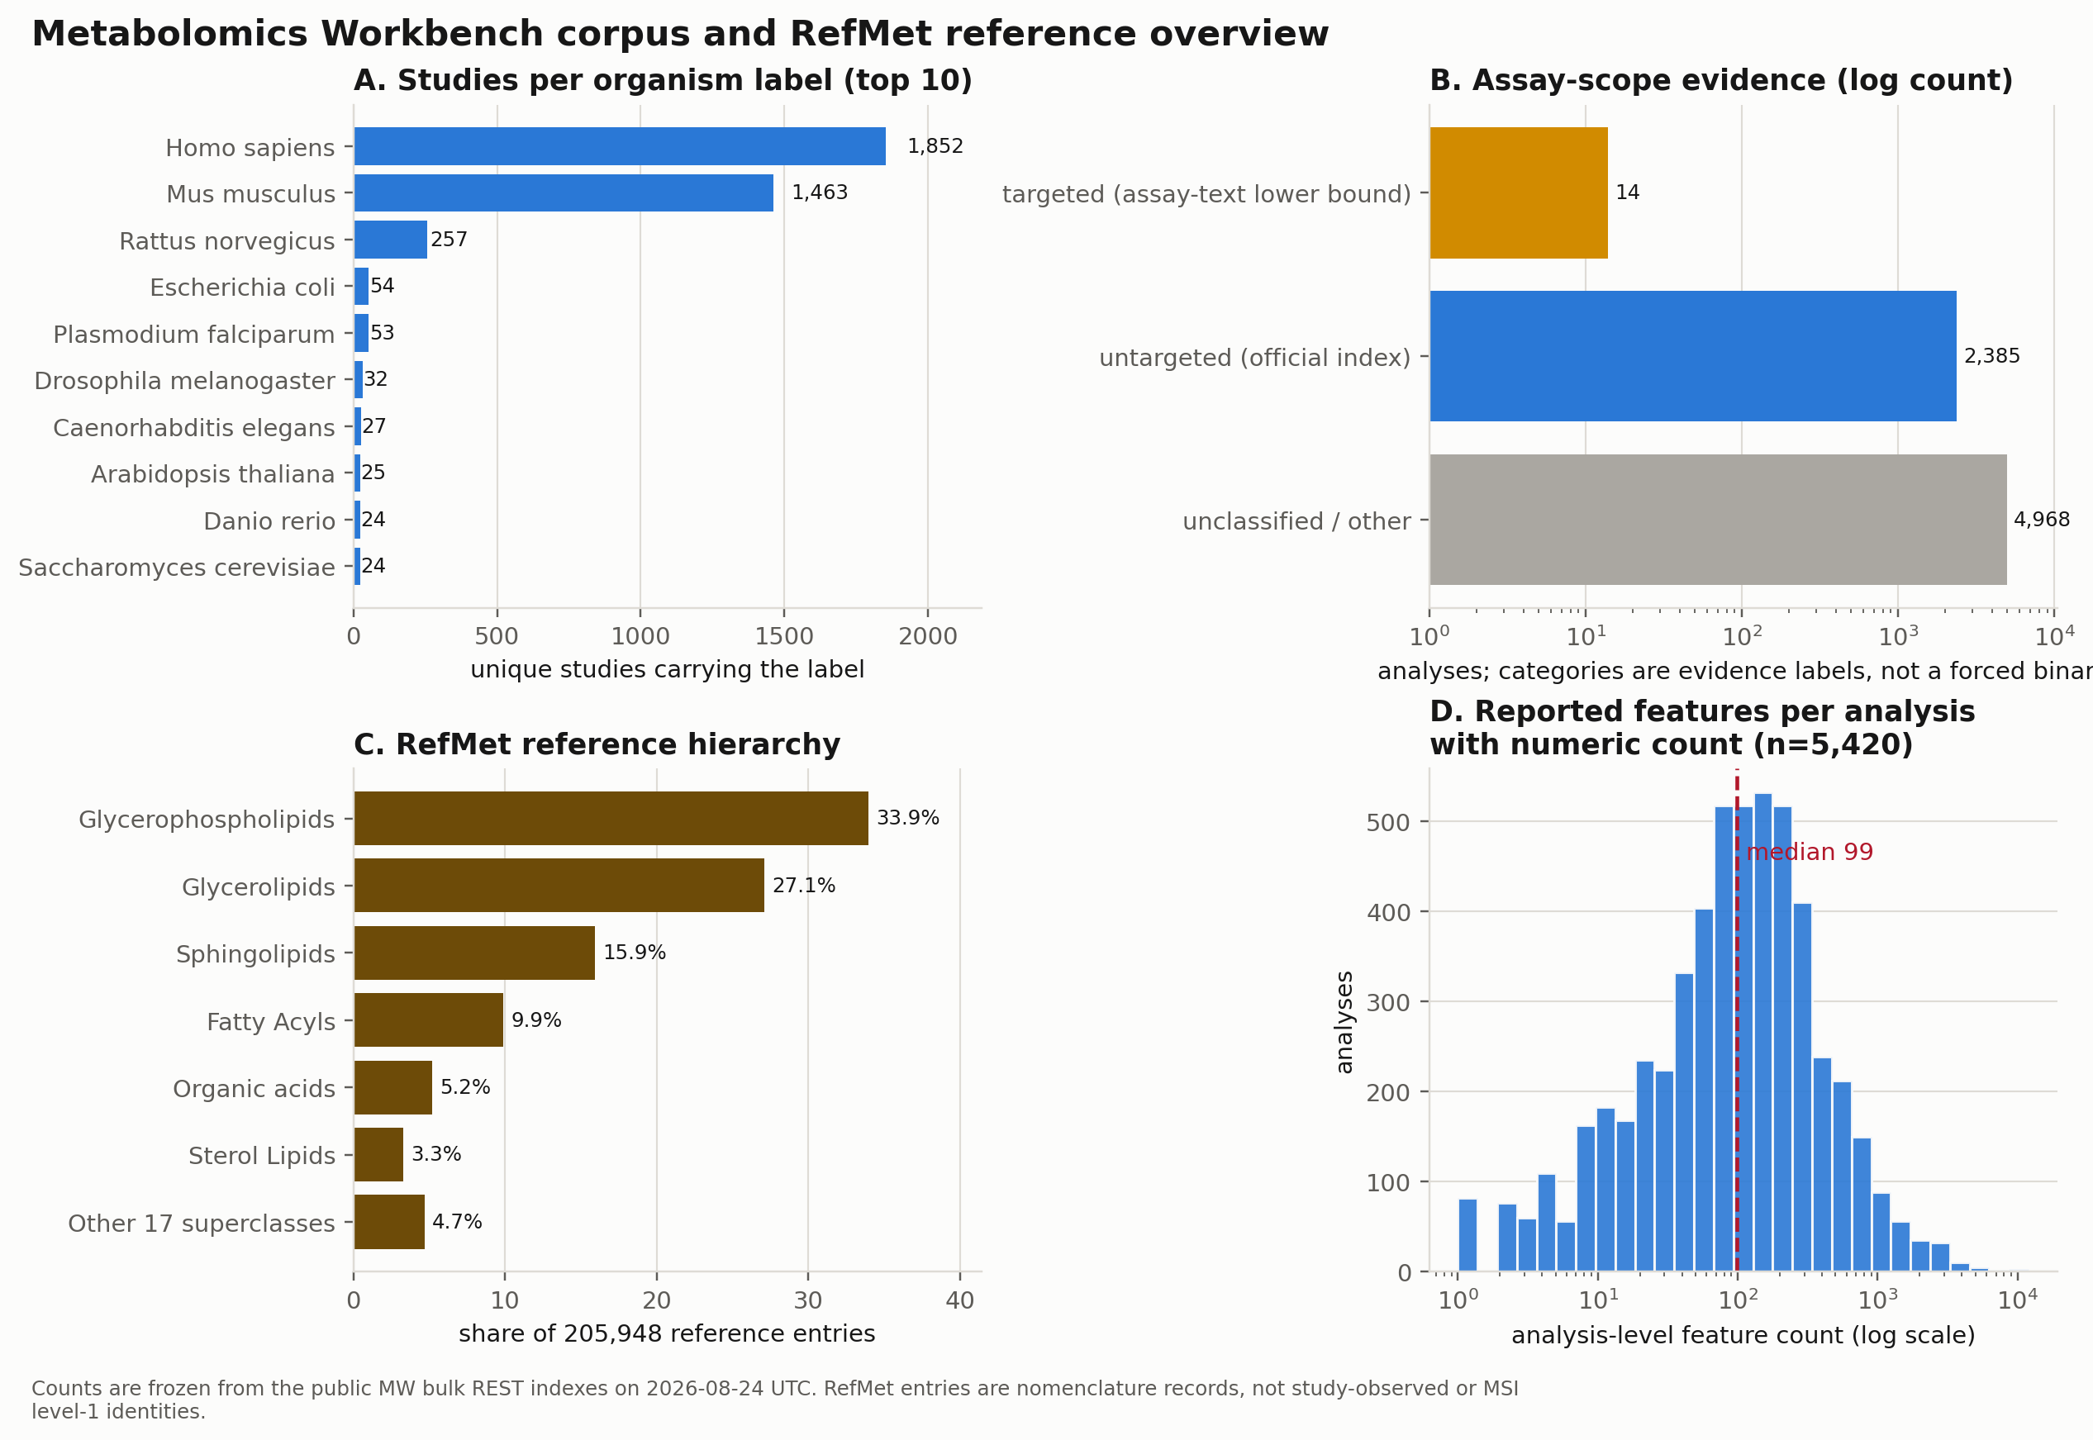
Scale amplifies the comparability problem
4,499
study summaries
7,367
analysis records
More records create more opportunities for hidden incompatibility.
Notes:
Timing: 2 minutes.
The frozen public corpus shows abundance, not immediate comparability.
Emphasize the different denominators: study summaries, analyses, feature incidences, and reference nomenclature cannot be treated as one count.
The scientific bottleneck is proving identity, assay, timing, phenotype, and estimand compatibility before combining results.
[Sources]
- /Users/samuelmontalvo/Documents/GitHub/metabotyping-agentic-workbench/reports_live/final_workbench_report/figures/corpus_landscape.png
- /Users/samuelmontalvo/Documents/GitHub/metabotyping-agentic-workbench/reports_live/final_workbench_report/final_report.html
- /Users/samuelmontalvo/Documents/GitHub/metabotyping-agentic-workbench/data/live/mw_corpus_snapshot/manifest.json

Slide 3
Six reviewable stages move evidence to a report
STAGE 1
STAGE 2
STAGE 3
STAGE 4
STAGE 5
Find studies
Extract
Harmonize
Analyze
Summarize
rank candidates
metadata cards
RefMet + variables
CSV + Markdown
evidence + limits
HUMAN GATES
TRACEABLE ARTIFACTS
STAGE 6 · REPORT
identity • protocol • estimand
typed tables + provenance
review packet + cited figures
Every stage can pause, abstain, or return to human review
Notes:
Timing: 2.5 minutes.
Use this as the talk map: find candidate studies, extract metadata, harmonize metabolite identities and variables, analyze study-specific contrasts, summarize the evidence and limitations, and package the result as a cited report.
Each stage creates inspectable artifacts. Structured results and provenance are persisted as CSV or JSON; human-readable reports and review packets are Markdown; figures are rendered from the persisted tables.
The visible shorthand, CSV + Markdown, emphasizes the handoff to a human reviewer. It does not imply that JSON provenance or figures are absent.
Uncertain identities, mappings, protocols, or estimands are routed to review queues and packets. They cannot enter deterministic ETL or be treated as accepted results without adjudication.
[Sources]
- /Users/samuelmontalvo/Documents/GitHub/metabotyping-agentic-workbench/src/metabotyping_agentic/io.py
- /Users/samuelmontalvo/Documents/GitHub/metabotyping-agentic-workbench/src/metabotyping_agentic/harmonization/harmonization_plan.py
- /Users/samuelmontalvo/Documents/GitHub/metabotyping-agentic-workbench/src/metabotyping_agentic/reports/render.py
- /Users/samuelmontalvo/Documents/GitHub/metabotyping-agentic-workbench/.agents/skills/human-review-packet/SKILL.md
- /Users/samuelmontalvo/Documents/GitHub/metabotyping-agentic-workbench/.agents/skills/harmonization-plan/SKILL.md

Slide 4
ChatGPT answers; skills standardize; agents execute
CONVERSATION
REUSABLE METHOD
GOAL-DIRECTED
ChatGPT
Skill
Agent
responds to prompts
instructions + checks
plans, tools, loops
USER ORCHESTRATES
NOT A WORKER
AGENT ORCHESTRATES
ask → inspect → ask again
called by a model or agent
selects skills + tools
Same model; different contract: answer or orchestrate.
Notes:
Timing: 1.5 minutes.
These are operating layers, not three different levels of intelligence.
With direct ChatGPT use, the model responds to a prompt and the user manages the sequence: ask, inspect, and ask again.
A skill is a reusable method or contract: structured instructions, checks, and an expected output. It does not independently decide to run.
An agent is goal-directed orchestration. It maintains state, chooses tools and skills, iterates, produces artifacts, and can pause for human review.
ChatGPT can host agentic behavior when it is given tools, state, and permission to coordinate a workflow. The distinction is the operating contract, not a separate kind of intelligence.
In this workbench, agents call domain skills such as study discovery, metadata-card extraction, identity resolution, crosswalking, analysis planning, and report packaging.
[Sources]
- /Users/samuelmontalvo/Documents/GitHub/metabotyping-agentic-workbench/README.md
- /Users/samuelmontalvo/Documents/GitHub/metabotyping-agentic-workbench/AGENTS.md
- /Users/samuelmontalvo/Documents/GitHub/metabotyping-agentic-workbench/.agents/skills
- /Users/samuelmontalvo/Documents/GitHub/metabotyping-agentic-workbench/src/metabotyping_agentic

Slide 5
Every evidence path stays traceable
EVIDENCE ENTRY
ALLOWLISTED RETRIEVAL
OFFLINE APPRAISAL
HUMAN GATES
START WITH
ONLINE
Gene / protein
MetGENE + MW MGP
DETERMINISTIC
REVIEW REQUIRED
symbol • alias • accession
annotation contexts; licence-aware
Typed ledgers
Decision gates
inference
coverage
evidence cards
review queue
licence
identity
protocol
estimand
START WITH
ONLINE
Metabolite / study
MW + literature
name • ID • m/z • paper
study, effect, and paper indices
Review packet + traceable artifacts
No autonomous acceptance, pooling, or identity claim
Notes:
Timing: 2.5 minutes.
The update is not another free-form agent layer. It adds explicit entry points and keeps retrieval separate from appraisal.
The gene route uses MetGENE and Metabolomics Workbench contexts; metabolite, study, effect, and literature routes use their own allowlisted adapters.
Retrieved records are appraised offline into typed inference, coverage, evidence-card, and review artifacts.
Licence, chemical identity, protocol, and estimand decisions remain named human gates. Unavailable, no-hit, unresolved, server-error, empty-body, and not-requested states are not collapsed.
[Sources]
- /Users/samuelmontalvo/Documents/GitHub/metabotyping-agentic-workbench/README.md
- /Users/samuelmontalvo/Documents/GitHub/metabotyping-agentic-workbench/AGENTS.md
- /Users/samuelmontalvo/Documents/GitHub/metabotyping-agentic-workbench/src/metabotyping_agentic/knowledge/source_registry.py
- /Users/samuelmontalvo/Documents/GitHub/metabotyping-agentic-workbench/src/metabotyping_agentic/live_sources/literature_search.py
- /Users/samuelmontalvo/Documents/GitHub/metabotyping-agentic-workbench/src/metabotyping_agentic/discovery/gene_metabolite_evidence.py

Slide 6
Discovery preserves both candidates and mirages
A plausible title is not enough: accession, metadata, codebook, assay, and timing remain visible gates.
direct match • enrichment • mirage • excluded
Notes:
Timing: 2 minutes.
This synthetic ranking rewards direct exercise/activity evidence, genetics, CPET, body composition, diet, and usable repository assets.
Two superficially relevant studies remain mirages because repository data or a codebook is missing.
The animal study is excluded by the human-participant criterion even though some metadata fields are complete.
[Sources]
- /Users/samuelmontalvo/Documents/GitHub/metabotyping-agentic-workbench/reports/aim1_catalog_report.md
- /Users/samuelmontalvo/Documents/GitHub/metabotyping-agentic-workbench/data/extracted/recommendations.csv

Slide 7
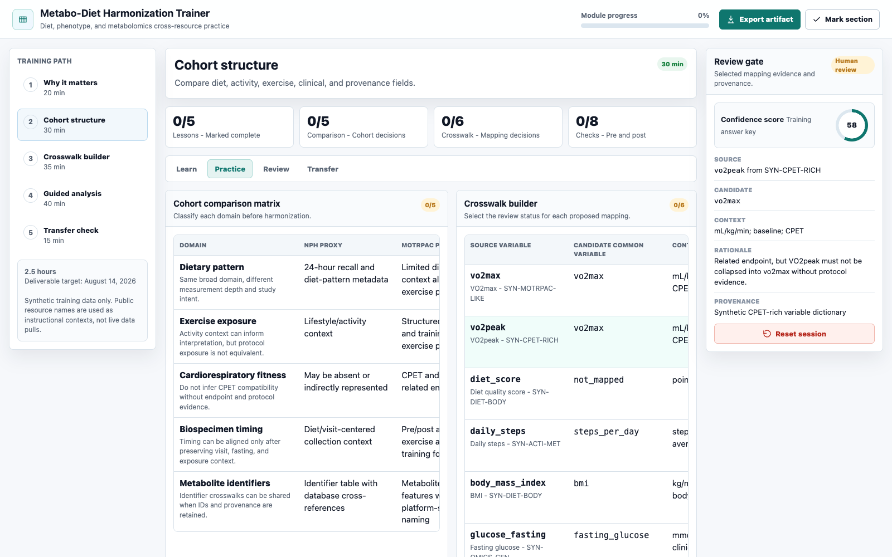
Metadata becomes a reviewable evidence card
Notes:
Timing: 2 minutes.
The agent extracts cohort, assay, biospecimen, phenotype, timing, unit, and provenance fields into typed metadata cards.
The interface makes incomplete fields and conflicting mappings visible before a crosswalk is accepted.
The screenshot is the repository's Metabo-Diet Harmonization Trainer, built with synthetic training data. It demonstrates the same review-gated metadata and crosswalk decisions used by the workbench.
[Sources]
- /Users/samuelmontalvo/Documents/GitHub/metabotyping-agentic-workbench/docs/metabo-diet-training-app/index.html
- /Users/samuelmontalvo/Documents/GitHub/metabotyping-agentic-workbench/docs/metabo-diet-training-app/app.js
- /Users/samuelmontalvo/Documents/GitHub/metabotyping-agentic-workbench/docs/metabo-diet-training-app/data.js
- /Users/samuelmontalvo/Documents/GitHub/metabotyping-agentic-workbench/.agents/skills/metadata-card-extraction/SKILL.md

Slide 8
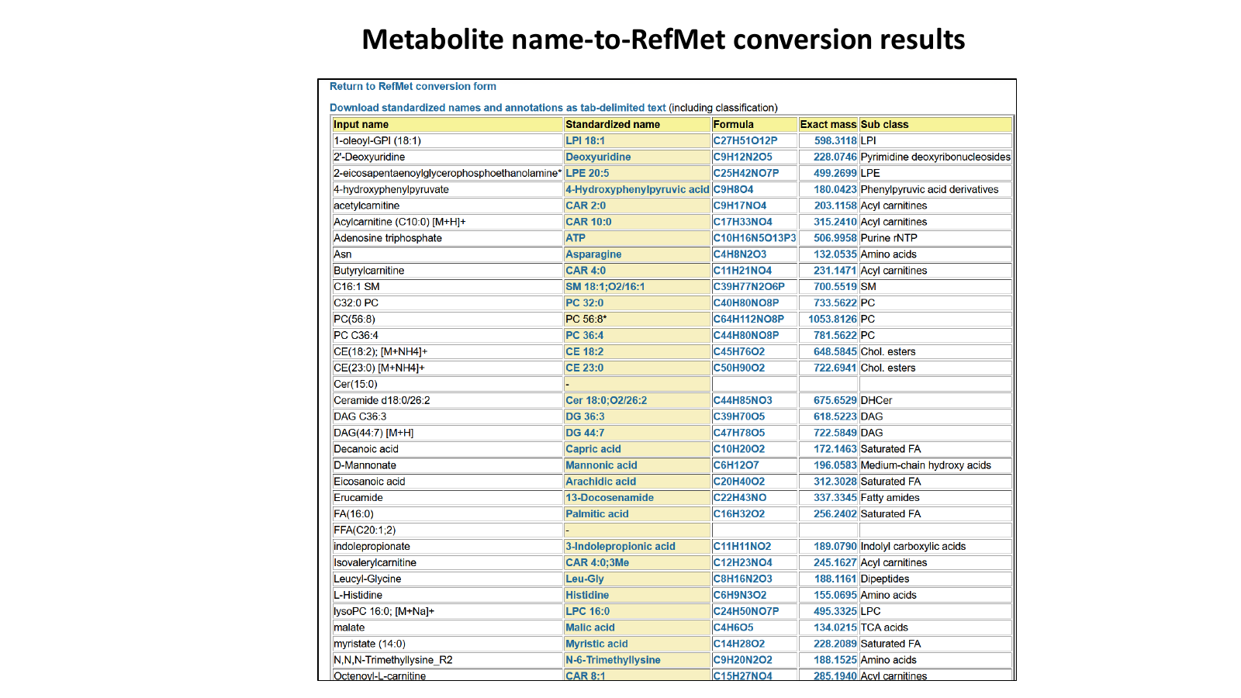
Private study data stay local; RefMet sees names only
Notes:
Timing: 2.5 minutes.
The privacy boundary is data minimization: participant identifiers, phenotypes, sample-level factors, and full quantitative matrices are not sent to RefMet.
During an online lookup, this implementation sends only the metabolite query name and receives standardized nomenclature fields. Offline analyses use the frozen local RefMet snapshot and do not call the network.
RefMet is a public nomenclature service, not a private-data vault. Security comes from keeping sensitive study data local and restricting network access to reviewed connector modules.
The returned RefMet label and hierarchy remain nomenclature evidence. They do not prove feature identity or authorize pooling; conflicting assay evidence stays review-gated.
This is an official RefMet tutorial screenshot. Counts visible in the historic tutorial interface are archival and are not used as current totals.
[Sources]
- https://www.metabolomicsworkbench.org/data/tutorials/Refmet_Metabolite_Database.pdf
- https://www.metabolomicsworkbench.org/databases/refmet/refmet.php
- /Users/samuelmontalvo/Documents/GitHub/metabotyping-agentic-workbench/README.md
- /Users/samuelmontalvo/Documents/GitHub/metabotyping-agentic-workbench/AGENTS.md
- /Users/samuelmontalvo/Documents/GitHub/metabotyping-agentic-workbench/src/metabotyping_agentic/live_sources/metabolomics_workbench.py
- /Users/samuelmontalvo/Documents/GitHub/metabotyping-agentic-workbench/tests/test_network_boundary.py
- /Users/samuelmontalvo/Documents/GitHub/metabotyping-agentic-workbench/data/live/refmet_annotations.csv
- /Users/samuelmontalvo/Documents/GitHub/metabotyping-agentic-workbench/data/live/refmet_annotations_provenance.json

Slide 9
Readiness scoring separates strong from fragile
*Readiness does not replace eligibility. The animal fixture remains excluded from the human scope.
Transparent metadata-backed triage score — not a risk-of-bias or assay-validity judgment
Notes:
Timing: 2 minutes.
The score combines study-design rigor, metadata completeness, metabolomics quality, and harmonization feasibility.
Use the animal fixture to explain the separation between readiness and eligibility: a record can be well described yet still outside the target population.
The score is a curation triage signal, not validated overall study quality or risk of bias.
[Sources]
- /Users/samuelmontalvo/Documents/GitHub/metabotyping-agentic-workbench/reports/aim3_evaluation_report.md
- /Users/samuelmontalvo/Documents/GitHub/metabotyping-agentic-workbench/data/extracted/quality_scores.json

Slide 10
MoTrPAC alignment is a planning signal
Metadata readiness answers: can we plan the comparison?
It does not answer: are the protocols equivalent?
Prerequisites include timing, matrix, platform, exercise/CPET, genetics, body composition, diet, and codebooks
Notes:
Timing: 2 minutes.
The alignment score records whether metadata contain prerequisites for a MoTrPAC-style comparison plan.
High readiness means the planning fields are present; it does not establish protocol equivalence, biological replication, or pooling permission.
The lowest score is driven by missing repository assets and core metadata, not a biological conclusion.
[Sources]
- /Users/samuelmontalvo/Documents/GitHub/metabotyping-agentic-workbench/reports/motrpac_alignment_report.md
- /Users/samuelmontalvo/Documents/GitHub/metabotyping-agentic-workbench/reports/motrpac_alignment.json

Slide 11
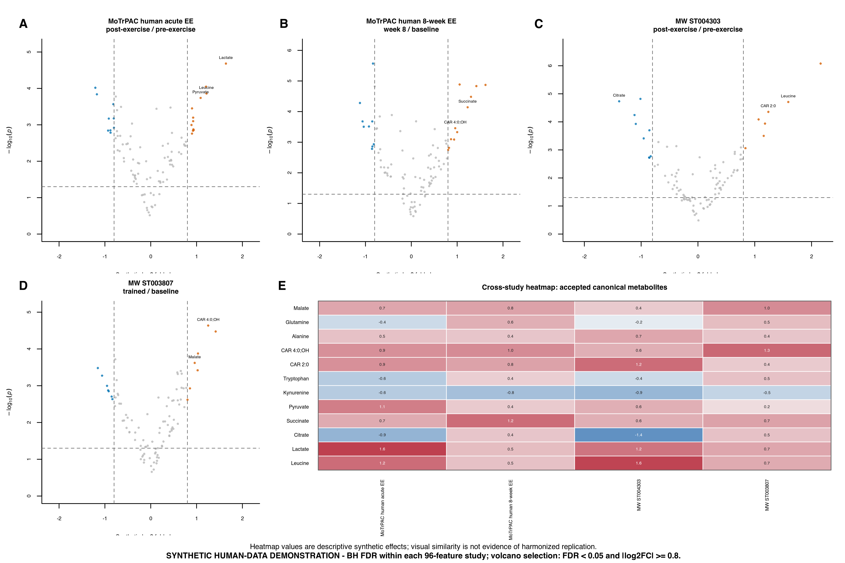
CSV + Markdown enable human verification
Notes:
Timing: 2.5 minutes.
The analysis does not terminate in an opaque chart. Plot data and study-contrast metadata are persisted as CSV before the figure is rendered, so a reviewer can inspect the exact rows behind each panel.
This displayed figure is generated from four_study_differential_results.csv, study_contrast_metadata.csv, and cross_study_heatmap_data.csv in the repository's synthetic four-study figure bundle.
The plotting contract also records dimensions, checksums, and provenance in a JSON manifest. Markdown reports and review packets explain interpretation, limitations, and unresolved decisions in a human-readable form.
Human verification remains required: persisted artifacts make the result auditable, but they do not make an agent output ground truth or authorize automatic pooling.
[Sources]
- /Users/samuelmontalvo/Documents/GitHub/metabotyping-agentic-workbench/scripts/render_synthetic_four_study_motrpac_mw_figure.R
- /Users/samuelmontalvo/Documents/GitHub/metabotyping-agentic-workbench/reports/synthetic_four_study_figure/four_study_differential_results.csv
- /Users/samuelmontalvo/Documents/GitHub/metabotyping-agentic-workbench/reports/synthetic_four_study_figure/study_contrast_metadata.csv
- /Users/samuelmontalvo/Documents/GitHub/metabotyping-agentic-workbench/reports/synthetic_four_study_figure/cross_study_heatmap_data.csv
- /Users/samuelmontalvo/Documents/GitHub/metabotyping-agentic-workbench/src/metabotyping_agentic/plotting/metabolomics.py
- /Users/samuelmontalvo/Documents/GitHub/metabotyping-agentic-workbench/.agents/skills/motrpac-plotting/SKILL.md
- /Users/samuelmontalvo/Documents/GitHub/metabotyping-agentic-workbench/reports/human_review_packet.md
- /Users/samuelmontalvo/Documents/GitHub/metabotyping-agentic-workbench/data/review/human_review_queue.csv

Slide 12
Gene-centric evidence stays an annotation chain
QUERY
HOP 1
HOP 2
HOP 3
HOP 4
Gene
Reaction
Compound
RefMet
MW study
symbol or accession
KEGG annotation
reaction participant
standard-name map
candidate accession
LICENCE GATE
CLAIM BOUNDARY
NEXT EVIDENCE
rows withheld by default
measurement not established
direct study re-fetch required
Four labeled hops • six evidence states • zero automatic measurement claims
Notes:
Timing: 2.5 minutes.
Walk the chain one hop at a time: queried gene to annotated reaction, reaction to compound, compound to standardized name, and standardized name to a repository study candidate.
Each hop explicitly states what it establishes and what it does not establish. The ledger writes measurement_established=not_established throughout.
MetGENE rows are KEGG-derived and are withheld unless a reviewer acknowledges the personal, non-commercial licence posture; provenance and escalation records are written either way.
A candidate study accession must be re-fetched directly from Metabolomics Workbench before describing its matrix, platform, measurement, or result.
[Sources]
- /Users/samuelmontalvo/Documents/GitHub/metabotyping-agentic-workbench/.agents/skills/gene-centric-metabolite-lookup/SKILL.md
- /Users/samuelmontalvo/Documents/GitHub/metabotyping-agentic-workbench/src/metabotyping_agentic/live_sources/metgene.py
- /Users/samuelmontalvo/Documents/GitHub/metabotyping-agentic-workbench/src/metabotyping_agentic/discovery/gene_metabolite_evidence.py
- /Users/samuelmontalvo/Documents/GitHub/metabotyping-agentic-workbench/src/metabotyping_agentic/live_sources/metabolomics_workbench.py

Slide 13
The safety boundary is executable
210 / 210
offline synthetic tests passed
0 failed • 0 errors • 0 skipped
0 / 12 unsafe auto-accepts
54 / 54
gene-centric gates
25 paired skills • 23 canonical agent roles • synthetic regression evidence only
Notes:
Timing: 2 minutes.
The strict offline synthetic release gate now reports 210 passed tests with no failures, errors, or skips.
The new gene-centric integrity gate contributes 54 tests covering licence withholding, annotation-versus-measurement semantics, distinct failure and no-hit states, adduct echo validation, and review routing.
The deterministic contract audit now covers 25 paired skill names and 23 paired canonical agent roles with no inventory issues.
The benchmark chart remains unchanged: the visible 80% quality-score agreement is still the imperfection to discuss. All of these are synthetic regression results, not independent scientific validation.
[Sources]
- /Users/samuelmontalvo/Documents/GitHub/metabotyping-agentic-workbench/docs/scientific_readiness_report.md
- /Users/samuelmontalvo/Documents/GitHub/metabotyping-agentic-workbench/docs/scientific_readiness_results.json
- /Users/samuelmontalvo/Documents/GitHub/metabotyping-agentic-workbench/docs/skill_evaluation_report.md
- /Users/samuelmontalvo/Documents/GitHub/metabotyping-agentic-workbench/tests/test_live_sources_metgene.py
- /Users/samuelmontalvo/Documents/GitHub/metabotyping-agentic-workbench/reports/benchmark_report.md

Slide 14
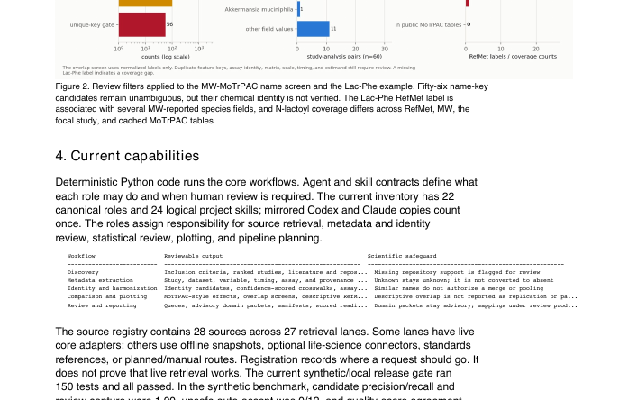
The agent system ends in a reviewable report
01
02
03
Metadata card
Summary figure
Review report
typed fields + provenance
coverage + contrasts
methods + limits + sources
Human review remains the final gate.
Notes:
Timing: 2 minutes.
The workflow does not end at a chart. It packages three linked layers: the reviewable metadata/crosswalk artifact, the summary figure, and a cited report with methods, limitations, and provenance.
The report is generated from frozen repository records and deterministic outputs; it does not convert unresolved identity, protocol, or estimand questions into accepted claims.
The final human-review packet makes it possible to inspect the evidence chain before deciding whether to validate, pool, or publish.
[Sources]
- /Users/samuelmontalvo/Documents/GitHub/metabotyping-agentic-workbench/docs/metabo-diet-training-app/index.html
- /Users/samuelmontalvo/Documents/GitHub/metabotyping-agentic-workbench/reports_live/final_workbench_report/figures/corpus_landscape.png
- /Users/samuelmontalvo/Documents/GitHub/metabotyping-agentic-workbench/reports_live/final_workbench_report/final_report.html
- /Users/samuelmontalvo/Documents/GitHub/metabotyping-agentic-workbench/output/pdf/metabotyping_agentic_workbench_final_report.pdf
- /Users/samuelmontalvo/Documents/GitHub/metabotyping-agentic-workbench/scripts/build_final_workbench_report.py

Slide 15
Project contributors
Samuel Montalvo, Ph.D. · Eric Leslie
Laurens van de Wiel · Matthew T. Wheeler | Stanford University
Notes:
Timing: 20 seconds.
Acknowledge the full project team: Samuel Montalvo, Eric Leslie, Laurens van de Wiel, and Matthew T. Wheeler, before returning to the closing decision.
The MoTrPAC-oriented public-summary proposal lists these four names as authors. The slide uses the requested contributor framing.
Open with the expanded scope: the workbench can start from a gene, metabolite, study, paper, or variable, but every path still ends in reviewable evidence rather than an autonomous scientific claim.
Preview the throughline: allowlisted retrieval, offline appraisal, explicit uncertainty states, human gates, and executable regression tests.
[Sources]
- /Users/samuelmontalvo/Documents/GitHub/metabotyping-agentic-workbench/output/doc/metabotyping_ai_public_summary_proposal/metabotyping_ai_public_summary_proposal.md
- /Users/samuelmontalvo/Documents/GitHub/metabotyping-agentic-workbench/README.md
- /Users/samuelmontalvo/Documents/GitHub/metabotyping-agentic-workbench/docs/skill_evaluation_report.md
- /Users/samuelmontalvo/.codex/skills/stanford-presentation-template/assets/stanford-slide-template.pptx

Slide 16
The decision is what to validate next
Define the first blinded benchmark together.
Samuel Montalvo, Ph.D. | Stanford University
Notes:
Timing: approximately 4 minutes for synthesis and discussion.
Close by returning to the opening: scale creates opportunity only when comparability decisions are traceable and review-gated.
Invite discussion around the first external validation cohort, assay diversity, and adjudication team.
[Sources]
- /Users/samuelmontalvo/Documents/GitHub/metabotyping-agentic-workbench/README.md
- /Users/samuelmontalvo/Documents/GitHub/metabotyping-agentic-workbench/docs/scientific_readiness_report.md

