Slide 1
MetaboTyping Agentic Workbench
Evidence-gated exercise-metabolomics reuse
Samuel Montalvo, Ph.D. | Stanford University
Notes:
Timing: 1 minute.
Open with the purpose: this is a workbench for deciding whether heterogeneous metabolomics evidence is reusable, not an autonomous system that declares studies equivalent.
Preview the throughline: discover candidates, preserve provenance, route uncertainty to experts, and test the safety boundary.
[Sources]
- /Users/samuelmontalvo/Documents/GitHub/metabotyping-agentic-workbench/README.md
- /Users/samuelmontalvo/.codex/skills/stanford-presentation-template/assets/stanford-slide-template.pptx

Slide 2
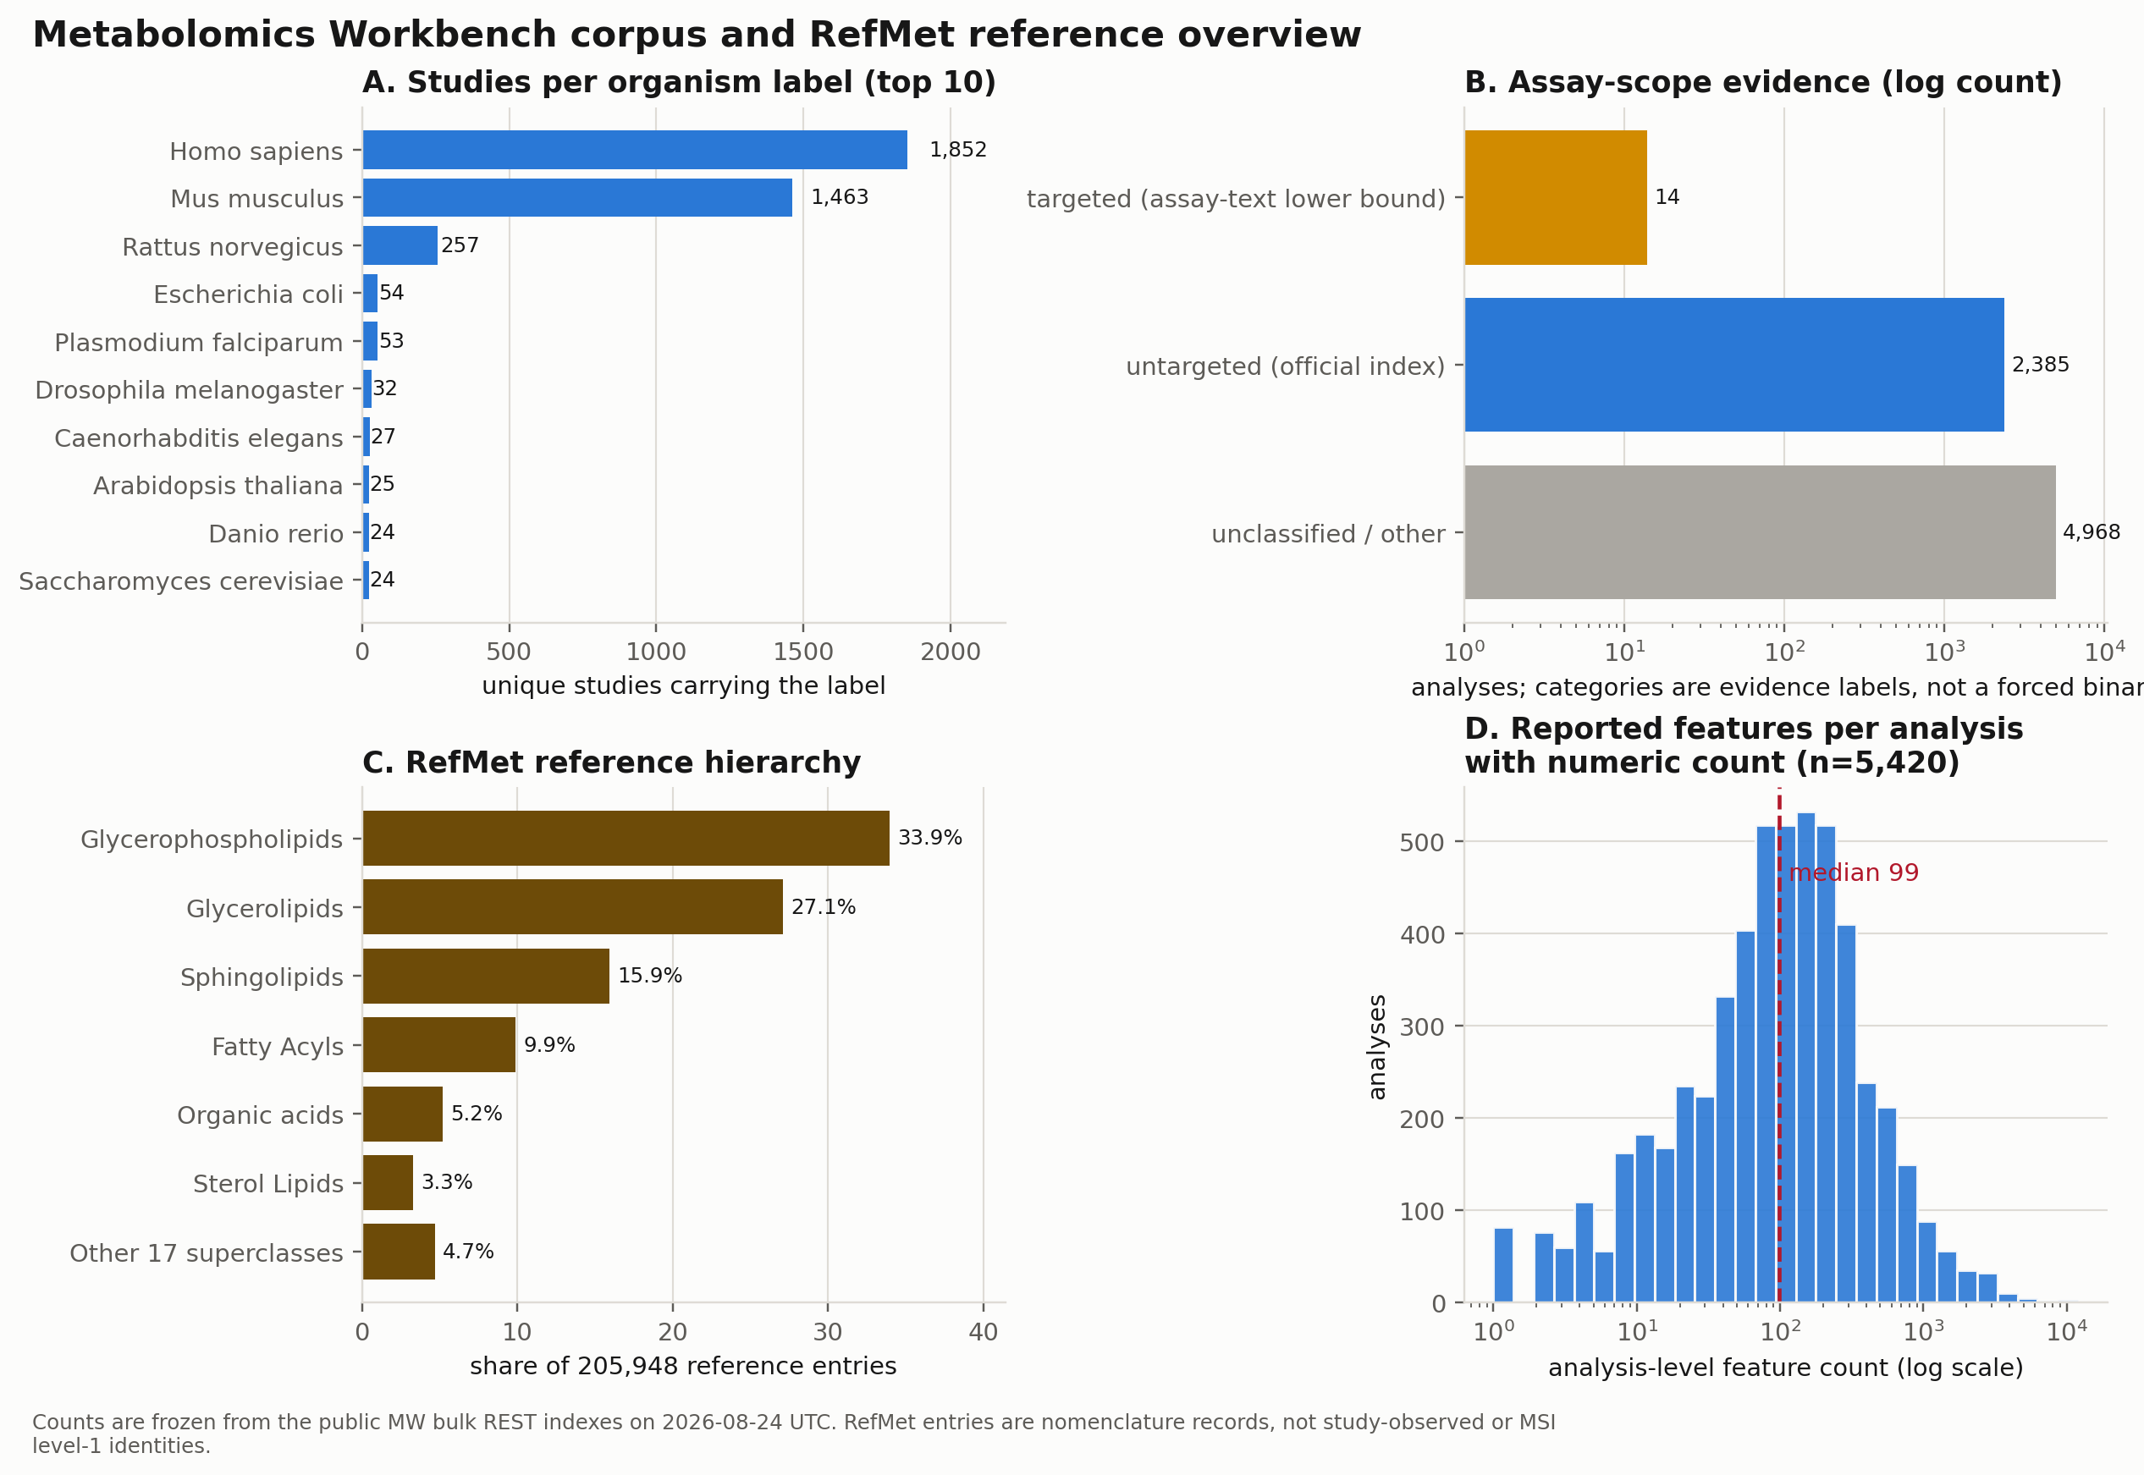
Scale amplifies the comparability problem
4,499
study summaries
7,367
analysis records
More records create more opportunities for hidden incompatibility.
Notes:
Timing: 2 minutes.
The frozen public corpus shows abundance, not immediate comparability.
Emphasize the different denominators: study summaries, analyses, feature incidences, and reference nomenclature cannot be treated as one count.
The scientific bottleneck is proving identity, assay, timing, phenotype, and estimand compatibility before combining results.
[Sources]
- /Users/samuelmontalvo/Documents/GitHub/metabotyping-agentic-workbench/reports_live/final_workbench_report/figures/corpus_landscape.png
- /Users/samuelmontalvo/Documents/GitHub/metabotyping-agentic-workbench/reports_live/final_workbench_report/final_report.html
- /Users/samuelmontalvo/Documents/GitHub/metabotyping-agentic-workbench/data/live/mw_corpus_snapshot/manifest.json

Slide 3
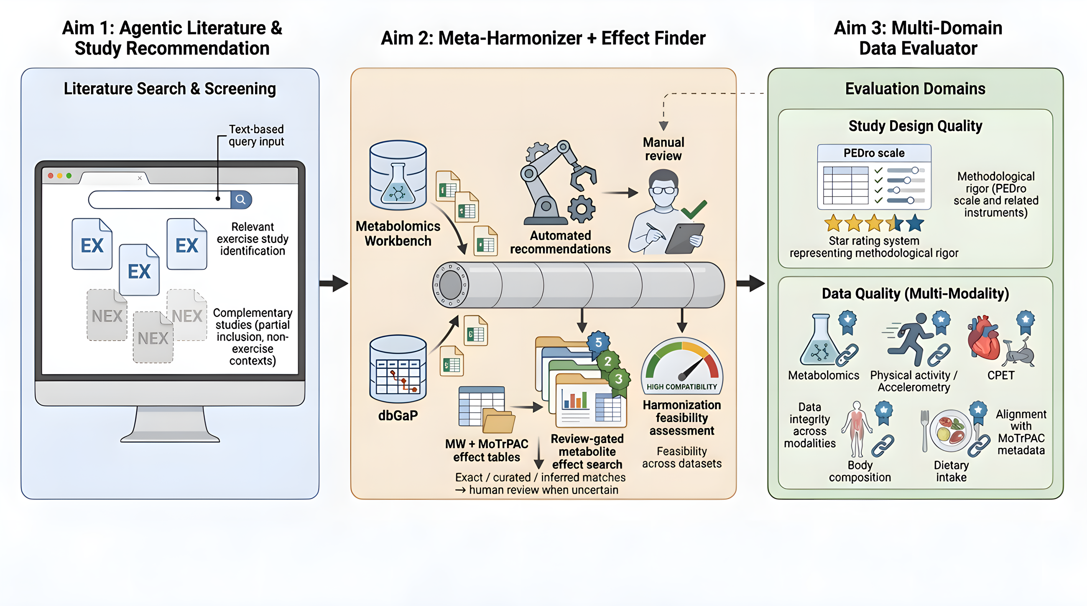
Three aims turn records into reviewable decisions
Notes:
Timing: 2 minutes.
Aim 1 discovers and ranks candidate studies while detecting mirages.
Aim 2 extracts evidence cards, proposes variable and assay mappings, and routes uncertain decisions to review.
Aim 3 scores metadata readiness and supports MoTrPAC-like comparison planning without asserting equivalence.
[Sources]
- /Users/samuelmontalvo/Documents/GitHub/metabotyping-agentic-workbench/docs/manuscript/figures/metabotyping_agentic_workbench_aims.png
- /Users/samuelmontalvo/Documents/GitHub/metabotyping-agentic-workbench/README.md

Slide 4
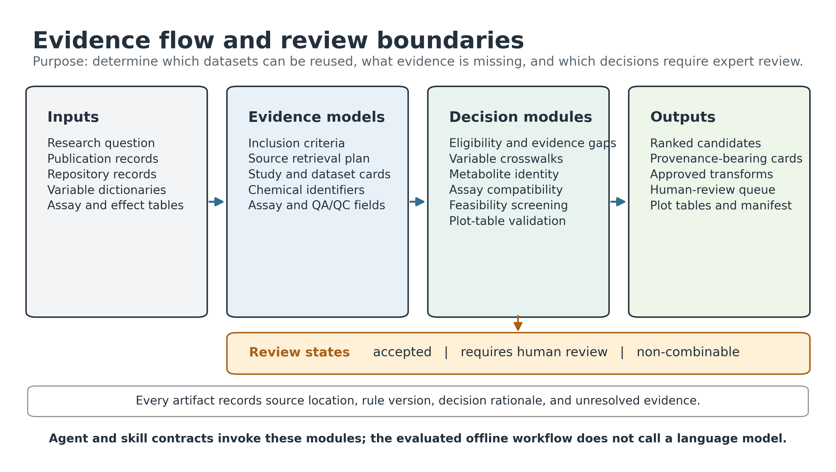
Every decision stays traceable
Notes:
Timing: 2.5 minutes.
Walk left to right: inputs become typed evidence models, deterministic decision modules, and reviewable outputs.
The important boundary is the state transition: accepted, requires human review, or non-combinable.
Every artifact retains source location, rule version, rationale, and unresolved evidence.
The evaluated offline workflow is deterministic; agent and skill contracts invoke these modules but do not bypass them.
[Sources]
- /Users/samuelmontalvo/Documents/GitHub/metabotyping-agentic-workbench/docs/manuscript/figures/metabotyping_agentic_workbench_architecture.png
- /Users/samuelmontalvo/Documents/GitHub/metabotyping-agentic-workbench/src/metabotyping_agentic/review/validation.py

Slide 5
Discovery preserves both candidates and mirages
A plausible title is not enough: accession, metadata, codebook, assay, and timing remain visible gates.
direct match • enrichment • mirage • excluded
Notes:
Timing: 2 minutes.
This synthetic ranking rewards direct exercise/activity evidence, genetics, CPET, body composition, diet, and usable repository assets.
Two superficially relevant studies remain mirages because repository data or a codebook is missing.
The animal study is excluded by the human-participant criterion even though some metadata fields are complete.
[Sources]
- /Users/samuelmontalvo/Documents/GitHub/metabotyping-agentic-workbench/reports/aim1_catalog_report.md
- /Users/samuelmontalvo/Documents/GitHub/metabotyping-agentic-workbench/data/extracted/recommendations.csv

Slide 6
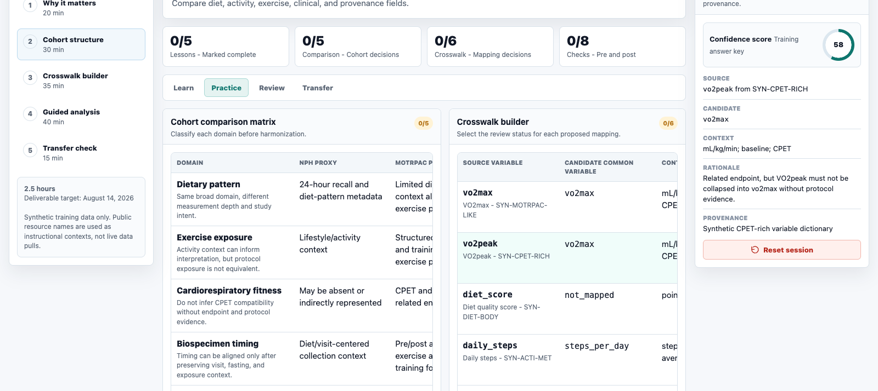
Review happens before mappings become data
Notes:
Timing: 2 minutes.
Use the screenshot to show what human-in-the-loop means operationally: reviewers see the source variable, candidate target, context, rationale, and provenance together.
The highlighted VO2peak example is intentionally not auto-collapsed to vo2max without protocol evidence.
The training interface uses synthetic data and public resource names only as instructional context.
[Sources]
- /Users/samuelmontalvo/Documents/GitHub/metabotyping-agentic-workbench/docs/metabo-diet-training-app/index.html
- /Users/samuelmontalvo/Documents/GitHub/metabotyping-agentic-workbench/tmp/stanford_30min_deck/metabo_app_screenshot.png
- /Users/samuelmontalvo/Documents/GitHub/metabotyping-agentic-workbench/reports/aim2_harmonization_report.md

Slide 7
Similar labels can lead to different decisions
vo2max
vo2max
ACCEPTED
same unit + endpoint evidence
vo2peak
vo2max
HUMAN REVIEW
related endpoint; protocol needed
diet_score
not_mapped
NON-COMBINABLE
no supported common variable
Notes:
Timing: 2 minutes.
Three examples show why label similarity is not a decision rule.
Exact identity with compatible unit and endpoint evidence can be accepted.
VO2peak to VO2max stays review-required until the exercise protocol and endpoint criteria are documented.
An unsupported diet score remains not mapped rather than being forced into a convenient category.
[Sources]
- /Users/samuelmontalvo/Documents/GitHub/metabotyping-agentic-workbench/reports/aim2_harmonization_report.md
- /Users/samuelmontalvo/Documents/GitHub/metabotyping-agentic-workbench/data/extracted/crosswalk.csv

Slide 8
Readiness scoring separates strong from fragile
*Readiness does not replace eligibility. The animal fixture remains excluded from the human scope.
Transparent metadata-backed triage score — not a risk-of-bias or assay-validity judgment
Notes:
Timing: 2 minutes.
The score combines study-design rigor, metadata completeness, metabolomics quality, and harmonization feasibility.
Use the animal fixture to explain the separation between readiness and eligibility: a record can be well described yet still outside the target population.
The score is a curation triage signal, not validated overall study quality or risk of bias.
[Sources]
- /Users/samuelmontalvo/Documents/GitHub/metabotyping-agentic-workbench/reports/aim3_evaluation_report.md
- /Users/samuelmontalvo/Documents/GitHub/metabotyping-agentic-workbench/data/extracted/quality_scores.json

Slide 9
MoTrPAC alignment is a planning signal
Metadata readiness answers: can we plan the comparison?
It does not answer: are the protocols equivalent?
Prerequisites include timing, matrix, platform, exercise/CPET, genetics, body composition, diet, and codebooks
Notes:
Timing: 2 minutes.
The alignment score records whether metadata contain prerequisites for a MoTrPAC-style comparison plan.
High readiness means the planning fields are present; it does not establish protocol equivalence, biological replication, or pooling permission.
The lowest score is driven by missing repository assets and core metadata, not a biological conclusion.
[Sources]
- /Users/samuelmontalvo/Documents/GitHub/metabotyping-agentic-workbench/reports/motrpac_alignment_report.md
- /Users/samuelmontalvo/Documents/GitHub/metabotyping-agentic-workbench/reports/motrpac_alignment.json

Slide 10
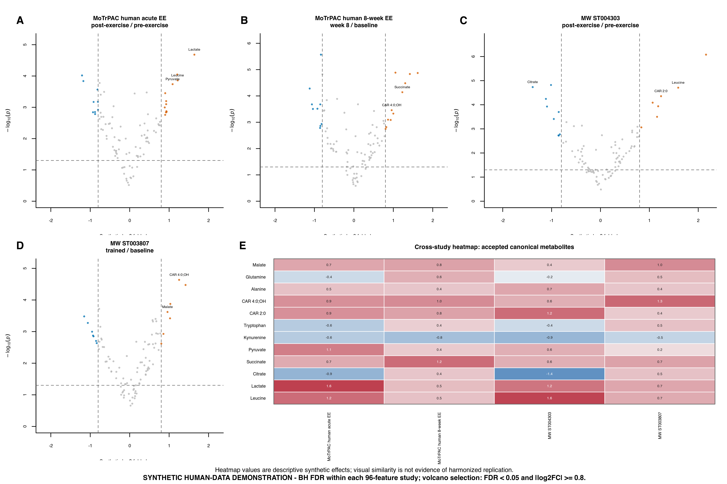
Study-specific contrasts remain explicit
Notes:
Timing: 2.5 minutes.
This synthetic demonstration retains four distinct contrasts: MoTrPAC acute, MoTrPAC eight-week, MW acute, and MW trained versus baseline.
The shared heatmap is restricted to reviewed canonical labels; each value remains tied to its original study contrast.
The visual is a planning and review artifact. Similarity across panels is not evidence of harmonized replication.
[Sources]
- /Users/samuelmontalvo/Documents/GitHub/metabotyping-agentic-workbench/reports/synthetic_four_study_figure/motrpac_mw_four_study_multiplot.png
- /Users/samuelmontalvo/Documents/GitHub/metabotyping-agentic-workbench/reports/synthetic_four_study_figure/study_contrast_metadata.csv
- /Users/samuelmontalvo/Documents/GitHub/metabotyping-agentic-workbench/reports/synthetic_four_study_figure/four_study_differential_results.csv

Slide 11
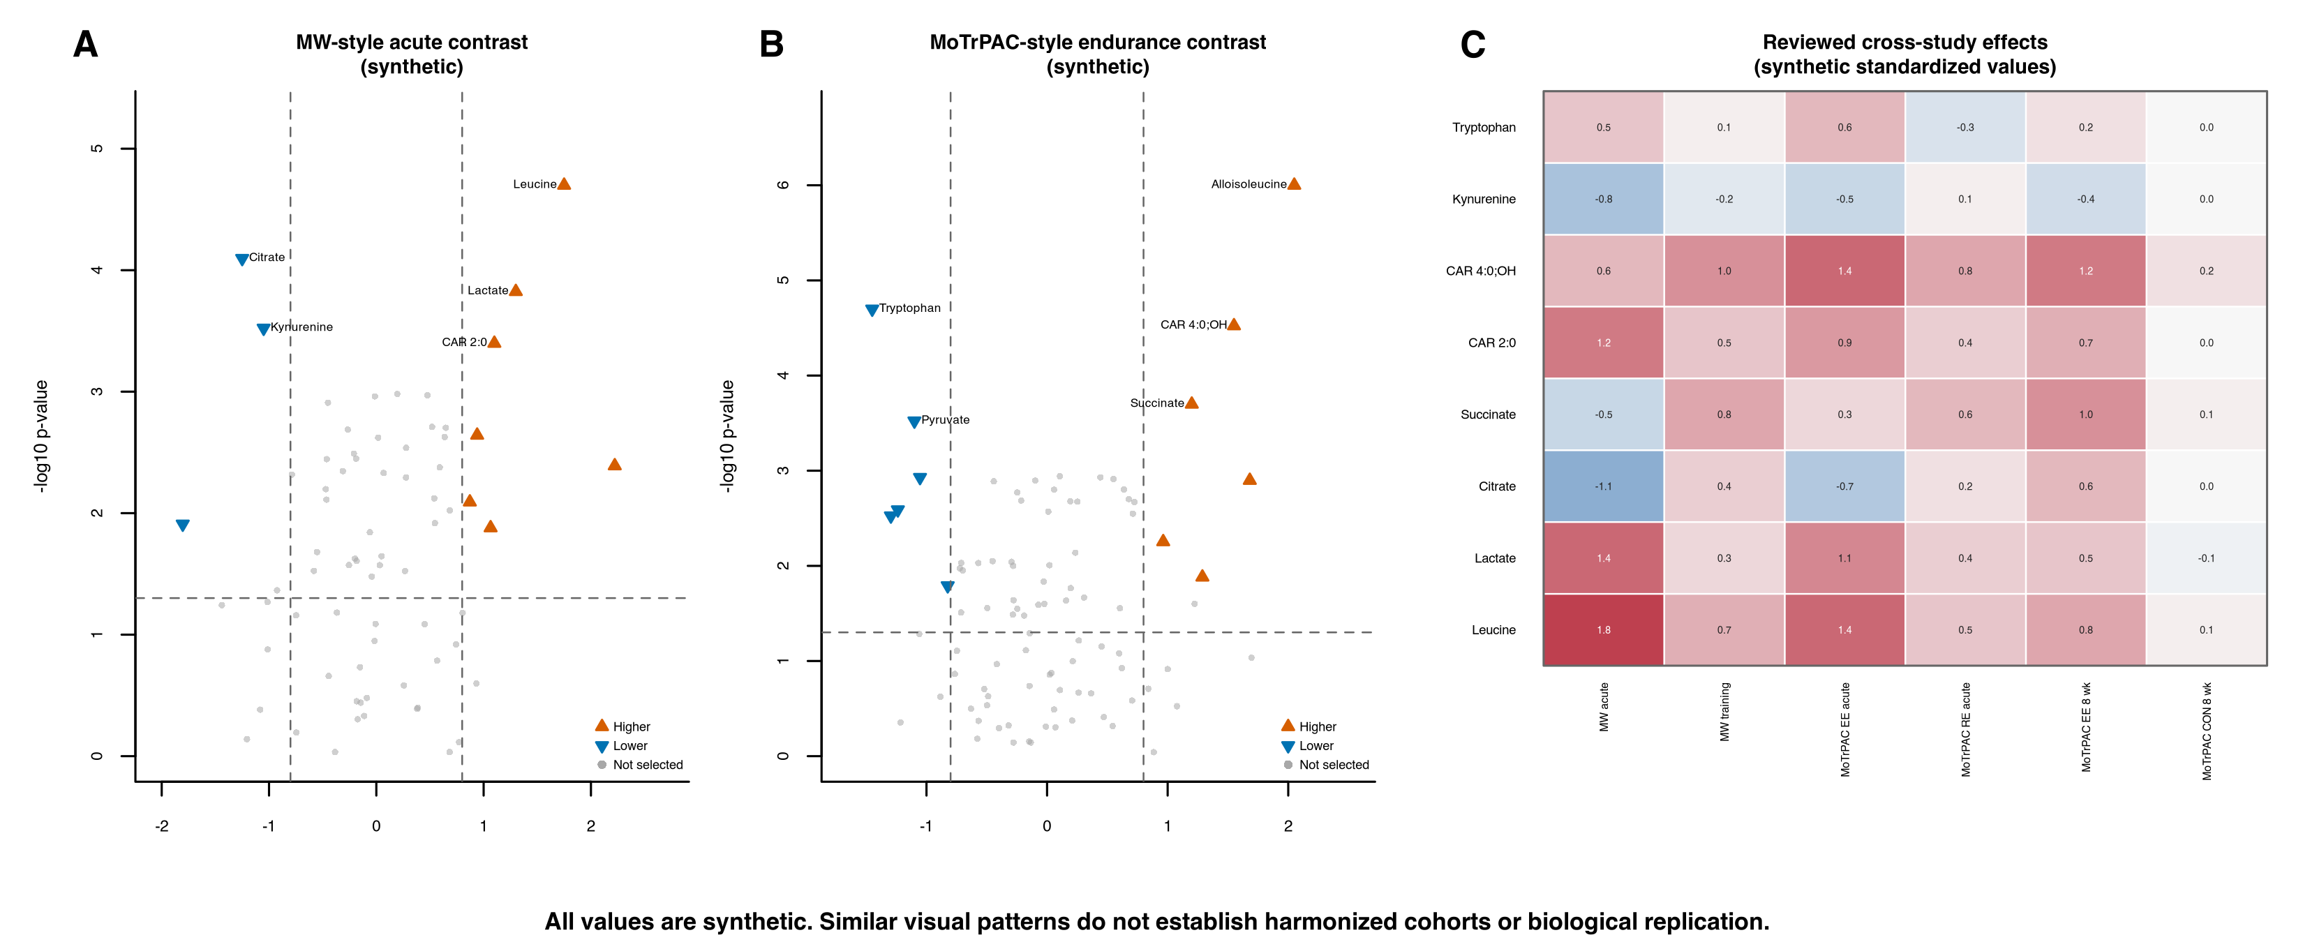
Plot outputs preserve contrast and hierarchy
Contrast-aware plots make uncertainty visible; they do not make cohorts equivalent.
Notes:
Timing: 2 minutes.
The plotting lane standardizes presentation while preserving contrast definitions, direction, multiplicity thresholds, and source metadata.
The heatmap contains reviewed cross-study values, not a pooled model.
The broader plot suite also includes single-metabolite trajectories and RefMet hierarchy views.
[Sources]
- /Users/samuelmontalvo/Documents/GitHub/metabotyping-agentic-workbench/docs/manuscript/figures/metabotyping_agent_plot_examples.png
- /Users/samuelmontalvo/Documents/GitHub/metabotyping-agentic-workbench/docs/manuscript/figures/synthetic_motrpac_plot_suite/figures
- /Users/samuelmontalvo/Documents/GitHub/metabotyping-agentic-workbench/src/metabotyping_agentic/plotting/metabolomics.py

Slide 12
The safety boundary is executable
156 / 156
offline synthetic tests passed
0 failed • 0 errors • 0 skipped
0 / 12 unsafe auto-accepts
Regression evidence on synthetic fixtures — not validation on independent cohorts or assay platforms
Notes:
Timing: 2 minutes.
The strict synthetic readiness gate currently reports 156 passed tests with no failures, errors, or skips.
The benchmark checks exact mapping candidates, review routing, review status, auto-accept safety, and score agreement against synthetic expert fixtures.
The 80% quality-score agreement is the visible imperfection: two fixtures fall outside the predefined tolerance.
This is regression evidence, not independent scientific validation.
[Sources]
- /Users/samuelmontalvo/Documents/GitHub/metabotyping-agentic-workbench/docs/scientific_readiness_report.md
- /Users/samuelmontalvo/Documents/GitHub/metabotyping-agentic-workbench/reports/benchmark_report.md
- /Users/samuelmontalvo/Documents/GitHub/metabotyping-agentic-workbench/reports/benchmark_disagreements.csv

Slide 13
The MVP is ready for blinded stress-testing
01
02
03
Freeze the benchmark
Blind the review
Report the errors
Lock cohorts, source snapshots, and adjudication rubric
Separate agent outputs from expert reference decisions
Measure unsafe accepts, missed reviews, abstentions, and drift
Advance empirical validity without relaxing the human-review gate.
Notes:
Timing: 2 minutes.
Recommend the next milestone as a frozen, blinded evaluation rather than another feature expansion.
Select external cohorts that span assay platforms and metadata quality, lock source snapshots and definitions, and keep experts blinded to the workbench output during reference adjudication.
Report both harmful and conservative errors: unsafe auto-accepts, missed review cases, unnecessary abstentions, and score drift.
[Sources]
- /Users/samuelmontalvo/Documents/GitHub/metabotyping-agentic-workbench/docs/agent_architecture_evaluation.md
- /Users/samuelmontalvo/Documents/GitHub/metabotyping-agentic-workbench/reports/benchmark_report.md
- /Users/samuelmontalvo/Documents/GitHub/metabotyping-agentic-workbench/docs/scientific_readiness_report.md

Slide 14
The decision is what to validate next
Define the first blinded benchmark together.
Samuel Montalvo, Ph.D. | Stanford University
Notes:
Timing: approximately 4 minutes for synthesis and discussion.
Close by returning to the opening: scale creates opportunity only when comparability decisions are traceable and review-gated.
Invite discussion around the first external validation cohort, assay diversity, and adjudication team.
[Sources]
- /Users/samuelmontalvo/Documents/GitHub/metabotyping-agentic-workbench/README.md
- /Users/samuelmontalvo/Documents/GitHub/metabotyping-agentic-workbench/docs/scientific_readiness_report.md

