Slide 1
MetaboTyping Workbench
Samuel Montalvo, Ph.D.
Stanford University
Notes:
[Sources]
- Visual template: Copy of Lab Update.pptx.
- Project identity: README.md.
[/Sources]

Slide 2
Exercise Metabolites
Exercise changes metabolism within minutes.
Capture
acute responses
Explain
individual variation
Find candidate
biomarkers
Timing, fitness, sex, diet, and assay design shape the signal.
Notes:
[Sources]
- Lewis GD et al. Sci Transl Med. 2010. PMID: 20505214.
- Contrepois K et al. Cell. 2020. PMID: 32470399.
- MoTrPAC Study Group. Nature. 2024. DOI: 10.1038/s41586-023-06877-w.
[/Sources]

Slide 3
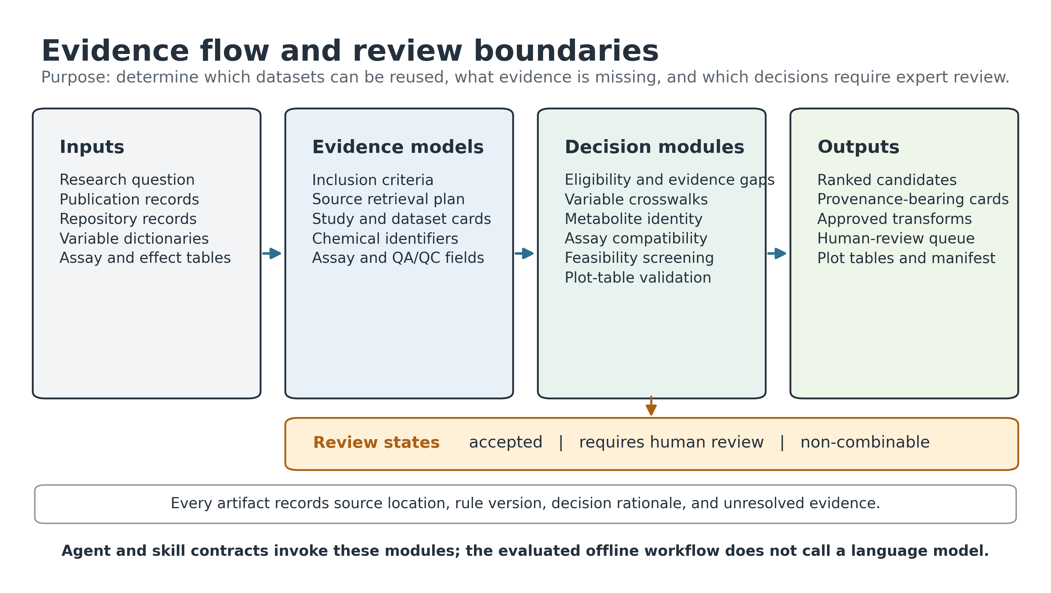
MetaboTyping Workbench
Notes:
[Sources]
- Architecture figure: docs/manuscript/figures/metabotyping_agentic_workbench_architecture.png.
- Workflow definitions: README.md.
[/Sources]

Slide 4
Objectives
01
Discover usable exercise-metabolomics studies
02
Build evidence-backed metadata and crosswalks
03
Send uncertain decisions to human review
Notes:
[Sources]
- Project aims and review boundaries: README.md and AGENTS.md.
[/Sources]

Slide 5
Agent Roles
Find records • extract metadata • prepare review questions
Notes:
[Sources]
- Agent and skill responsibilities: README.md and .agents/skills/.
[/Sources]

Slide 6
Human Review
Agents advise. Schemas and code block unreviewed actions.
Notes:
[Sources]
- Human-review and non-executable packet rules: AGENTS.md and src/metabotyping_agentic/review/.
[/Sources]

Slide 7
Finding usable datasets
DISCOVER
VERIFY
RANK
Exercise + metabolomics
Access + metadata
Evidence + readiness
Missing accessions, codebooks, or timing remain visible gaps.
Notes:
[Sources]
- Discovery and mirage criteria: README.md, AGENTS.md, and src/metabotyping_agentic/.
[/Sources]

Slide 8
Harmonization
Names are not identities
VO₂peak is not VO₂max
Assays may not be comparable
Notes:
[Sources]
- Identity, VO₂peak/VO₂max, and assay-comparability rules: AGENTS.md.
[/Sources]

Slide 9
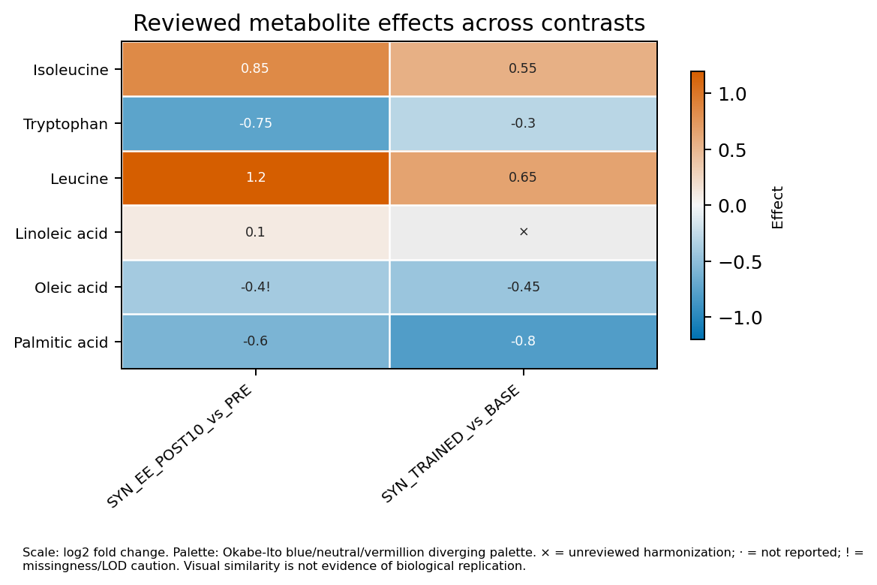
Reviewable outputs
Ranked studies • provenance cards • review queue • plots
Notes:
[Sources]
- Synthetic heatmap: docs/manuscript/figures/synthetic_motrpac_plot_suite/figures/effect_heatmap.png.
- Report outputs: src/metabotyping_agentic/reports/.
[/Sources]

