Slide 1

OFFLINE MVP USING SYNTHETIC DATA
MetaboTyping Agentic Workbench
A workflow that helps curators find and harmonize
metabolomics datasets
Samuel Montalvo, Ph.D.
Bioinformatics Center | Molecular Transducers of Physical Activity
Wu Tsai Human Performance Alliance
Division of Cardiovascular Medicine
Stanford University
August 2026
Notes:
[Sources]
- Stanford visual source: stanford-slide-template.pptx and stanford-university-wordmark-cardinal.png.
- Project identity and scope: README.md.
[/Sources]

Slide 2
METABOTYPING AGENTIC WORKBENCH
Reusing data starts with the evidence
Before combining studies, investigators need to know what was measured, when samples were collected, which methods were used, and how confidently metabolites were identified.
1
2
3
4
Find candidate
studies
Check access
and metadata
Compare variables
and assays
Send unresolved cases
for review
Similar names do not prove
chemical identity.
VO₂peak and VO₂max need
protocol evidence.
Relative intensities cannot
be pooled by default.
The workbench keeps these gaps visible instead of treating uncertain records as analysis-ready.
Notes:
[Sources]
- Problem framing and scientific guardrails: README.md.
- Evidence-flow purpose and interpretation limits: docs/manuscript/metabotyping_agentic_workbench_manuscript.md.
- VO₂peak/VO₂max rule and pooling boundaries: AGENTS.md.
[/Sources]

Slide 3
METABOTYPING AGENTIC WORKBENCH
The workflow keeps evidence and decisions linked
Each step produces a reviewable artifact, so curators can trace and revise a decision.
01
02
03
04
Inputs
Evidence records
Rule-based checks
Outputs for review
Research question
Publication + repository records
Variable dictionaries
Assay + effect tables
Inclusion criteria
Source retrieval plan
Study + dataset cards
Chemical + QA/QC fields
Eligibility and gaps
Variable crosswalks
Identity and assay checks
MoTrPAC readiness
Ranked studies
Cards with provenance
Approved transforms
Review queue and plot manifest
REVIEW STATES
accepted | needs human review | cannot be combined
Each artifact keeps its source, rule version, rationale, and open questions.
Notes:
[Sources]
- Architecture source: docs/manuscript/figures/metabotyping_agentic_workbench_architecture.png.
- Deterministic workflow and outputs: README.md and src/metabotyping_agentic/reports/render.py.
[/Sources]

Slide 4
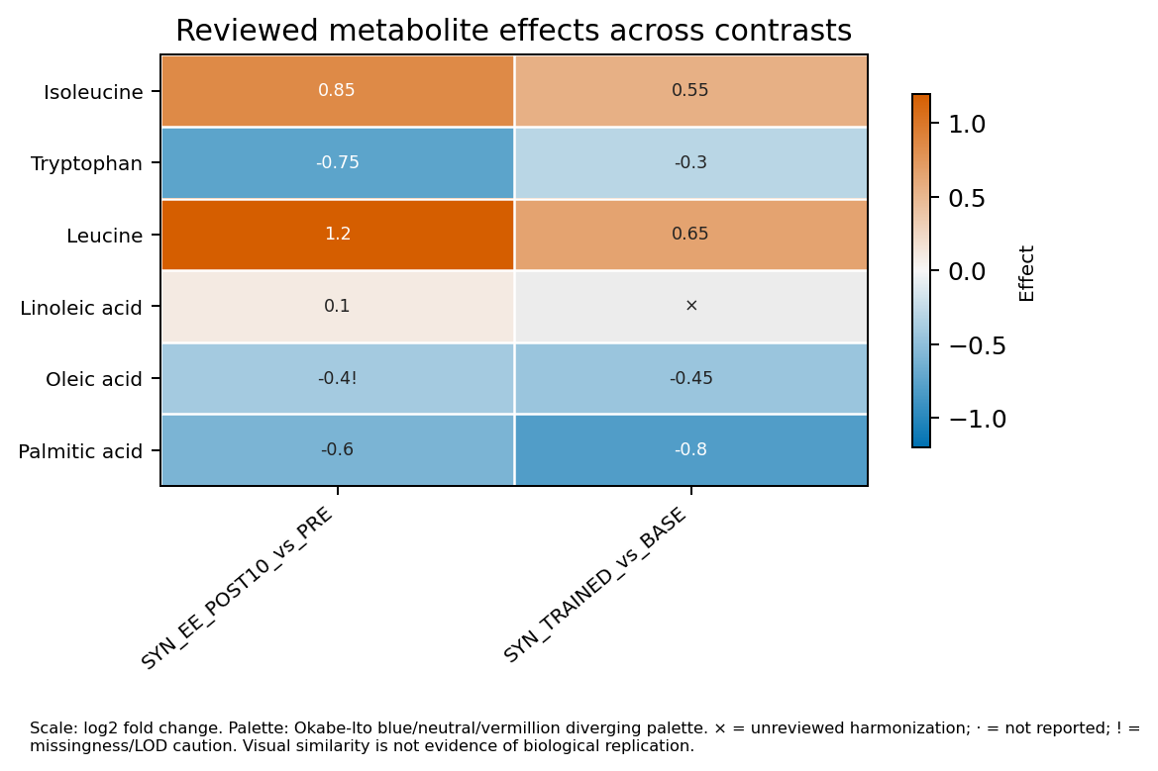
METABOTYPING AGENTIC WORKBENCH
Unresolved cases stop for human review
01
Agents organize the evidence
Agent and skill interfaces collect evidence and prepare questions for reviewers.
02
Schemas limit what agents can claim
Review packets are advisory. They require human adjudication and cannot trigger executable actions.
03
Python enforces the decision
Only approved mappings and transforms can reach ETL or plotting.
VO₂peak and VO₂max require protocol review
A name match alone cannot authorize pooling
The synthetic heatmap keeps the contrast and review status explicit. Similar patterns do not establish replication.
Notes:
[Sources]
- DomainReviewPacket authority boundary: README.md, src/metabotyping_agentic/review/models.py, and src/metabotyping_agentic/review/validation.py.
- Synthetic heatmap: docs/manuscript/figures/synthetic_motrpac_plot_suite/figures/effect_heatmap.png.
- CPET and identity/pooling safeguards: AGENTS.md and README.md.
[/Sources]

Slide 5
METABOTYPING AGENTIC WORKBENCH
The offline MVP passes its synthetic test suite
128 / 128
What we checked
• Deterministic rules reproduce expected results
• Evidence artifacts retain their provenance
• Review and network boundaries are enforced
offline synthetic tests passed
verified 19 August 2026
What remains untested
21 paired agent roles
23 paired skill contracts
Offline core requires no network access
• Performance on independent studies and cohorts
• Whether assays are comparable across platforms
• Biological replication or causal inference
NEXT STEP
Benchmark frozen public records from several assay platforms
Use at least two blinded curators and formal adjudication
Notes:
[Sources]
- Strict synthetic gate: docs/scientific_readiness_report.md; project .venv rerun on 2026-08-19 returned PASS with tests_run=128.
- Agent and skill inventory: README.md release 0.2.0.
- External-validation limitations and proposed benchmark: docs/scientific_readiness_report.md and docs/manuscript/metabotyping_agentic_workbench_manuscript.md.
[/Sources]

