Slide 1

MetaboTyping Agentic Workbench
Evidence-gated discovery, curation, and harmonization
for metabolomics reuse
Samuel Montalvo, Ph.D.
Bioinformatics Center | Molecular Transducers of Physical Activity
Wu Tsai Human Performance Alliance
Division of Cardiovascular Medicine
Stanford University
August 2026
Notes:
[Sources]
- Stanford visual source: stanford-slide-template.pptx and stanford-university-wordmark-cardinal.png.
- Project identity and scope: README.md.
[/Sources]

Slide 2
METABOTYPING AGENTIC WORKBENCH
Evidence gaps are the bottleneck
Before studies can be combined, investigators must establish what was measured, when, how, and with what identity and assay evidence.
1
2
3
4
Find usable
studies
Verify metadata
and access
Reconcile
variables + assays
Send uncertainty
to expert review
Name similarity is not
chemical identity.
VO₂peak is not
automatically VO₂max.
Relative intensities are not
automatically poolable.
Without explicit evidence states, confident automation can silently convert uncertainty into analysis-ready data.
Notes:
[Sources]
- Problem framing and scientific guardrails: README.md.
- Evidence-flow purpose and interpretation limits: docs/manuscript/metabotyping_agentic_workbench_manuscript.md.
- VO₂peak/VO₂max rule and pooling boundaries: AGENTS.md.
[/Sources]

Slide 3
METABOTYPING AGENTIC WORKBENCH
Metabolites reveal how exercise changes biology
Exercise rapidly shifts fuels, amino acids, lipids, and signaling molecules, while training reshapes metabolism across tissues.
1
2
3
4
Capture rapid
responses
Map tissue
communication
Explain response
variation
Find testable
biomarkers
Timing and intensity change
the observed signature.
Sex, fitness, diet, and assay
design can shift results.
Many studies are small,
single-tissue, or sparsely sampled.
Larger, harmonized studies can separate reproducible biology from context-specific signals and support precision-exercise hypotheses.
Notes:
[Sources]
- Lewis GD et al. Metabolic signatures of exercise in human plasma. Sci Transl Med. 2010;2(33):33ra37. PMID: 20505214. DOI: 10.1126/scitranslmed.3001006.
- Contrepois K et al. Molecular Choreography of Acute Exercise. Cell. 2020;181(5):1112-1130.e16. PMID: 32470399. DOI: 10.1016/j.cell.2020.04.043.
- Nayor M et al. Metabolic Architecture of Acute Exercise Response in Middle-Aged Adults in the Community. Circulation. 2020. PMID: 32927962. DOI: 10.1161/CIRCULATIONAHA.120.050281.
- MoTrPAC Study Group. Temporal dynamics of the multi-omic response to endurance exercise training. Nature. 2024;629:174-183. DOI: 10.1038/s41586-023-06877-w.
- Darragh IA et al. Within-Subject Variability and the Influence of Exercise Training History on the Resting Plasma Metabolome in Men. Int J Sport Nutr Exerc Metab. 2023;33(3):141-150. PMID: 36963408. DOI: 10.1123/ijsnem.2022-0177.
[/Sources]

Slide 4
METABOTYPING AGENTIC WORKBENCH
Every decision stays traceable
Heterogeneous records become explicit evidence models before any decision moves downstream.
01
02
03
04
Inputs
Evidence models
Deterministic decisions
Reviewable outputs
Research question
Publication + repository records
Variable dictionaries
Assay + effect tables
Inclusion criteria
Source retrieval plan
Study + dataset cards
Chemical + QA/QC fields
Eligibility + gaps
Variable crosswalks
Identity + assay checks
MoTrPAC readiness
Ranked candidates
Provenance-bearing cards
Approved transforms
Review queue + plot manifest
REVIEW STATES
accepted | requires human review | non-combinable
Every artifact records source location, rule version, rationale, and unresolved evidence.
Notes:
[Sources]
- Architecture source: docs/manuscript/figures/metabotyping_agentic_workbench_architecture.png.
- Deterministic workflow and outputs: README.md and src/metabotyping_agentic/reports/render.py.
[/Sources]

Slide 5
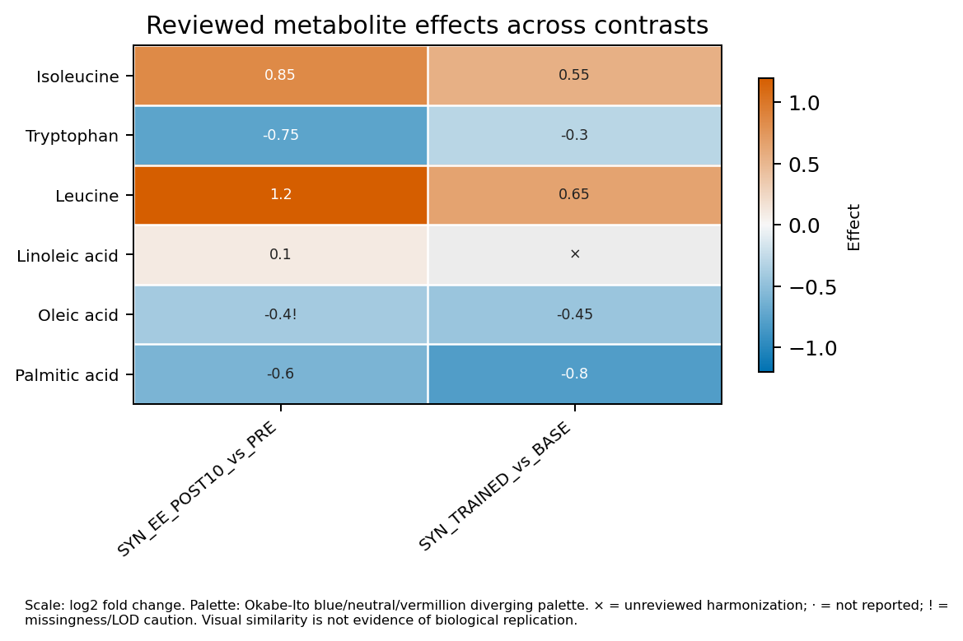
METABOTYPING AGENTIC WORKBENCH
Human review is a hard boundary
01
Contracts propose—never decide
Agent and skill interfaces assemble evidence and frame questions for review.
02
Schemas enforce advisory output
Typed packets require human adjudication and contain no executable actions.
03
Code blocks unsafe merges
Only approved mappings and transforms can reach ETL or plotting artifacts.
Synthetic, contrast-explicit output. Unreviewed harmonization remains visible; visual similarity is not replication evidence.
Notes:
[Sources]
- DomainReviewPacket authority boundary: README.md, src/metabotyping_agentic/review/models.py, and src/metabotyping_agentic/review/validation.py.
- Synthetic heatmap: docs/manuscript/figures/synthetic_motrpac_plot_suite/figures/effect_heatmap.png.
- CPET and identity/pooling safeguards: AGENTS.md and README.md.
[/Sources]

Slide 6
METABOTYPING AGENTIC WORKBENCH
The offline prototype passes its synthetic test suite
128 / 128
What this demonstrates
• Reproducible, deterministic rule behavior
• Provenance retention across evidence artifacts
• Enforcement of review and network boundaries
offline synthetic tests passed
verified 19 August 2026
What this does not demonstrate
21 paired agent roles
23 paired skill contracts
Network-free offline core
• Accuracy on independent studies or cohorts
• Cross-platform assay commutability
• Biological replication or causal inference
NEXT MILESTONE
Frozen public-record benchmark across diverse assay platforms
≥2 blinded curators + adjudication
Notes:
[Sources]
- Strict synthetic gate: docs/scientific_readiness_report.md; project .venv rerun on 2026-08-19 returned PASS with tests_run=128.
- Agent and skill inventory: README.md release 0.2.0.
- External-validation limitations and proposed benchmark: docs/scientific_readiness_report.md and docs/manuscript/metabotyping_agentic_workbench_manuscript.md.
[/Sources]

