Slide 1

MetaboTyping Agentic Workbench
Finding and harmonizing exercise-metabolomics datasets
Samuel Montalvo, Ph.D.
Bioinformatics Center | Molecular Transducers of Physical Activity
Wu Tsai Human Performance Alliance
Division of Cardiovascular Medicine
Stanford University
August 2026
Notes:
[Sources]
- Stanford visual source: stanford-slide-template.pptx and stanford-university-wordmark-cardinal.png.
- Project identity and scope: README.md.
[/Sources]

Slide 2
Evidence determines whether data can be reused
To combine studies, we must know what was measured, when, and how.
1
2
3
4
Find studies
Check metadata
Compare measures
Review uncertainty
Names ≠
chemical identity
VO₂peak ≠
VO₂max
Intensity data
may not pool
The workbench keeps uncertainty visible.
Notes:
[Sources]
- Problem framing and scientific guardrails: README.md.
- Evidence-flow purpose and interpretation limits: docs/manuscript/metabotyping_agentic_workbench_manuscript.md.
- VO₂peak/VO₂max rule and pooling boundaries: AGENTS.md.
[/Sources]

Slide 3
Metabolites reveal how exercise changes biology
Metabolites show how exercise changes fuel use, signaling, and adaptation.
1
2
3
4
Acute
response
Tissue
signals
Individual
variation
Candidate
biomarkers
Timing matters.
Context matters.
Larger cohorts
are needed.
Harmonized studies reveal what is reproducible.
Notes:
[Sources]
- Lewis GD et al. Metabolic signatures of exercise in human plasma. Sci Transl Med. 2010;2(33):33ra37. PMID: 20505214. DOI: 10.1126/scitranslmed.3001006.
- Contrepois K et al. Molecular Choreography of Acute Exercise. Cell. 2020;181(5):1112-1130.e16. PMID: 32470399. DOI: 10.1016/j.cell.2020.04.043.
- Nayor M et al. Metabolic Architecture of Acute Exercise Response in Middle-Aged Adults in the Community. Circulation. 2020. PMID: 32927962. DOI: 10.1161/CIRCULATIONAHA.120.050281.
- MoTrPAC Study Group. Temporal dynamics of the multi-omic response to endurance exercise training. Nature. 2024;629:174-183. DOI: 10.1038/s41586-023-06877-w.
- Darragh IA et al. Within-Subject Variability and the Influence of Exercise Training History on the Resting Plasma Metabolome in Men. Int J Sport Nutr Exerc Metab. 2023;33(3):141-150. PMID: 36963408. DOI: 10.1123/ijsnem.2022-0177.
[/Sources]

Slide 4
Every decision stays traceable
Evidence moves through four reviewable steps.
01
02
03
04
Inputs
Evidence
Checks
Outputs
Question + records
Variables + assays
Criteria + provenance
Study + dataset cards
Eligibility + identity
Crosswalk + assay checks
Ranked studies
Review queue + plots
REVIEW STATES
accepted | review needed | cannot combine
Every output keeps its source and rationale.
Notes:
[Sources]
- Architecture source: docs/manuscript/figures/metabotyping_agentic_workbench_architecture.png.
- Deterministic workflow and outputs: README.md and src/metabotyping_agentic/reports/render.py.
[/Sources]

Slide 5
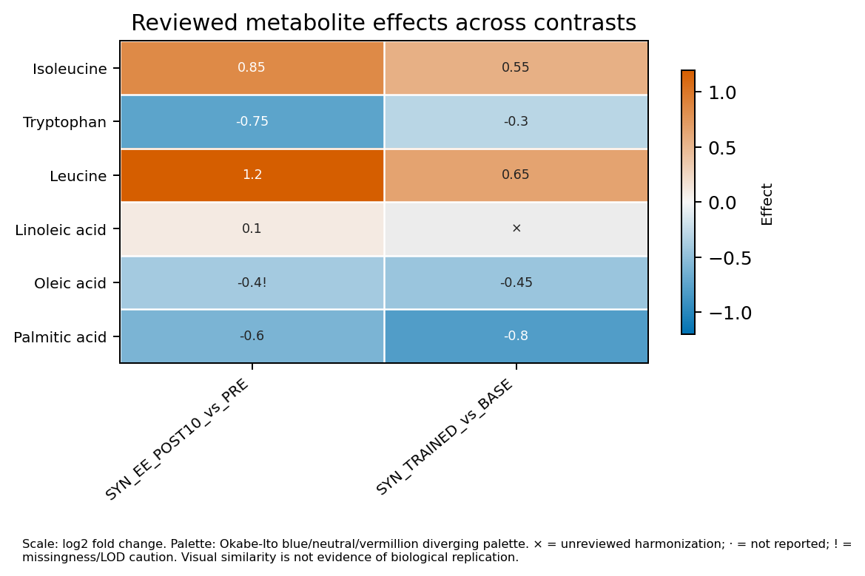
Human review is a hard boundary
01
Agents organize evidence
They collect sources and frame review questions.
02
Schemas require review
Packets remain advisory and cannot act.
03
Code enforces approval
Only approved mappings reach analysis.
Synthetic example: unreviewed results remain visible and do not prove replication.
Notes:
[Sources]
- DomainReviewPacket authority boundary: README.md, src/metabotyping_agentic/review/models.py, and src/metabotyping_agentic/review/validation.py.
- Synthetic heatmap: docs/manuscript/figures/synthetic_motrpac_plot_suite/figures/effect_heatmap.png.
- CPET and identity/pooling safeguards: AGENTS.md and README.md.
[/Sources]

Slide 6
The offline prototype passes 128 synthetic tests
128 / 128
What passed
• Deterministic rules
• Provenance tracking
• Review and network boundaries
offline synthetic tests
19 August 2026
Still untested
21 agent roles
23 skill contracts
No network required
• Independent studies
• Cross-platform comparability
• Biological replication
NEXT
Benchmark public records across assay platforms
Use two blinded curators + adjudication
Notes:
[Sources]
- Strict synthetic gate: docs/scientific_readiness_report.md; project .venv rerun on 2026-08-19 returned PASS with tests_run=128.
- Agent and skill inventory: README.md release 0.2.0.
- External-validation limitations and proposed benchmark: docs/scientific_readiness_report.md and docs/manuscript/metabotyping_agentic_workbench_manuscript.md.
[/Sources]

