Slide 1
5G Wizard Validation
Arien Sligar

Slide 2
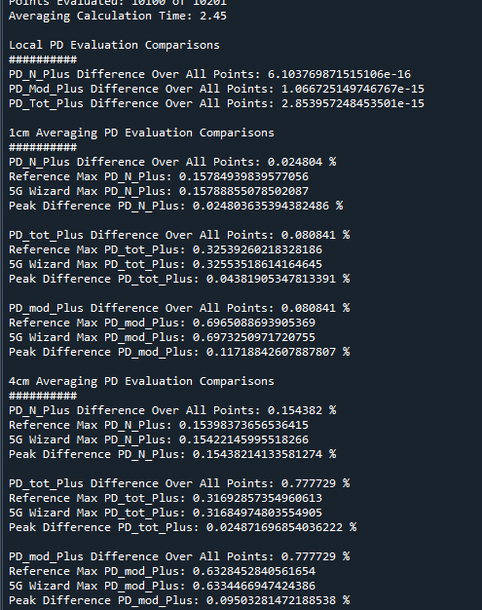
Comparison Summary
5G Wizard Calculation Time
~2.5 seconds for 1cm^2 surface per quantity
~ 3 seconds for 4cm^2 surface per quantity
Discussion:
The results will not be exactly the same because the reference data is based on analytic equations that can be re-evaluated at any requested point. In our simulations, we are operating on a fixed grid of values that cannot be moved (we could re-export but that is tedious). For example, in the reference data, the grid of points to evaluate PD on is calculated. These points are fixed (x,y). When the average values are calculated at (x1,y1), a new set of grid points (x’,y’) are generated that align with the orientation of the averaging surface. As the averaging surface is rotated, a new set of points (x’,y’) are generated for each orientation.
No matter the orientation of the averaging square, a new set of points to evaluate that align with the averaging square. In the 5G wizard, because we are dealing with a fixed grid of points output from the simulation, when the averaging square rotates, for each rotation there may be a different set of points that fall within the averaging square. If a point does not fall within the averaging square at one rotation, it may fall within at another rotation.

Slide 3
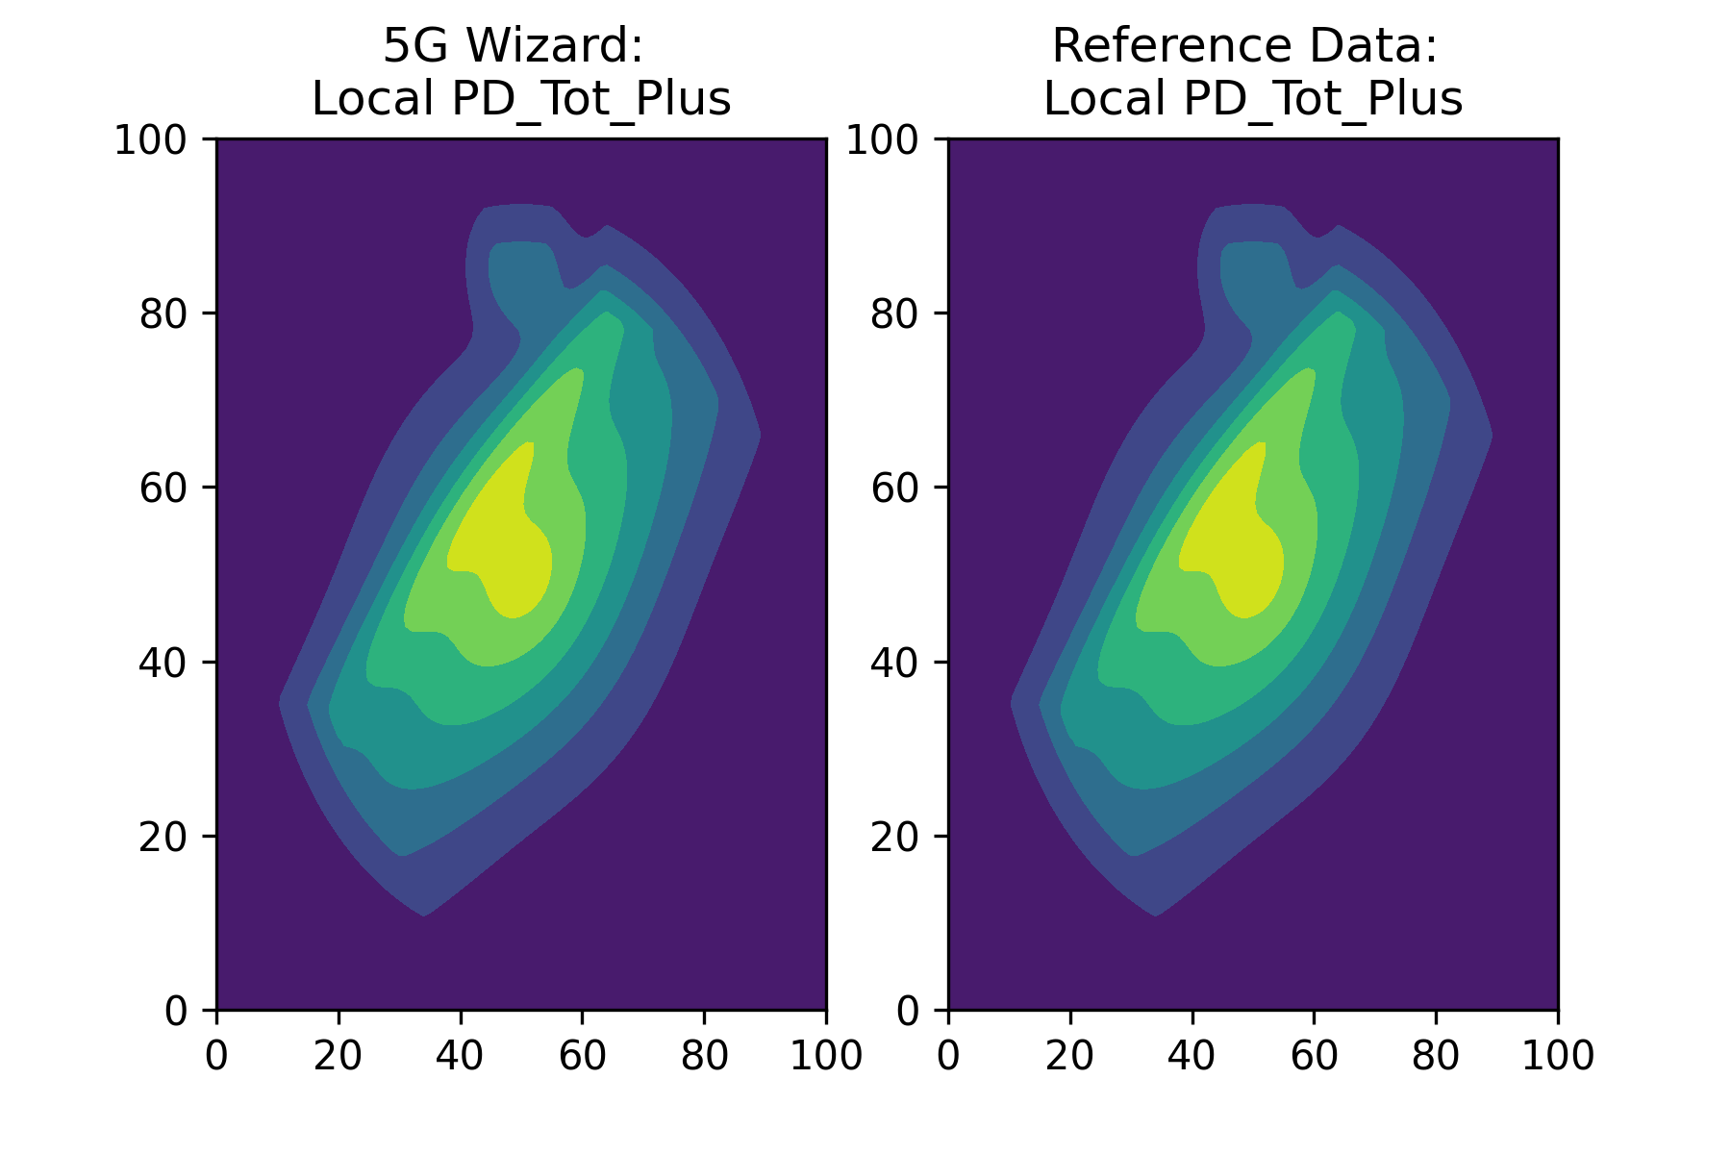
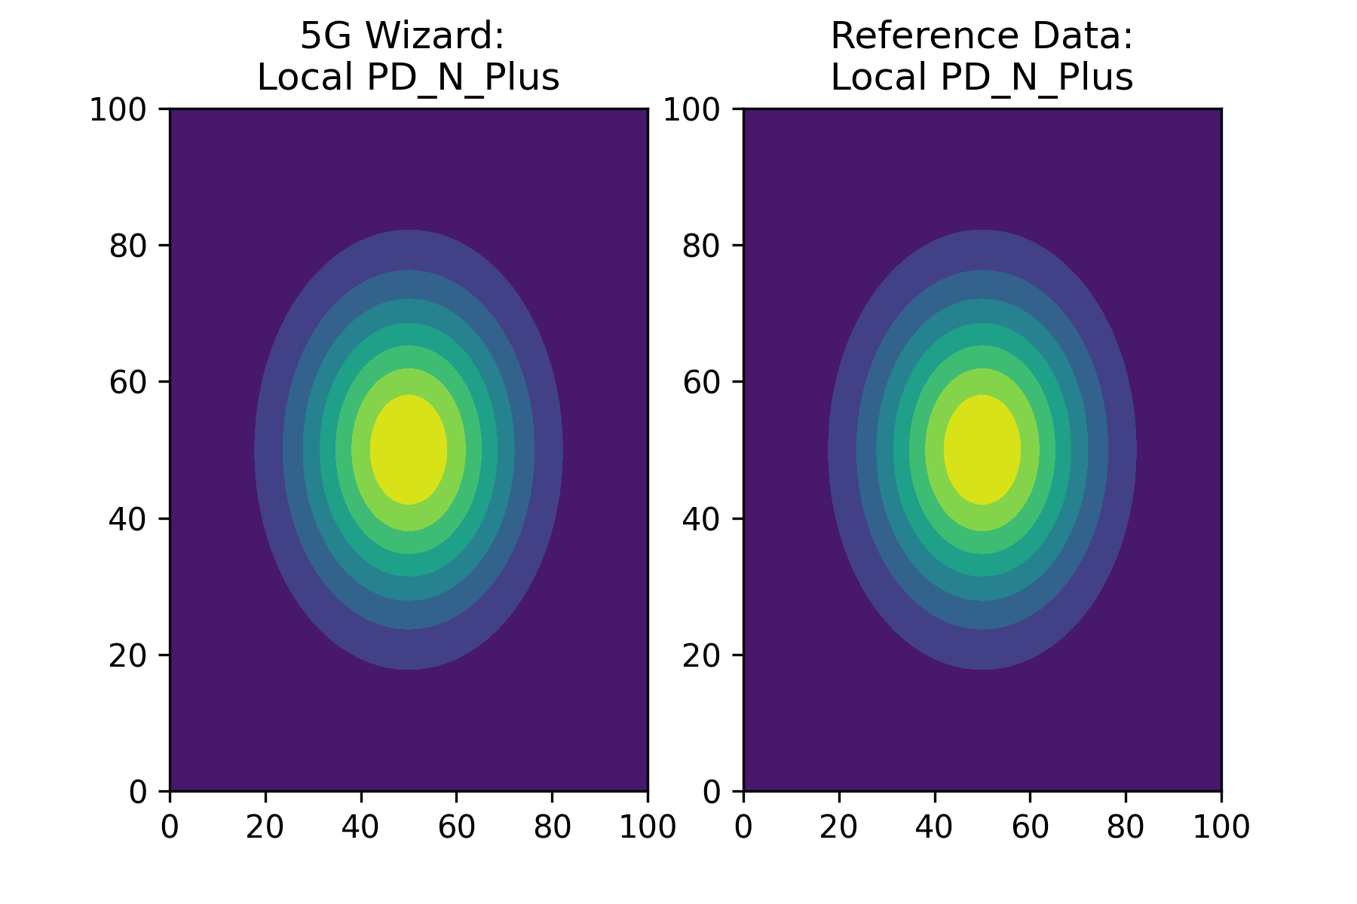
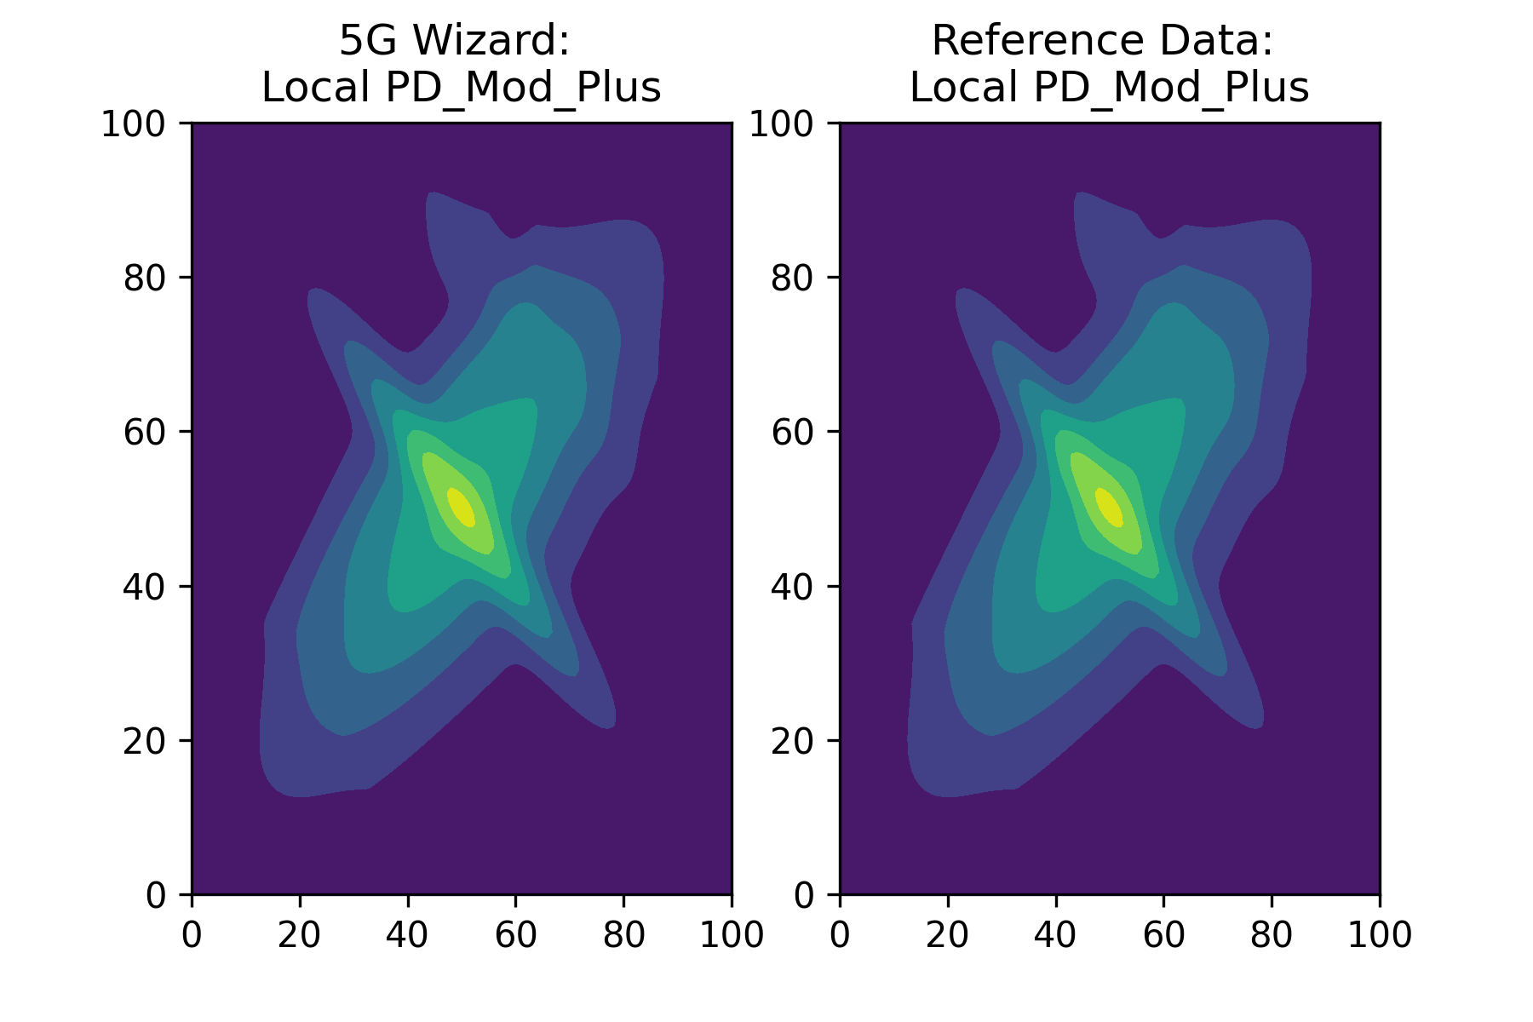
Local PD Comparison
PD_N_Plus Difference: 6.103769871515106e-16
PD_Mod_Plus Difference: 1.066725149746767e-15
PD_Tot_Plus Difference: 2.853957248453501e-15

Slide 4

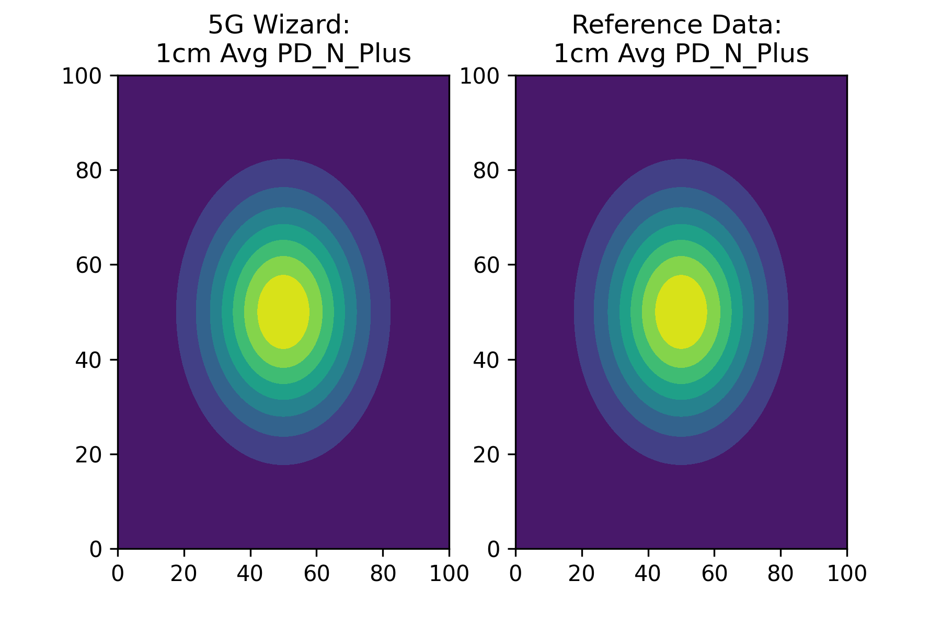
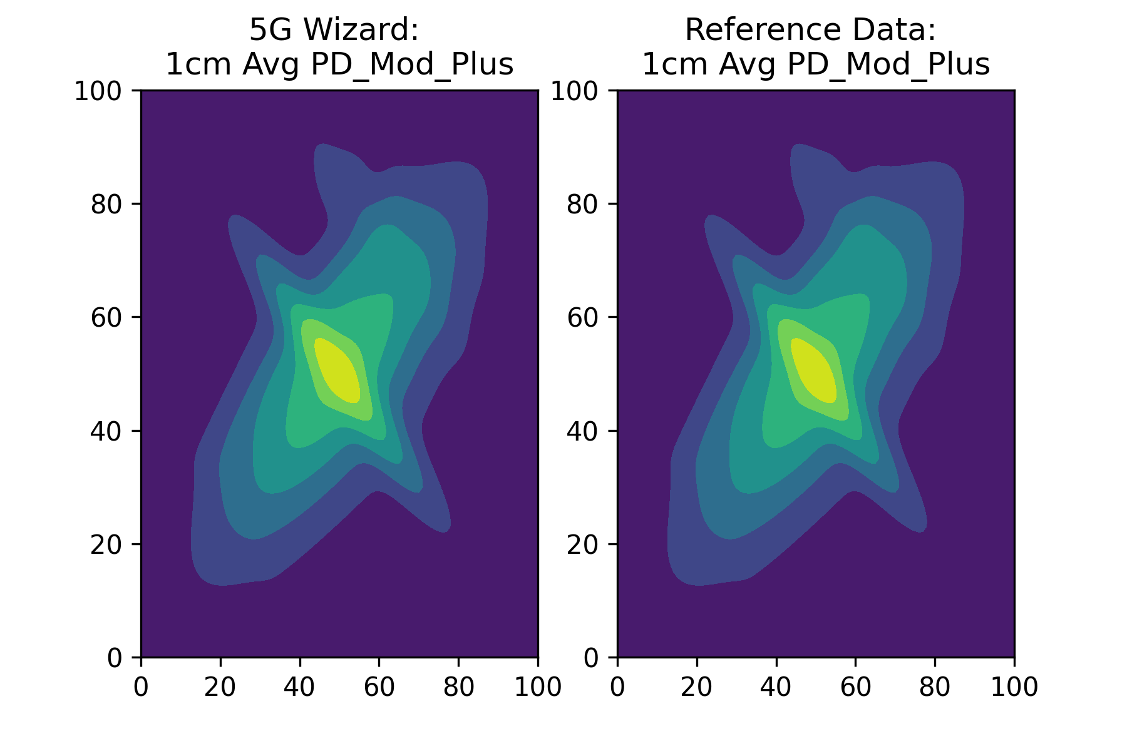
1cm^2 Averaging Surface
PD_N_Plus Difference: 0.024804 %
Reference Max PD_N_Plus: 0.15784939839577056
5G Wizard Max PD_N_Plus: 0.15788855078502087
PD_tot_Plus Difference: 0.080841 %
Reference Max PD_tot_Plus: 0.32539260218328186
5G Wizard Max PD_tot_Plus: 0.32553518614164645
PD_N_Plus Difference: 0.080841 %
Reference Max PD_mod_Plus: 0.6965088693905369
5G Wizard Max PD_mod_Plus: 0.6973250971720755

Slide 5

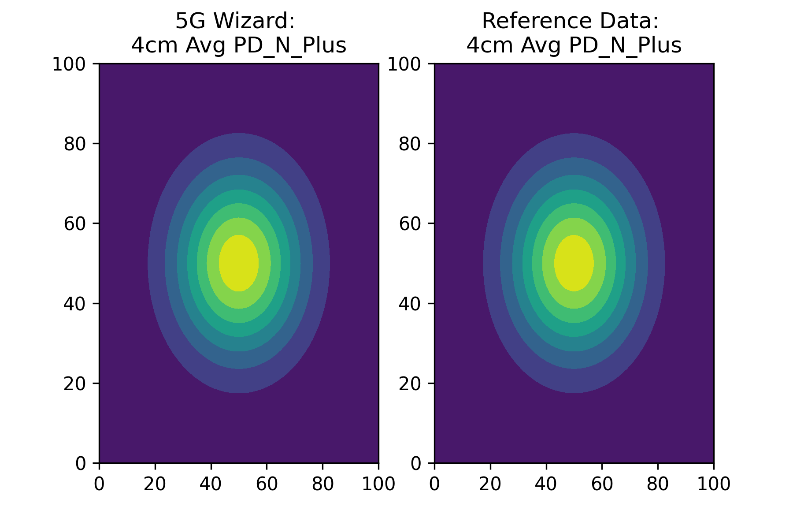
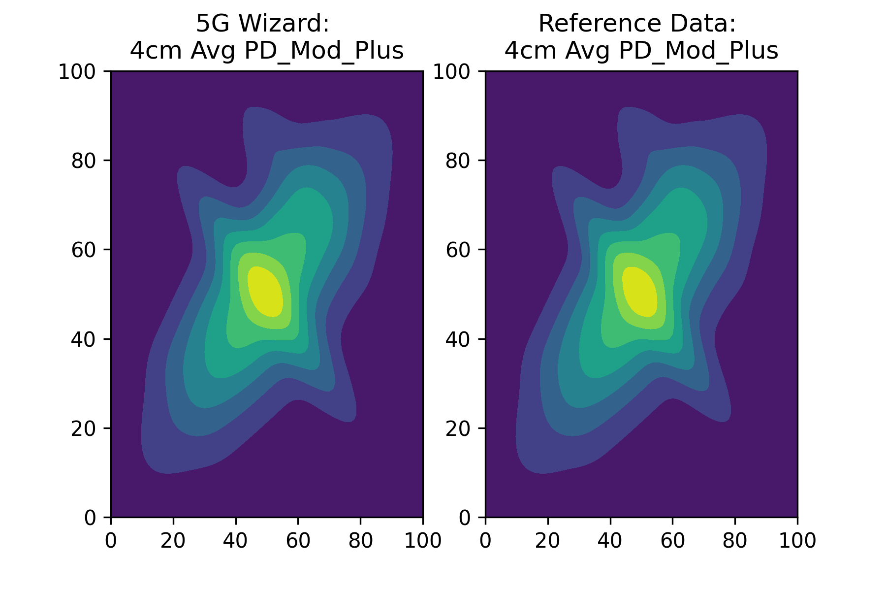
4cm^2 Averaging Surface
PD_N_Plus Difference: 0.154382 %
Reference Max PD_N_Plus: 0.15398373656536415
5G Wizard Max PD_N_Plus: 0.15422145995518266
PD_tot_Plus Difference: 0.777729 %
Reference Max PD_tot_Plus: 0.31692857354960613
5G Wizard Max PD_tot_Plus: 0.31684974803554905
PD_mod_Plus Difference: 0.777729 %
Reference Max PD_mod_Plus: 0.6328452840561654
5G Wizard Max PD_mod_Plus: 0.6334466947424386

