Slide 1

Parallel Minimum-Spanning-Tree
Matteo Kamm, Hulda Lilja Hannesdóttir, Samuel Anzalone, Šimon Hrabec, Mike Marti
23rd of December 2021

Slide 2
Roadmap
Introduction
Approach & Setup
Results
Future Work

Slide 3
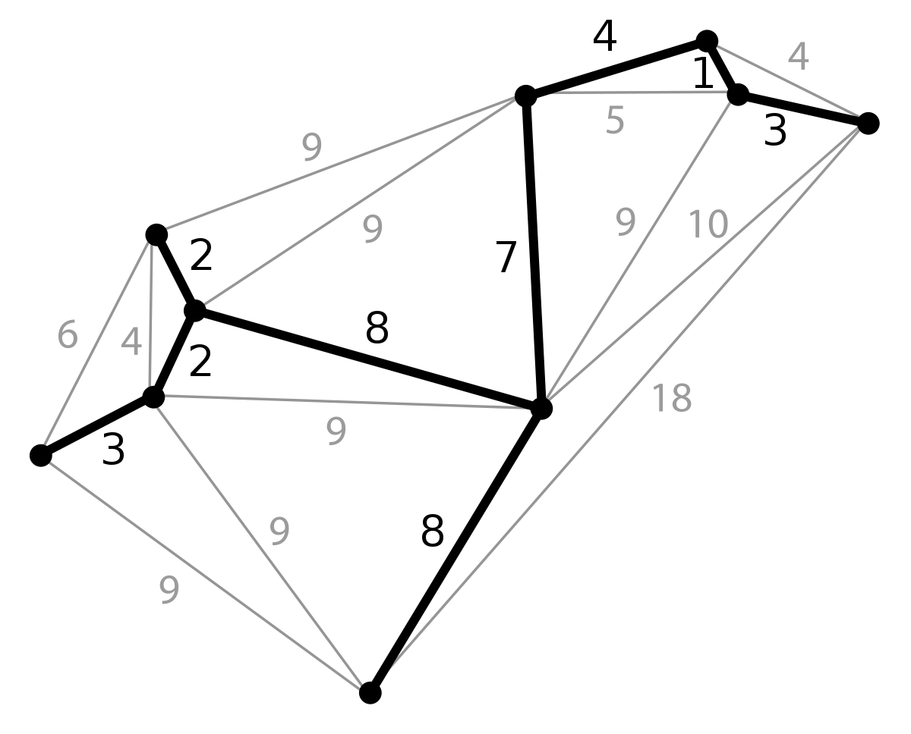
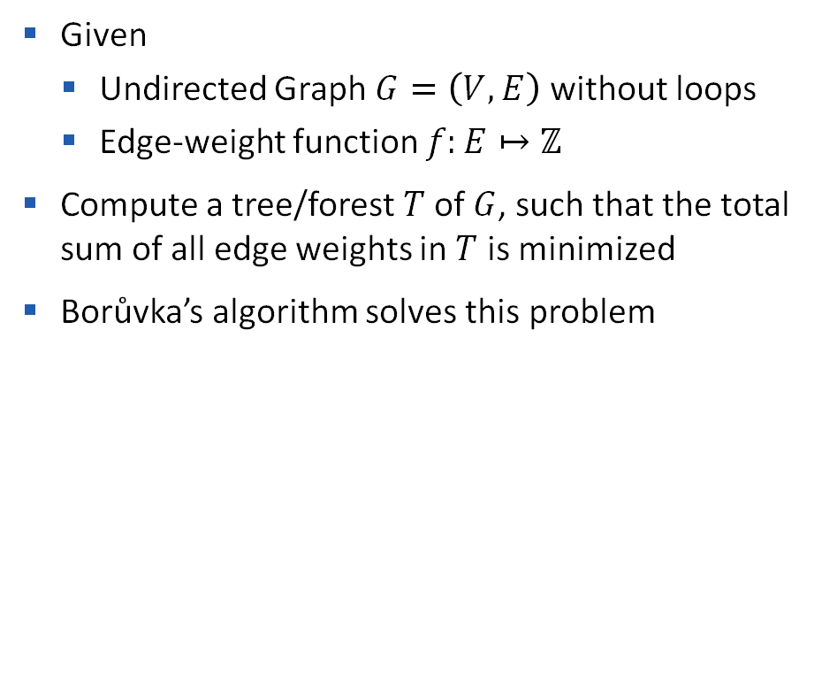
Problem Statement Minimum-Spanning-Tree
Given
Undirected Graph $G=\left(V,E\right)$ without loops
Edge-weight function $f:E↦ℤ$
Compute a tree/forest $T$of $G$, such that the total sum of all edge weights in $T$ is minimized
Borůvka’s algorithm solves this problem

Slide 4
Borůvka’s Algorithm
4
14
1
10
8
5
6
3
7

Slide 5
Borůvka’s Algorithm
4
14
1
10
8
5
6
3
7

Slide 6
Borůvka’s Algorithm
4
14
1
8
10
5
6

Slide 7
Borůvka’s Algorithm
14
1
5
8
10
6

Slide 8
Borůvka’s Algorithm
14
5
10

Slide 9
Borůvka’s Algorithm
14
5
10

Slide 10
Borůvka’s Algorithm

Slide 11
Borůvka’s Algorithm
4
14
1
10
8
5
6
3
7

Slide 12
Roadmap
Introduction
Approach & Setup
Results
Future Work

Slide 13
Approach
Distributing work
By edges
By vertices

Slide 14
Approach
Component is represented by deterministically selected node (root)
Every vertex knows about the roots of the components
Component merge strategies to find new root
Disjoint-set data structure
Root finding
Pointer-Jumping
Supervertex-Pointer-Jumping
?
root = 8
root = 5

Slide 15

Disjoint-set data structure
Stores a partition of a set into disjoint subsets
Provides operations:
Find representative of a set $𝒪(m⋅α(n))$
Merge two sets $𝒪(m⋅α(n))$
Notes:
TODO

Slide 16
Disjoint-set data structure
Each node stores
Parent pointer
The rank (upper bound of the height)
Path compression during find operation
Union by rank
Notes:
TODO

Slide 17

Root finding
Iterate until we find root node (self loop)
In the worst case this takes up to $𝒪\left(n^{2}\right)$ time

Slide 18

Pointer-Jumping
Select parent of parent as intermediate root for all nodes
Repeat until all nodes point to actual root
In the worst case this takes up to $𝒪(n log(n))$time

Slide 19
Pointer-Jumping
Select parent of parent as intermediate root for all nodes
Repeat until all nodes point to actual root
In the worst case this takes up to $𝒪(n log(n))$time

Slide 20
Pointer-Jumping
Select parent of parent as intermediate root for all nodes
Repeat until all nodes point to actual root
In the worst case this takes up to $𝒪(n log(n))$time

Slide 21
Supervertex-Pointer-Jumping
Select super vertices with probability 1/2
Use pointer jumping for non-super vertices to reach super vertex or root
Perform one more pointer jump for super vertices
Repeat with super vertices
Perform one more pointer jump for non-super vertices
Work is linear in the number of vertices

Slide 22
Supervertex-Pointer-Jumping
Select super vertices with probability 1/2
Use pointer jumping for non-super vertices to reach super vertex or root
Perform one more pointer jump for super vertices
Repeat with super vertices
Perform one more pointer jump for non-super vertices
Work is linear in the number of vertices

Slide 23
Supervertex-Pointer-Jumping
Select super vertices with probability 1/2
Use pointer jumping for non-super vertices to reach super vertex or root
Perform one more pointer jump for super vertices
Repeat with super vertices
Perform one more pointer jump for non-super vertices
Work is linear in the number of vertices

Slide 24
Supervertex-Pointer-Jumping
Select super vertices with probability 1/2
Use pointer jumping for non-super vertices to reach super vertex or root
Perform one more pointer jump for super vertices
Repeat with super vertices
Perform one more pointer jump for non-super vertices
Work is linear in the number of vertices

Slide 25
Supervertex-Pointer-Jumping
Select super vertices with probability 1/2
Use pointer jumping for non-super vertices to reach super vertex or root
Perform one more pointer jump for super vertices
Repeat with super vertices
Perform one more pointer jump for non-super vertices
Work is linear in the number of vertices

Slide 26
Supervertex-Pointer-Jumping
Select super vertices with probability 1/2
Use pointer jumping for non-super vertices to reach super vertex or root
Perform one more pointer jump for super vertices
Repeat with super vertices
Perform one more pointer jump for non-super vertices
Work is linear in the number of vertices

Slide 27
Supervertex-Pointer-Jumping
Select super vertices with probability 1/2
Use pointer jumping for non-super vertices to reach super vertex or root
Perform one more pointer jump for super vertices
Repeat with super vertices
Perform one more pointer jump for non-super vertices
Work is linear in the number of vertices

Slide 28
Supervertex-Pointer-Jumping
Select super vertices with probability 1/2
Use pointer jumping for non-super vertices to reach super vertex or root
Perform one more pointer jump for super vertices
Repeat with super vertices
Perform one more pointer jump for non-super vertices
Work is linear in the number of vertices

Slide 29
Supervertex-Pointer-Jumping
Select super vertices with probability 1/2
Use pointer jumping for non-super vertices to reach super vertex or root
Perform one more pointer jump for super vertices
Repeat with super vertices
Perform one more pointer jump for non-super vertices
Work is linear in the number of vertices

Slide 30
Setup
C++
OpenMPI
Unit testing using Catch2
Use Boost as the reference implementation
Notes:
TODO

Slide 31
Roadmap
Introduction
Approach & Setup
Results
Future Work

Slide 32
Results
We use LIKWID API markers, 10 measurements
LIKWID uses hardware counters
Flexibility to measure other metrics in the future such as FLOPS or memory access
Benchmark done on a local server with 18 core Intel Core i9-10980XE CPU
Markers are around the whole function body
MPI chooses cores

Slide 33
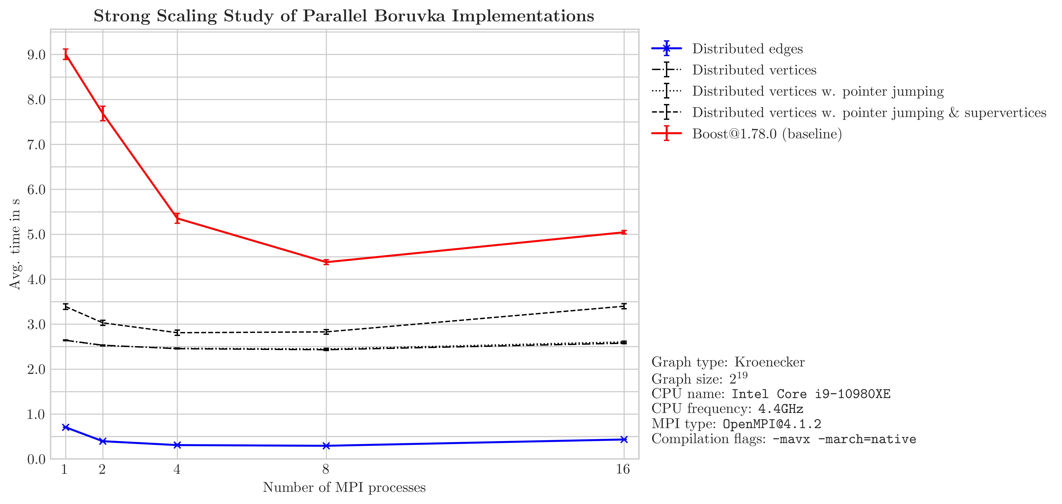
Results

Slide 34
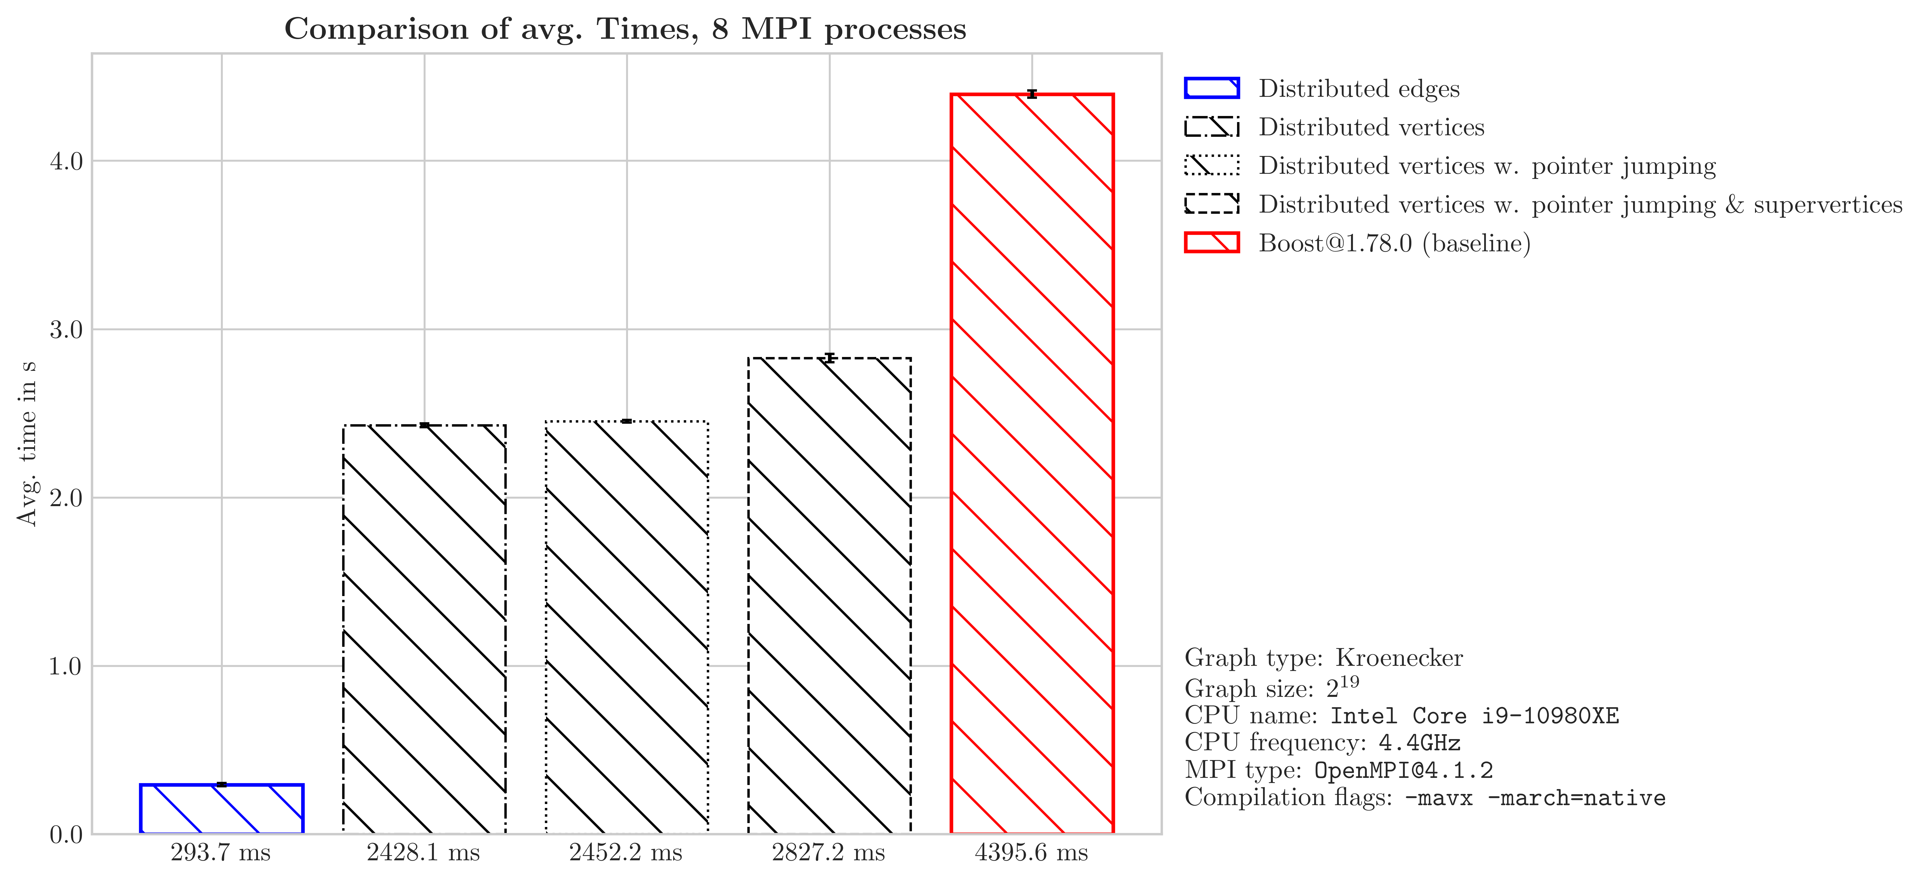
Results

Slide 35
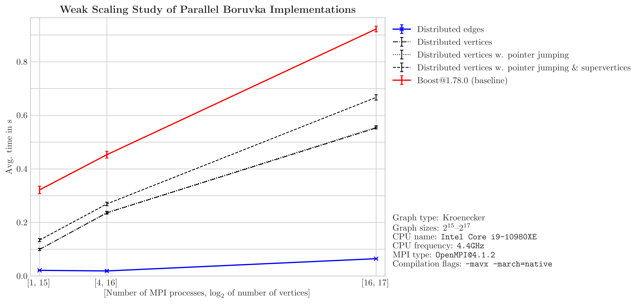
Results

Slide 36
Roadmap
Introduction
Approach & Setup
Results
Future Work

Slide 37
Future Work
Figure out which parts of the algorithms take up the most work
Test on different cluster (RACKlette with 128 cores)
Pin the cores MPI chooses for more consistency
Try handling resizing of arrays (gets smaller in each iteration)
Parallelize Disjoint Set data structure
Try different compiler flags
Try remote memory access in MPI (especially in component merge)
Test if MPI_IN_PLACE results in better performance due to less data structure generation
Notes:
TODO

Slide 38
Conclusion
Results are promising
Distributing work by edges seems to perform best
We think there is still room for improvement
Boost seems to not be as optimized as initially thought

Slide 39
