Slide 1
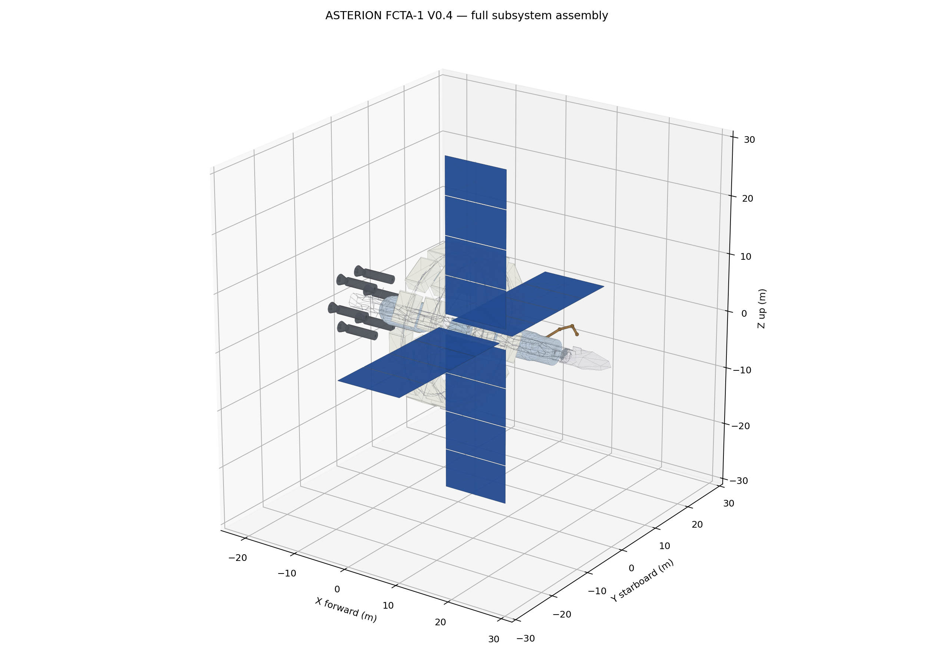
ASTERION FCTA-1
Version 0.9 Design Review
A Siemens NX + ANSYS + NX CAM open-source aerospace portfolio: a modular orbit-assembled spacecraft and detachable Skimmer aeroshuttle.
53.2 t
57.8 m
0.196 Hz
updated dry docked mass
deployed span
first supported mode
ASTERION FCTA-1 v0.9 • 1/10

Slide 2
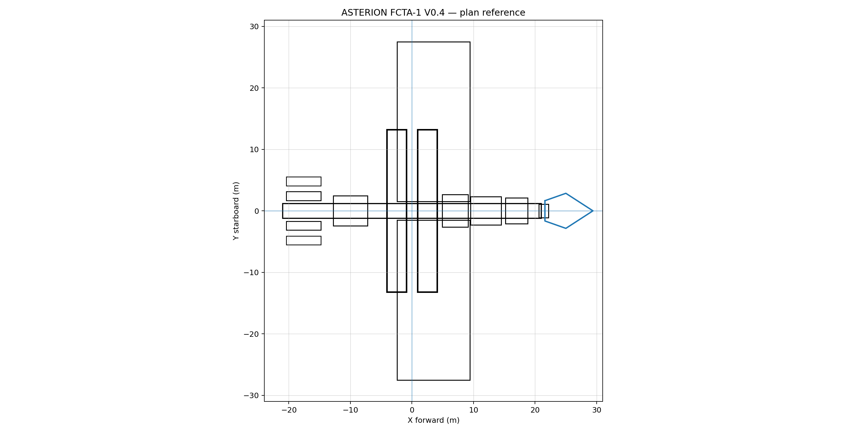
System architecture
Central spine, twin counter-rotating rings, six propulsion pods, four solar wings, six radiators and a detachable Skimmer are integrated into one controlled coordinate system.
24
6
6
4
habitation sectors
propulsion pods
radiator panels
solar wings
ASTERION FCTA-1 v0.9 • 2/10

Slide 3
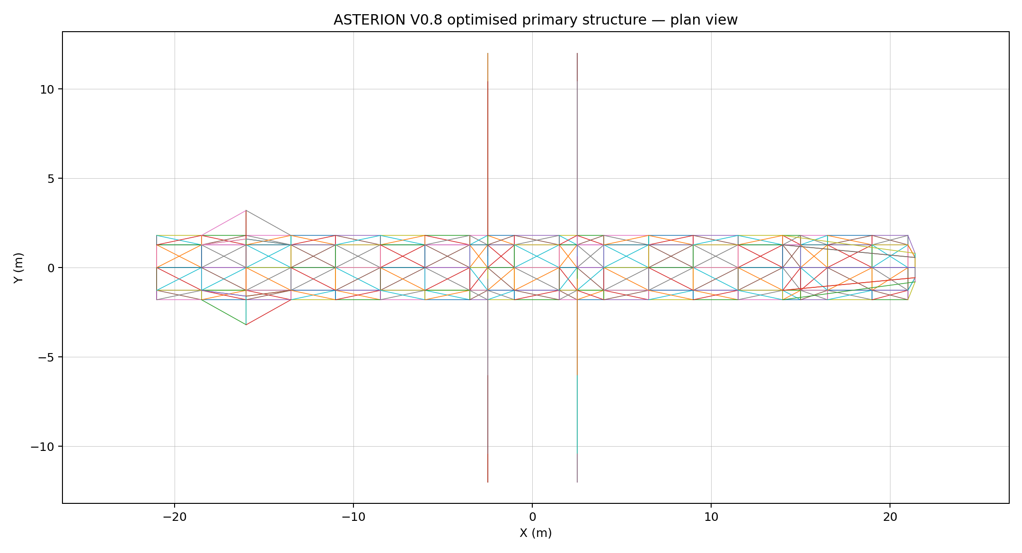
CAD evolution: envelope to optimized structure
NX master skeleton → primary truss → full subsystem assembly → redesigned structure. The v0.8 structure adds torque braces, forward docking load spreaders and propulsion struts.
Native NX parts are intentionally not claimed as generated here. The release supplies neutral geometry, expressions, tutorials and reconstruction logic for your installed NX environment.
222
648
10.4 t
structural nodes
beam elements
structural mass
ASTERION FCTA-1 v0.9 • 3/10

Slide 4
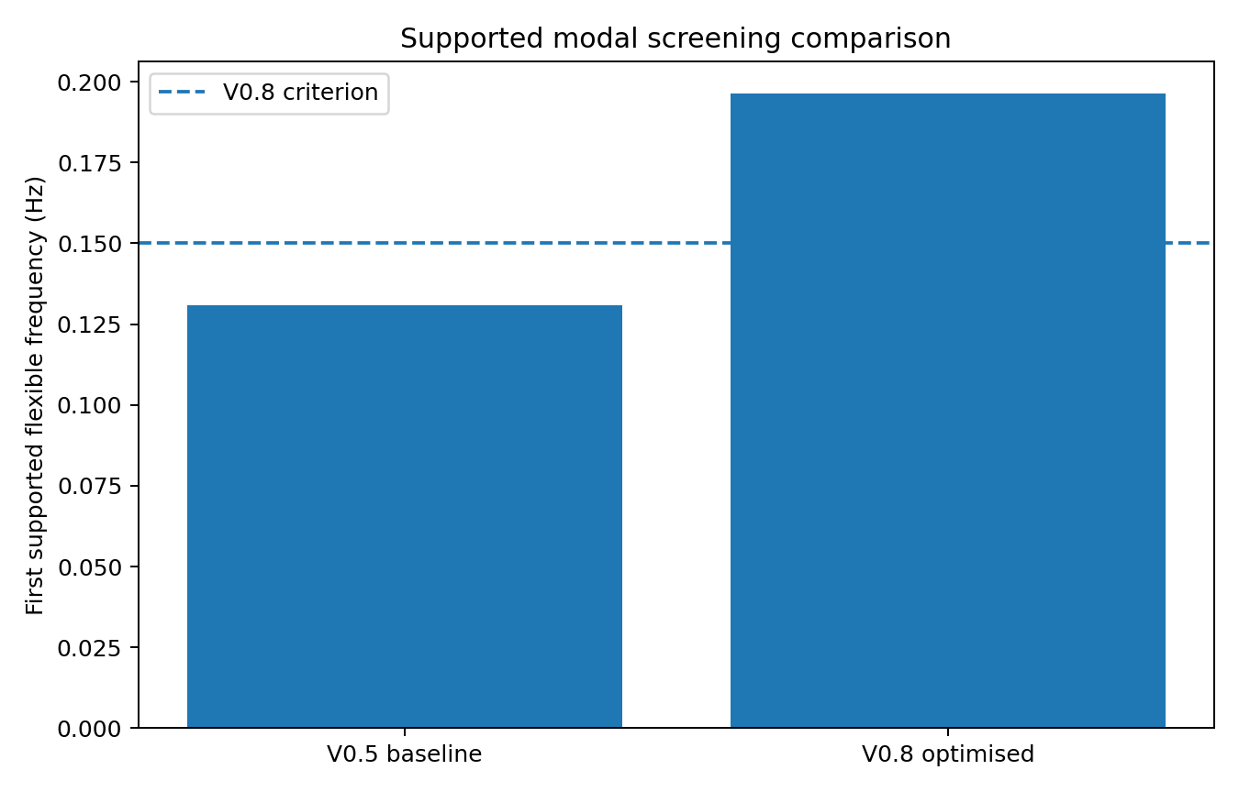
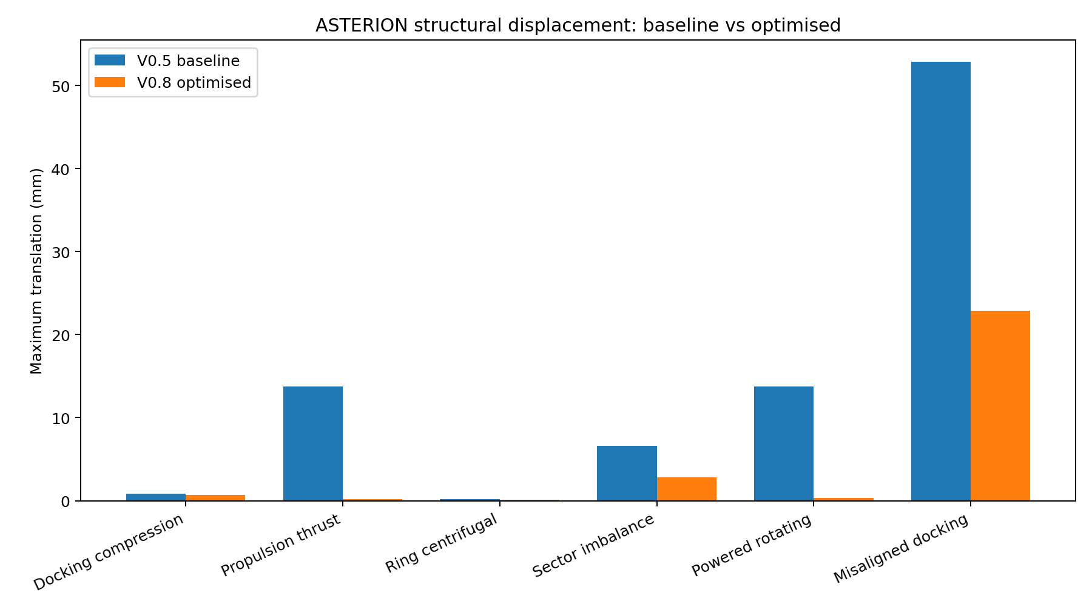
Structural redesign closed the major v0.5 warnings
Propulsion translation reduced by 98.4%; misaligned-docking translation reduced by 56.7%; first supported mode increased by 50.2%.
ASTERION FCTA-1 v0.9 • 4/10

Slide 5
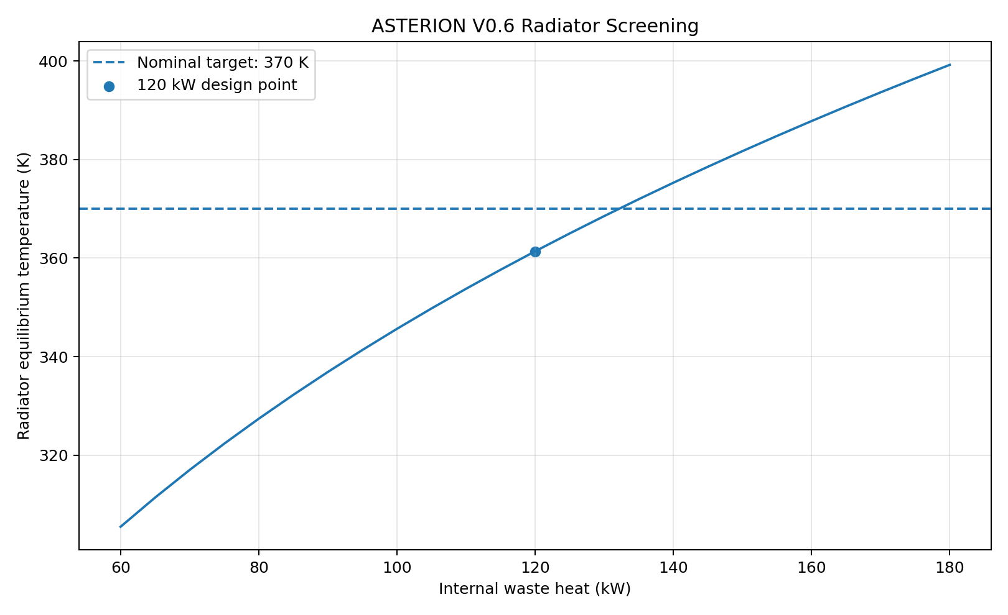
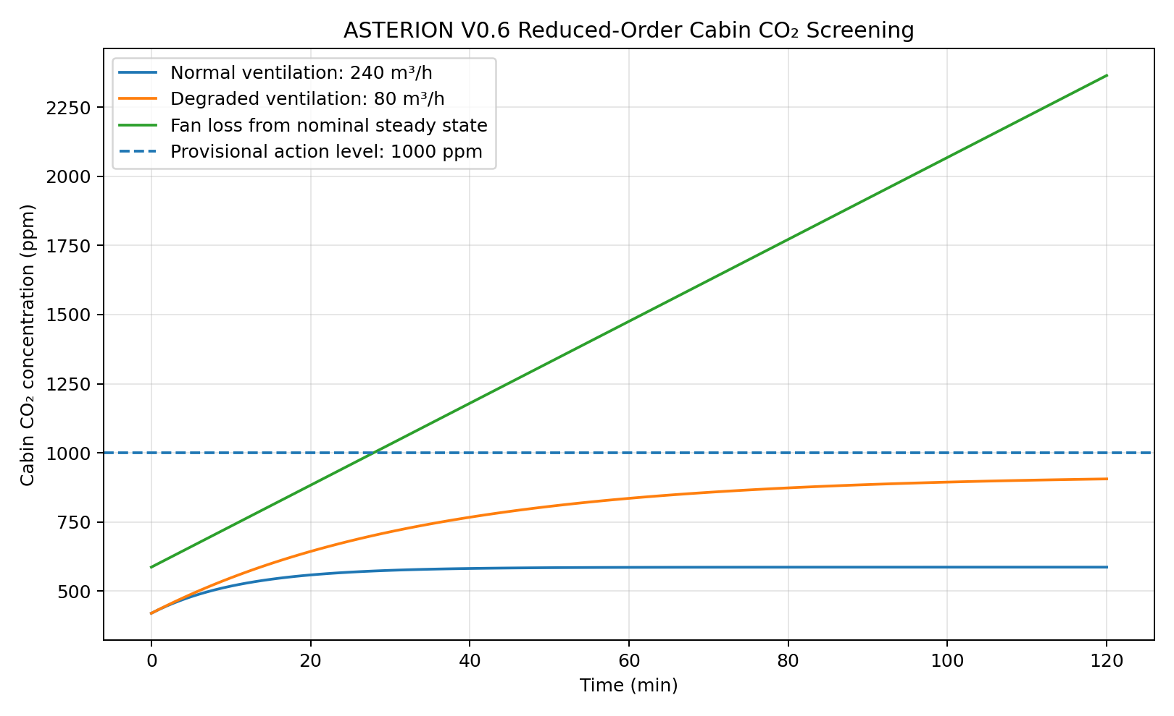
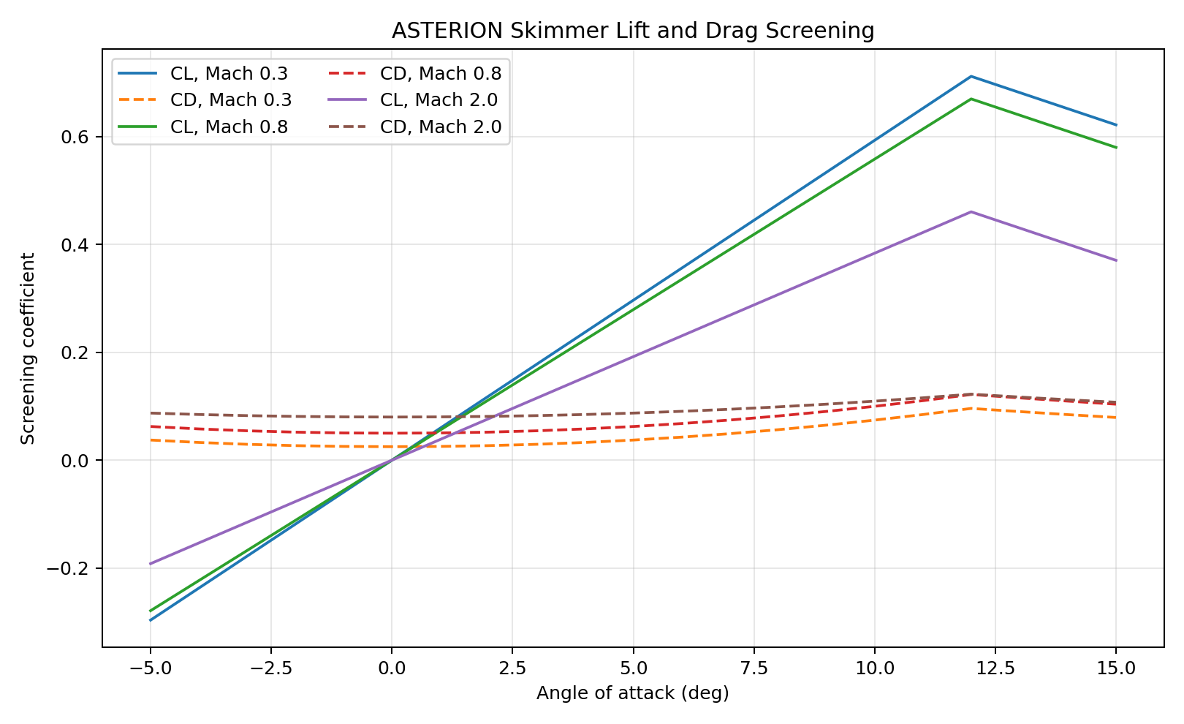
Thermal and CFD screening
Radiator sizing passes nominal screening; cabin fan-loss cases require emergency CO₂ management; Skimmer CFD is prepared as home-PC-scale Mach 0.3 / 0.8 / 2.0 studies.
ASTERION FCTA-1 v0.9 • 5/10

Slide 6
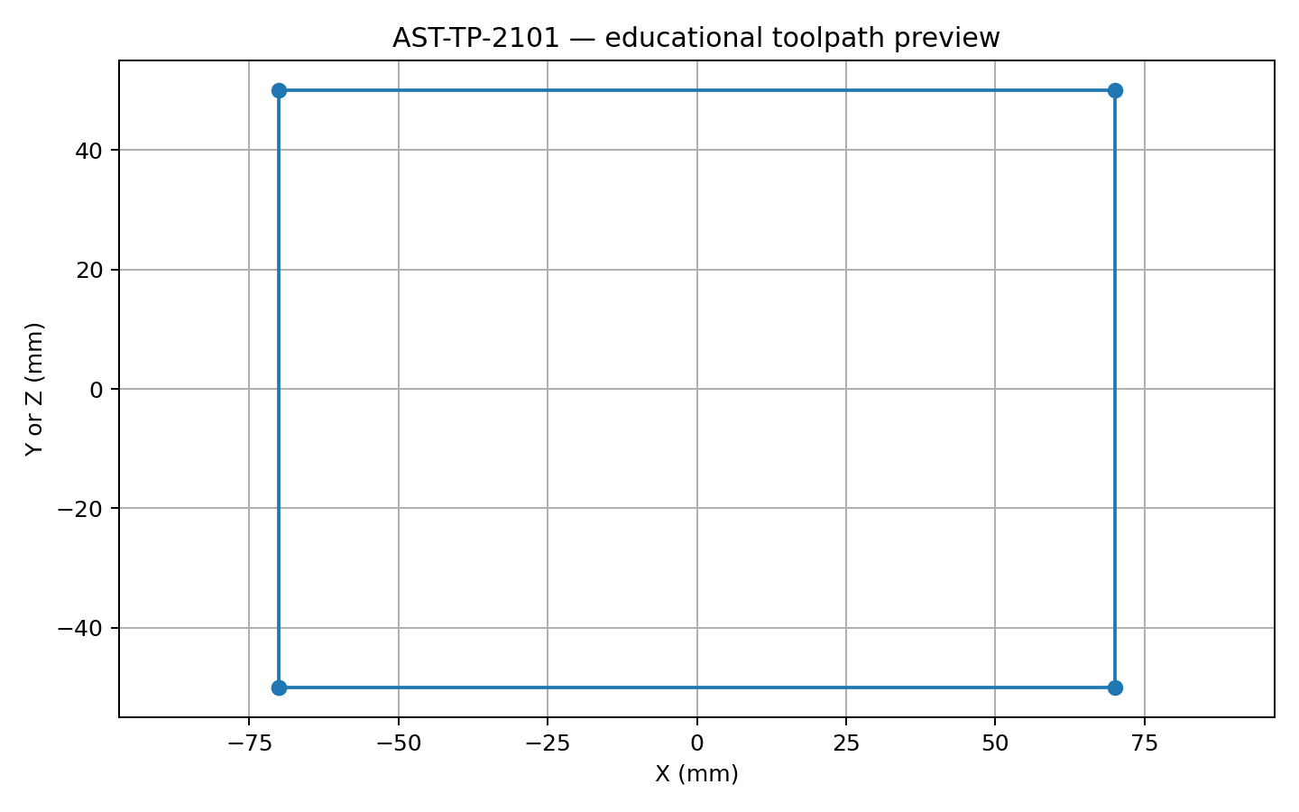
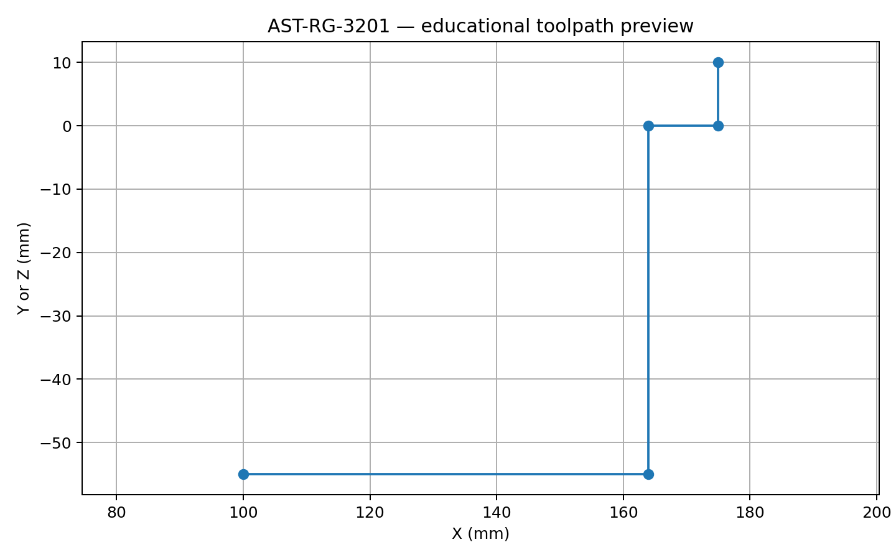
NX CAM manufacturing portfolio
Four representative parts demonstrate machining strategy: thruster-gimbal bracket, ring-bearing housing, Skimmer rib and lightweight bulkhead. G-code remains simulation-only until verified on a real machine/postprocessor.
ASTERION FCTA-1 v0.9 • 6/10

Slide 7
Verification discipline
22
requirements closed in the v0.9 documentation baseline
Result-import templates now exist for static, modal, buckling, thermal, Fluent and CAM verification records. Version 1.0 should replace package-level closure with native NX/ANSYS evidence generated on your PC.
Evidence hierarchy
Release boundary
1. Hand calculation / reduced-order screening
2. NX or ANSYS native result
3. Interpretation, limitation and corrective action
No solved ANSYS database or native NX part is claimed here. The repository provides reproducible setup, neutral models, templates and portfolio-ready documentation.
ASTERION FCTA-1 v0.9 • 7/10

Slide 8
GitHub Pages presentation layer
Version 0.9 adds a Three.js web-viewer scaffold with selectable full-assembly and optimized-structure GLB models. It is ready for a public GitHub Pages portfolio with your native screenshots added later.
HTML/CSS/JS
GLB
v1.0
web app
models
release target
The viewer uses CDN-hosted Three.js by default; vendor the modules locally for offline publication.
ASTERION FCTA-1 v0.9 • 8/10

Slide 9
Clear engineering limitations
No unrestricted travel claim
Asterion is constraint-reduced, not reactionless or faster-than-light.
No flight certification
The design is a CAD/CAE/CAM demonstrator, not a validated spacecraft.
Native evidence pending
NX parts, ANSYS solves and CAM verification must be completed on your PC.
Skimmer is conceptual
It supports aeronautical CFD study, not re-entry certification.
Professional portfolio strength comes from transparency: the project records assumptions, failures, redesign choices and next validation steps.
ASTERION FCTA-1 v0.9 • 9/10

Slide 10
Version 1.0 release gates
Add native NX model screenshots, ANSYS solver results, mesh-convergence evidence, NX CAM simulation captures, physical prototype photos and filled result-import templates.
Final portfolio message
ASTERION demonstrates how a radical aerospace concept can be disciplined by CAD, CAE, CAM, validation and honest engineering limits.
ASTERION FCTA-1 v0.9 • 10/10

