Slide 1
ALY 6130 . ENTERPRISE RISK MANAGEMENT . SIGNATURE ASSESSMENT
Enterprise Risk Assessment of Apple’s Acquisition of Netflix
A Competitive Intelligence and Quantitative Risk Analytics Approach
Samuel Tweneboah-Kodua Nyamekye Adebukola Fadina Sandeep Kaur
College of Professional Studies, Northeastern University . Spring 2026 . Instructor: [Insert instructor name]
Notes:
Group presentation, about 15 minutes. Suggested split: Samuel slides 1 to 5, Adebukola slides 6 to 10, Sandeep slides 11 to 15. Open with the question we set out to answer: should Apple acquire Netflix, and what are the risks if it does.

Slide 2
OVERVIEW
What this assessment covers
Our approach
The three competitive risks
Identify the risks of the acquisition
Assess them qualitatively on a 1 to 9 scale
Model the biggest ones quantitatively
Recommend responses and the indicators to watch
R1
High
Regulatory and antitrust
R2
Subscriber churn and competitive response
High
R3
Cybersecurity and data integration
Medium
Notes:
Frame the deck. We work the full enterprise risk cycle: identify, qualify, quantify, respond. Three competitive risks carry the analysis, two High and one Medium.

Slide 3
THE SCENARIO
Apple acquires Netflix
Apple buys instant scale in subscription streaming
Bundling Netflix into Apple One lifts Services revenue
It pushes Apple into content production at a new scale
Direct rivalry with Disney, Amazon, and Warner Bros Discovery
A deal this size draws heavy regulatory attention
301M
$153B
Netflix paid memberships
Apple cash on hand
~$400B
2.2B
Netflix market value
Apple active devices
Notes:
Set the scene. Netflix brings about 301 million subscribers and a global content engine. Apple brings cash, devices, and a bundle. The prize is scale, but the size of the deal is exactly what creates the regulatory risk.

Slide 4
IDENTIFYING THE RISKS
From SWOT to three competitive risks
Strengths
Weaknesses
Cash and 2.2B device reach
Brand and privacy trust
Thin content experience
Integration and culture
Opportunities
Threats
Instant streaming scale
Bundling lifts ARPU
Antitrust and content arms race
Churn and data exposure
Notes:
We surfaced risks with PESTEL, Porter, and a risk breakdown structure, organized them in this SWOT, then narrowed to the three competitive risks that define the deal. The threats and weaknesses are where R1, R2, and R3 come from.

Slide 5
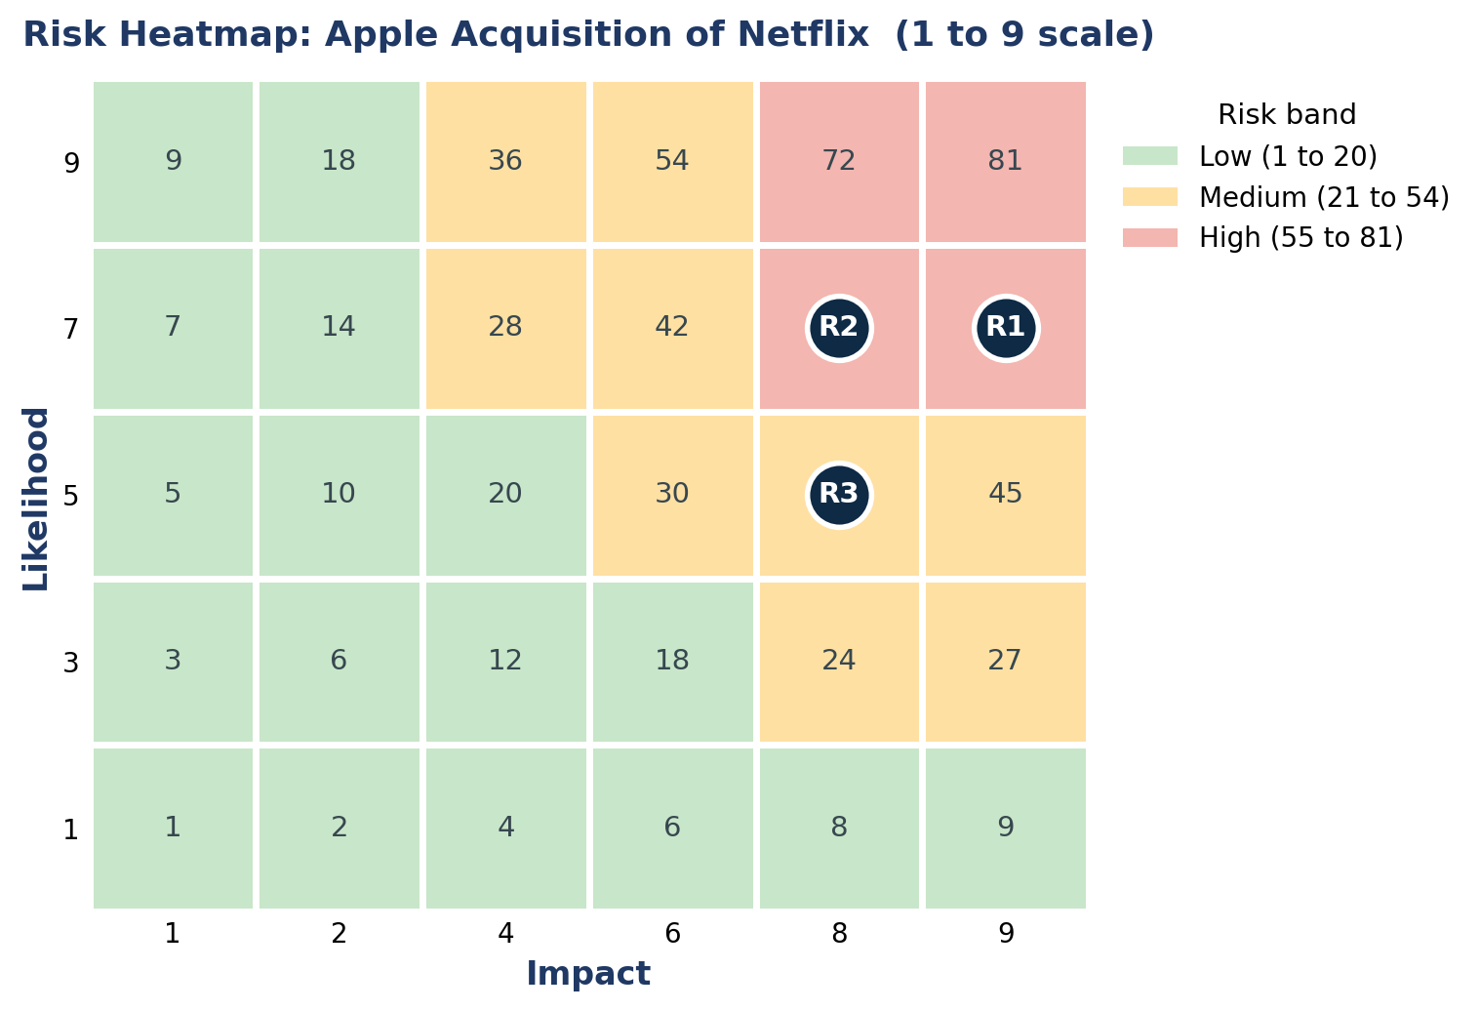
THE THREE RISKS
Scored on the 1 to 9 scale
R1 High
Regulatory and antitrust
7 x 9 = 63
R2 High
Churn and competitive response
7 x 8 = 56
R3 Medium
Cybersecurity and data integration
5 x 8 = 40
Notes:
Likelihood times impact gives the score. R1 at 63 and R2 at 56 land in the High band, R3 at 40 in Medium. The heatmap makes the ranking visible at a glance.

Slide 6
QUALITATIVE ASSESSMENT
Scenario and Industry Fusion analytics
Scenario Analytics (Ch. 22)
Industry Fusion Analytics (Ch. 17)
Three futures for the deal
Clean approval
Approval with remedies
A blocked deal
Each risk traced across all three
Fuse signals across the industry
Competitor moves and regulator posture
Churn trends and security data
Triangulate, not one source
All three risks clear the bar for quantitative work
Notes:
Two course methods carried the qualitative work. Scenario Analytics stress tested each risk across three futures. Industry Fusion triangulated each risk across many signals. The conclusion: all three need quantitative modeling.

Slide 7
QUANTITATIVE APPROACH
Four ways we put numbers on the risk
1
Probability distributions
2
Machine learning prediction
Expected loss, variance, and exposure for each risk
A churn model built on the Key Risk Indicators
3
Monte Carlo simulation
4
Integrated situation assessment
50,000 trials per risk to map the spread of outcomes
Business and non business factors feed every input
Synthetic data simulates the business environment, with assumptions stated in the notebooks.
Notes:
The quantitative engine has four parts. Distributions give expected loss and tail. The ML model predicts churn from the KRIs. Monte Carlo shows the spread. The integrated assessment wires the business and non business environment into the inputs.

Slide 8
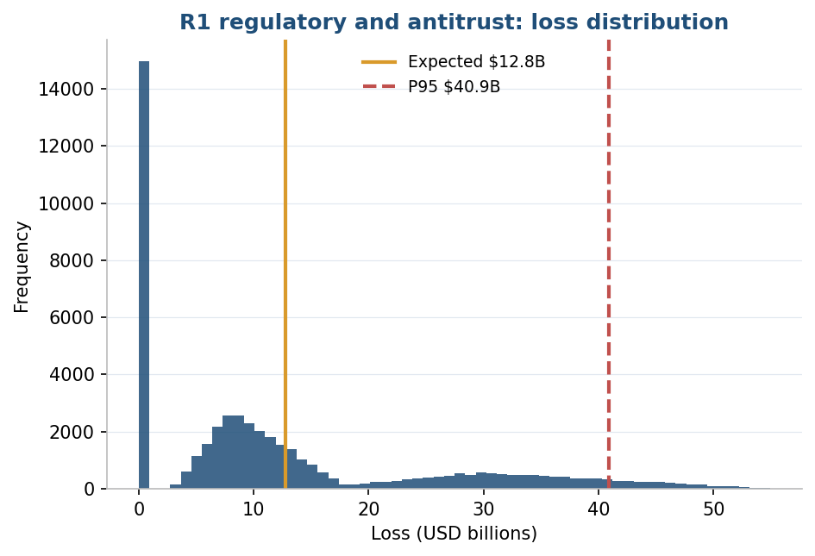
R1 . REGULATORY AND ANTITRUST
The regulatory exposure is the largest
$12.8B
$40.9B
expected loss
P95 tail loss
Outcomes modeled
Clean approval 30%, remedies 45%, block 25%
Loss is the break fee plus lost synergies
Not insurable, since insurance does not cover a block
Notes:
R1 is the heaviest exposure. The Monte Carlo gives an expected loss near 12.8 billion and a P95 tail near 40.9 billion, driven by the block scenario. This risk cannot be transferred, which shapes the response.

Slide 9
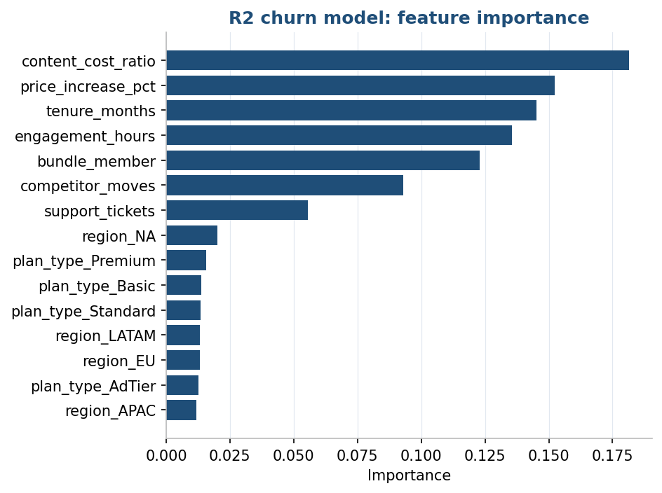
R2 . SUBSCRIBER CHURN
A model that predicts churn from the KRIs
0.71
$1.9B
churn model AUC
first year revenue at risk
What it tells us
Top drivers are the same quantities we track as KRIs
Content cost, price increases, tenure, and engagement
Monte Carlo on churn puts the P95 revenue loss near $4.4B
Notes:
R2 has two parts. The machine learning model reaches an honest AUC of 0.71, and the drivers it relies on are exactly our KRIs, which validates them. The Monte Carlo on churn puts first year revenue at risk near 1.9 billion, with a P95 near 4.4 billion.

Slide 10
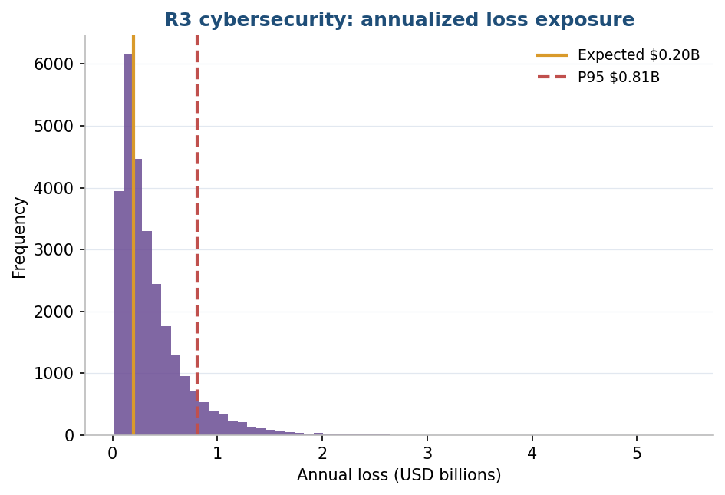
R3 . CYBERSECURITY
A FAIR loss model with a heavy tail
$0.20B
$1.41B
expected annual loss
P99 tail loss
How it is built
FAIR model: breach frequency times severity
Records breached and cost per record drive severity
Strong controls like MFA and patching cut frequency
Notes:
R3 uses a FAIR model. Expected annual loss is moderate near 200 million, but the tail is heavy, with a P99 near 1.4 billion. The controls we track as KRIs, MFA and patching, are what hold the frequency down.

Slide 11
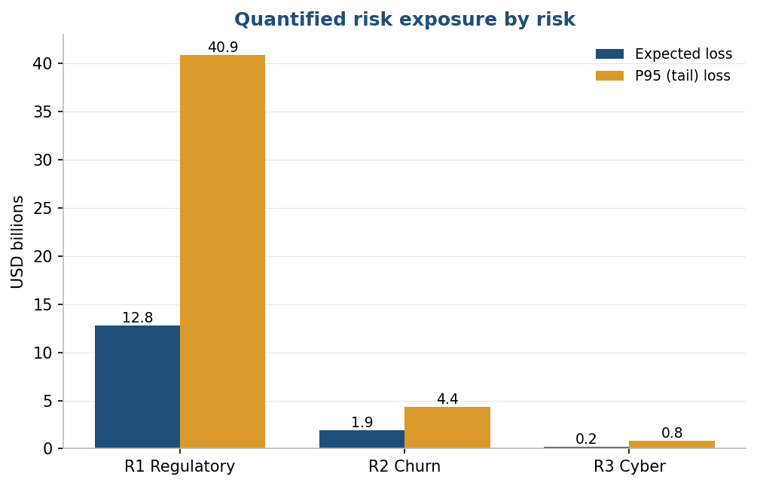
RISK EXPOSURE
Where the money is at risk
R1 regulatory dwarfs the other two
R2 churn is material, in the low billions
R3 cyber is smaller but carries a heavy tail
Expected loss sets the priority
The tail, P95, sizes the contingency reserve
This ranking drives where management looks first
Notes:
Side by side, R1 dominates the exposure. R2 is material. R3 is smaller but tail heavy. Expected loss sets priority, and the tail sizes the reserves. This is the ranking management should act on.

Slide 12
RISK RESPONSE
A strategy matched to each risk
R1 Regulatory
R2 Churn
R3 Cyber
Mitigate + Accept
Mitigate + Exploit
Mitigate + Transfer + Accept
Prepare remedies early, engage legal and policy, hold a contingency reserve. Not transferable.
Disciplined content spend, careful bundling, win back programs. Cross sell to the Apple base.
MFA, patch SLAs, monitoring, zero trust. Transfer the tail through cyber insurance.
Notes:
Each response fits the risk. R1 is mitigate and accept, since it cannot be insured. R2 is mitigate plus a positive exploit of the Apple base. R3 is mitigate, transfer through cyber insurance, and accept the small residual.

Slide 13
KEY RISK INDICATORS
What we watch, and the red triggers
R1 Regulatory
R2 Churn
R3 Cyber
Probability of approval, red below 50%
Milestone slippage, red over 90 days
Monthly churn, red above 4%
Content cost ratio, red above 60%
MFA adoption, red below 95%
Mean time to detect, red over 72 hours
A move into Red invokes that risk’s response strategy. Leading indicators warn early, lagging indicators confirm.
Notes:
Each risk has a Green, Amber, Red panel. These are the headline indicators and their red triggers. Leading indicators warn before the risk hits, lagging ones confirm. Red pulls the response strategy off the shelf.

Slide 14
CONCLUSIONS AND RECOMMENDATIONS
What we recommend
Proceed only with remedies ready
R1 governs the deal. Prepare divestitures and commitments, and hold a reserve for a 40 billion dollar tail.
Protect the subscriber base
R2 puts billions of revenue at risk. Bundle carefully, invest in retention, and watch the churn KRIs.
Harden the data, insure the tail
R3 is smaller but tail heavy. Enforce MFA and patching, and transfer the extreme loss.
Notes:
Close with the recommendation. The deal is viable, but the regulatory path governs it. Prepare remedies and a reserve for R1, protect subscribers for R2, and harden and insure for R3. Then hand to questions.

Slide 15
REFERENCES
References
Apple Inc. (2024). Form 10-K for fiscal year 2024. U.S. Securities and Exchange Commission.
Chapman, P., et al. (2000). CRISP-DM 1.0: Step-by-step data mining guide. SPSS Inc.
Fleisher, C. S., & Bensoussan, B. E. (2015). Business and competitive analysis (2nd ed.). Pearson FT Press.
Freund, J., & Jones, J. (2014). Measuring and managing information risk: A FAIR approach. Butterworth-Heinemann.
Hubbard, D. W., & Seiersen, R. (2016). How to measure anything in cybersecurity risk. Wiley.
Netflix, Inc. (2025). Q4 2024 shareholder letter.
Thank you. Questions?
Notes:
Thank the audience and open for questions. Keep the notebooks and the report handy for any drill down on the numbers.

