Slide 1
Alcatel-Lucent Enterprise
Corporate Presentation
June 2025

Slide 2




We are Alcatel-Lucent Enterprise
We provide secure networking and communication solutions enabling organizations and industries to accelerate their operational efficiencies and competitiveness.
In the Cloud. On Premises. Hybrid.
Networking
Communications
Services

Slide 3
Our Values Drive our Behavior
Speed & Agility
Customer Centricity
Reliability

Slide 4




We are Committed to Creating and Delivering Technology for a Sustainable Future
We focus on three pillars, providing technology solutions for the good of the environment, people and business.
Environmental Sustainability
Social Responsibility
Corporate Governance
We participate in the United Nations Global Compact and are assessed by EcoVadis in our commitment to driving positive change within our operations and across our business ecosystem.
Notes:
Our ESG strategy is driven by our customers' expectations, regulatory requirements (notably the European Green Deal), and our responsibility as a company.
We conducted an in-depth analysis of our impacts, which enabled us to identify eight priority areas on which to focus our efforts. Our ambition is to contribute to a more resilient world, for individuals and businesses alike, through technology, embodying our vision of "Technology for Good."
To achieve this goal, we must:
Transform ourselves to reduce the negative impacts (particularly environmental) of our solutions:
For example, our ambitious greenhouse gas reduction targets are aligned with the 1.5°C trajectory set by the Science-Based Targets initiative (SBTi), a leading authority in the field.
Our progress is assessed annually by EcoVadis to ensure adherence to ESG best practices and identify necessary areas for improvement.
Develop services based on our technologies to support our customers in building their own resilience.

Slide 5






We Develop and Deliver Products and Solutions for Key Industries
Government/Public
Education
Healthcare
Optimizing government efficiency & public safety for a better life
Empowering student success through innovative learning experiences.
Optimizing the care pathway for better outcomes
Transportation
Energy & Utilities
Hospitality
From connected
to smart transportation
Enabling smarter, safer and greener energy & utilities.
Empowering staff digital services to deliver enhanced guest experiences

Slide 6

Our Most Comprehensive Communication Portfolio
Our innovative and unique communications portfolio allows organization of all sizes to choose the best options for their business.
You decide on the business model – CAPEX, subscription, or pay-per-use.
You decide on your business implementation model – on-premises, cloud or hybrid.
Our solutions seamlessly integrate with business applications, fostering IT and OT convergence.

Slide 7

Our Networks Offer an Optimal User Experience
We deliver mission-critical AI-powered and automated networks, ensuring a high-quality user experience.
We support extensive IoT use with secure connectivity through a Zero Trust Network.
Our AI-embedded solutions allow organizations to make operational efficiencies safely.
Our network solutions seamlessly integrate with business applications, fostering IT and OT convergence.

Slide 8

Our Solutions are Secure and Compliant by Design
Our highly secure solutions ensure strict data privacy, compliant with country and industry regulation.
Our solutions are fully compliant with data protection requirements of organizations and individuals at a national sovereignty and international/Europe industry level.
We are committed to open standards and smooth integration with other IT systems.

Slide 9

We Support our Customers’ Business Goals
You choose your business implementation model – on premises, cloud and hybrid.
You decide which business model – license, subscription, pay per use.
Our AI-embedded Products & Services allow you to make real operational efficiencies.

Slide 10

We Provide Industry-tailored Services - 1
We enable organizations to transform, maximizing technology adoption, productivity, return on investment and security.
Customer Care
Human support 24/7 solving your queries in real-time
Managed Services
Supporting and maintaining your technology infrastructure to meet agreed SLAs.
Professional Services
Experts supporting your teams to tailor and deliver technology projects, from concept to successful implementation.

Slide 11

We Provide Industry-tailored Services - 2
We enable organizations to transform, maximizing technology adoption, productivity, return on investment and security.
Training Services
Enhancing your teams’ skills and knowledge to benefit from technology adoption and optimal usage
Customer Success
Helping customers to optimize adoption and usage with best practices for maximum business value
Consulting Services
Our industry experts work hand-in-hand with your teams to design and implement specialized solutions and services, helping you achieve maximum Return on Investment

Slide 12






What Market Experts Say About Us
ALE Strengths - Campus networking fabric: Clients in ALE’s key target verticals (government, healthcare, transportation and education) looking for simplified management and streamlined automation will benefit from ALE’s fabric architecture and industry specific expertise
Magic Quadrant for Enterprise Wired and Wireless LAN Infrastructure – March 2024
Alcatel-Lucent Enterprise is positioned in the Major Players category in the 2023 IDC MarketScape for worldwide communications platform as a service
IDC MarketScape: Worldwide Communications Platform as a Service 2023 Vendor Assessment – May 2023
Subscribe Today: ALE's NaaS allows customers to pay a low hardware entry fee and monthly, quarterly, or annual subscription fees, to better align budgets with projects or revenue. Channel partners benefit with a NaaS portal to order and track subscription licenses.
Alcatel-Lucent Enterprise – Enterprise Networking & Data Center – November 2023
Product Portfolio Rating: Very Strong
Alcatel-Lucent Enterprise - Collaboration and Communications – March 2024
Rainbow is a truly sovereign and fully open communications service.
Omdia Universe: Unified Communications as a Service (UCaaS), 2023 – March 2023

Slide 13

We are Committed to Successful Partner Relationships
We enable our partners to evolve their customer offering with complementary services to help secure technology transitions and cloud migration for their customers.
Channel Partners
Sell, integrate, support
Alliance Partners
Global expertise and reach
Technology Partners
Complementing our offer

Slide 14

















Some of Our Customers
Education
Transport
Healthcare
Government/Public
Energy and Utilities
CH Mayotte
Gotthard Tunnel
Royal Prince Alfred Hospital, NSW Health
Nevada Department
of Transportation
Hospitality
Retail
Hokkaido Municipality

Slide 15


We are Proud of Our Ongoing Journey
HQ in Paris, France
3,400 partners
1M+ customers globally
100+ years’ experience and innovation
50+ representative offices worldwide

Slide 16
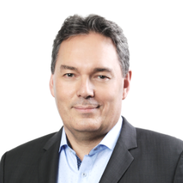

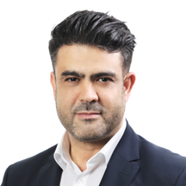

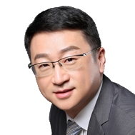
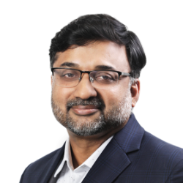
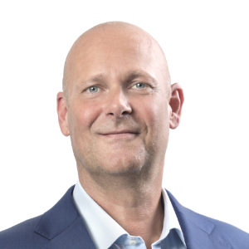
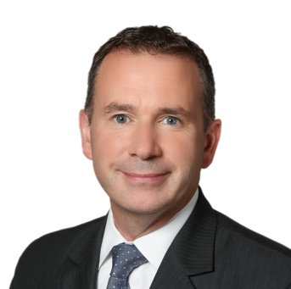
Meet Our Executive Team
Stephan Robineau
EVP, Networks
Business Division
Nicolas Brunel
EVP, Communications
Business Division
Moussa Zaghdoud
EVP, Cloud Communications
Business Division
Sandrine El Khodry
EVP, Global Sales and Marketing
Yann Zhang
CEO
Rasheed Mohamad
Global Revenue and
Operations officer
Maarten Huntjens
EVP, Global
Human Resources and Real Estate
Marc Blecken
EVP, Finance

