Slide 1
Tetromino Design Document
Samuel Vargas

Slide 2
Player Navigation FSM
Idle
WALK
+
SPRINT
WALK
Start Walking
Stop Walking
Walking
Start Running
Stop Running
Running

Slide 3
Player

Slide 4
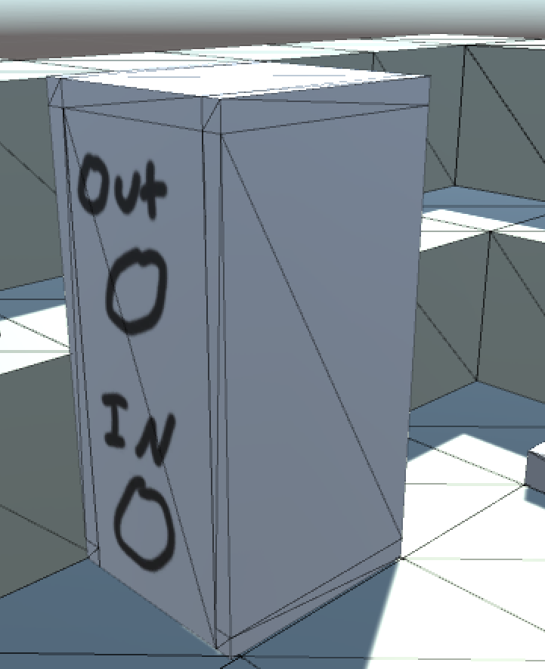
Color Changer
Players can enter a ColorChanger to modify their exterior color.
Players must be certain colors to interact with certain objects.
In / Out represent the expected colors.

Slide 5
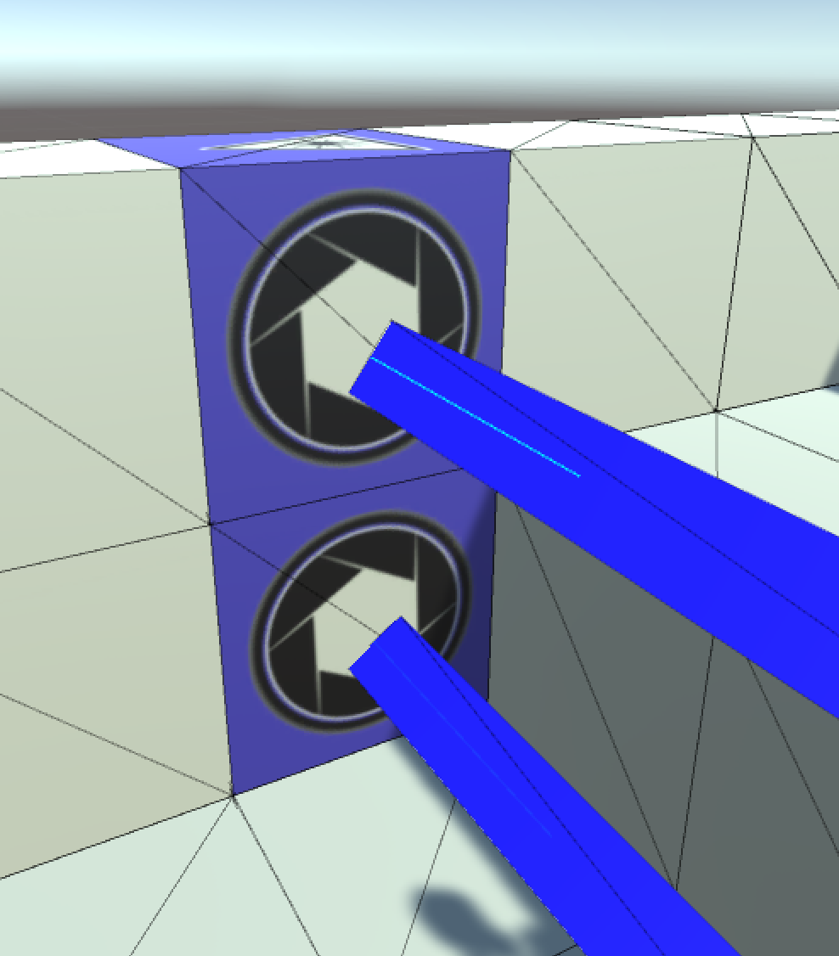
Lasers
Emitted from Laser blocks.
Can be obstructed by the player.
Can be moved around the environment.

Slide 6
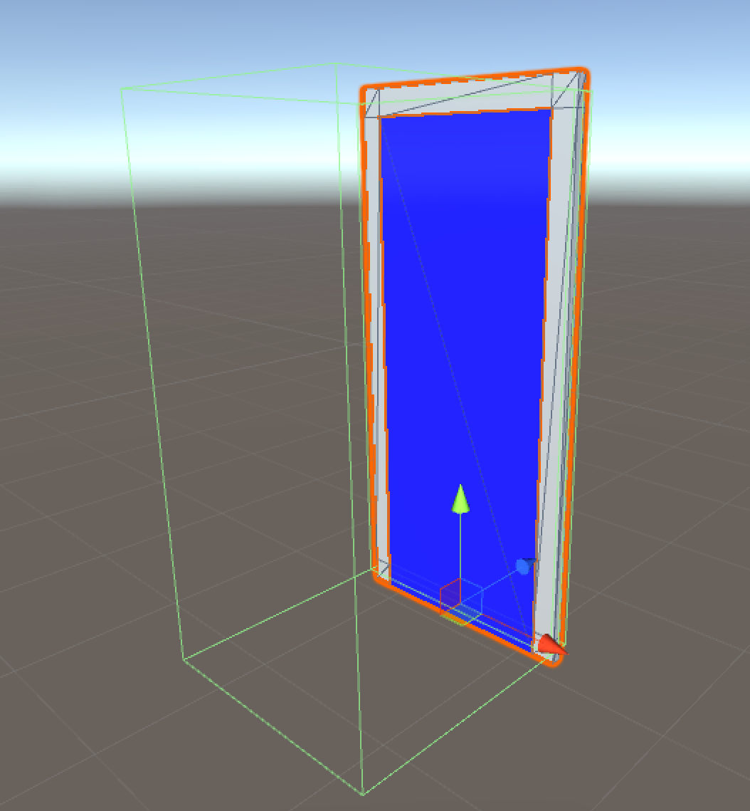
Color Gate

Slide 7
Camera
(

Slide 8
Recorder

