Slide 1
Hollywood Programming
Class 3: Advanced level
Making Applications with RapaGUI
github.com/SamuraiCrow/AmiWest2022
github.com/SamuraiCrow/RapaEdit
Presented by Samuel D. Crow
Notes:
Welcome to the 3rd session. Here we’ll cover making Hollywood applications using the RapaGUI plug-in by going through the source code of the RapaEdit GUI builder application sources on GitHub.

Slide 2
RapaGUI Plug-in
Cross-platform GUI plug-in
Uses MUI on Amiga-likes
Uses wxWidgets on Win/Mac/Linux
Uses custom widgets on Android
Doesn’t support iOS yet
Notes:
To give a little background of RapaGUI, it’s the cross-platform GUI plug-in for Hollywood.
It’s based on MUI on the Amiga-likes and wxWidgets on the mainstream OS’s.
It’s got a cut-down mobile version for Android but iOS requires its own proprietary GUI file format used by Apple’s own GUI builder.

Slide 3
RapaEdit Walk-through
RapaEdit is an editor for GUI interfaces made for RapaGUI
It employs the most advanced modular techniques possible in Hollywood: Object-Oriented Programming style
Apache 2.0 Open-Source license
Notes:
The RapaEdit GUI builder I wrote for RapaGUI was written to demonstrate advanced object-oriented techniques on Hollywood.
It’s modularity helps programmers work independently on different parts of the code.
Since it’s under the Apache 2.0 license anyone is welcome to join the development team.

Slide 4
RapaEdit’s Own GUI
<?xml version="1.0" encoding="iso-8859-1"?>
<application id="RapaEdit">
  <menubar id="menu">
    <menu title="File" id="mn_file">
      <item id="mn_new" help="Start a new document">_New</item>
      <item id="mn_open" help="Open an existing document">_Open</item>
      <item id="mn_save" help="Save document to existing file">_Save</item>
      <item id="mn_saveas" help="Save document to a new file">Save _As...</item>
      <item />
      <item id="mn_preview" help="Preview GUI">_Preview</item>
      <item id="mn_export" help="Export to new XML file">E_xport Script As...</item>
      <item />
      <item id="mn_quit" help="Exit the program">_Quit</item>
    </menu>
    <menu title="Gadget" id="mn_gadget">
    ...
Notes:
Let’s start by going through the RapaEdit.xml file that contains the skeleton of RapaEdit’s own GUI.
The ID sub-tags on each item are used by the event handler and elsewhere in RapaGUI.
I’ve put “mn_” on the IDs of every menu item so I can use a text filter to process items separately. This will make the event handler more modular as we’ll see later on.
The empty menu items represent horizontal lines in the menu to keep things organized.

Slide 5
Toolbar
<window id="win_" title="RapaEdit" menubar="menu" notify="CloseRequest" width="640" height="400">
  <vgroup>
    <toolbar>
      <button id="tb_new" icon="2">New</button>
      <button />
      <button id="tb_open" icon="3">Open</button>
      <button id="tb_close" icon="4">Close</button>
      <button />
      <button id="tb_save" icon="5">Save</button>
      <button id="tb_saveas" icon="6">Save As</button>
      <button />
      <button id="tb_upgadget" icon="10">Move Up</button>
      <button id="tb_downgadget" icon="11">Move Down</button>
    </toolbar>
Notes:
The toolbar buttons are defined similarly but have icons assigned to them using the internal brushes loaded in by the Hollywood preprocessor directives in the script.
The window has a notification called “CloseRequest” that allows us to put a warning requester when exiting the program. Otherwise it would exit as soon as you hit the exit gadget without any warning or checks for unsaved data.

Slide 6
Sidebar
<hsplitter id="spl_split">
  <vgroup>
    <listview id="lv_gadgets" forcemode="listview" notify="DoubleClick">
      <column sortable="1" />
    </listview>
    <button id="tb_addgadget" icon="7">Add</button>
    <button id="tb_removegadget" icon="8">Remove</button>
    <button id="tb_editgadget" icon="9">Edit</button>
    <hline />
    <button id="tree_deselect">Deselect icon</button>
    <hline />
    <button id="wa_window" icon="7" >Add Window</button>
    <button id="wa_dialog" icon="7" >Add Dialog</button>
  </vgroup>
Notes:
HSplitter is a frame gadget just introduced in the most recent version of RapaGUI. It allows resizable frames to be used.
VGroup stacks the items contained in in vertically as is common to most resizable GUIs.
The listview and buttons are pretty straightforward. Notice though that they each have prefixes before the underscore also.

Slide 7
Main Treeview and Closers
        <treeview id="tree_hierarchy">
          <column />
        </treeview>
      </hsplitter>
    </vgroup>
  </window>
</application>
This is what the editor generates
But it does it graphically!
Notes:
The treeview has similar definition to the listview of the previous frame but more methods are defined for treeview gadgets than listview gadgets.
All the close tags just wrap up the XML.
The editor generates all this stuff for other programs but does it graphically.

Slide 8
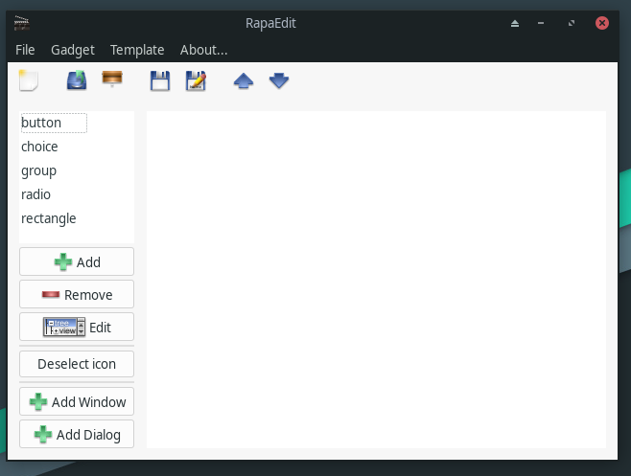
What it Looks Like
Notes:
And here’s what the application looks like after all that XML file format is added.

Slide 9
Event Handling
Gadgets are identified by the ID sub-tag in the XML definition (case-sensitive)
Events are generated based on the gadget type
The message data is another member of the event table type
Usually handled with a large switch statement but I handle it with table look-ups
Notes:
Now let’s cover the event-handling.
As mentioned earlier, the ID sub-tags identify the gadgets and XML is case sensitive.
Event types are dependent on the gadget type.
The message data items are parameters passed within the event messages.
In all the RapaGUI example programs, a switch statement was used but using table look-ups is more modular and allows the different classes to have their own event handlers by encoding their messages with a prefix.

Slide 10
Global Event Handler
Function p_ProcessGUI(message)
  Switch message.action
  Case "RapaGUI":
    Local prefixLength=FindStr(message.id, "_")+1
    ;Check for Local prefixes and event handlers
    Local prefix$=LeftStr(message.id, prefixLength)
    Local handler=RawGet(prefixes, prefix$)
    ;Invoke local event handler from class
    handler(message, prefixLength)
  EndSwitch
EndFunction
Notes:
Here’s an abbreviated form of the global event handler from the main script in RapaEdit.hws. It only has some debugging information removed.
The only switch statement filters out messages that aren’t generated by RapaGUI widgets, which is the only kind there are so far in this program.
The prefixes table accessed by the RawGet command holds the prefixes and handlers for each class.

Slide 11
Show Me the Source!
Here it comes!

