Slide 1
OS for DS 2023 a Network Programming with Sockets
Reading:
APUE 3rd ed., 16 (mainly) + 3-6
Beej's Guide to Network Programming
http://beej.us/guide/bgnet/

Slide 2
Outline
Basic socket programming
Concurrent communication

Slide 3
Sockets
process sends/receives messages to/from its socket
socket analogous to door
sending process shoves message out door
sending process relies on transport infrastructure on other side of door which brings message to socket at receiving process
host or
server
host or
server
controlled by
app developer
process
process
socket
socket
TCP with
buffers,
variables
TCP with
buffers,
variables
Internet

Slide 4
Client-Server Model
Asymmetric Communication
Client sends requests
Server sends replies
Server/Daemon
Well-known name (e.g., IP address + port)
Waits for contact
Processes requests, sends replies
Client
Initiates contact
Waits for response
Client
Client
Server
Client
Client

Slide 5
TCP Service I assume this is reminder only
Reliable Data Transfer
Guarantees delivery of all data
Exactly once if no catastrophic failures
Ordered Data Transfer
Guarantees in-order delivery of data
If A sends M1 followed by M2 to B, B never receives M2 before M1
Regulated Data Flow
Monitors network and adjusts transmission appropriately
Prevents senders from wasting bandwidth
Reduces global congestion problems
Data Transmission
Full-Duplex byte stream
Connection setup and teardown

Slide 6
UDP Services I assume this is reminder only
User Datagram Protocol Service
Provides a thin layer over IP
16-bit port space (distinct from TCP ports) allows multiple recipients on a single host

Slide 7
Byte Ordering I assume this is reminder
Big Endian vs. Little Endian
Little Endian (Intel, DEC):
Least significant byte of word is stored in the lowest memory address
Big Endian (Sun, SGI, HP):
Most significant byte of word is stored in the lowest memory address
Network Byte Order = Big Endian
Allows both sides to communicate
Must be used for some data (i.e. IP Addresses)
Good form for all binary data
Least significant Byte 0xBB
Most significant Byte 0xAA
Little-Endian
Most significant Byte 0xAA
Least significant Byte 0xBB
Big-Endian (Network-Byte-Order)
0x1000
0x1001
Memory address

Slide 8
Byte Ordering Functions
16- and 32-bit conversion functions (for platform independence)
Examples:
int m, n;
short int s,t;
m = ntohl (n) net-to-host long (32-bit) translation
s = ntohs (t) net-to-host short (16-bit) translation
n = htonl (m) host-to-net long (32-bit) translation
t = htons (s) host-to-net short (16-bit) translation

Slide 9
BSD Sockets Only Red is in Scope
BSD Sockets
PF_INET sockets
PF_PACKET
Socket
PF_NETLINK
Socket
UDS
SOCK_
STREAM
SOCK_
DGRAM
SOCK_
RAW
TCP
UDP
IP
Network device

Slide 10
Socket Address Structure
Socket address
struct sockaddr {
short sa_family;
char sa_data[14];
};
Internet address:
struct sockaddr_in {
short sin_family; /* e.g., AF_INET */
ushort sin_port; /* TCP/UDP port */
struct in_addr sin_addr; /* IP address */
unsigned char sin_zero[8]; /* Same size as struct sockaddr */
};
IP address:
struct in_addr {
in_addr_t s_addr; /* 32-bit IP address */
};
all but sin_family in network byte order

Slide 11
Address Access/Conversion Functions
All binary values are network byte ordered
struct hostent* gethostbyname (const char* hostname);
Translate English host name to IP address (uses DNS)
struct hostent* gethostbyaddr (const char* addr, size_t len, int family);
Translate IP address to English host name (not secure)
Better used in combination of gethostbyname() to validate the results
char* inet_ntoa (struct in_addr inaddr);
Translate IP address to ASCII dotted-decimal notation (e.g., “128.32.36.37”)
int gethostname (char* name, size_t namelen);
Read host’s name (use with gethostbyname to find local IP)
(/etc/hosts)

Slide 12
Structure: hostent
The hostent data structure (from /usr/include/netdb.h)
canonical domain name and aliases
list of addresses associated with machine
also address type and length information
struct hostent {
char* h_name; /* official name of host */
char** h_aliases; /* NULL-terminated alias list */
int h_addrtype /* address type (AF_INET) */
int h_length; /* length of addresses (4B) */
char** h_addr_list; /* NULL-terminated address list */
#define h_addr h_addr_list[0];/* backward-compatibility */
};

Slide 13
Address Access/Conversion Functions
in_addr_t inet_addr (const char* strptr);
Translate dotted-decimal notation to IP address (Network Byte Order); returns -1 on failure, thus cannot handle broadcast value “255.255.255.255”
struct sockaddr_in ina;
ina.sin_addr.s_addr = inet_addr("10.12.110.57");
int inet_aton (const char *strptr, struct in_addr *inaddr);
Translate dotted-decimal notation to IP address; returns 1 on success, 0 on failure
struct sockaddr_in my_addr;
my_addr.sin_family = AF_INET; // host byte order
my_addr.sin_port = htons(MYPORT); // short, network byte order
inet_aton("10.12.110.57",&(my_addr.sin_addr));
memset(&(my_addr.sin_zero), '\0', 8); // zero the rest of the struct

Slide 14
IPv6
There are insufficient amount of IPs
Other changes were back ported (IPsec) or not so important (jumbograms, double checksum)
The internet is moving (very very slowly) to IPv6
Some IPv6 concepts
Address space is 64bit address and 64bit “built in NAT”
Some different data structures
IPv6 is only slight adaptation and only on socket and address printing functions

Slide 15
IPv6 adaptation
Most of you use phone with IPv6
Most of you use network and laptop (on wifi) with UPv4.
In internet traffic we are close to 50%

Slide 16
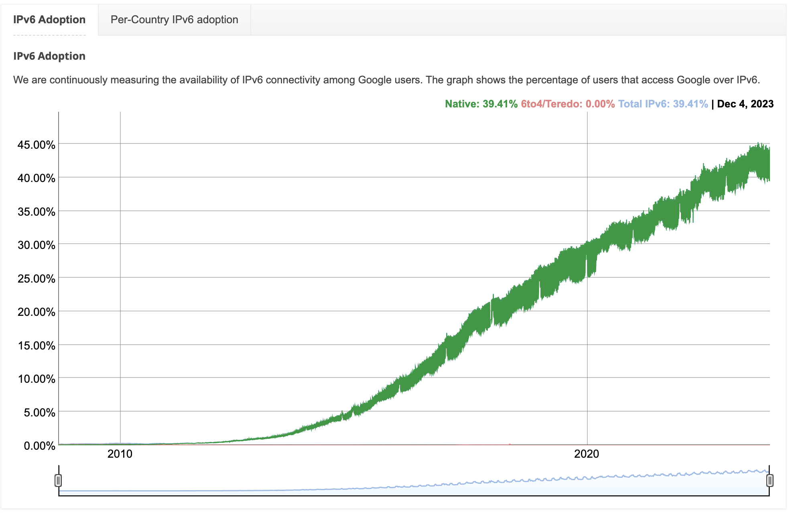
IPv6 adaptation – network traffic

Slide 17
Sockets API
Creation and Setup
Establishing a Connection (TCP)
Sending and Receiving Data
Tearing Down a Connection (TCP)

Slide 18
Socket Functions
TCP Server
socket(2)
TCP Client
Well-known
port
bind(2)
listen(2)
accept(2)
socket(2)
blocks until connection
from client
connect(2)
TCP three-way handshaking
write(2)
data (request)
read(2)
Send(2)/recv(2) can also be used
process request

Slide 19
Socket Functions
socket(2)
blocks until connection
from client
TCP Server
TCP Client
connect(2)
TCP three-way handshaking
send(2)
data (request)
recv(2)
process request
data (reply)
send(2)
recv(2)
close(2)
read(2)
close(2)

Slide 20
Socket Creation and Setup
Include file <sys/socket.h>
Create a socket
int socket (int domain, int type, int protocol);
Returns file descriptor or -1.
Bind a socket to a local IP address and port number
int bind (int sockfd, struct sockaddr* myaddr, int addrlen);
Put socket into passive state (wait for connections rather than initiate a connection).
int listen (int sockfd, int backlog);
Accept connections
int accept (int sockfd, struct sockaddr* cliaddr, int* addrlen);
Returns file descriptor or -1.

Slide 21
Functions: socket
int socket (int domain, int type, int protocol);
Create a socket.
Returns file descriptor or -1. Also sets errno on failure.
domain: protocol family (same as address family)
PF_INET for IPv4
other possibilities: PF_INET6 (IPv6), PF_UNIX or PF_LOCAL (Unix socket), PF_ROUTE (routing)
type: style of communication
SOCK_STREAM for TCP (with PF_INET)
SOCK_DGRAM for UDP (with PF_INET)
protocol: protocol within family
typically 0
getprotobyname(), /etc/protocols for list of protocols

Slide 22
Function: bind
int bind (int sockfd, struct sockaddr* myaddr, int addrlen);
Bind a socket to a local IP address and port number.
Returns 0 on success, -1 and sets errno on failure.
sockfd: socket file descriptor (returned from socket)
myaddr: includes IP address and port number
IP address: set by kernel if value passed is INADDR_ANY, else set by caller
port number: set by kernel if value passed is 0, else set by caller
addrlen: length of address structure
= sizeof (struct sockaddr_in)
socket.socket_state = TCP_CLOSE;

Slide 23
TCP and UDP Ports
Allocated and assigned by the Internet Assigned Numbers Authority
see RFC 1700 or
ftp://ftp.isi.edu/in-notes/iana/assignments/port-numbers
1-512
standard services (see /etc/services)
super-user only
513-1023
registered and controlled, also used for identity verification
super-user only
1024-49151
registered services/ephemeral ports
49152-65535
private/ephemeral ports

Slide 24
Functions: listen
int listen (int sockfd, int backlog);
Put socket into passive state (wait for connections rather than initiate a connection).
Returns 0 on success, -1 and sets errno on failure.
sockfd: socket file descriptor (returned from socket)
backlog: bound on length of unaccepted connection queue (connection backlog); kernel will cap, thus better to set high
socket.socket_state = TCP_LISTEN;

Slide 25
Functions: accept
int accept (int sockfd, struct sockaddr* cliaddr, int* addrlen);
Accept a new connection.
Returns file descriptor or -1. Also sets errno on failure.
sockfd: socket file descriptor (returned from socket)
cliaddr: IP address and port number of client (returned from call)
addrlen: length of address structure = pointer to int set to sizeof (struct sockaddr_in)
addrlen is a value-result argument:
the caller passes the size of the address structure, the kernel returns the size of the client’s address (the number of bytes written)

Slide 26
Accept (cont'd)
A new socket was cloned from the listening socket
If there are no incoming connection to accept
Non-Blocking—accept operation failed and throw away the new socket
Blocking—accept operation was added to the wait queue (default)

Slide 27
server
#include <stdio.h>
#include <stdlib.h>
#include <errno.h>
#include <string.h>
#include <sys/types.h>
#include <netinet/in.h>
#include <sys/socket.h>
#include <sys/wait.h>
#define PORT 3490
#define BACKLOG 10 /* how many pending
connections queue
will hold */

Slide 28
Server – no IPv6 (code you are used to)
main()
{
int sockfd, new_fd; /* listen on sock_fd, new connection on new_fd */
struct sockaddr_in my_addr; /* my address */
struct sockaddr_in their_addr; /* connector addr */
int sin_size;
if ((sockfd = socket(PF_INET, SOCK_STREAM, 0))==-1){
perror("socket");
exit(1);
}

Slide 29
Server – no IPv6 (code you are used to)
my_addr.sin_family = AF_INET; /* host byte order */
my_addr.sin_port = htons(MYPORT); /* short, network
byte order */
my_addr.sin_addr.s_addr = htonl(INADDR_ANY);
/* INADDR_ANY allows clients to connect to any one of the host’s IP address */
bzero(&(my_addr.sin_zero), 8); /* zero the struct */
if (bind(sockfd, (struct sockaddr *)&my_addr,
sizeof(struct sockaddr)) == -1) {
perror("bind");
exit(1);
}

Slide 30
Server – no IPv6 (code you are used to)
if (listen(sockfd, BACKLOG) == -1) {
perror("listen");
exit(1);
}
while(1) { /* main accept() loop */
sin_size = sizeof(struct sockaddr_in);
if ((new_fd = accept(sockfd, (struct sockaddr*)
&their_addr,&sin_size)) == -1) {
perror("accept");
continue;
}
printf("server: got connection from %s\n",
inet_ntoa(their_addr.sin_addr));

Slide 31
Establishing a Connection
Include file <sys/socket.h>
int connect (int sockfd, struct sockaddr* servaddr, int addrlen);
Connect to another socket.
Returns 0 on success, -1 and sets errno on failure.
sockfd: socket file descriptor (returned from socket)
servaddr: IP address and port number of server
addrlen: length of address structure
= sizeof (struct sockaddr_in)

Slide 32
Connect
Before connecting,
socket.socket_state = SS_UNCONNECTED;
Add the sock to tcp_listening_hash waiting for server’s response

Slide 33
Client – no IPv6 (code you are used to)
if ((sockfd = socket (PF_INET, SOCK_STREAM, 0)) == -1) {
perror (“socket”);
exit (1);
}
their_addr.sin_family = AF_INET; /* interp’d by host */
their_addr.sin_port = htons (PORT);
their_addr.sin_addr = *((struct in_addr*)he->h_addr);
bzero (&(their_addr.sin_zero), 8);
/* zero rest of struct */
if (connect (sockfd, (struct sockaddr*)&their_addr,
sizeof (struct sockaddr)) == -1) {
perror (“connect”);
exit (1);
}

Slide 34
Sockets API
Creation and Setup
Establishing a Connection (TCP)
Sending and Receiving Data
Tearing Down a Connection (TCP)

Slide 35
Sending and Receiving Data
Write/Read data to/from a stream (TCP) or “connected” datagram (UDP) socket.
int write (int sockfd, char* buf, size_t nbytes);
int read (int sockfd, char* buf, size_t nbytes);
int send (int sockfd, char* buf, size_t nbytes, int flags);
int recv (int sockfd, char* buf, size_t nbytes, int flags);
Write/Read a datagram to/from a UDP socket.
int sendto (int sockfd, char* buf, size_t nbytes, int flags, struct sockaddr* destaddr, int addrlen);
int recvfrom (int sockfd, char* buf, size_t nbytes, int flags, struct sockaddr* srcaddr, int* addrlen);

Slide 36
Functions: write
int write (int sockfd, char* buf, size_t nbytes);
Write data to a stream (TCP) or “connected” datagram (UDP) socket.
Returns number of bytes written or -1. Also sets errno on failure.
sockfd: socket file descriptor (returned from socket)
buf: data buffer
nbytes: number of bytes to try to write
Some reasons for failure or partial writes:
process received interrupt or signal
kernel resources unavailable (e.g., buffers)

Slide 37
Functions: read
int read (int sockfd, char* buf, size_t nbytes);
Read data from a stream (TCP) or “connected” datagram (UDP) socket.
Returns number of bytes read or -1. Also sets errno on failure.
Returns 0 if socket closed.
sockfd: socket file descriptor (returned from socket)
buf: data buffer
nbytes: number of bytes to try to read

Slide 38
What about send(2)/recv(2)
Send/recv has the following modifications (compared to read/write)
More accurate errno messages – usually has no effect on us.
Flags in read/write is always 0.
In our course flags are zero anyway (and in many cases in real life)
Use whatever you want

Slide 39
Tearing Down a Connection
int close (int sockfd);
Close a socket.
Returns 0 on success, -1 and sets errno on failure.
int shutdown (int sockfd, int howto);
Force termination of communication across a socket in one or both directions.
Returns 0 on success, -1 and sets errno on failure.

Slide 40
Functions: close
int close (int sockfd);
Close a socket.
Returns 0 on success, -1 and sets errno on failure.
sockfd: socket file descriptor (returned from socket)
Closes communication on socket in both directions.
All data sent before close are delivered to other side (although this aspect can be overridden).
After close, sockfd is not valid for reading or writing.

Slide 41
Functions: shutdown
int shutdown (int sockfd, int howto);
Force termination of communication across a socket in one or both directions.
Returns 0 on success, -1 and sets errno on failure.
sockfd: socket file descriptor (returned from socket)
howto:
SHUT_RD to stop reading
SHUT_WR to stop writing
SHUT_RDWR to stop both

Slide 42
UDP Connection Example
client
server
socket
socket
bind
sendto
recvfrom
sendto
recvfrom
close

Slide 43
Functions: sendto
int sendto (int sockfd, char* buf, size_t nbytes, int flags, struct sockaddr* destaddr, int addrlen);
Send a datagram to another UDP socket.
Returns number of bytes written or -1. Also sets errno on failure.
sockfd: socket file descriptor (returned from socket)
buf: data buffer
nbytes: number of bytes to try to read
flags: see man page for details; typically use 0
destaddr: IP address and port number of destination socket
addrlen: length of address structure
= sizeof (struct sockaddr_in)

Slide 44
Functions: recvfrom
int recvfrom (int sockfd, char* buf, size_t nbytes, int flags, struct sockaddr* srcaddr, int* addrlen);
Read a datagram from a UDP socket.
Returns number of bytes read (0 is valid) or -1. Also sets errno on failure.
sockfd: socket file descriptor (returned from socket)
buf: data buffer
nbytes: number of bytes to try to read
flags: see man page for details; typically use 0
srcaddr: IP address and port number of sending socket (returned from call)
addrlen: length of address structure = pointer to int set to sizeof (struct sockaddr_in)

Slide 45
Some news I guess : connected UDP sockets
UDP does not support connections! (as you now from net course)
However UDP sockets is an OS entity that can be connect(2)ed.
If we connect UDP sockets we set default destination thus we can use read(2)/write(2)/send(2)/recv(2) with UDP sockets.
But there is no accept(2)

