Slide 1
Piranha_Project
Accelerating Secure Multi-Party Computations with GPUs
University of Basel, 02.11.2023
PETHPC-HS23, Seminar Report
Joan Moser

Slide 2
A Quick Reminder
Training Neural Networks on sensitive data

Slide 3
A Quick Reminder
Training Neural Networks on sensitive data
Violates privacy

Slide 4
A Quick Reminder
Training Neural Networks on sensitive data
Violates privacy
MPC Protocols can preserve privacy

Slide 5
A Quick Reminder
Training Neural Networks on sensitive data
Violates privacy
MPC Protocols can preserve privacy
MPC Protocols very slow

Slide 6
A Quick Reminder
Training Neural Networks on sensitive data
Violates privacy
MPC Protocols can preserve privacy
MPC Protocols very slow
GPU Acceleration

Slide 7
A Quick Reminder
Training Neural Networks on sensitive data
Violates privacy
MPC Protocols can preserve privacy
MPC Protocols very slow
GPU Acceleration
Requires specialist knowledge

Slide 8
A Quick Reminder
Training Neural Networks on sensitive data
Violates privacy
MPC Protocols can preserve privacy
MPC Protocols very slow
GPU Acceleration
Requires specialist knowledge
Piranha!

Slide 9
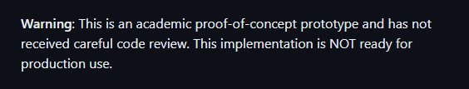
A Quick Reminder
Training Neural Networks on sensitive data
Violates privacy
MPC Protocols can preserve privacy
MPC Protocols very slow
GPU Acceleration
Requires specialist knowledge
Piranha!
But…

Slide 10
My Project
Get Piranha to run on SciCORE
Consistency, Power, Reproducibility

Slide 11
My Project
Get Piranha to run on SciCORE
Consistency, Power, Reproducibility
Try to reproduce some figures
What is the same what is different?

Slide 12
My Project
Get Piranha to run on SciCORE
Consistency, Power, Reproducibility
Try to reproduce some figures
What is the same what is different?
Investigate new combinations
What did the paper leave out?

Slide 13
My Problems

Slide 14
My Problems
It does not work

Slide 15
My Problems
It does not work
Why?
SciCORE Modules vs sudo apt install

Slide 16
My Problems
It does not work
Why?
SciCORE Modules vs sudo apt install
Identify Modules or manually install

Slide 17
My Problems
It does not work
Why?
SciCORE Modules vs sudo apt install
Identify Modules or manually install
Makefile not working

Slide 18
My Problems
It does not work
Why?
SciCORE Modules vs sudo apt install
Identify Modules or manually install
Makefile not working
Edit Makefile by hand

Slide 19
My Problems
It does not work
Why?
SciCORE Modules vs sudo apt install
Identify Modules or manually install
Makefile not working
Edit Makefile by hand
Code to produce dataset not working

Slide 20
My Problems
It does not work
Why?
SciCORE Modules vs sudo apt install
Identify Modules or manually install
Makefile not working
Edit Makefile by hand
Code to produce dataset not working
Produce Locally and upload to GitHub

Slide 21
My Problems
It does not work
Why?
SciCORE Modules vs sudo apt install
Identify Modules or manually install
Makefile not working
Edit Makefile by hand
Code to produce dataset not working
Produce Locally and upload to GitHub
Building Piranha still not working!

Slide 22
My Problems
It does not work
Why?
SciCORE Modules vs sudo apt install
Identify Modules or manually install
Makefile not working
Edit Makefile by hand
Code to produce dataset not working
Produce Locally and upload to GitHub
Building Piranha still not working!
Different parts of Makefile compiled by different GCC versions

Slide 23
My Project
Get Piranha to run on SciCORE
Consistency, Power, Reproducibility
Try to reproduce some figures
What is the same what is different?
Investigate new combinations
What did the paper leave out?

Slide 24
My Project
Get Piranha to run on SciCORE
Consistency, Power, Reproducibility
Try to reproduce some figures
What is the same what is different?
Investigate new combinations
What did the paper leave out?

Slide 25
My Project
Get Piranha to run on SciCORE
Consistency, Power, Reproducibility
It’s Thursday morning
Try to reproduce some figures
What is the same what is different?
Investigate new combinations
What did the paper leave out?

Slide 26
My Project
Get Piranha to run on SciCORE
Consistency, Power, Reproducibility
It’s Thursday morning
Try to reproduce some figures
What is the same what is different?
Investigate new combinations
What did the paper leave out?
How Piranha work?
What parameters influence what?

Slide 27
How does it work?

Slide 28
How does it work?
piranha_build
Fixed Point Precision
MPC Protocol

Slide 29
How does it work?
piranha_build
Fixed Point Precision
MPC Protocol
Config.json
Party ips
NN model
Number of Epochs
Number of Iterations
Batch Size
…
Outputs

Slide 30
How does it work?
piranha_build
Fixed Point Precision
MPC Protocol
Piranha Run
./piranha_build –p 0 –c config.json
Config.json
Party ips
NN model
Number of Epochs
Number of Iterations
Batch Size
…
Outputs

Slide 31
How does it work?
piranha_build
Fixed Point Precision
MPC Protocol
Piranha Run
./piranha_build –p 0 –c config.json
Config.json
Party ips
NN model
Number of Epochs
Number of Iterations
Batch Size
…
Outputs
a100
Output!

Slide 32
Project Questions
Reproduce Figure 5
Fixed Point Precision – Accuracy Graph
Does fixed point precision impact runtime / memory?
Reproduce
Performance of different MPC protocols & NN models

Slide 33
Project Questions
Reproduce Figure 5
Fixed Point Precision – Accuracy Graph
Does fixed point precision impact runtime / memory?
Reproduce
Performance of different MPC protocols & NN models
It’s Thursday!

Slide 34
What SciCORE instance to use?
XLarge
(42 cores, 270GB RAM)
Medium
(14 cores, 90GB RAM)

Slide 35
What SciCORE instance to use?

Slide 36
What SciCORE instance to use?
VERY slow
>1h vs >10 min

Slide 37
What SciCORE instance to use?
SciCORE Instance doesn’t seem to make a diffrence
VERY slow
>1h vs >10 min

Slide 38
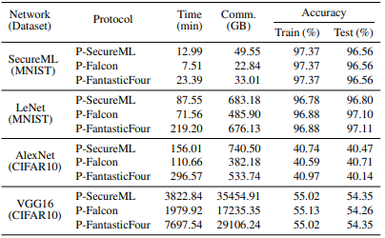



We are worse!
Only 95% in >1h

Slide 39
Why?
Set Iterations instead of Epochs?

Slide 40
Why?
Set Iterations instead of Epochs?

Slide 41
Why?
Set Iterations instead of Epochs?
Too low!

Slide 42
Why?

Slide 43
Maybe we need a different NN

Slide 44
Maybe we need a different NN

Slide 45
Maybe we need a different FPP?

Slide 46
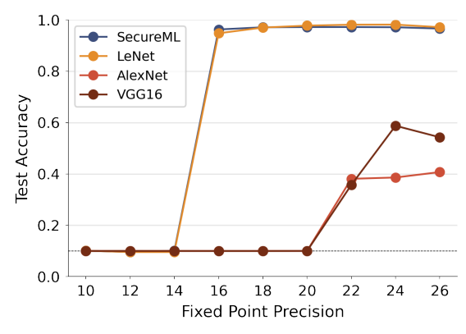

Maybe we need a different FPP?
Suspiciously high

Slide 47
Maybe we need a different MPC protocol?

Slide 48

Maybe we need a different MPC protocol?
Should be ~10% according to paper

Slide 49
Memory Management
Same output,
every iteration,
every epoch,
for different fixed point precision

Slide 50
Conclusion
Piranha is useful (in concept)
Not read for use yet!
Bugs in Makefile,
Bugs in configs,
Bugs when parsing,
Ect…

Slide 51
What went wrong?

Slide 52
What went wrong?
Misunderstood the Project
Not just swapping a few parameters

Slide 53
What went wrong?
Misunderstood the Project
Not just swapping a few parameters
Decided Experiments too early
Didn’t know runtime
Build on top of previous results

Slide 54
What went wrong?
Misunderstood the Project
Not just swapping a few parameters
Decided Experiments too early
Didn’t know runtime
Build on top of previous results
Evaluation had to be slimmed down
Very few reruns to verify results
Couldn’t do proper analysis as hoped

Slide 55
What went wrong?
Misunderstood the Project
Not just swapping a few parameters
Decided Experiments too early
Didn’t know runtime
Build on top of previous results
Evaluation had to be slimmed down
Very few reruns to verify results
Couldn’t do proper analysis as hoped
Sometimes it is what it is
Stay flexible, get help

Slide 56
What went wrong?
Beware ye who enter here!
https://github.com/Samuraig5/piranha
Misunderstood the Project
Not just swapping a few parameters
Decided Experiments too early
Didn’t know runtime
Build on top of previous results
Evaluation had to be slimmed down
Very few reruns to verify results
Couldn’t do proper analysis as hoped
Sometimes it is what it is
Stay flexible, get help
Special thanks to Osman!

