Slide 2
Mahout Workshop, Section 3
Allen Day, PhD
MapR Technologies

Slide 3
Details – Allen Day
MapR Technologies
Professional Services
Data Scientist
My Background
Contact info
aday@maprtech.com
allenday@allenday.com
@allenday
+1 (310) 804-5304

Slide 5
Section 3 (this one)

Slide 6
Section 4 (next one)

Slide 7
By Request: Some Clustering Use-Cases
Scientific Imaging
Related genes, related stars, related sequences
Market Research
Segmenting markets, product positioning
Social Network Analysis
Notes:
glamorous
[5^lAmErEs]
adj.
富有魅力的, 迷人的

Slide 8
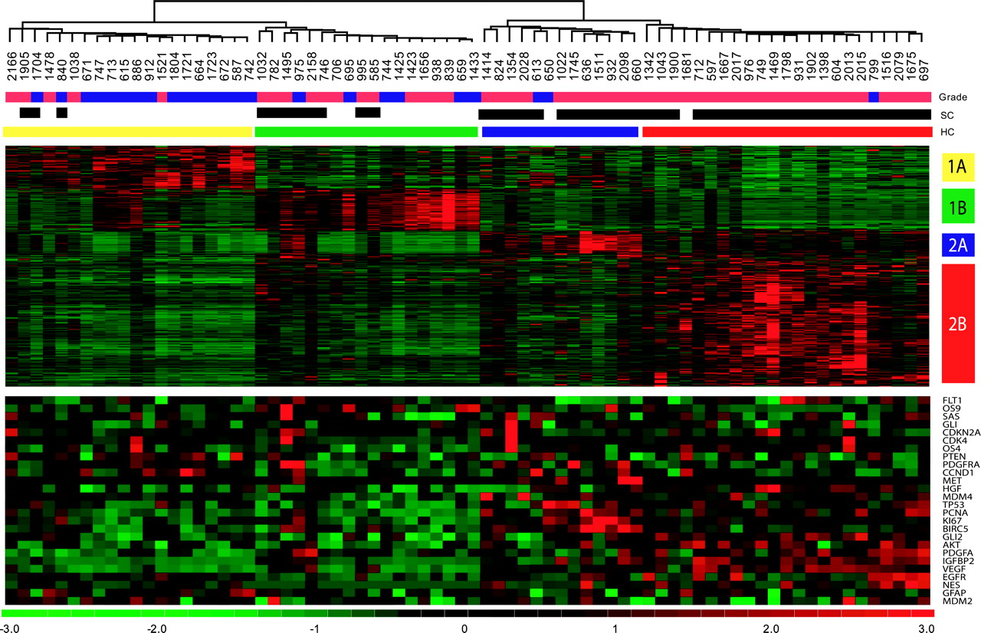

Hierarchical clustering dendogram of 74 gliomas with 595 genes significantly different between survival cluster group 1 and survival cluster group 2; 595 genes identified as significantly different between survival cluster group 1 and survival cluster group...
Freije W A et al. Cancer Res 2004;64:6503-6510
©2004 by American Association for Cancer Research
Notes:
Hierarchical clustering dendogram of 74 gliomas with 595 genes significantly different between survival cluster group 1 and survival cluster group 2; 595 genes identified as significantly different between survival cluster group 1 and survival cluster group 2 were used for unsupervised hierarchical clustering of tumor specimens and genes. Gliomas are listed across the top by tumor identification number and are joined by a dendrogram. Tumors are also identified by group membership. Grade indicates grade III histology (blue) or grade IV histology (red). SC indicates membership in initial survival cluster analysis survival cluster group 1 (white, n = 29) or survival cluster group 2 (black, n = 45). Group membership by hierarchical clustering (HC) is indicated by a colored bar: hierarchical cluster 1A (yellow, n = 20), hierarchical cluster 1B (green, n = 18), hierarchical cluster 2A (blue, n = 13), and hierarchical cluster 2B (red, n = 23). The upper red/green expression diagram shows expression data from the 595 survival associated probe sets, indicating strong clustering into four classes corresponding to hierarchical cluster 1A, hierarchical cluster 1B, hierarchical cluster 2A, and hierarchical cluster 2B. Log 2-fold intensities and color relationships are at the bottom. Hierarchical cluster classification of genes is indicated along the right edge for the gene clusters. The lower red/green expression diagram represents genes examined previously and associated with gliomagenesis. From top to bottom the genes are vascular endothelial growth factor receptor (FLT1; ref. 39 ), osteosarcoma amplified 9 (OS9; ref. 47 ), SAS (48) , glioma associated oncogene (GLI; ref. 49 ), CDKN2A (50) , cyclin dependent kinase 4 (CDK4; ref. 48 ), osteosarcoma amplified 4 (OS4; ref. 47 ), PTEN (14) , platelet derived growth factor receptor α (PDGFRA; ref. 51 ), cyclin D1 (CCND1; ref. 52 ), hepatocyte growth factor receptor (MET; ref. 33 ), hepatocyte growth factor (HGF; ref. 53 ), murine double-minute 4 (MDM4; ref. 54 ), TP53 (55) , proliferating cell nuclear antigen (PCNA; ref. 56 ), Ki67 (12) , survivin (BIRC5; ref. 57 ), glioma associated-kruppel family member 2 (GLI2; ref. 58 ), v-AKT murine thymoma viral oncogene homologue 1 (AKT; ref. 59 ), PDGFA (60) , insulin-like growth factor binding protein 2 (IGFBP2; ref. 61 ), vascular endothelial growth factor (VEGF; ref. 39 ), epidermal growth factor receptor (EGFR; ref. 62 ), nestin (NES; ref. 63 ), glial fibrillary acidic protein (GFAP; ref. 64 ), and MDM2 (51) .

Slide 9
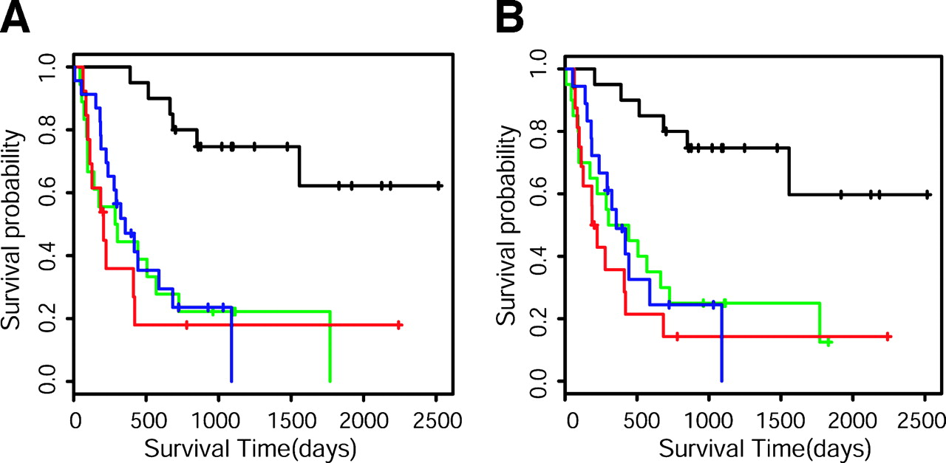
http://cancerres.aacrjournals.org/content/64/18/6503.long
Survival analysis of gliomas grouped by gene expression.
Freije W A et al. Cancer Res 2004;64:6503-6510
©2004 by American Association for Cancer Research
Notes:
Survival analysis of gliomas grouped by gene expression. A, Kaplan-Meier survival plots of patients whose tumors were grouped into hierarchical cluster 1A, hierarchical cluster 1B, hierarchical cluster 2A, and hierarchical cluster 2B by hierarchical clustering. Black line, hierarchical cluster 1A group (n = 20). Green line, hierarchical cluster 1B group (n = 18). Red, hierarchical cluster 2A (n = 13). Blue, hierarchical cluster 2B group (n = 23). Log rank P = 0.00011. B, Kaplan-Meier survival plot of the patients as classified by the 44 gene voting protocol. Black line, hierarchical cluster 1A group (n = 20). Green line, hierarchical cluster 1B group (n = 20). Red, hierarchical cluster 2A (n = 16). Blue, hierarchical cluster 2B group (n = 18; log rank P = 0.00022).

Slide 10
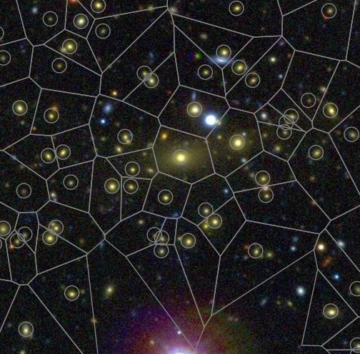

Slide 11
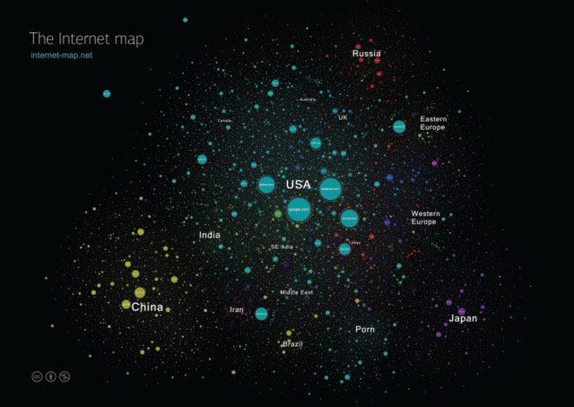

Slide 12
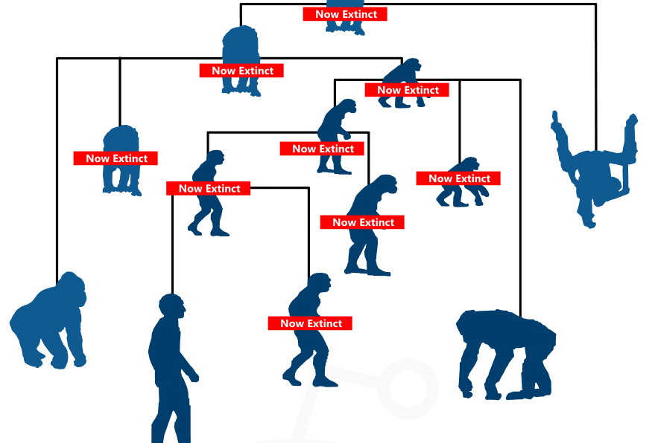

Slide 13
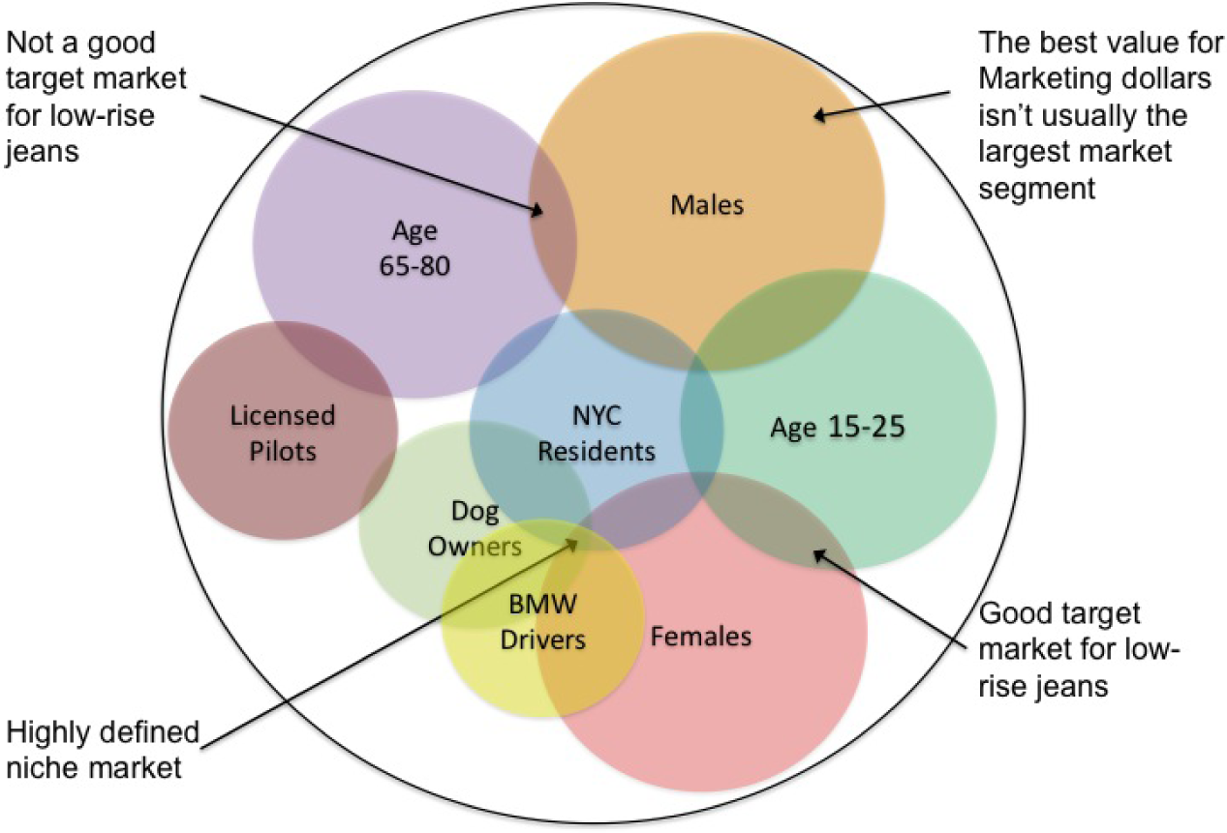

Slide 14
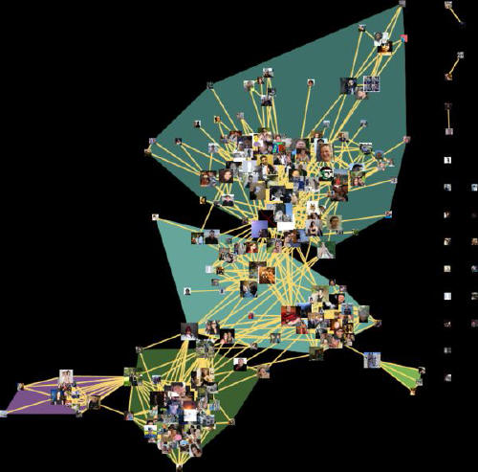

Slide 15
Canopy Clustering

Slide 16
K-means complexity:
k * n * O(distance metric) * num(iterations)

Slide 17
Selecting Canopy Centers

Slide 18
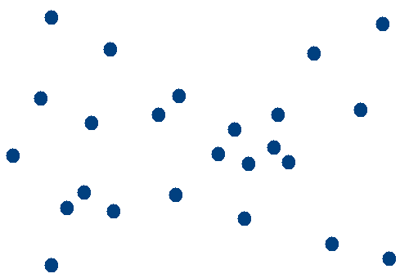
Observations

Slide 19
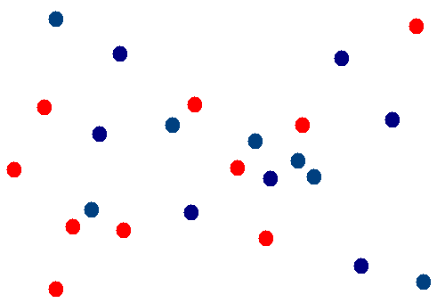
Map1
Shard Observations

Slide 20
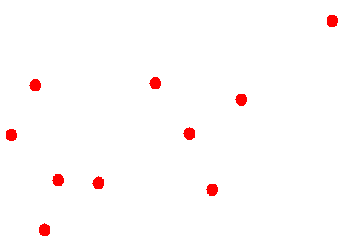
Map2
Process RED Shard

Slide 21
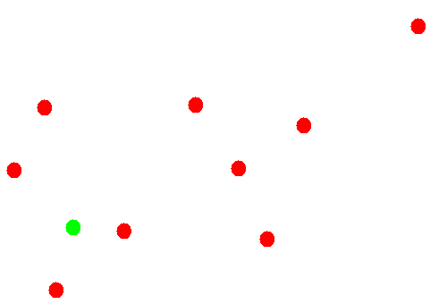
Map2
Pick 1st Canopy Center

Slide 22
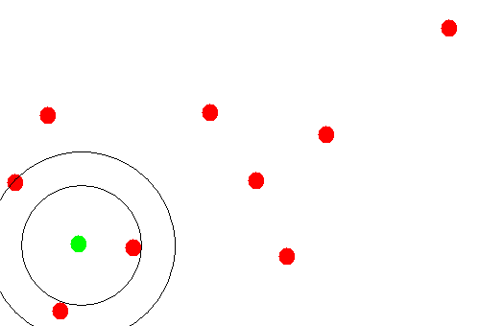
Map2
Assign Points to 1st Canopy

Slide 23
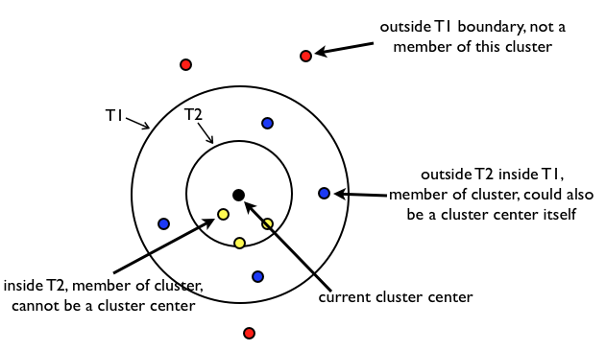

Slide 24
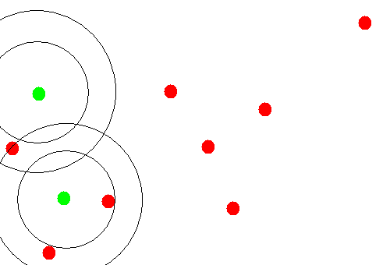
Map2
Pick 2nd Canopy & Assign

Slide 25
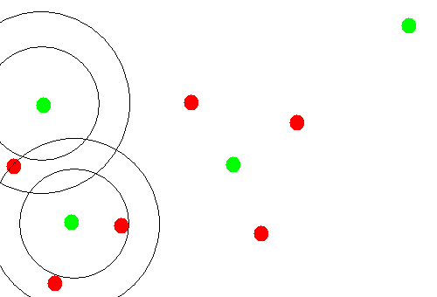
Map2
Pick 3rd/4th Canopies & Assign

Slide 26
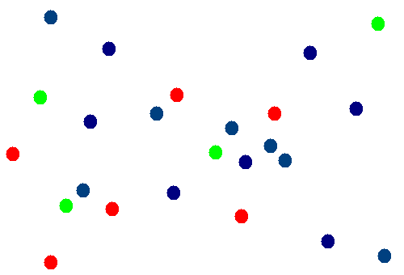
Reduce2
Merge with BLUE Shard

Slide 27
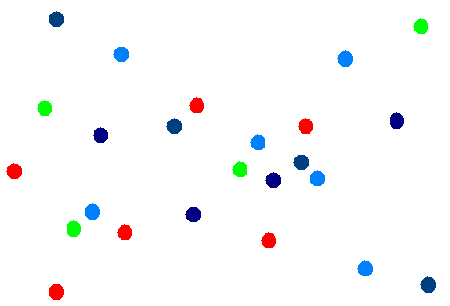
Reduce2
…which also got Canopies

Slide 28
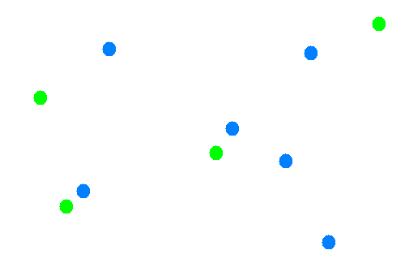
Reduce2
Group Merged Canopies

Slide 29
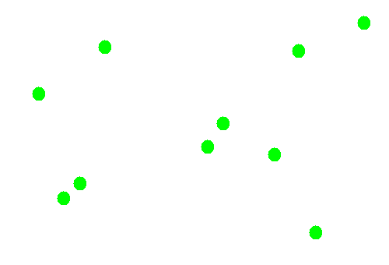
Reduce2
Group Merged Canopies

Slide 30
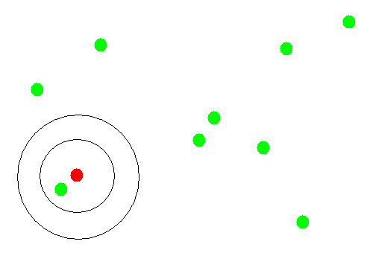
Reduce2
…and Canopy Cluster Again

Slide 31
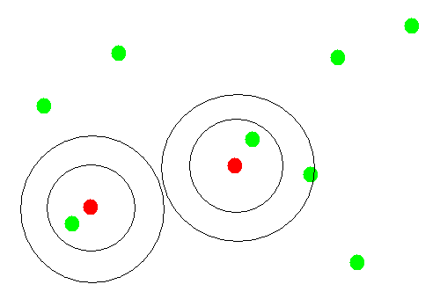
Reduce2
…and Canopy Cluster Again

Slide 32
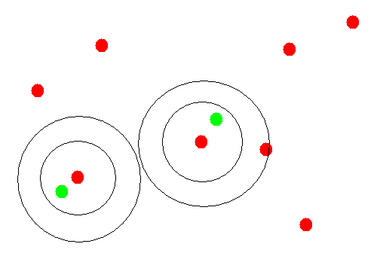
Reduce2
…and Canopy Cluster Again

Slide 33
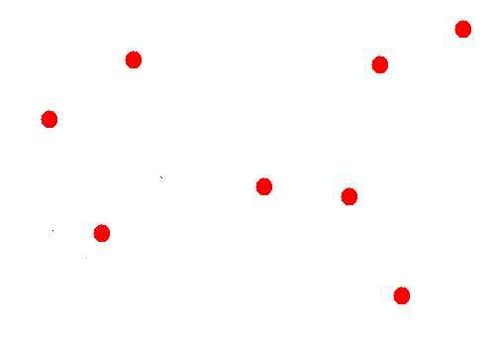
Reduce2
…to Merge Similar Canopies

Slide 34
Assigning Points to Canopies

Slide 35
Map3
Canopy Centers

Slide 36
Map3
Observations

Slide 37
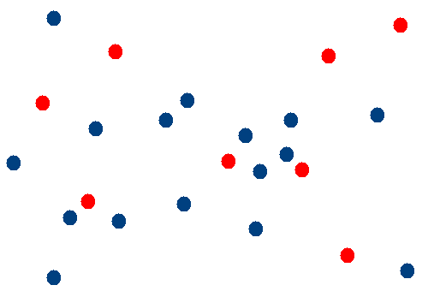
Map3
Canopy Centers

Slide 38
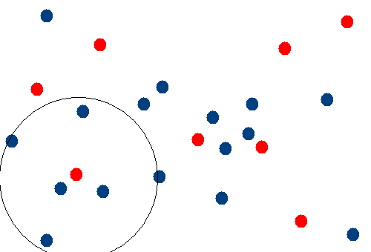
Map3
Assign to 1st Canopy Center

Slide 39
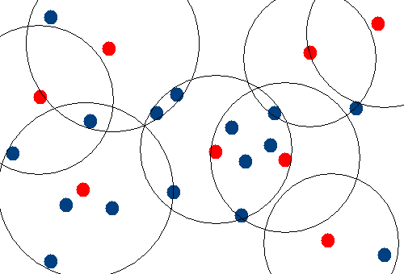
Map3
Multiple Assignment OK!

Slide 40
K-Means Map

Slide 41
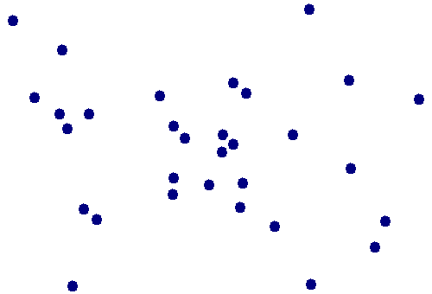
Map4+
Observations

Slide 42
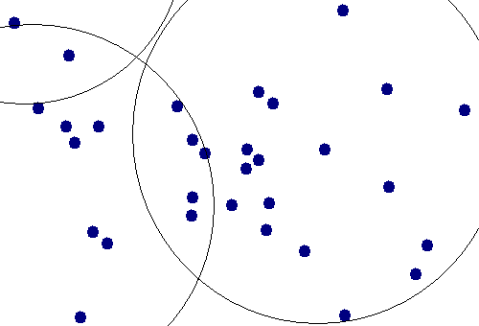
Map3
K-Means, Within Canopy

Slide 43
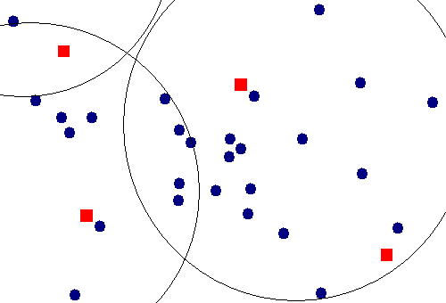

Slide 44
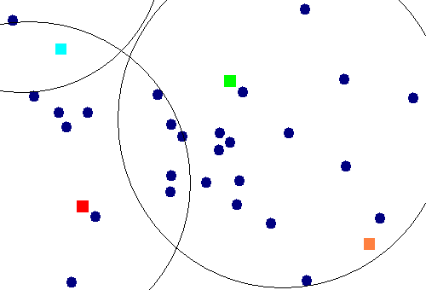

Slide 45
K-means complexity:
k * n * O(distance metric) * num(iterations)
Canopy complexity?
O(sharding) + O(~distance metric) + O(collapsing) + O(assignment)
Canopy + K-means Complexity?
O(K-means(n, k)) + O(Canopy(n))

Slide 46
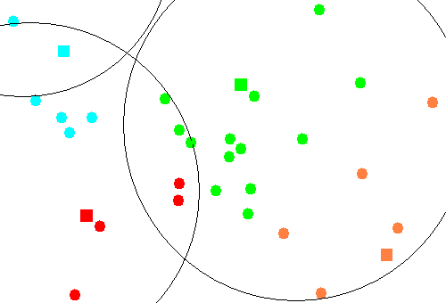

Slide 47
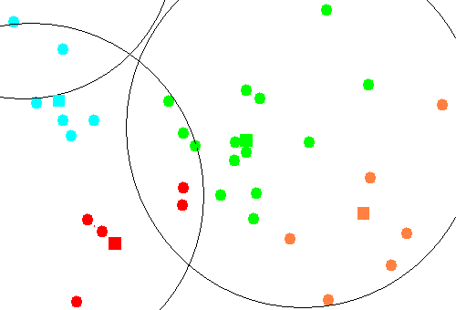

Slide 48


Slide 50
Document/Corpus Normalization

Slide 51
Why Normalize?
Tokenization
“New York” vs. “New Whole Foods” vs “New shoes”
This example is overloaded with a Named Entity example
Segmentation
I’m with Dr. Who.
I live on Willow Dr. Where do you live?
Cleanup: Casing, Stemming, Spell Checking
“teh” => “the”
loose => lose (?)
dogs => dog
(jump, jumps, jumped, jumping) => jump

Slide 52
How to Normalize?
Text => [LIBRARY] => Structured
Typically a nested data structure
Metadata
Document body
Perhaps with some markup
Choose the options you need
Provide domain-specific knowledge!
Gazetteers, stopword lists, keyword lists

Slide 53
Text Processing Libraries
OpenNLP <= I’ve worked with this one
MALLET <= and a bit of this one
NLTK
Weka

Slide 54
Document vs. Corpus
Methods described on preceding slides apply at document level
Corpus level transformations available
How to detect new stop words?
How to detect new key words?
How to detect synonyms?
mis-spelling? Or related word?

Slide 56
Tika
http://tika.apache.org/

Slide 57
Tika Introduction
It’s a Text Processing Library
It’s an Apache Software Foundation Project
http://tika.apache.org/
It’s designed to handle many document formats
Office – PDF, DOC, XLS, PPT
Archives – 7Z, ZIP, TGZ
HTML, Images, etc
Good for Extracting Metadata
Author, EXIF, Geospatial, Dates

Slide 58
Parser p = new AutoDetectParser();
MetaData md = new MetaData();
p.parse(
input,
ContentHandler ch,
md,
…
);

Slide 59
Tika Introduction
Understands nested structures
Full-on SAX parsing available on data and metadata
Flexible input and output types
URI
InputStream
etc

