Slide 2
Mahout Workshop, Section 4
Allen Day, PhD
MapR Technologies

Slide 4
Section 3 (this one)

Slide 5
Section 4 (next one)

Slide 6
Section 4 (next one)

Slide 7
TF-IDF

Slide 8
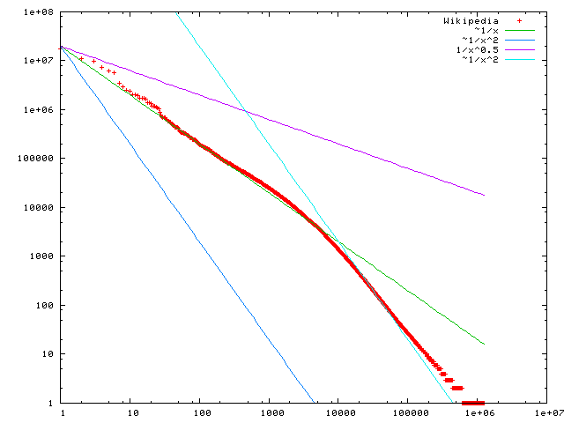
Observation: Unequal Word Distributions
Stop words
Jargon
Frequency
http://en.wikipedia.org/wiki/Zipf's_law
Rank

Slide 9
Motivation: “Undo” Effect of Unequal Distribution
 | doc1 | doc2 | doc3 | TF (max) | DF(bool)
car | 27 | 4 | 24 | 27 | 3
auto | 3 | 33 | 0 | 33 | 2
insurance | 0 | 33 | 29 | 33 | 2
best | 14 | 0 | 17 | 17 | 2
 | doc1 | doc2 | doc3 | TF (max) | DF (bool)
car | 27/27 * log(3/3) | 4/27 * log(3/3) | 24/27 * log(3/3) | 27 | 3
auto | 3/33 * log(3/2) | 33/33 * log(3/2) | 0/33 * log(3/2) | 33 | 2
insurance | 0/33 * log(3/2) | 33/33 * log(3/2) | 29/33 * log(3/2) | 33 | 2
best | 14/17 * log(3/2) | 0/17 * log(3/2) | 17/17 * log(3/2) | 17 | 2

Slide 10
Motivation: “Undo” Effect of Unequal Distribution
MAX
 | doc1 | doc2 | doc3 | TF (max) | DF (bool)
car | 27/27 * log(3/3) | 4/27 * log(3/3) | 24/27 * log(3/3) | 27 | 3
auto | 3/33 * log(2/3) | 33/33 * log(2/3) | 0/33 * log(2/3) | 33 | 2
insurance | 0/33 * log(2/3) | 33/33 * log(2/3) | 29/33 * log(2/3) | 33 | 2
best | 14/17 * log(2/3) | 0/17 * log(2/3) | 17/17 * log(2/3) | 17 | 2
 | doc1 | doc2 | doc3 | TF (max) | DF (bool)
car | 0 | 0 | 0 | 27 | 3
auto | 0.04 | 0.40 | 0 | 33 | 2
insurance | 0 | 0.40 | 0.35 | 33 | 2
best | 0.14 | 0 | 0.40 | 17 | 2
Note that I’ve used TF_{max} and DF_{bool} here. Other tf*idf variants are also valid.

Slide 11
Motivation: “Undo” Effect of Unequal Distribution
SUM
 | doc1 | doc2 | doc3 | TF (sum) | DF (bool)
car | 27/55 * log(3/3) | 4/55 * log(3/3) | 24/55 * log(3/3) | 55 | 3
auto | 3/36 * log(3/2) | 33/36 * log(3/2) | 0/36 * log(3/2) | 36 | 2
insurance | 0/62 * log(3/2) | 33/62 * log(3/2) | 29/62 * log(3/2) | 62 | 2
best | 14/31 * log(3/2) | 0/31 * log(3/2) | 17/31 * log(3/2) | 31 | 2
 | doc1 | doc2 | doc3 | TF (sum) | DF (bool)
car | 0 | 0 | 0 | 27 | 3
auto | 0.03 | 0.37 | 0 | 33 | 2
insurance | 0 | 0.21 | 0.19 | 33 | 2
best | 0.18 | 0 | 0.22 | 17 | 2
Note that I’ve used TF_{max} and DF_{bool} here. Other tf*idf variants are also valid.

Slide 13
TF-IDF in Cascading (on Hadoop)

Slide 14
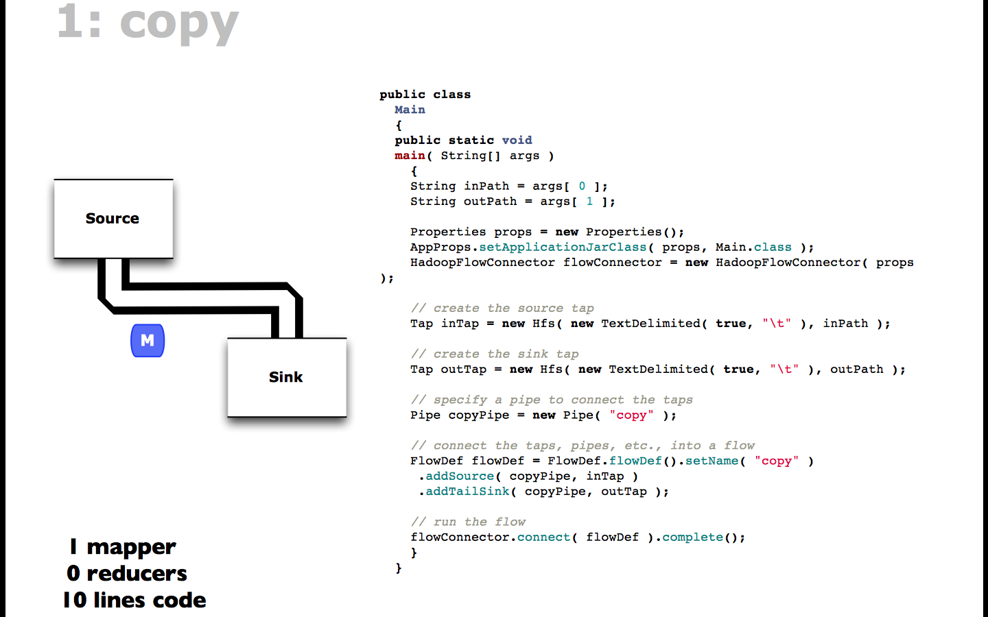
http://www.slideshare.net/pacoid/intro-to-data-science-for-enterprise-big-data

Slide 15
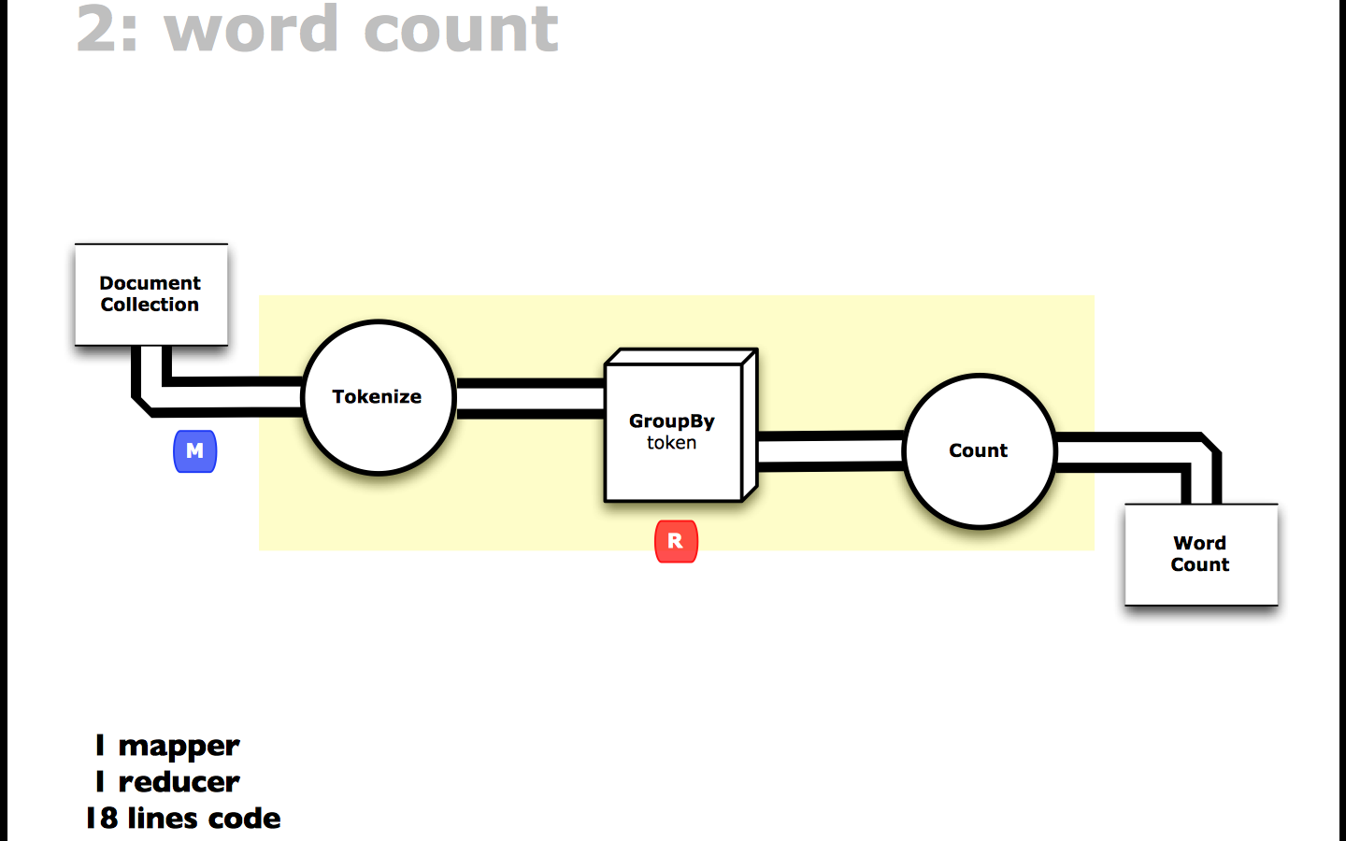
http://www.slideshare.net/pacoid/intro-to-data-science-for-enterprise-big-data

Slide 16
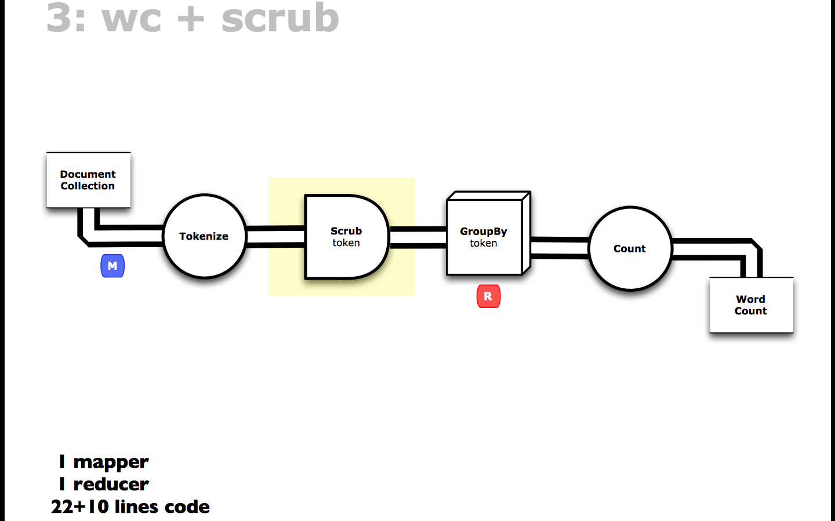
http://www.slideshare.net/pacoid/intro-to-data-science-for-enterprise-big-data

Slide 17
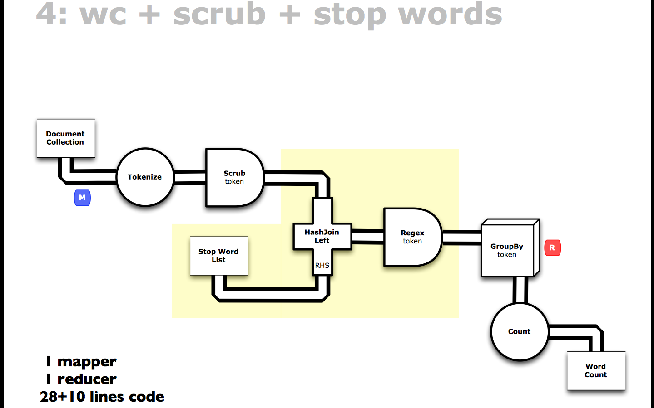
http://www.slideshare.net/pacoid/intro-to-data-science-for-enterprise-big-data

Slide 18
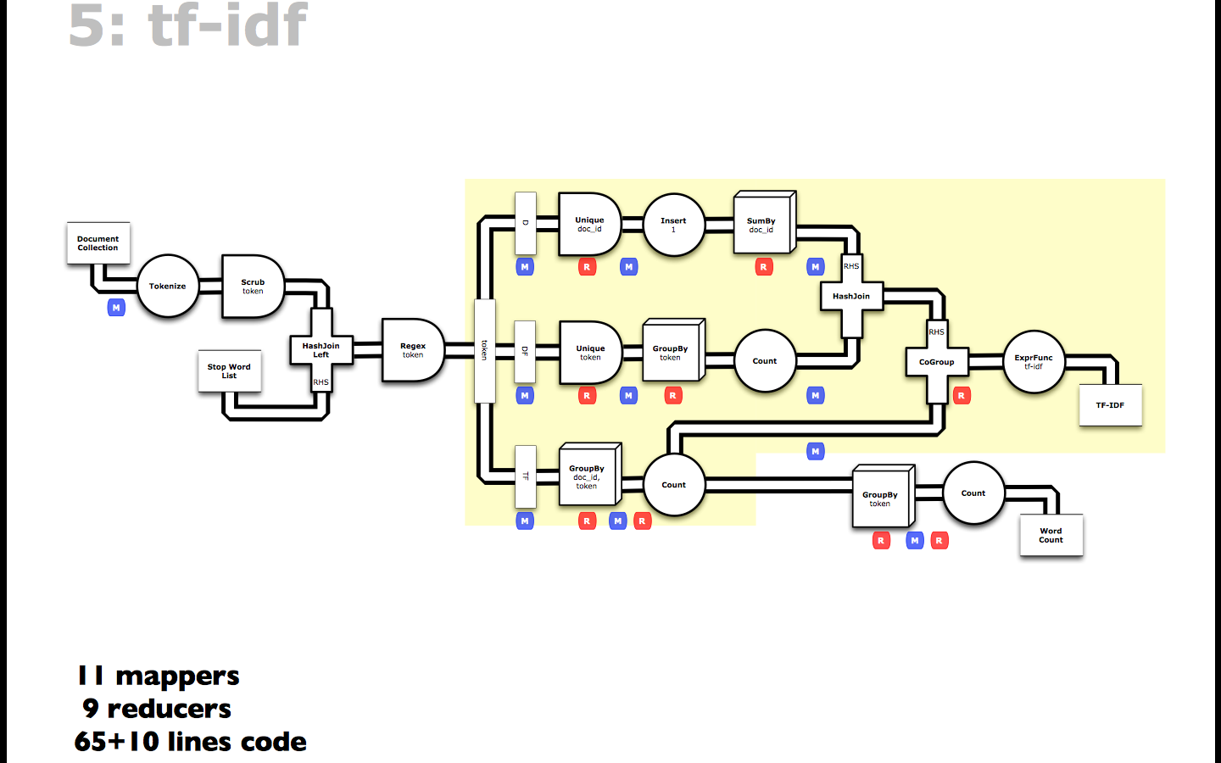
http://www.slideshare.net/pacoid/intro-to-data-science-for-enterprise-big-data

Slide 19
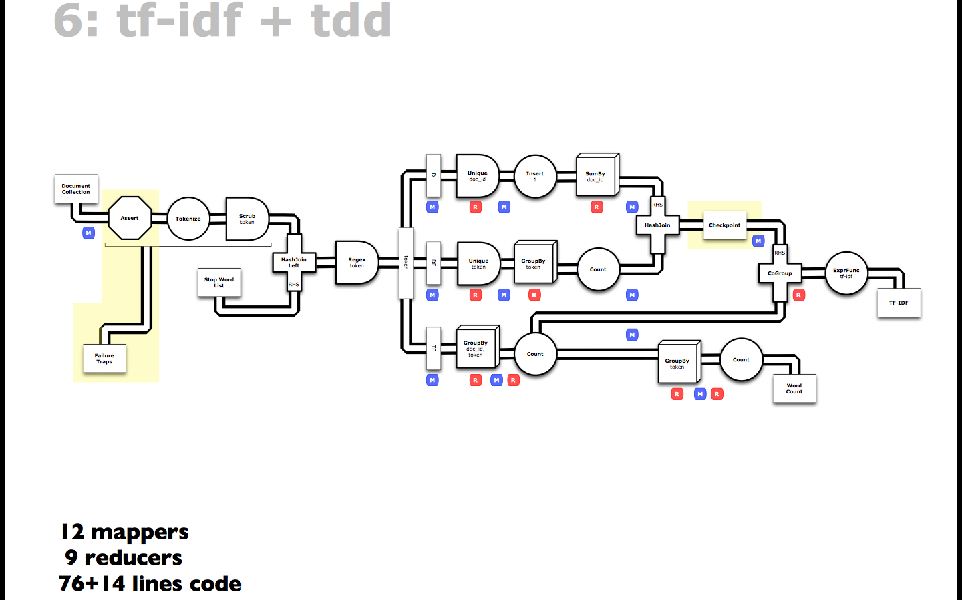
http://www.slideshare.net/pacoid/intro-to-data-science-for-enterprise-big-data

Slide 21
Classification Intro

Slide 22
What is it?
D-dimensional observations X (x₁, …, x_{n})
2+ known classes K on some subset of X
Find function f(x) to assign each X to a class K
Make it perform well
Precision vs Recall. Resource and time complexity

Slide 23
What is it?
D-dimensional observations X (x₁, …, x_{n})
2+ known classes K on some subset of X
Find function f(x) to assign each X to a class K
Make it perform well
Precision vs Recall. Resource and time complexity

Slide 24
Applications
Security – Does an observation fall outside of normal behavior boundaries?
Marketing – Can a user’s gender be inferred by browsing behavior? Search terms?
Search – Does the user’s query pattern imply she wants documents of a particular class?
Health – Emergency Room triage. Does this patient need to be seen immediately?

Slide 25
Learning is impossible, unless…
x1
x2
Unknown
function
x3
y = f (x1, x2, x3, x4)
x4
Example
x1 x2 x3 x4 y
Given:
Training examples (x,f (x))
of unknown function f
Find:
A good approximation to f
1 0 0 1 0 0
2 0 1 0 0 0
3 0 0 1 1 1
4 1 0 0 1 1
5 0 1 1 0 0
6 1 1 0 0 0
7 0 1 0 1 0

Slide 26
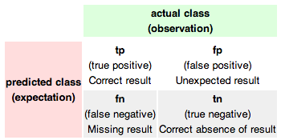
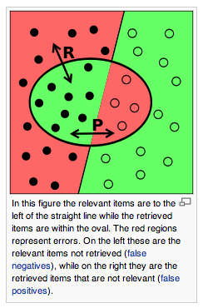


Precision vs. Recall aka Sensitivity vs. Specificity
http://en.wikipedia.org/wiki/Precision_and_recall

Slide 27
D-dimensional observations X (x₁, …, x_{n})
2+ known classes K on some subset of X
Find function f(x) to assign each X to a class K
Make it perform well
Precision vs Recall. Resource and time complexity

Slide 28
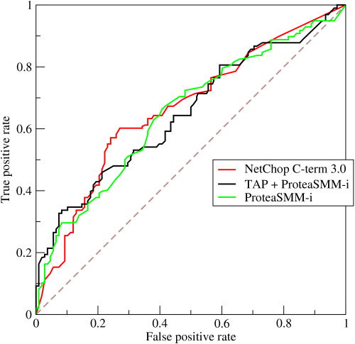
ROC Curve
http://en.wikipedia.org/wiki/Receiver_operating_characteristic

Slide 29
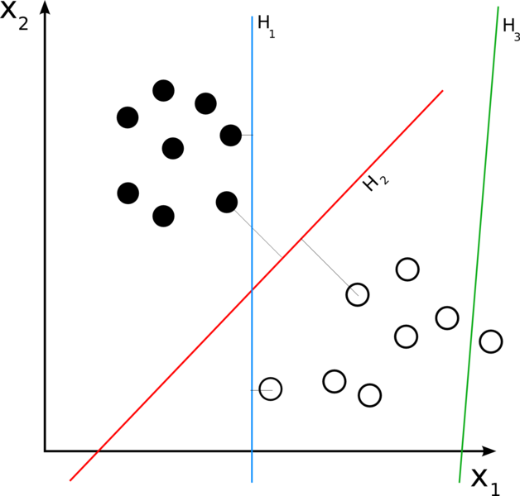
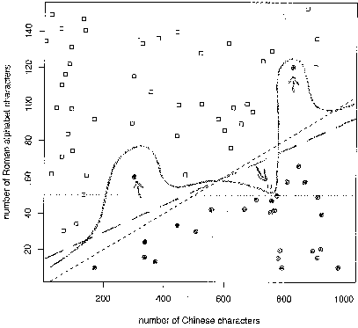
Linear vs. Non-linear
http://en.wikipedia.org/wiki/Linear_classifier

Slide 30
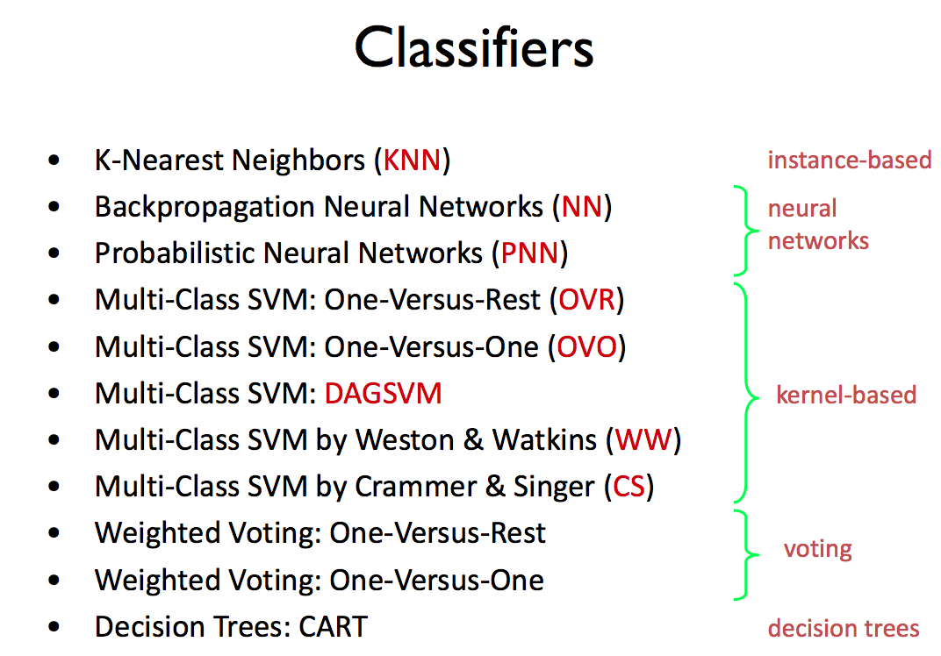

Slide 31
Naïve Bayesian Classifiers
Support Vector Machines

Slide 32
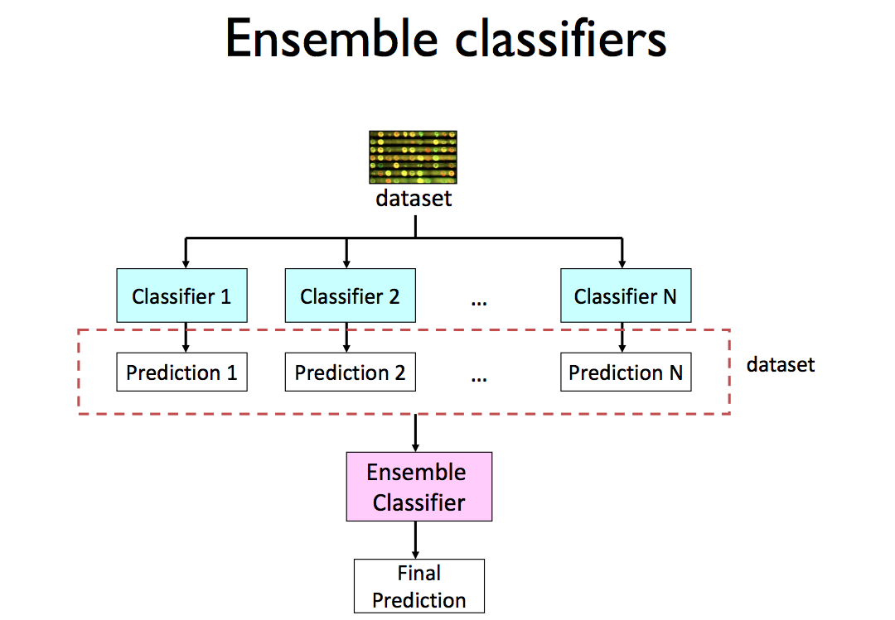

Slide 34
Naïve Bayes

Slide 35
What is it?
A classifier that:
Can train on a small # of observations
Assumes independence between features
Simple to implement
http://en.wikipedia.org/wiki/Naive_Bayes

Slide 36
Applications
Typically K=2-class classifiers
K>2 possible
E.g.
Spam vs. Non-spam
Female vs. Male

Slide 37
Prior vs. Posterior Probabilities
Description vs. Prediction

Slide 38
How does it work?
Given the prior probability of a class k in K
…the prior probabilities of N object features
…and their associations with k
Calculate the posterior probability that a given object belongs to class k
Easier to work through an example
http://bit.ly/10alkWY
http://en.wikipedia.org/wiki/Naive_Bayes

Slide 39
Making Best use of Data
Train vs. Test
Cross-validation
ROC Ensembles
http://en.wikipedia.org/wiki/Naive_Bayes

Slide 41
Hierarchical Clustering

