Slide 2
Mahout Workshop, Section 1
Allen Day, PhD
MapR Technologies

Slide 3
K-means Clustering

Slide 5
K-Means – Overview
Given a parameter K
And a set of observations X (x₁, …, x_{n}) that are d-dimensional vectors
Identify K mean vectors (centroids) C that partition the data

Slide 6
Lloyd’s Algorithm
Part of CS folk-lore
Developed in the late 50’s for signal quantization, published in 80’s
initialize k cluster centroids somehow
for each of many iterations:
for each data point:
assign point to nearest cluster
recompute cluster centroids from points assigned to clusters
Highly variable quality, several restarts recommended

Slide 7
Lloyd’s Algorithm

Slide 8
Hands-on Lab
Environment tuning
echo $JAVA_HOME
which mahout
http://bit.ly/15eZHG5 ~ L 137
http://bit.ly/12bxnRN ~ L 106
http://bit.ly/14qiE97
http://cwiki.apache.org/MAHOUT/quick-tour-of-text-analysis-using-the-mahout-command-line.html

Slide 9
How to Choose the K centroids?
Using a-priori knowledge is useful…
Leads to faster convergence
More consistent results

Slide 11
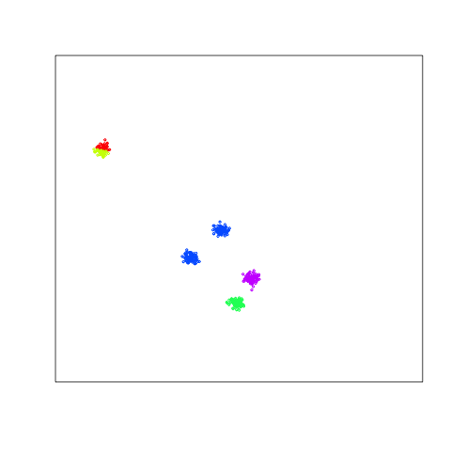
Typical K-means Failure
Selecting two seeds here cannot be
fixed with Lloyds
Result is that these two clusters get glued together

Slide 12
Limitations of K-means
K-means has problems when clusters are of differing
Sizes
Densities
Non-globular shapes
K-means has problems when the data contains outliers.

Slide 13
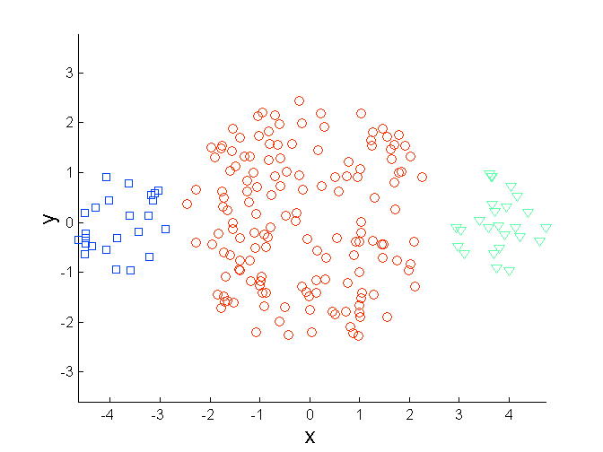
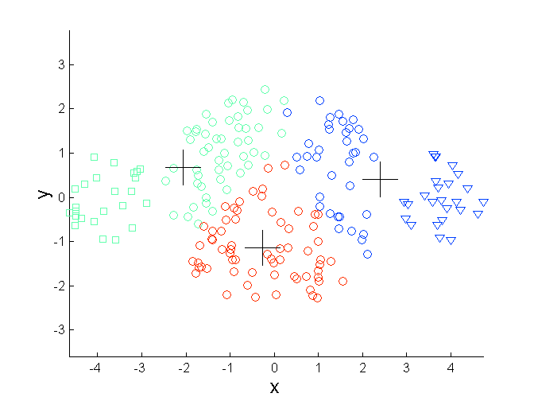
Limitations of K-means: Differing Sizes
Original Points
K-means (3 Clusters)

Slide 14
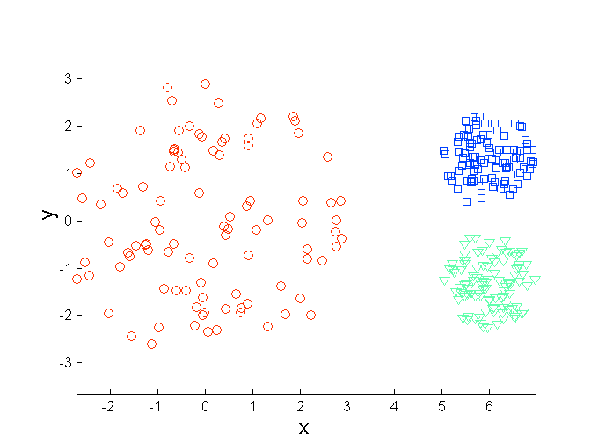
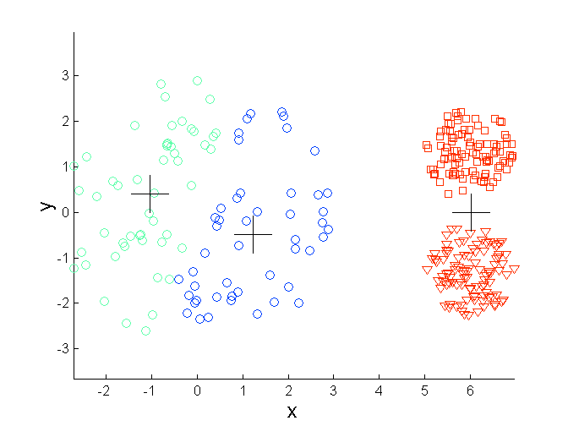
Limitations of K-means: Differing Density
Original Points
K-means (3 Clusters)

Slide 15
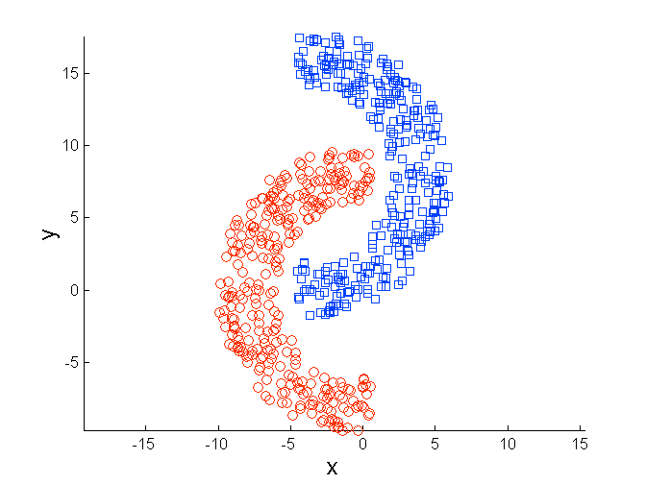
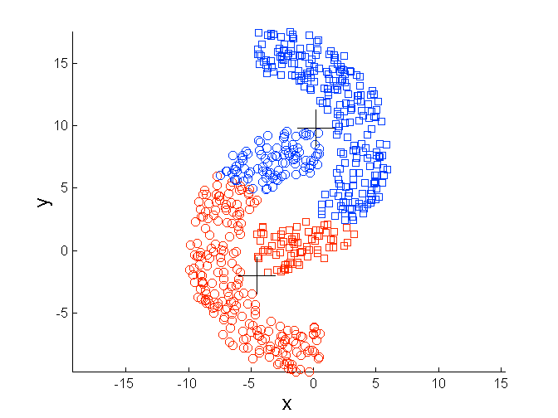
Limitations of K-means: Non-globular Shapes
Original Points
K-means (2 Clusters)

Slide 16
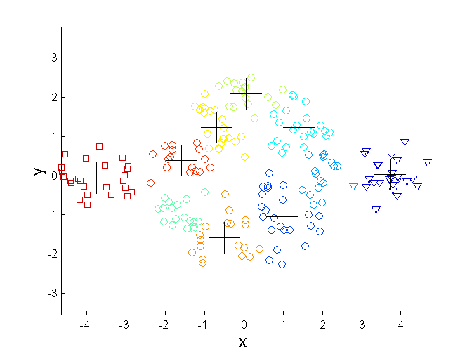
Overcoming K-means Limitations
Original Points K-means Clusters
One solution is to use many clusters.
Find parts of clusters, but need to put together.

Slide 17
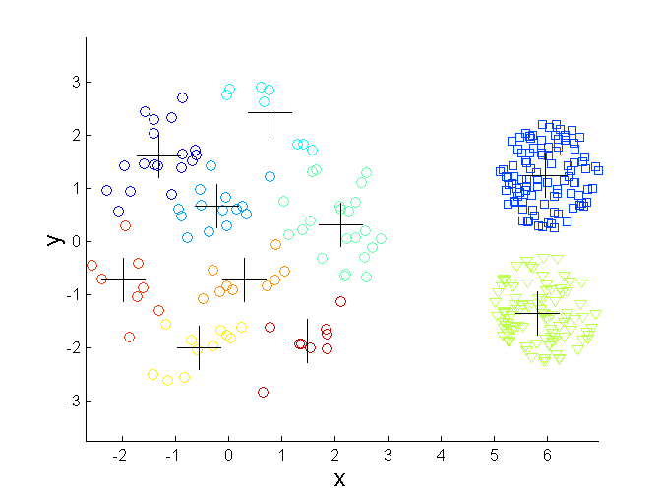
Overcoming K-means Limitations
Original Points K-means Clusters

Slide 18
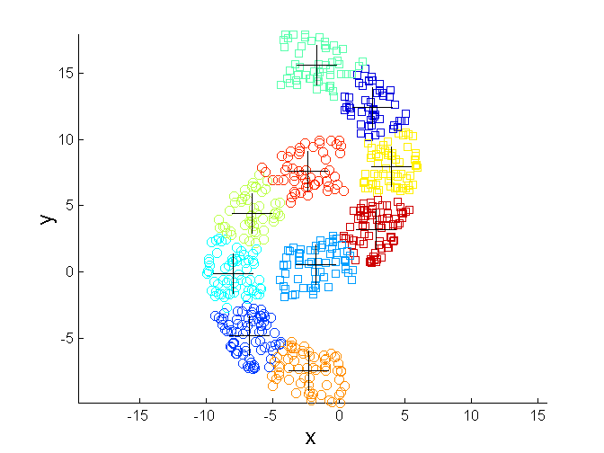
Overcoming K-means Limitations
Original Points K-means Clusters

Slide 19
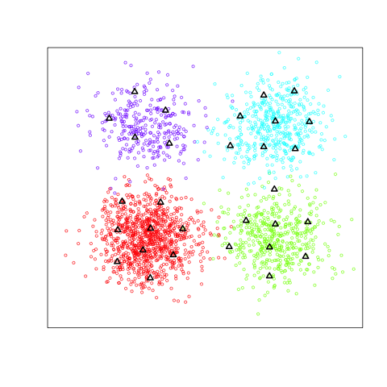
How to Choose K?

Slide 21
Quality and tuning

Slide 22
How to Choose K?
What to Measure?

Slide 23
Hands-on Lab
Environment tuning
echo $JAVA_HOME
which mahout
http://bit.ly/15eZHG5 ~ L 137
http://bit.ly/12bxnRN ~ L 106
http://bit.ly/14qiE97
http://cwiki.apache.org/MAHOUT/quick-tour-of-text-analysis-using-the-mahout-command-line.html

Slide 24
Inter- and Intra-Cluster Distance
Finding groups of objects such that the objects in a group will be similar (or related) to one another and different from (or unrelated to) the objects in other groups
Inter-cluster distances are maximized
Intra-cluster distances are minimized

Slide 25
Evaluating K-means Clusters
Most common measure is Sum of Squared Error (SSE)
For each point, the error is the distance to the nearest cluster
To get SSE, we square these errors and sum them.
x is a data point in cluster C_{i} and m_{i} is the representative point for cluster C_{i}
can show that m_{i} corresponds to the center (mean) of the cluster
Given two clusterings, we can choose the one with the smallest error
One easy way to reduce SSE is to increase K, the number of clusters

Slide 26
Impact of Distance Metric
Distance Metric Choice affects clustering
Euclidean vs Cosine vs Manhattan
How do these affect inter- and intra-cluster (mean/max/min) distances?
Domain-specific knowledge – boosting
x_{n} = (f₁, f₂, … f_{k})
x_{n} = (w₁f₁, w₂f₂, … w_{k}f_{k})

Slide 27
Evaluating K-means Clusters
Need to incorporate measure of separation between clusters, not only similarity inside each cluster
Dissimilarity ratio = (inter-cluster distance / intra-cluster distance)

