Slide 2
Mahout Workshop, Section 6
Allen Day, PhD
MapR Technologies

Slide 3
Section 6 (this one)

Slide 4
LSA & SVD
Latent Semantic Analysis and Singular Value Decomposition

Slide 5
LSA – Applications
Has proved to be a valuable tool in many areas of NLP as well as IR
summarization
cross-language IR
topics segmentation
text classification
question answering
more

Slide 6
The Problem
The vector space method
term (rows) by document (columns) matrix, based on occurrence
translate into vectors in a vector space
one vector for each document
cosine to measure distance between vectors (documents)
small angle = large cosine = similar
large angle = small cosine = dissimilar

Slide 7
The Problem
A quick diversion
Standard measures in IR
Precision: portion of selected items that the system got right
Recall: portion of the target items that the system selected

Slide 8
The Problem
Two problems that arose using the vector space model:
synonymy: many ways to refer to the same object, e.g. car and automobile
leads to poor recall
polysemy: most words have more than one distinct meaning, e.g.model, python, chip
leads to poor precision

Slide 9
The Problem
Example: Vector Space Model
(from Lillian Lee)
auto
engine
bonnet
tyres
lorry
boot
car
emissions
hood
make
model
trunk
make
hidden
Markov
model
emissions
normalize
Synonymy
Will have small cosine
but are related
Polysemy
Will have large cosine
but not truly related

Slide 10
LSA
What is the difference between LSI and LSA???
LSI refers to using it for indexing or information retrieval.
LSA refers to everything else.

Slide 11
LSA
Implementation: four basic steps
term by document matrix (more generally term by context) tend to be sparce
convert matrix entries to weights, typically:
L(i,j) * G(i): local and global
a_ij -> log(freq(a_ij)) divided by entropy for row (-sum (p logp), over p: entries in the row)
weight directly by estimated importance in passage
weight inversely by degree to which knowing word occurred provides information about the passage it appeared in
TF-IDF?

Slide 12
LSA
Four basic steps
Rank-reduced Singular Value Decomposition (SVD) performed on matrix
all but the k highest singular values are set to 0
produces k-dimensional approximation of the original matrix (in least-squares sense)
this is the “semantic space”
Compute similarities between entities in semantic space (usually with cosine)

Slide 13
*
*
Second principal component
*
*
First principal component
*
*
*
*
*
*
*
*
*
Original axes
*
*
*
*
*
*
*
*
*
*
*
Data points

Slide 14
PCA (application for SVD)
Principal Components Analysis (PCA): approximating a high-dimensional data set with a lower-dimensional subspace
*
*
Second principal component
*
*
First principal component
*
*
*
*
*
*
*
*
*
Original axes
*
*
*
*
*
*
*
*
*
*
*
Data points

Slide 15
LSA
SVD
unique mathematical decomposition of a matrix into the product of three matrices:
two with orthonormal columns
one with singular values on the diagonal
treat it as a black box
tool for dimension reduction
similarity measure based on co-occurrence
finds optimal projection into low-dimensional space

Slide 16
LSA
SVD
can be viewed as a method for rotating the matrix axes in n-dimensional space, so that the first axis runs along the direction of the largest variation among the documents
the second dimension runs along the direction with the second largest variation
and so on
generalized least-squares method
Cartoons follow…

Slide 17
Total Least Squares
One final least squares application
Fitting a line: vertical vs. perpendicular error

Slide 18
PCA (application for SVD)
Principal Components Analysis (PCA): approximating a high-dimensional data set with a lower-dimensional subspace
*
*
Second principal component
*
*
First principal component
*
*
*
*
*
*
*
*
*
Original axes
*
*
*
*
*
*
*
*
*
*
*
Data points

Slide 19
Uses of PCA
Compression: each new image can be approximated by projection onto first few principal components
Recognition: for a new image, project onto first few principal components, match feature vectors

Slide 20
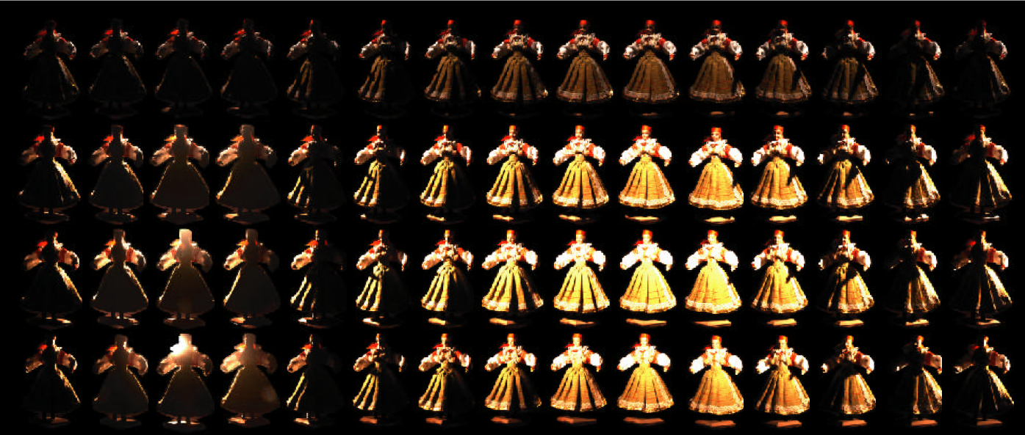
PCA for Relighting
Images under different illumination
[Matusik & McMillan]

Slide 21
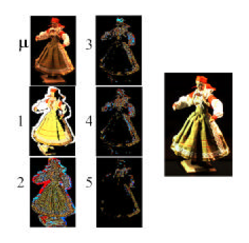
PCA for Relighting
Images under different illumination
Most variation captured by first 5 principal components – can re-illuminate by combining only a few images
[Matusik & McMillan]

Slide 22
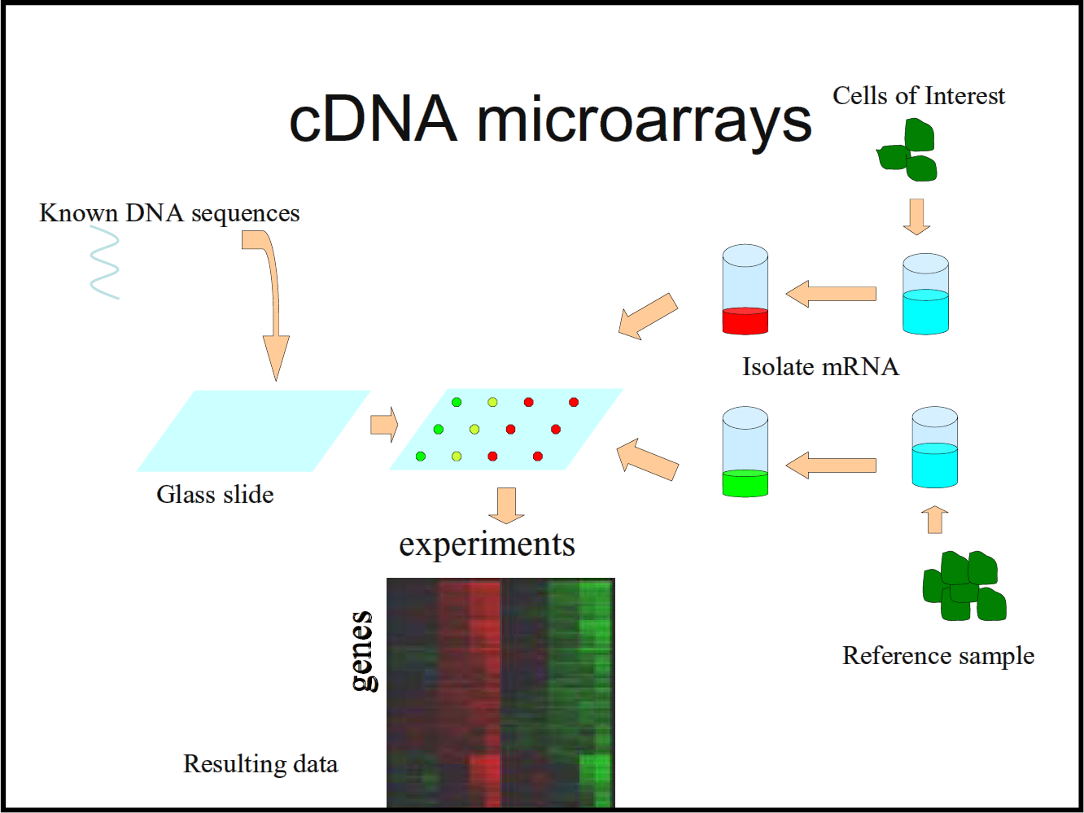
PCA for DNA Microarrays
Measure gene activation under different conditions
[Troyanskaya]

Slide 23
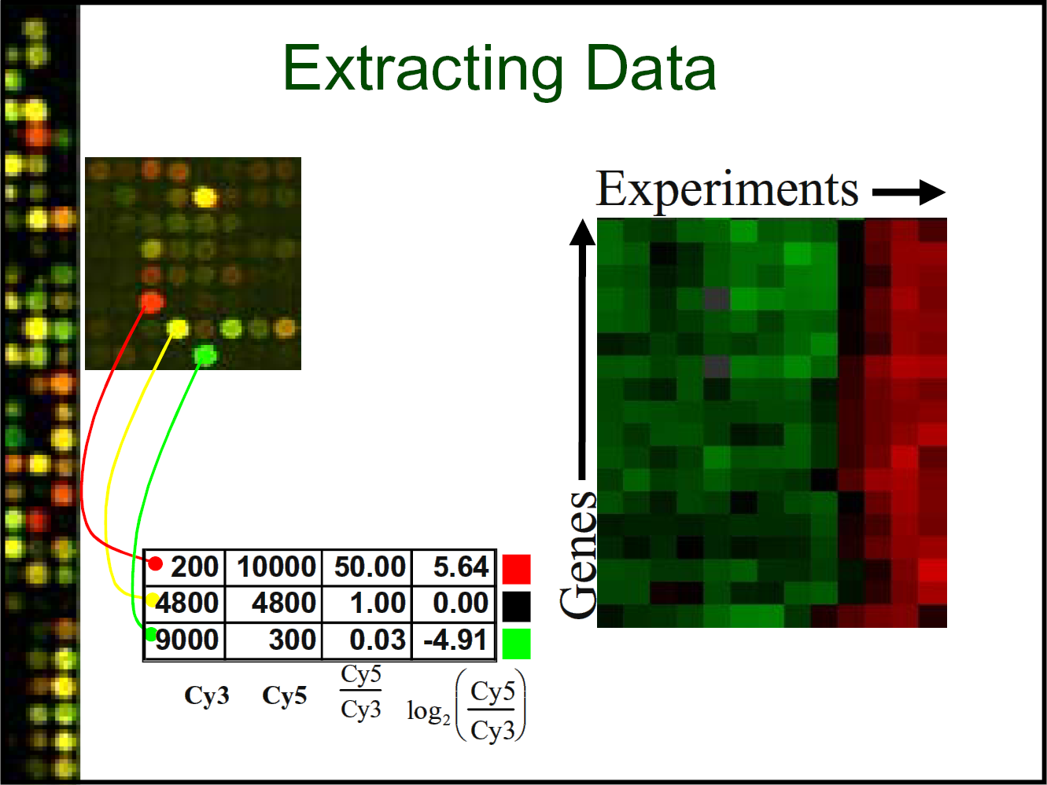
PCA for DNA Microarrays
Measure gene activation under different conditions
[Troyanskaya]

Slide 24
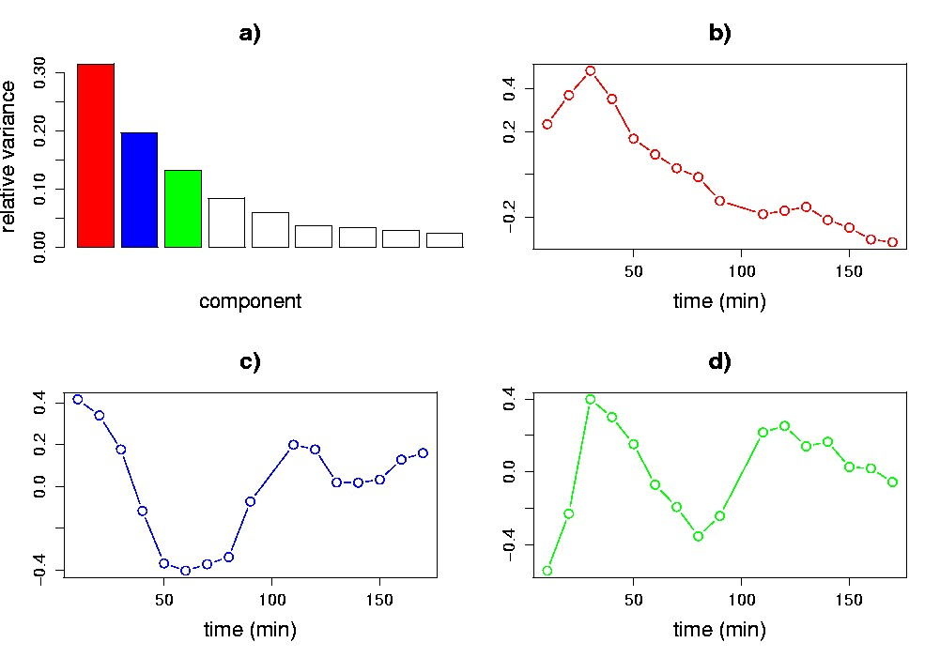
PCA for DNA Microarrays
PCA shows patterns of correlated activation
Genes with same pattern might have similar function
[Wall et al.]

Slide 25
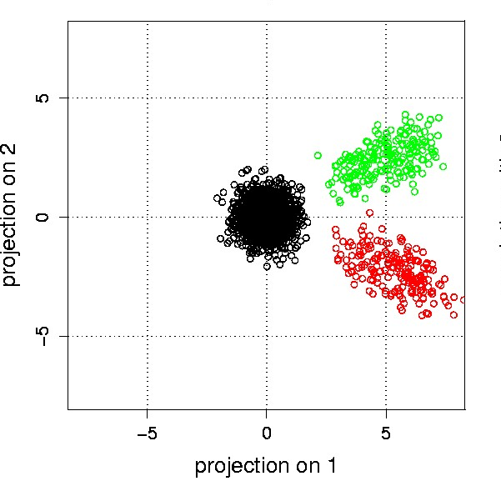
PCA for DNA Microarrays
PCA shows patterns of correlated activation
Genes with same pattern might have similar function
Note: Day, et al.
[Wall et al.]

Slide 26
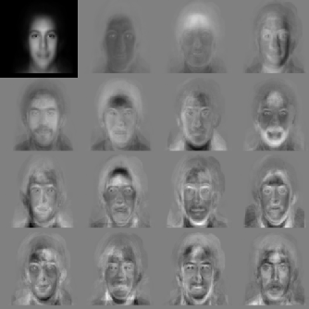
PCA on Faces: “Eigenfaces”
First principal component
Average face
Other components
For all except average, “gray” = 0, “white” > 0,
“black” < 0

Slide 27
SVD Exercise, Part 1

