Slide 2
Mahout Workshop, Section 1
Allen Day, PhD
MapR Technologies

Slide 3
K-means Clustering

Slide 5
K-Means – Overview
Given a parameter K
And a set of observations X (x₁, …, x_{n}) that are d-dimensional vectors
Identify K mean vectors (centroids) C that partition the data

Slide 6
Lloyd’s Algorithm
Part of CS folk-lore
Developed in the late 50’s for signal quantization, published in 80’s
initialize k cluster centroids somehow
for each of many iterations:
for each data point:
assign point to nearest cluster
recompute cluster centroids from points assigned to clusters
Highly variable quality, several restarts recommended

Slide 7
Lloyd’s Algorithm

Slide 8
Hands-on Lab
https://cwiki.apache.org/MAHOUT/k-means-clustering.html

Slide 9
How to Choose the K centroids?
Using a-priori knowledge is useful…
Leads to faster convergence
More consistent results

Slide 11
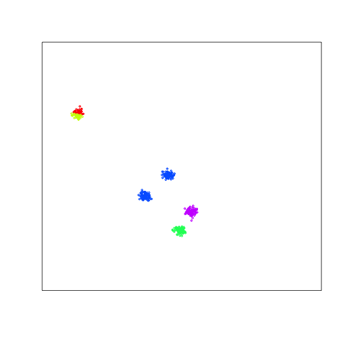
Typical K-means Failure
Selecting two seeds here cannot be
fixed with Lloyds
Result is that these two clusters get glued together

Slide 12
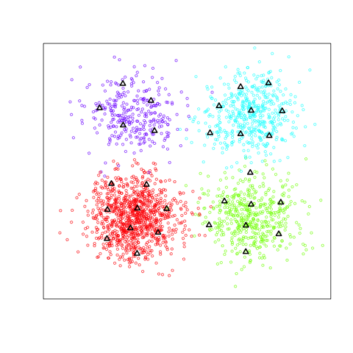
How to Choose K?

Slide 14
How to Choose K?
What to Measure?

Slide 15
Quality and tuning

