Slide 1



Slide 2
Purpose
Taggy help the users store memo and notes by utilizing tags in a convenient and practical way

Slide 3
Target audience
Taggy should be appealing for everyone who is a frequent smartphone user in the age group between 12-35

Slide 4




Ads
Refferals
Data Analytics

Slide 5
Business costs
Deployment
Marketing
Development
Technical support
Maintenance

Slide 6



Competition
Other memo applications
Evernote
Keep
One Note

Slide 7
Key differentiations
Unique Tag functionality
Adding informatic features
Applying data analytical insights
Sustainable revenue streams
Appealing aesthetics for target group

Slide 8
Supply & Demand
There are 2.53 billon smartphone users worldwide
Approximately 25% of them uses a memo application
The total market is therefore 632.5 million customers
The application is free and distributed on Android & iOS

Slide 9
Technical specifications
1
∞
User
user_ID (pk)
firstName
lastName
email
userName
password
Item
item_ID (pk)
itemName
user_ID (fk)
Tag
tag_ID (pk)
tagName
user_ID (fk)
1 ∞
∞
∞
Item_tag
Item_ID (fk)
tag_ID (fk)

Slide 10

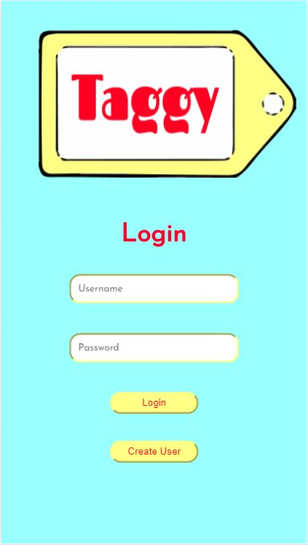
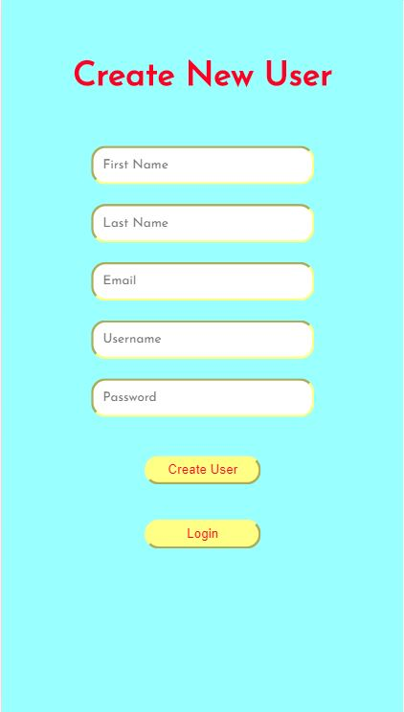


Slide 11

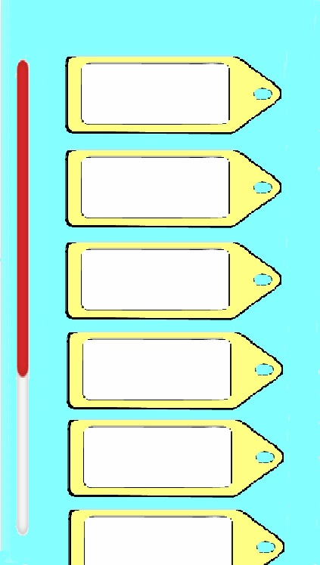








Race against the machine
Race against the machine
Race against the machine
Race against the machine
Race against the machine
Race against the machine

Slide 12


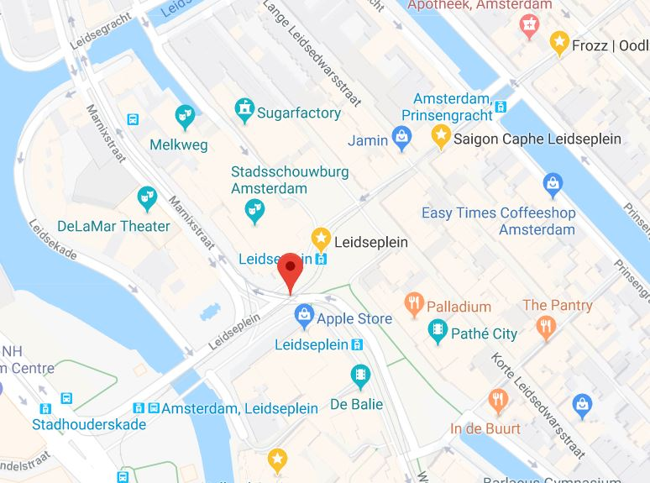



Race against the machine
Race against the machine

Slide 13
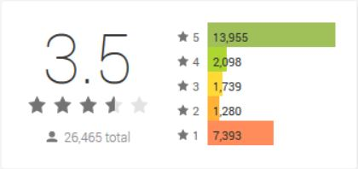

Race against the machine
Race against the machine

Slide 14


