Slide 1

A Tool To Detect Credit Card Fraud
Sourab Seriker - 1002245769
Sushanth Dayala – 1002241874
Samved Thimmasarthy – 1002246648
Roshan Nawaz Mohammed – 1002245127

Slide 2
Introduction
Phase I focused on designing a fraud detection tool.
Aimed to address real-world challenges faced by financial institutions.
Targeted class imbalance, real-time detection, and false positives.
Leveraged advanced machine learning techniques.
Used big data processing tools like PySpark.
Aimed to create a user-friendly interface for analysts.
Built a scalable solution for high transaction volumes.
Focused on regulatory compliance and ethical considerations.

Slide 3

Problem Statement
Credit card fraud is a growing concern in financial systems.
Challenges include:
- Low fraud occurrence (class
imbalance).
- Large-scale transactional data.
- Need for minimal false
positives to reduce disruptions.
- Timely detection for proactive
measures.
Existing solutions often rely on outdated rule-based methods.
Financial losses and reputational risks are significant.

Slide 4
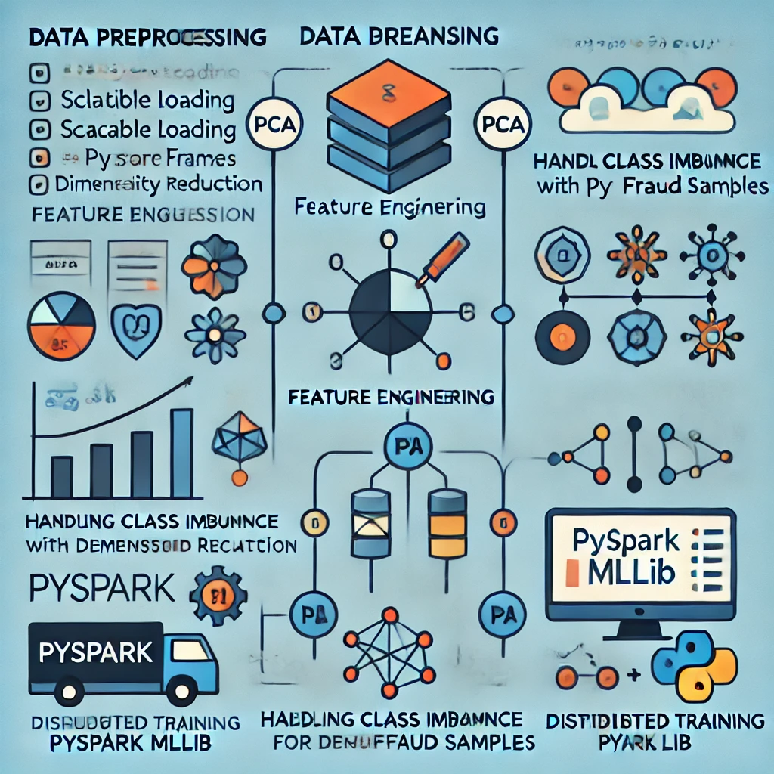
Technical Blueprint
Data Preprocessing:
- Scalable loading with PySpark DataFrames.
- Data cleaning and feature engineering.
- PCA for dimensionality reduction.
Handling Class Imbalance:
- SMOTE for creating synthetic fraud
samples.
ML Models:
- Linear Regression, Decision Trees, Random
Forests.
- Distributed training using PySpark MLlib.

Slide 5
Dataset Insights
Transaction dataset analyzed with millions of records. Over 280,000 transactions make it ideal for big data tools like PySpark.
Fraudulent transactions were significantly fewer.
Features included timestamps, transaction amounts, and locations.
Identified strong patterns of fraud clustering in certain conditions.
Preprocessed data for consistency and quality.

Slide 6
Evaluation Metrics
Precision-Recall Curve:
- Showed the tool's capability in handling
Imbalanced data.
ROC Curve:
- Evaluated true positive vs. false positive rates.
Accuracy and F1-Score:
- Provided a comprehensive evaluation of mode
performance.
- Balanced metric for precision and recall.
Highlighted the balance between fraud detection and false alarms.

Slide 7
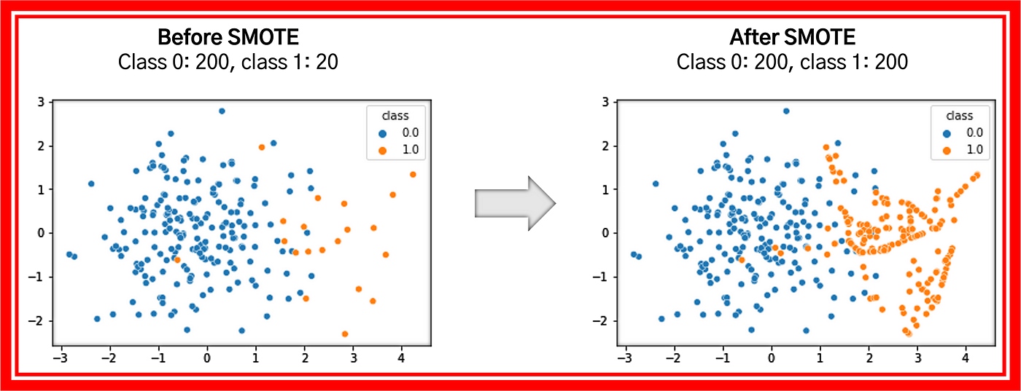
Impact of SMOTE
Addressed class imbalance in fraudulent transactions.
Enhanced model accuracy for minority class detection.
Increased recall without compromising precision.
Balanced dataset improved the overall learning process.
Techniques like cost-sensitive learning can be combined with SMOTE for further improvements in fraud detection scenarios.

Slide 8
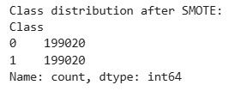
Graphs and Visuals
Include visuals for:
- Dataset distribution before and
after SMOTE.
- Precision-Recall metrics and ROC curves
for model performance.
- Model accuracy improvements
over iterations.

Slide 9
Limitations Identified
Class Imbalance: Fraud detection is complicated by the low incidence of fraudulent transactions compared to legitimate ones.
Computational Complexity: Processing large datasets with PySpark requires significant computational resources.
Hyperparameter tuning (grid search) required extensive resources.
Simulated datasets limited model generalizability.
Heavy reliance on preprocessed data may limit flexibility in real-world scenarios.

Slide 10
Phase Outcome
Addressing class imbalance early is critical for model success.
PySpark is effective for handling large-scale transactional data.
SMOTE significantly improves minority class detection.
Evaluation metrics must focus on imbalanced dataset distinction.
Designing solutions that scale efficiently with increasing data volume is essential for real-world applications in fraud detection.

Slide 11
Phase Outcome
Developed a scalable pipeline for fraud detection.
Addressed foundational challenges in class imbalance.
Provided actionable insights for Phase II improvements.
Established robust evaluation methods for fraud detection.

Slide 12
Conclusion
This credit card fraud detection system leverages a PySpark-based pipeline to efficiently process large-scale transactional data. It effectively tackles issues such as class imbalance, scalability, and ethical considerations to deliver precise and trustworthy fraud detection insights. Designed with advanced visualization features, it empowers analysts to identify and interpret fraud patterns effortlessly. With a strong emphasis on technical reliability, this solution serves as a robust and responsible tool for combating credit card fraud.

