Slide 1
Progressive Encoding-Decoding using Convolutional Autoencoder
Samveed Desai
Research Intern
IISc Bangalore

Slide 2
Problem Statement
Image Compression using Neural Networks
Methods researched upon throughout the internship—
GAN – Generative Compression
RNN – LSTM Model
Residual Image, for compression
Method Used –
>Progressive Encoding-Decoding using CAE
References:
https://arxiv.org/abs/1703.01467
https://arxiv.org/abs/1511.06085
https://arxiv.org/pdf/1608.05148.pdf
https://ai.googleblog.com/2016/09/image-compression-with-neural-networks.html

Slide 3
Approach Used
We have used a Deep Convolutional Auto-Encoder here, which progressively encodes and decodes the image.
Progressive Encoding and Decoding basically means that once we specify a general architecture, we don’t train the entire network again for different compression rates. We just train the newly added layers, w.r.t each compression rate.
INPUT
IMAGE
Deep CNN Based
Encoder
Deep CNN Based
Decoder
OUTPUT
IMAGE

Slide 4
Implementation
I used the CIFAR-10 and CIFAR-100 datasets combined together as both of them have 32*32 images and thus, my total dataset was 100000 images.
I used 4 compression rates in this research: 33%,50%,67% and 87.5%
The network for 33% compression has 5 convolution(including Pooling, and excluding Activation layers) and 5 deconvolution layers.
The network for 50% has 9 convolution and 9 deconvolution layers.
The network for 67% has 13 convolution and 13 deconvolution layers.
The network for 87.5% has 16 convolution and 16 deconvolution layers.
P.S : The last network does not have 4 layers more than the previous trend, (which is observed as a general trend), because, on experimentation, it produced less quality images

Slide 5
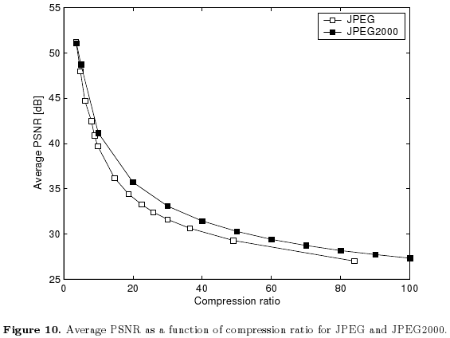
Results
Following are the graphs comparing JPEG (and JPEG-2000) with our research

Slide 6
Conclusions
As we see, for relatively smaller compression ratios, the results are similar to JPEG but as we increase the compression rate, the quality of the algorithm we designed degrades.
The number of filters and layers are variable and so, we can experiment and get similar and even better results than the JPEG compression.
The algorithm was tested on a GPU 1080X and it took ~4 mins for the network with 32 layers to be computed.
This is a great area of research, as image compression will be a major concern down the line.
Other algorithms involving GAN’s and RNN’s look promising to work on and are found to exceed JPEG’s compression results by a large margin.

Slide 7
I would like to thank my instructor, Rajiv Sir, for helping me out always and making me understand the basics, regarding the problem statement.
I would also like to thank all the Mtech’s and PhD’s present in the lab, who always helped me, even though they were busy and took time to help me understand.
THANK YOU!!

