Slide 1
Sales & Profit Dashboard Overview

Slide 2
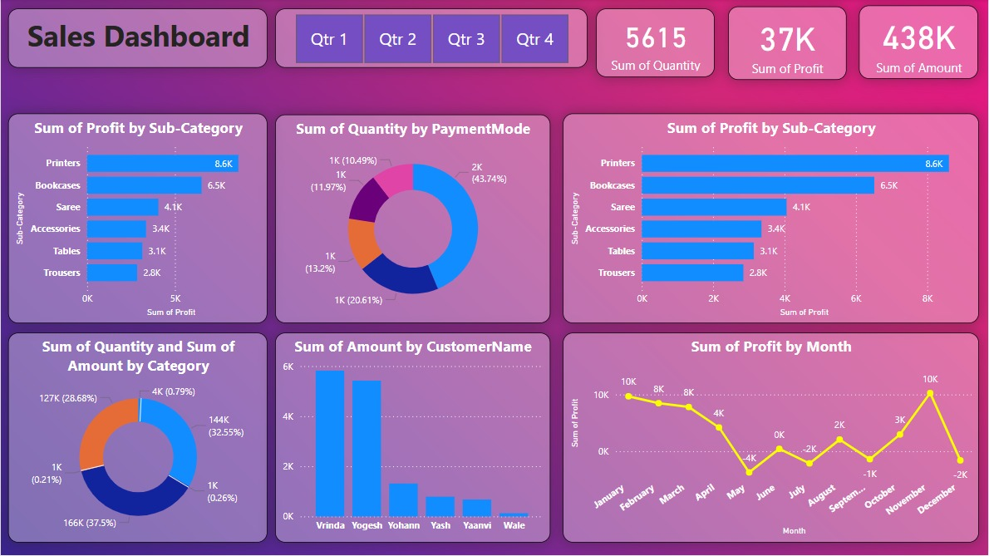

Slide 3
Key Metrics (2025 Overview)
• Total Quantity Sold: 5,615 units
• Total Profit: ₹37,000
• Total Revenue (Amount): ₹438,000

Slide 4
Key Insights & Analysis
• Top profit-making sub-category: Printers (₹8.6K)
• Peak profit months: January, November (₹10K each)
• Highest sales category share: 166K (~37%)
• Dominant payment mode accounts for 43.74% of transactions
• Notable Customers: Vrinda, Yogesh, Yohann

Slide 5
Recommendations
• Continue investment in high-profit sub-categories (Printers, Bookcases)
• Investigate dip in profits between July–September for corrective action
• Promote and reward top customer segments and preferred payment methods
• Explore growth strategies for underperforming categories

