Slide 1

Project Happiness
Members:
Rebeca Hassan, Fiona Nguyen, Veronique Singh, Justin Stubbs, Sam Wimberly

Slide 2

Motivation & Summary
Hypothesis:
Happiness is positively influenced by economy, family situation, and health
Questions:
Which variables influenced happiness the most?
Is there a correlation between suicide rate and happiness?
This Photo by Unknown Author is licensed under CC BY

Slide 3
Overview
Which variables influenced happiness the most?
We found that economy, health, and family situation has the strongest correlation to happiness
Is there a correlation between suicide rate and happiness?
Yes, there is a weak positive correlation between the two variables, but not in the way we thought initially

Slide 4



Data Sources
The variables economy (GDP per capita), health (life expectancy), social support (can you depend on family and friends?), and the happiness score data came from the World Happiness Reports (2015-2017)
Suicide rates were found in the website
Human Development Index was found in

Slide 5
Data Cleanup & Exploration
Exploration and cleanup process
Reconcile columns and standardized the different CSV files
Pivot
We wanted to track down alcohol consumption data, but found that the data was difficult to find and did not pursue
We could not do regional analysis for all three years available because of unavailable data
Issues post-data exploration
Country names and mismatched of country names in different data sets
Solved: using ISO alpha 3 country codes

Slide 6
Data Analysis

Slide 7
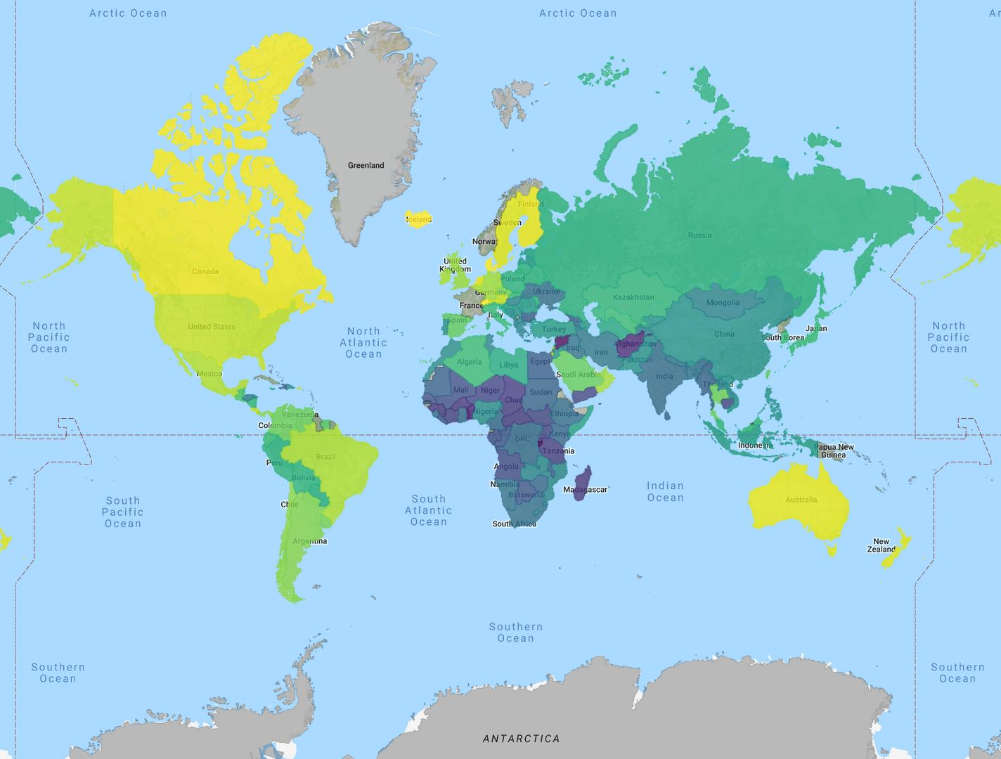
Happiness Heatmap
High Low

Slide 8
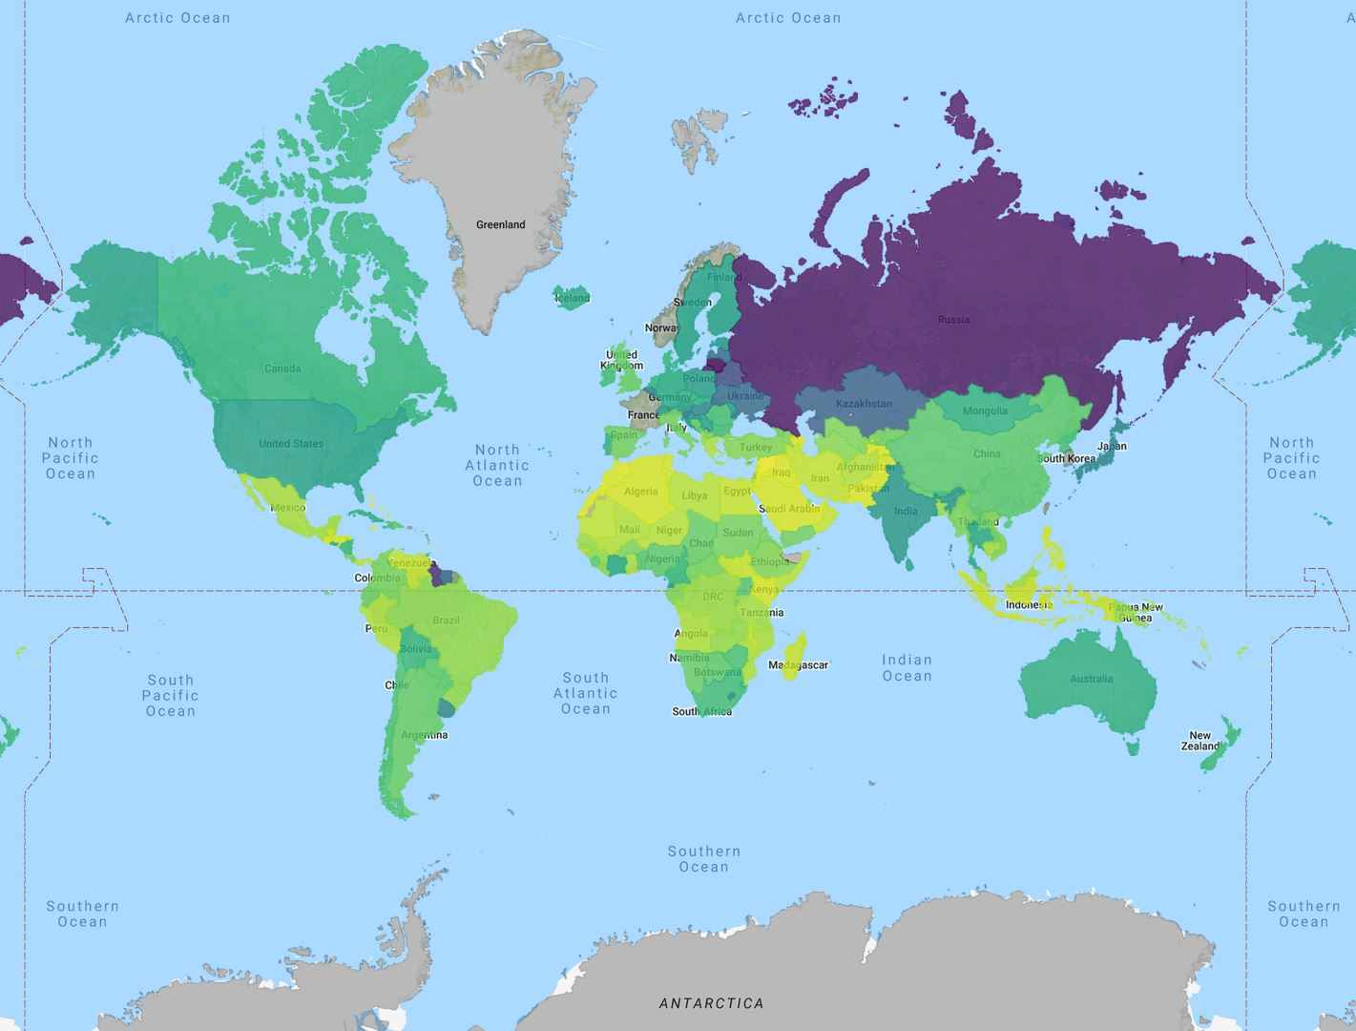
Suicide Rates

Slide 9
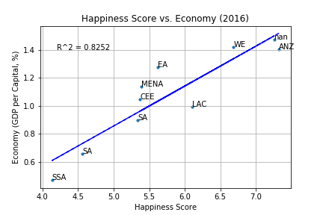
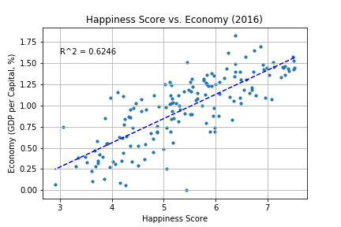
Region
Country

Slide 10
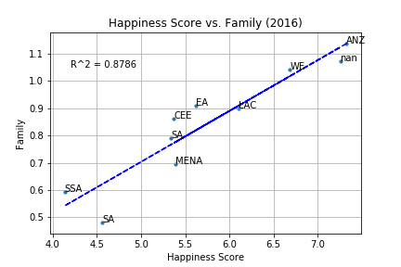
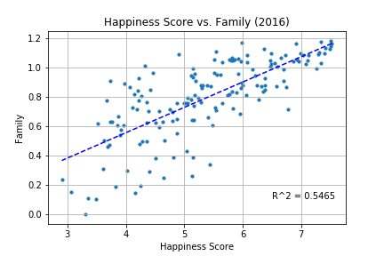
Region
Country

Slide 11
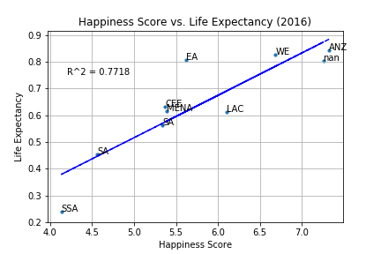
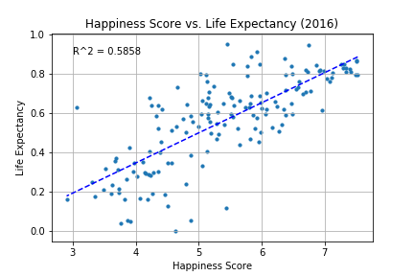
Region
Country

Slide 12
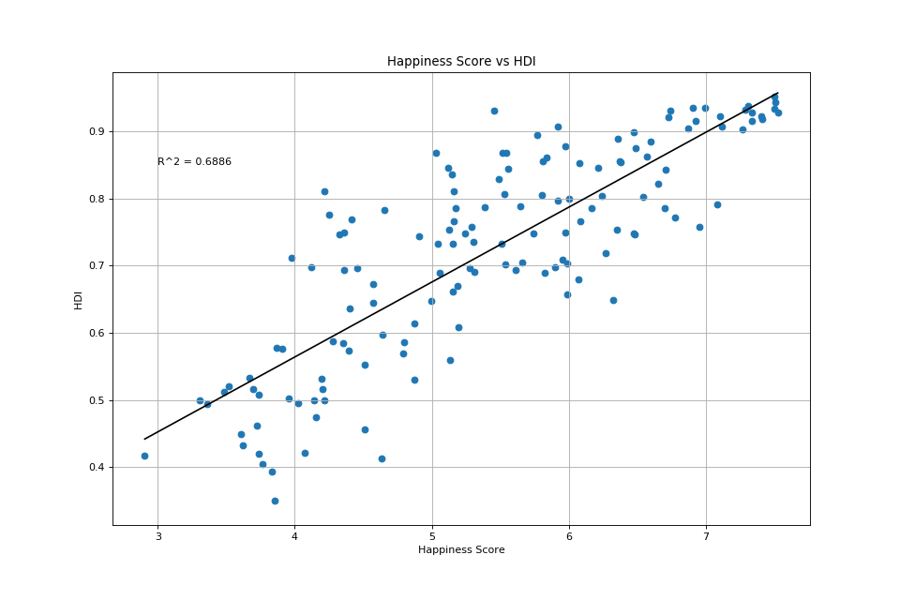

Slide 13
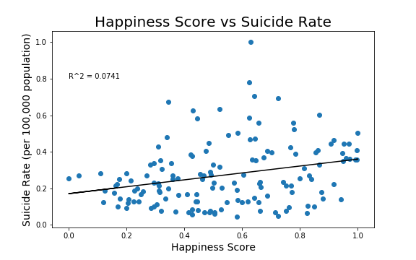

Slide 14
Discussion
Discuss your findings. Did you find what you expected to find? If not, why not? What inferences or general conclusions can you draw from your analysis?

Slide 15

Lessons Learned
Issues
Different types of missing data
Dropping and add columns
Country names
imported a new library, called PYCOUNTRY
What would you research next, if you had two more weeks?
We would like to research why there is a weak positive correlation between suicide rate and happiness score, since it didn’t go the way we thought it would
This Photo by Unknown Author is licensed under CC BY-SA-NC

Slide 16


