Slide 1
Portfolio Design Brief

Slide 2
Basic Scope
Landing Page
“About Me” Section
“Showcase” Section
“Contact Me” Section
Blog Main Page
  Blog Posts

Slide 3
Basic Scope - Sitemap
LANDING PAGE
ABOUT ME
SHOWCASE
BLOG POST 1
BLOG POST 2
CONTACT ME
BLOG POST ...
BLOG
BLOG POST N-1
BLOG POST N

Slide 4
Design Considerations
Colours – Dark theme
  Personal Preference
Layout – Grid base with header + footer universal across all pages
  Allow for conversion to single page app

Slide 5
Common Components
Header
  Contains Navigation Menu
Footer
  Social Media Links and Copyright information

Slide 6
Common Components
Cards
  Used to contain linked information and visually separate
  Scaling of background colour and shadows to show depth in stacked containers

Slide 7
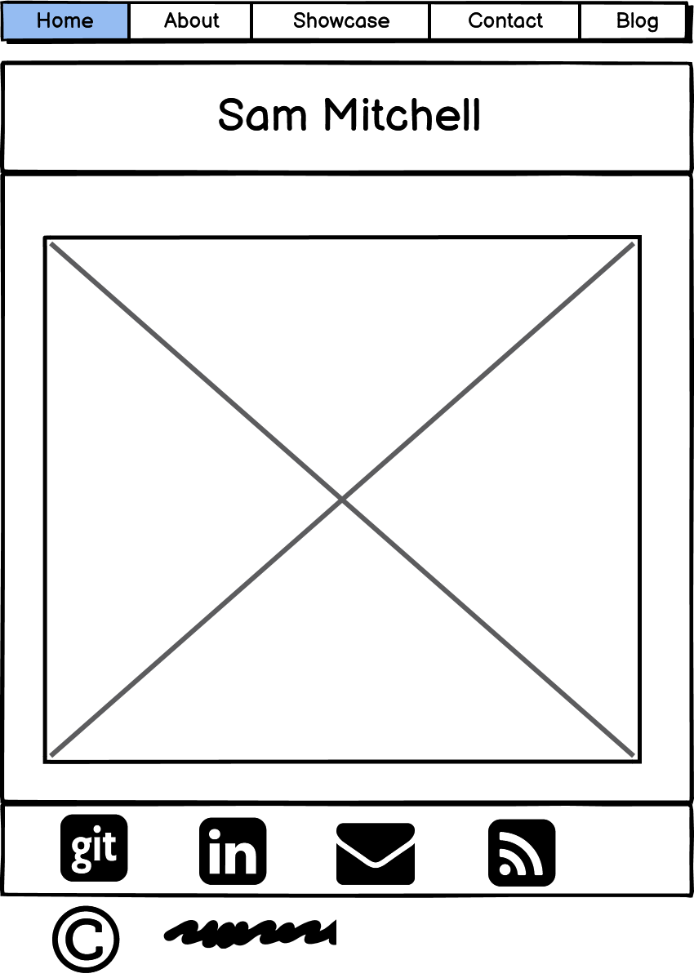
Site Walkthrough – Landing Page

Slide 8
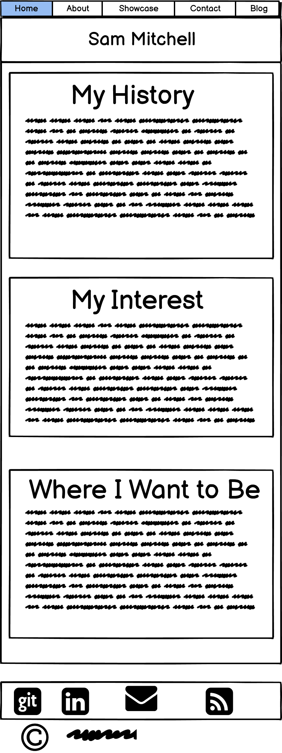
Site Walkthrough – About Me

Slide 9
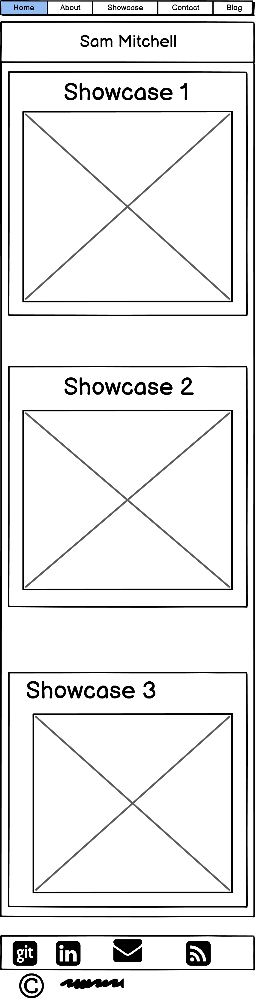
Site Walkthrough – Showcase
Vertical layout on smaller displays
Flip Cards with graphic on front and text on rear

Slide 10
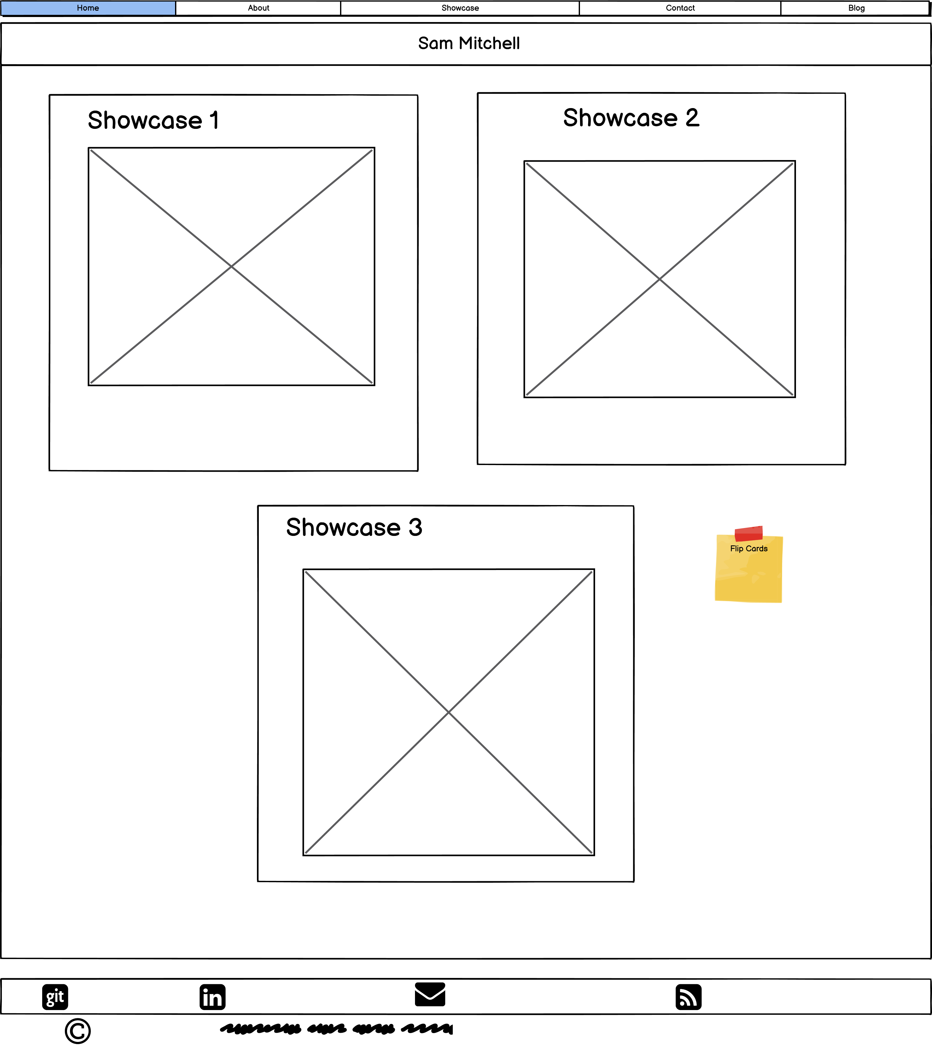
Site Walkthrough – Showcase
Horizontal Flex /w wrapping on larger displays
Flip Cards with graphic on front and text on rear

Slide 11
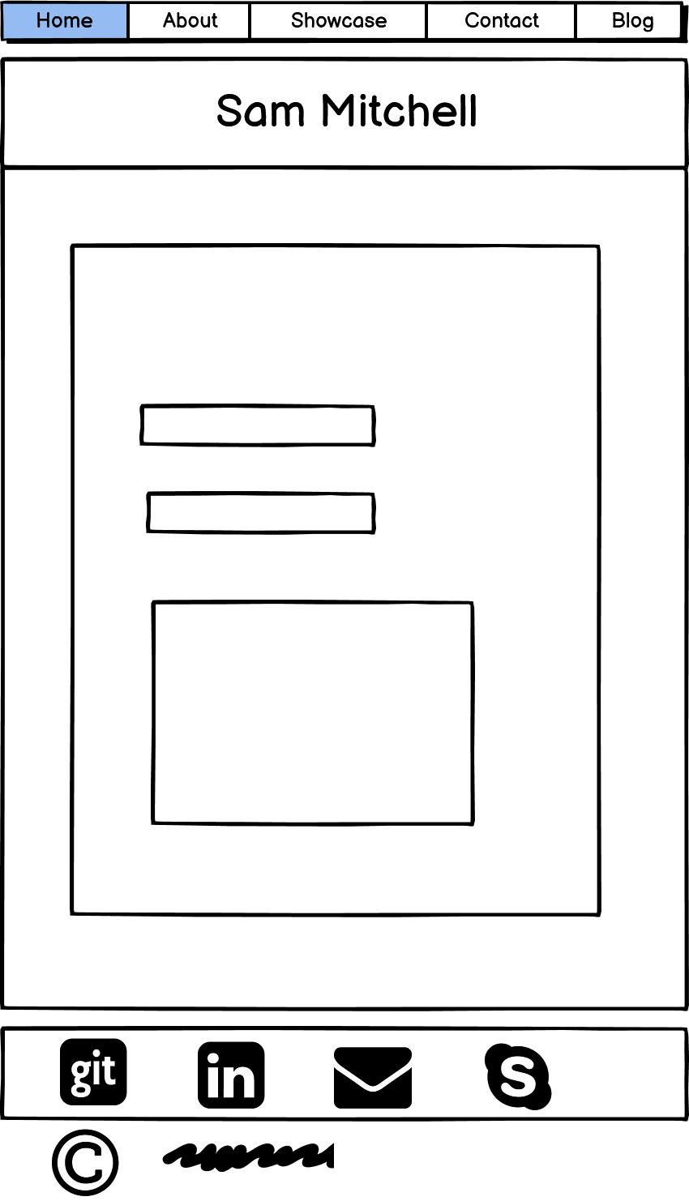
Site Walkthrough – Contact
Web form to allow messages to be sent without
exposing my email address

Slide 12
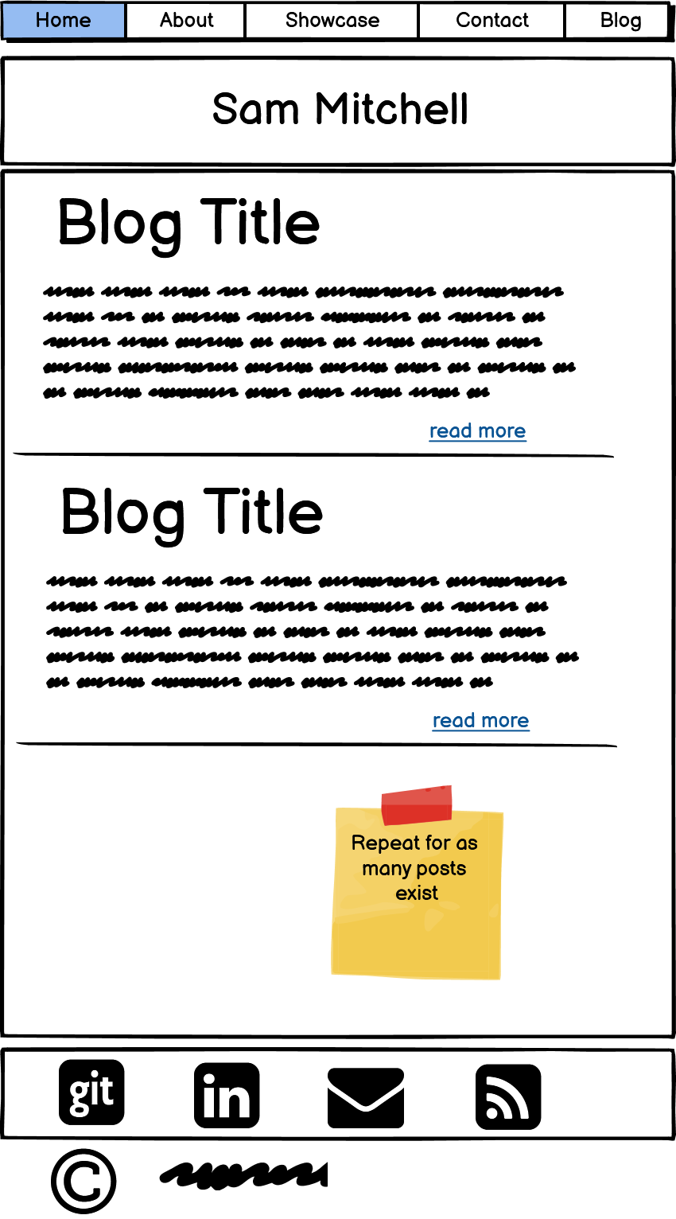
Site Walkthrough – Blog

Slide 13
Major Deviations
Addition of a nav sidebar on the blog site

Slide 14
Major Deviations
Addition of a nav sidebar on the blog site

Slide 15
Outstanding Issues
Layout
  Increased responsiveness
  CSS to be made more modular and reusable
Design
  Rebuild showcase cards. No flip, instead expand to show additional content
  Introduce use of subtle gradients on some elements

Slide 16
Outstanding Issues
Content
  Image optimisation

Slide 17
Any Questions?

