Slide 1
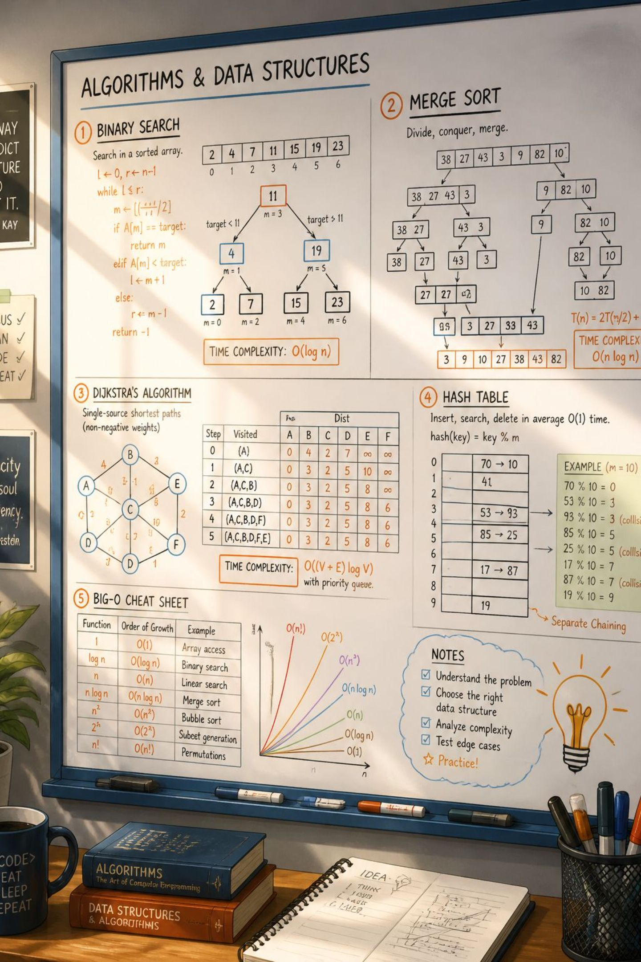
Understanding Concept Learning: Fundamentals and Applications
This deck explains concept learning — the process by which a system acquires a formal definition of a concept from examples — and shows how hypotheses are represented, evaluated, and refined. We'll cover the general-to-specific ordering of hypotheses, the role of training examples, and how concept learning supports classification and knowledge extraction.

Slide 2

What is Concept Learning? Defining the Task
Concept learning is the task of inferring a Boolean function (a concept) that maps instances (with attributes) to labels (positive/negative). Given a set of labeled training examples, the learner searches a hypothesis space to find hypotheses that correctly classify seen instances and generalize to unseen ones. This formalizes intuitive tasks like "which emails are spam?" or "which patients have condition X?".

Slide 3

The Importance of Concept Learning in Machine Learning
Concept learning underpins supervised learning and many practical systems: - Provides a structured way to generalize from examples to rules. - Enables interpretable models when hypotheses are symbolic. - Serves as a foundation for feature selection, bias-variance tradeoff reasoning, and active learning strategies. Good concept learners improve prediction accuracy, reduce error, and make model behavior easier to inspect and debug.

Slide 4
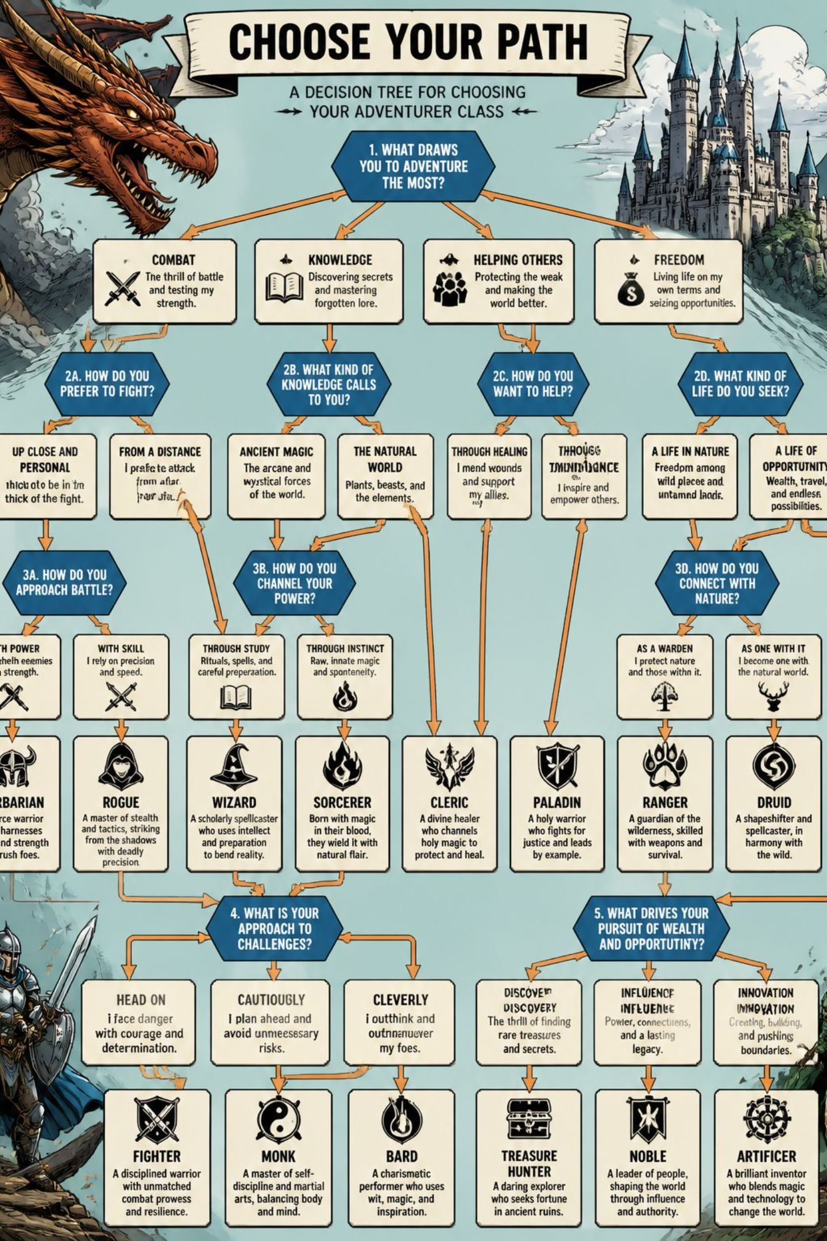
Representing Hypotheses: Attributes, Values, and Structures
A hypothesis is a candidate concept expressed using the instance attributes. Common representations: - Conjunctive (attribute = value) rules (e.g., Outlook=Sunny AND Humidity=Low). - Decision trees (hierarchical attribute tests). - Logical formulas (first-order or propositional logic). - Feature vectors with weight vectors (linear classifiers). Representational choices determine expressiveness, interpretability, and the size of the hypothesis space the learner must search.

Slide 5

Evaluating Hypotheses: Consistency and Coverage
Two core evaluation criteria: - Consistency: A hypothesis is consistent if it correctly classifies all training examples (no contradictions). Complete consistency may be impossible with noisy data. - Coverage (or generality): Measures how many instances the hypothesis classifies as positive. Overly general hypotheses may misclassify many negatives; overly specific ones may overfit. Practical evaluation uses cross-validation, held-out data, or statistical measures (precision, recall, accuracy) to balance fit and generalization.

Slide 6
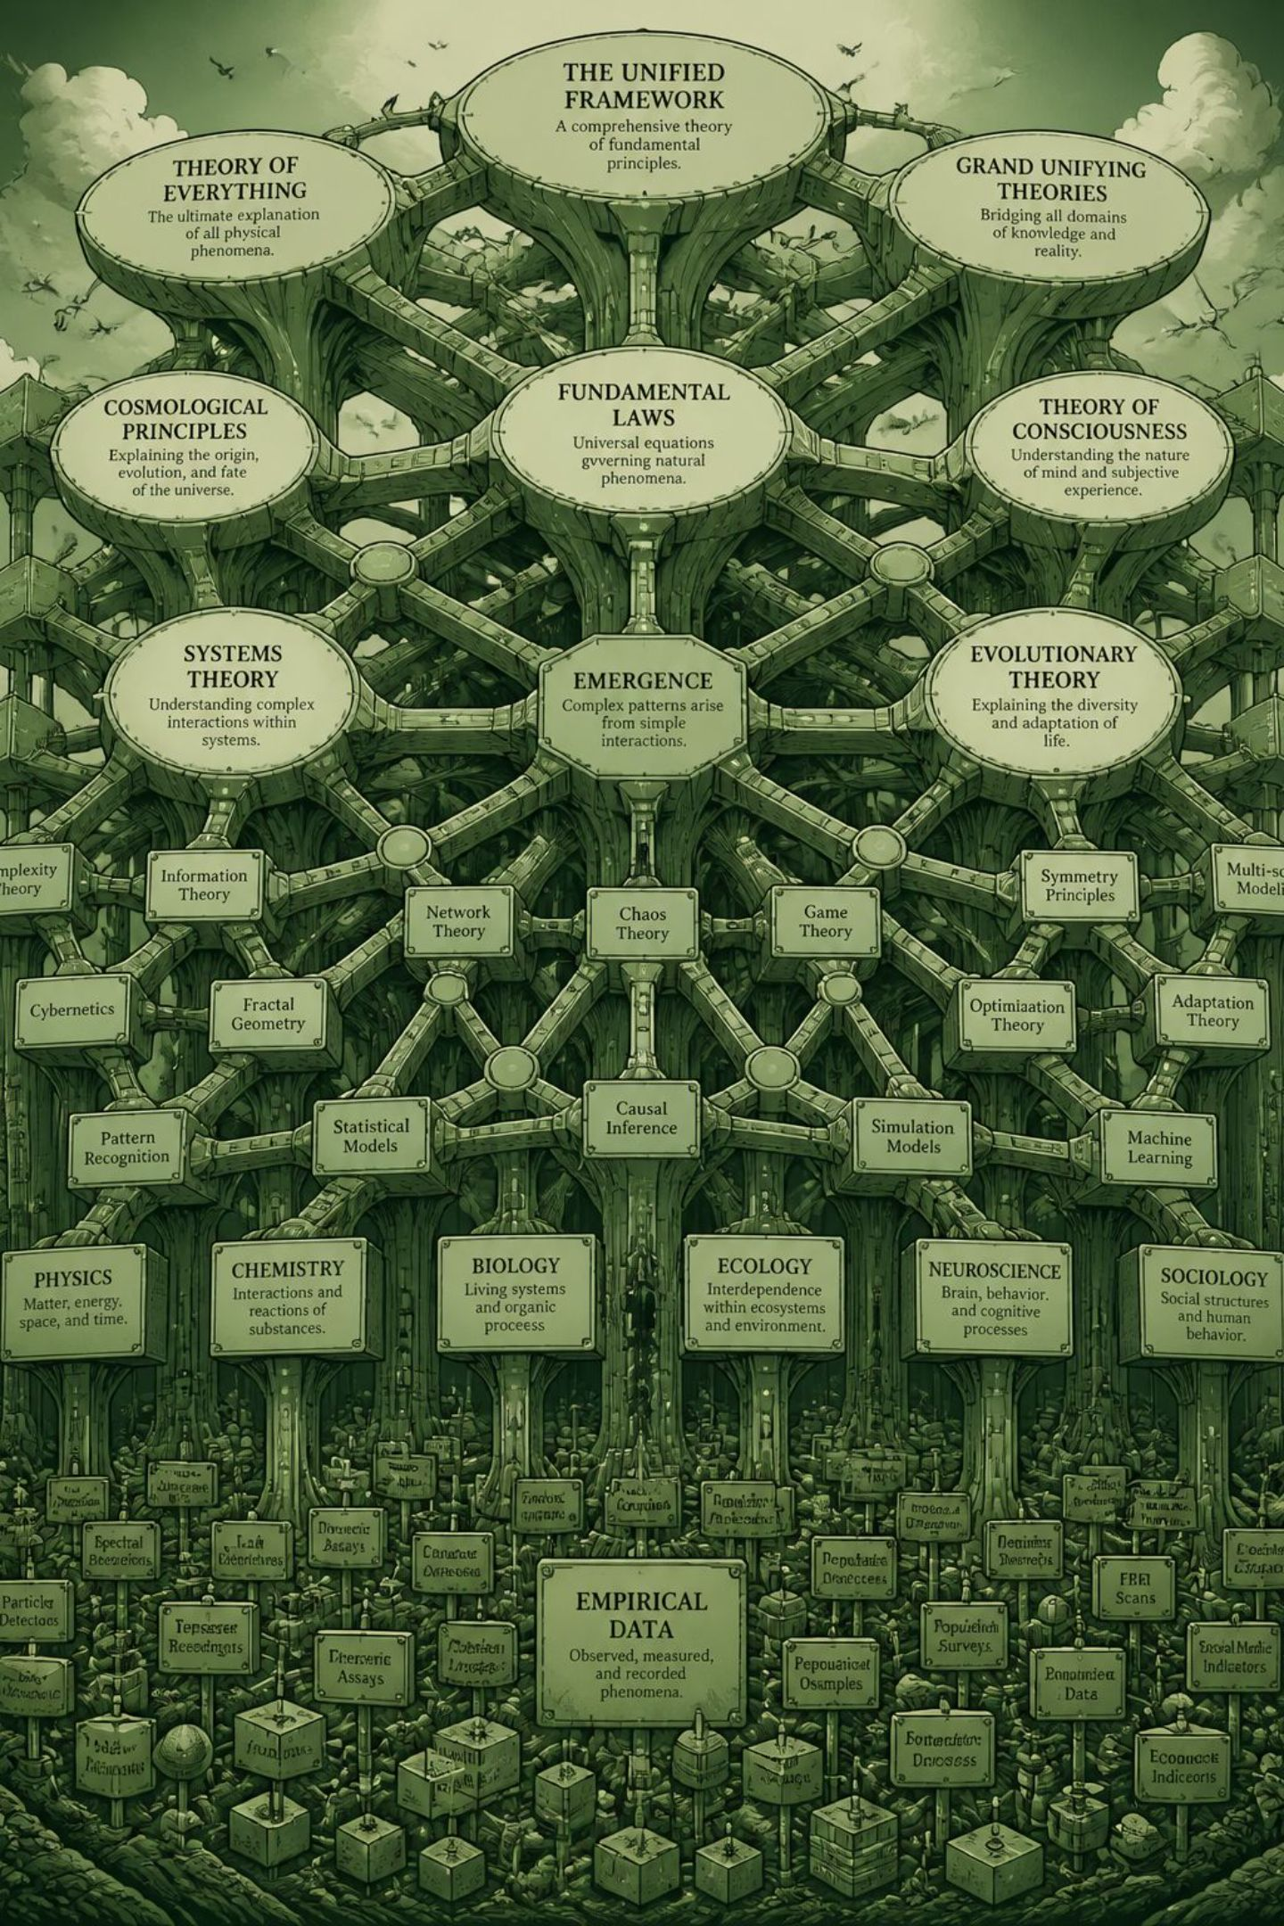
General-to-Specific Ordering: Navigating the Hypothesis Space
The hypothesis space can be partially ordered from most specific to most general. This ordering supports systematic search strategies: - Start with the most specific hypothesis that fits a positive example, and generalize minimally to include additional positives. - Or start with the most general hypothesis and specialize to exclude negatives. Algorithms (e.g., Find-S, version spaces) maintain boundary sets: the most specific (S) and most general (G) hypotheses consistent with data, narrowing the space as examples arrive.

Slide 7

The Role of Training Examples: Refining and Constraining Hypotheses
Training examples drive learning by eliminating inconsistent hypotheses: - Positive examples force generalization of S (expand to cover them). - Negative examples force specialization of G (restrict to exclude them). Each labeled example shrinks the feasible region in hypothesis space; repeated exposure converges S and G toward target concepts (or to a small set of plausible hypotheses if noise exists). Example selection quality, quantity, and diversity directly impact convergence speed and final accuracy.

Slide 8
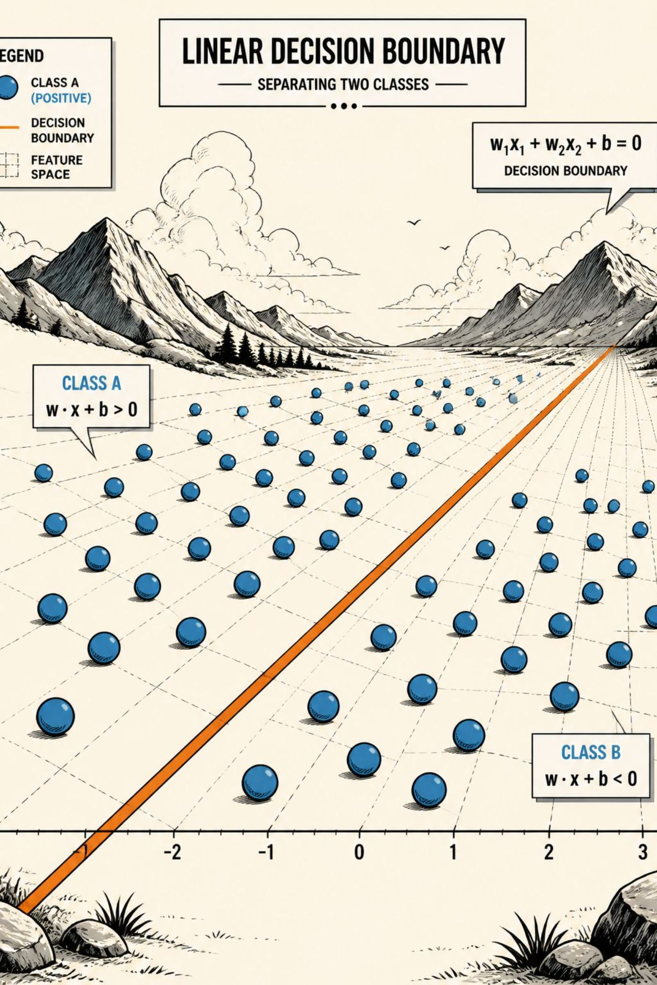
Concept Learning for Classification Problems
In classification, concept learning produces a decision rule that maps input attributes to discrete class labels. Benefits include: - Clear mapping from attributes to predicted class (interpretable rules). - Ability to incorporate inductive biases (e.g., prefer shorter rules, smooth decision boundaries) that guide generalization. - Integration with preprocessing: feature engineering, discretization, and attribute selection improve hypothesis clarity and performance. Concept learners can be adapted for multiclass tasks, probabilistic outputs, and ensemble methods for robustness.

Slide 9

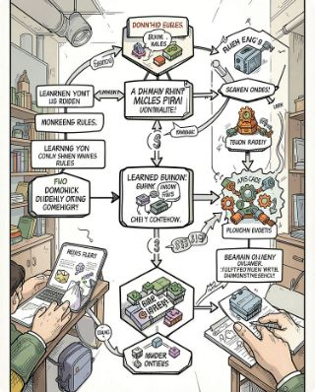

Extracting Knowledge: Beyond Simple Classification
Rule Extraction
Knowledge Integration
Insight Discovery
Derived hypotheses become human-readable rules used for explanations, compliance, and decision support.
Learned concepts can seed ontologies, taxonomies, or knowledge graphs to enrich domain models.
Patterns found during concept learning reveal causal hypotheses, subgroups, and anomalies worth further study.
Concept learning therefore supports not only prediction but also explanation, policy encoding, and domain knowledge growth — useful in healthcare, finance, and scientific discovery.

Slide 10


Key Takeaways: Impact and Future Directions
Concept learning formalizes how systems generalize from examples into hypotheses.
Hypotheses are represented in many forms (rules, trees, linear models), each with trade-offs.
Evaluation balances consistency (fit) and coverage (generality) to avoid overfitting or underfitting.
General-to-specific ordering and training examples drive efficient search and refinement in hypothesis space.
Beyond classification, concept learning enables interpretable rules and knowledge extraction that inform decisions and research.
Next steps: Experiment with different hypothesis representations, monitor S and G boundaries during training, and prioritize diverse, high-quality examples to accelerate learning.

