Slide 1



CAMPUSCYBER COURSE x

Slide 2








02 – Exploitation Web

Slide 3
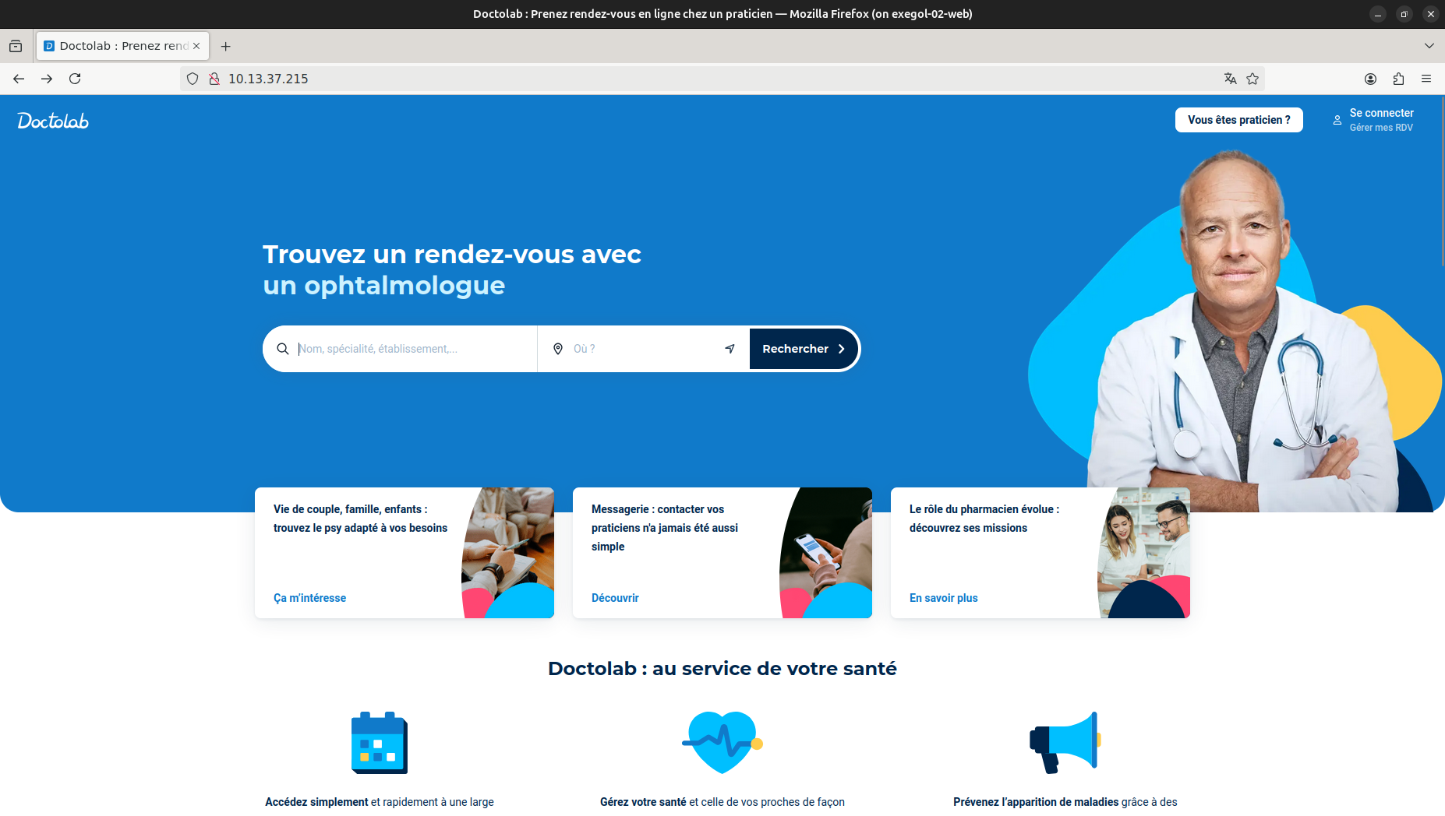
02 – Exploitation Web - Fuzzing

Slide 4
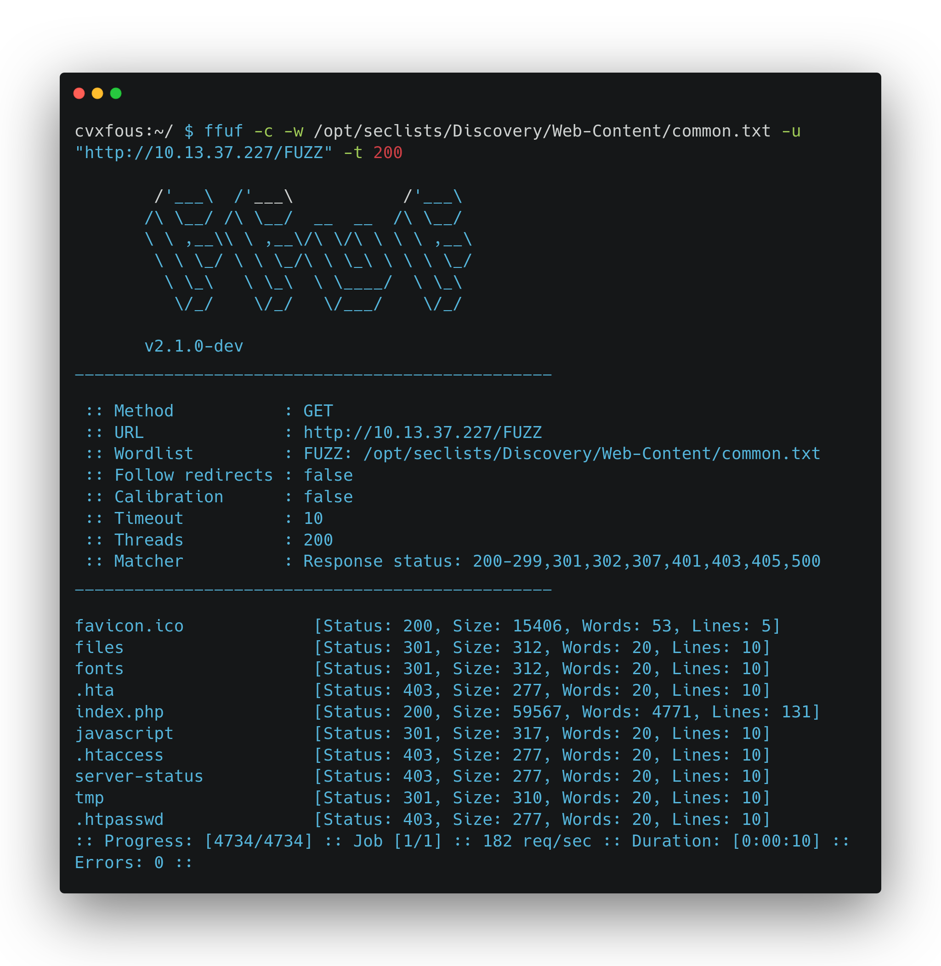

02 – Exploitation Web - Fuzzing

Slide 5
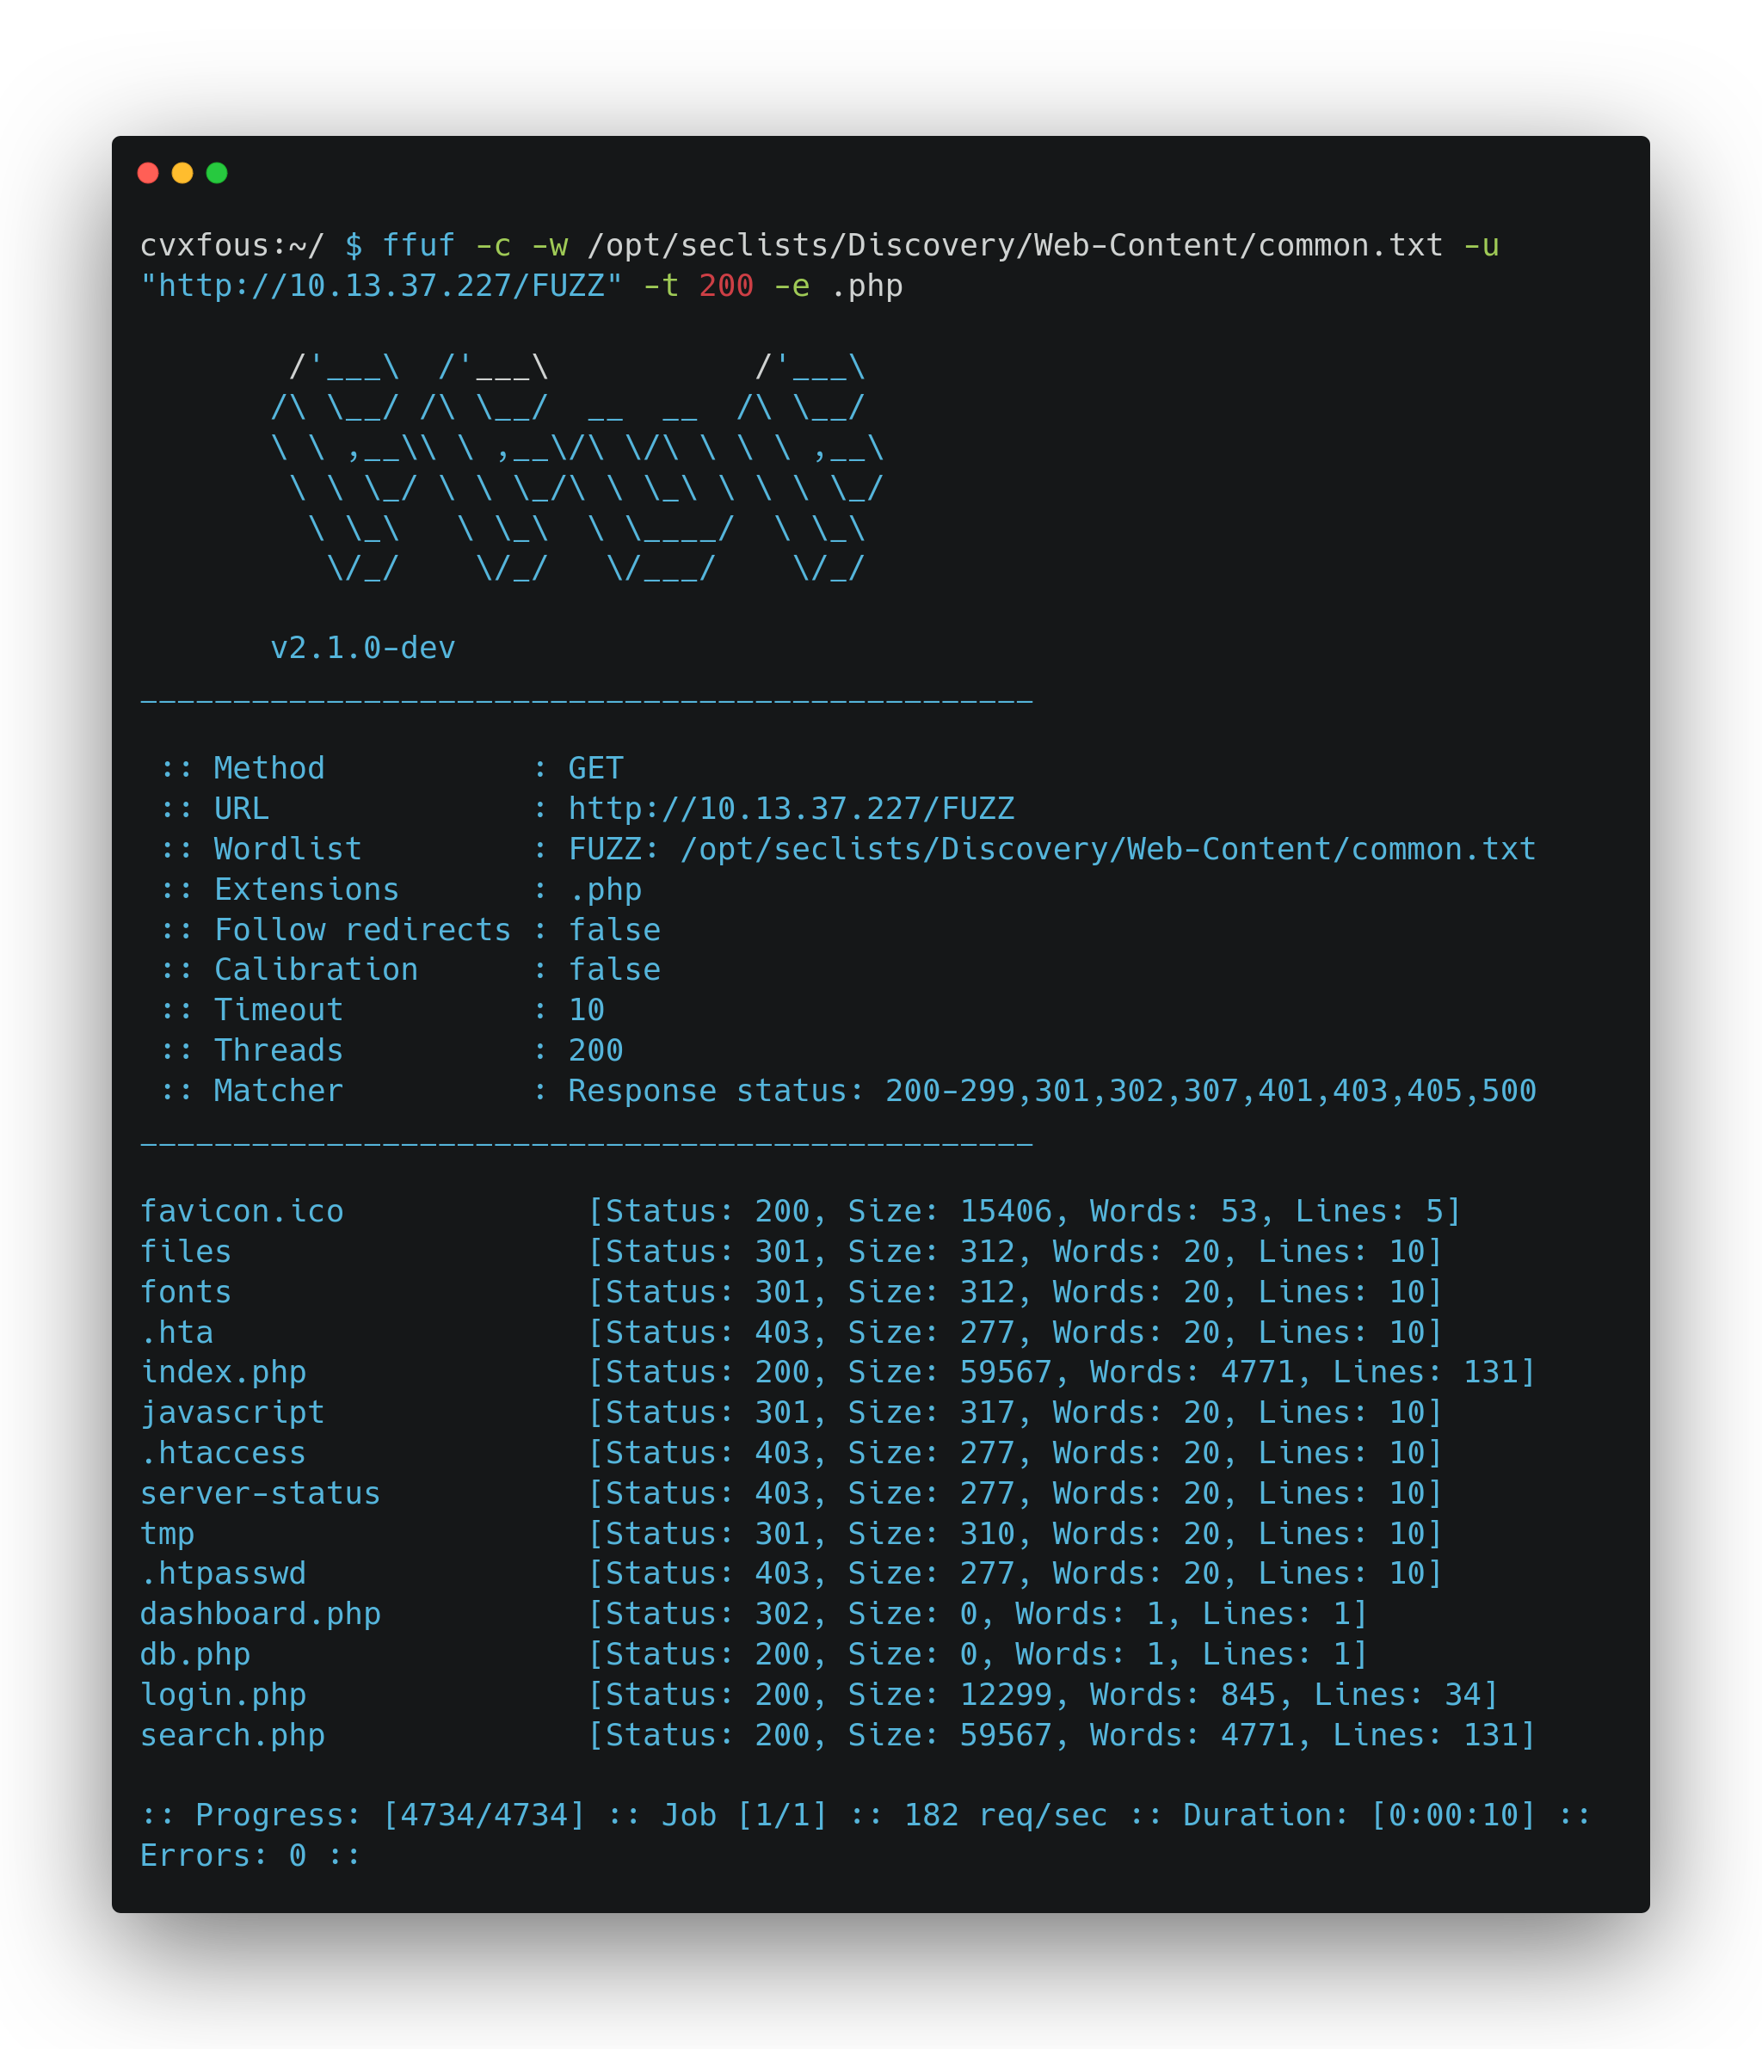
02 – Exploitation Web - Fuzzing ext

Slide 6
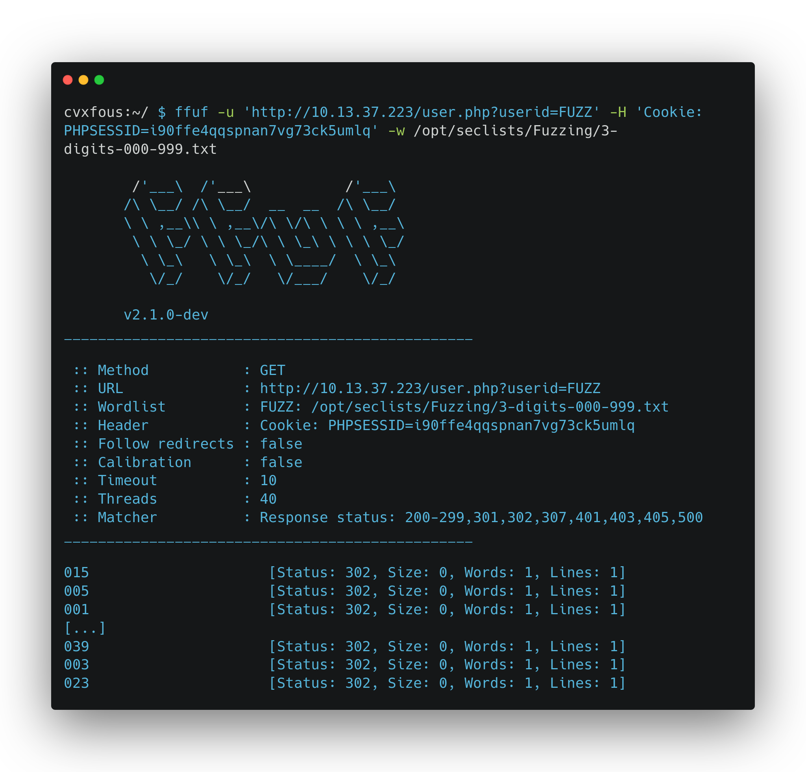
02 – Exploitation Web – Fuzzing key

Slide 7
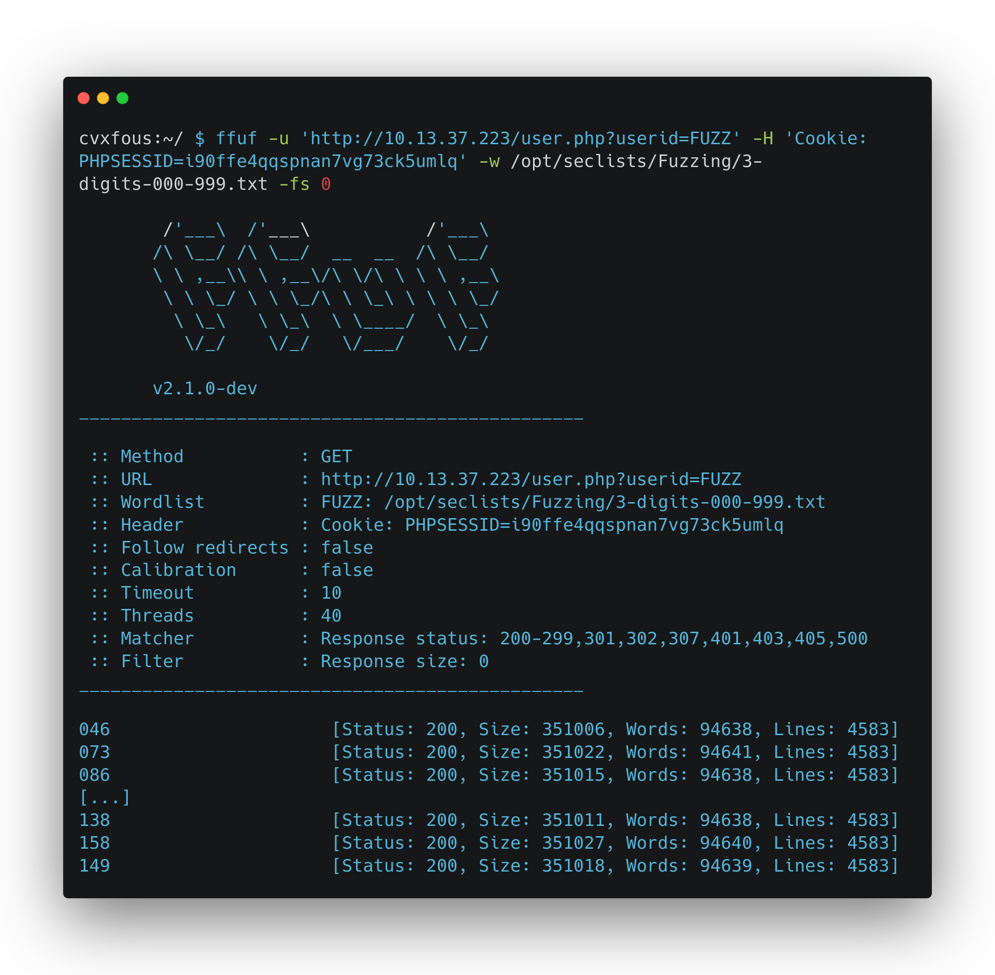
02 – Exploitation Web - Fuzzing filters

Slide 8
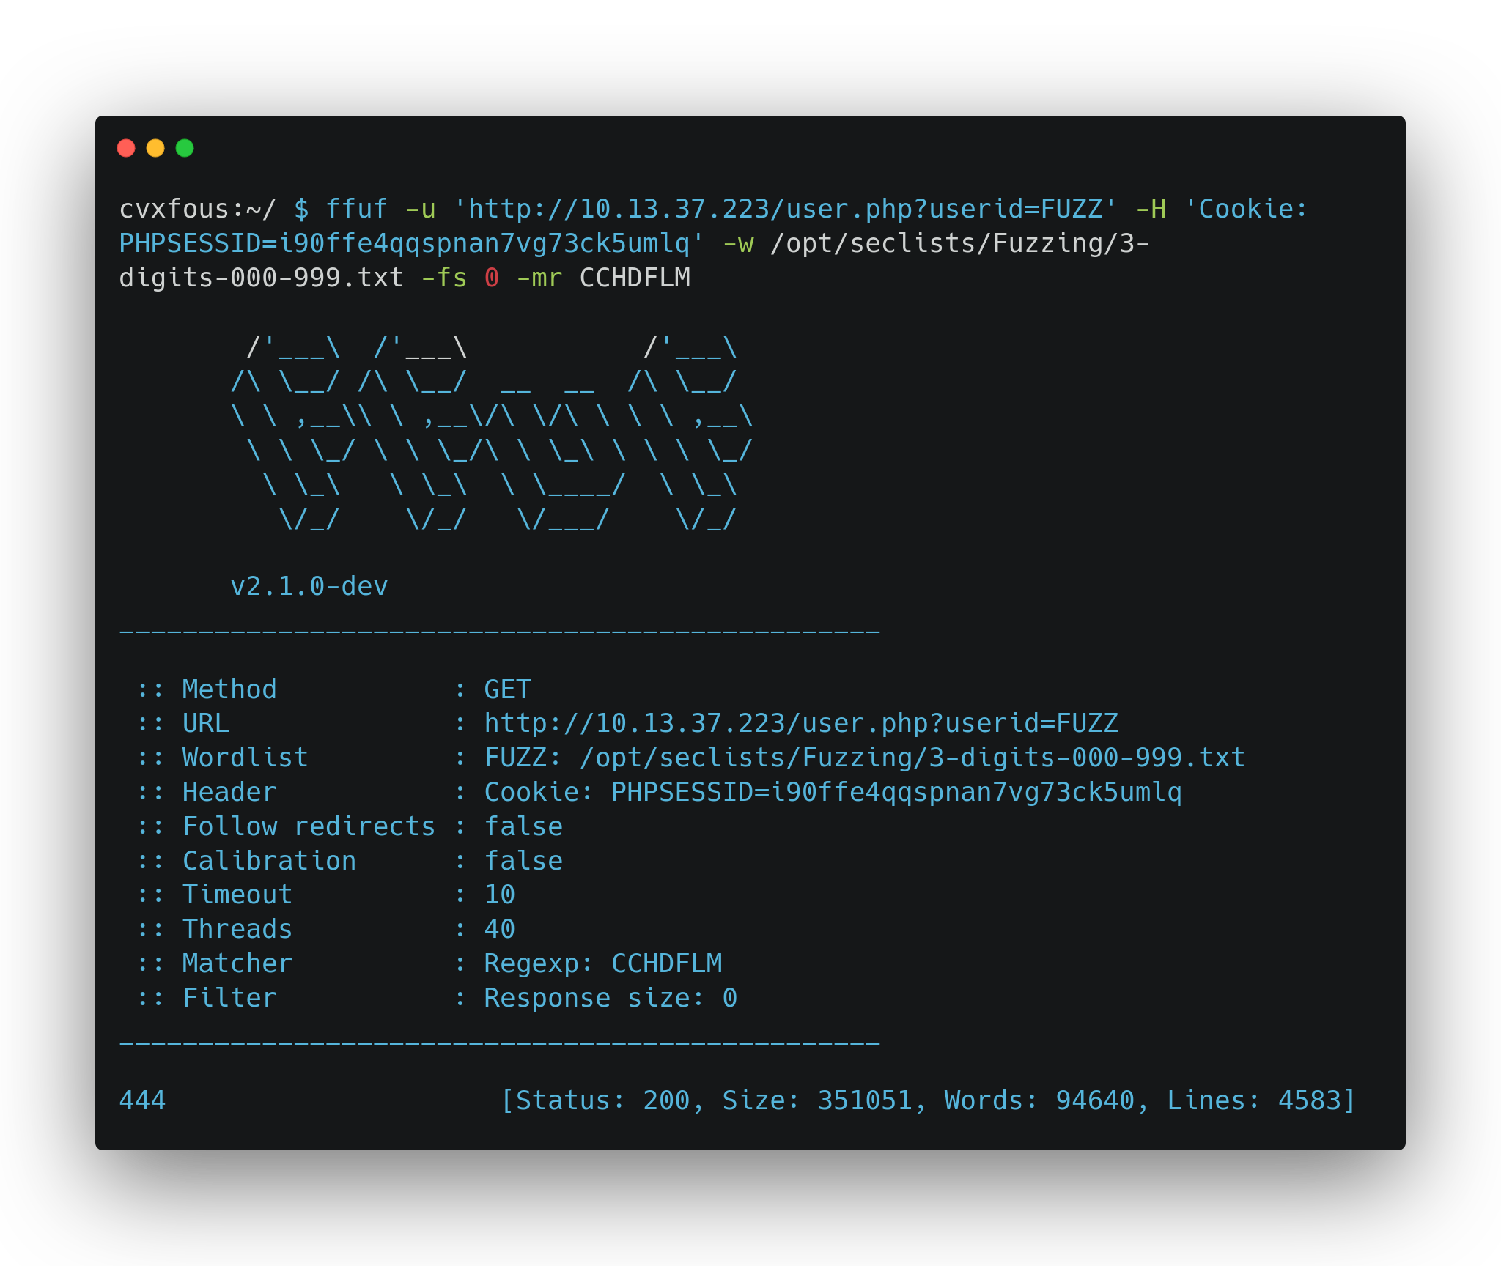
02 – Exploitation Web - Fuzzing match

Slide 9
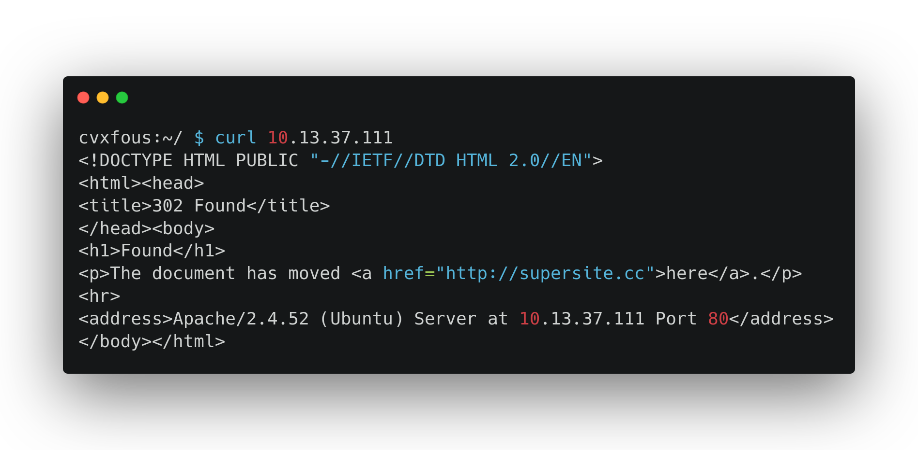
02 – Exploitation Web - Vhosts

Slide 10
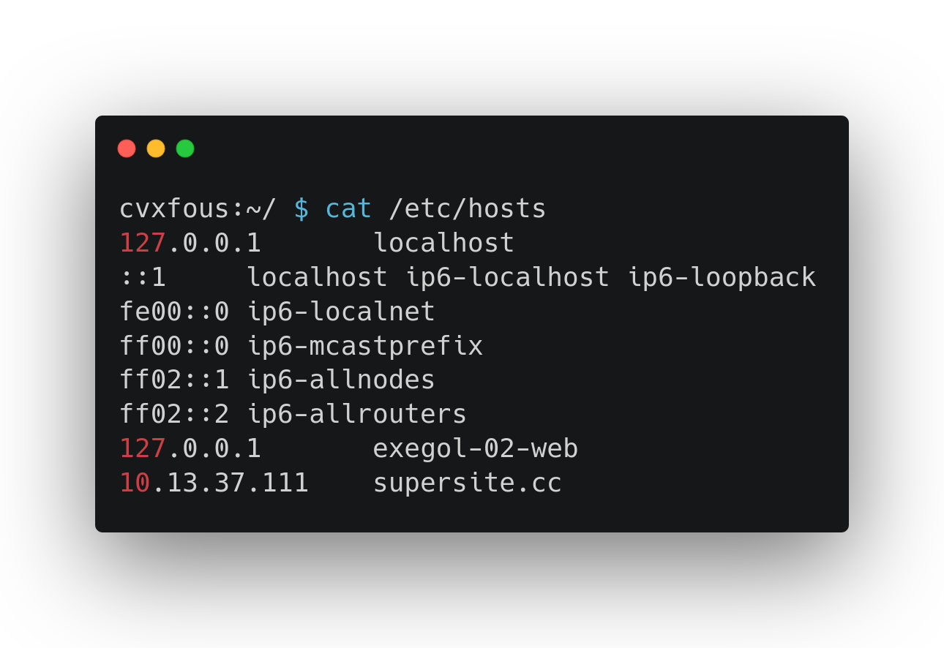
02 – Exploitation Web - Vhosts

Slide 11
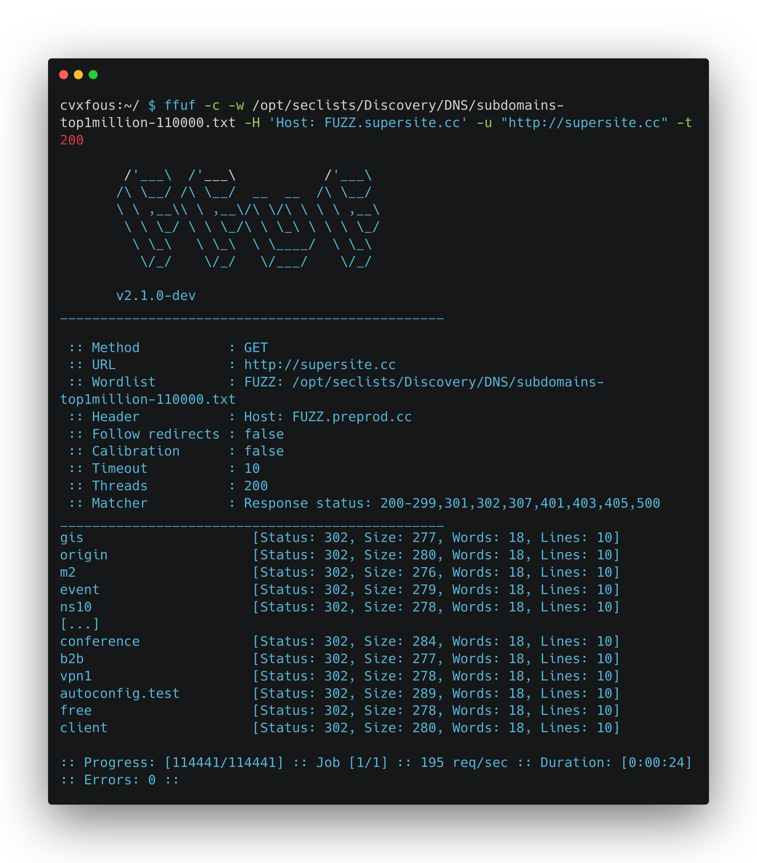
02 – Exploitation Web - Fuzzing Vhosts

Slide 12
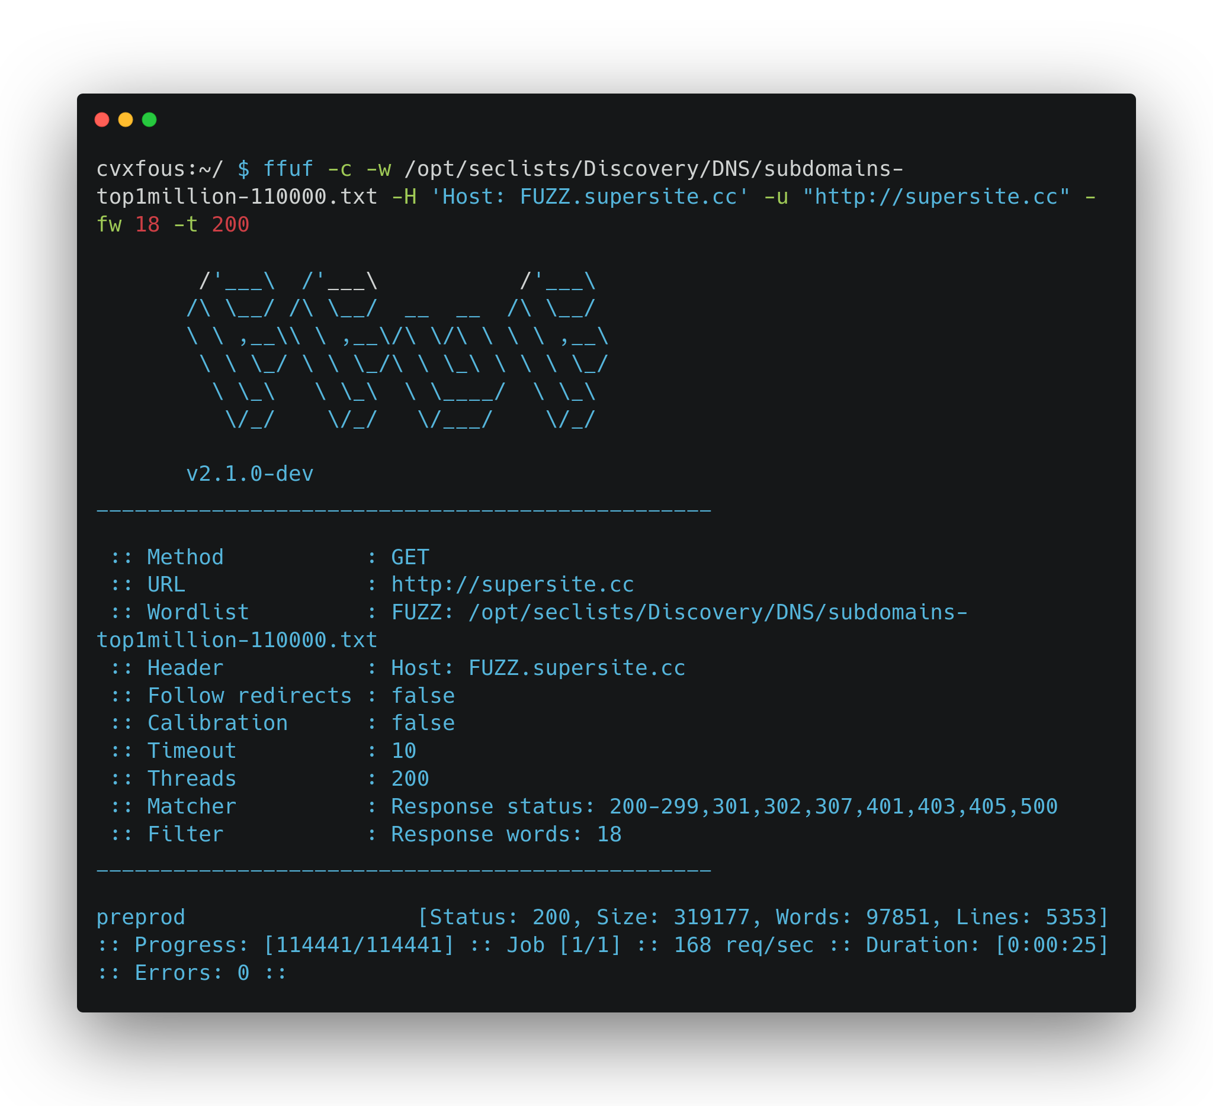
02 – Exploitation Web - Fuzzing Vhosts

Slide 13
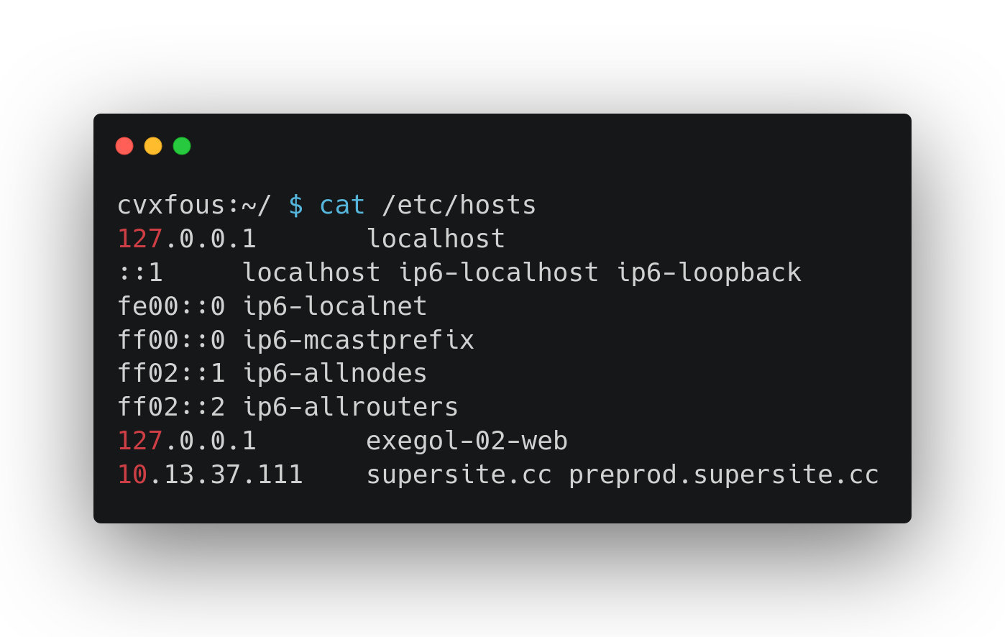
02 – Exploitation Web – Fuzzing Vhosts

Slide 14
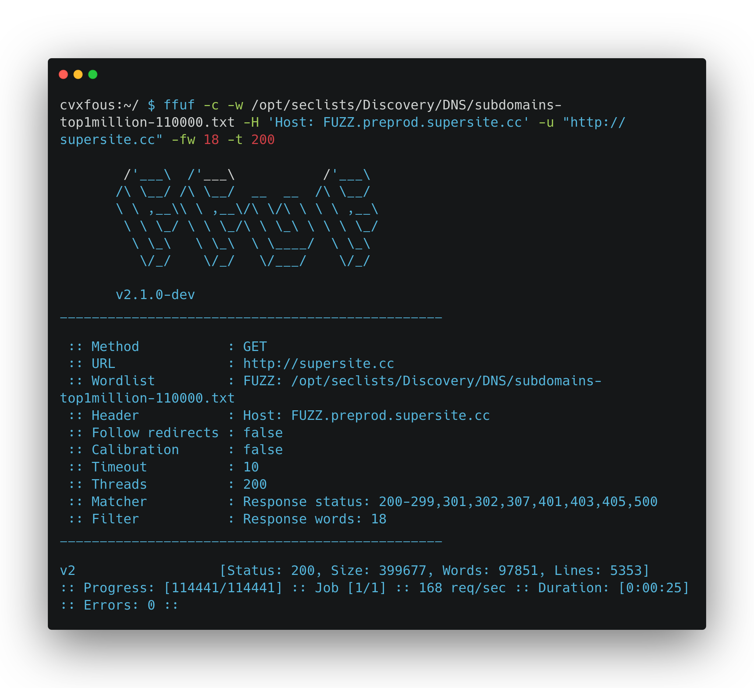
02 – Exploitation Web - Fuzzing Vhosts

Slide 15
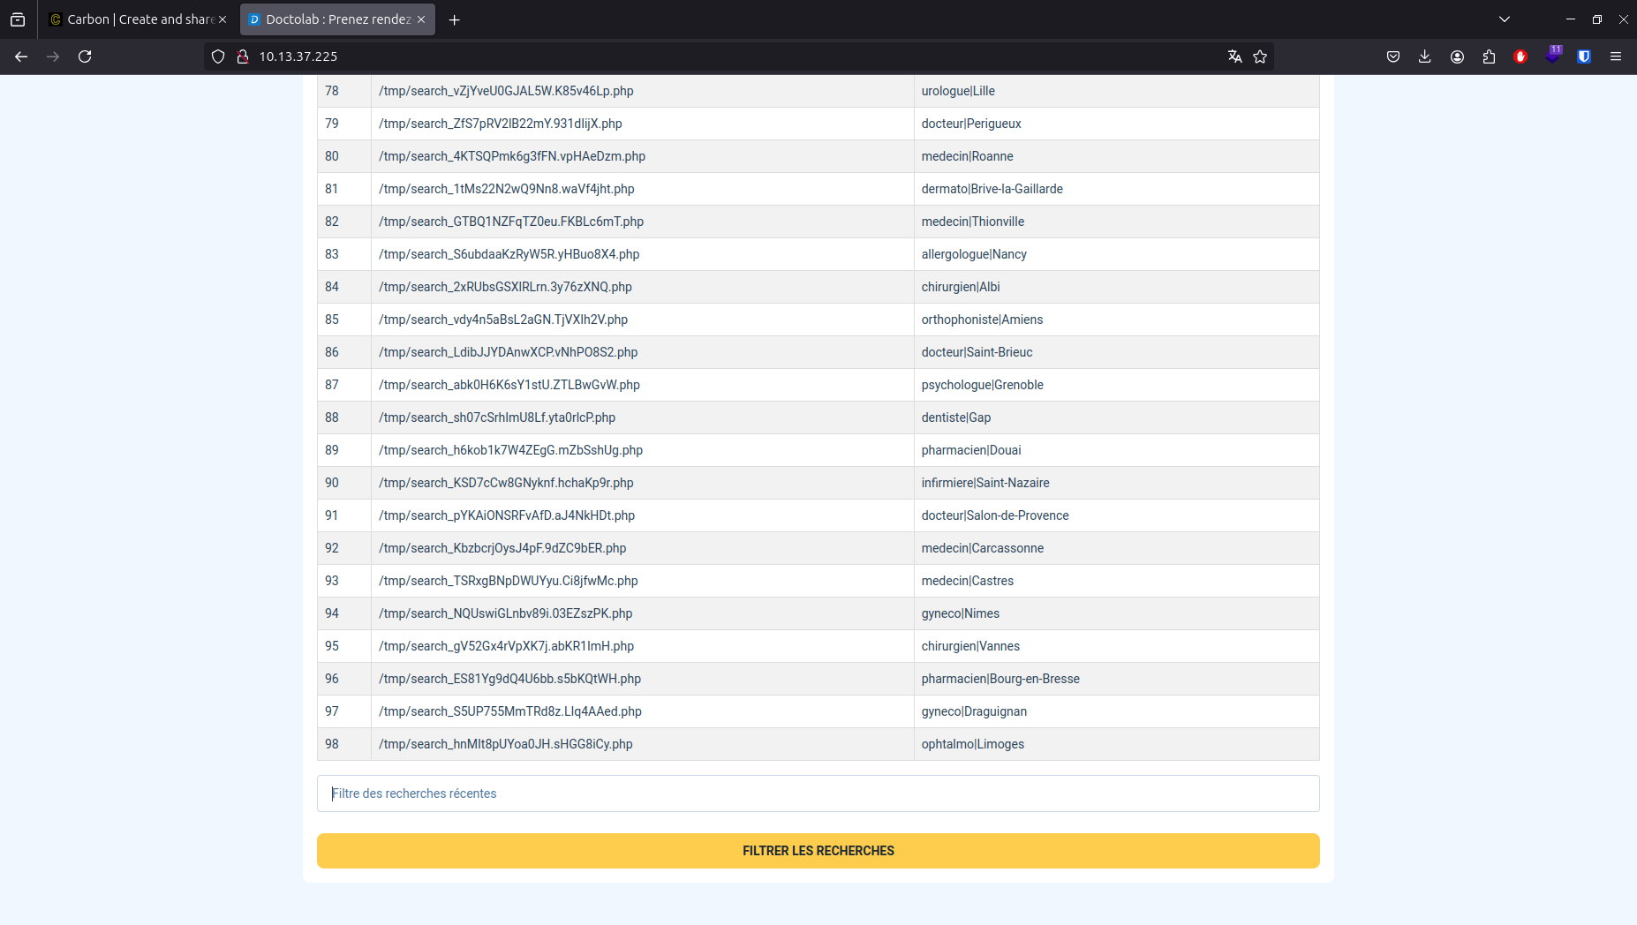
02 – Exploitation Web - SQLi

Slide 16
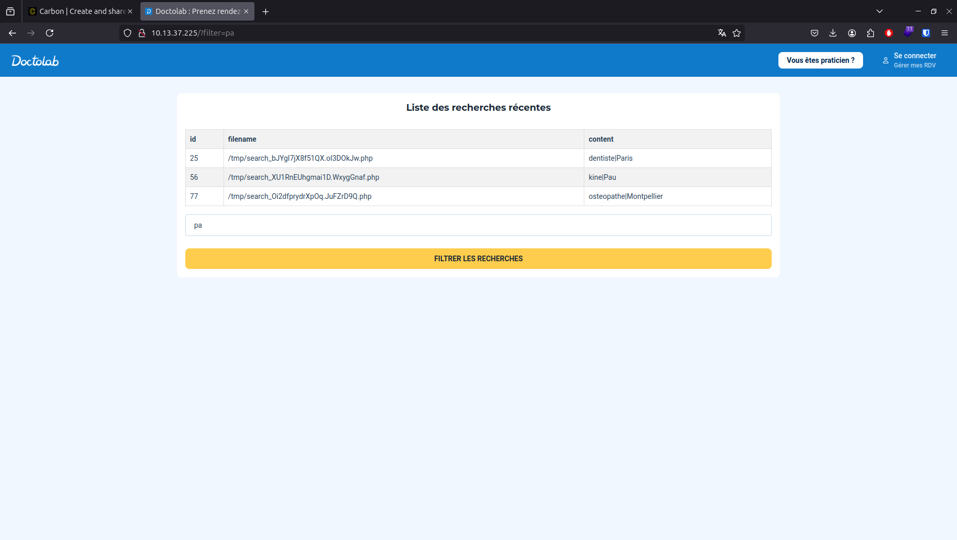
02 – Exploitation Web - SQLi entry

Slide 17
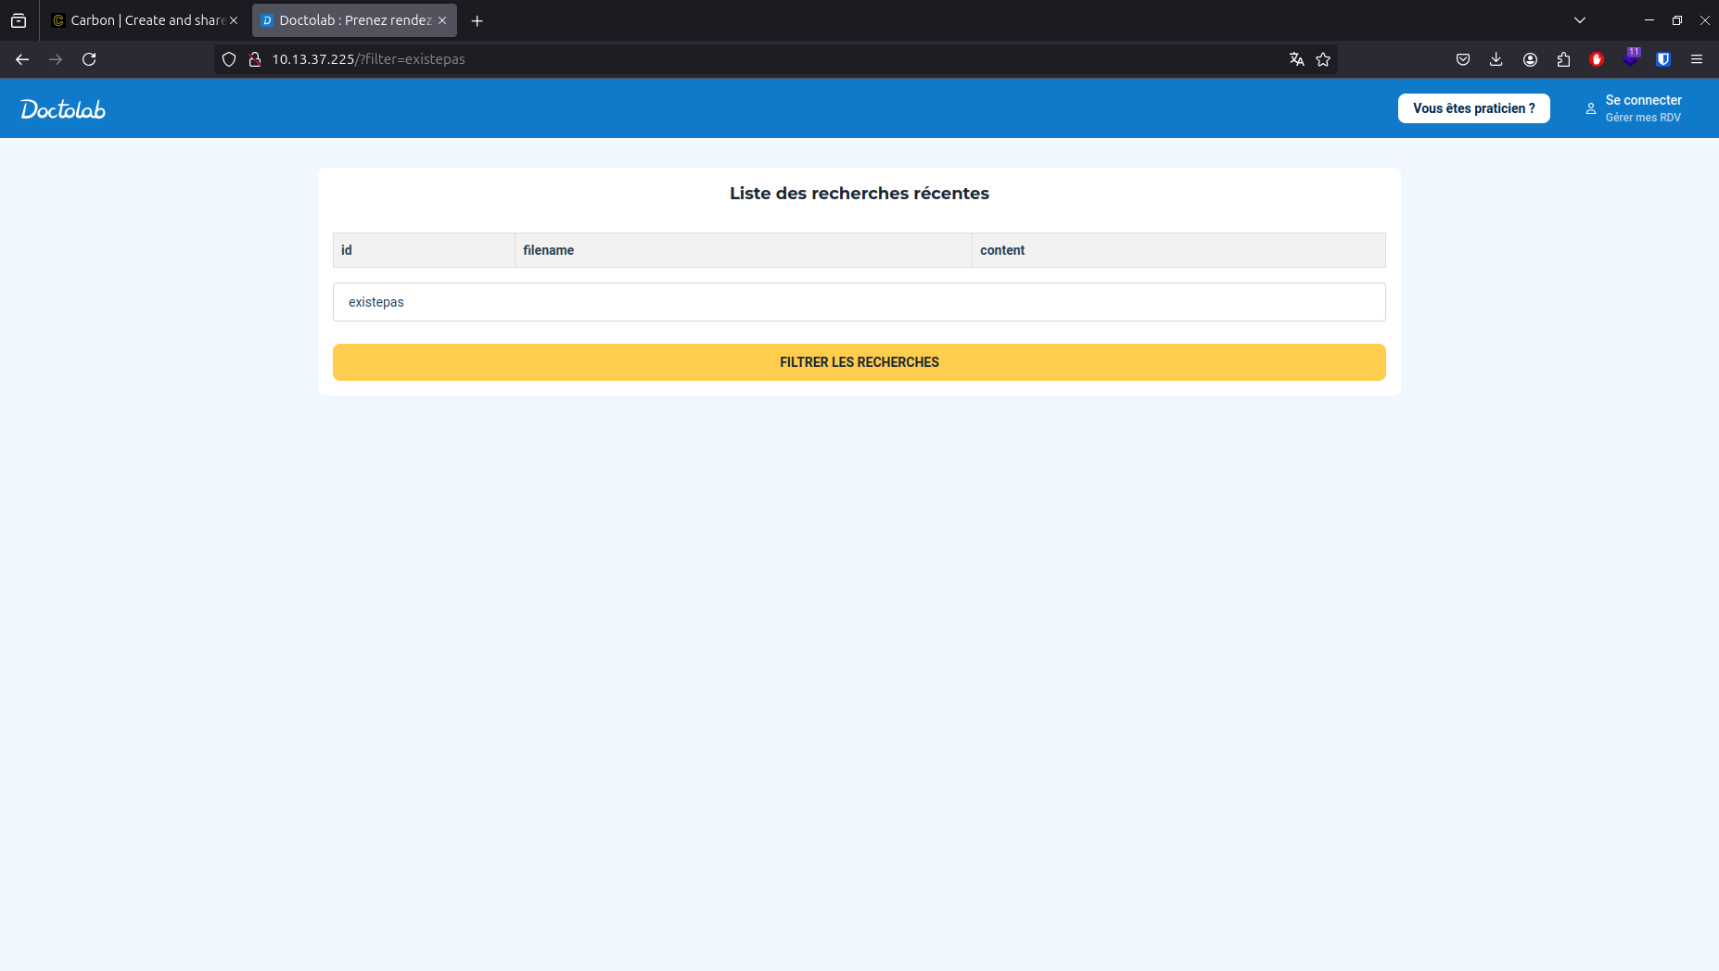
02 – Exploitation Web - SQLi no entry

Slide 18
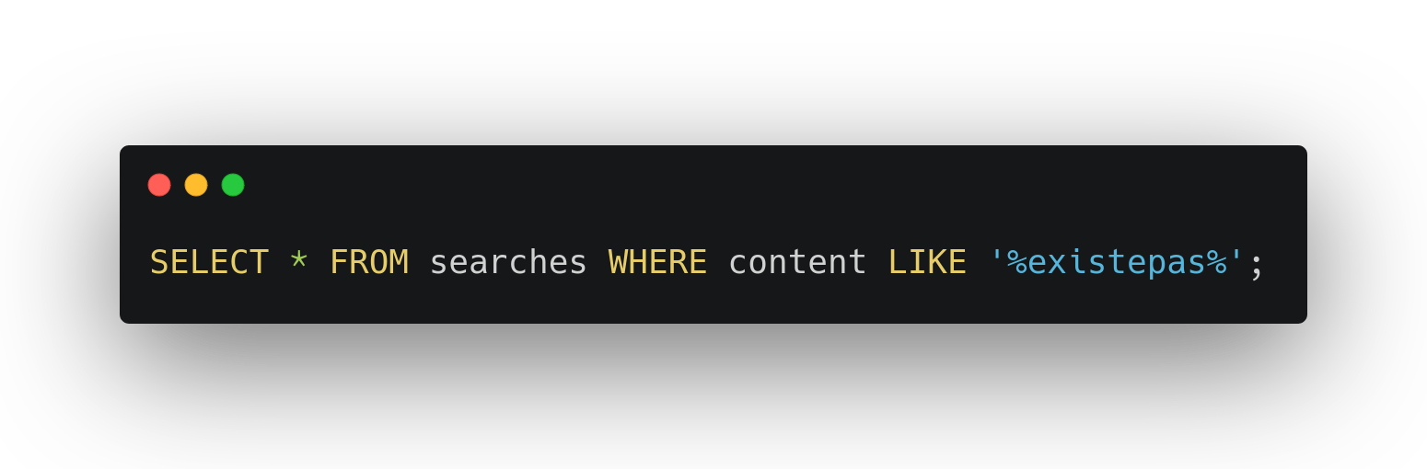
02 – Exploitation Web - SQLi no entry

Slide 19
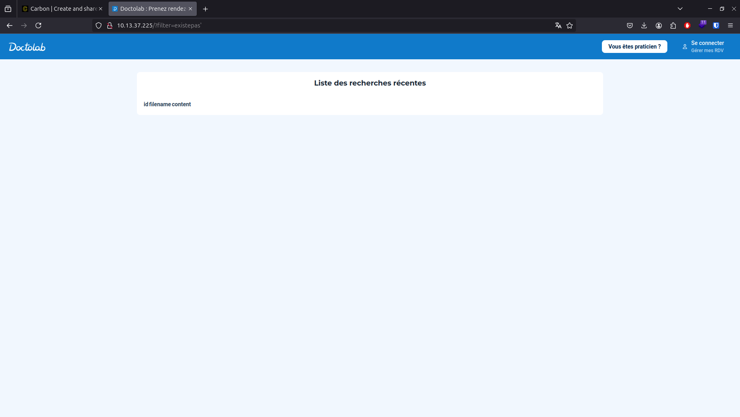
02 – Exploitation Web - SQLi error 500

Slide 20
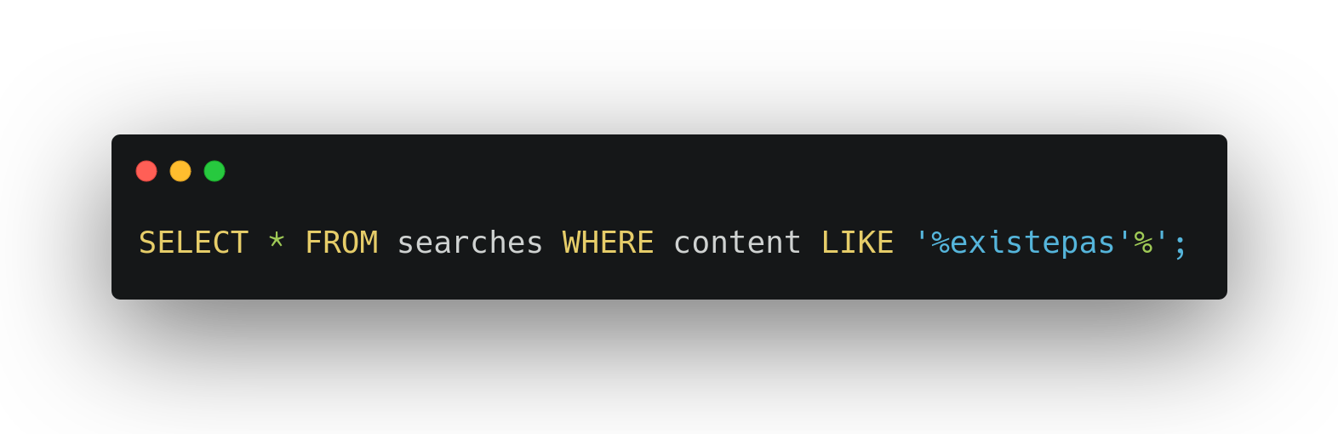
02 – Exploitation Web - SQLi error 500

Slide 21
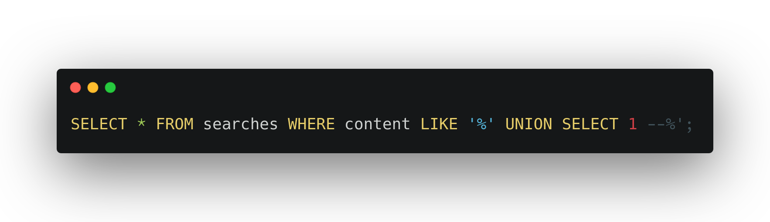
02 – Exploitation Web - SQLi UNION

Slide 22
02 – Exploitation Web - SQLi UNION

Slide 23
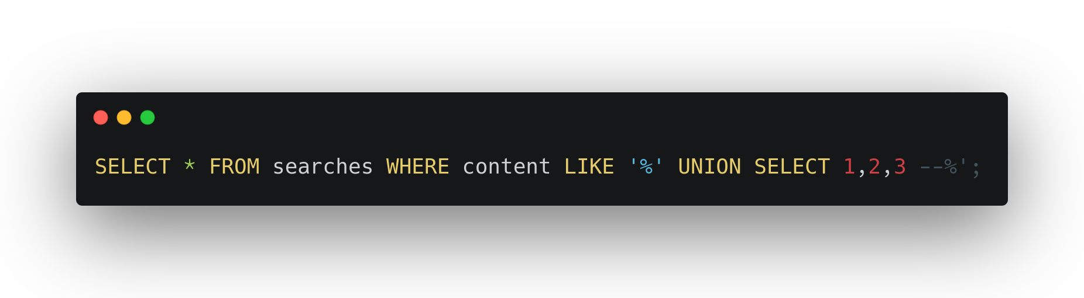
02 – Exploitation Web - SQLi UNION

Slide 24
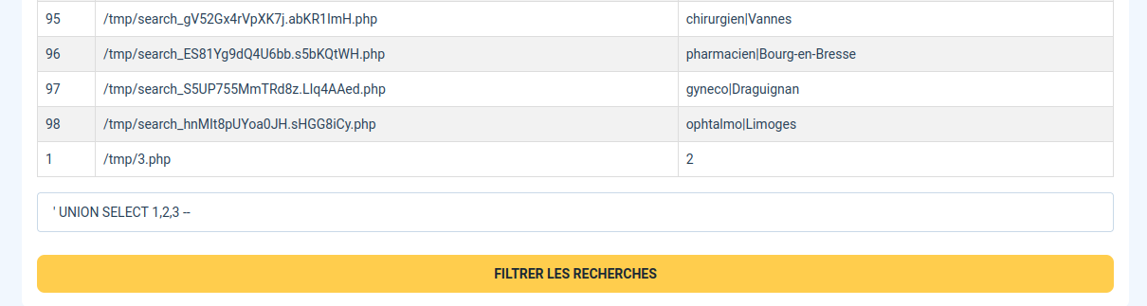
02 – Exploitation Web - SQLi UNION

Slide 25
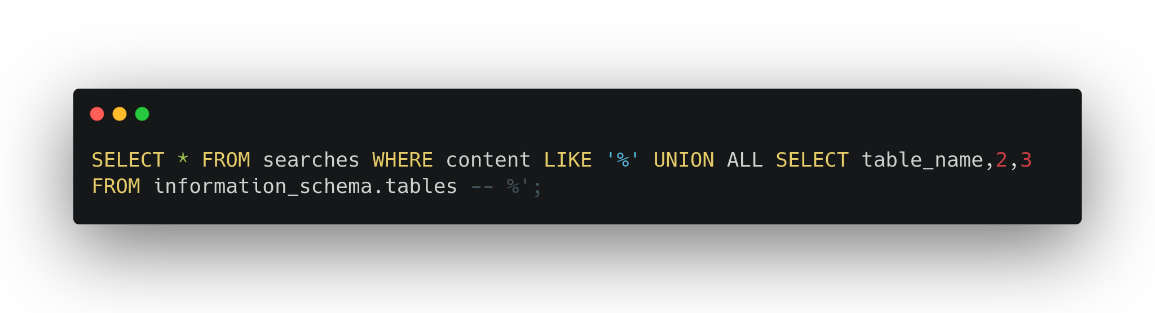
02 – Exploitation Web - SQLi tables

Slide 26
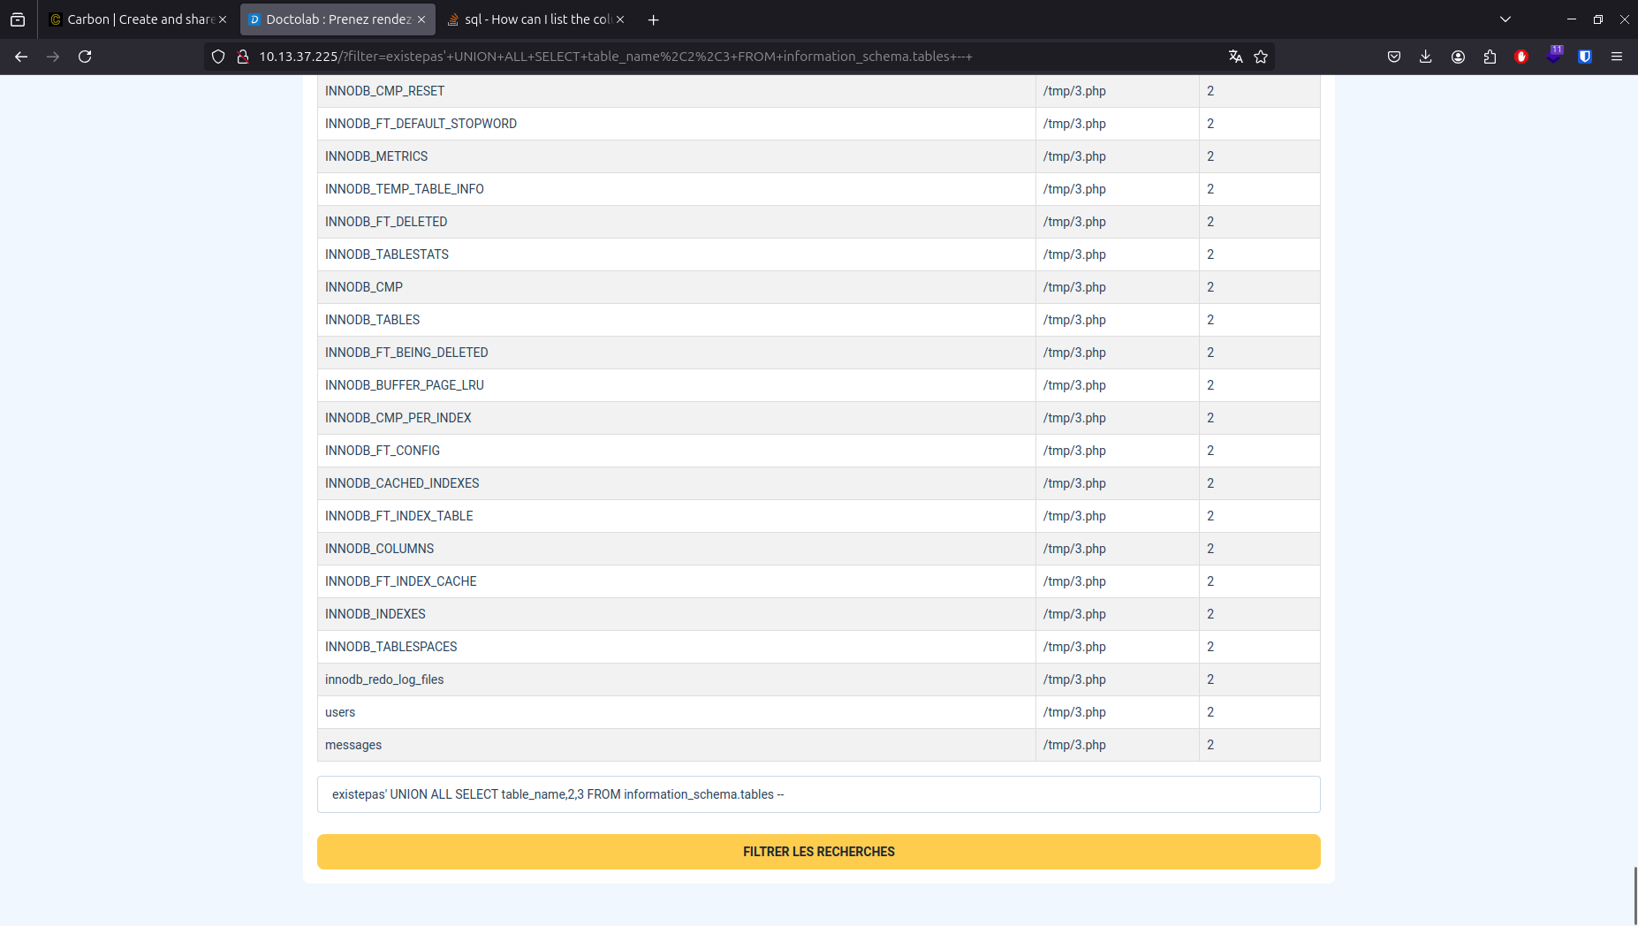
02 – Exploitation Web - SQLi tables

Slide 27
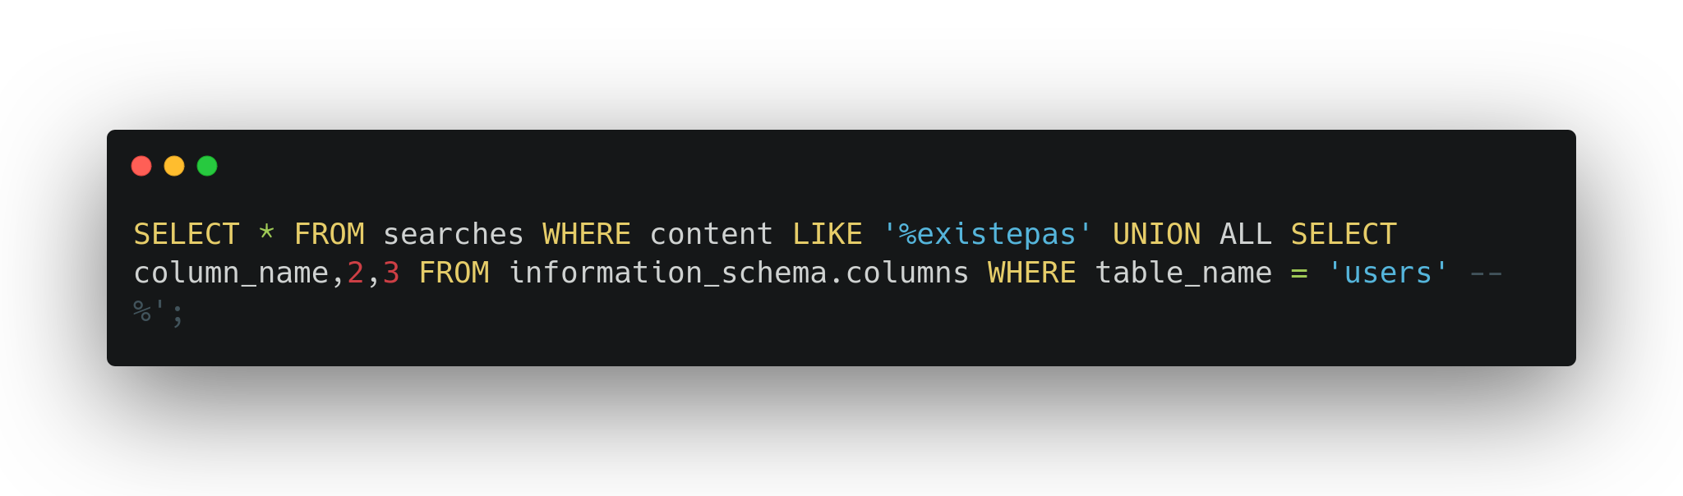
02 – Exploitation Web - SQLi columns

Slide 28
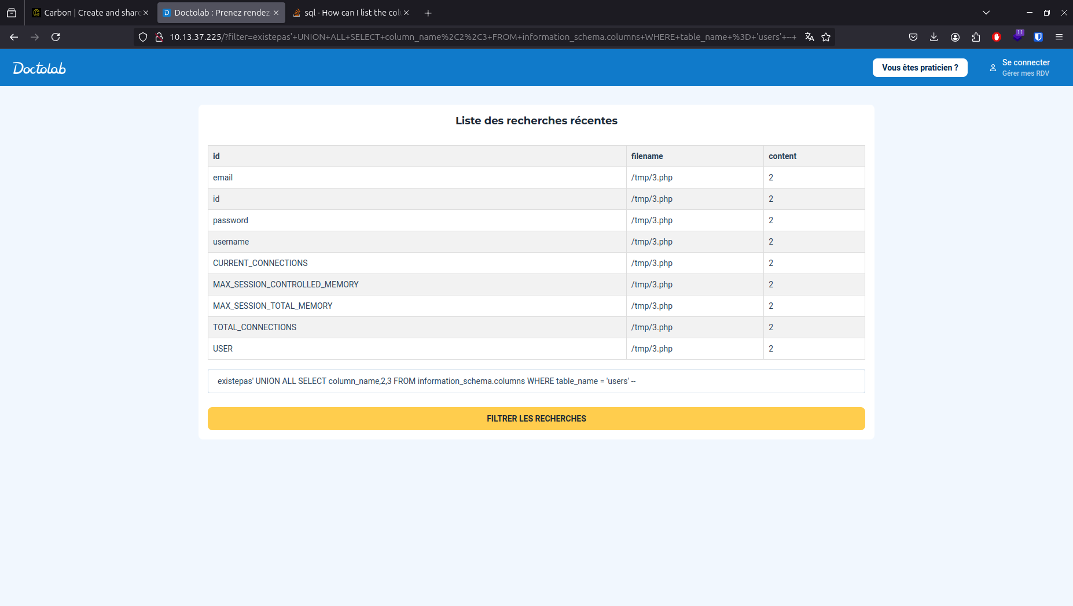
02 – Exploitation Web - SQLi columns

Slide 29
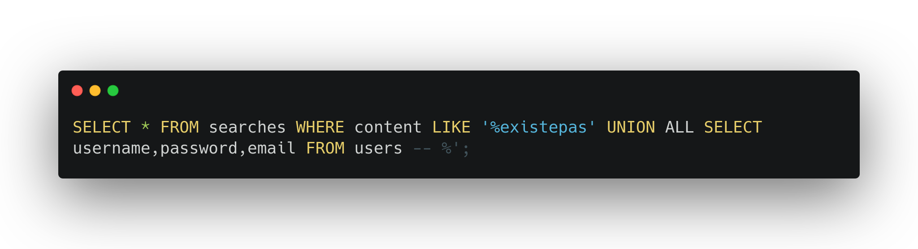
02 – Exploitation Web - SQLi users

Slide 30
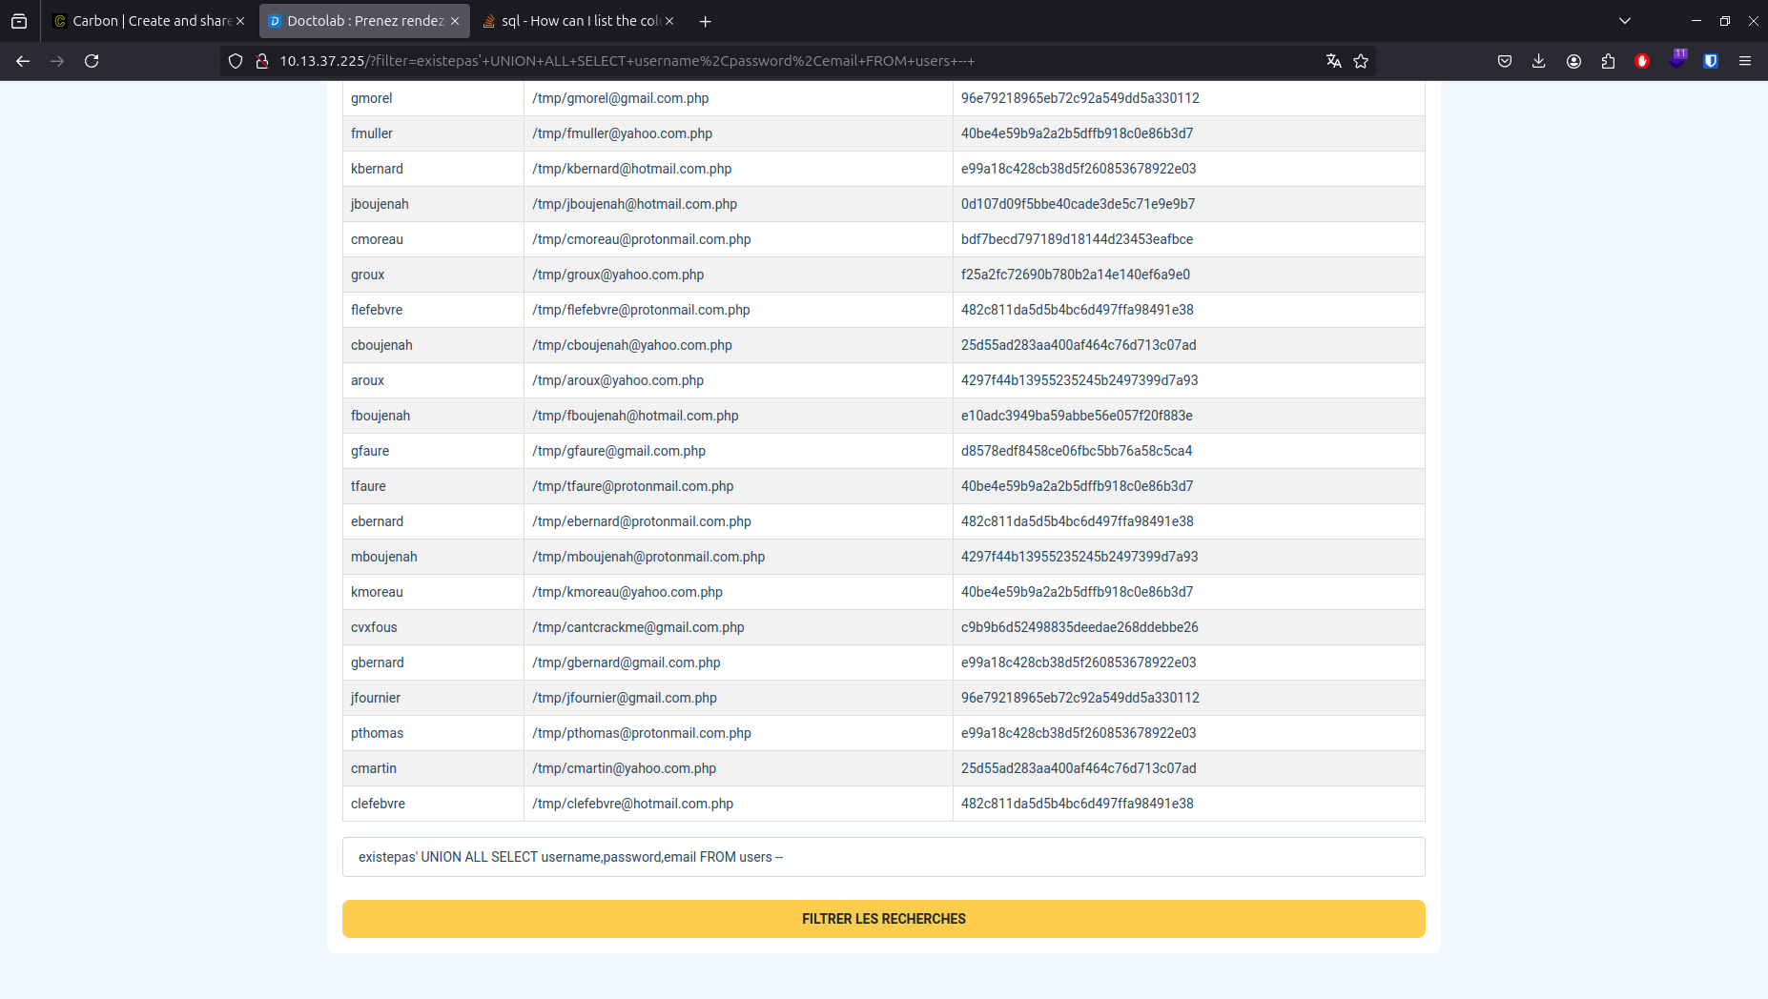
02 – Exploitation Web - SQLi users

Slide 31
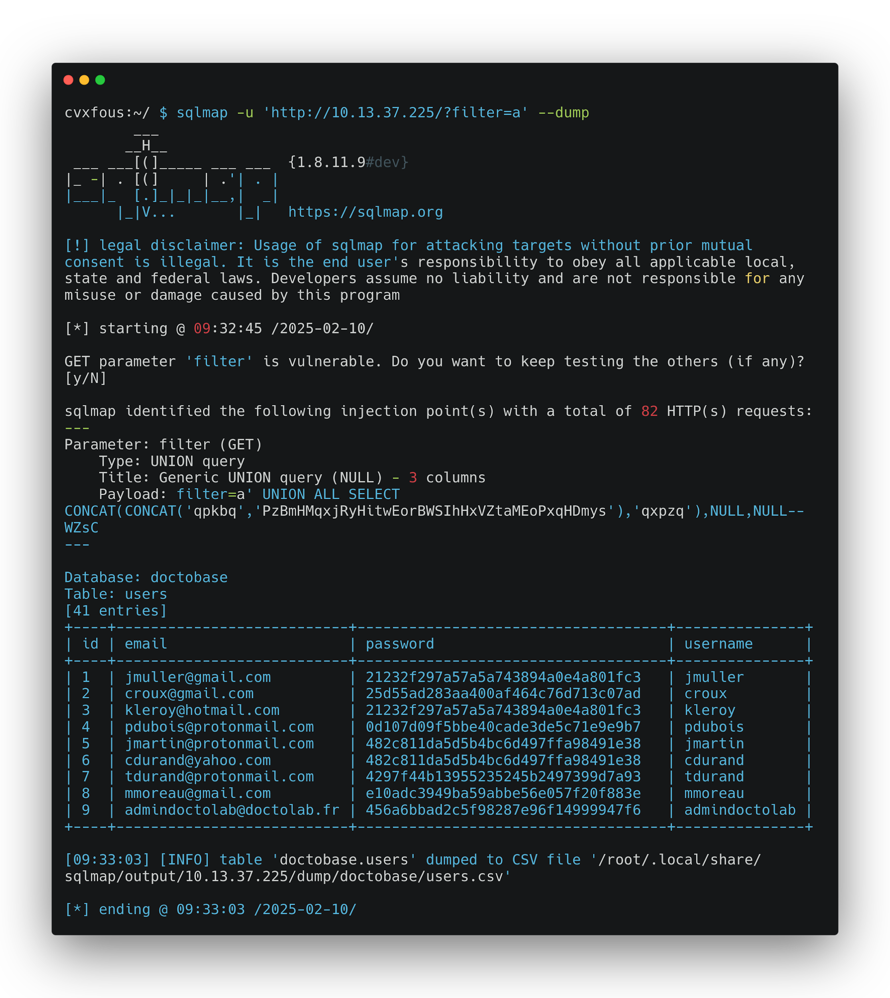
02 – Exploitation Web - SQLi sqlmap

Slide 32
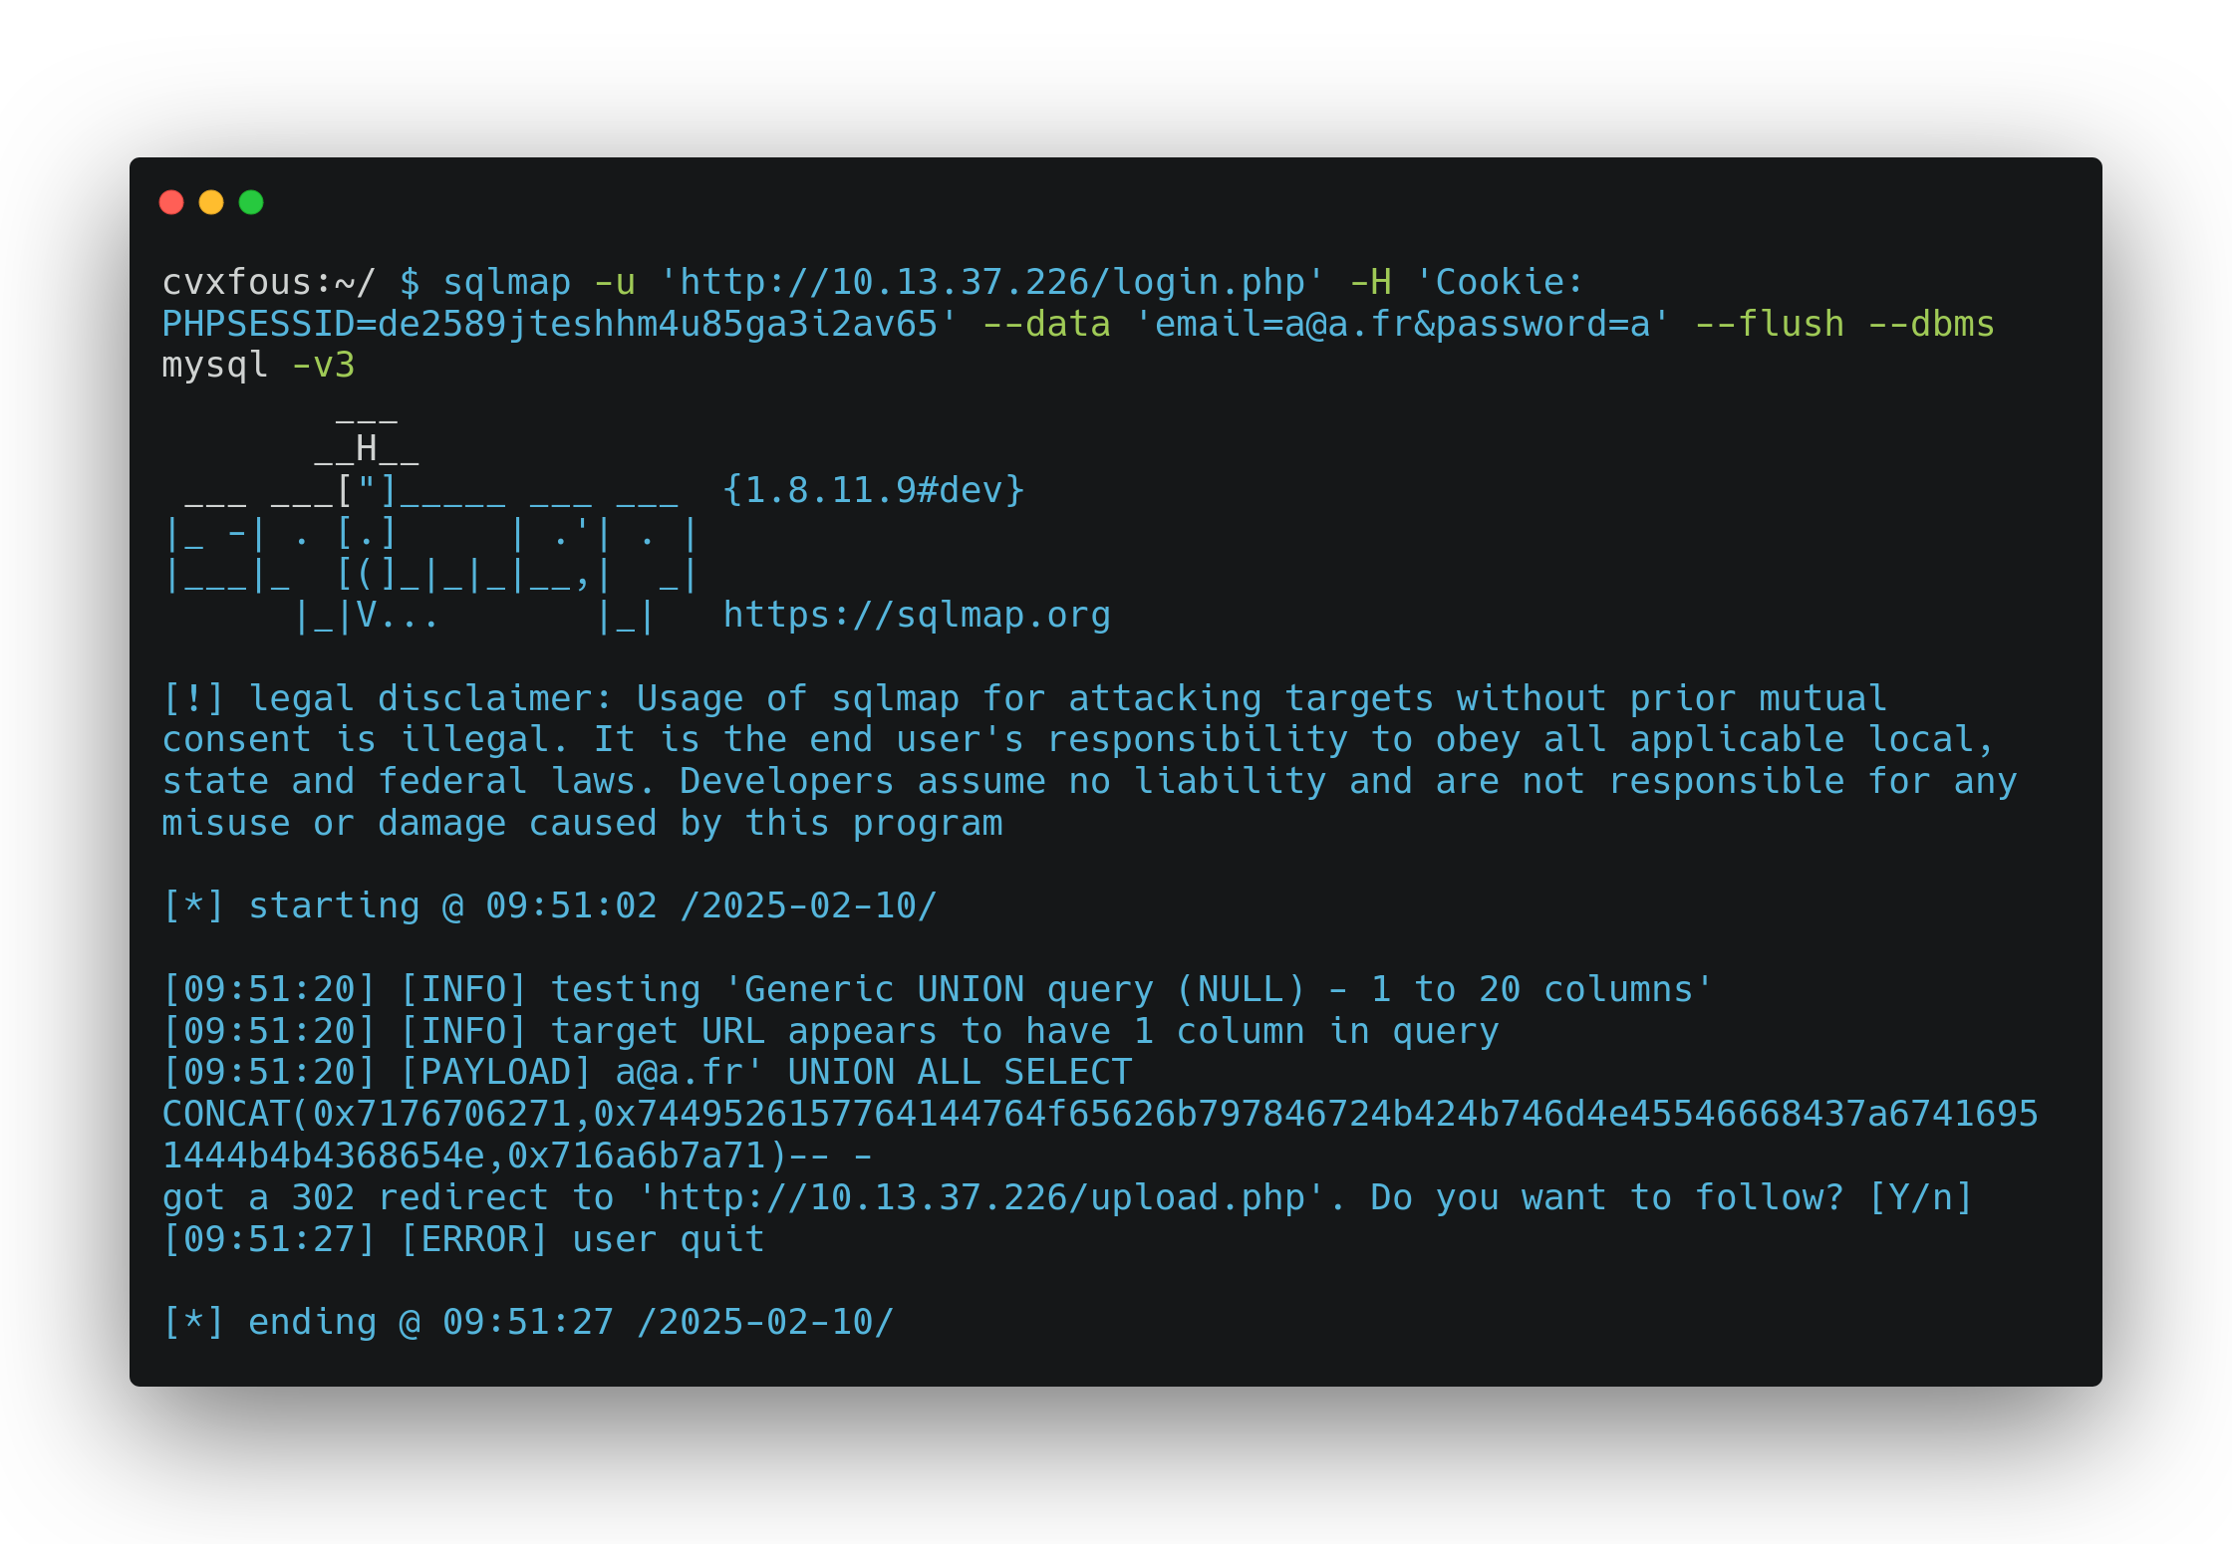
02 – Exploitation Web - SQLi sqlmap -v3

Slide 33
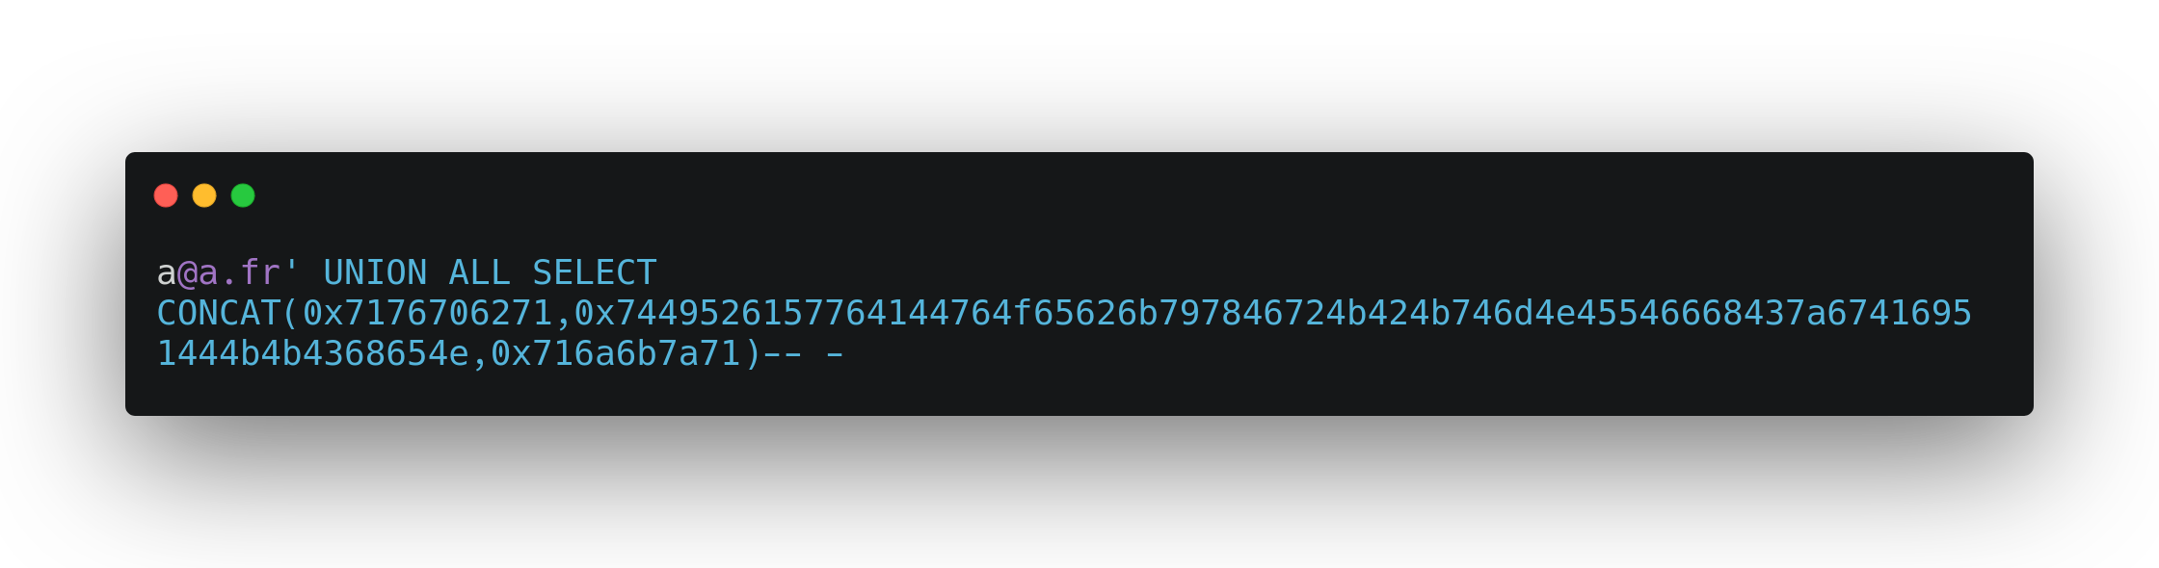
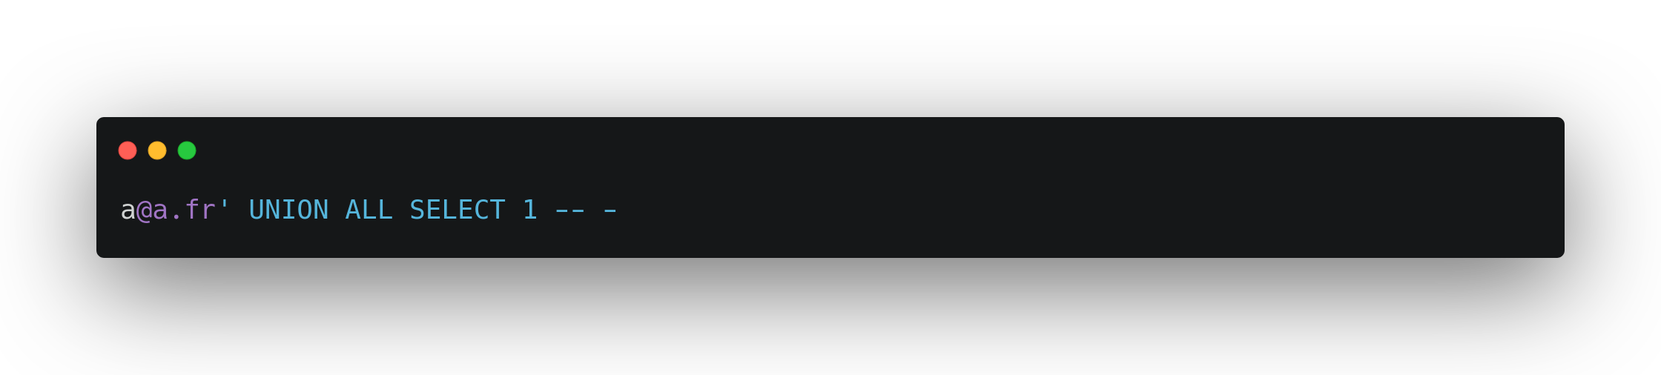
02 – Exploitation Web - SQLi bypass

Slide 34
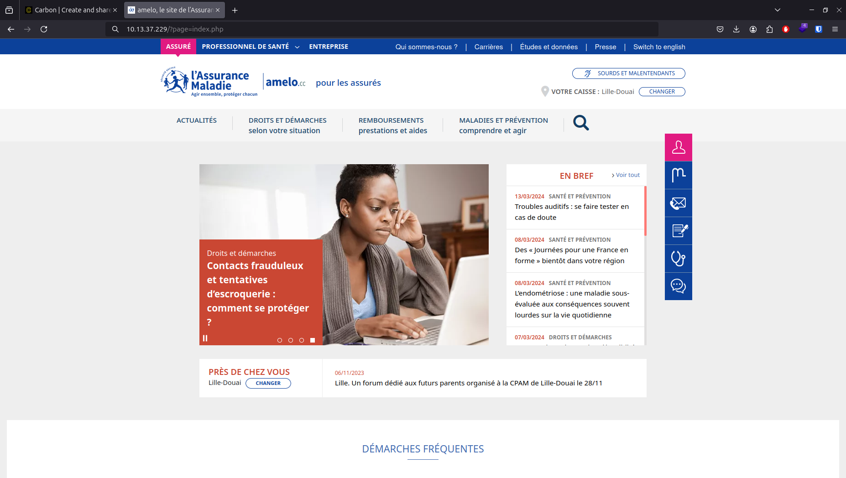
02 – Exploitation Web - LFI

Slide 35
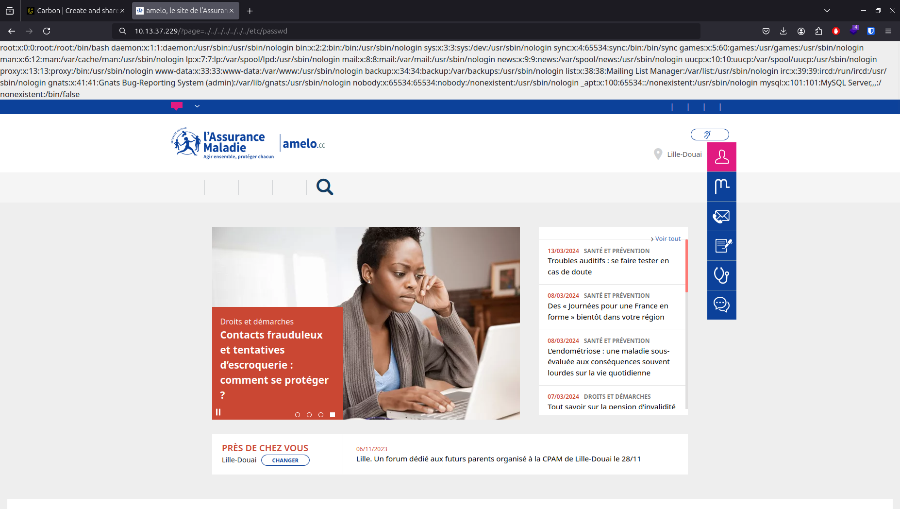
02 – Exploitation Web - LFI etc/passwd

Slide 36
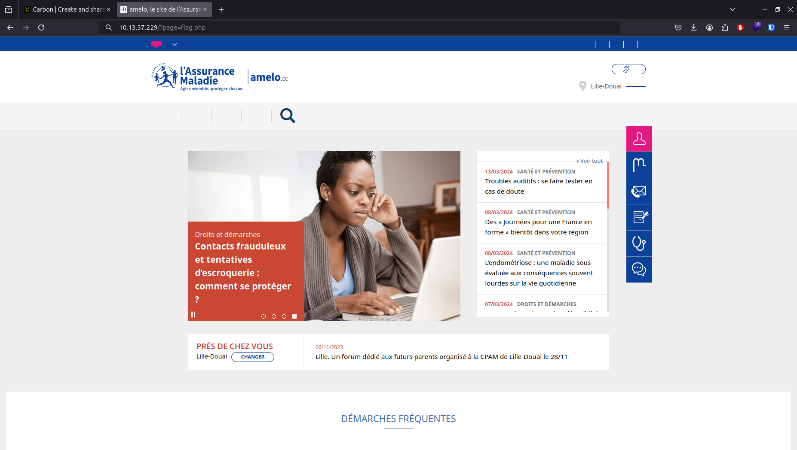
02 – Exploitation Web - LFI flag.php

Slide 37
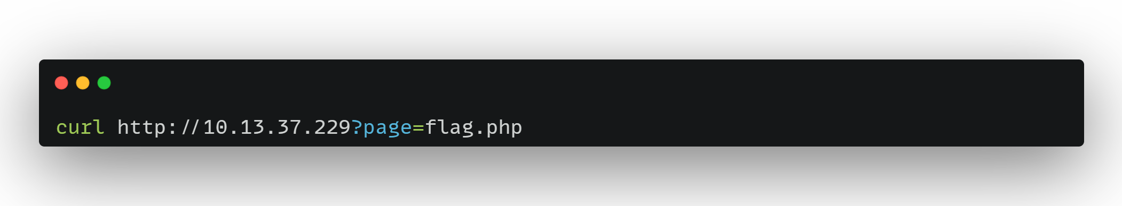
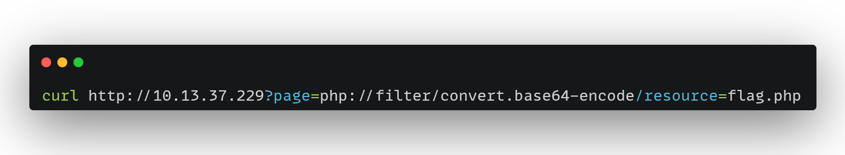
02 – Exploitation Web - LFI wrappers

Slide 38
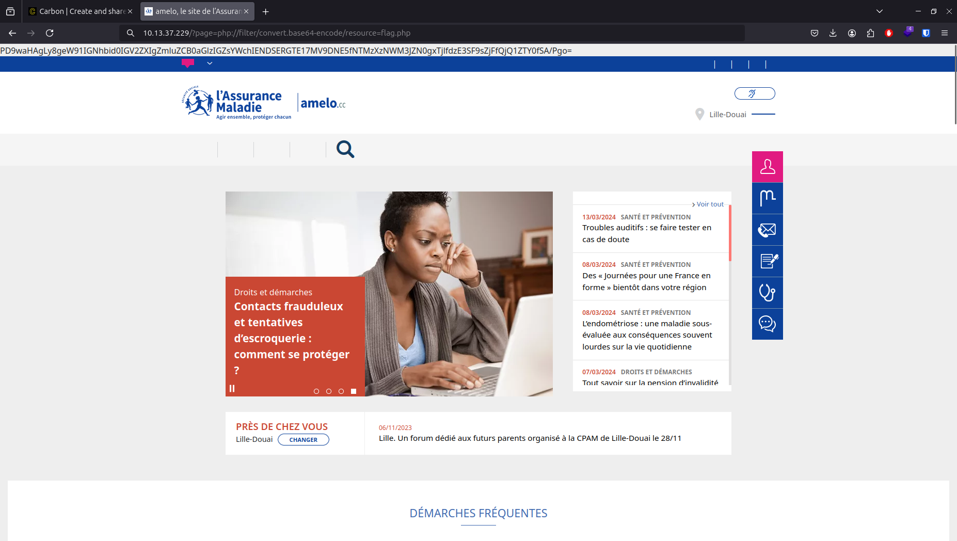
02 – Exploitation Web - LFI wrappers

Slide 39
02 – Exploitation Web - XSS

Slide 40
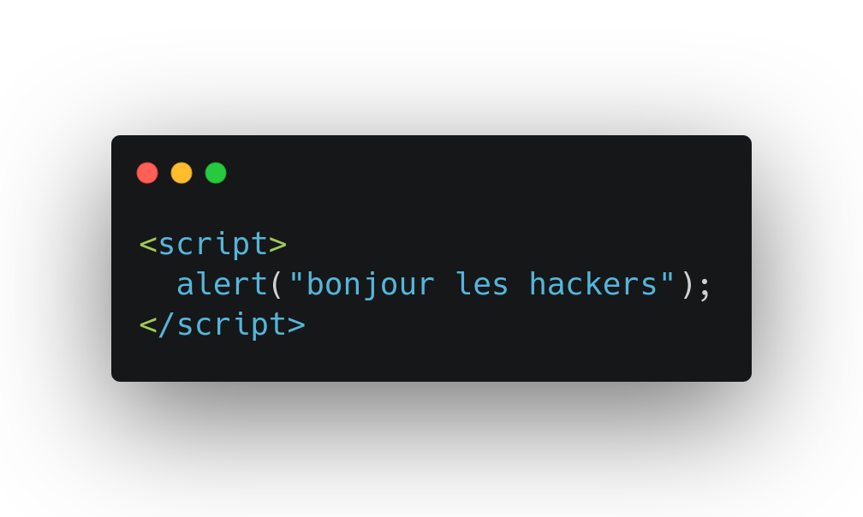
02 – Exploitation Web - XSS alert

Slide 41
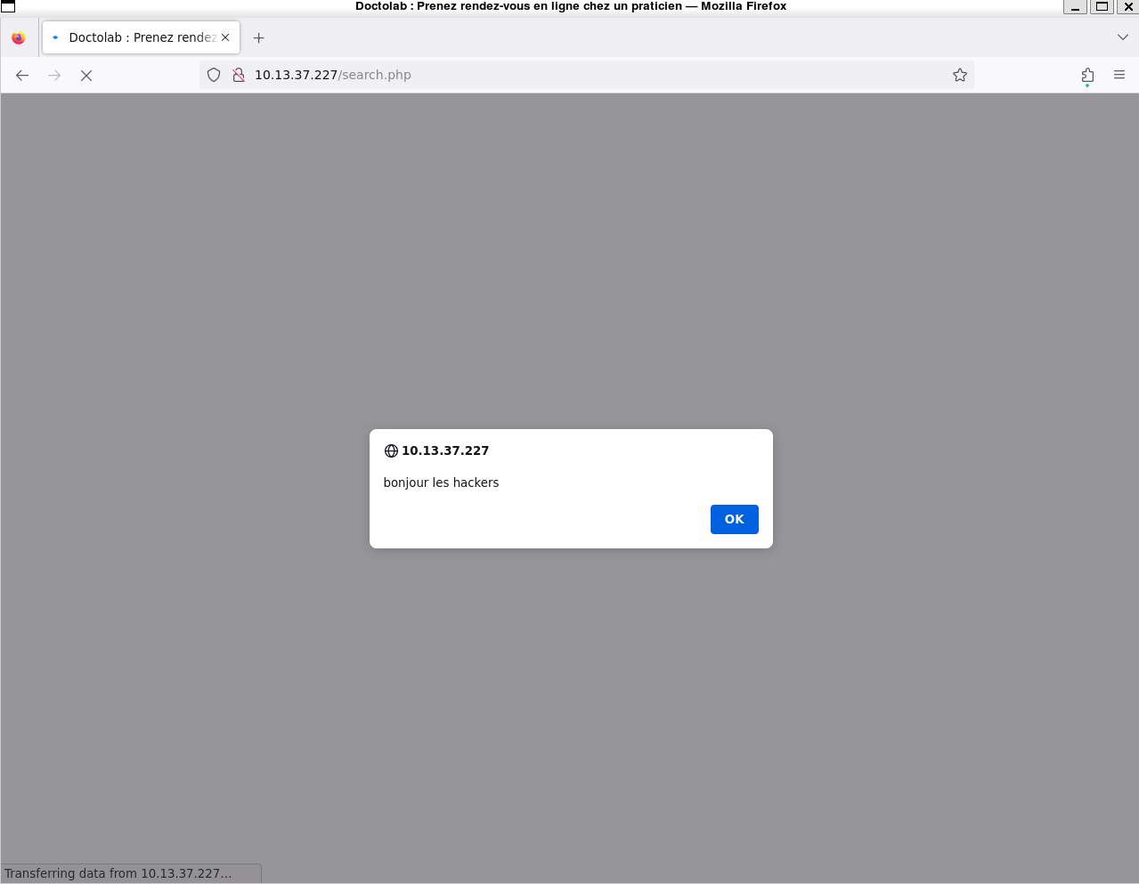
02 – Exploitation Web - XSS alert

Slide 42
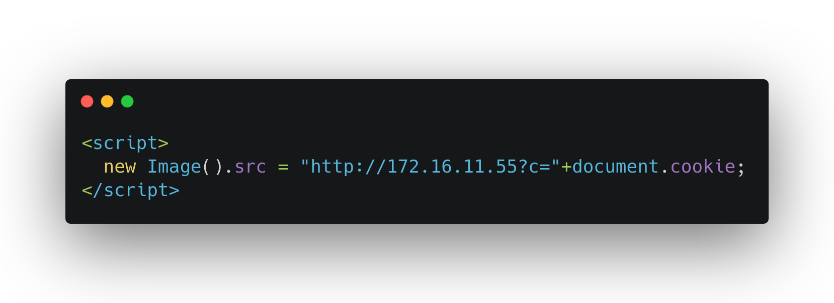
02 – Exploitation Web - XSS image

Slide 43
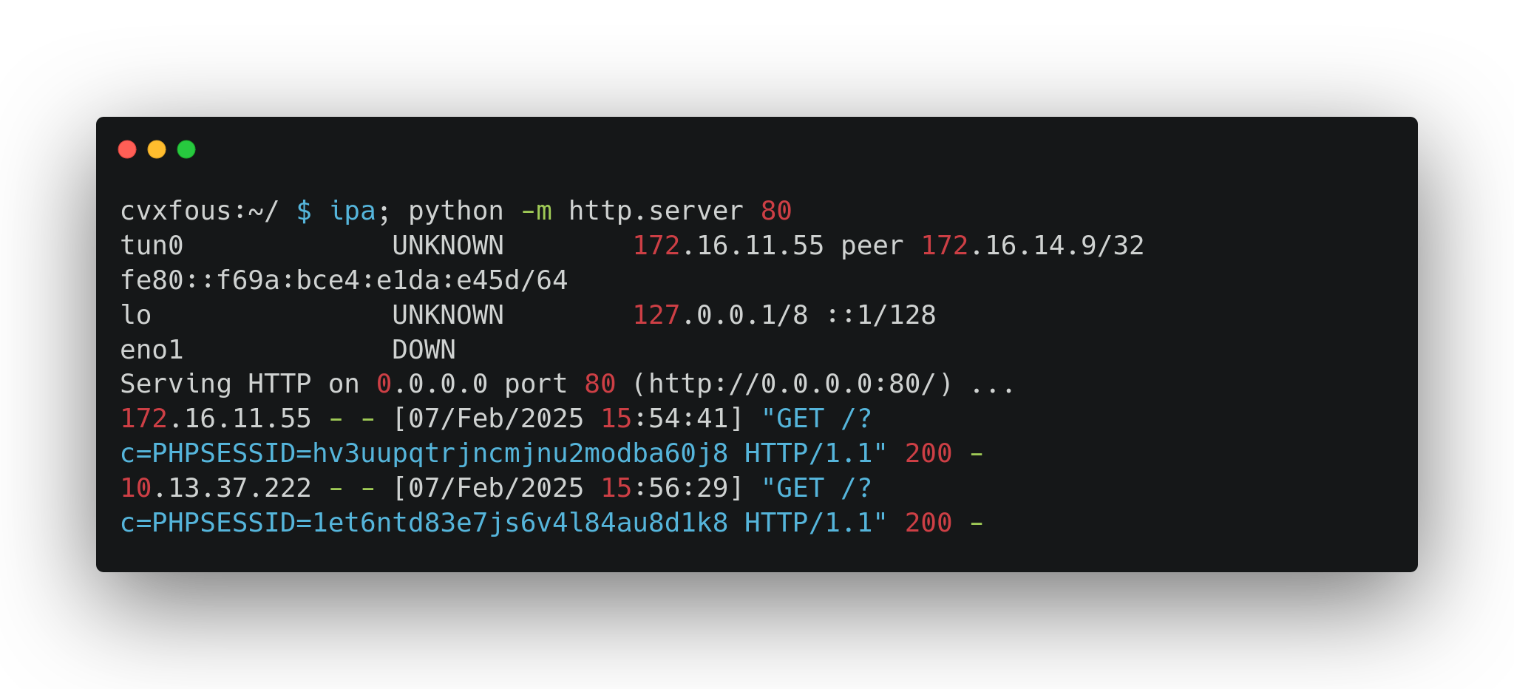
02 – Exploitation Web - XSS cookies

Slide 44
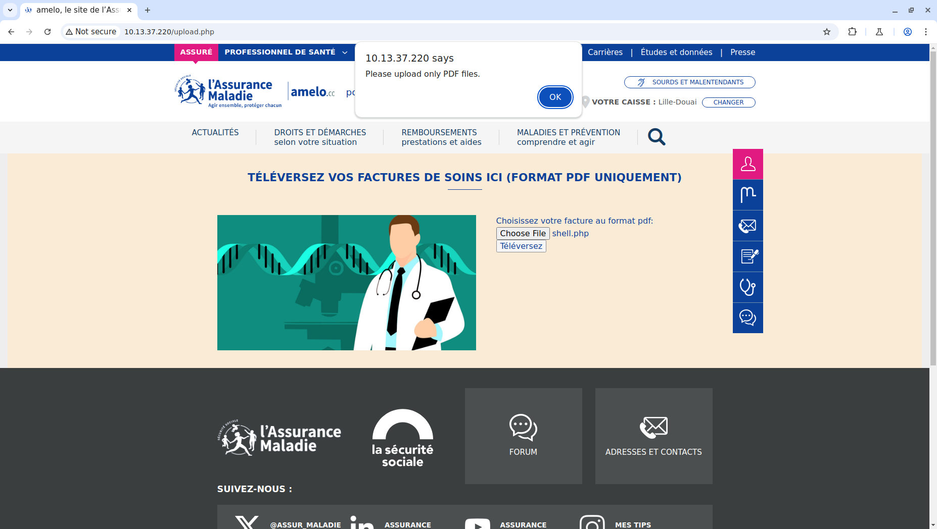
02 – Exploitation Web - Upload front

Slide 45
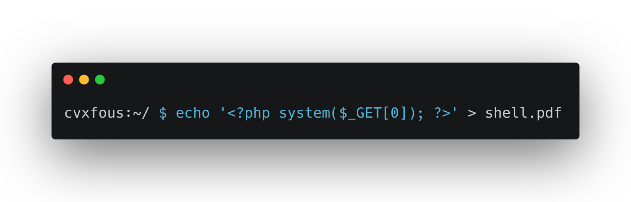
02 – Exploitation Web - Upload webshell

Slide 46
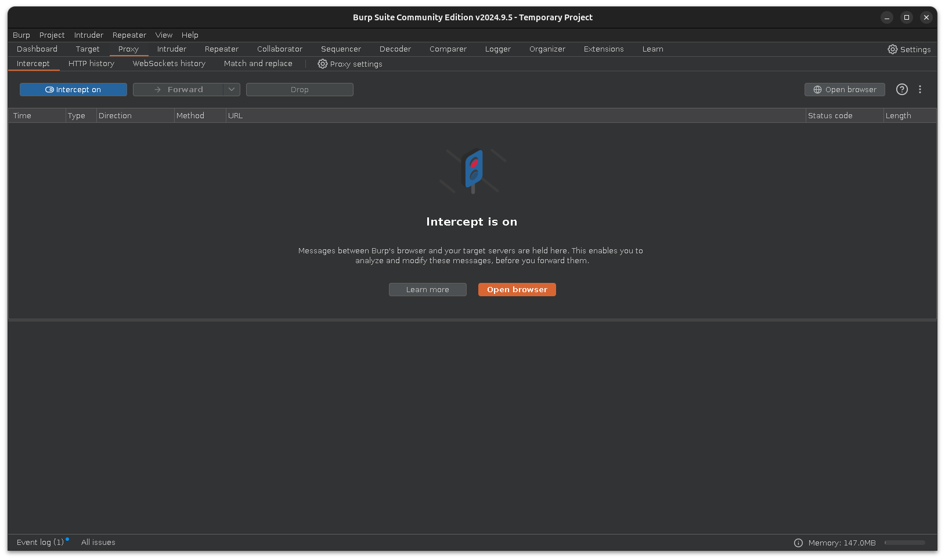

02 – Exploitation Web - Upload Burp

Slide 47
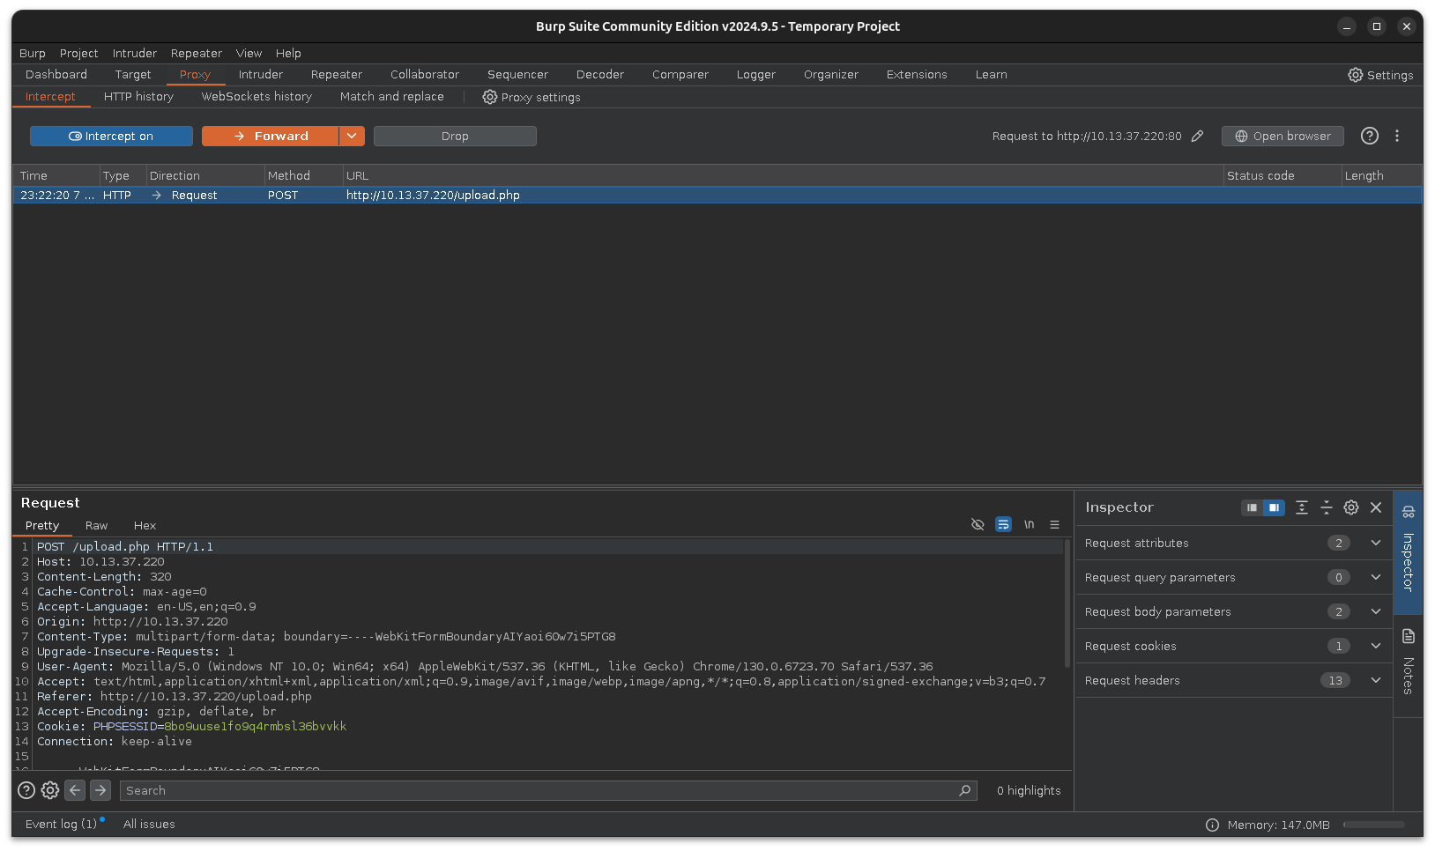
02 – Exploitation Web - Upload Proxy

Slide 48
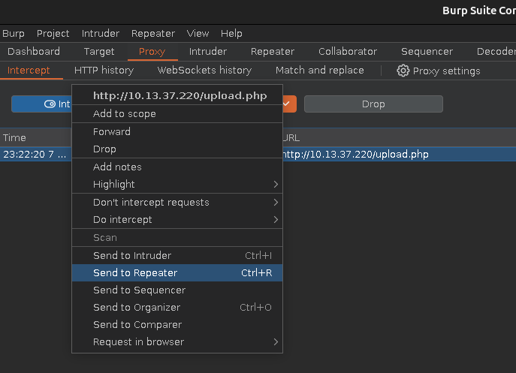
02 – Exploitation Web - Upload Repeat

Slide 49
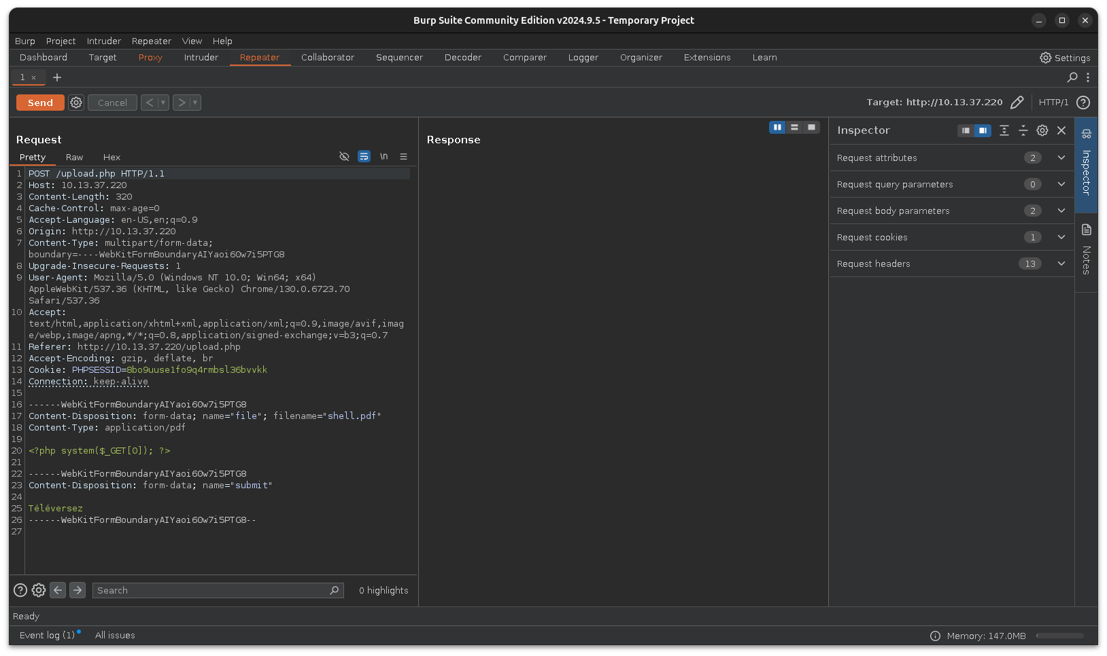
02 – Exploitation Web - Upload Repeat

Slide 50
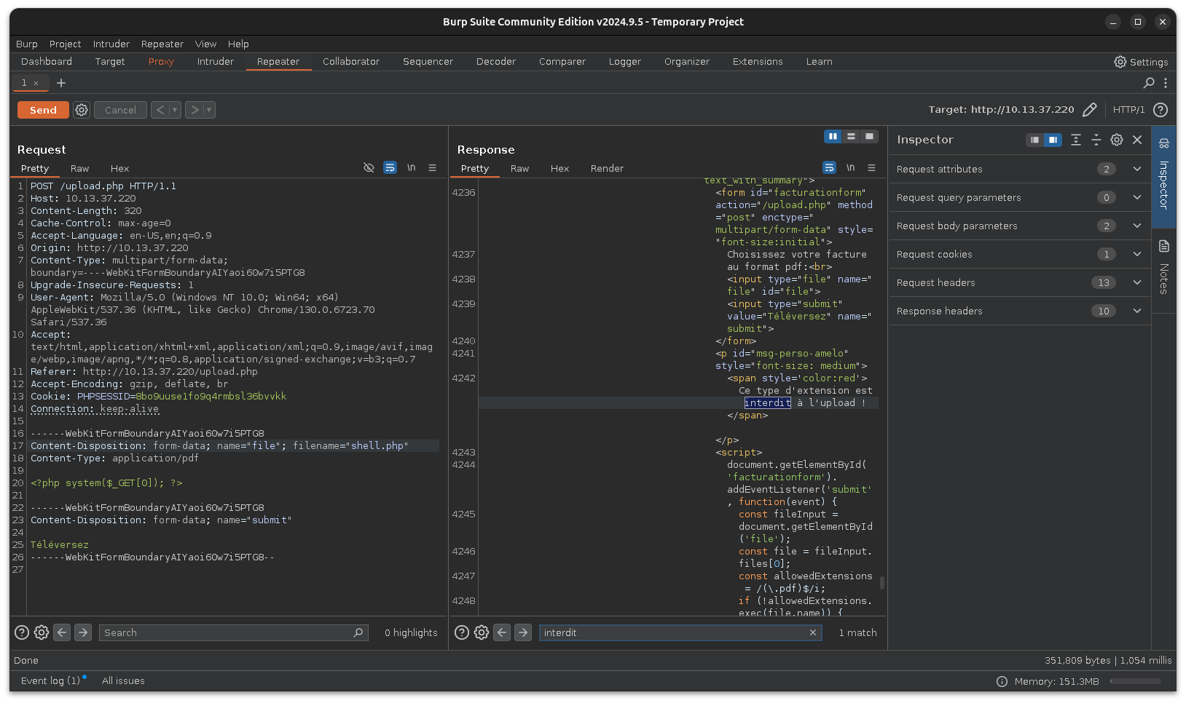
02 – Exploitation Web - Upload PHP

Slide 51
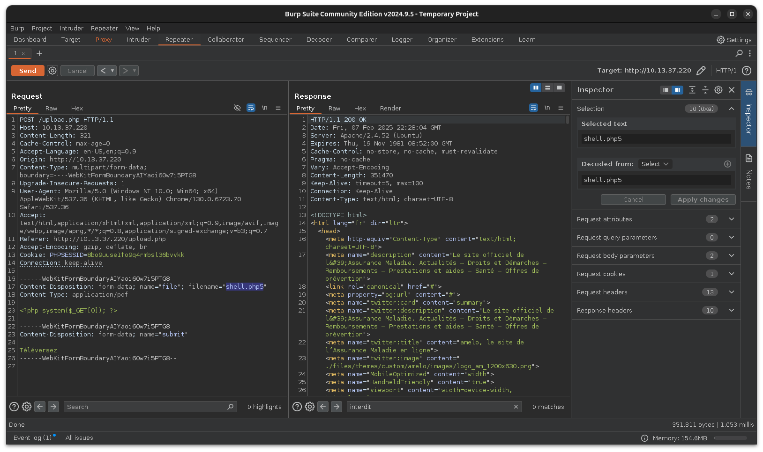
02 – Exploitation Web - Upload PHP5?

Slide 52
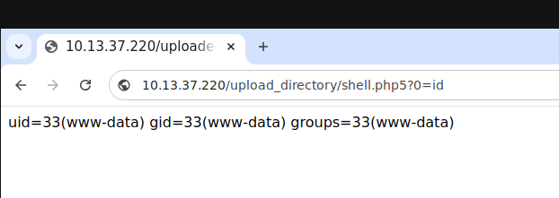
02 – Exploitation Web - Upload PHP5?

