Slide 1
How to use a resistive touchscreen TOUCHSCREEN
SummerSchool - 2019
Pascal Sartoretti (pascal.sartoretti@hevs.ch)

Slide 2
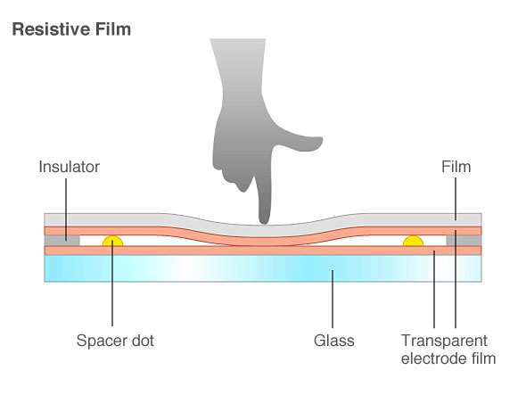
What’s a resistive touchscreen?

Slide 3
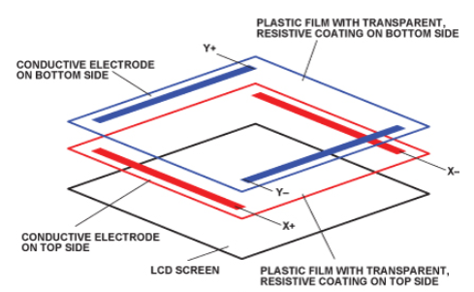
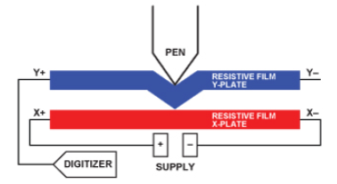
How it works

Slide 4
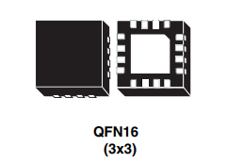
How to measure (with STMPE811)
Advantages:
I2C interface (easy)
Disadvantages:
price (2.30 CHF)
very hard to weld (for students ;-)
only manufacturer capabilities
power consumption

Slide 5
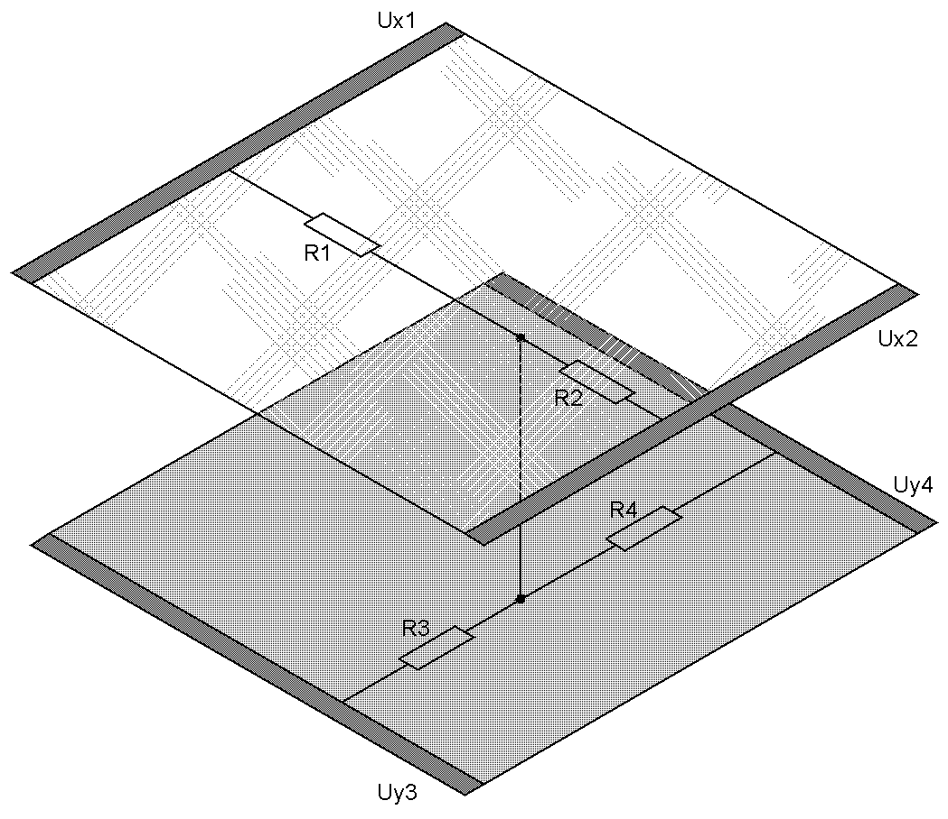
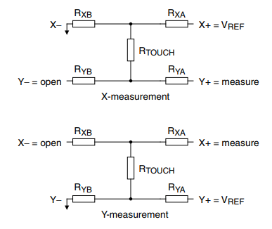
How to measure without any dedicated IC
Advantages:
Cheap
Upgradable
Zero power (interrupt mode)
Disadvantages:
A little bit more code

Slide 6
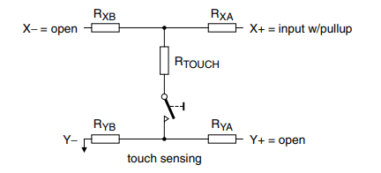
How to detect pressure with interrupts

Slide 7
Coding idea
Wait for touch interrupt
Measure X, Y and Z with interrupt mode
When no more pressure, wait touch interrupt again
Don’t forget to use uC pin with interrupt and analog input capability
Improvements: two fingers gesture recognition
(see: “AD7879 Controller Enables Gesture Recognition on Resistive Touch Screens” on the web)

