Slide 1
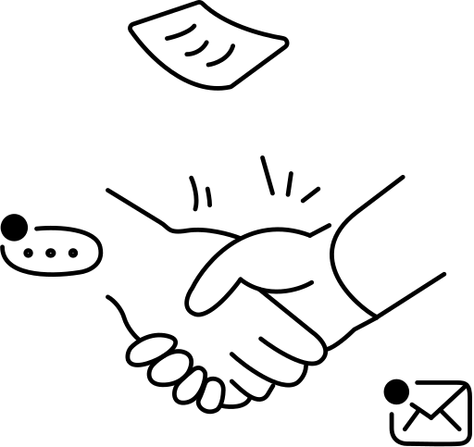
B2B Expertise, Built for Revenue
Consultant turned content strategist

Slide 2


The Old Playbook Is Broken
Cold email is dead
Inboxes are flooded, reply rates are near zero. Buyers ignore everything templated.
Content takes too long
Most teams spend weeks on a post that gets 12 likes and zero leads.
LinkedIn is a red ocean
Everyone is posting, but very few position themselves as the expert buyers trust.
So how do you stand out and get clients, without burning 20 hours a week?

Slide 3


Two Levers, One System
Premium Content
Targeted Leads
+
High-quality posts that position you as the go-to expert. Content builds trust before the first call.
Real buying signals tell you who's ready to talk. No cold outreach, just warm conversations.
IGENTIV STUDIO
We handle both.

Slide 4

How We Do It
Brand System Design system, voice, structured context built first.
Weekly Content AI + human systems. Your audience can't tell.
Fresh Leads Matched to your ICP, filtered by intent signals.

Slide 5
We position you as the expert, find the leads, you close.
Book a 15-min call. No pitch, just conversation.

Slide 6

Follow for more
Samy Chouaf

